Slide 1
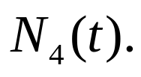
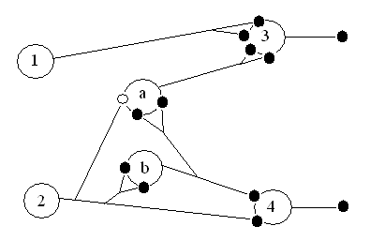

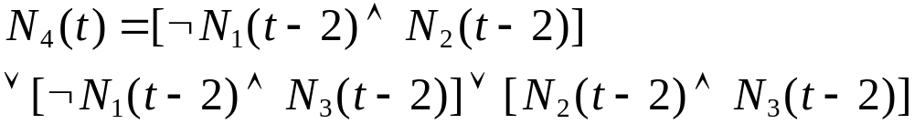
Homework 1 (15pts)
(A) In the following network, write the propositional
expression for (5pts)
(B) Construct McCulloch-Pitts networks for the
following expressions: (10pts)
1.
2.

Slide 2

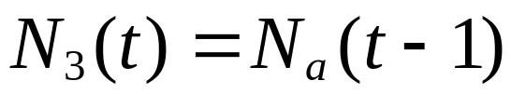
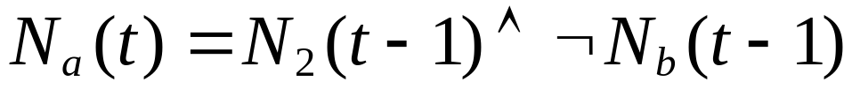
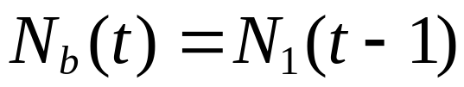
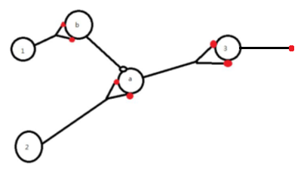
Answer:
(A)
(B)(1)(i)

Slide 3
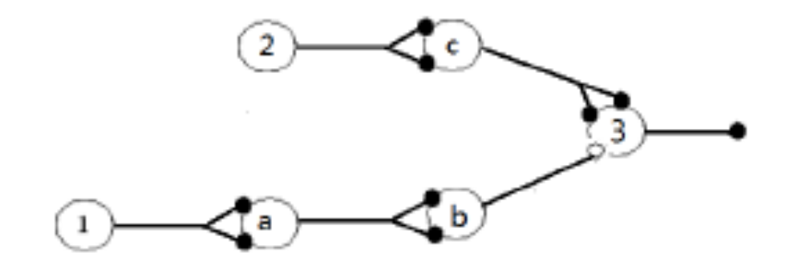
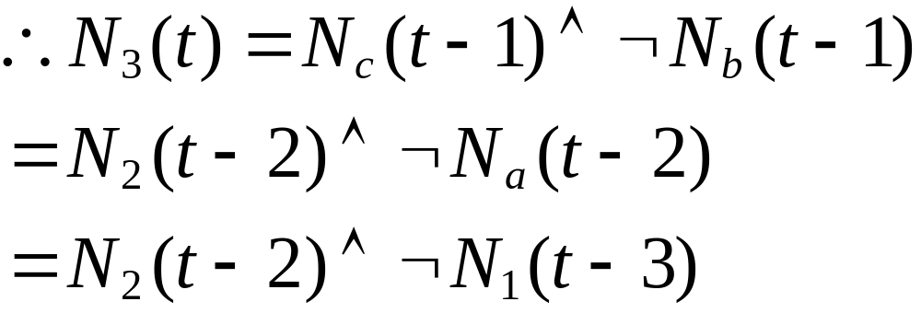
(ii)

Slide 4
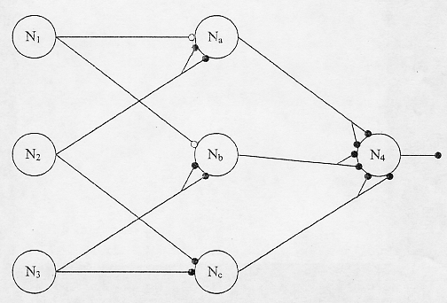
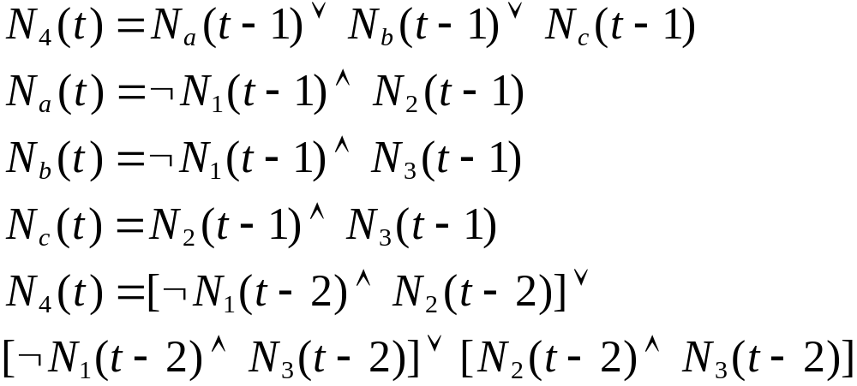
(B )(2)

Slide 5

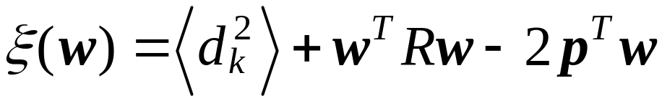
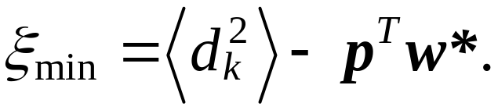
Homework 2 (10pts)
1) Derive the optimal that minimizes the mean
squared error .
2) Show that the minimum value of the mean squared
error can be written as

Slide 6
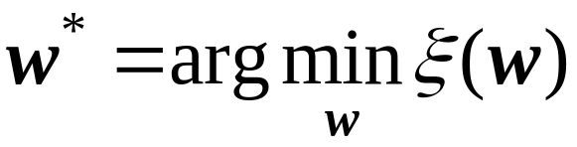
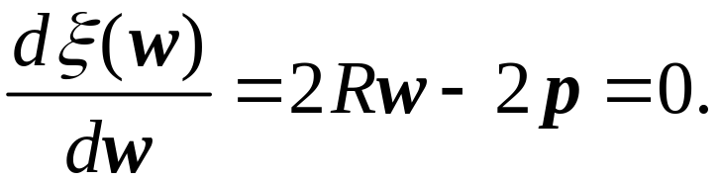
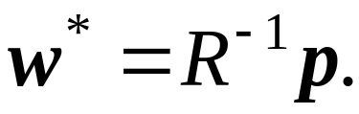
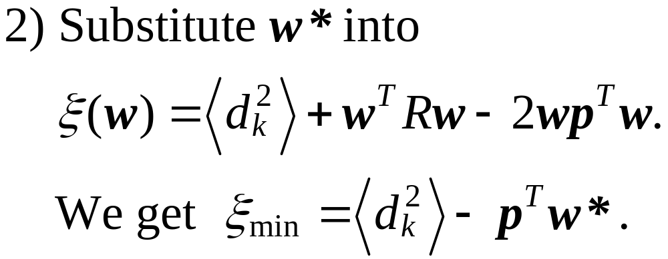
Answer:
1) The optimal

Slide 7
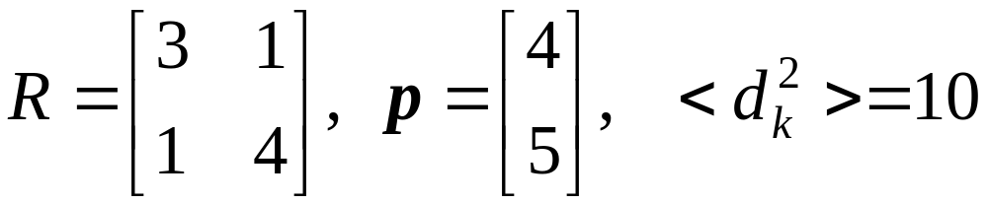
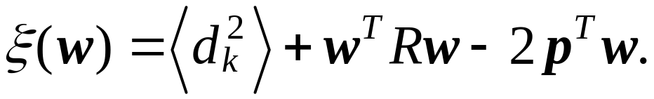
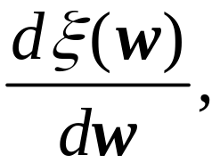
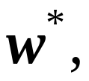

Homework 3 (15pts)
Let
for
Find i) ii) the optimum weight vector
iii) the minimum mean square error
iv) Show the paraboloid is concave upward.

Slide 8
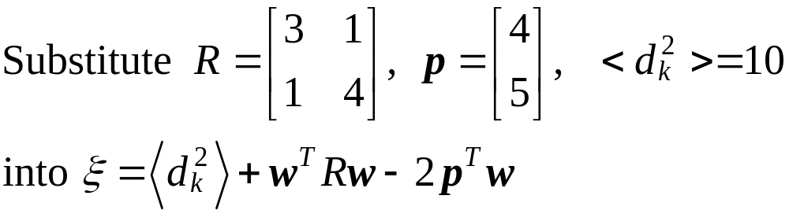
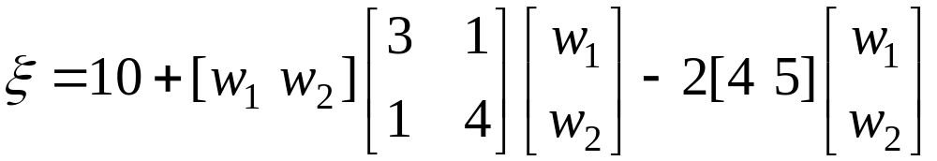
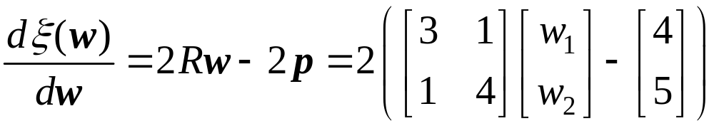
Answer:
i)

Slide 9
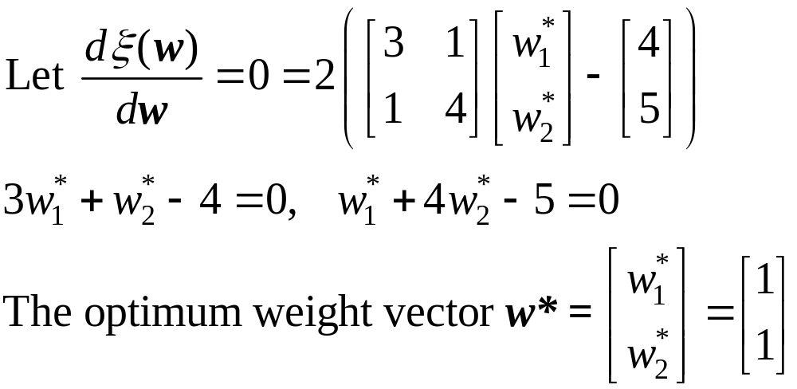
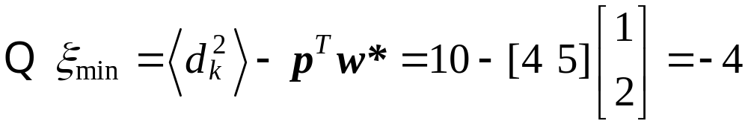
ii)
iii)

Slide 10
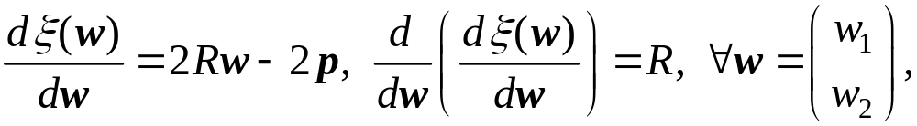
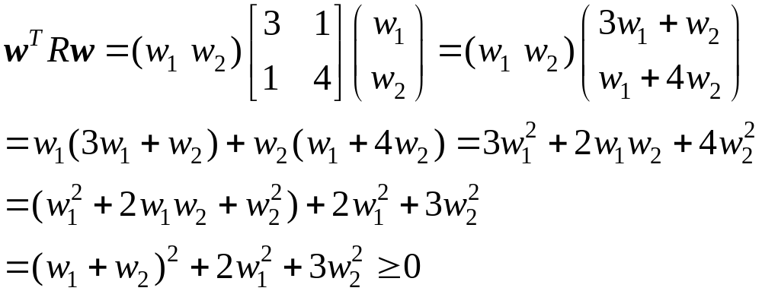
iv)
i.e., R is semi-positive definite.
The paraboloid is concave upward.

Slide 11
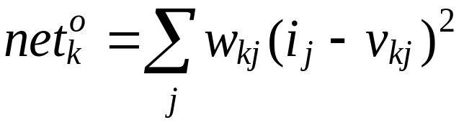
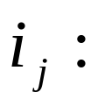
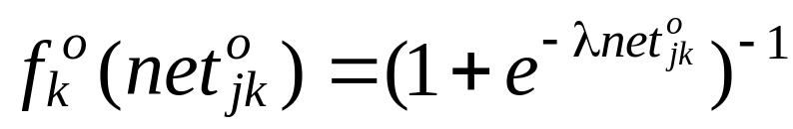
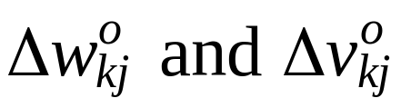
Homework 4 (30pts)
Consider quadratic neurons for the output nodes of a backpropagation neural network, i.e., the net input to
output node k is computed by
the jth input value
The output functions of output nodes are sigmoid,
Determine the updating equations of
for hidden-layer neurons.

Slide 12
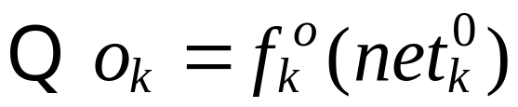
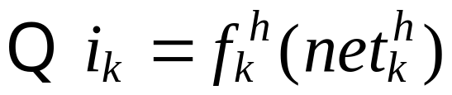
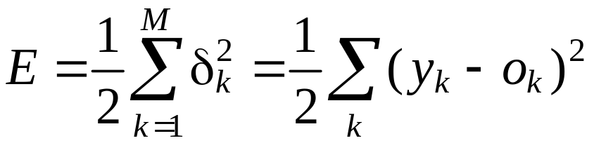
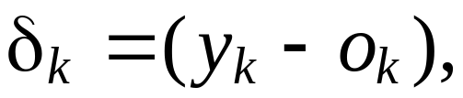
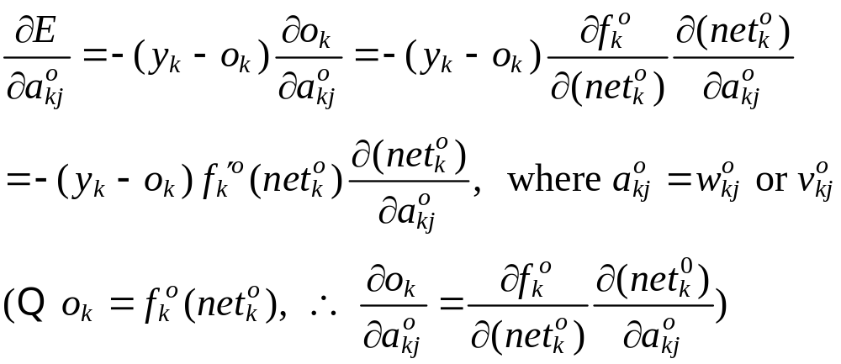
Answer:
output of output node
output of hidden node

Slide 13
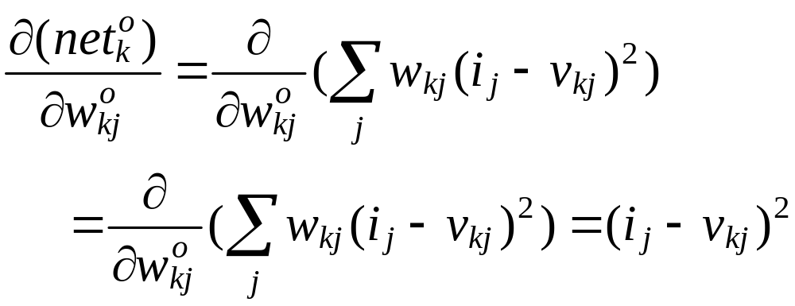
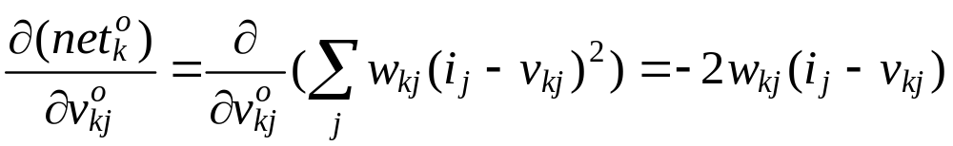
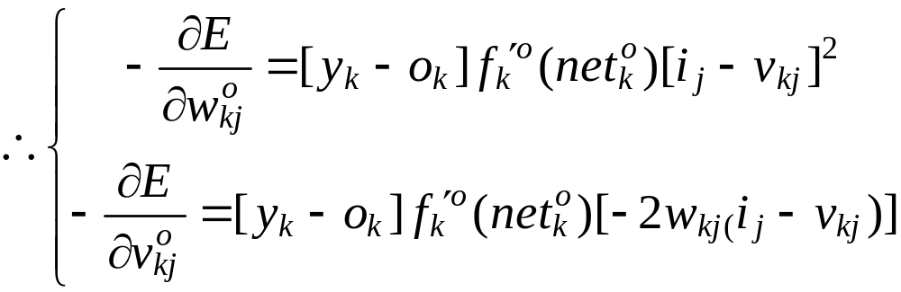

Slide 14
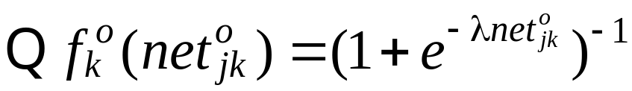
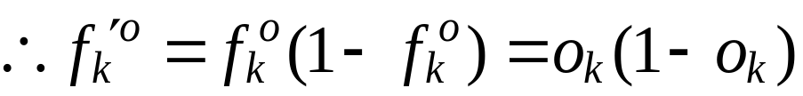
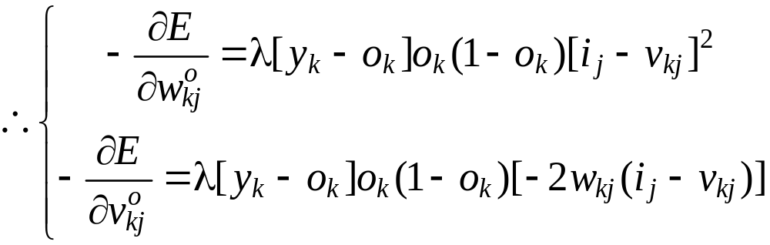
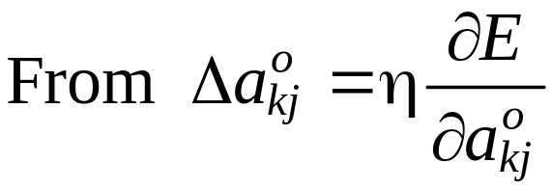
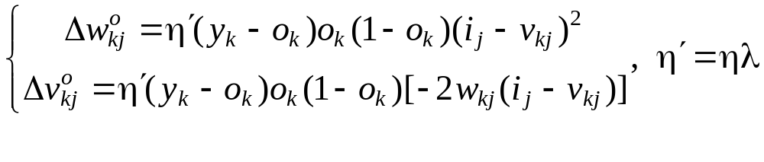

Slide 15
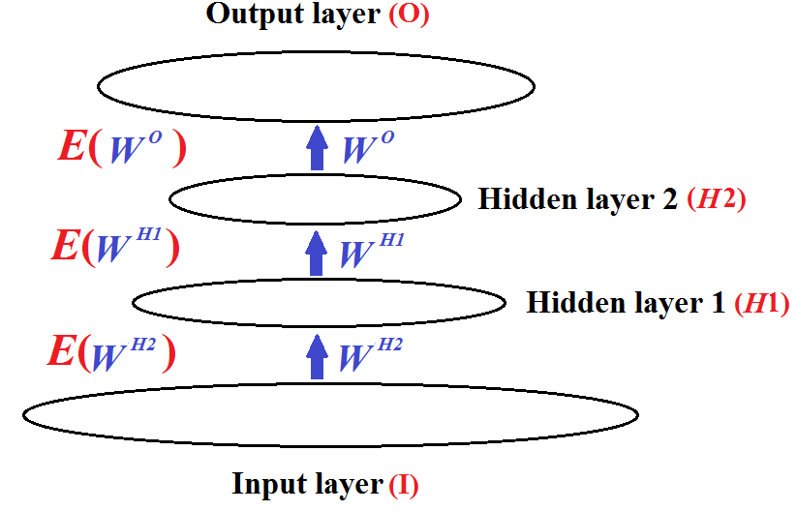
Homework 5 (30pts)
Consider a network with two hidden layers.
Determine the weight-updating equations of neurons on the second hidden layer (H2).

Slide 16
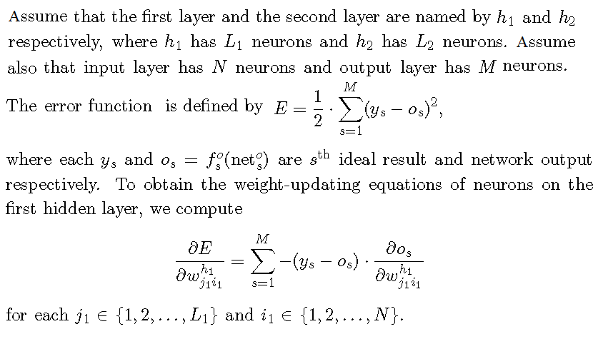
Answer 1:

Slide 17
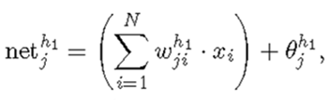

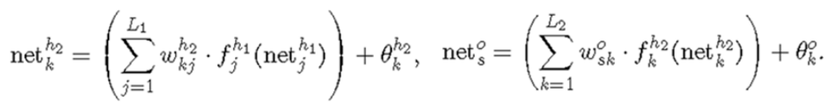
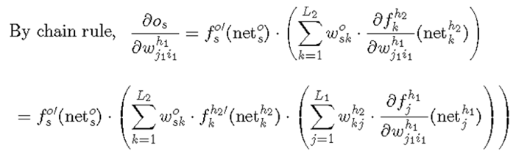

observe that

Slide 18


To be continued for the weight-updating equations of

Slide 19

Answer 2:
Let the 2-hidden-layer neural network look like below

Slide 20



Slide 21




Slide 22


Slide 23


Homework 6 (10pts), Due 5/25
A Hopfield network made up 5 neurons, in which three
bipolar patterns were stored, where
Construct the weight matrix for these three patterns.

Slide 24


Homework 7 (15pts), Due 5/25
Show that the following function F of a Hopfield network is an energy function

Slide 25



Hint:
Start with the energy function of the Hopfield network
and the weight is defined as

