Slide 1
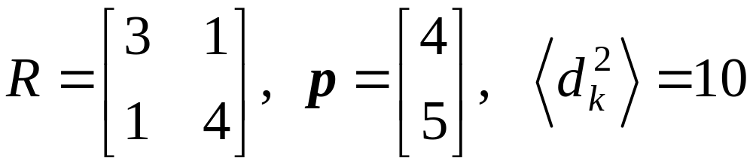
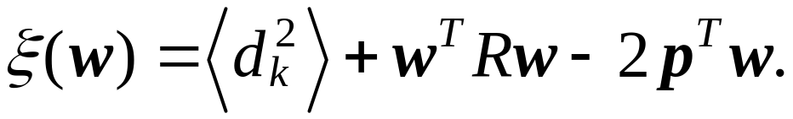
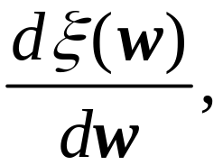
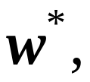

Homework 1 (100pts) Due 3/13
Let
for
Find i) ii) the optimum weight vector
iii) the minimum mean square error
iv) Show the paraboloid is concave upward.

Slide 2
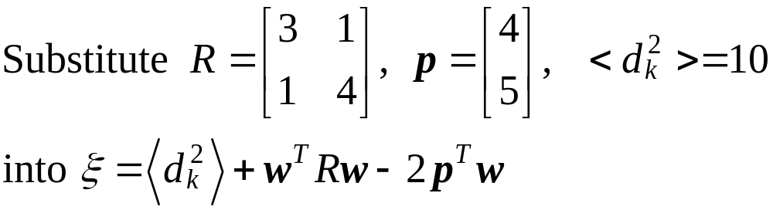
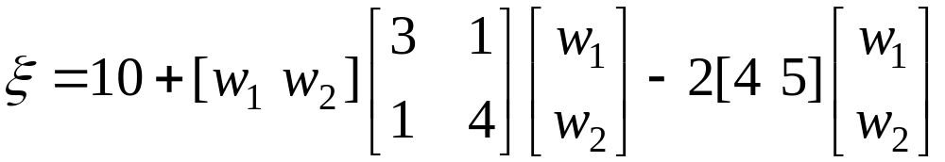
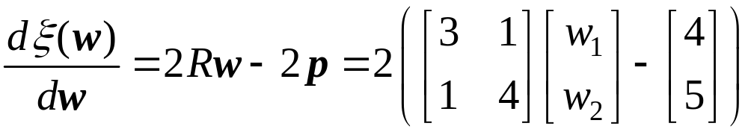
Answer 1:
i)

Slide 3
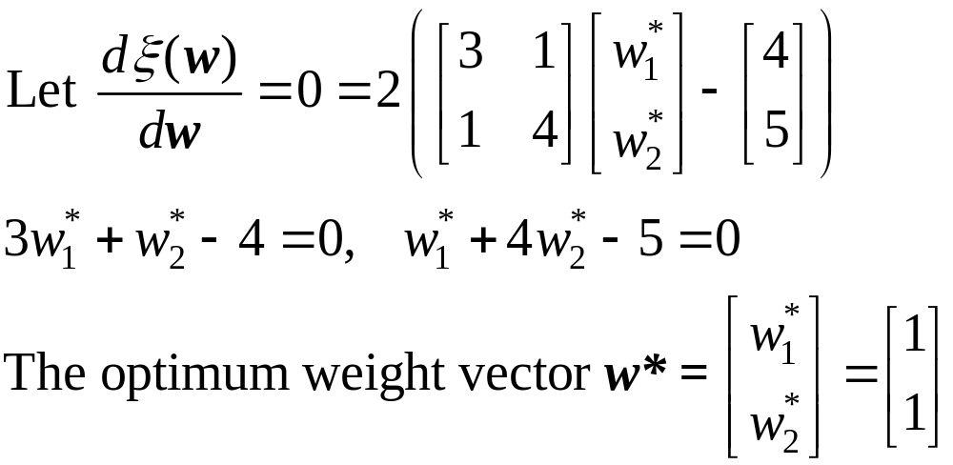
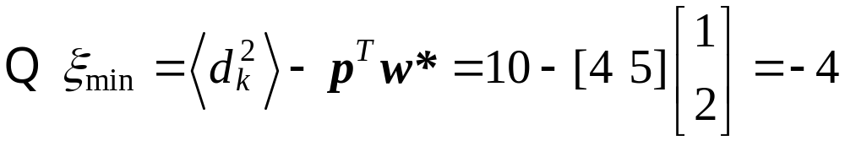
ii)
iii)

Slide 4
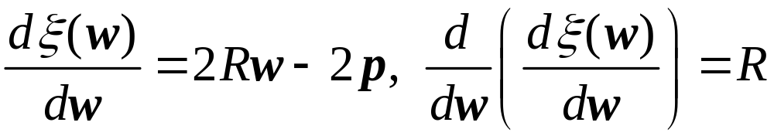
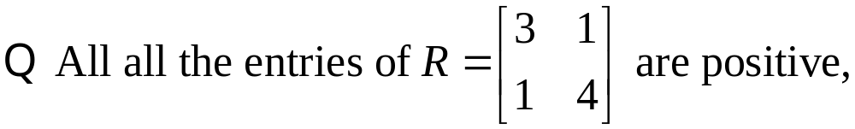
iv)
the paraboloid is concave upward.

Slide 5
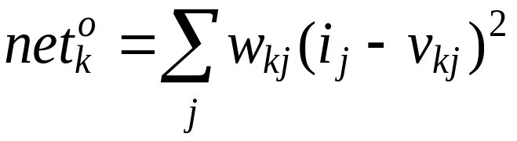
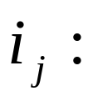
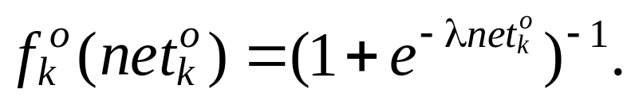

Homework 2 (100pts) Due 3/20
Consider quadratic neurons for the output nodes of a backpropagation neural network, i.e., the net input to
output node k is computed by
the jth input value
The output functions of output nodes are sigmoid,
Derive the updating equations of for
output-layer neurons.

Slide 6
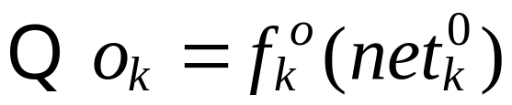
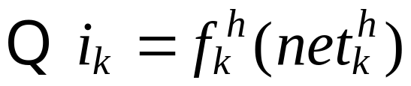
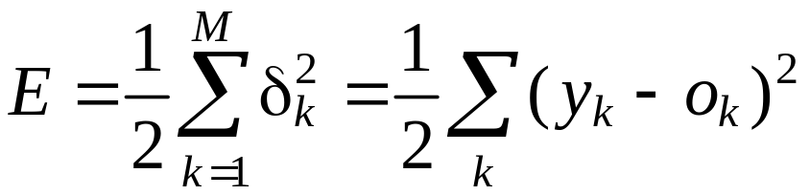
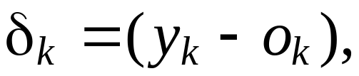
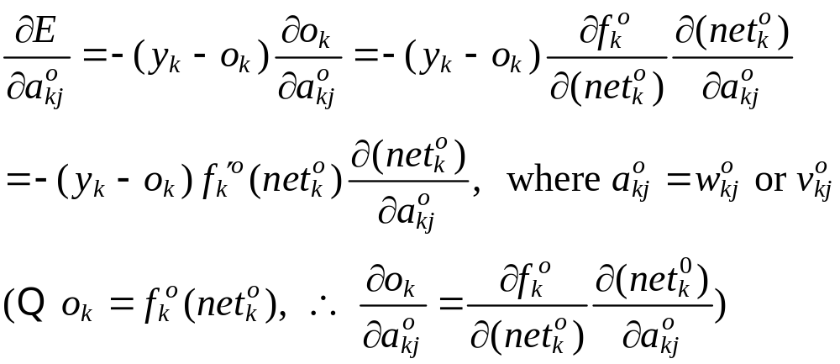
Answer 2:
output of output node
output of hidden node

Slide 7
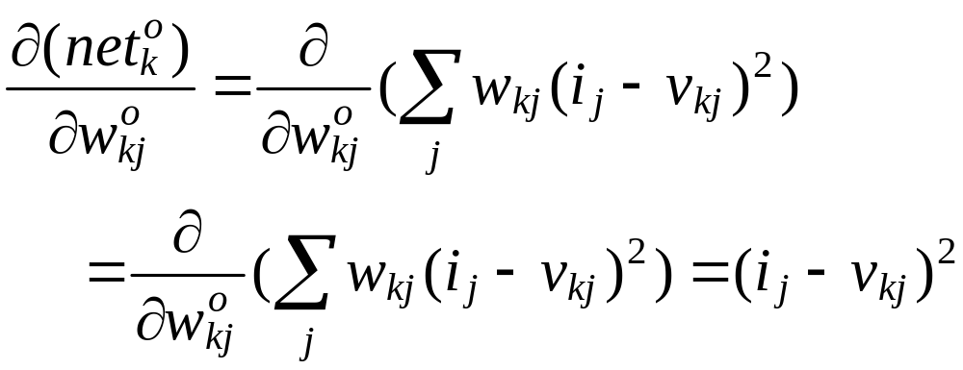
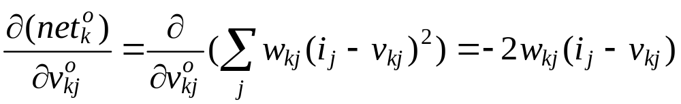
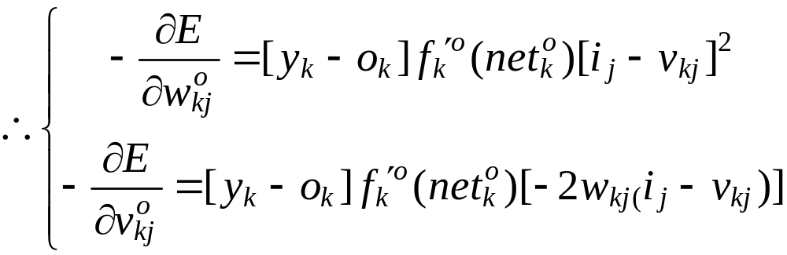

Slide 8
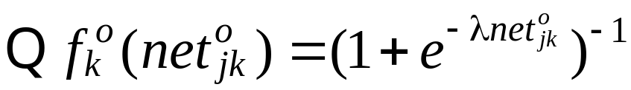
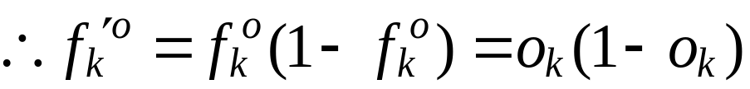
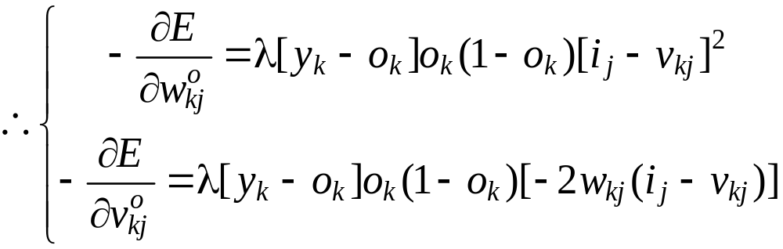
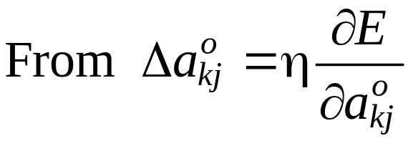
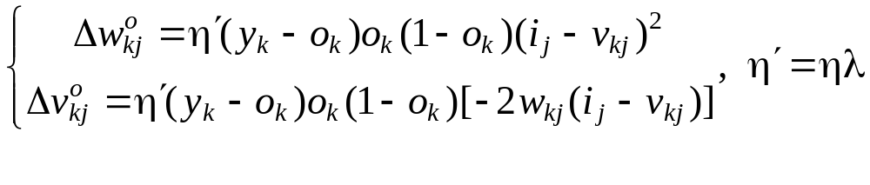

Slide 9
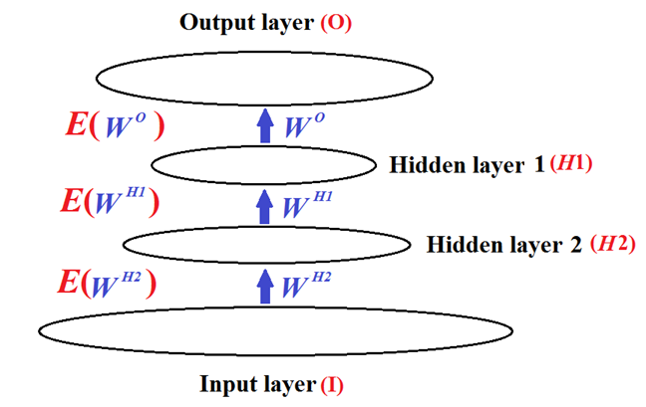
Homework 3 (100pts) Due 3/27
Consider a network with two hidden layers.
Determine the weight-updating equations of neurons on the second hidden layer (H2) using the activation
and net input functions defined in the class PPT.

Slide 10
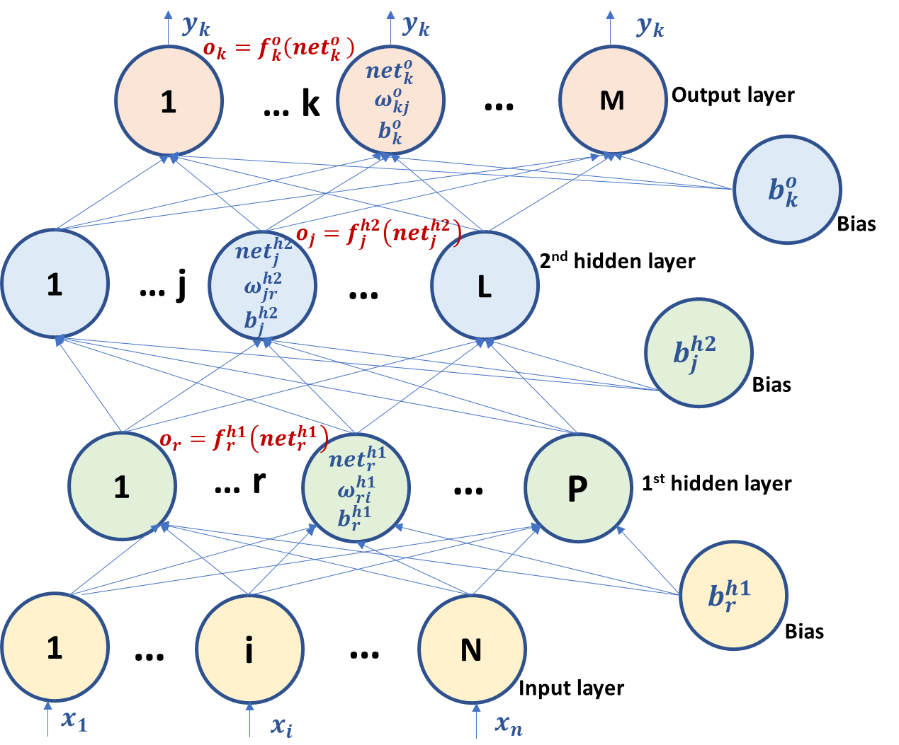
Answer 3:
Let the 2-hidden-layer neural network look like below

Slide 11

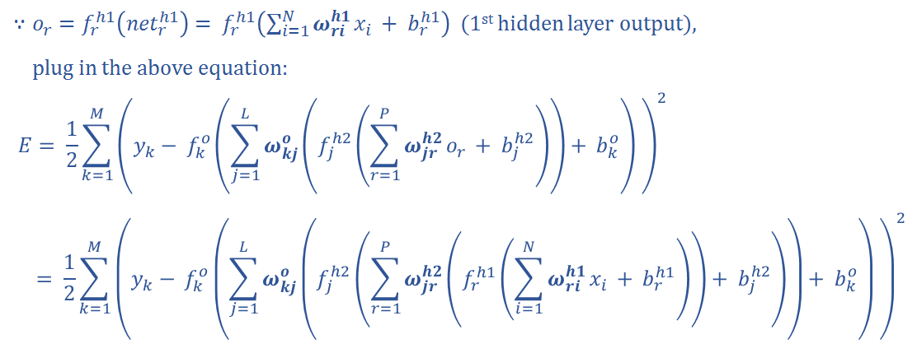

Slide 12




Slide 13
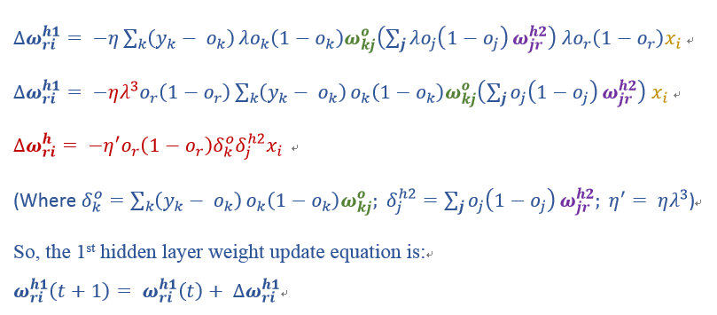

Slide 14
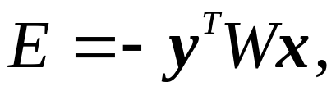
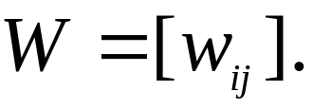
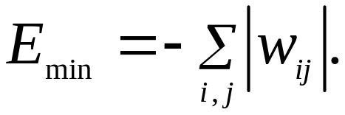
Homework 4 (50pts)
Let the energy function of an NN be
where x and y are bipolar vectors and
Show
No answer 4.

Slide 15

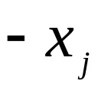
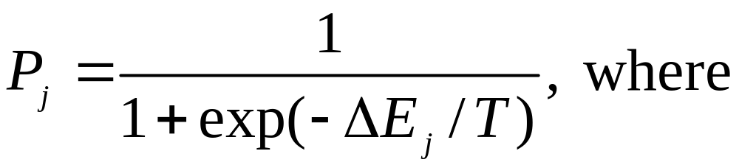
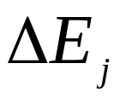
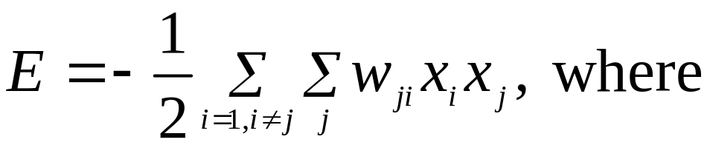
Homework 5 (100pts)
Consider a stochastic, two-state neuron j operating at temperature T. This neuron changes from state to
state with probability
: the energy change resulting from the state change.
The total energy of the Boltzmann machine is defined as

Slide 16
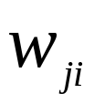
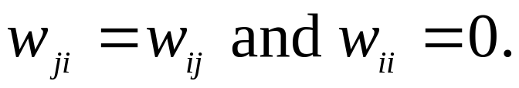
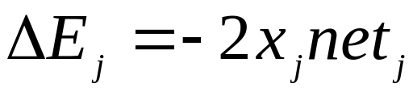
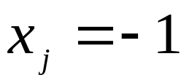

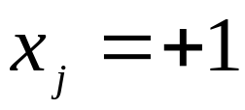
: the synaptic weight from neuron i to neuron j, with
a) Show that
b) Suppose that initially state , what is the
probability that is changed to state +1.
c) Suppose that initially state , what is the
probability that is changed to state -1.
No answer 5.

