Slide 1
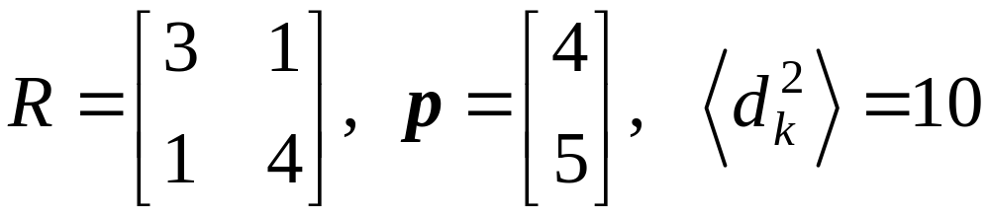
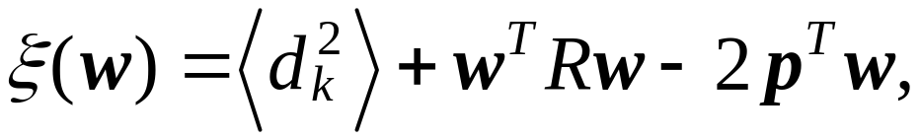

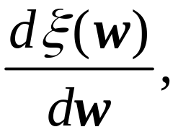
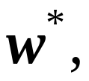

Homework 1 (30pts) Due 3/18
Let
for
which reveals
a paraboloid in the space
Find i) ii) the optimum weight vector
iii) the minimum mean square error

Slide 2
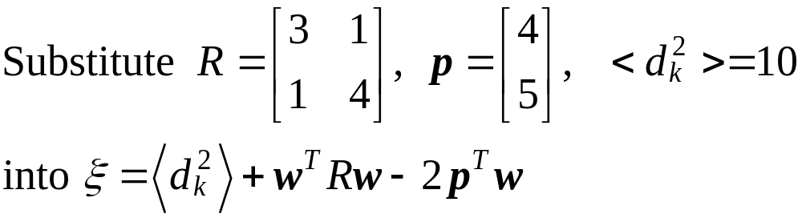
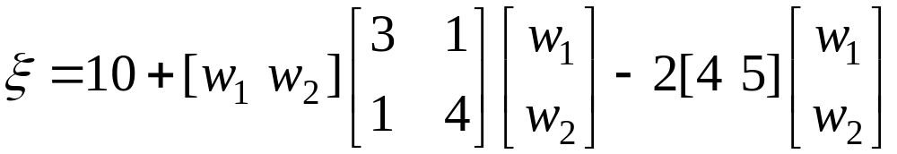
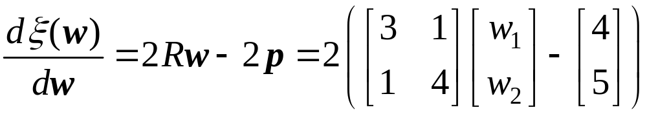
Answer:
i)

Slide 3
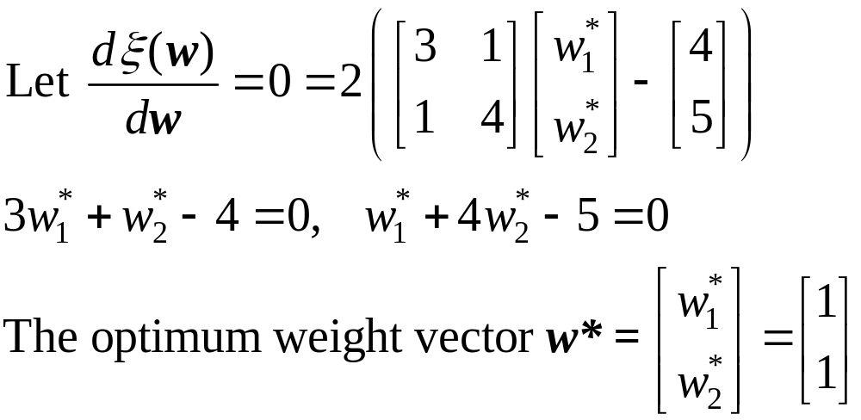
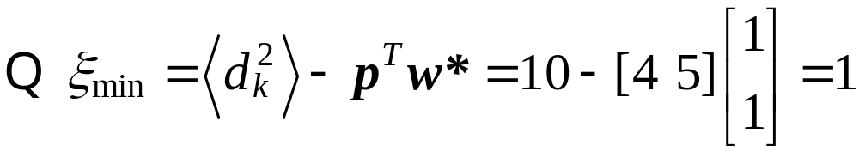
ii)
iii)

Slide 4
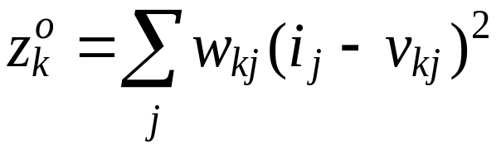
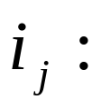
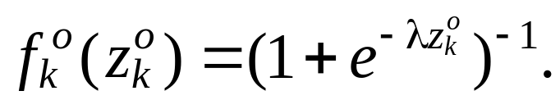

Homework 2 (50pts) Due 4/1
Consider quadratic neurons for the output nodes of a backpropagation neural network, i.e., the net input to
output node k is computed by
the jth input value
The output functions of output nodes are sigmoid,
Derive the updating equations of for
output-layer neurons.

Slide 5
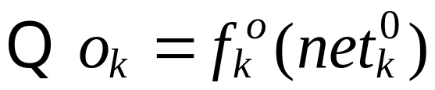
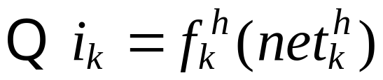
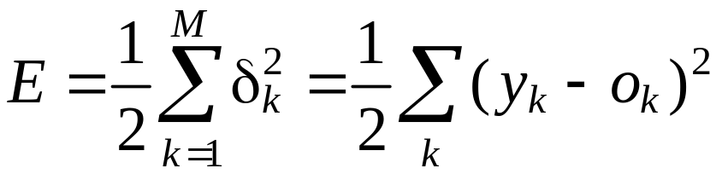
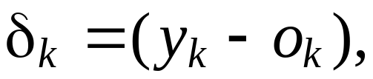
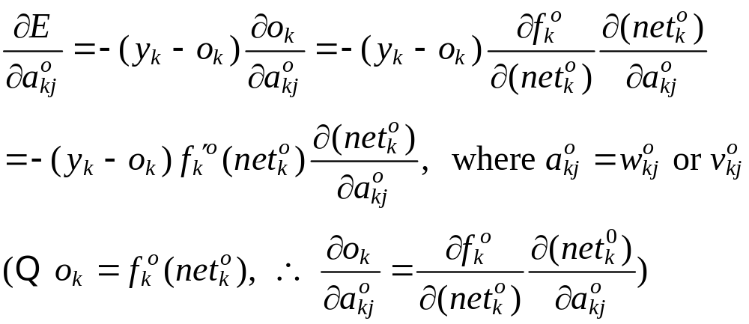
Answer 2:
output of output node
output of hidden node

Slide 6
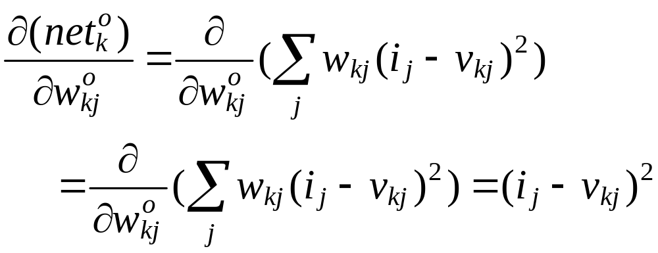
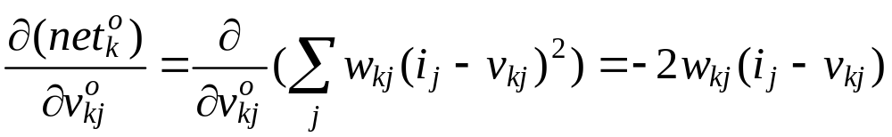
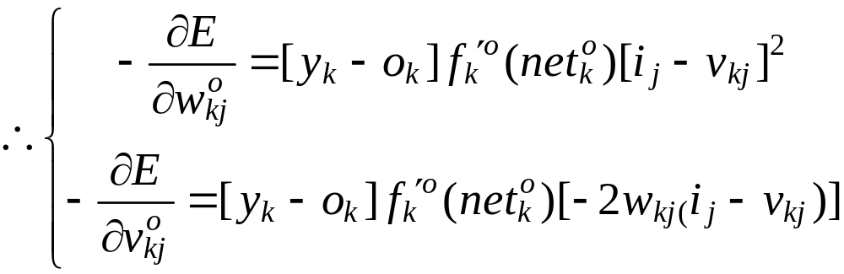

Slide 7
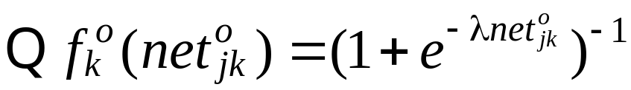
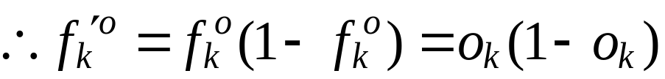
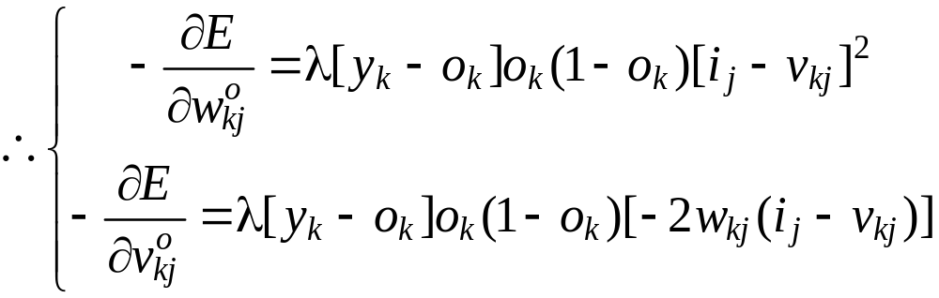
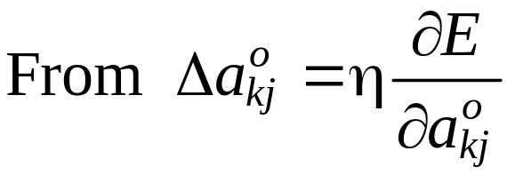
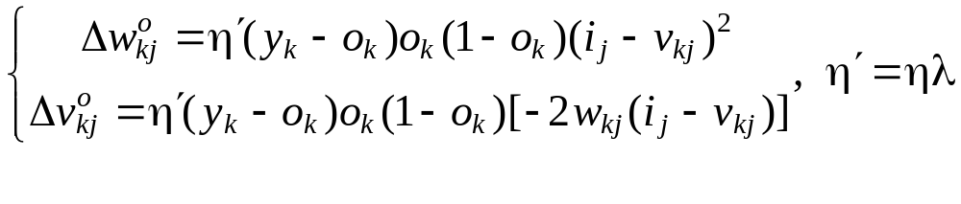

Slide 8
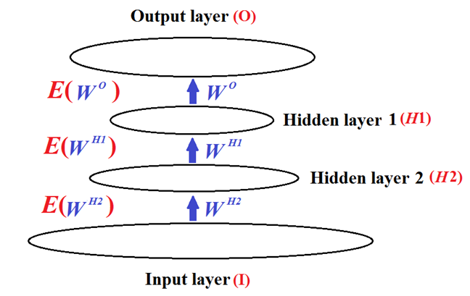
Homework 3 (50pts) Due 4/8
Consider a network with two hidden layers.
Determine the weight-updating equations of neurons on the second hidden layer (H2) using the activation
and net input functions defined in the class PPT.

Slide 9
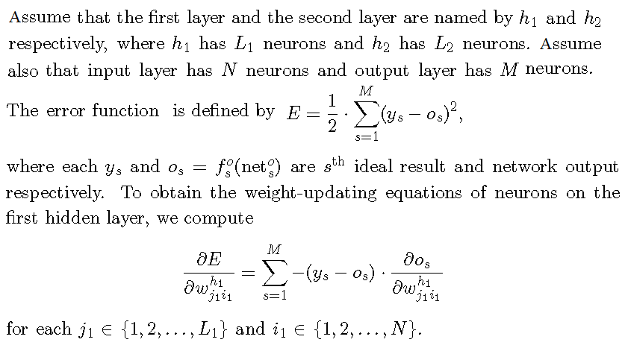
Answer 3:

Slide 10





observe that

Slide 11
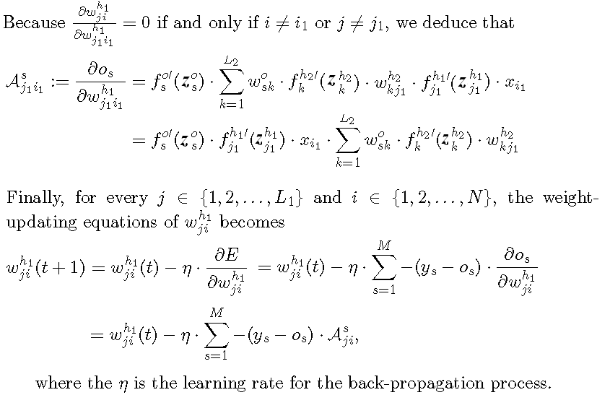

To be continued for the weight-updating equations of

Slide 12
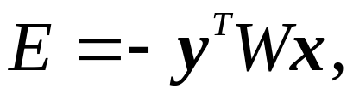
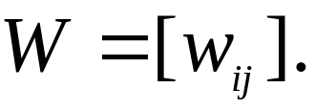
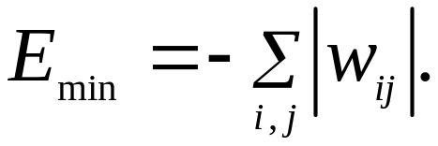
Homework 4 (50pts)
Let the energy function of an NN be
where x and y are bipolar vectors and
Show

Slide 13

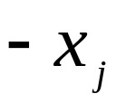
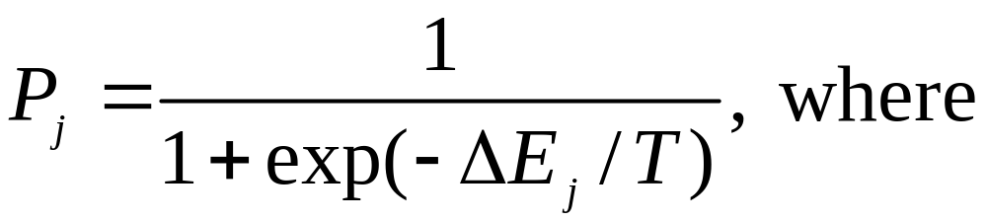
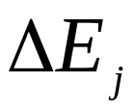
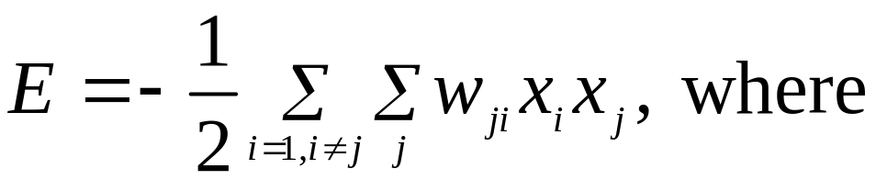
Homework 5 (100pts)
Consider a stochastic, two-state neuron j operating at temperature T. This neuron changes from state to
state with probability
: the energy change resulting from the state change.
The total energy of the Boltzmann machine is defined as

Slide 14
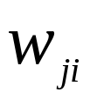
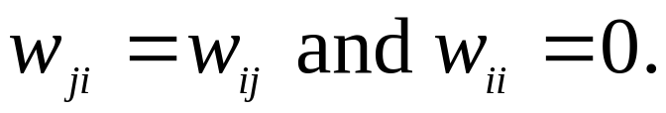
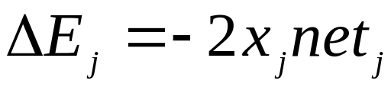
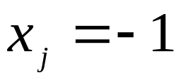

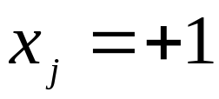
: the synaptic weight from neuron i to neuron j, with
a) Show that
b) Suppose that initially state , what is the
probability that is changed to state +1.
c) Suppose that initially state , what is the
probability that is changed to state -1.

