Slide 1
A Fine-grained Modulation Technology for ZigBee Backscatter Communication
Zhaoyuan Xu

Slide 2




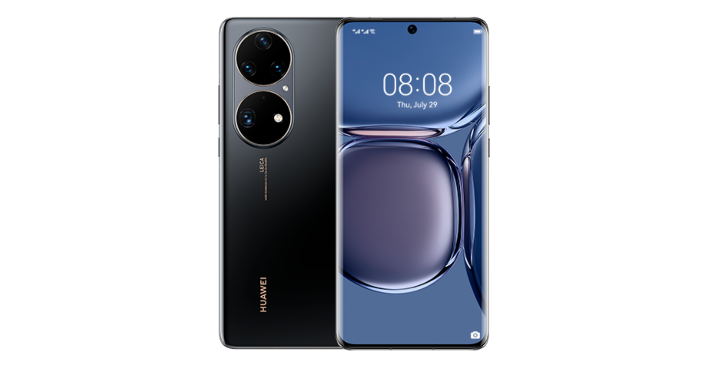



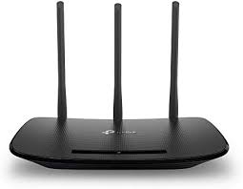
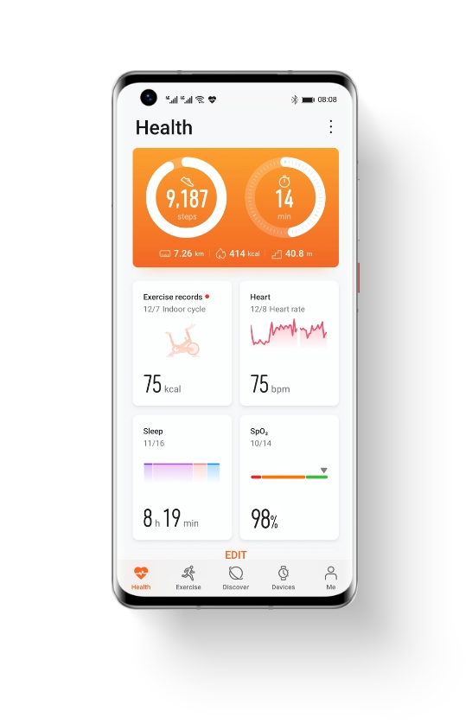
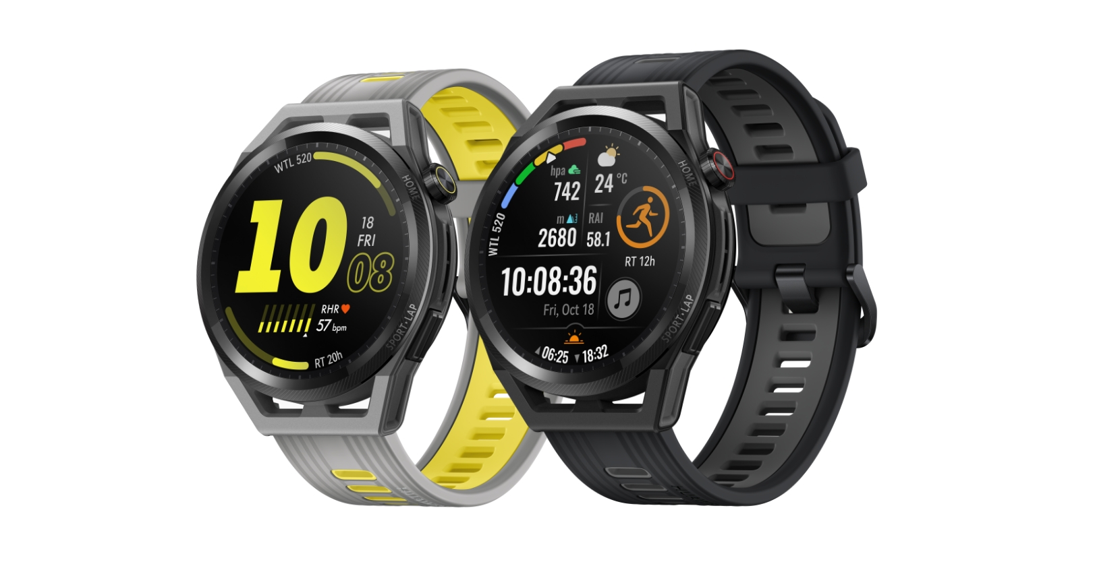
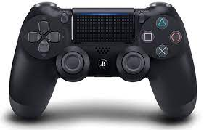


Introduction
…

Slide 3
Introduction
Lighting Control
Healthcare
Smart Home
Manufacturing
Energy Management

Slide 4


Introduction
Conventional Zigbee radios consume too much power.

Slide 5
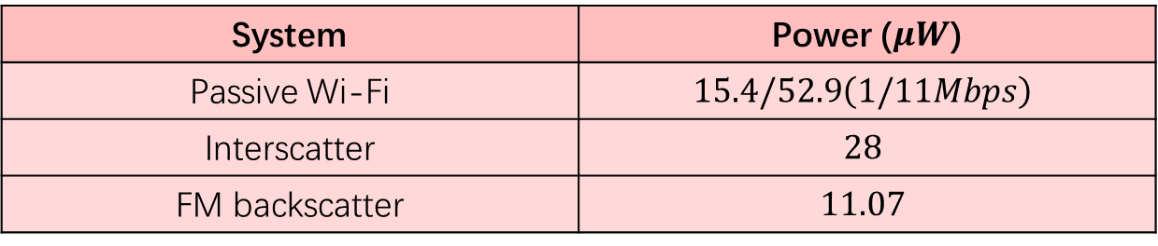
Introduction
Backscatter technology helps to reduce power greatly.
Ambient signals
Tag
Backscatter signals
System | Power ($μW$)
Passive Wi-Fi | $$15.4/52.9\left(1/11Mbps\right)$$
Interscatter | $$28$$
FM backscatter | $$11.07$$

Slide 6
Motivation
Symbol 0
Symbol 1
Tag operations
FreeRider design: productive data communication
Exciting signal
Excitation source
Receiver 1
Tag data
Backscatter signal
Receiver 2

Slide 7
Motivation
Symbol 0
Symbol 1
Ambiguous symbol
Exciting signal
Tag operations
Backscatter signal
Due to the synchronization errors, the backscatter signal is ambiguous.

Slide 8
Motivation
Symbol 0
Symbol 1
Ambiguous symbol
Exciting signal
FreeRider takes redundancy coding for
the backscatter signal generation
Tag operations
Backscatter signal
N
N
N
‘1’
‘0’
‘1’

Slide 9
Problem
Symbol 0
Symbol 1
Ambiguous symbol
Exciting signal
FreeRider has a 4*N throughput reduction in theory.
Tag operations
2. N symbols are used to transmit 1 tag bit.
Backscatter signal
N
N
N
1. One symbol contains 4 bits information.
‘1’
‘0’
‘1’

Slide 10
Can we take one ZigBee symbol to contain 4 tag bits?

Slide 11






























Design
Symbol i
Excitation
Frequency
$$f_{c}+f_{0}$$
$$f_{c}+f_{0}$$
$$f_{c}−f_{0}$$
$$f_{c}−f_{0}$$
$$f_{c}+f_{0}$$
Phase
$$π$$
$$\frac{3π}{2}$$
$$0$$
$$\frac{3π}{2}$$
$$π$$
Our design is based on the symbol difference.
Tag
Frequency
$$f_{s}−2f_{0}$$
$$f_{s}$$
$$f_{s}+2f_{0}$$
$$f_{s}$$
$$f_{s}−2f_{0}$$
Phase
$$π$$
$$0$$
$$0$$
$$π$$
$$π$$
Backscatter
Frequency
$$f_{c}+f_{s}−f_{0}$$
$$f_{c}+f_{s}+f_{0}$$
$$f_{c}+f_{s}+f_{0}$$
$$f_{c}+f_{s}−f_{0}$$
$$f_{c}+f_{s}−f_{0}$$
Phase
$$0$$
$$\frac{3π}{2}$$
$$0$$
$$\frac{π}{2}$$
$$0$$

Slide 12
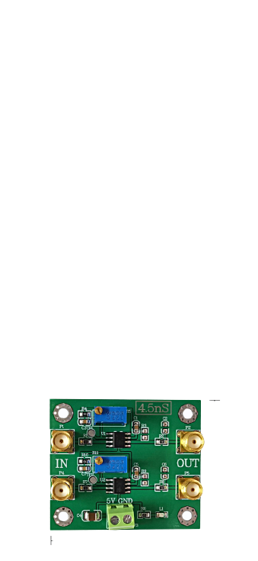
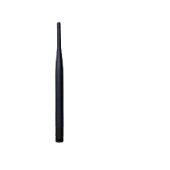
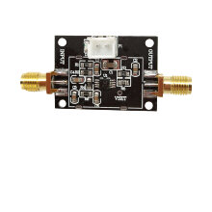
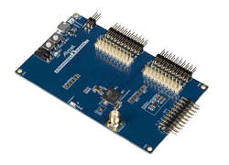
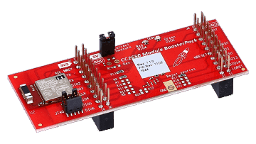
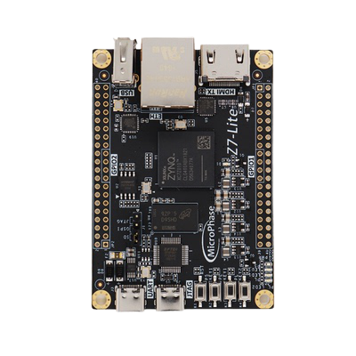

Implementation
ATMEGA256RF2
CC2650
fixed distance (5 cm)
uplink distance

Slide 13
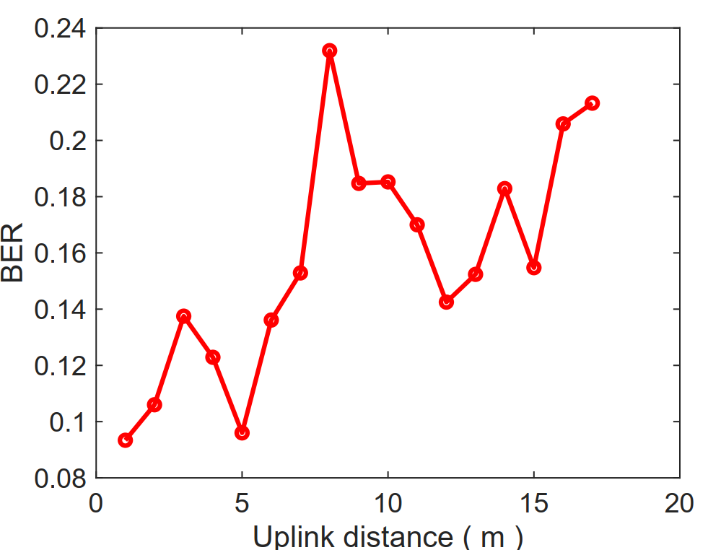
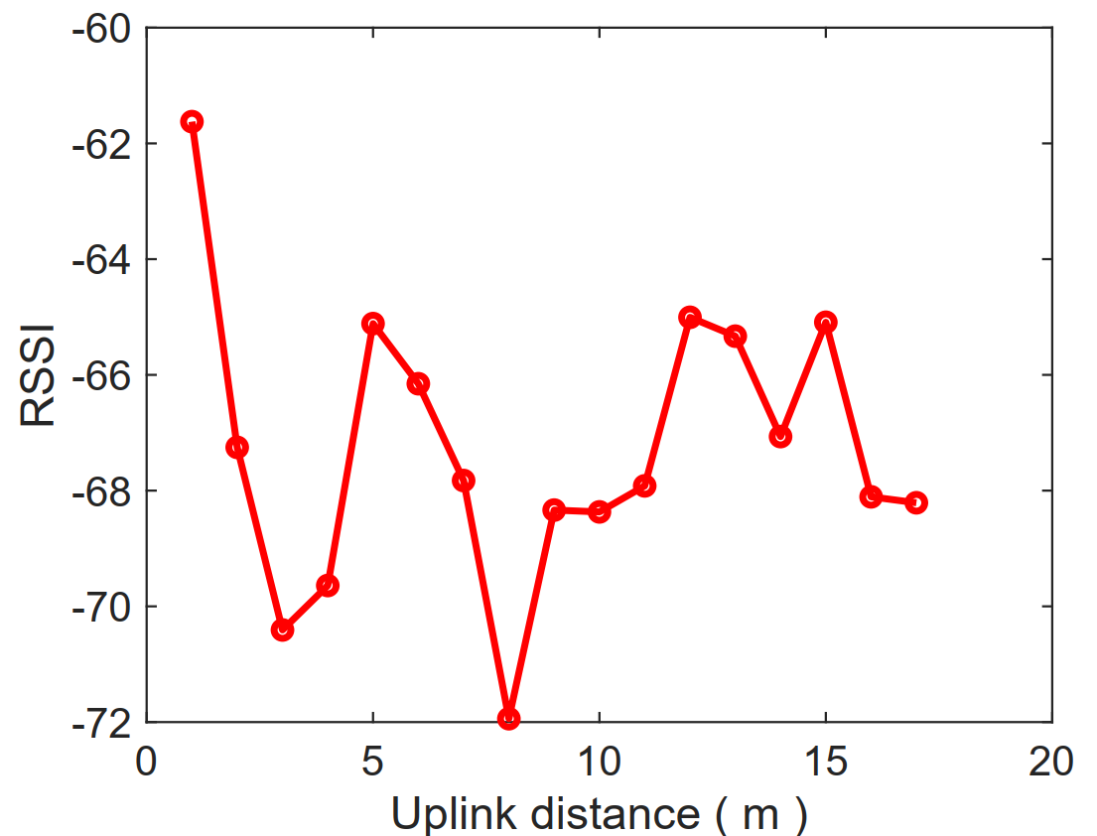
Evaluation
BER and RSSI variance.

Slide 14
Conclusion
1. We introduced for the first time a symbol-level modulation technology for ZigBee backscatter communication.
2. It utilized various square waves of a few discrete frequencies and phases for the symbol-level ZigBee codeword translation.

