Slide 1
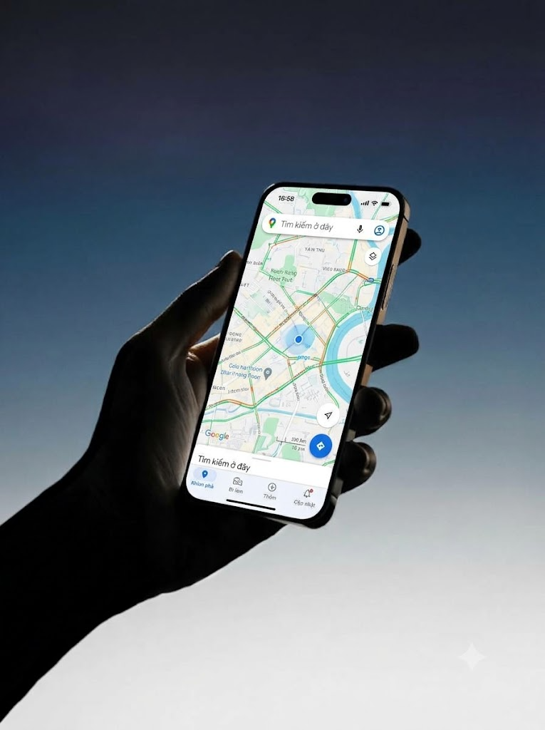
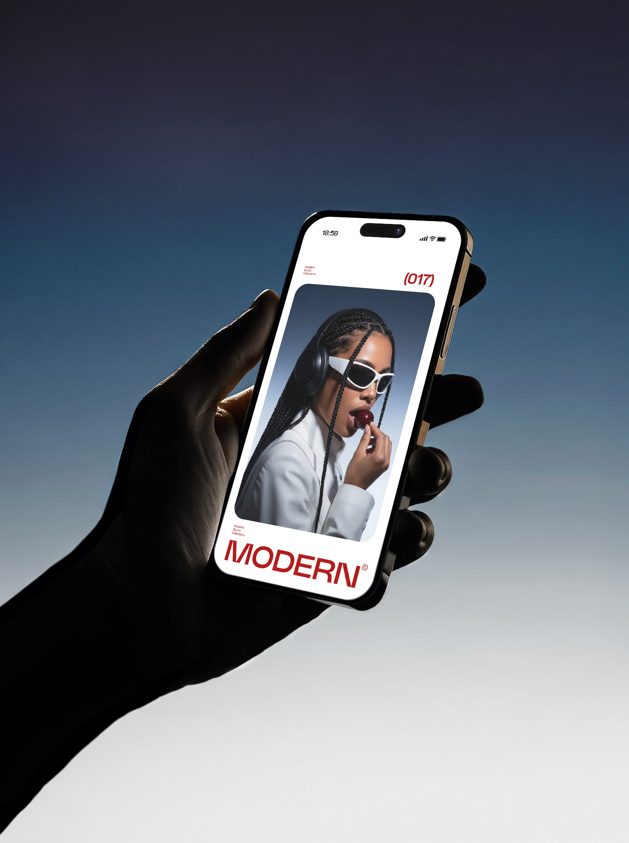
Campus bite ai
Group ID: 06
01/32

Slide 2
Table of contents
01
02
03
04
05
Introduction and Problem Statement
Introduction and Problem Statement
Proposed Solution and Workflow
Computational Thinking: 4 Pillars
Case Study and Evaluation Plan
Responsible AI and Conclusion
02/32

Slide 3
01
Introduction
&
Problem statement
03/32

Slide 4
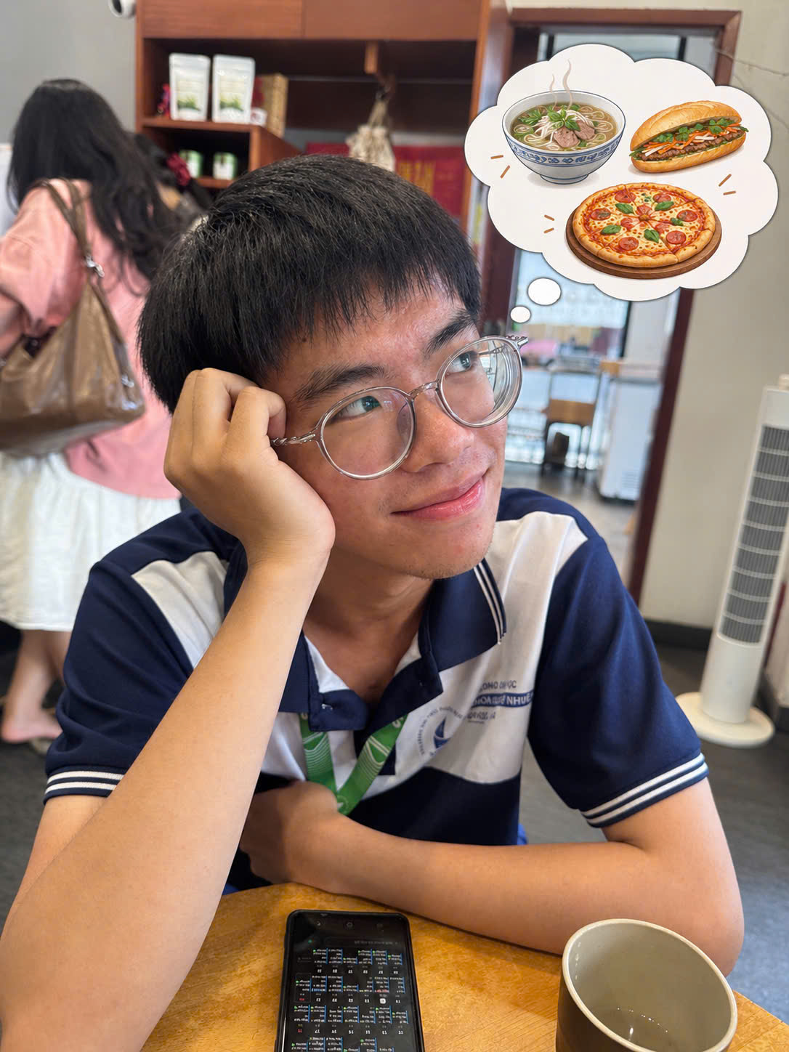
Problem
Statement
Students especially freshman often struggle to find affordable and suitable food places around HCMUS like small local vendors and eateries hidden in alleys.
Help students make informed food choices based on their actual needs
Scope Discoverability.
Budget Constraints.
Travel Costs.
Unreliable Information.
- Food safety.
04/32

Slide 5
Problem
Statement
Students especially freshman often struggle to find affordable and suitable food places around HCMUS like small local vendors and eateries hidden in alleys.
Help students make informed food choices based on their actual needs
Limited Discoverability.
Budget Constraints.
Travel Costs.
Unreliable Information.
- Food safety.
05/32

Slide 6
Target users & objectives
Target users
objectives
HCMUS students with limited budgets.
Understand natural-language food requests.
Discover relevant local eateries.
Students unfamiliar with the surrounding area.
Compare food prices and travel costs.
Students searching for specific dishes or drink.
Recommend places based on preferences and reliability.
Groups with shared budgets and preferences.
Provide transparent information and navigation options.
06/32

Slide 7
02
Proposed solution
& workflow
07/32

Slide 8
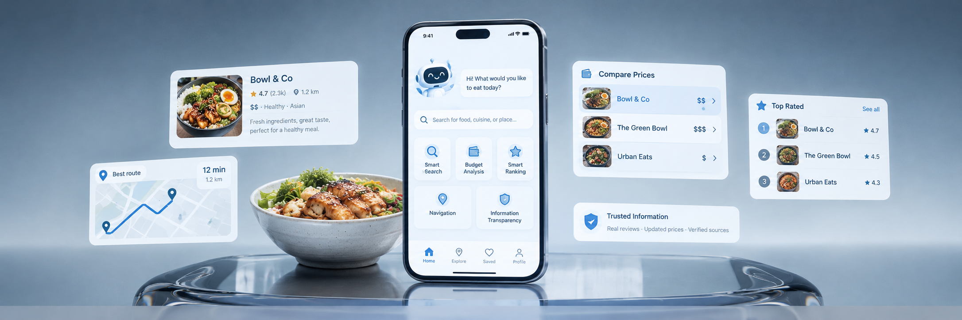

Proposed solution
Users describe what they want in natural language. The system identifies their requirements, retrieves candidate eateries, compares costs, and ranks suitable options.
08/32

Slide 9
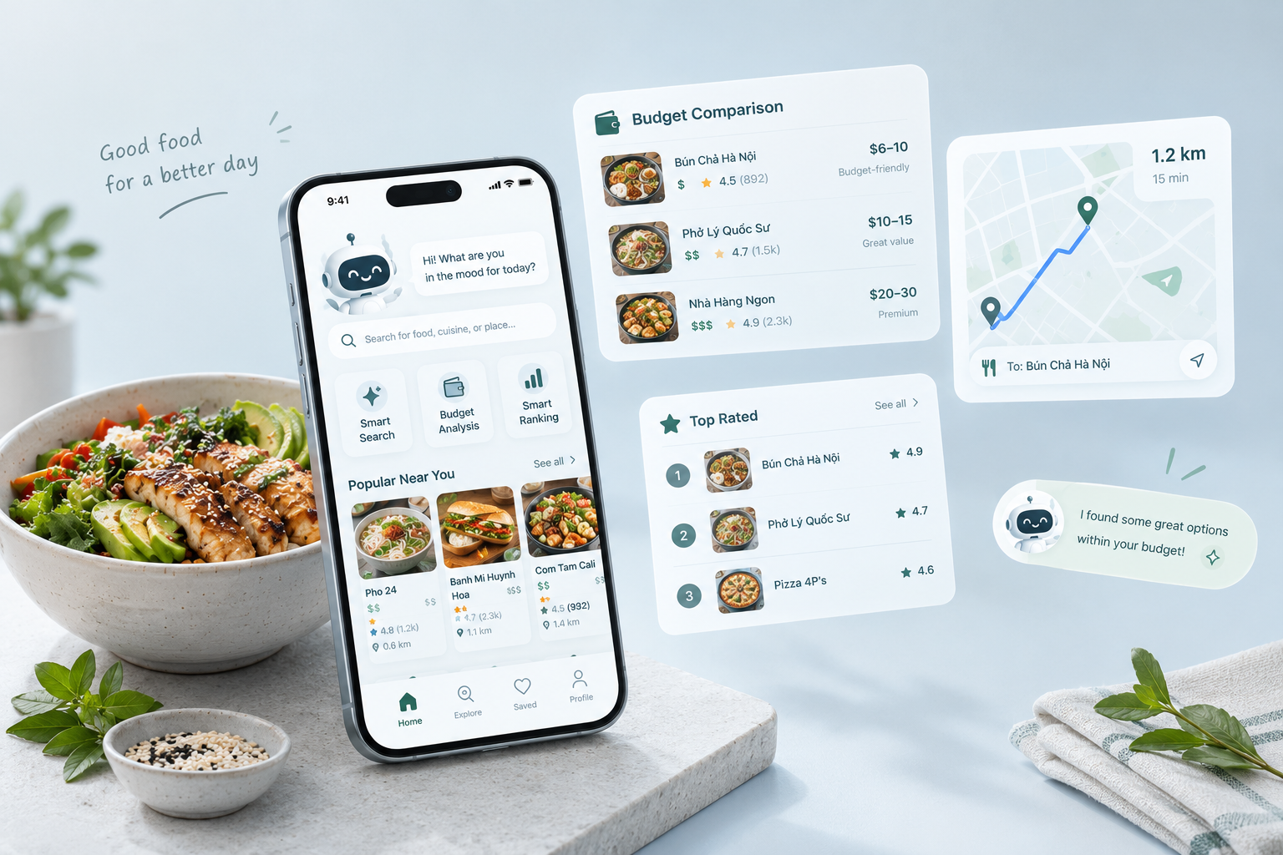
Core features
Users describe what they want in natural language. The system identifies their requirements, retrieves candidate eateries, compares costs, and ranks suitable options.
Smart Search
Budget-Aware Recommendations
Location & Navigation
Preference-Based Filtering
Information Transparency
09/32

Slide 10
SYSTEM WORKFLOW
REQUEST
Receive the user’s food request.
UNDERSTAND
Extract budget, dish, location and preference.
ROUTE
Determine the relevant search area.
RETRIEVE & COMPUTE
Find candidates and estimate costs.
REASON
Filter and rank candidate places.
VERIFY
Check constraints and data quality.
REASON & ACT
10/32
Present recommendations and route options.

Slide 11
03
Computational thinking:
4 pillars
11/32

Slide 12
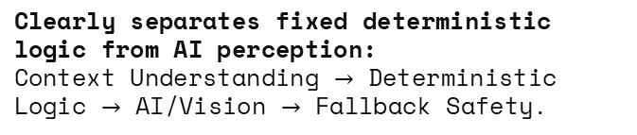
DeComPosition
Assistant level
System-level
Client interface: Mobile UI & AR Camera for user queries and visual guidance.
Assistant System / Orchestrator: Central orchestration engine parsing inputs, routing tasks, and managing exceptions.
Clearly separates fixed deterministic logic from AI perception:
Context Understanding $→$ Deterministic Logic $→$ AI/Vision $→$ Fallback Safety.
Database & Knowledge Base: Stores hidden eateries, menus, pricing, ratings, GPS coordinates, and landmark images.
12/32

Slide 13
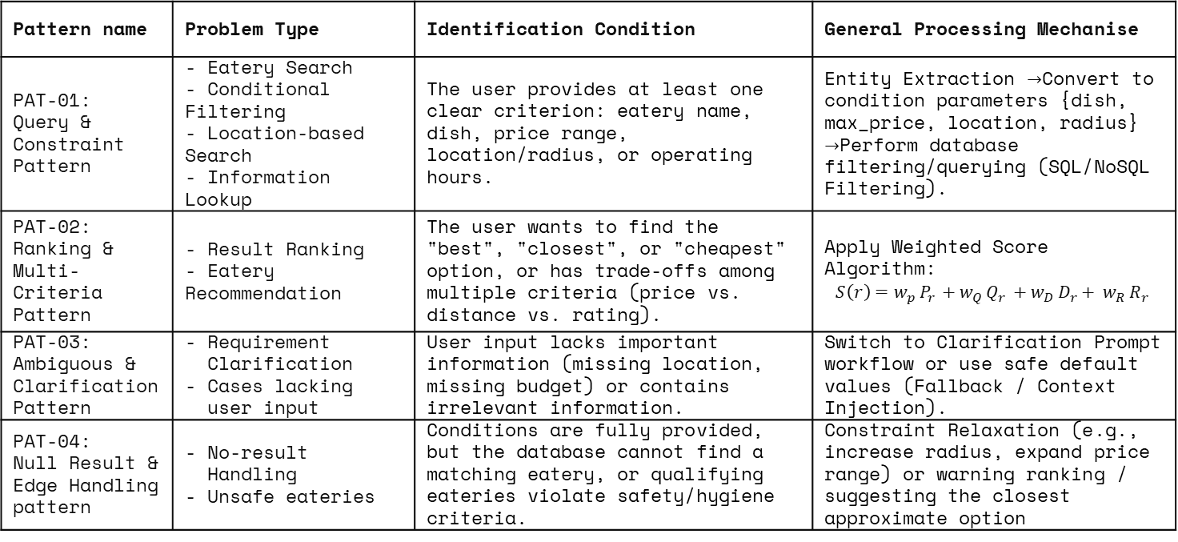
Pattern recognition
Pattern name | Problem Type | Identification Condition | General Processing Mechanise
PAT-01: Query & Constraint Pattern | - Eatery Search - Conditional Filtering - Location-based Search - Information Lookup | The user provides at least one clear criterion: eatery name, dish, price range, location/radius, or operating hours. | Entity Extraction $→$Convert to condition parameters {dish, max_price, location, radius} $→$Perform database filtering/querying (SQL/NoSQL Filtering).
PAT-02: Ranking & Multi-Criteria Pattern | - Result Ranking - Eatery Recommendation | The user wants to find the "best", "closest", or "cheapest" option, or has trade-offs among multiple criteria (price vs. distance vs. rating). | Apply Weighted Score Algorithm: $${S\left(r\right)=w_{p }P_{r }+w_{Q }Q_{r }+{w_{D }D_{r}+ w}_{R }R_{r}}_{ }$$
PAT-03: Ambiguous & Clarification Pattern | Requirement Clarification Cases lacking user input | User input lacks important information (missing location, missing budget) or contains irrelevant information. | Switch to Clarification Prompt workflow or use safe default values (Fallback / Context Injection).
PAT-04: Null Result & Edge Handling pattern | No-result Handling Unsafe eateries | Conditions are fully provided, but the database cannot find a matching eatery, or qualifying eateries violate safety/hygiene criteria. | Constraint Relaxation (e.g., increase radius, expand price range) or warning ranking / suggesting the closest approximate option
13/32

Slide 14
Pattern recognition
System-side cases
Case | Description | Related Patterns
Missing location information | information The system does not have enough location data to find eateries by area or distance | P03, P07
Missing dish information | The system lacks reliable data on the dishes served by the eatery | P06, P07
No matching information despite complete user requirements | The user has provided all necessary conditions, but existing data contains no meeting eateries | P08
14/32

Slide 15
Pattern recognition
user-side cases
Case | Description
Providing total spending only | The user only states the budget or expected total spending amount
Providing dish name only | The user only states the budget or expected total spending amount
Not providing current location | The user does not provide their location and no available location information exists
Providing rating preference only | The user only specifies the desired rating level or requirements based on ratings
Providing irrelevant information | The input information is irrelevant to searching for or recommending eateries
15/32

Slide 16
Abstraction
Vendor Profile
Vendor ID: Unique identifier string
Coordinates: GPS location
PriceRange: Operational limits
VerifiedStatus: Safety status
RatingScore: User average
2. User Profile
User Location: Current coordinates
MaxBudget: Max spending threshold
Allergies: Restricted ingredients list
TargetDish: Search query string
3. Alley Graph G(V,E)
Vertical (V): Intersections, landmarks & eateries
Edges (E): Physical alley segments
Weight (W): Segment length in meters
16/32

Slide 17
Noise Stripped vs Retained Computable Models
01
02
03
-Noise Stripped: Conversational fillers, emotions ("ngon ngon"), slang ("35 cành")
-Retained Abstraction: Normalized JSON Entities (dish, max_price, location)
-Noise Stripped: Seating, AC, table material, parking fees, owner history
-Retained Abstraction: Boolean predicate filtering
-Noise Stripped: Overhead wires, trash bins, wall colors, weather, crowds
-Retained Abstraction: Weighted Graph G(V, E) with physical distances
04
05
06
-Noise Stripped: Long subjective text reviews, personal moods, food décor
-Retained Abstraction: Multi-objective weighted numeric score
-Noise Stripped: Moving pedestrians, motorbikes, sunlight glare, shadows
-Retained Abstraction: Keypoint feature vector distance
-Noise Stripped: Continuous processing of blurry frames or GPS jitter
-Retained Abstraction: Discrete FSM states & step-by-step text guidance
17/32

Slide 18
Algorithmic Design
Stage 1. Ingestion and Input Varification
Validate query integrity, enforce non-empty inputs, and verify geolocation requirements.
Stage 2. Candidate Retrieval
Query spatial database for vendors matching dish preferences and initial budget limit.
Stage 3. Hard Constraint Filtering
Eliminate over-budget venues, unverified food safety vendors, and allergen matches.
Stage 4. Total Cost & Scoring Execution
Calculate total transit costs and evaluate multi-factor composite suitability scores.
Stage 5. Ranking & Distance Tie-Breaking
Order candidate list by score; resolve identical scores using shortest proximity.
18/32

Slide 19
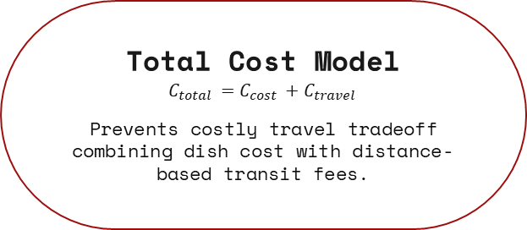
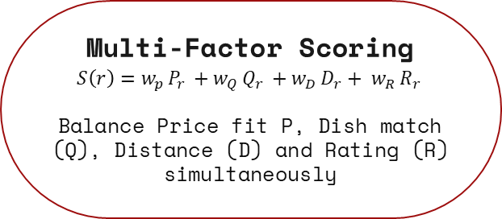
Algorithmic Design
Total Cost Model
$$C_{total }=C_{cost }+C_{travel }$$
Prevents costly travel tradeoff combining dish cost with distance-based transit fees.
Multi-Factor Scoring
$${S\left(r\right)=w_{p }P_{r }+w_{Q }Q_{r }+{w_{D }D_{r}+ w}_{R }R_{r}}_{ }$$
Balance Price fit P, Dish match (Q), Distance (D) and Rating (R) simultaneously
Hard Constraint Filter
Strictly discards candidates exceeding budget, lacking safety verification, or containing user allergens.
Distance Tie-Breaking
When two vendors share equal composite scores S(r), prioritize the one closest to user location
19/32

Slide 20
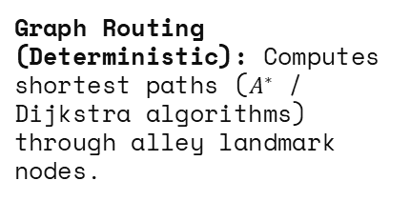
Technical sub-problem
01
02
03
Intent Parsing & Entity Extraction (AI): Converts unstructured user queries into structured JSON entities (intent, dish, max price, location anchor).
Budget & Constraint Checking (Deterministic): Queries database to filter eateries satisfying hard constraints like price limits and opening hours.
Graph Routing (Deterministic): Computes shortest paths ($A^{∗}$ / Dijkstra algorithms) through alley landmark nodes.
04
05
06
Ranking Score Calculation (Deterministic): Computes weighted scores based on ratings, distance, and price to sort recommendations.
Visual Landmark Matching (Computer Vision): Matches camera frames with database landmark photos to verify user turns (match_found, ar_overlay_instruction).
Fallback Navigation (Deterministic Rules): Automatically switches from AR to step-by-step text guidance when GPS signal or vision confidence is poor.
20/32

Slide 21
04
Case study
&
Evaluation plan
21/32

Slide 22

case study
USER REQUEST
“We are three HCMUS students near Campus 2. We want a quiet milk tea shop where we can study on a weekday afternoon. Our total budget is 100,000 VND.”
BUDGET CALCULATION
$$3×28,000=84,000\text{ VND}$$
$$100,000−84,000=16,000\text{ VND}$$
EXTRACTED CONSTRAINTS
Group size: 3
Purpose: Studying
Preferences: Quiet environment, tables, power outlets
Budget: 100,000 VND total
Drink: Milk tea
Location: HCMUS Campus 2
22/32

Slide 23
case study
USER REQUEST
“We are three HCMUS students near Campus 2. We want a quiet milk tea shop where we can study on a weekday afternoon. Our total budget is 100,000 VND.”
BUDGET CALCULATION
$$3×28,000=84,000\text{ VND}$$
$$100,000−84,000=16,000\text{ VND}$$
EXTRACTED CONSTRAINTS
Group size: 3
Purpose: Studying
Preferences: Quiet environment, tables, power outlets
Budget: 100,000 VND total
Drink: Milk tea
Location: HCMUS Campus 2
23/32

Slide 24

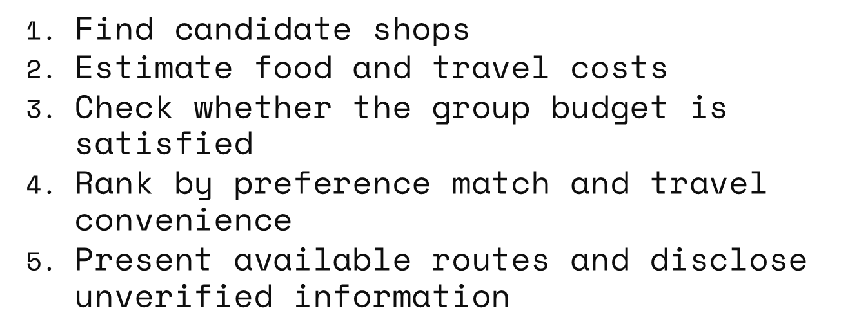
case study
EXPECTED SYSTEM BEHAVIOR
$\text{Find candidate shops}$
$\text{Estimate food and travel costs}$
$\text{Check whether the group budget is satisfied}$
$\text{Rank by preference match and travel convenience}$
$\text{Present available routes and disclose unverified information}$
24/32

Slide 25
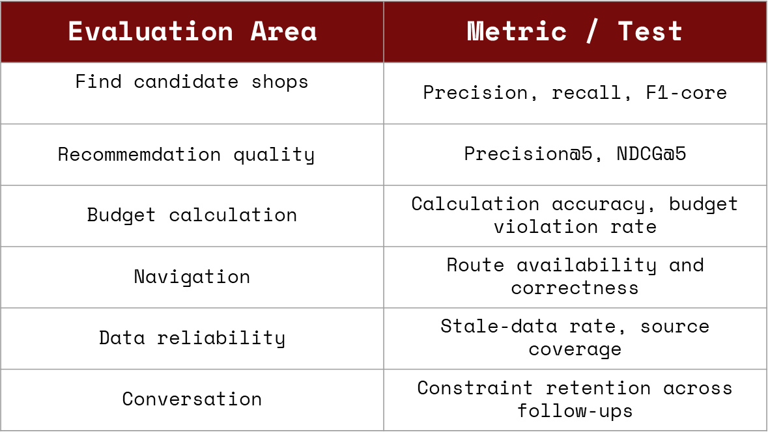
EVALUATION PLAN
Evaluation Area | Metric / Test
$$\text{Find candidate shops}$$ | Precision, recall, F1-core
$$\text{Recommemdation quality}$$ | Precision@5, NDCG@5
Budget calculation | Calculation accuracy, budget violation rate
Navigation | Route availability and correctness
Data reliability | Stale-data rate, source coverage
Conversation | Constraint retention across follow-ups
25/32

Slide 26
EVALUATION PLAN
TEST SCENARIOS
Travel cost outweighs food savings
Budget-only request
Uncertain allergy information
Dish-only request
Missing location
Outdated place information
EVALUATION STATUS
Planned evaluation.Results will be reported after testing.
26/32

Slide 27
05
Responsible AI
& conclusion
27/32

Slide 28
Responsible AI &limitationS
RESPONSIBLE
AI
Privacy
Transparency
Safety
Fairness
Avoid automatically disadvantaging small vendors with few reviews
Request only necessary location information
Identify data sources and verification status
Never make unsupported allergy-free or food-safety claims
28/32

Slide 29
Responsible AI &limitationS
01
02
Incomplete data for small street vendors
Biased or insufficient reviews
05
LIMITATIONS
Changing prices and opening hours
Dependence on external mapping services
Difficult-to-verify alley locations
04
03
MITIGATION
Clearly label uncertainty, allow corrections, and recheck important information when possible
29/32

Slide 30
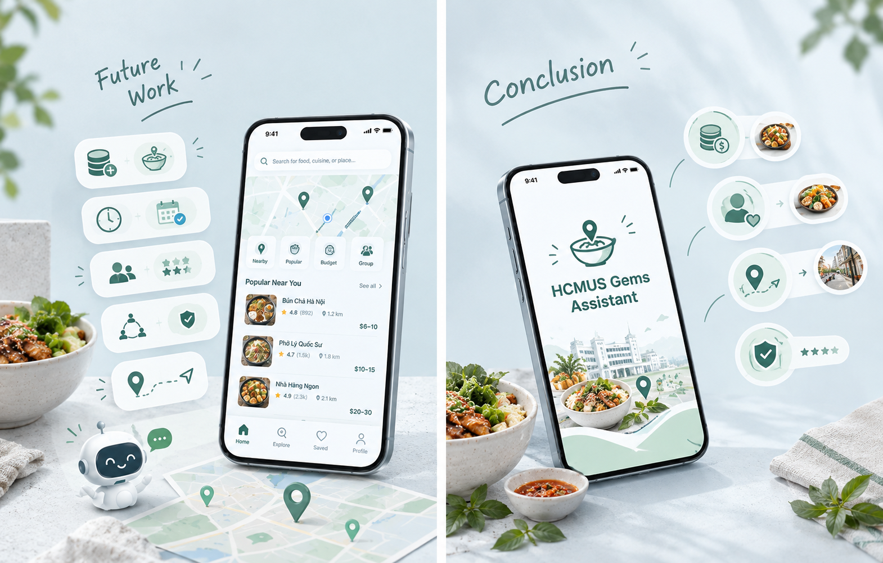
conclusion
30/32

Slide 31
CONCLUSION
HCMUS Gems Assistant aims to help students discover local food places by balancing budget, preferences, travel costs, and information reliability
31/32

Slide 32
Thank you
Do you have any questions?
32/32

