Slide 1
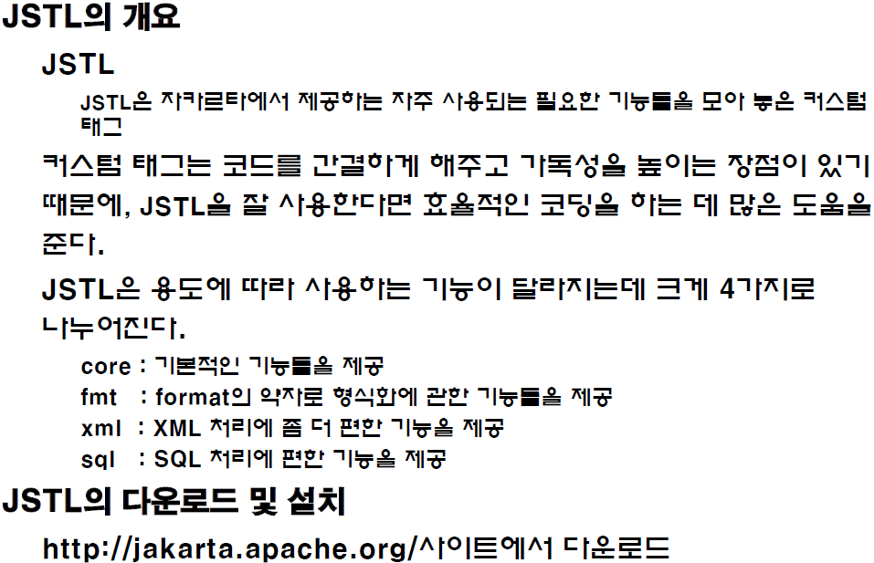
JSTL(JSP Standard Tab Library)

Slide 2
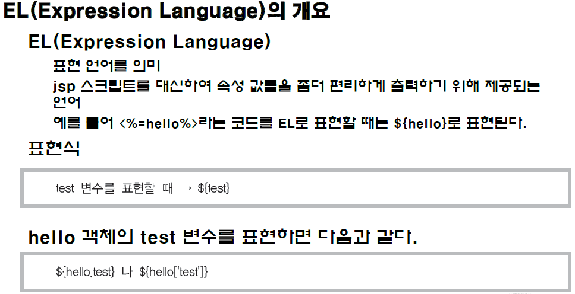
JSTL(JSP Standard Tab Library)

Slide 3
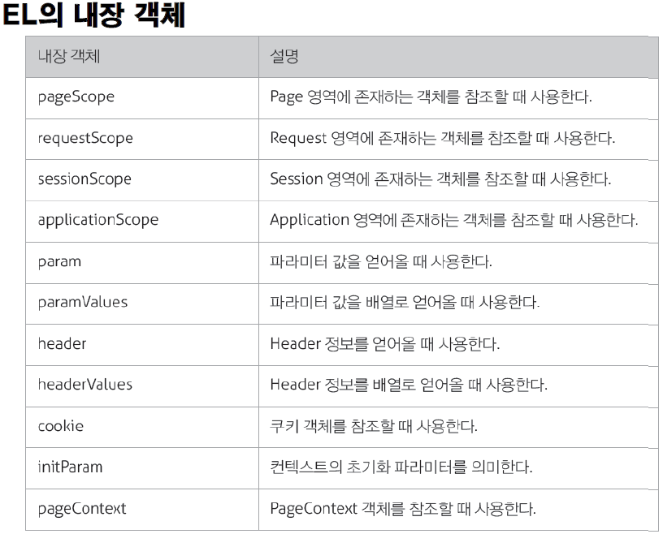
JSTL(JSP Standard Tab Library)
Notes:
Ex1) el_test.jap, el_test2.js

Slide 4
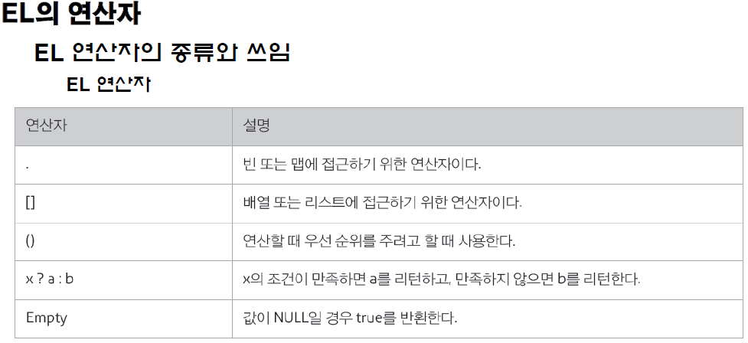
JSTL(JSP Standard Tab Library)

Slide 5
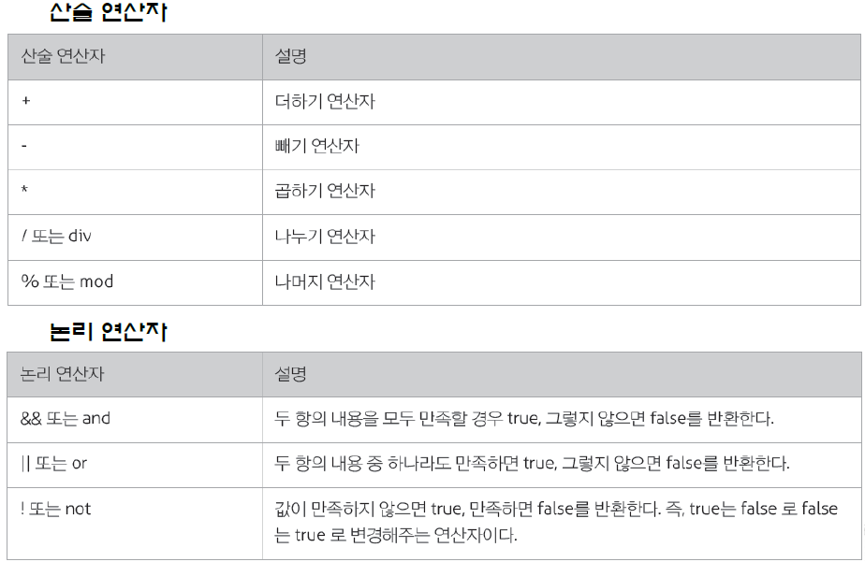
JSTL(JSP Standard Tab Library)

Slide 6
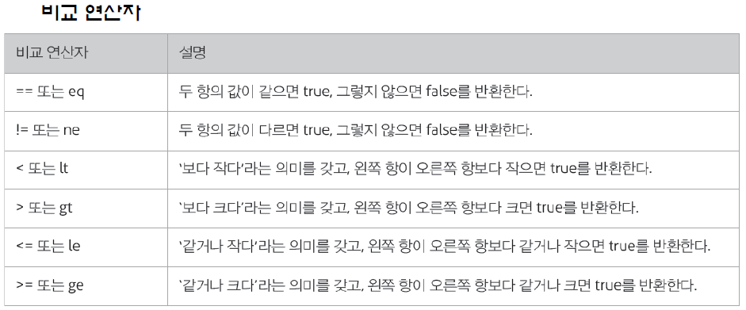
JSTL(JSP Standard Tab Library)

Slide 7
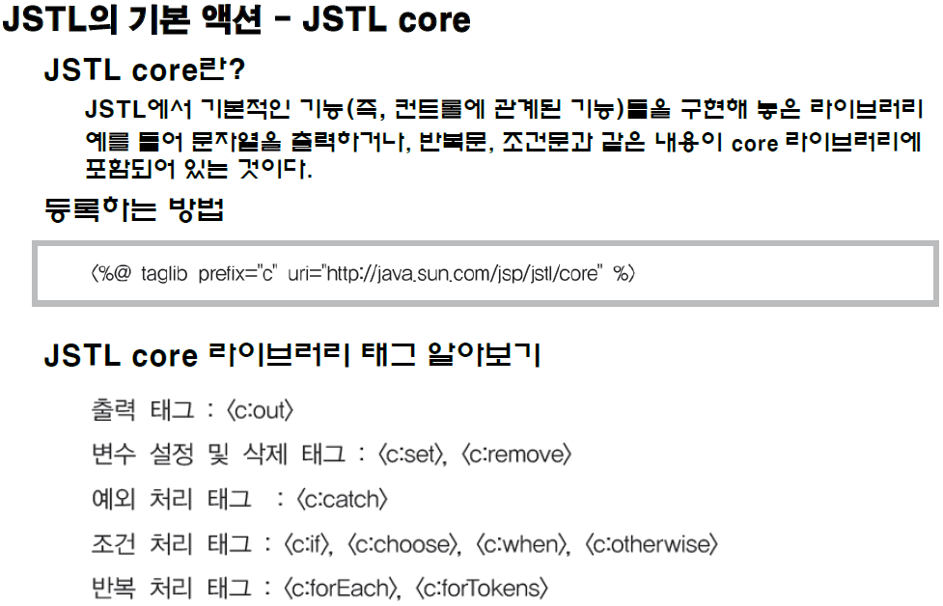
JSTL(JSP Standard Tab Library)

Slide 8
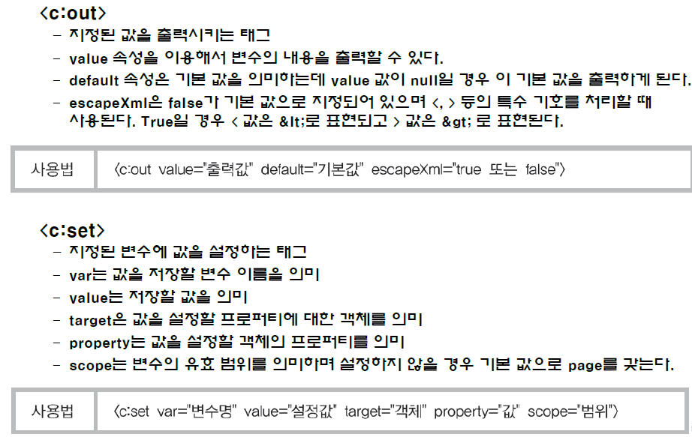
JSTL(JSP Standard Tab Library)

Slide 9
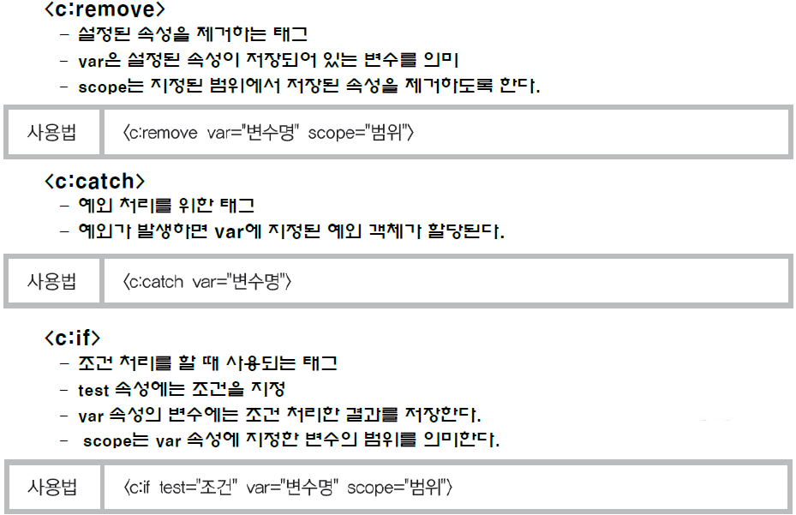
JSTL(JSP Standard Tab Library)

Slide 10
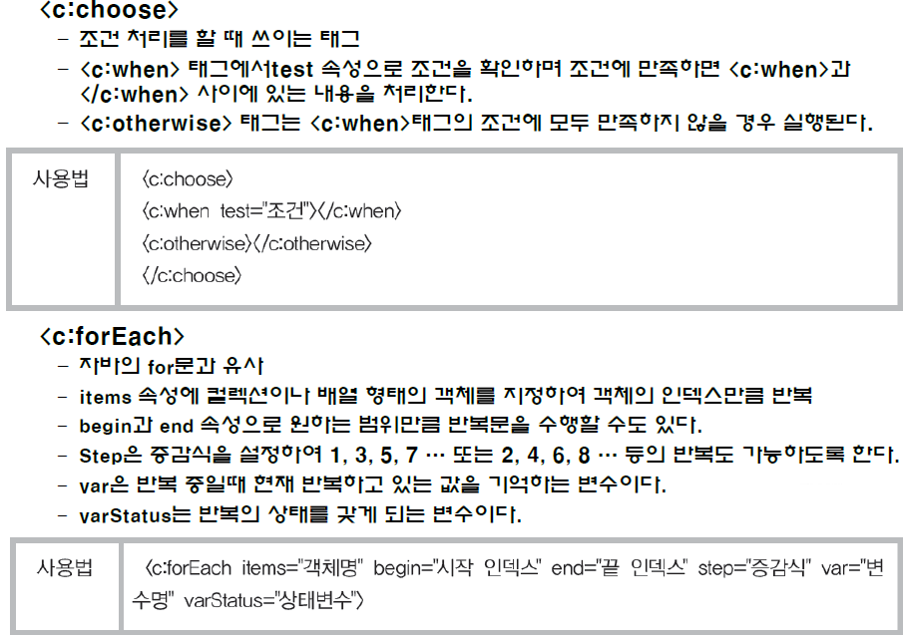
JSTL(JSP Standard Tab Library)

Slide 11
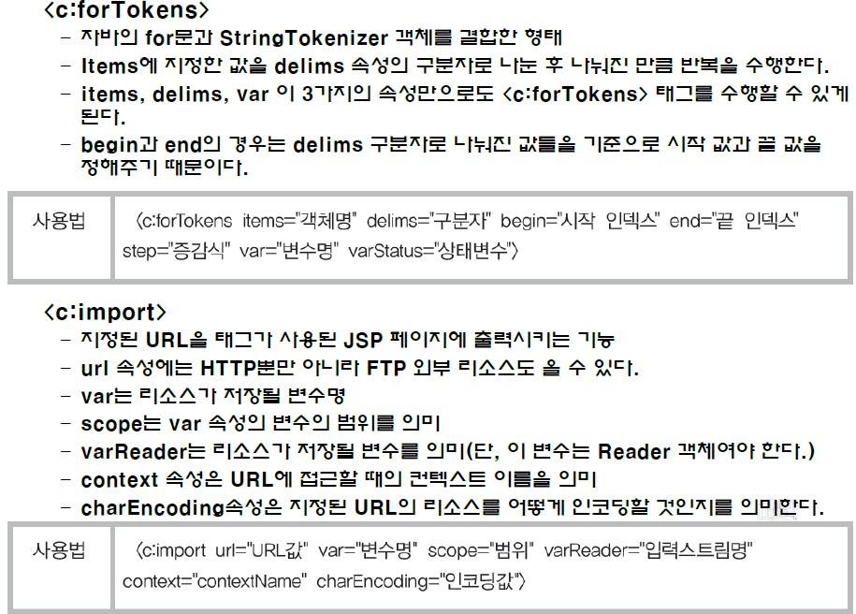
JSTL(JSP Standard Tab Library)

Slide 12
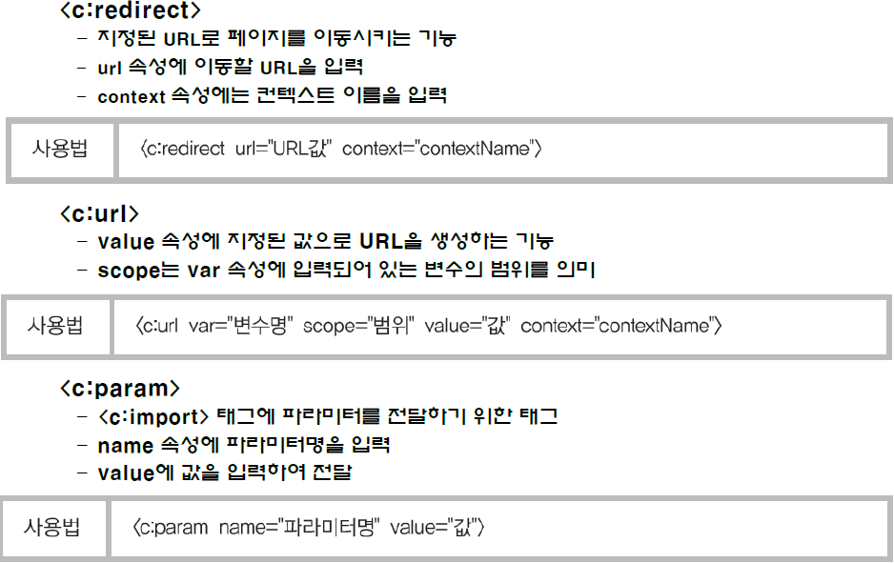
JSTL(JSP Standard Tab Library)

Slide 13
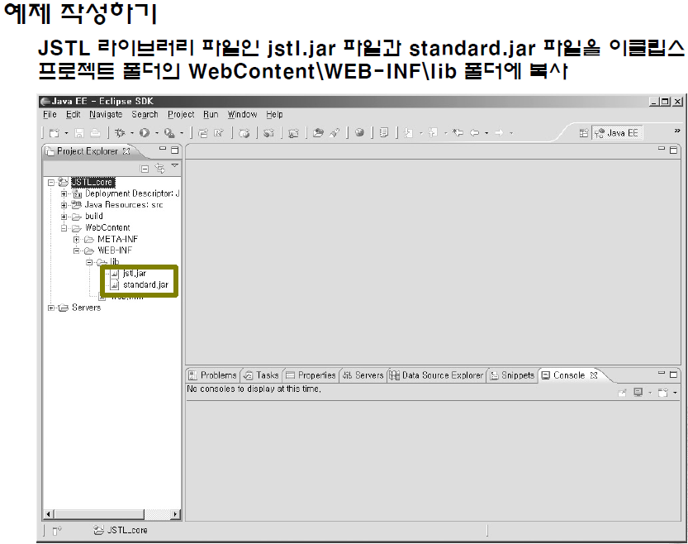
JSTL(JSP Standard Tab Library)
Notes:
Ex3)jstl_core_ex1.jsp
Ex4)jstl_core_ex2.jsp

Slide 14
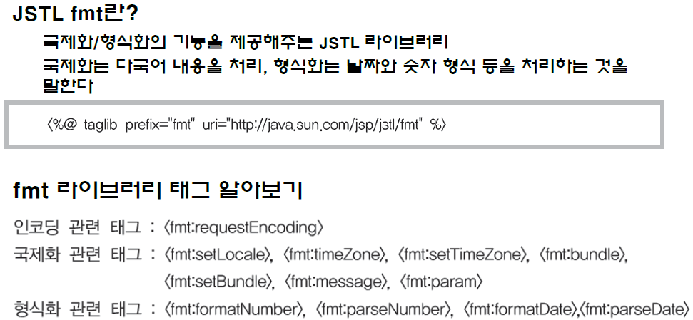
JSTL(JSP Standard Tab Library)
JSTP의 국제화/형식화 액션 – fmt

Slide 15
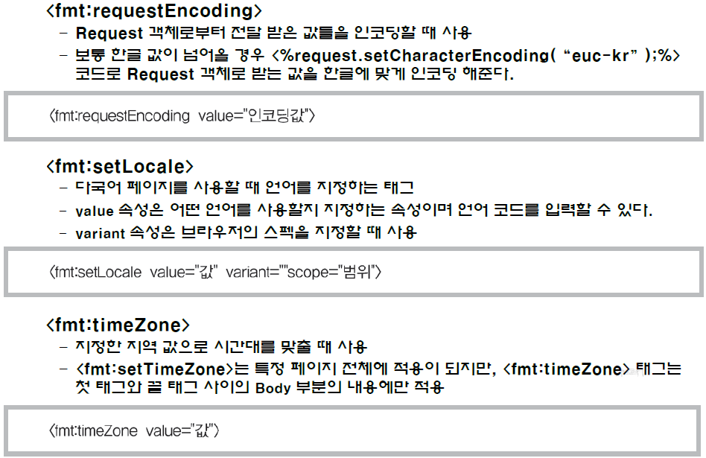
JSTL(JSP Standard Tab Library)

Slide 16
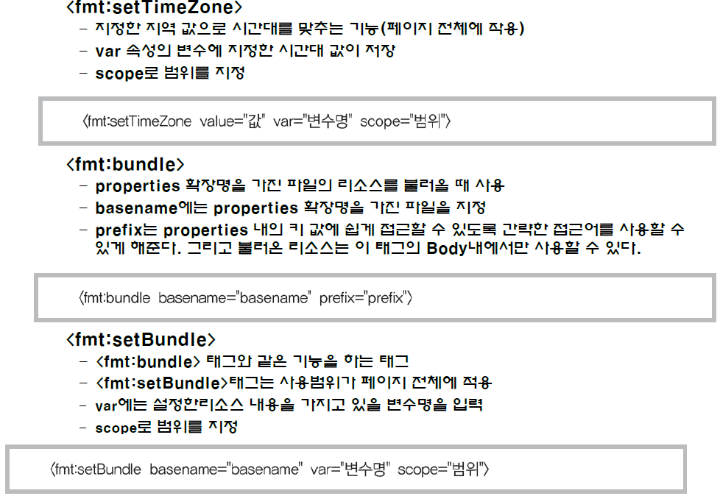
JSTL(JSP Standard Tab Library)

Slide 17
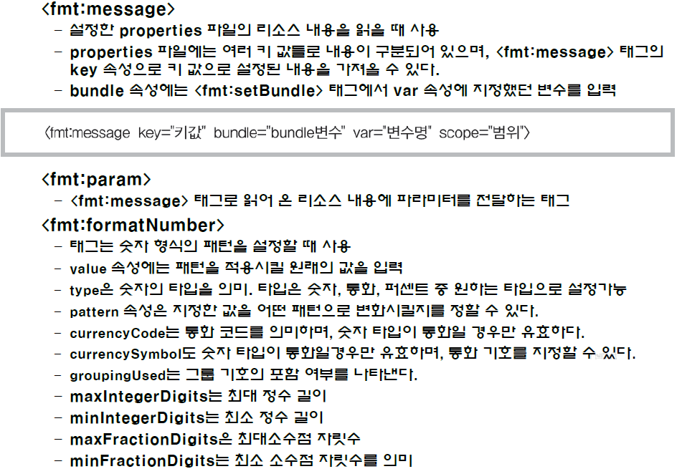
JSTL(JSP Standard Tab Library)

Slide 18
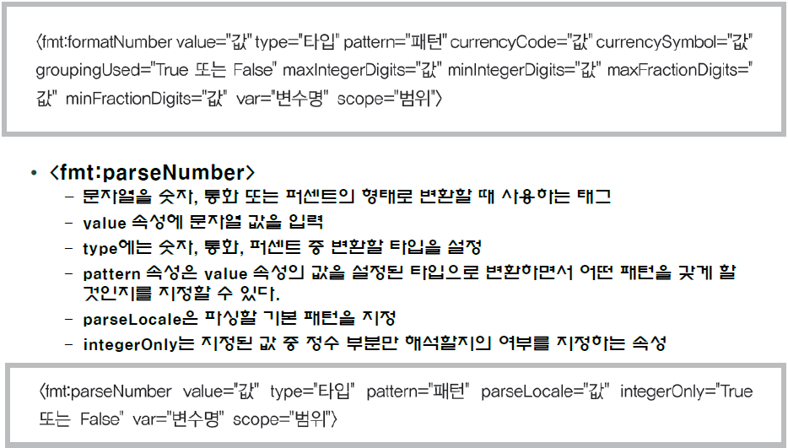
JSTL(JSP Standard Tab Library)

Slide 19
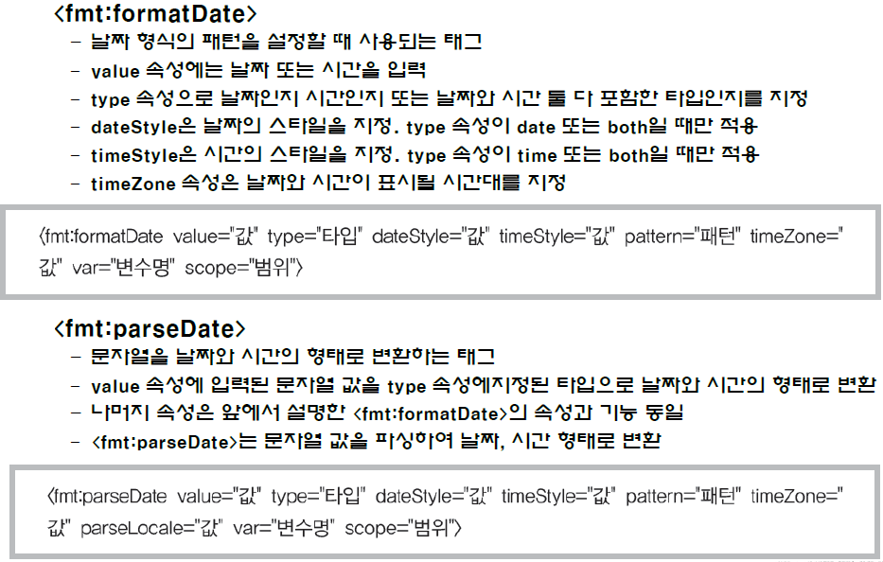
JSTL(JSP Standard Tab Library)
Notes:
Ex5) jstl_fmt_ex.jsp

Slide 20
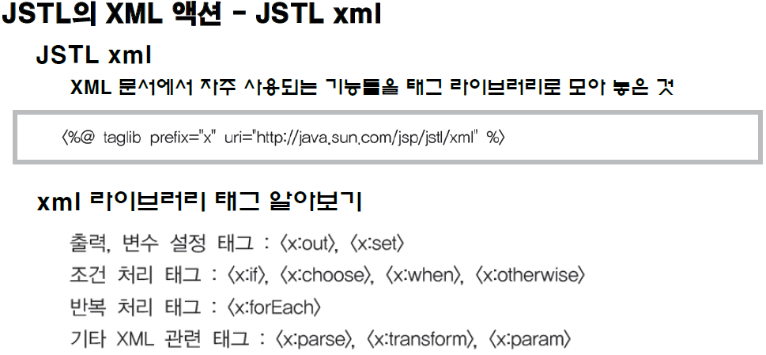
JSTL(JSP Standard Tab Library)

Slide 21
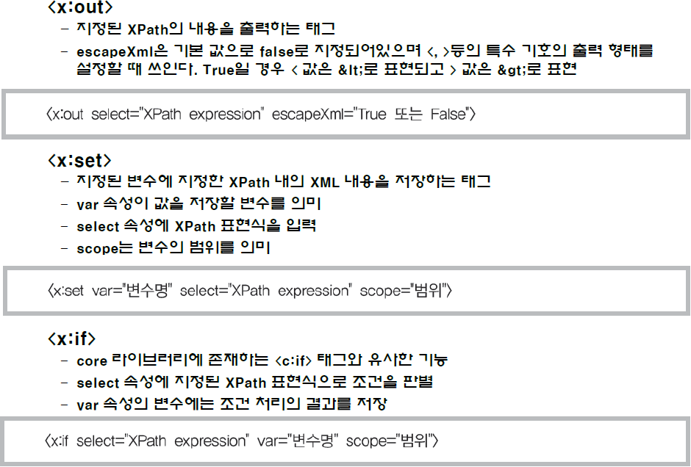
JSTL(JSP Standard Tab Library)

Slide 22
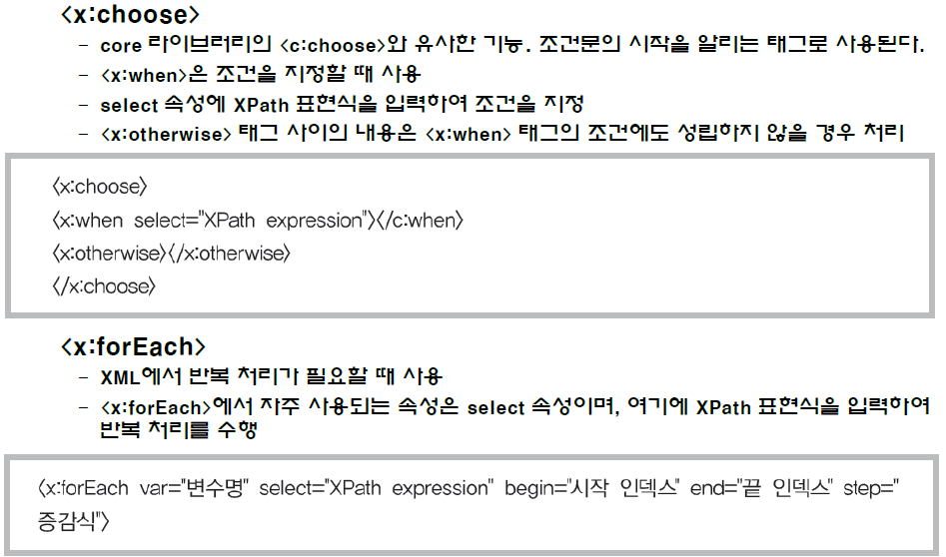
JSTL(JSP Standard Tab Library)

Slide 23
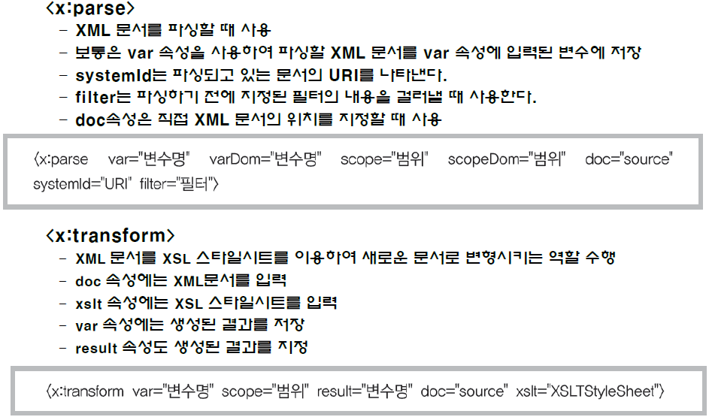
JSTL(JSP Standard Tab Library)

Slide 24
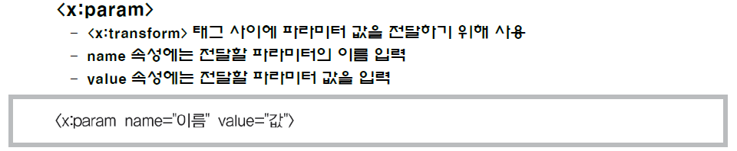
JSTL(JSP Standard Tab Library)
Notes:
Ex6) jstl_xml_ex.jsp
실행결과 Error (xml라이브러리는JSTL에 포함되어 있지 않다.)
xalan.jar 파일을 라이브러리 폴더에 등록하면 사용 가능하다.
http://xml.apache.org/xalan-j에서 다운로드 받을 수 있다.

Slide 25
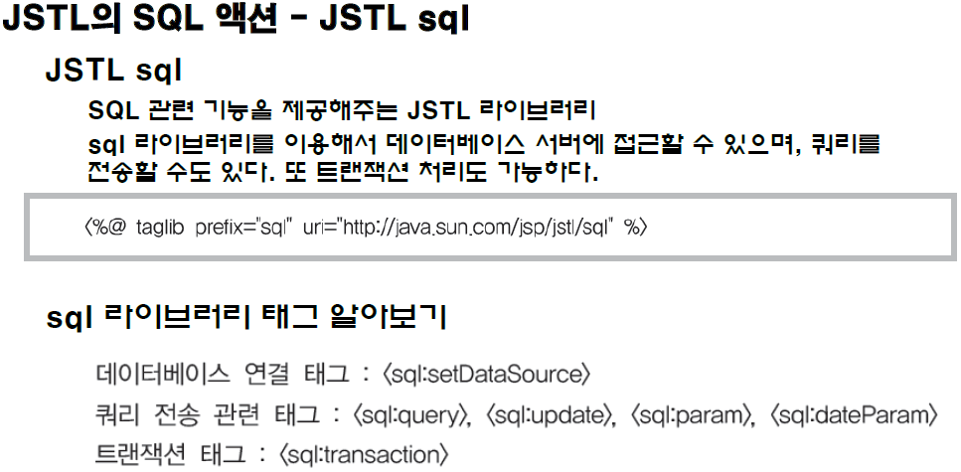
JSTL(JSP Standard Tab Library)

Slide 26
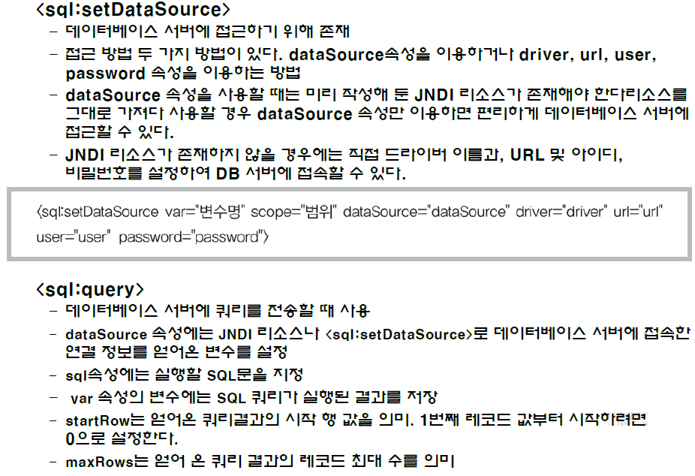
JSTL(JSP Standard Tab Library)

Slide 27
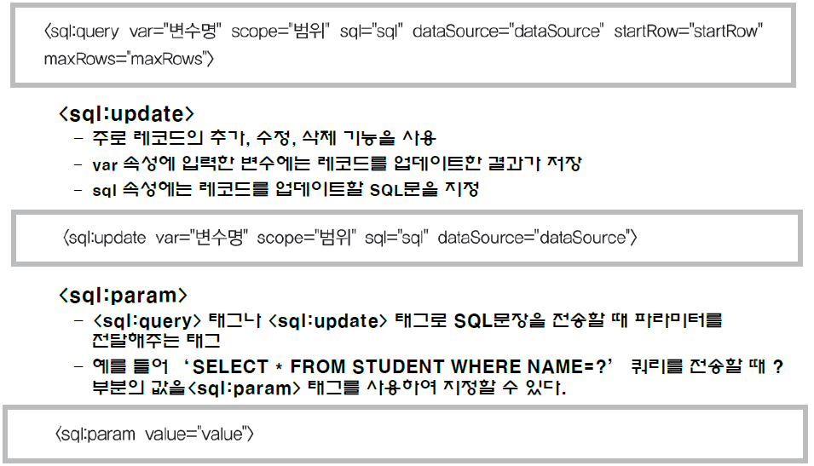
JSTL(JSP Standard Tab Library)

Slide 28
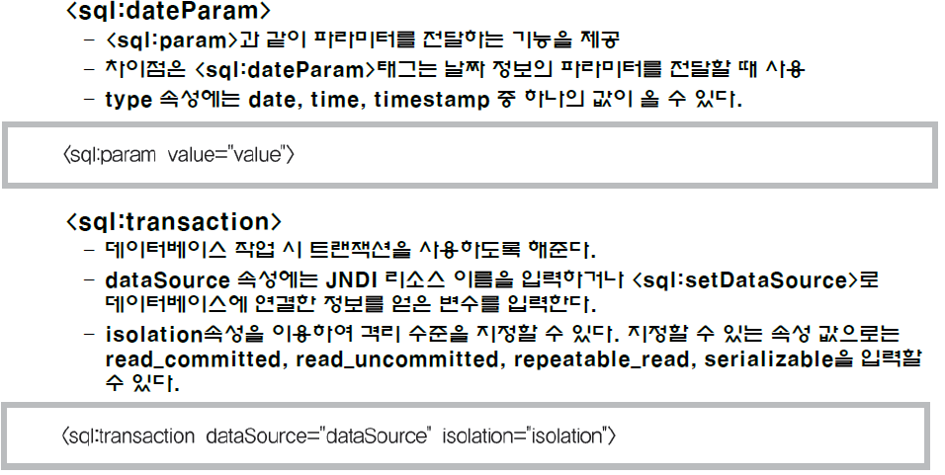
JSTL(JSP Standard Tab Library)

Slide 29
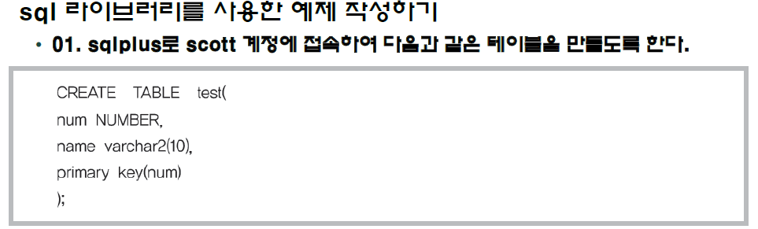
JSTL(JSP Standard Tab Library)
Notes:
Ex7) jstl_sql_ex.jsp

