Slide 1
Analysis of Two Electrivity Demand Time Series and Comparing Their periodecities
Xiaoyu He
2022.10.31
Notes:
Hello, everyone. Welcome to my presentation. I‘m Xiaoyu He. For my master’s thesis, I analysed the underlying trend of data set of half-hour records in two substations( Albion St and Arnside), which contains electricity demand series between 2009 and 2015. We used the R package tseries and timeSeries, and presented my dissertation by LaTex.

Slide 2
Processes of Modelling
Fourier Series and Spectrum Analysis
Prospects of Method Application
CONTENTS
Notes:
Today I will focus on these three aspects: Processes of Modelling, Fourier Series and Spectrum Analysis , Prospects of Method Application.

Slide 3
PART 01
Modelling Processes
Notes:
At first, in the Modelling Processes to examine the underlying trend of data set, I simulated A Trigonometric Regression with SARMA Residuals in processes of modelling.

Slide 4
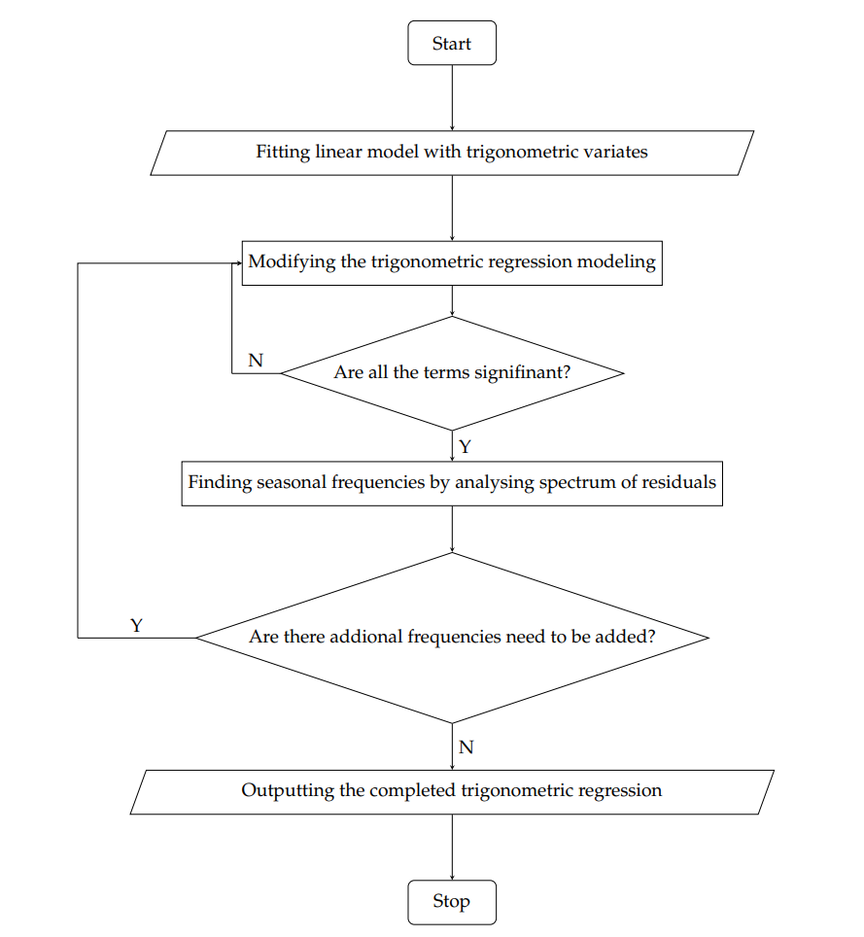
Modelling Processes - Flowchart
Analysis of Electricity Demand at BspAlb
Visualization of the Time Series
Fitting a Trigonometric Regression Model
The SARMA Modelling For the Residuals
Analysis of Electricity Demand at BspArn
Comparisons on Periodicities
Notes:
Left is the steps that I did on Modelling Process, and right is thee flowchart of my analyses for electricity demand series at both of Albion St and Arnside.
I was working with a focus on investigation of stationarity by visualization of the Time Series and tests, Fitting a Trigonometric Regression Model, and Finding the optimal Seasonal ARMA Modelling For the Residuals.

Slide 5
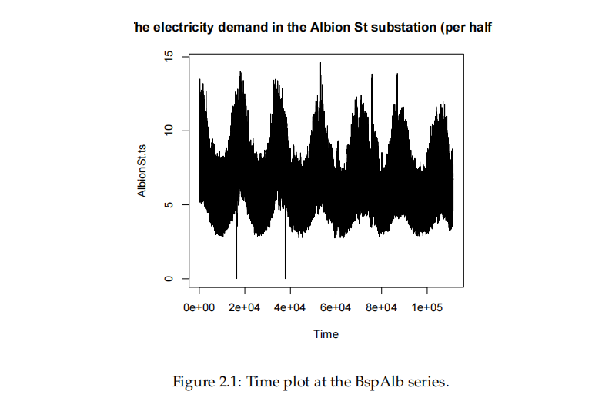
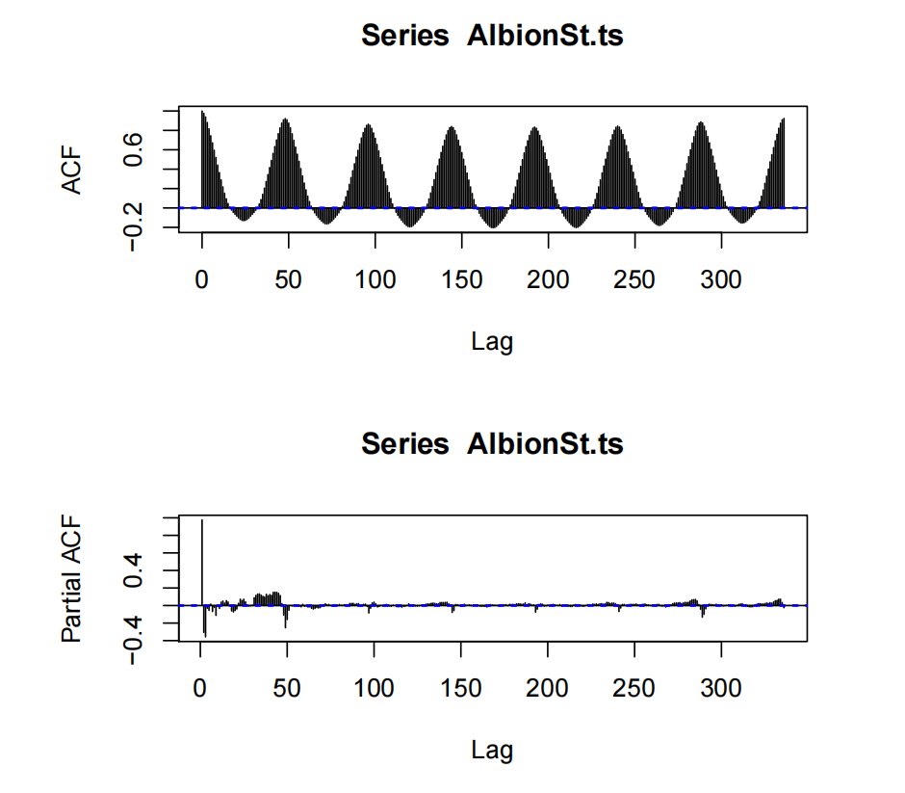
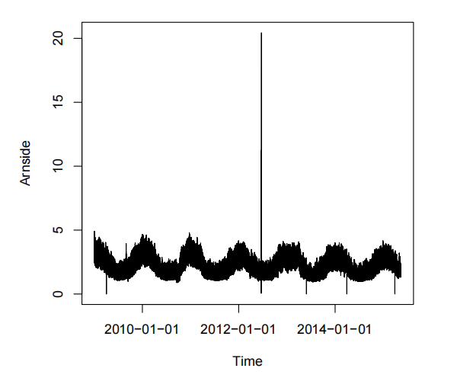
01
Modelling Processes - Visualizations
Albion St ) and BspArn(Arnside
Albion St ) and BspArn(Arnside
Arnside Albion St
Visualizations of demand for electricity time-depending series at Albion St and Arnside
ACF and PACF plots
Notes:
These are the Visualizations for both of Albion St and Arnside.
Taken Albion St as an example, I substituted NA with the mean 6.72 and visualized the replaced time series on the upper left plot, which shows fluctuation of the time series. The most interesting aspect of this graph is that the demand for electricity touched two lower points in May and June and varies in an annual period, which indicated the significant practice of the seasonal adjusted process. Besides, the decreasing or increasing trends were not obvious in the plot, thereby instead of using linear regression, a trigonometric regression was modelled for the electricity demand at the BspAlb.
Moreover, for investigating stationarity I used the autocorrelation function (ACF) and the partial autocorrelation function (PACF) plots shown as the right. The ACF plot does not appear an exponential decay, which demonstrates that the autocorrelations of the consecutive lags of the BspAlb series are formally dependent. Hence, the electricity demand at BspAlb is a periodic but non-stationary time series. From this perspective, the priority of my study was stabilising the time series by a seasonal adjustment process as well as discovering seasonal frequencies.
From the ACF plot, the correlations are periodic with a circle of 48 dots or one day, which indicates the periodicities of the BspAlb series are no less than 48 dots. On the other hand, through analyses of time plots, it was appropriate to assume that the cycles are shorter than a week.
Hence, a trigonometric regression model with a weekly periodic variation including 48∗7 dots was fitted for the BspAlb series.

Slide 6
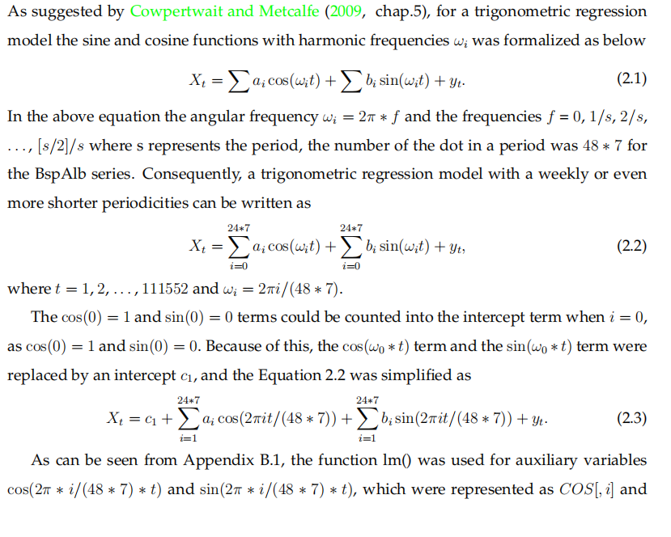
02
Modelling - Trigonometric Regression Model
（Model Initialization)
Albion St ) and BspArn(Arnside
A trigonometric regression model with the sine and cosine variables was formalized as below:
Where ωi = 2π ∗ f; and the frequencies f = 0, 1/s, 2/s,. . . , [s/2]/s
where s represents the period.
Besides, the cos(0) = 1 and sin(0) = 0 terms could be counted into the intercept term when i = 0, as cos(0) = 1 and sin(0) = 0.
Hence, the cos(ω0 ∗ t) and the sin(ω0 ∗ t) terms were replaced by an intercept c1, and the trigonometric regression model with a weekly or even more shorter periodicities can be simplified as
Notes:
Therefore, I decided fitting a trigonometric regression model by using sine and cosine variables with harmonic frequencies ωi, that was formalized as 2 pai multiple the frequencies f, and notifiably where S in f represents the period, the number of the dot in a period was 48 ∗ 7 for the BspAlb series.
Given that cos(0) = 1 and sin(0) = 0 these terms were counted into the intercept term when i = 0, a trigonometric regression model with a weekly or even more shorter periodicities can be written as the Equation on the bottom.

Slide 7
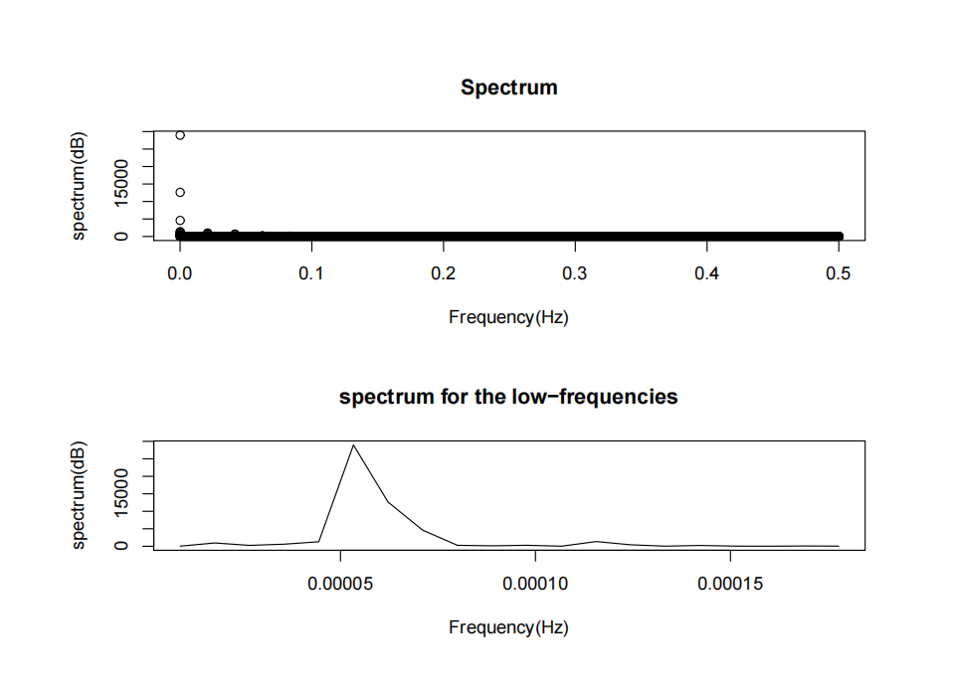
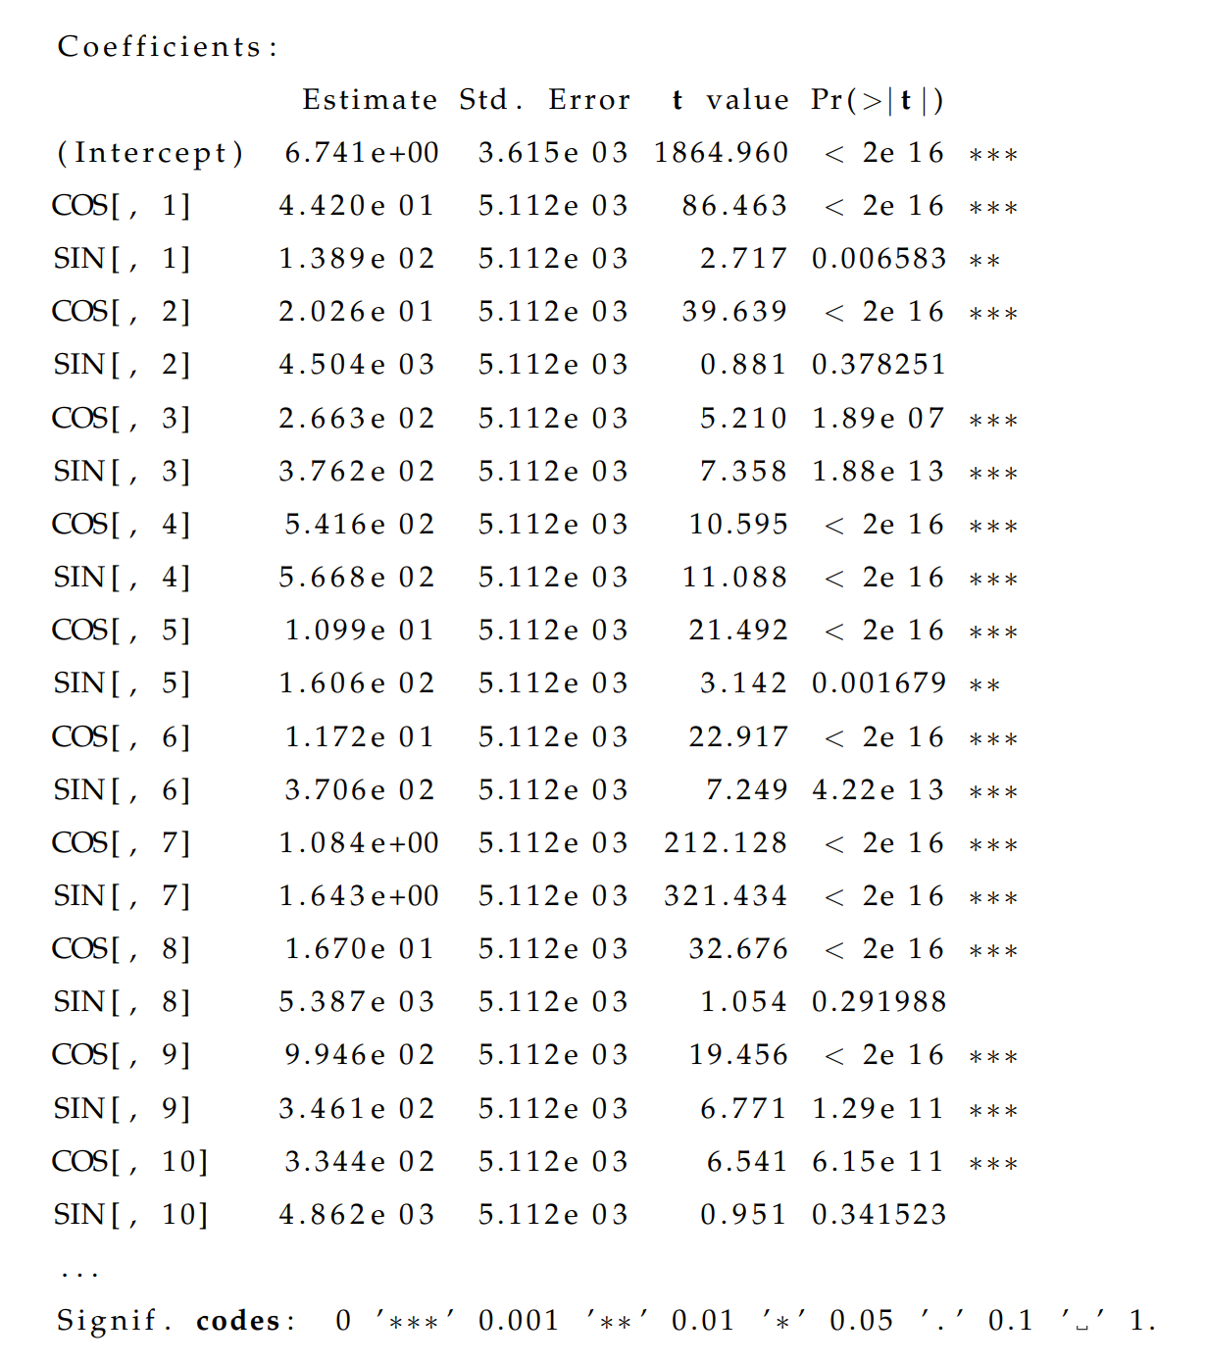
02
Modelling - Trigonometric Regression Model
（Model Optimization)
Albion St ) and BspArn(Arnside
0.0000531 = 1/48 ∗ 7 ∗ 56
Notes:
In the Model Optimization step, I identified significant terms by manually deleting the insignificant items after using Linear Models function in R, and verified the results through ACF and PACF plots and spectrum analyses. We defined that a frequency is a contributing factor for the trigonometric regression modelling, if both of the cos and sin variables are statistically significant at an arbitrary level. For instance, the frequency 4/(48*7)(divided by)or 4 dots was deduced as a important frequency, as significant P-values were obtained for both of them. By contrast, the frequency 2 dots should be rejected because the p-value of sin is 0.378.
As shown in the lower right plot, there are several peaks approaching to the frequency 0. Following the property of spectrum, the frequencies which contributes to the variance most, are the frequencies with higher spikes in the spectrum. In this case, the additional frequencies were detected by doing the first spectrum analysis for the trigonometric regression models. Since the maximal peak in spectrum was observed as 28963.75 corresponding to a frequency 0.0000533.Following the approximation, a considerable periodicity was deduced as 56 weeks and the corresponding sinusoidal and cosinusoidal variables were added to the fitted model.
Potential periodicities were discovered programmatically in R and transformed to frequencies. And then the significant terms were picked by the results of p-value tests again and again until there are no non-significant terms and no peaks are shown in the spectrum analyses. Evatually, 60 important frequencies and 90 significant terms were selected for our improved trigonometric regression model.

Slide 8
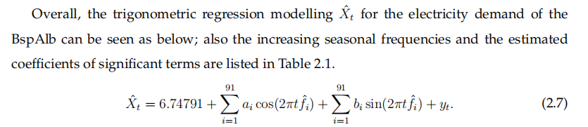
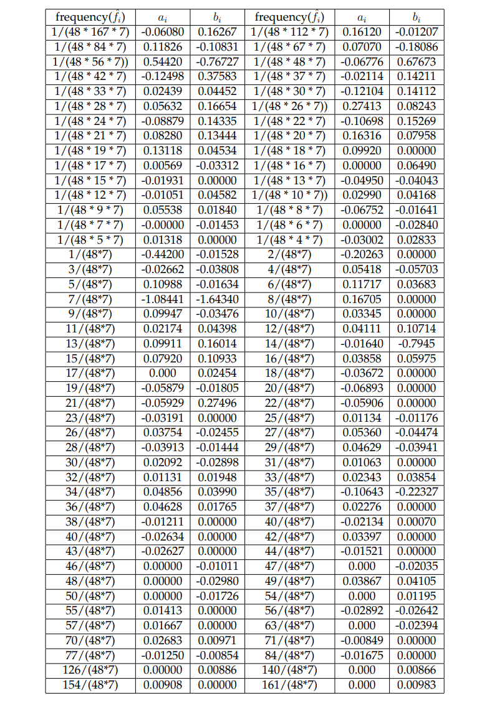
02
Modelling - Trigonometric Regression Model
（Model Fitting）
Albion St ) and BspArn(Arnside
Notes:
The processes were repeated five times, and eventually the frequencies and the estimated coefficients of the significant terms in the trigonometric regression modelling at BspAlb were shown as the Equation and table. As I mentioned there are 90 significant terms in the final Trigonometric Regression Model, there just presents part of significant terms.

Slide 9
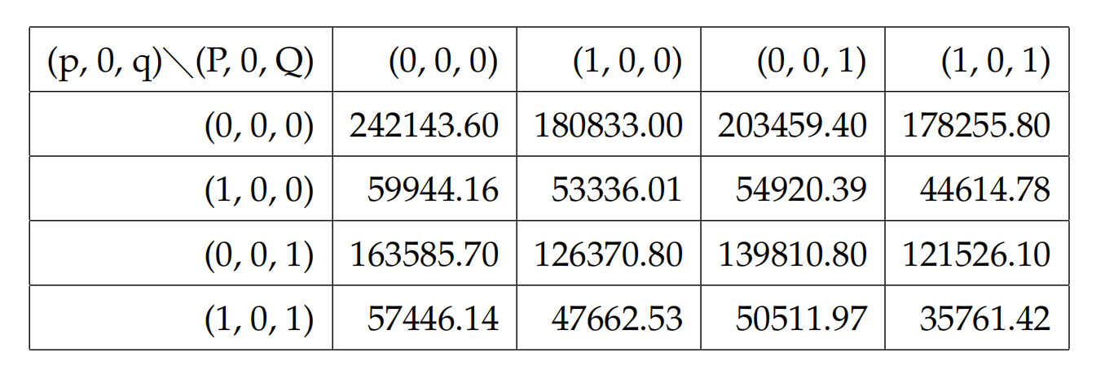

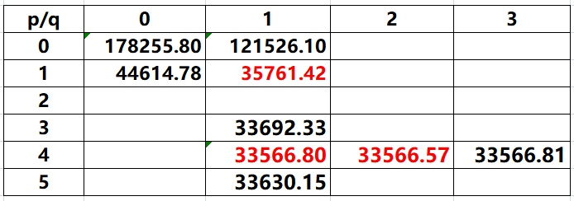


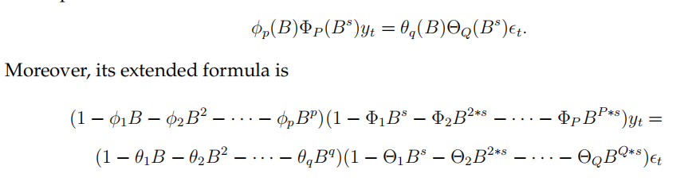

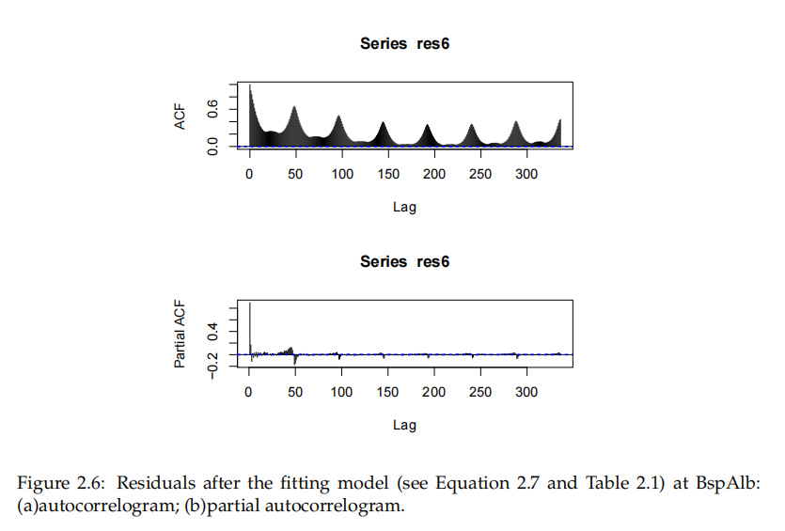
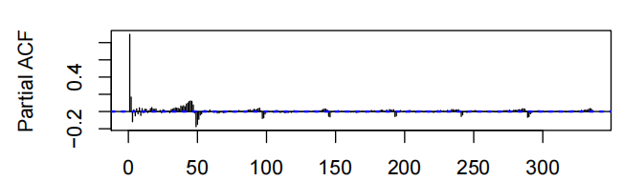

03
Modelling - SARMA Modelling For the Residuals
（ACF and PACF plots）
Xˆ
t
is the trigonometric regression model
Trigonometric Regression Model
Residuals
Notes:
Based on my previous study, the tendency of electricity demand at each BSP X at time t can be described as the sum of a trigonometric regression model X hat at time t and a Residual yt,which can be formalized as shown in the upper left. Then Xt represented the prediction series for the electricity demand at a bulk supply point.
The ACF and PACF plots for the error series were displayed at the bottom right. The correlation coefficients in ACF were observed less than 5%, except lag=0, which exceeded the 95% confidence interval. Besides,it was noticeable that the PACF plot seemed to be unsatisfied, whereas a reason was observed as the partial autocorrelations are between -0.04 and 0.08. Hence, the error series was a white noise. And seemingly the residual yt would be fitted to a SARMA model.
Beginning with a seasonal autoregressive integrated moving average model with parameters s, p, d, q, P, D and Q symbolized in the first model, I determined d = D = 0, since there would be a catastrophe in the prediction caused by taking a difference and the tendency is limited. Then the next step would be to find an appropriate seasonal ARMA model instead of a SARIMA model for the residuals of the proceeding trigonometric regression modelling.
Noticably, there is no agreed notation on how to represent the backward shift (or lag) operator. In this dissertation, the term B was used to refer this formal operation, whose function can be used for prediction and displayed as the relation between y at t−1 and y at t.
For the next step, the optimal seasonal ARMA modelling were designed with estimating parameters by utilising AIC. I started by permutation and found the lowest AIC=35761.42 when all p&q terms equal to 1. Then I kept q=1 and calculated AIC as increasing p gradually. And it turns out an optimal result in q=4 with AIC= 33566.80. Similarly, I found lowest AIC when q =2. And same steps for the seasonal terms and I eventually mimicked a SARMA Modelling with p,q =4,2 and seasonal p,q =5,5 For the Residuals.

Slide 10
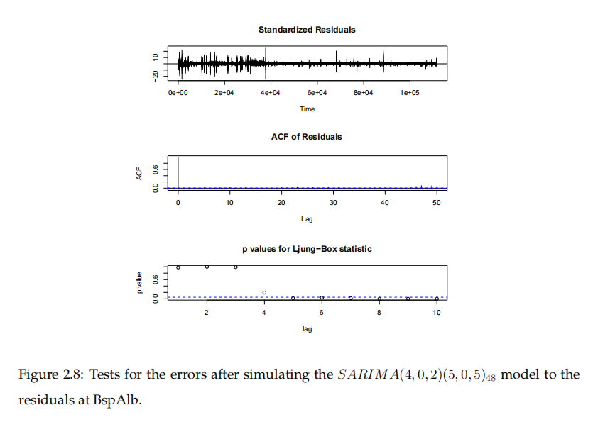
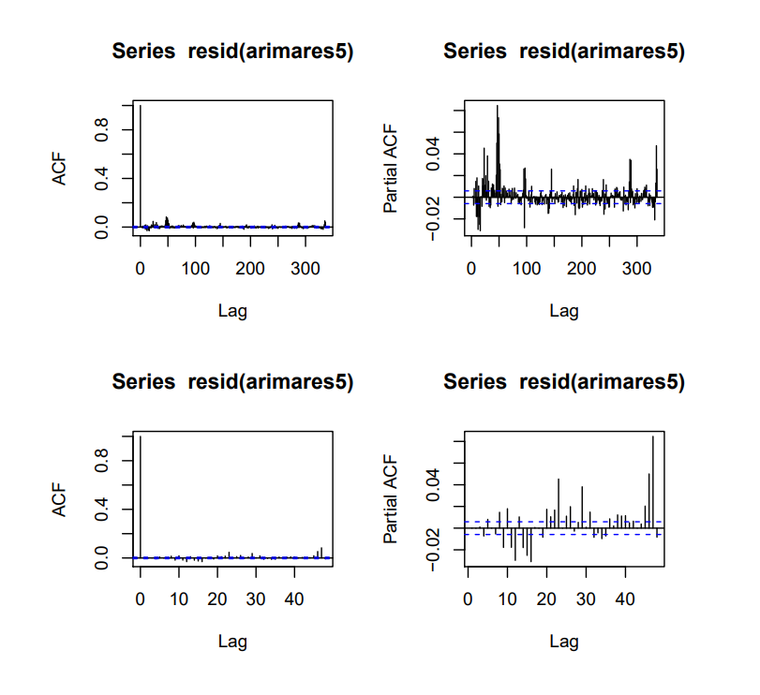
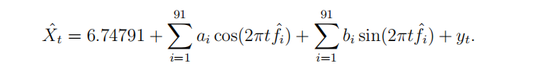
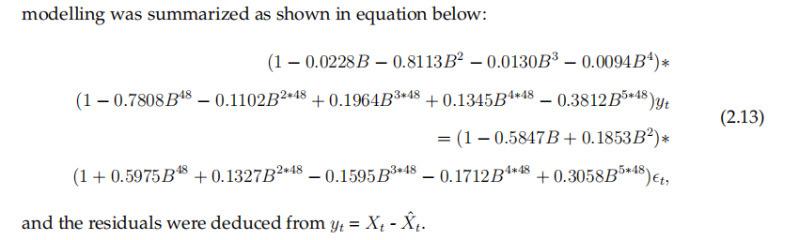
03
Modelling - SARMA Modelling For the Residuals
（White noise tests）
The trigonometric regression modelling with a SARMA residuals fitting for the electricity demand of the BspAlb
Notes:
In terms of tests for the errors after simulating the SARIMA model with period 48 and p=4, q=2, seasonal p=5, and seasonal q= 5 to the residuals at BspAlb including acf and pacf in all lags and lower lags and Ljung-Box, I tested the error as a white noise and completed my modelling. The trigonometric regression modelling with a SARMA residuals fitting for the electricity demand of the BspAlb are illustrated as the lower right equations.

Slide 11
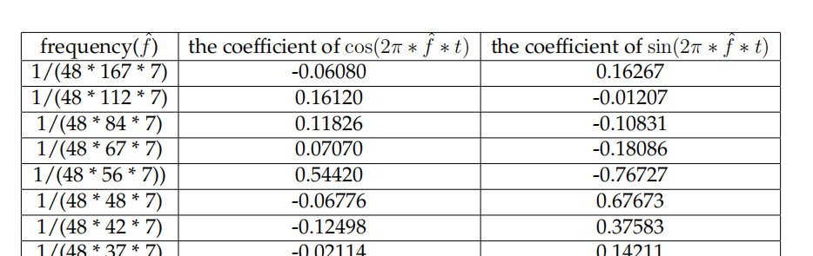
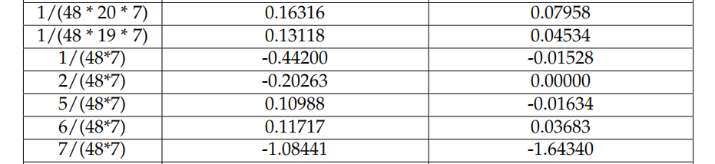
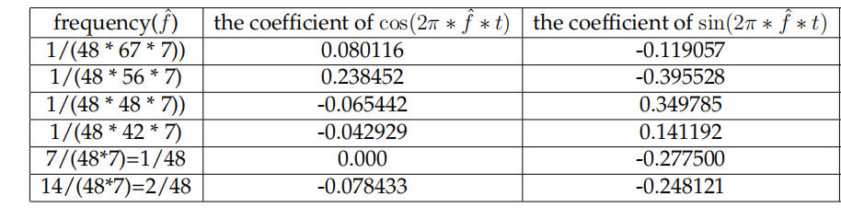
Periodicities between BspAlb and BspArn
Albion St ) and BspArn(Arnside
Albion
Stability of Diurnal periodic
variation at a domestic BSP
Arnside
Yearly periodicity
Non-domestic BSP
Albion
Stability of Diurnal periodic
variation at a domestic BSP
Arnside
Yearly periodicity
Non-domestic BSP
Notes:
Then let’s move on to comparisons between two of them. Finally, the simulation of energy series at the BspAlb indicated a periodicity as being reasonably substantiated as daily, which differs from the yearly periodicity for the BspArn series. Hence, it was deduced that the BspAlb should be a domestic load, and the BspArn should be treated as a non-domestic load.

Slide 12
PART 02
Fourier Series and Spectrum Analysis
Notes:
Secondly, I used Fourier Series theorems and Spectrum Analysis for the feasibility of fitting on Trigonometric Regressions and confirming the peridencities.

Slide 13
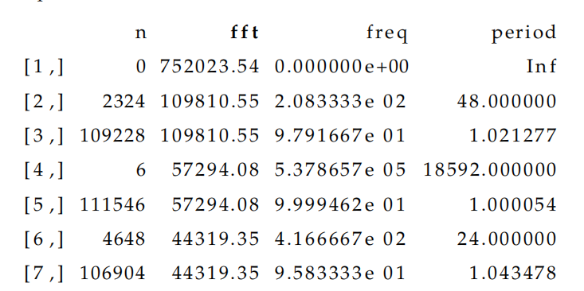
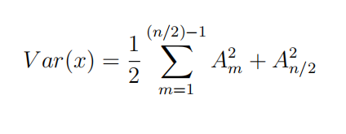
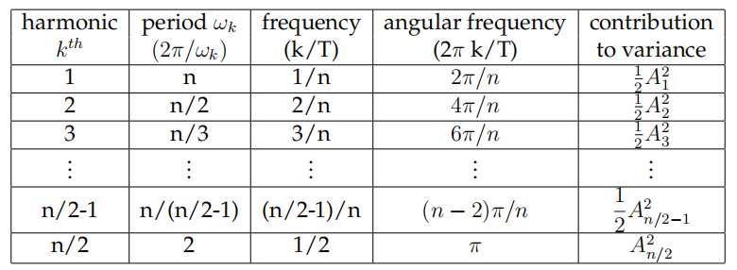
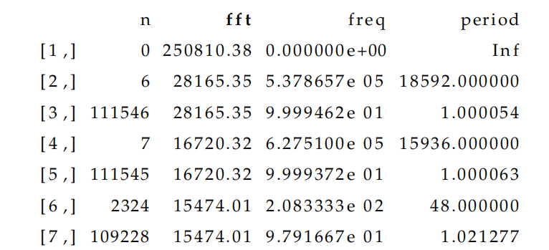
Analysis of Periodicities by the DFT
Periods, frequencies and contributions on variance of the k
th harmonic series.
The Parseval’s Theorem:
The change of the amplitude, which is the weighted sum of squares of weighting sine and weighting cosine functions, is represented in the periodogram as a spectrum entropy caused by a segment ∆ti, which can be illustrated as a formulaic form:
Periods, frequencies and contributions on variance of the k^{th} harmonic series.
Notes:
As shown in the first plot, the periodogram of a time series demonstrates variances and oscillations over each Fourier frequency. And according to the Parseval’theorem it also illustrates the contribution of the weight of this frequency on the total variance. In the Table, according to the different harmonic series, the corresponding periods, frequencies and the contributions to variance were demonstrated.
For the results, the most significant frequency is 0, which meant that there could be no periodicity for the BspAlb series.
To estimate the potential periodicity, the second line of the outputs was analysed alternatively and finally the most significant contributed periodicity could be assumed as 48 and 18592, which are the daily and yearly periodicities for the electricity demand series at the BspAlb and BspArn substations, separately.

Slide 14
Prospects on Application
PART 03
Notes:
Thirdly, on the Prospects of Application,

Slide 15
Prospects on Application
Albion St ) and BspArn(Arnside
For next step:
Complete data analysis process for time-dependent covariates in regression modeling
Time series analysis
Study oscillations for periodicity
Notes:
The research provided me with a fundamental data analysis process for time-dependent covariates in regression modeling. Besides, the analysis on the periodicity of time series and the verification of periodicities through spectrum analysis with fast discrete Fourier transform (FFT) allow for future periodicity discovery and the construction of a sophisticated modeling system.

Slide 16


Albion St ) and BspArn(Arnside
THANKS FOR YOUR WATCHING!

