Slide 1

Notes:
Cover slide

Slide 2
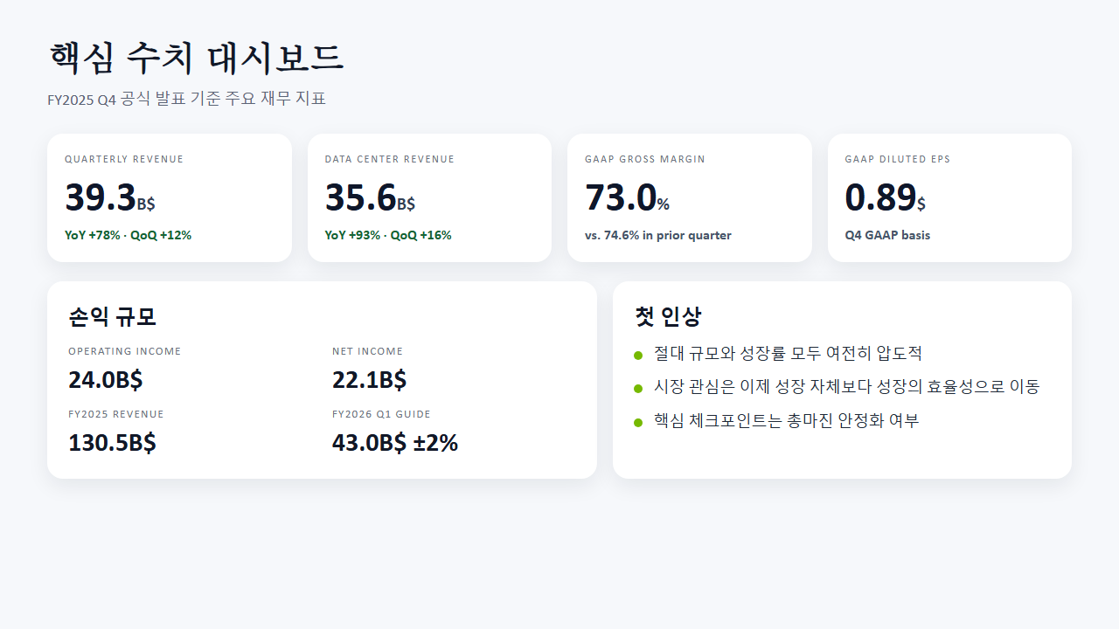
Notes:
Key metrics

Slide 3

Notes:
Business mix analysis

Slide 4
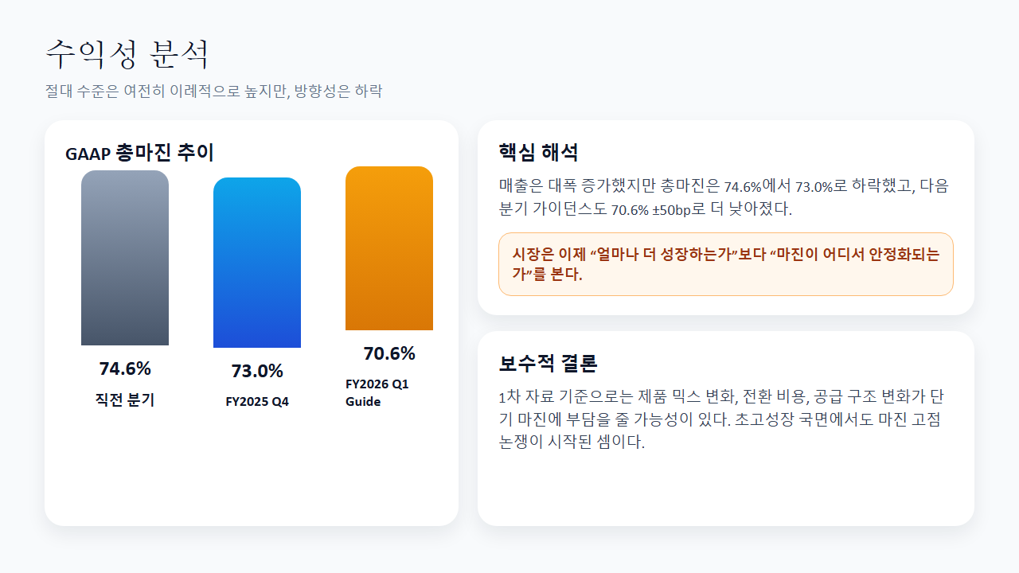
Notes:
Margin analysis

Slide 5
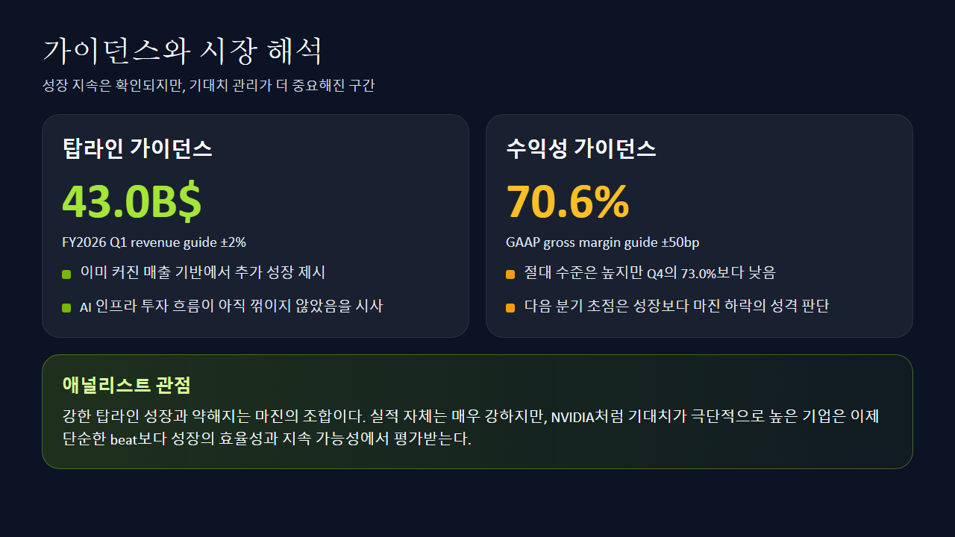
Notes:
Guidance and expectations

Slide 6
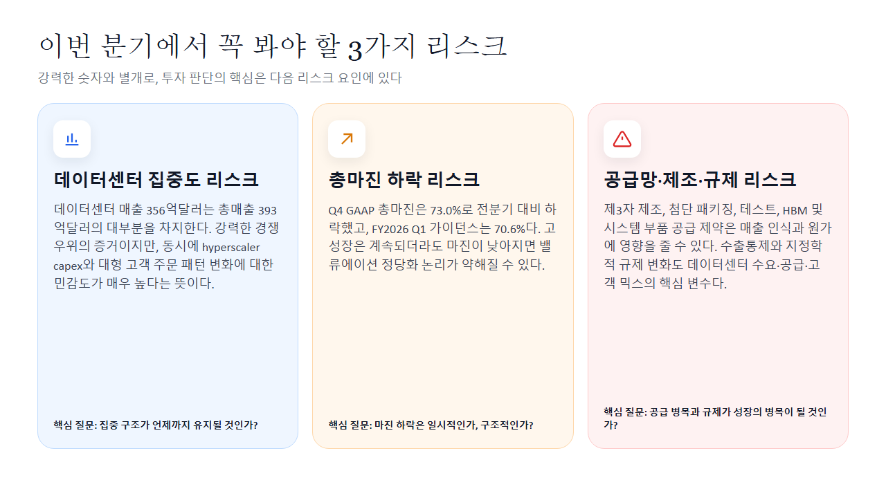
Notes:
Risk factors

Slide 7

Notes:
Summary slide

