Slide 1
Cluster Analysis

Slide 2
Chapter Outline
1) Overview
2) Basic Concept
3) Statistics Associated with Cluster Analysis
4) Conducting Cluster Analysis
  Formulating the Problem
  Selecting a Distance or Similarity Measure
  Selecting a Clustering Procedure
  Deciding on the Number of Clusters
  Interpreting and Profiling the Clusters
  Assessing Reliability and Validity

Slide 3
Cluster Analysis
Used to classify objects (cases) into homogeneous groups called clusters.
Objects in each cluster tend to be similar and dissimilar to objects in the other clusters.
Both cluster analysis and discriminant analysis are concerned with classification.
Discriminant analysis requires prior knowledge of group membership.
In cluster analysis groups are suggested by the data.

Slide 4
An Ideal Clustering Situation
Fig. 20.1
Variable 1
Variable 2

Slide 5
More Common Clustering Situation
Fig. 20.2
Variable 1
X
Variable 2

Slide 6
Statistics Associated with Cluster Analysis
Agglomeration schedule. Gives information on the objects or cases being combined at each stage of a hierarchical clustering process.
Cluster centroid. Mean values of the variables for all the cases in a particular cluster.
Cluster centers. Initial starting points in nonhierarchical clustering. Clusters are built around these centers, or seeds.
Cluster membership. Indicates the cluster to which each object or case belongs.

Slide 7
Statistics Associated with Cluster Analysis
Dendrogram (A tree graph). A graphical device for displaying clustering results.
-Vertical lines represent clusters that are joined together.
-The position of the line on the scale indicates distances at which clusters were joined.
Distances between cluster centers. These distances indicate how separated the individual pairs of clusters are. Clusters that are widely separated are distinct, and therefore desirable.
Icicle diagram. Another type of graphical display of clustering results.

Slide 8
Conducting Cluster Analysis
Fig. 20.3
Formulate the Problem
Select a Distance Measure
Select a Clustering Procedure
Decide on the Number of Clusters
Interpret and Profile Clusters
Assess the Validity of Clustering

Slide 9
Formulating the Problem
Most important is selecting the variables on which the clustering is based.
Inclusion of even one or two irrelevant variables may distort a clustering solution.
Variables selected should describe the similarity between objects in terms that are relevant to the marketing research problem.
Should be selected based on past research, theory, or a consideration of the hypotheses being tested.

Slide 10
Select a Similarity Measure
Similarity measure can be correlations or distances
The most commonly used measure of similarity is the Euclidean distance. The city-block distance is also used.
If variables measured in vastly different units, we must standardize data. Also eliminate outliers
Use of different similarity/distance measures may lead to different clustering results.
Hence, it is advisable to use different measures and compare the results.

Slide 11
Classification of Clustering Procedures
Clustering Procedures
Fig. 20.4
Hierarchical
Nonhierarchical
Agglomerative
Divisive
Linkage
Variance
Centroid
Sequential
Parallel
Optimizing
Methods
Methods
Methods
Threshold
Threshold
Partitioning
Ward’s
Method
Single
Complete
Average
Linkage
Linkage
Linkage

Slide 12
Hierarchical Clustering Methods
Hierarchical clustering is characterized by the development of a hierarchy or tree-like structure.
-Agglomerative clustering starts with each object in a separate cluster. Clusters are formed by grouping objects into bigger and bigger clusters.
-Divisive clustering starts with all the objects grouped in a single cluster. Clusters are divided or split until each object is in a separate cluster.
Agglomerative methods are commonly used in marketing research. They consist of linkage methods, variance methods, and centroid methods.

Slide 13
Hierarchical Agglomerative Clustering-Linkage Method
The single linkage method is based on minimum distance, or the nearest neighbor rule.
The complete linkage method is based on the maximum distance or the furthest neighbor approach.
The average linkage method the distance between two clusters is defined as the average of the distances between all pairs of objects

Slide 14
Linkage Methods of Clustering
Fig. 20.5
Single Linkage
Minimum Distance
Cluster 1
Cluster 2
Complete Linkage
Maximum Distance
Cluster 1
Cluster 2
Average Linkage
Average Distance
Cluster 1
Cluster 2

Slide 15
Hierarchical Agglomerative Clustering-Variance and Centroid Method
Variance methods generate clusters to minimize the within-cluster variance.
Ward's procedure is commonly used. For each cluster, the sum of squares is calculated. The two clusters with the smallest increase in the overall sum of squares within cluster distances are combined.
In the centroid methods, the distance between two clusters is the distance between their centroids (means for all the variables),
Of the hierarchical methods, average linkage and Ward's methods have been shown to perform better than the other procedures.

Slide 16
Other Agglomerative Clustering Methods
Fig. 20.6
Ward’s Procedure
Centroid Method

Slide 17
Nonhierarchical Clustering Methods
The nonhierarchical clustering methods are frequently referred to as k-means clustering. .
-In the sequential threshold method, a cluster center is selected and all objects within a prespecified threshold value from the center are grouped together.
-In the parallel threshold method, several cluster centers are selected and objects within the threshold level are grouped with the nearest center.
-The optimizing partitioning method differs from the two threshold procedures in that objects can later be reassigned to clusters to optimize an overall criterion, such as average within cluster distance for a given number of clusters.

Slide 18
Idea Behind K-Means
Algorithm for K-means clustering
1. Partition items into K clusters
2. Assign items to cluster with nearest centroid mean
3. Recalculate centroids both for cluster receiving and losing item
4. Repeat steps 2 and 3 till no more reassignments

Slide 19
Select a Clustering Procedure
The hierarchical and nonhierarchical methods should be used in tandem.
-First, an initial clustering solution is obtained using a hierarchical procedure (e.g. Ward's).
-The number of clusters and cluster centroids so obtained are used as inputs to the optimizing partitioning method.
Choice of a clustering method and choice of a distance measure are interrelated. For example, squared Euclidean distances should be used with the Ward's and centroid methods. Several nonhierarchical procedures also use squared Euclidean distances.

Slide 20
Decide Number of Clusters
Theoretical, conceptual, or practical considerations.
In hierarchical clustering, the distances at which clusters are combined (from agglomeration schedule) can be used
Stop when similarity measure value makes sudden jumps between steps
In nonhierarchical clustering, the ratio of total within-group variance to between-group variance can be plotted against the number of clusters.
The relative sizes of the clusters should be meaningful.

Slide 21
Interpreting and Profiling Clusters
Involves examining the cluster centroids. The centroids enable us to describe each cluster by assigning it a name or label.
Profile the clusters in terms of variables that were not used for clustering. These may include demographic, psychographic, product usage, media usage, or other variables.

Slide 22
Assess Reliability and Validity
Perform cluster analysis on the same data using different distance measures. Compare the results across measures to determine the stability of the solutions.
Use different methods of clustering and compare the results.
Split the data randomly into halves. Perform clustering separately on each half. Compare cluster centroids across the two subsamples.
Delete variables randomly. Perform clustering based on the reduced set of variables. Compare the results with those obtained by clustering based on the entire set of variables.
In nonhierarchical clustering, the solution may depend on the order of cases in the data set. Make multiple runs using different order of cases until the solution stabilizes.

Slide 23
Example of Cluster Analysis
Consumers were asked about their attitudes about shopping. Six variables were selected:
V1: Shopping is fun
V2: Shopping is bad for your budget
V3: I combine shopping with eating out
V4: I try to get the best buys when shopping
V5: I don’t care about shopping
V6: You can save money by comparing prices
Responses were on a 7-pt scale (1=disagree; 7=agree)

Slide 24
Attitudinal Data For Clustering
Table 20.1
Case No. V₁ V₂ V₃ V₄ V₅ V₆
1 6 4 7 3 2 3
2 2 3 1 4 5 4
3 7 2 6 4 1 3
4 4 6 4 5 3 6
5 1 3 2 2 6 4
6 6 4 6 3 3 4
7 5 3 6 3 3 4
8 7 3 7 4 1 4
9 2 4 3 3 6 3
10 3 5 3 6 4 6
11 1 3 2 3 5 3
12 5 4 5 4 2 4
13 2 2 1 5 4 4
14 4 6 4 6 4 7
15 6 5 4 2 1 4
16 3 5 4 6 4 7
17 4 4 7 2 2 5
18 3 7 2 6 4 3
19 4 6 3 7 2 7
20 2 3 2 4 7

Slide 25
Results of Hierarchical Clustering
Table 20.2
Agglomeration Schedule Using Ward’s Procedure
Stage cluster
Clusters combined first appears
Stage Cluster 1 Cluster 2 Coefficient Cluster 1 Cluster 2 Next stage
1 14 16 1.000000 0 0 6
2 6 7 2.000000 0 0 7
3 2 13 3.500000 0 0 15
4 5 11 5.000000 0 0 11
5 3 8 6.500000 0 0 16
6 10 14 8.160000 0 1 9
7 6 12 10.166667 2 0 10
8 9 20 13.000000 0 0 11
9 4 10 15.583000 0 6 12
10 1 6 18.500000 6 7 13
11 5 9 23.000000 4 8 15
12 4 19 27.750000 9 0 17
13 1 17 33.100000 10 0 14
14 1 15 41.333000 13 0 16
15 2 5 51.833000 3 11 18
16 1 3 64.500000 14 5 19
17 4 18 79.667000 12 0 18
18 2 4 172.662000 15 17 19
19 1 2 328.600000 16 18 0

Slide 26
Results of Hierarchical Clustering
Table 20.2, cont.
Cluster Membership of Cases
Number of Clusters
Label case 4 3 2
1 1 1 1
2 2 2 2
3 1 1 1
4 3 3 2
5 2 2 2
6 1 1 1
7 1 1 1
8 1 1 1
9 2 2 2
10 3 3 2
11 2 2 2
12 1 1 1
13 2 2 2
14 3 3 2
15 1 1 1
16 3 3 2
17 1 1 1
18 4 3 2
19 3 3 2
20 2 2 2

Slide 27
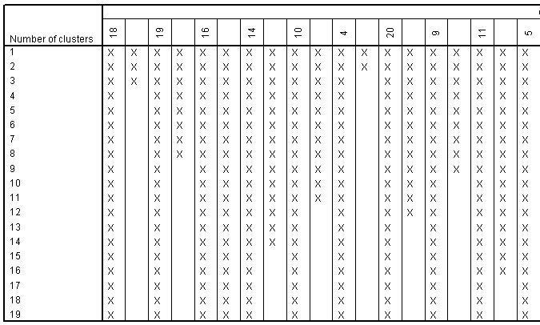
Vertical Icicle Plot
Fig. 20.7

Slide 28
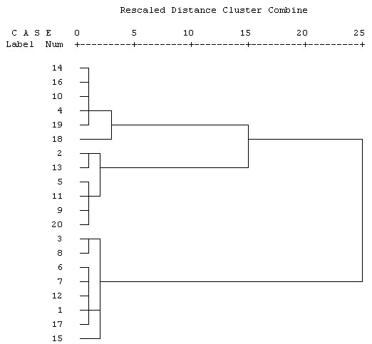
Dendrogram
Fig. 20.8

Slide 29
Cluster Centroids
Table 20.3
Means of Variables
Cluster No. V₁ V₂ V₃ V₄ V₅ V₆
    1 5.750 3.625 6.000 3.125 1.750 3.875
    2 1.667 3.000 1.833 3.500 5.500 3.333
    3 3.500 5.833 3.333 6.000 3.500 6.000

Slide 30
Nonhierarchical Clustering
Table 20.4
Initial Cluster Centers
Cluster
1
2
3
V1
4
2
7
V2
6
3
2
V3
3
2
6
V4
7
4
4
V5
2
7
1
V6
7
2
3
a
Iteration History
Change in Cluster Centers
Iteration
1
2
3
1
2.154
2.102
2.550
2
0.000
0.000
0.000
a.
Convergence achieved due to no or small distance
change. The maximum distance by which any center
has changed is 0.000. The current iteration is 2. The
minimum distance between initial centers is 7.746.

Slide 31
Nonhierarchical Clustering
Table 20.4 cont.
Cluster Membership
Case Number
Cluster
Distance
1
3
1.414
2
2
1.323
3
3
2.550
4
1
1.404
5
2
1.848
6
3
1.225
7
3
1.500
8
3
2.121
9
2
1.756
10
1
1.143
11
2
1.041
12
3
1.581
13
2
2.598
14
1
1.404
15
3
2.828
16
1
1.624
17
3
2.598
18
1
3.555
19
1
2.154
20
2
2.102

Slide 32
Nonhierarchical Clustering
Table 20.4, cont.
Final Cluster Centers
Cluster
1
2
3
V1
V2
V3
V4
V5
V6
4
6
3
6
4
6
2
3
2
4
6
3
6
4
6
3
2
4
Distances between Final Cluster Centers
Cluster
1
2
3
1
2
3
5.568
5.698
5.568
6.928
5.698
6.928

Slide 33
Nonhierarchical Clustering
Table 20.4, cont.
ANOVA
Cluster
Error
Mean Square
df
Mean Square
df
F
Sig.
V1
29.108
2
0.608
17
47.888
0.000
V2
13.546
2
0.630
17
21.505
0.000
V3
31.392
2
0.833
17
37.670
0.000
V4
15.713
2
0.728
17
21.585
0.000
V5
22.537
2
0.816
17
27.614
0.000
V6
12.171
2
1.071
17
11.363
0.001
The F tests should be used only for descriptive purposes because the clusters have been
chosen to maximize the differences among cases in different clusters. The observed
significance levels are not corrected for this, and thus cannot be interpreted as tests of the
hypothesis that the cluster means are equal.
Number of Cases in each Cluster
Cluster
1
6.000
2
6.000
3
8.000
Valid
20.000
Missing
0.000

