Slide 1
FeathersJS
Real time API via Socket IO

Slide 2
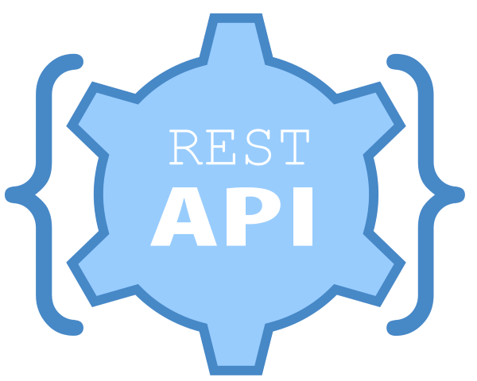



Why we are here today and what we will cover
Feathers JS real time API;
REST (HTTP transport);
Socket IO (messaging transport via WebSockets);
User authorization via Oauth;
When to use HTTP and when WebSockets;
MQTT vs Socket IO

Slide 3
A bit of a practice
Server implementation with FeathersJS
Receive data from client
Forward data to the UI in real time
Client implementation (React)
Receives data from the server
Built up chart
Control other clients over UI via Socket IO client

Slide 4
What we will cover only shortly
Deployment of real time messaging servers
Horizontal scaling out
Messaging backplanes

Slide 5

Who am I
Sergey Sedelnikov
Solution Architect – Project Manager
Stora Enso Oyj
Tampere, Finland
I got a master degree in Mathematical Simulation of Controll Processes in 2003, Pacific National University, Khabarovsk Russia
I moved to Finland in 2011, worked as consultant in different companies at Helsinki, Vantaa, Espoo.
Joined Stora Enso at 2016 as a Solution Architect, moved to Tampere in 2018 to join the Intelligent Packaging division of Stora Enso

Slide 6



Stora Enso Oyj
We are the renewable materials company!
The renewable materials company, Stora Enso develops and produces solutions based on wood and biomass for a range of industries and applications worldwide.

Slide 7



Stora Enso Oyj
27 000 employees worldwide
Tampere office - Pack Performance Center. Intelligent Packaging Division. 30 employees.

Slide 8
Back to Technology, what we are going to achieve today
Example case:
We are having two motors, they need to send their current speed data every 200 ms to the server;
Server needs to receive this data and forward it to the Web UI where operator sees the statistics;
Operator can change each motor speed;
If one motor changes it’s speed, another motor need also to change it’s speed to keep the average speed as defined in the system configuration.

Slide 9

What is Feathers JS and why realtime?
Feathers JS is A REST and real-time API layer for Node.js, React Native and the browser.
Transport agnostic, supports Express, SocketIO and Primus
We will focus on HTTP and SocketIO transports. https://feathersjs.com

Slide 10
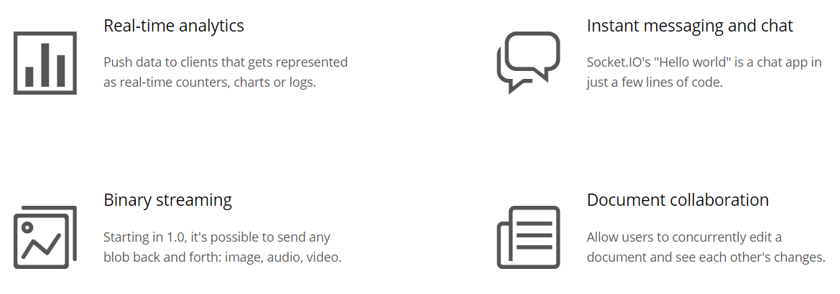
What is Socket IO?
“Socket.IO enables real-time, bidirectional and event-based communication. It works on every platform, browser or device, focusing equally on reliability and speed.”
https://socket.io
Users WebSocket as a transport but NOT a WebSocket implementation – it adds additional layer of logic and own protocol specification

Slide 11
FeathersJS Architecture
Feathers is a normal API with request/response pattern;
It has authentication layer via PassportJS that is working via so called “before hooks”;
Powerful hooks mechanism where you can define what happens before each call, after each call and in case of errors – for instance audit events saving, Authorization of the user based on Roles, etc.

Slide 12
FeathersJS Architecture
As the most important Real Time Notifications for every authenticated client that some service got some method executed – a real power of real time reactive applications.

Slide 13
Let’s get to code
Sample code repo: https://github.com/serge-sedelnikov/feathersjs-lecture
More about FeathersJS: https://feathersjs.com

Slide 14
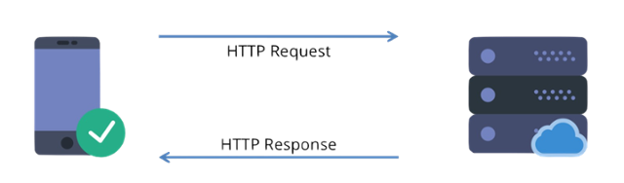
HTTP vs SocketIO API Access
Use HTTP when:
No need to keep connection all the time;
Connection is poor;
Traffic is limited;
No need to react on events, only execute CRUD methods with request/response pattern;

Slide 15
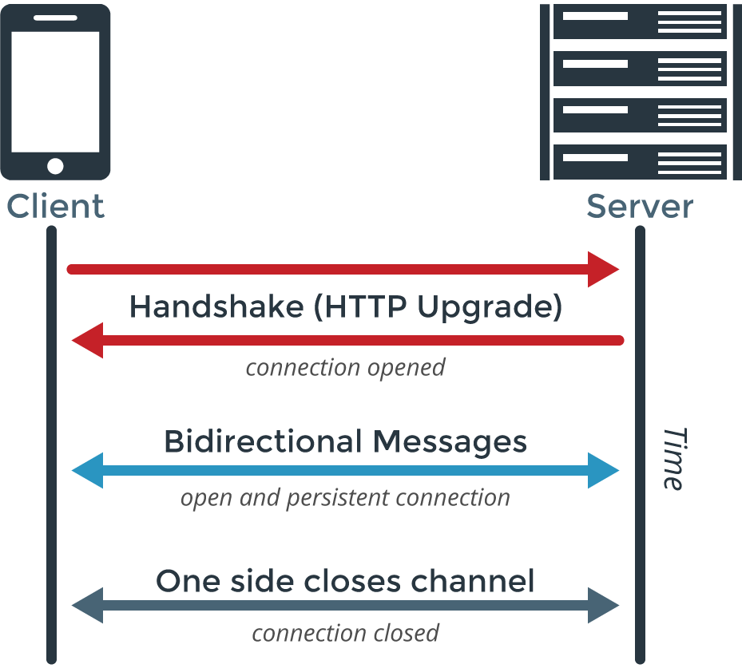
HTTP vs SocketIO API Access
Use SocketIO when:
Need an immediate notifications on CRUD events;
Connection is stable;
Need a faster request/response;
Need to react on other clients behavior;

Slide 16
HTTP vs SocketIO API Access
Can one client use both HTTP and SocketIO transports?
Yes it can;
However, if you are using SocketIO client, it is unnecessary to use HTTP as SocketIO client is generally provides faster access to the server;
Avoid using both transports in one client – this is a good practice to keep one server access layer;

Slide 17

SocketIO vs MQTT, is SocketIO good for IoT?
SocketIO yes, but actually no.. Too heavy traffic for small devices.
MQTT - yes. It was designed for IoT – for oil pumps in the rural areas with limited connection. Used on ocean vessels to send telemetry to the main land.

Slide 18
SocketIO vs MQTT
SocketIO is not a real IoT communication protocol – it guaranties the communication between the client and server;
In the other hand MQTT is this machine to machine TCP based protocol that is much more suitable for IoT devices.

Slide 19
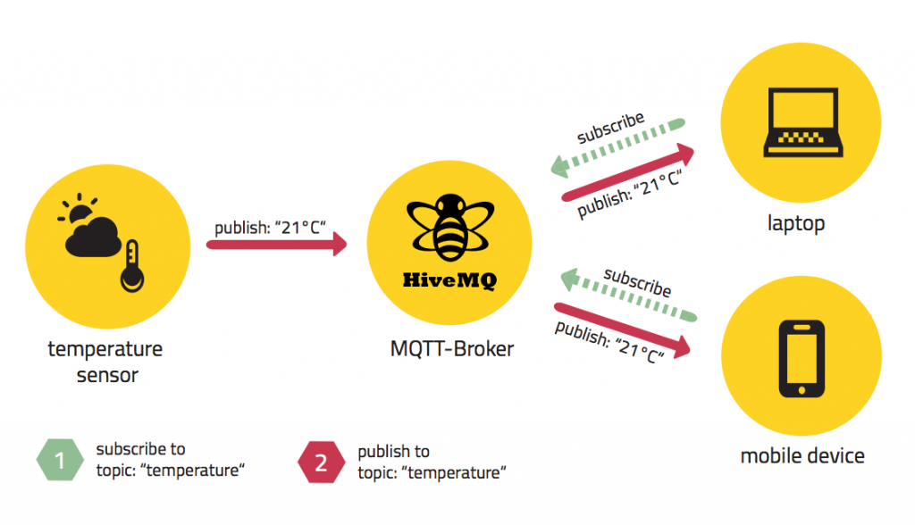
SocketIO vs MQTT
MQTT is Machine 2 Machine pub sub platform. Publisher can publish any thing on some channel and subscriber can subscribe to channel and listen to publisher;
SocketIO only provides communication between client and server – not between multiple clients via pub-sub pattern.

Slide 20
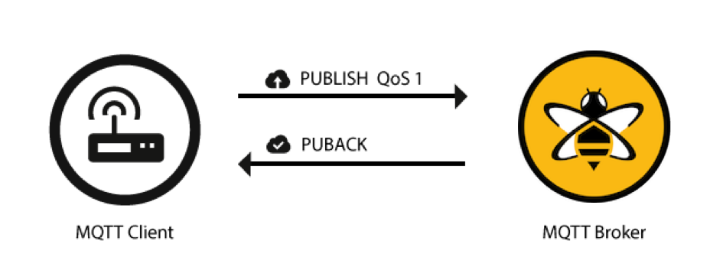
SocketIO vs MQTT
MQTT provides the delivery guaranty of three levels (Quality of Service): QoS0, QoS1, QoS2: at most 1, at least 1, exactly 1 message. Even on connection break.
SocketIO do not guaranty message delivery on connection dropped and reestablished.

Slide 21
SocketIO vs MQTT
MQTT requires separate broker to be hosted and opened for the access over TCP;
SocketIO is hosted on the same server that clients are getting access to.

Slide 22
Real time API Deployment
Deployment one machine is as easy as copy/paste.

Slide 23
Real time API Deployment
Deployment on multiple machines with load balancer requires to use messaging backplane via Redis.
For FeathersJS the module named ‘feathers-sync’ can be used.

Slide 24
Real time API Deployment
Deployment on multiple machines with load balancer requires to use messaging backplane via Redis.
For FeathersJS the module named ‘feathers-sync’ can be used.

Slide 25

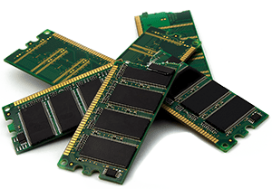
Redis?
Redis is an open source (BSD licensed), in-memory data structure store, used as a database, cache and message broker;
It supports data structures such as strings, hashes, lists, sets, sorted sets with range queries, bitmaps, hyperloglogs, geospatial indexes with radius queries and streams.

Slide 26
Redis?
Cache;
Message Broker (Pub/Sub pattern);
In-Memory data storage.
Each record is a key-value;
Each record’s value can be fetched by key;
Each key value can be cleaned;
If record has time-to-live (TTL) property, it is automatically deleted;
Redis is fast, but if restarted, all data is lost;
Mostly used for Cache-Aside pattern, and as a message broker (as in the backplane case)

Slide 27
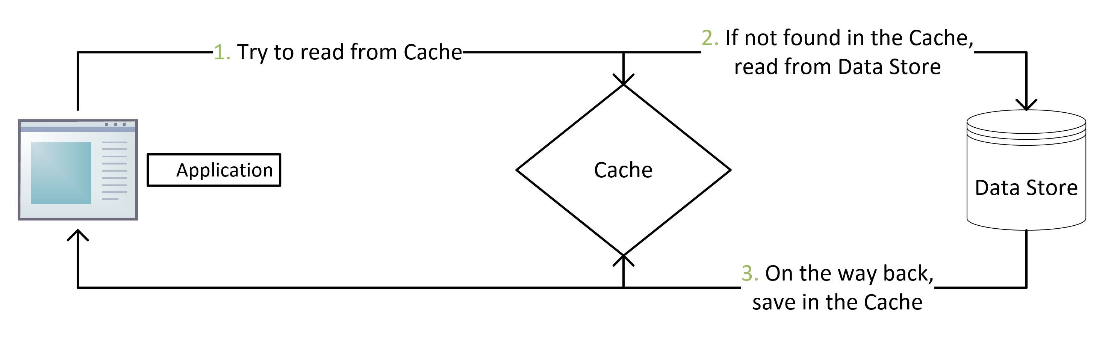

Redis?
Cache-Aside pattern

Slide 28
Load Balancing?
Used for horizontal scaling up;
Clients are accessing via one IP address but several physical machines are working on client’s request;
Usually used for stateless services like RESTful API;
In case of state-full services, different techniques are used to store and sync state between nodes – maybe next lecture topic.
Do not mix load balancing with traffic manager; Traffic manager usually works with GEO-replication – grants access to the closest deployment next to geo position of the client, Load balancing usually grants access randomly or based on load. But they can work together in complex systems.

Slide 29
Complex systems are much more difficult
Remember about security;
User authentication/authorization;
Opened ports and protocols;
OS vulnerabilities;
Hackers love to beak into IoT networks due to lack of security;
Some small devices and controllers can’t even use encryption due to limited memory and CPU;
Remember about gateways between the Internet and devices;
And more… And more….

Slide 30
Contacts and Questions
Thank you for tour time!
Ask me any question by email: sergey.sedelnikov@storaenso.com
I will try to answer, thought it may be short, do not get angry if there would be a delay.

