Slide 1
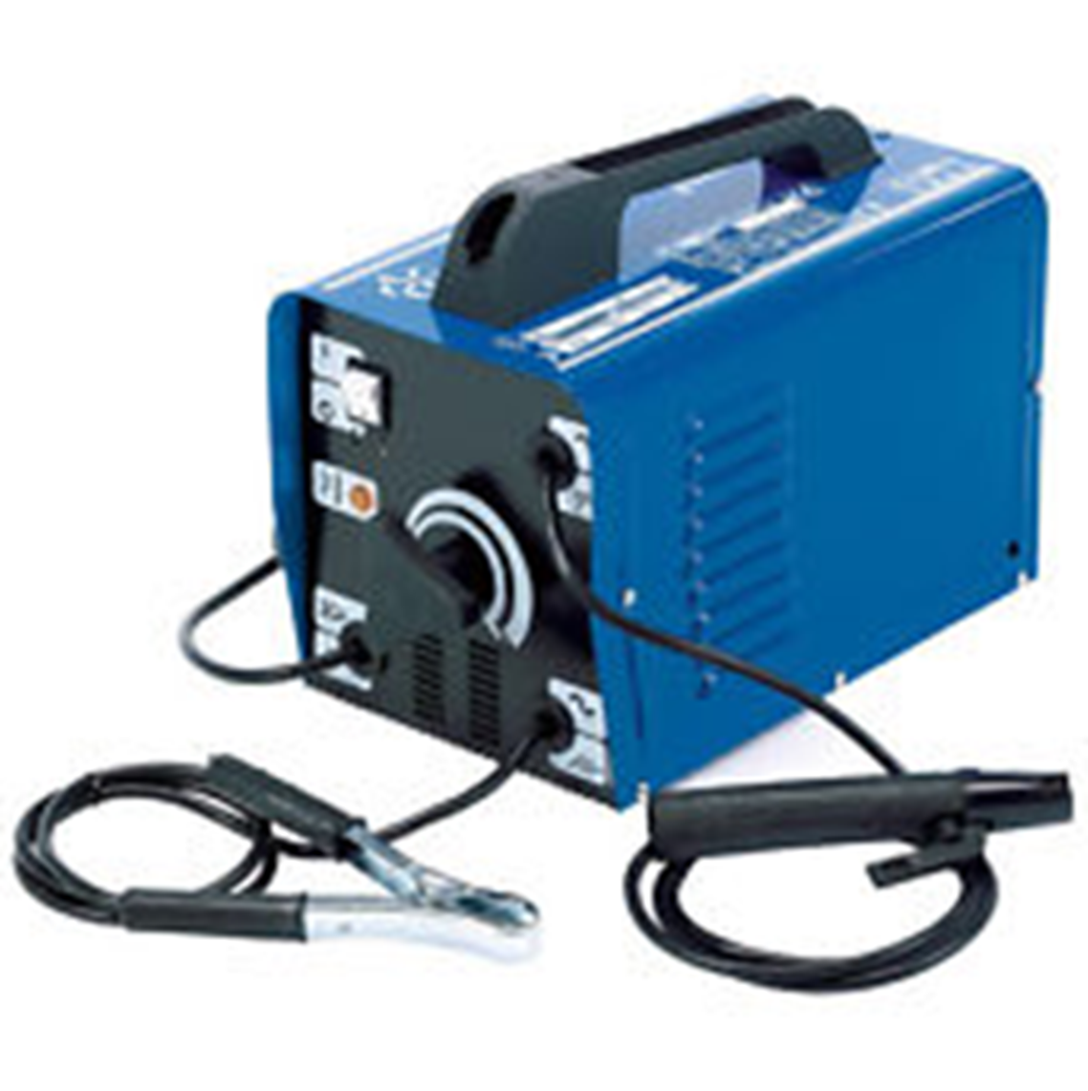

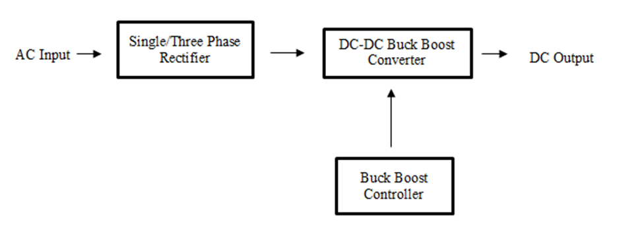
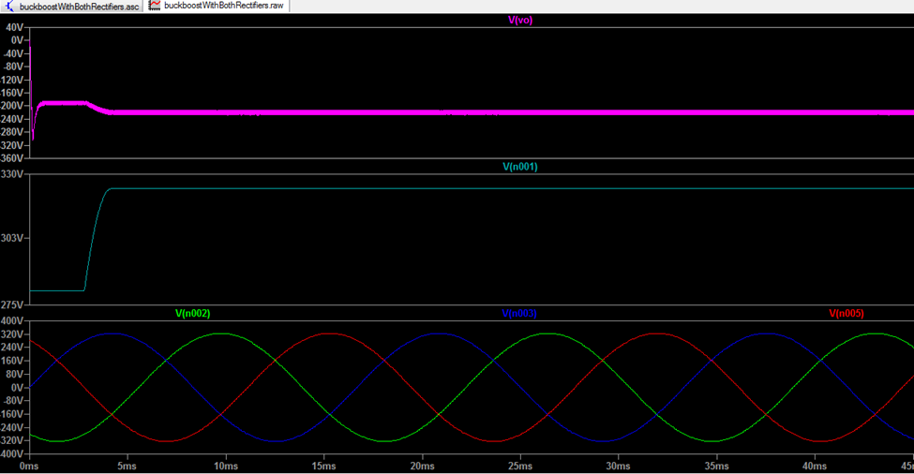
The Design of AC – DC Converter Power Supply for Welding Machines
Serge Iragena, Electrical Engineering, University of Maryland Eastern Shore
A welding power supply is a device that provides electric current to perform a fusion of materials(usually metals or thermoplastics) by melting them, which requires a high current and high voltage.
WHAT IS A WELDING MACHINE?
PROJECT DESCRIPTION
The end goal of this project was to design an AC-DC power supply that takes a wide range of AC input voltages to supply a steady output DC voltage to be used in welding machines. The system is designed to generate a 14.4-kilowatt power supply that will operate on both single phase and three phase inputs, with emphasis on cost and reliability. The generation of self-configuring power supply is implemented with two input rectifier stages to enable the system to operate on single and three phase line voltage. The focus of this project is the power supply input rectifier stage, DC-DC buck-boost converter, and the control unit shown in the block diagram.
AC input voltage range: 120V – 600V
Single/three phase
DC output voltage: 285V
Output current: 50A
CIRCUITRY SIMULATIONS
DESIGN REQUIREMENTS
ENGE 476 -Senior Design, Fall 2018

