Slide 1

Recoletos Community Outreach Program Community Extension Mobile Responsive Website (ReCOP – ComEx)
Presented by:
AUSTRIA, MARIAN T.
JAMINAL, IVAN ASHLEY F.
MAJILLO, SERGE ANGELO I.
QUINTIN, ALEX AUSTIN S.
SOTTO, MARIE LEEN S.

Slide 2
What is Outreach?
As defined in Merriam-Webster’s dictionary, an “outreach” is an act of reaching out, the extent or limit of reach and the extending of services or assistance beyond current or usual limits.

Slide 3
Caritas et Scientia
San Sebastian College Recoletos – de Cavite has been promoting its philosophy, ‘Caritas et Scientia,’ which means charity and knowledge, striving to deliver it’s extension and outreach services to the community.

Slide 4
Re-COP
The Recoletos de Cavite Community Outreach Program Office or Re-COP is the Institution’s center for all community outreach related activities and the schools connecting body to various organizations and individuals.

Slide 5
Process
Presently, the process of outreach activities in the Re-COP Office is still done through papers and through manual process.
organizations or individuals who wish to conduct an outreach program activities lack the visibility on prospect beneficiaries.

Slide 6
Statement of the Problem
The reoccurring instance of untracked and lost outreach proposal and records.
The limited number and information about linkages, communities and volunteers of outreach activities .
The low participation rate and exposure of outreach activities conducted by SSCR-dC.

Slide 7
The incomplete content and non-unified format of post outreach activity reports filed by partners and ReCOP Office.
The lack of funding mechanisms and resources for outreach activities.

Slide 8
Observations
The manual process of outreach activity requisition and approval.
The lack of visibility on the list of bonafide partners, communities, beneficiaries, outreach events and schedules.
The poor advertisement of outreach programs .

Slide 9
The non-unified format for the outreach programs and reports.
The absence of notifying mechanisms for event directors and participants about event cancellations or rescheduling.
The limited number of partners and linkages as well as event sponsors and participants.

Slide 10
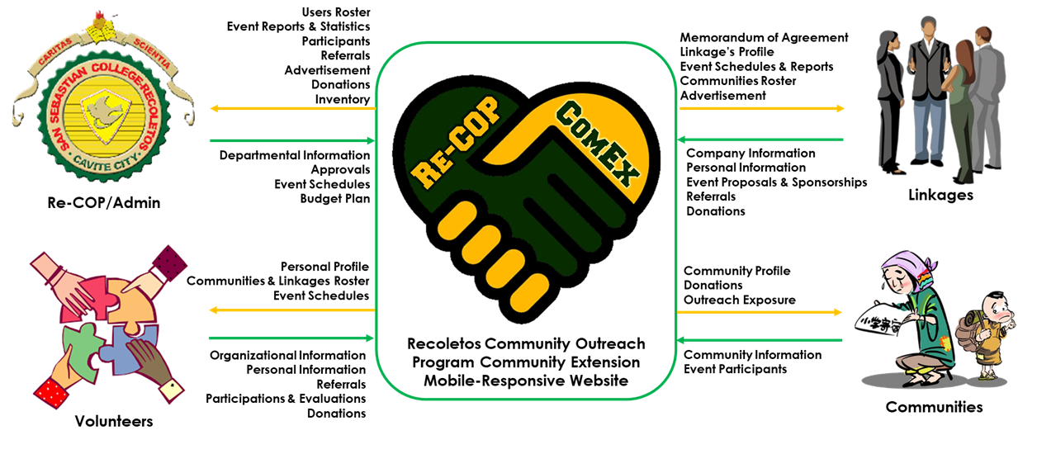
Conceptual Framework

Slide 11
Project Description
Recoletos Community Outreach Program Community Extension Website focuses around the creation of a mobile-responsive web application that will centralize the transactions between SSCRdC and it’s partners and linkages.

Slide 12
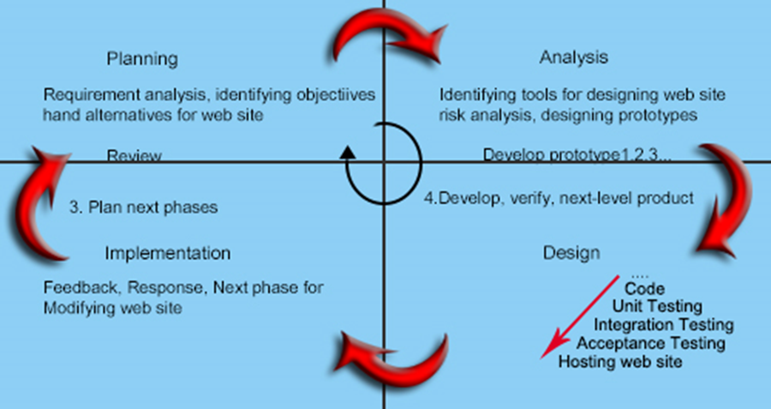
WDLC
The researchers used the spiral model under the Web Development Life Cycle.

Slide 13
Project Features
Mobile-Responsive Web Application.
Nowadays, using gadgets such as mobile phones, tablets, and laptops etc. enables visitors to find websites anytime and anywhere given that internet connection is available. The researchers utilized frameworks like Python-Flask and Bulma CSS in order to achieve a website design that will scale to almost all devices available today.

Slide 14
Project Features
Partners and Beneficiaries Visibility.
The proposed website will provide a list of partners and beneficiaries currently affiliated to SSCR-dC. In addition, the users will be able to search through the list to find prospect outreach sponsors and receivers.

Slide 15
Project Features
Outreach Attendance and Evaluation Reports.
The system will enable the client to monitor event participation rates as well as the participant’s feedback and rating on outreach program activities. The reports were displayed in tables and graphs.

Slide 16
Project Features
Outreach Updates.
Website will enable users to stay updated about the latest news and status about upcoming, ongoing and completed outreach program activities. The website will also enable push notifications through emails an hour before an outreach activity is to be conducted.

Slide 17
Project Features
Outreach Activities Advertisement.
The website will promote and advertise in-house outreach activities that will help the school to be known not just for providing a good quality education but also for helping its partner communities and the environment.

Slide 18
Project Features
Faster Proposal Approval.
Through ReCOP-ComEx Website, manual process of requesting proposal can be easy and lessen the time it takes to approve. The website will be sending the activity proposal requests to the offices concerned via email. The email will be containing the attached documentary requirements and an acknowledgement form that the receiver must accomplish to sign the proposal.

Slide 19
Project Features
Partners and Beneficiaries Referral.
The website will require newly signed users to refer at least one community or organization the school can help or can be partners with. The referred parties will be receiving an email with the link to website’s sign-up page.

Slide 20
Roles and Responsibilities
Re-COP Admin
- the administrator of the website can do the following:
(1) views the pending outreach activities, approved or disapproved outreach activities, completed outreach activities
(2) approves proposed outreach activities proposed by partners and linkages
(3) declines proposed activities by partners and linkages due to certain grounds like not proposing the activity 2 weeks before the activity, unclear information of the proposed activity

Slide 21
(4) cancel events due to certain grounds e.g. bad weather
(5) create institutional outreach activities that registered users can view and join
(6) arrange memorandum of agreement for partners and linkages
(7) notifies the joined registered users about upcoming outreach activities that the registered users joined, also notifies users about outreach activities so that users can join the activity
(8) budgets institutional activities of the Re-COP
(9) schedules the outreach activities to applicable time and date

Slide 22
Registered Users
- registered users of the website can do the following:
views outreach activities that they can register to
refers prospect partners and linkages that can benefit the Re-COP
join outreach activities that is approved by the Re-COP

Slide 23
Partners and Linkages
- partners and linkages of the website can do the following:
(1)cancel events due to
(2) sign memorandum of agreement to the Re-COP (3) notifies participants on the outreach program the user registered to
(4) budgets the outreach activity conducted by the partners and linkages

Slide 24
(5) schedules the proposed activity they proposed to the Re-COP
(6) refers possible partners and linkages of the Re-COP
(7) propose outreach activities to the Re-COP
Visitors
- visitors of the website can do the following:
(1) view outreach activities of the Re-COP

Slide 25
Visitors
- visitors of the website can do the following:
(1) view outreach activities of the Re-COP

Slide 26
Hardware and Software Development Tools
I/O Device | Monitor, Mouse, Keyboard, CPU
Processor | Intel Core i5 – 8250U 1.60GHz processor
Motherboard | ASPIRE E5-576G
Memory | 4GB DDR3
Hard Disk Drive | 2Tb
Auxiliaries | NVIDIA GeForce MX150 with 2 GB of dedicated GDDR5 VRAM 15.6" Full HD 1920 x 1080 high-brightness resolution 8X DVD-Super Multi double-layer drive WLAN: 802.11a/b/g/n/ac wireless LAN 41.4 Wh 2800 mAh 14.8 V 4-cell Li-ion battery pack
Hardware Development Tools

Slide 27
Compiler | Python
Database Server | MySQL
Database Integrated Development Environment | phpMyAdmin
Design of User Interface | Bulma and Adobe Photoshop
Text Editor | Sublime text
System Documentation | Microsoft Word 2016
Operating System | Microsoft Windows 10 Home
Software Development Tools

Slide 28
Hardware and Software Requirements
Hardware | Minimum | Recommended
Processor | 1 GigaHertz (GHz) | 3.4 GHz
RAM | 1 GB for 32-bit 2 GB for 64-bit | 2 GB for 32-bit 4 GB for 64-bit
Hard disk space | 16 GB for 32-bit OS 20 GB for 64-bit OS | 250 GB for 32-bit OS 500 GB for 64-bit OS
Hardware Requirements for Web

Slide 29
Software | Minimum | Recommended
Browser | Google Chrome Version 70.0.3538 | Google Chrome Version 71 and up
Operating System | Microsoft Windows 8.1 | Microsoft Windows 10
Database Engine | XAMPP 3.2.2.0 | XAMPP 3.2.2.0
Software Requirements

Slide 30
Cost and Benefit Analysis
COSTS |  |  |  | BENEFITS
*One-Time Cost |  |  |  | *Tangible
Development Cost |  |  | 100,000.00 | Less Papers |  |  |  | 5,160.00
 |  | Total: | 100,000.00 | Additional donations |  |  |  | 89,700.00
 |  |  |  |  |  |  | Total: | 94,860.00
*Recurring Cost |  |  |  | *Intangible
Domain Name |  |  | 1,148.00 | Faster event proposals |  |  |  | 0.00
 |  | Total: | 1,148.00 | Easier search for beneficiaries |  |  |  | 0.00
 |  |  |  | Improve brand image |  |  |  | 0.00
 |  |  |  | Increase partners and linkages |  |  |  | 0.00
 |  |  |  | Increase event participation rate |  |  |  | 0.00
 |  |  |  |  |  |  | Total: | 0.00

Slide 31
Net Present Value and Payback Analysis
The table above is the NPV and Payback Analysis with a discount rate of ten (10) percent.

