Slide 1


Virtualization
technologies
Part 3
DevOps Spring 2017

Slide 2
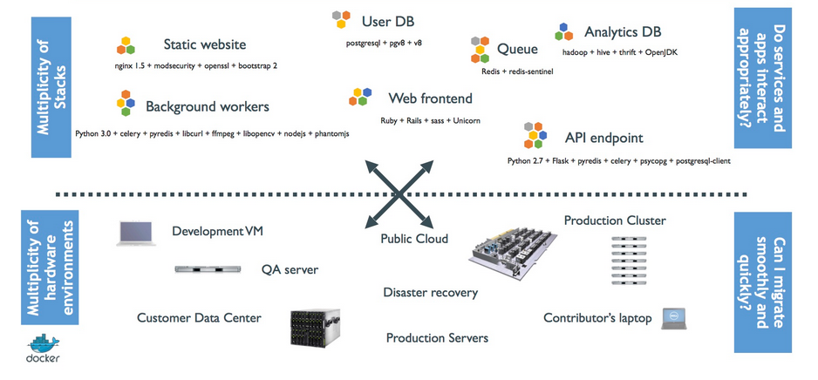
THE CHALLENGE

Slide 3
THE CHALLENGE

Slide 4
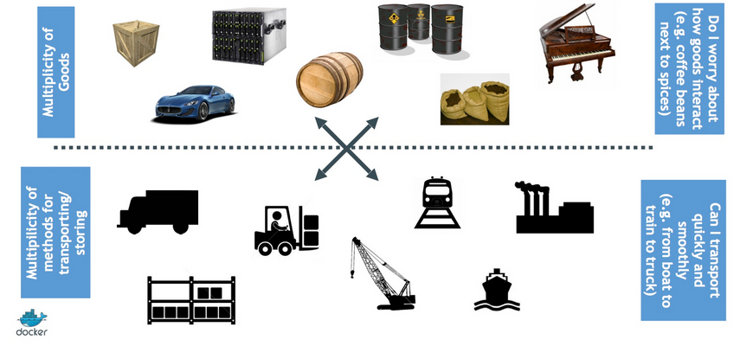
CARGO TRANSPORT PRE-1960

Slide 5
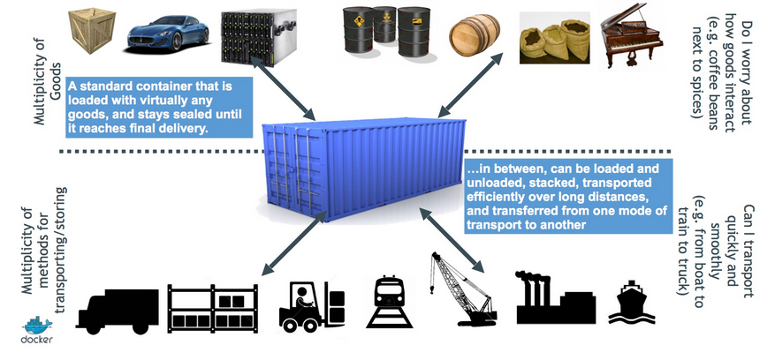
SOLUTION: INTERMODAL SHIPPING CONTAINER

Slide 6
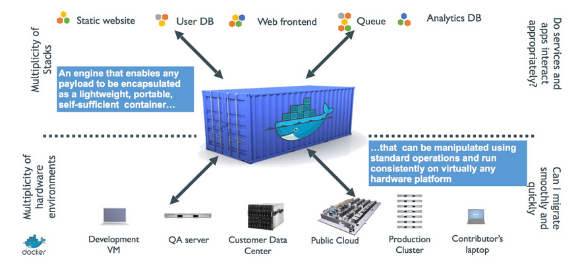
DOCKER IS A SHIPPING CONTAINER SYSTEM FOR CODE

Slide 7
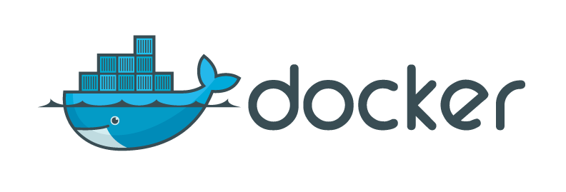
Meet the Docker Container
A portable store for a single component and its dependencies
Build once, run anywhere
Improved pipeline and testing
Faster deploy cycles, startup time
Clear separation between application and infrastructure
Resource optimization

Slide 8
Docker itself does not do
Monitoring
Logging
Cluster management
Access control

Slide 9
Run first container
$ docker run ubuntu echo “Hello container!”
Image check/pull
Container creation:
Allocation of a file system and mounts a read-write layer
Allocation of a network/bridge interface
Allocation of an IP address
Execution of a specified process
Connection to standard input, outputs and errors. Also logged.

Slide 10
Images, Containers, Registry
Client
Server
push
Docker Registry
Docker Daemon
Image
Container
Image
Docker CLI
run
Image
Image
Image
build
pull
Dockerfile
Image

Slide 11
IMAGES
Check out the images present on the host
$ docker images
Pull an image from the repository
$ docker pull redis
Check out intermediate file layers
$ docker images –a
Removing
$ docker rmi redis

Slide 12
CONTAINERS
A container with a finishing command
Interactive containers
$ docker run ubuntu echo “hello world”
$ docker ps
$ docker ps –a
$ docker rm [Hash]
$ docker run –-rm ubuntu echo “hello world”
$ docker run –it ubuntu /bin/bash
$ docker ps
$ exit

Slide 13
DAEMON CONTAINER
$ docker run -d -p 6379:6379 redis
$ redis-cli ping
$ docker exec <container_id> ls
$ docker exec -it <container_id> /bin/bash
Stop and kill that container now

