Slide 2
CPSS Fast Compilation
September 2016

Slide 3
Overview
Improving performance:
Including instead of calling make for each directory – make runs only once (non recursive make).
Parallel compilation
~600 call Make
1 call Make

Slide 4
Minimal time of build WM image
Regular: 7-14 min
New: ~1 Min
Linux
Fast: 10 -25 Min
New: ~5 Min
Windows

Slide 5
Regular-Fast make definition changes
Top-level make for build
presteraTopMake
Package
Folder
gtBuild
_Makefie
Make_cpss_Lnx/Make_cpss_Win
gtTopMake
_<Package>_TopMakeDef

Slide 6
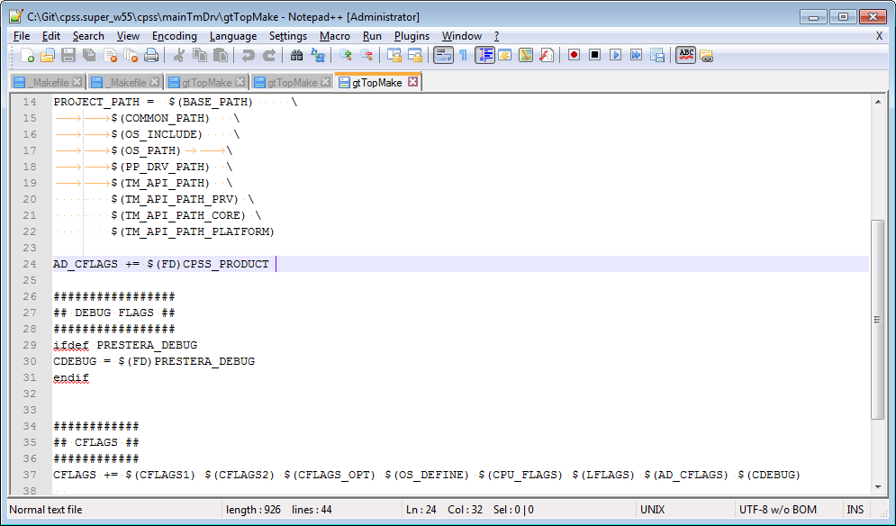
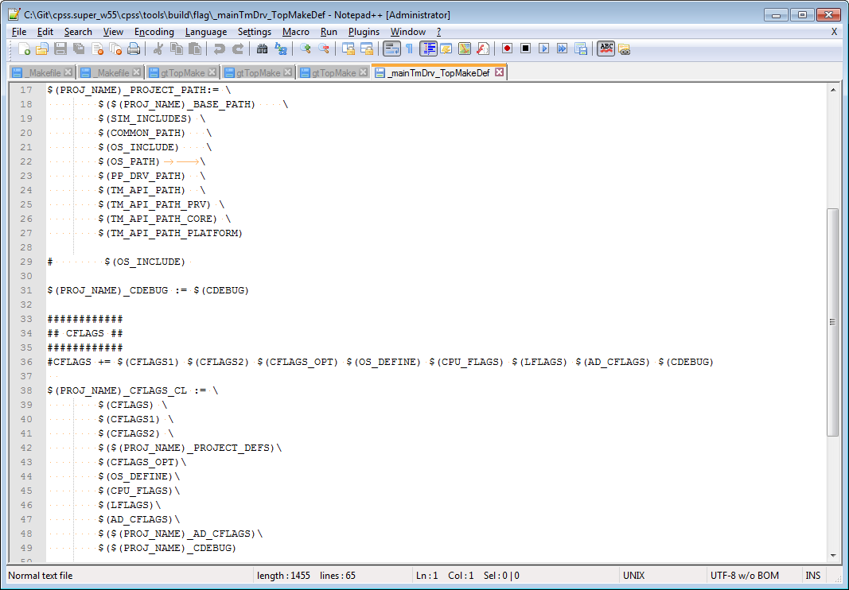
cpss\mainTmDrv\gtTopMake cpss\tools\build\flag\_mainTmDrv_TopMakeDef

Slide 7
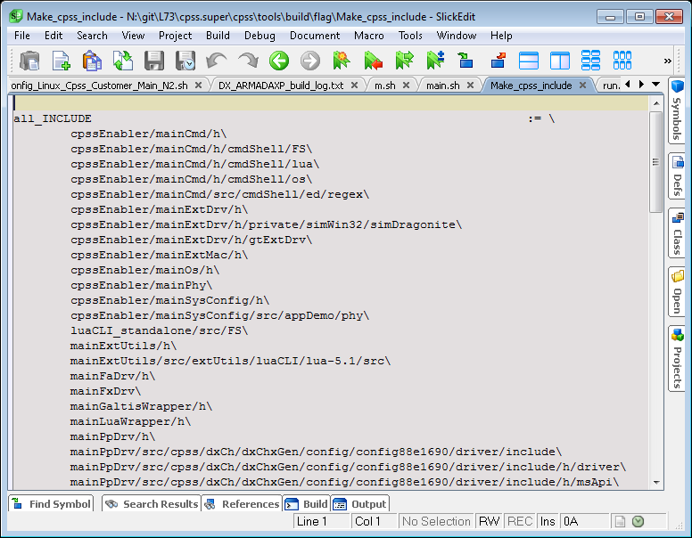
Now fast compilation used for all packeges all_INCLUDE located in inux/cpss.super/cpss/tools/build/flag\Make_cpss_include

Slide 8
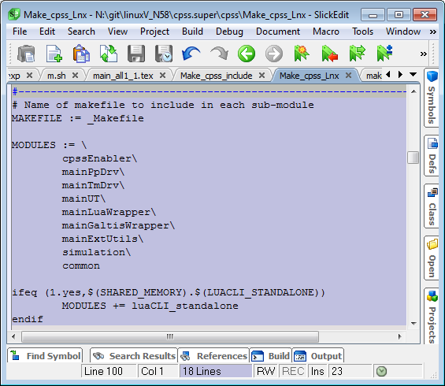
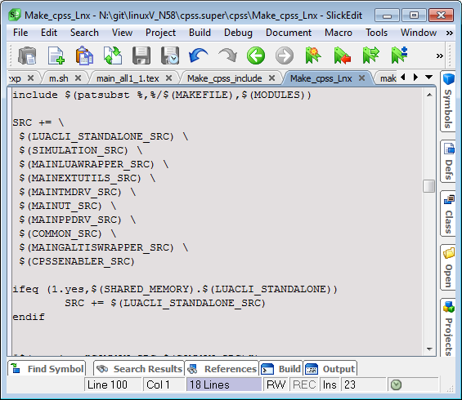
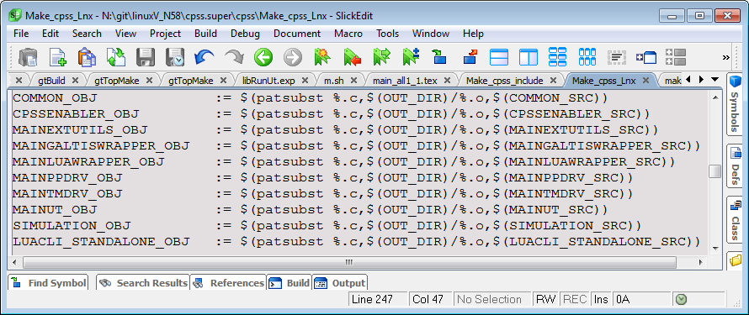
New top-level make packages (MODULES) include sub-makefiles.

Slide 9
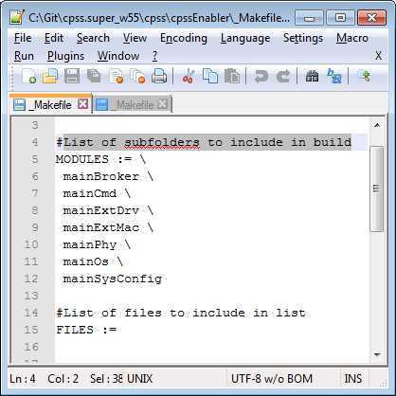
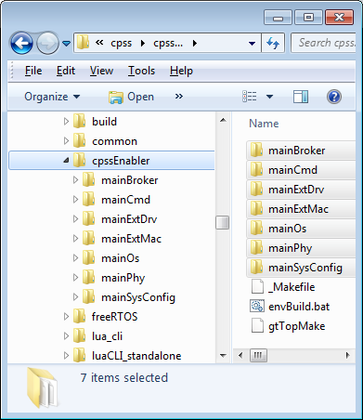
List of subfolders to include in build

Slide 10
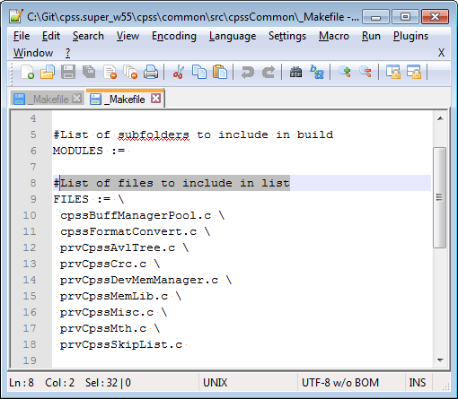
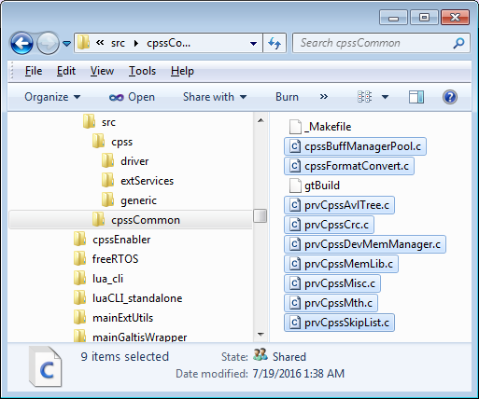
List of files to include in list

Slide 11
Make file Flags and Includes
Build
Flags
Compiler
OS
Packages
Folder
Addition AD_CFLAGS
Addition AD_CFLAGS

Slide 12
Requirements for Fast Compilation system
Moving flags from level folder to package
Full lists definition for MODULES and FILES

Slide 13
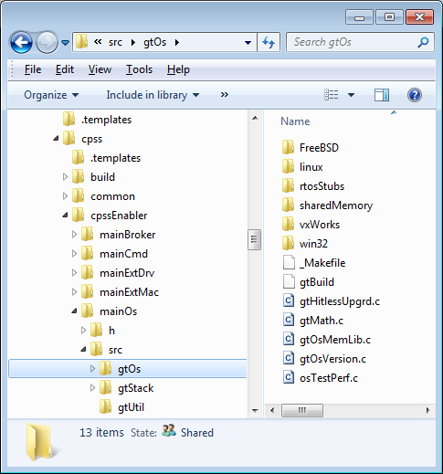
Old/New directory list definition
SUBDIRS
SUBDIRS = NONE
MODULES :=
MODULES list
#ifeq (ON, $(EXCLUDE_COMMON)) # SUBDIRS = NONE
#endif
ifeq (ON, $(EXCLUDE_COMMON))
MODULES :=
else
#List of subfolders to include in build
MODULES := \
linux \
sharedMemory
endif

Slide 14
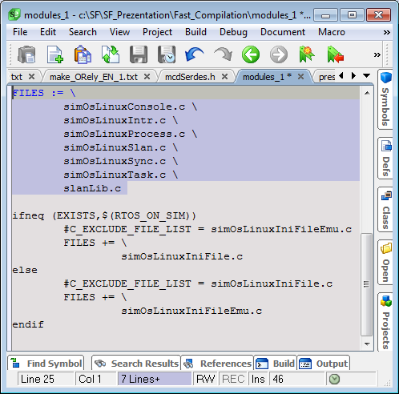
Regular-Fast file list definition
C_FILE_LIST
FILES list
C_EXCLUDE_FILE_LIST
Used only FILES
C_EXCLUDE_FILE_LIST= ALL
FILES :=

Slide 15
Test/Update Fast Compilation procedure
Run Fast Compilation
Developer/JENKINS check compilation/linker errors
Log
Update Make files
_Makefile

Slide 16
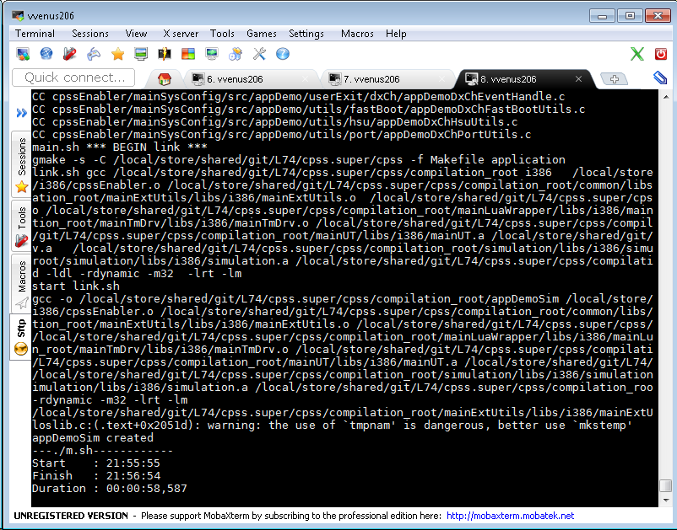
Example run Fast Compilation WM i386 for Linux environment
cpss.super/cpss/build_cpss.sh DX_ALL i386 silent FAST_COMP
or
run cpss/build.sh with parameter –v
or
run cpss/m.sh

Slide 17
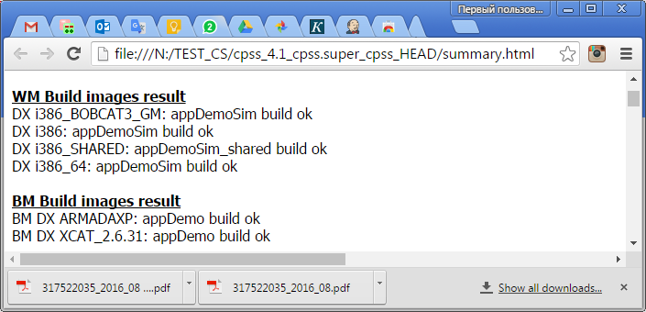
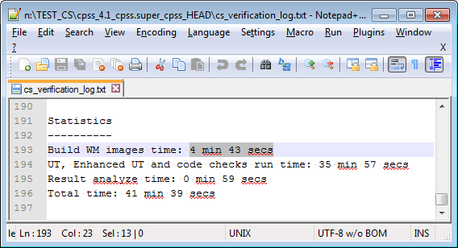
Run cs_verification_f with fast compilation
cpss/tools/genScripts/codeChecks/cs_verification_f.sh

Slide 18
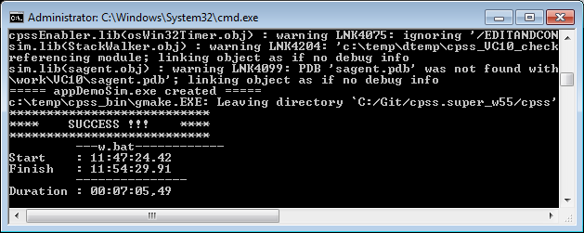
Example run Fast Compilation WM for Windows environment
copy f:\Objects\cpss\bin\gmake2.exe c:\temp\cpss_bin\gmake2.exe
cpss\build_cpss.bat DX_ALL VC10 NO_COPY_BIN VC10 FAST_COMP
or
cpss\cmd /c W.bat N 41_668 (compilation on the Build.sh - main.sh level)

Slide 19
Build CPSS procedures
Top-level
Build.sh
main.sh
_Makefie
Windows: build_cpss.bat
Linux: bulid_cpss.sh

Slide 20
Linux: build_cpss.sh definitions
##################################################################################
## build_cpss.sh
##################################################################################
##
## APPDEMO IMAGE BUILD WRAPPER
##
##################################################################################
## ARGUMENTS : Can be defined in any order
##
## CPU and PP_TYPE are the mandatory parameters - the rest are optional
## MANDATORY PARAMETERS
## -----------------------------------
## CPU : ARM5181 ARM5281 PPC603 PPC85XX EP3041A XCAT XCAT_BE i386 i386_64 XCAT_2.6.31
## XCAT_BE_2.6.31 ARM78200 ARM78200_BE ARMADAXP ARMADAXP_BE XCAT_3.4 XCAT_3.4_BE
## MIPS64 INTEL64 INTEL64_32 INTEL32 MSYS MSYS_2_6_32 ARMADAXP_3.4.69 ARMADA_385
## MSYS_3_10 ARMADA_390 MSYS_BE
## PP_TYPE : DX_ALL

Slide 21
build_cpss.sh definitions - continue
## OPTIONAL PARAMETERS
## -------------------------------
## PRODUCT : CPSS_ENABLER CPSS_LIB CPSS_ENABLER_NOKM CPSS_BLOB CPSS_USE_MUTEX_PROFILER
## CPSS_ENABLER_SHARED CPSS_LIB_SHARED CPSS_ENABLER_SHARED_NOKM
## - default value CPSS_ENABLER
## UT : UTF_YES UTF_NO - default value UTF_YES ( build UT )
## CPSS_LOG : CPSS_LOG_YES CPSS_LOG_NO - default value CPSS_LOG_YES
## LUA : NOLUA (the same as LUA_NO) - by default LUA code is included, NOLUA removes LUA support
## NO_EXAMPLES : remove examples from LUA code
## GALTIS : NOGALTIS - galtis code not used
## TOOLKIT : SDK_5_V5 SDK_5_V7 SDK_3.2 SDK_1.2.4 ELDK_3.1
## Build options : UNZIP ENVBASE CUST SHLIB SO_LIB - no defaulf value
## Build options : UNZIP ENVBASE CUST SHLIB - no defaulf value
## GM_LION : specify using of GM libs for DX LION simulation image build
## GM_BOBCAT2 : specify using of GM libs for GM_BOBCAT2 simulation image build
## GM_BOBCAT2_B0 : specify using of GM libs for GM_BOBCAT2_B0 simulation image build
## GM_BOBCAT3 : specify using of GM libs for GM_BOBCAT3 simulation image build
## NOKERNEL : Do not build kernel
## NOLINK : Only build libs - do not try to link
## silent : Build CPSS silently (-s make's option)(as default) or verbose - Build CPSS verbose
## FAST_COMP : Non-Recursive fast compilation options - no defaulf value

Slide 22
main.sh definitions
#!/usr/bin/env bash
#
# PSS/CPSS build script
#
# Enviroment variables:
# 1. Project depended
# PSS_PATH required for PSS* projects
# CPSS_PATH required for CPSS* projects and PSS_O_CPSS
#
# 2. OS depended
# 2.1. Linux BM
# LINUX_DIST_PATH required. Kernel sources should be found here,
# kernel will be compiled in this directory
# LSP_USER_BASE required.
# LSP_SUBDIR try $LSP_USER_BASE/$LSP_SUBDIR/$LINUX_LSP_NAME first
# Otherwise use $LSP_USER_BASE/$LINUX_LSP_NAME
# LINUX_KERNEL_VERSION (or DEFAULT_LINUX_KERNEL_VERSION from CPU defs)
# LINUX_LSP_NAME (or DEFAULT_LINUX_LSP_NAME from CPU defs)
# LINUX_BUILD_KERNEL set to YES to build kernel. Default is YES
#

Slide 23
main.sh definitions - continue
# Options:
# -T toolkit Choose toolkit.
# VC,eldk,GnuEabi,Tornado,gcc(native for simulation),etc
# refers $tool_build/toolkit/${toolkit_name}.sh
#
# Default toolkit for each supported OS defined in CPU file
#
# -b BUS override management bus.
# Default is CPU specific
#
# -x XBAR set XBAR type. Default NONE
#
# -s SO_LIB Build shared objects. Default NONE.
#
# -u UTF_YES|UTF_NO
# Incude UTF. Default YES
# -a CPSS_LOG_YES|CPSS_LOG_NO
# Enable/disable CPSS API log. Default is CPSS_LOG_YES.
#
# -C Do build in current directory only
# This option developed to be used with simple script
# Example (bld_cpss_sim)
# #!/bin/bash
# export CPSS_PATH=/home/serg/tmp/Marvell/cpss
# $CPSS_PATH/Build.sh $1 \
# -u UTF_YES -L \
# Linux i386 LinuxWM \
# DX simulation CPSS_ENABLER \
# /home/serg/tmp/Marvell/objs -
# Run this script with no option to build whole project
# Add -C parameter to build in current directory only
#

Slide 24
main.sh definitions - continue
# -D DEV | ENVBASE | CUST
# If DEV Run in developer mode - spawn an interactive shell
# after finishing of all steps (BSP copy, compile and link)
#
# If ENBASE - spawn an interactive
# shell after all environment set and host OS depended
# preparation actions is done
#
# If CUST - spawn an interactive shell
# after finishing compile and link
#
# -q Run script silently - only warning and error
# messages will be visible
#
# -l lua CLI compilation and build
# -e LUA_CLI without examples
# -N NOKERNEL|NOLINK|NOKERNEL_NOLINK
# no linux kernel build | no appDemo link
#
# -R The directory to copy uImage and rootfs.tgz
# -g force Golden Module Lib usage
# -d ClearCase baseline
# -p Coverity Server Port Number
# -v Non-Recursive fast compilation
# -w Build CPSS verbose

Slide 25
main.sh definitions - continue
# Parameters:
# 1. Host OS Linux, WIN32, FreeBSD
# 2. Target CPU PPC603, PPC6024, PPC603_VB, ARM_EV, ARM_RD, ARM_SP,
# ARM_GM, ARM5181, ARM5281, i386, etc
# refers $tool_build/cpu/${target_cpu}.sh
# 3. Target OS Linux,vxWorks,uClinux,WIN32,FreeBSD
# refers $tool_build/os/${target_os}.sh
#
# 4. the prestera PP family (DX, SX, EX, MX, DXSX)
# 5. pp type: HW(BM), simulation, GM
# 6. product type: PSS, CPSS, POC, PSS_O_CPSS
#
# 7. compilation root
# 8. (image) destination path

Slide 26
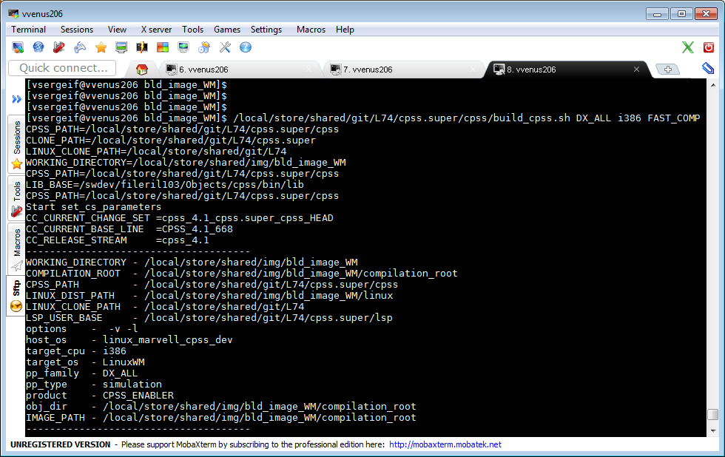
Linux: build_cpss.sh base build WM i386 fast compilation log

Slide 27
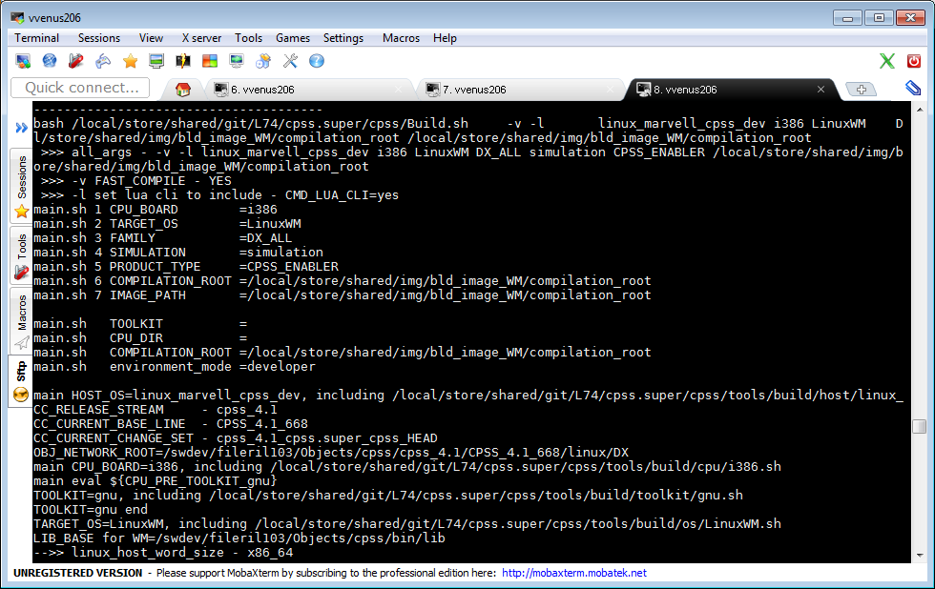
build_cpss.sh build WM i386 fast compilation log -continue

Slide 28
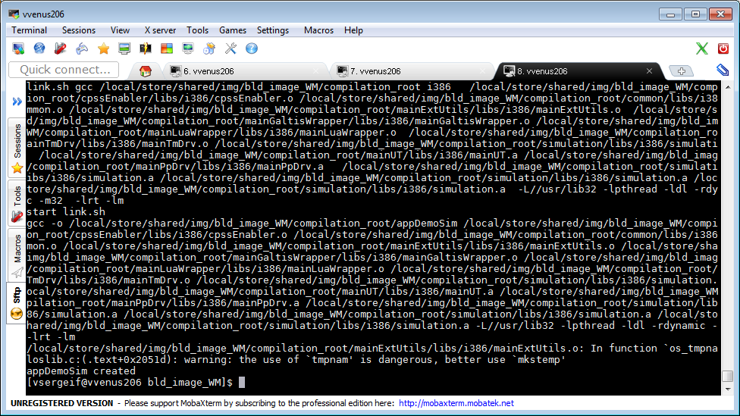
build_cpss.sh build WM i386 fast compilation log - end

Slide 29
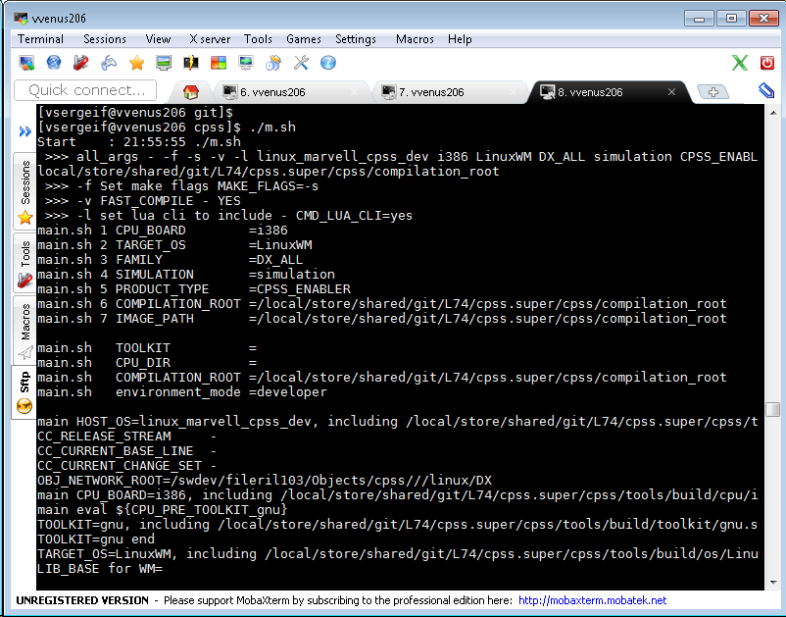
Linux: cpss/m.sh - Build.sh(main.sh) base example build WM i386 fast compilation log

Slide 30
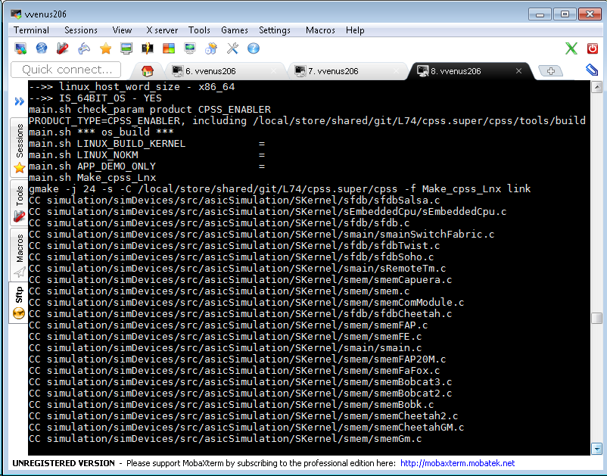
Build.sh(main.sh) example build WM i386 fast compilation log - continue

Slide 31
Build.sh(main.sh) example build WM i386 fast compilation log - end

Slide 32
Windows: build_cpss.bat definitions
::::::::::::::::::::::::::::::::::::::::::::::::::::::::::::::::::::::::::::::::::
:: build_cpss.bat
::::::::::::::::::::::::::::::::::::::::::::::::::::::::::::::::::::::::::::::::::
:: DEVELOPER IMAGE BUILD WRAPPER
:: $Revision: 44 $
::::::::::::::::::::::::::::::::::::::::::::::::::::::::::::::::::::::::::::::::::
:: ARGUMENTS : [Can be defined in any order]
:: CPU : ARM5181 ARM5281 ARM78200 ARM78200_BE ARM78200RD ARM78200RD_BE ARMADAXP ARMADAXP_BE
:: PPC603 PPC85XX PPC85XX_LION_RD XCAT XCAT_BE VC VC8 VC10 VC10_64 BC
:: PP_TYPE : DX_ALL
:: TOOLKIT : DIAB WB26 WB26_DIAB WB33 WB33_DIAB
:: PRODUCT : CPSS_ENABLER
:: UT : UTF_YES (default) or UTF_NO
:: CPSS_LOG : CPSS_LOG_YES (default) or CPSS_LOG_NO
:: LUA : NOLUA (the same as LUA_NO) - by default LUA code is included, NOLUA removes LUA support
:: GALTIS : NOGALTIS (the same as GALTIS_NO) - by default GALTIS code is included, NOGALTIS removes GALTIS support
:: BUS_OPTION : type of management bus - PCI(PEX) SMI PCI_SMI PCI_SMI_I2C
:: Builld optons: DEV ENVBASE CUST
:: GM_MODE : GM_LION GM_XCAT2 GM_LION2 GM_BOBCAT2 GM_BOBCAT2_B0 GM_BOBK_CAELUM
:: Additional
:: options : SUB20
:: options : NO_COPY_BIN - in developer mode don't copy(or check) binary files from f:\Objects\cpss\bin to c:\temp\cpss_bin
:: For example:build_cpss.bat DX_ALL VC10 NO_COPY_BIN
:: options : FAST_COMP - Non-Recursive fast compilation
:: options : silent - Build CPSS silently (-s make's option)(as default) or verbose - Build CPSS verbose

Slide 33
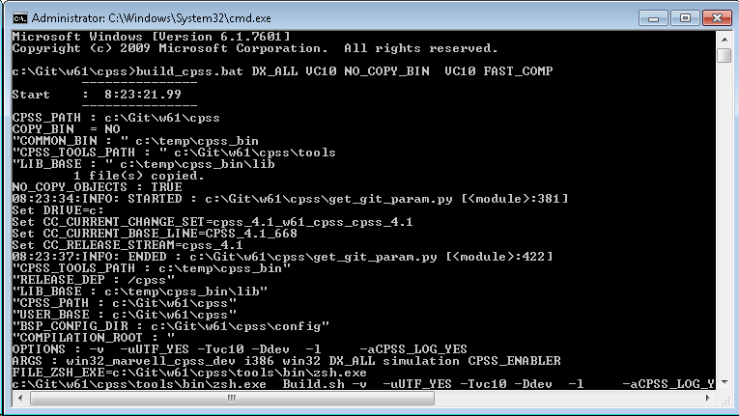
Windows: build_cpss.bat base fast compilation log

Slide 34
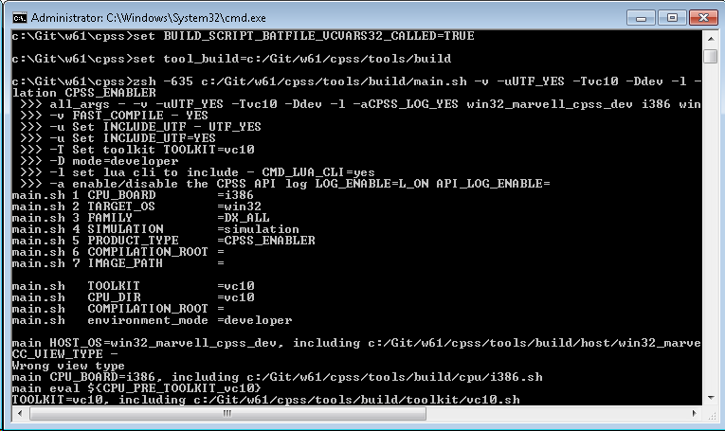
build_cpss.bat fast compilation log - continue

Slide 35
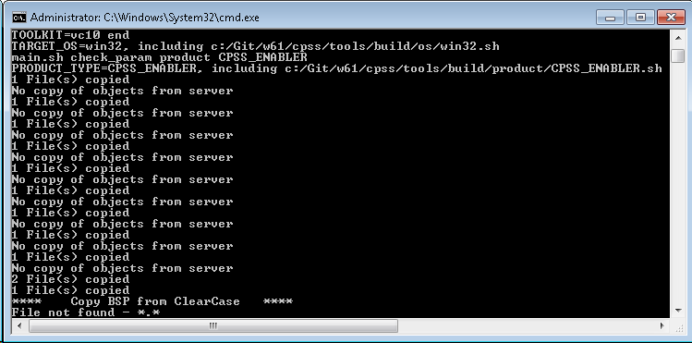
build_cpss.bat fast compilation log - continue

Slide 36
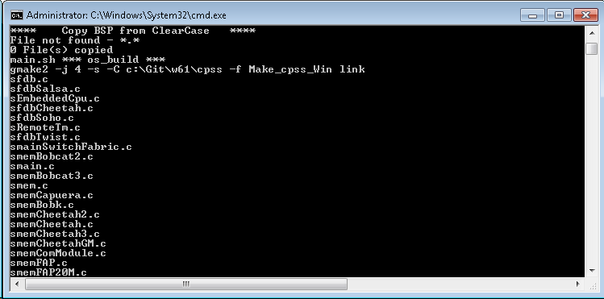
build_cpss.bat fast compilation log - continue

Slide 37
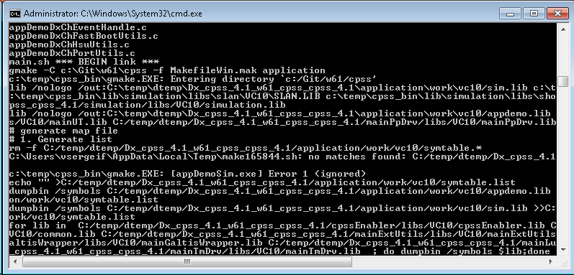
build_cpss.bat fast compilation log - continue

Slide 38
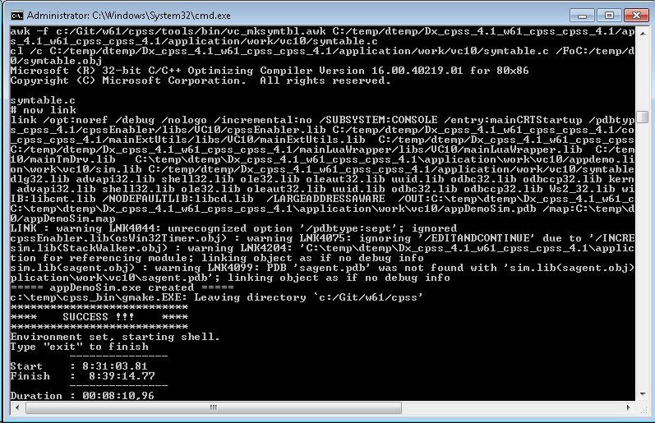
build_cpss.bat fast compilation log - end

Slide 39
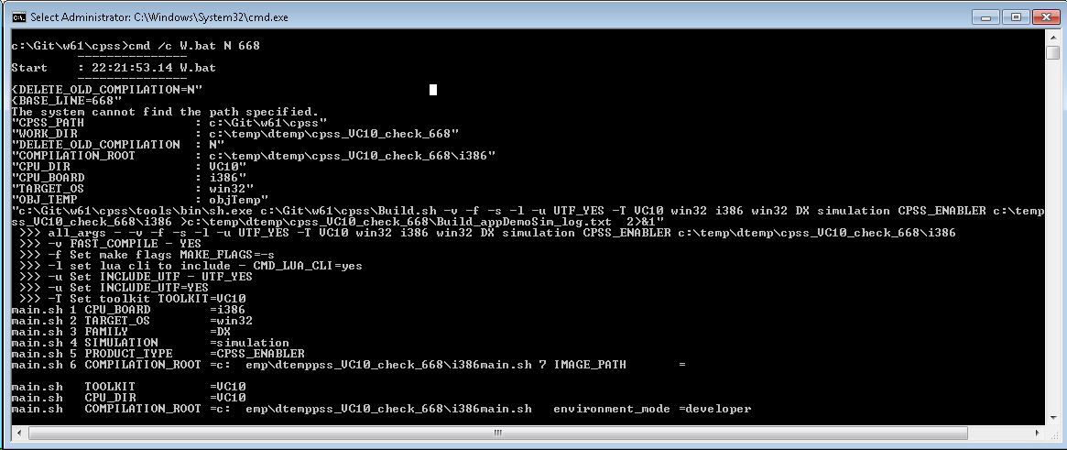
Windows:W.bat - Build.sh(main.sh) base fast compilation log
cpss\W.bat example bath file for WM build:
Parameter #1 SET DELETE_OLD_COMPILATION=Y/N
Parameter #2 Compilation folder suffix

Slide 41
Thank You!

