Slide 1

Web Services
WS. Sergey Gagarin
Notes:
No

Slide 2
Key points of this presentation
Limitations of OO programming
Benefits of Aspect Oriented software development
The main approaches in AO programming
PHP library for AOP
AOP. Sergey Gagarin

Slide 3
Programming paradigms
* Agent-oriented
* Component-based
o Flow-based
o Pipeline
* Concatenative
* Concurrent computing
* Data-driven
* Declarative (contrast: Imperative)
o Constraint
o Functional
o Dataflow
+ Cell-oriented (spreadsheets)
+ Reactive
o Logic
+ Abductive logic
+ Constraint logic
+ Inductive logic
* Event-driven
o Service-oriented
o Time-driven
* Expression-oriented
* Feature-oriented
* Function-level (contrast: Value-level)
* Imperative (contrast: Declarative)
o Procedural
* Language-oriented
o Domain-specific
o Grammar-oriented
+ Dialecting
o Intentional
* Metaprogramming
o Automatic
o Generic
+ Template
# Policy-based
o Reflective
+ Attribute-oriented* Non-structured (contrast: Structured)
o Array (contrast: Scalar)
o Iterative
* Nondeterministic
* Parallel computing
o Process-oriented
* Programming in the large and programming in the small
* Structured (contrast: Non-structured)
o Modular (contrast: Monolithic)
o Recursive
o Object-oriented
+ Automata-based
+ By separation of concerns:
# Aspect-oriented
# Subject-oriented
# Role-oriented
+ Class-based
+ Prototype-based
* Value-level (contrast: Function-level)
* Semantic
Notes:
Not going too deep into programming paradigms lets have a look at where Web Services fit. We Use Data-Driven programming, we use Modularisation, Object-Oriented programming approach. And last time we were talking about Aspect Oriented programming.
Now Web Services. WS are in Event – Driven development here. So as servise requested it should be provided.

Slide 4
WS Definition
W3C : “A Web service is a software system designed to
support interoperable machine-to-machine interaction
over a network. It has an interface described in
a machine-processable format (specifically WSDL)”
WS can be defined as a Web-application, which following certain standards
The basic Web Services platform is XML + HTTP.
AOP. Sergey Gagarin
Notes:
We will try to figure out which sort of interactions is meant here. And what is truly maching-to-maching interactions can mean.
The basic Web Services platform is XML for data representation and + HTTP as a transport protocol.

Slide 5
Benefits - Interoperability
Web Services are language and platform independent.
XML messages can be read by any application.
Notes:
What we try to achieve with Web Services is Interoperability.
Then we need to have WS language and platform independent.
And the way to carry a clear message is XML format.
Now when we know what to do and How Lets have a look at what we already have with a standard web application.

Slide 6
Similarity
Web applications are built around the Web browser
standards and can be used by any browser on any platform.
Web based on request-response model.
Notes:
But any Web Application try to achieve Ineteroperability. And it is built around some standards – web Browser’s standards in this case.

Slide 7
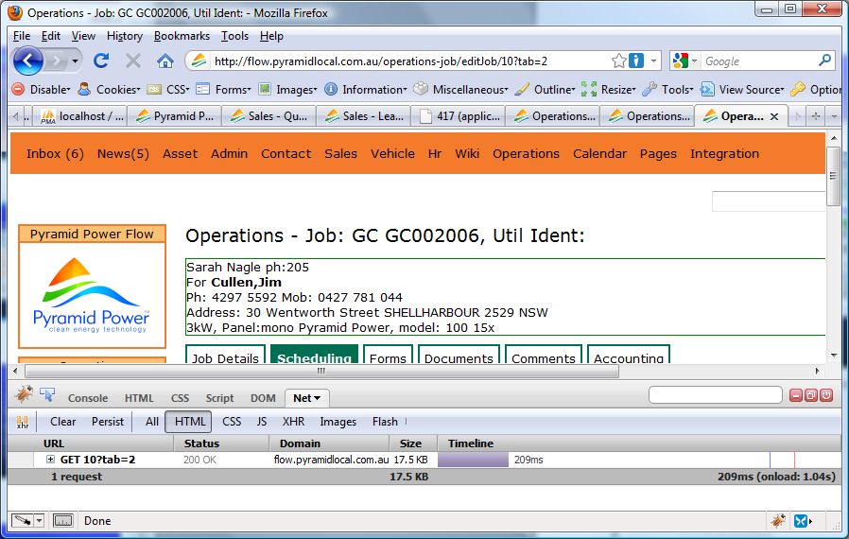
GET Request
Notes:
Here we can see a GET request.
Flow is clever enough to read the URL, get the Module name, find the method script, read GET parameters, than run the script and send back the response in form of html text. The browser represent the info for us.

Slide 8
<!DOCTYPE html PUBLIC "-//W3C//DTD XHTML 1.0 Transitional//EN"
"http://www.w3.org/TR/xhtml1/DTD/xhtml1-transitional.dtd">
<html xmlns="http://www.w3.org/1999/xhtml" lang="en" xml:lang="en">
<head>
<meta http-equiv="Content-Type" content="text/html; charset=iso-8859-1" />
<title>Operations - Job: GC GC002006, Util Ident:</title>
<link rel="icon" href="http://flow.pyramidlocal.com.au/img/favicon.png" type="image/png"/>
<link rel="stylesheet" type="text/css" href="http://flow.pyramidlocal.com.au/css/flow.css" />
</head>
<body>
<table width="100%" align="center">
<tr>
<td colspan="2">
<div id="top-nav">
<ul class="navlinks">
<li><a href="http://flow.pyramidlocal.com.au/pages/index" alt="" class="">Pages</a></li>
<li><a href="http://flow.pyramidlocal.com.au/integration/index" alt="" class="">Integration</a></li>
</ul>
<div id="simple-search" style="margin-top: 6px;">
<form action="http://flow.pyramidlocal.com.au/search/results" method="get">
<input style="width: 150px;" type="text" name="q" id="q" value=""/>
</ul>
</div>
</div>
</td>
<td valign="top" height="100%">
<div id="center">
<div id="body">
<span class="content-header">Operations - Job: GC GC002006, Util Ident:</span>
<p></p>
<div id='jobInfoDiv' style='border:1px green solid;' width:800px;> Sarah Nagle ph:205<br> For <b>Cullen,Jim</b><br> Ph: 4297 5592 Mob: 0427 781 044<br>Address: 30 Wentworth Street SHELLHARBOUR 2529 NSW<br>3kW, Panel:mono Pyramid Power, model: 100 15x</div>
<div class="tabs"><br />
Notes:
This is a response which browser can understand because it is a web standard.

Slide 9
Interoperability has Highest Priority
Notes:
Browsers for different platform will support such interactions. We all on-line we all interact. We do not need to know how the browsers work. They will do the job.

Slide 10
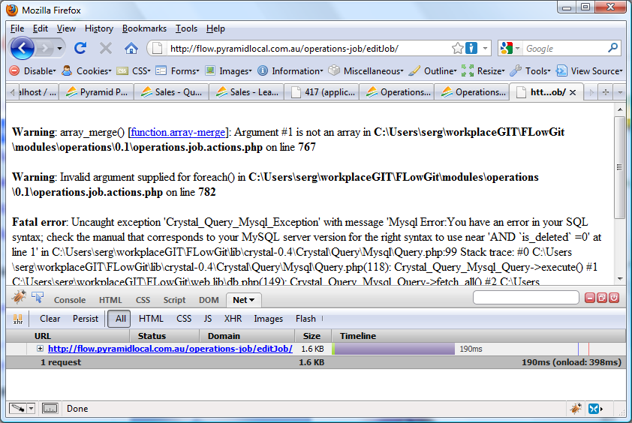
Notes:
But what happen if I do not know much about this method and try to call it ?
We still want to interact BUT HOW ?
Error message. Not like this one if I try to call some one else server obviously.
So I need to contact developer and ask about API.

Slide 11
Notes:
Now have a look how WS can help us.
WS supposed to have some API as you can see. The picture looks very similar to what we saw on the previous slides.
Many computers want to interact and Users send requests and so on.

Slide 12
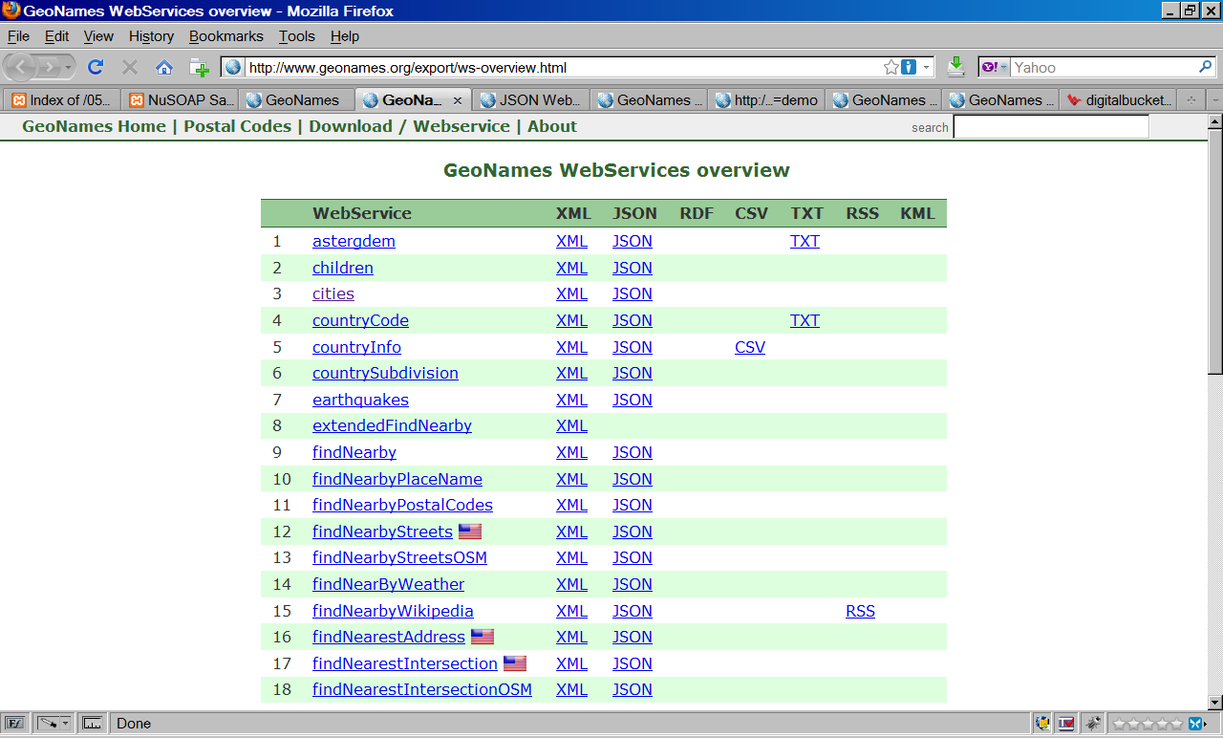
Notes:
Here is an Example of web services available on www.geonames.org.

Slide 13
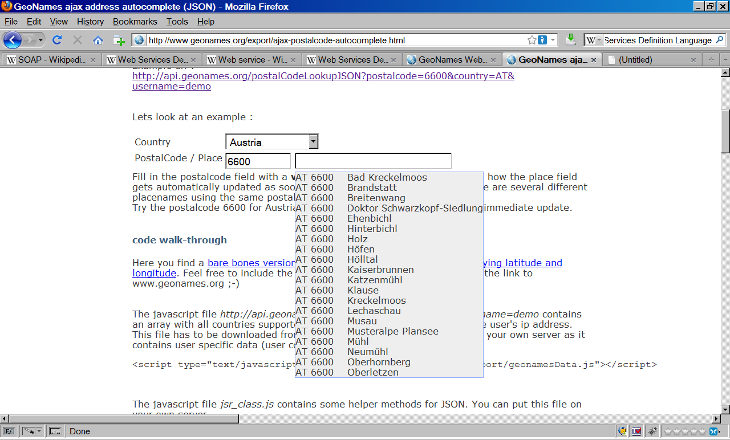
Notes:
On this page is a Demo of one of the Web Services offered. We type in PostCode and have Suburbs (or places) field autocompleted.

Slide 14
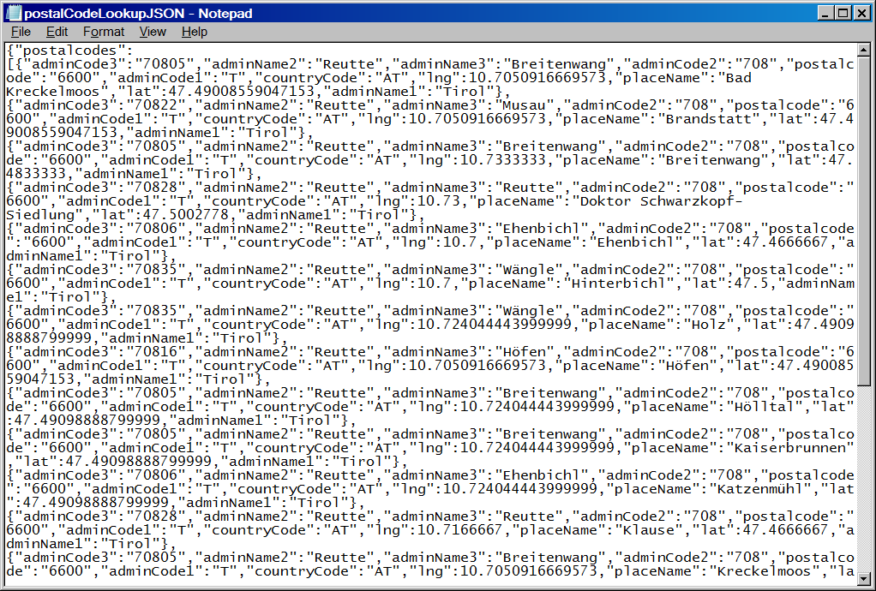
Notes:
Here is an JSON representation of Web Server Response.

Slide 15
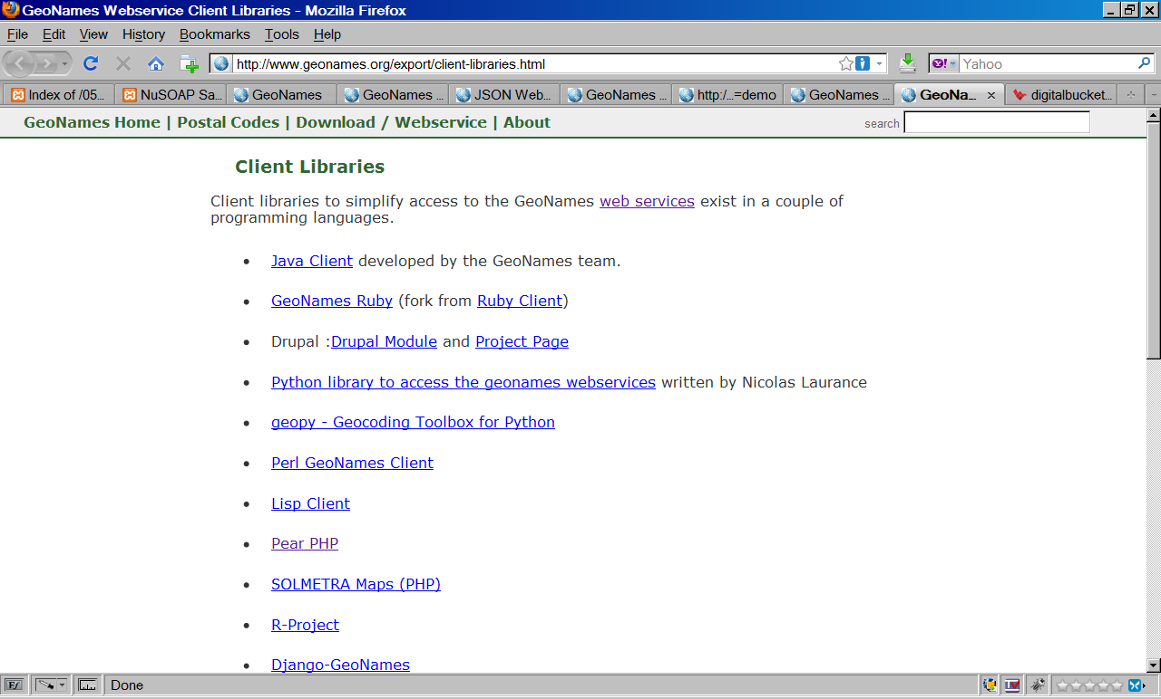

Slide 16
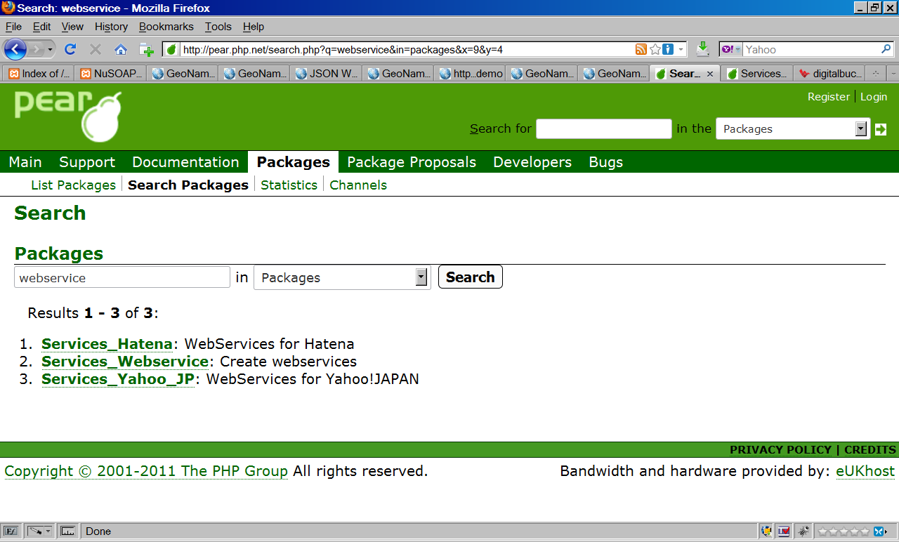
Notes:
Packages are oriented for some particular Web Services. Not to many to go actually.

Slide 17
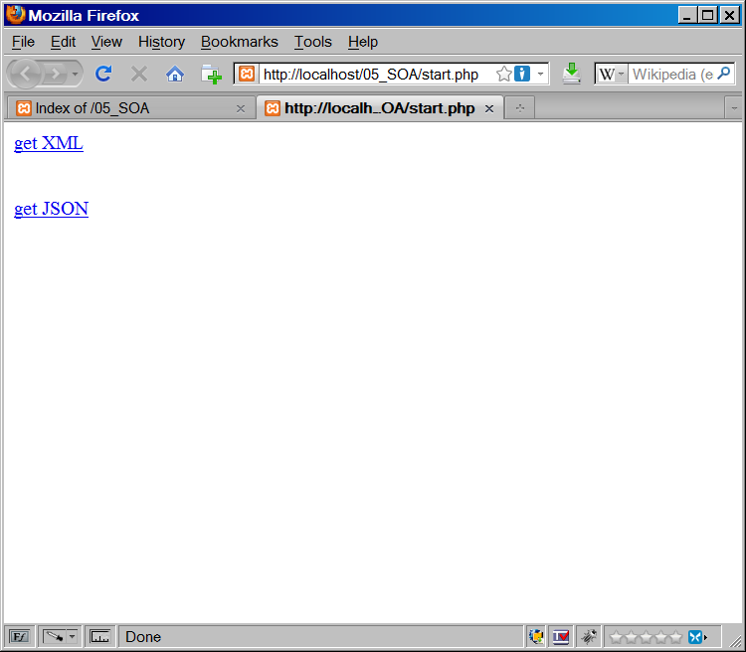
Notes:
My own example of implementation of such Web Service.

Slide 18
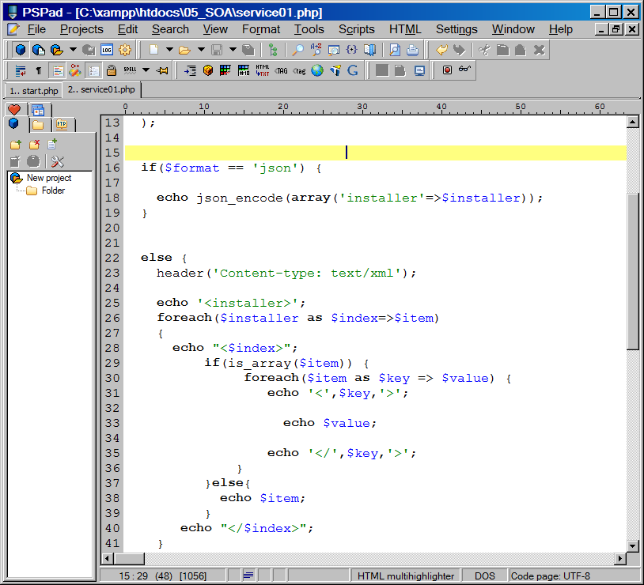

Slide 19
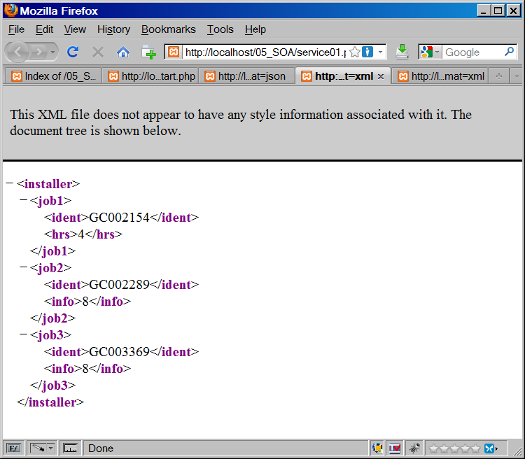

Slide 20
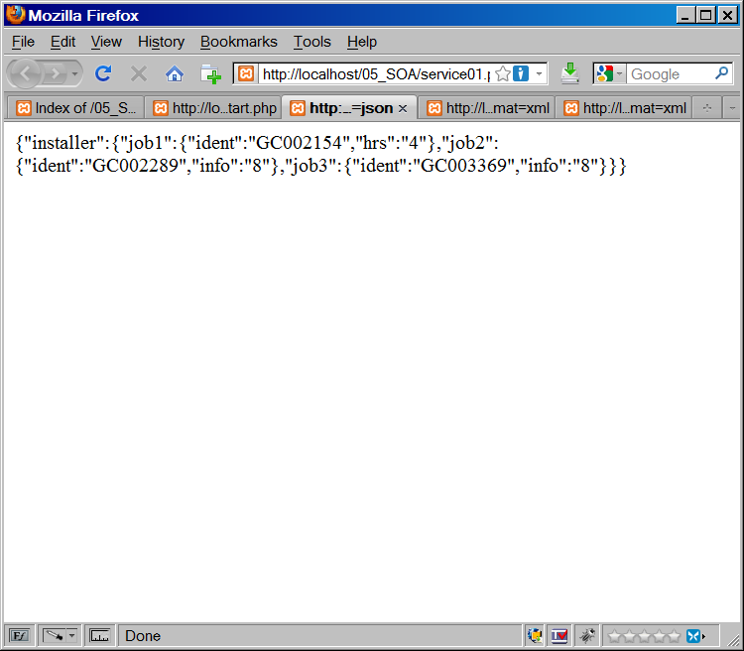

Slide 21
This sort of Web Services does not fully comply with WS definition.
WS is similar to standard request.
Still need to know WS API.
But with use of Web Services Description Language (WSDL) WS API it can be published and retrieved automatically.

Slide 22
Another element of the web services is SOAP. SOAP originally stood for Simple Object Access Protocol, and lately also Service Oriented Architecture Protocol (wikipedia)

Slide 23
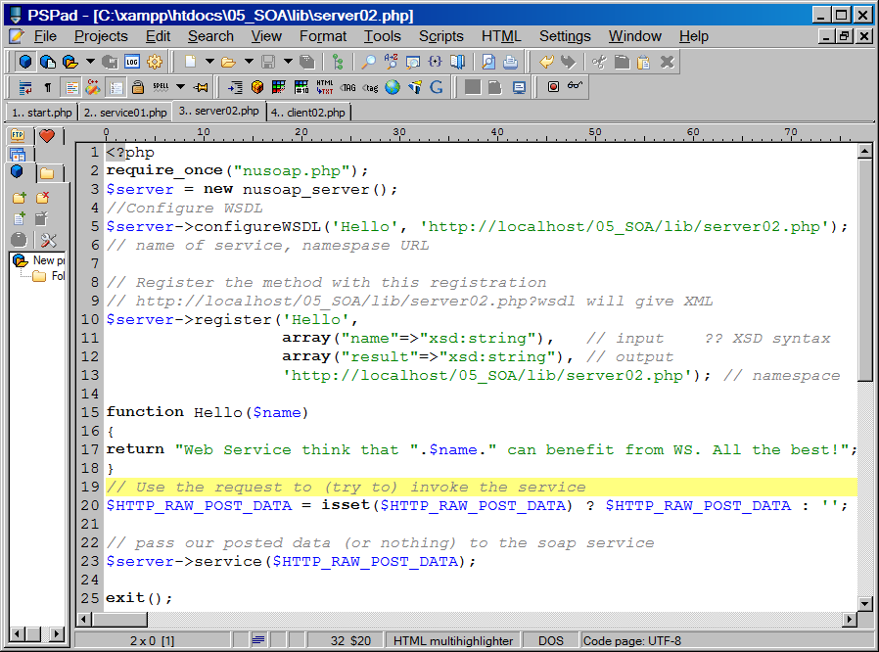

Slide 24
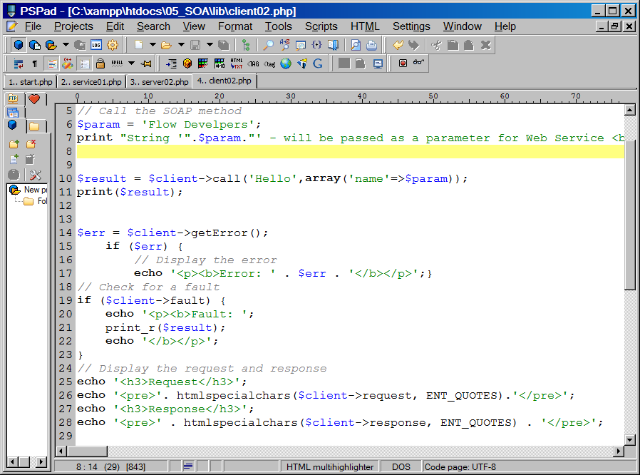

Slide 25
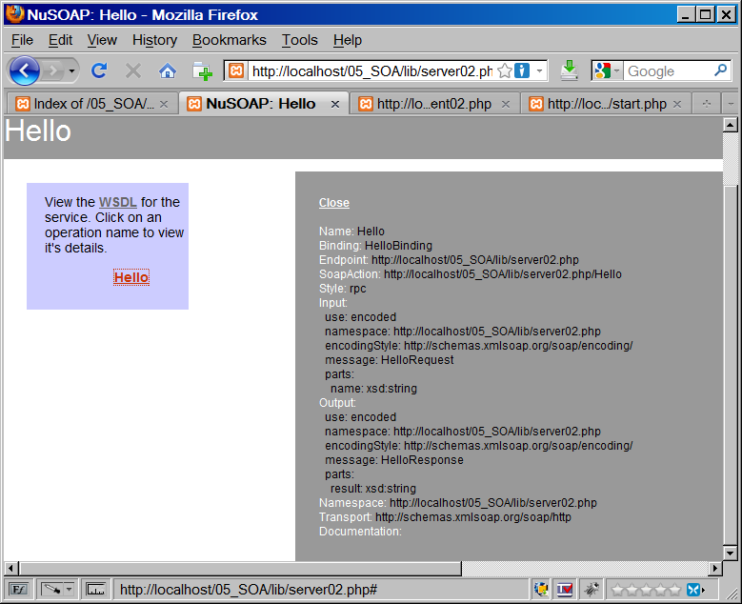

Slide 26
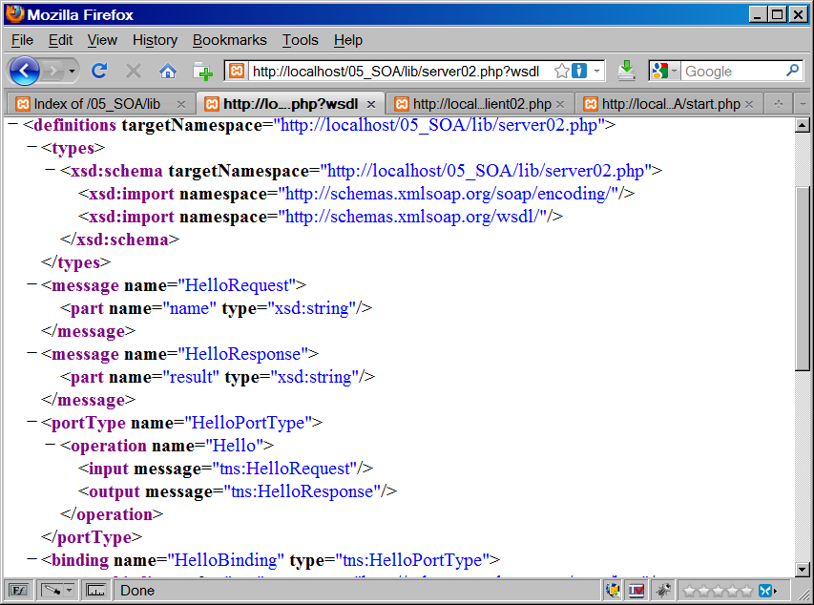

Slide 27
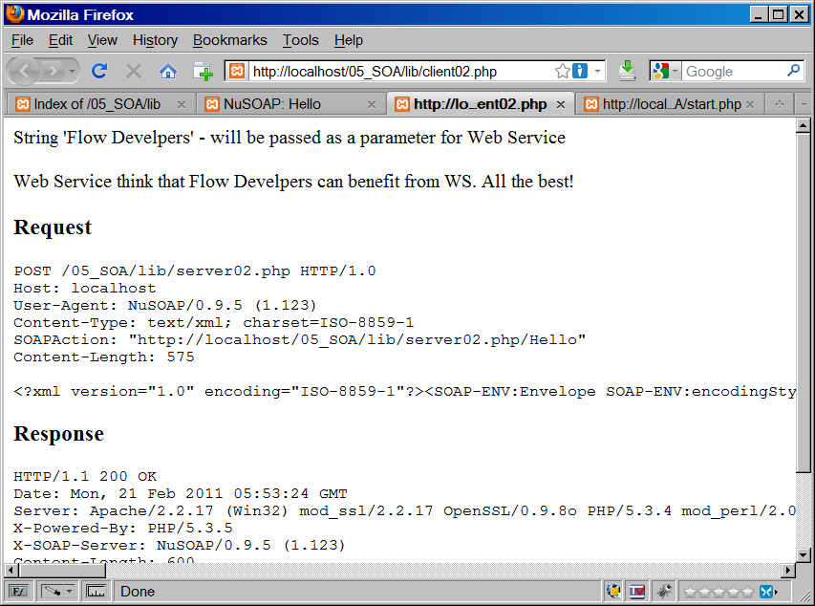

Slide 28
SOAP Building Blocks
A SOAP message is an ordinary XML document containing the following elements:
1. An Envelope element that identifies the XML document as a SOAP message
2. A Header element that contains header information
3. A Body element that contains call and response information
4. A Fault element containing errors and status information

Slide 29
Passing Files with Complex Type.

Slide 30
For simple needs such as get info in String or Array forms Web Services are not required.
But still it can be the easiest way to communicate if developers can't interact directly and some changes in service is required. WS introduce available method in very clear – standard format.
For message oriented services sending XML could be enough.
But for sending more complex data which requires object serialisation it can not be sufficient.
In this presentation I will cover only message oriented services and we will see the similarity.

Slide 31
In other words, Web service is a program that executes when a request is made of it, and it produces some kind of result that is returned to the caller. Significant difference between web services and web pages is that to retrieve information from web pages, a caller needs to know only UML and for using web services a caller also needs to know required method signature.
The system which send request should be able to recognise the method signature and create appropriate request in the perfect case request will contain required parameters. You will see the generated request in the Testing system introduced today.
When request generated from a script the developer can use a package to create formatted request according to specification and pass only the method name and parameters.

Slide 32
The main approaches in AOP
AOP in PHP.
http://www.mfaop.com – looks like promising implementation for PHP
For this presentation light library was used.
Source: http://dsheiko.com/
The main steps are:
1. create a new aspect
2. Then we set up a Pointcut
3. Specify the program code - advices
4. Call Aspect::apply($aspect)
AOP. Sergey Gagarin

Slide 33
Resources.
http://www.geonames.org/export/ws-overview.html
http://www.w3schools.com/soap/soap_syntax.asp
http://en.wikipedia.org/wiki/Web_service
AOP. Sergey Gagarin

Slide 34
Any questions ?
AOP. Sergey Gagarin
Notes:
No

