Slide 1


DESIGN, IMPLEMENTATION, AND EVALUATION OF NAPALI: A NOVEL
DISTRIBUTED SENSOR NETWORK FOR IMPROVED POWER QUALITY
MONITORING.
Sergey Negrashov
March 10, 2020,
Dr

Slide 2


Outline
- Event Detection
- Napali
- Power Quality
- OPQ Network
- Evaluation
- Applications
- Future Work

Slide 3

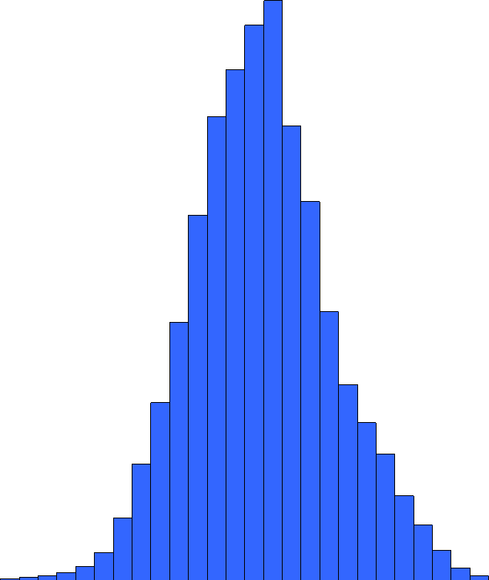
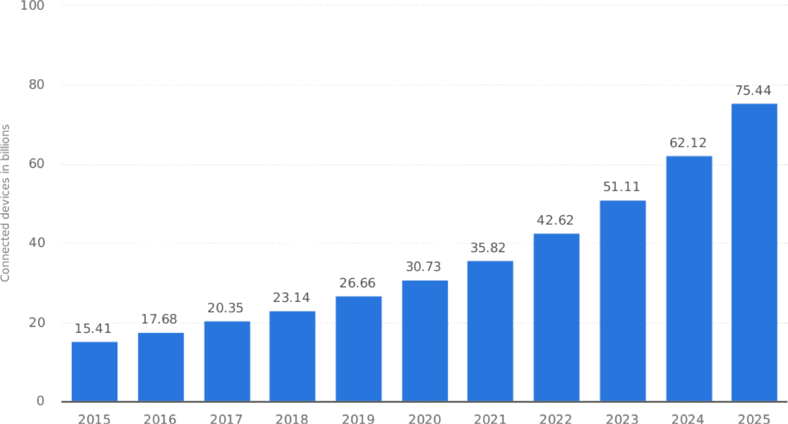




Big Data and IOT
Forbes 2018

Slide 4



Event Detection
Detection
Classification
Animal
Bunny
Fancy
Bunny

Slide 5

Traditional Methods
Metric Extraction
Threshold
Event Storage

Slide 6
Distributed Event Detection
Naive Detection
Send Everything
Self-Triggering
Detect Locally
?
?
?

Slide 7




Issues Current Methods
Naive Detection
- Bandwidth
- Memory
Self-Triggered
- Detection Efficiency
1010001010100110101001
1010001010100110101001
!

Slide 8

Napali
- Sensor forward metrics to the sink
- Sensor stores raw data locally
- Sink builds a statistical model of the sensor
- Sink requests data from the sensor
- Requires two way communication
Metrics
Data
Commands

Slide 9



Napali
- Sink maintains a coarse view of the entire system.
- Sink filters out local events.
- Sink determines which devices participate in event detection
Data Plz!
OK!

Slide 10
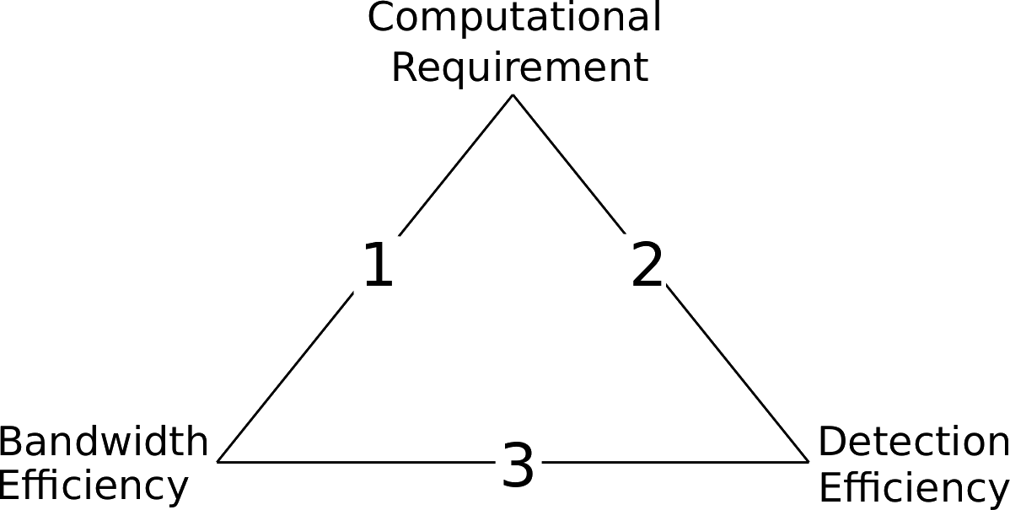
Comparison From Sensors Perspective
Pick Two!
1. Self-Triggered
2. Naive
3. Napali

Slide 11
Comparison From Sink Perspective
Computational Cost:
1. Self-Triggered
2. Naive
3. Napali
3
1
2

Slide 12
Claim
Napali provides a novel architecture that is both a feasible solution to the problem of distributed power quality monitoring and provides significant benefits over the two standard alternative architectures.

Slide 13

Claims of the Thesis
1. Napali minimizes bandwidth
2. Napali mitigates device latency effects
3. Napali minimizes sink processing requirements
4. Sub-threshold data acquisition is a viable event detection strategy
5. Temporal locality triggering results in a low false negative detection

Slide 14
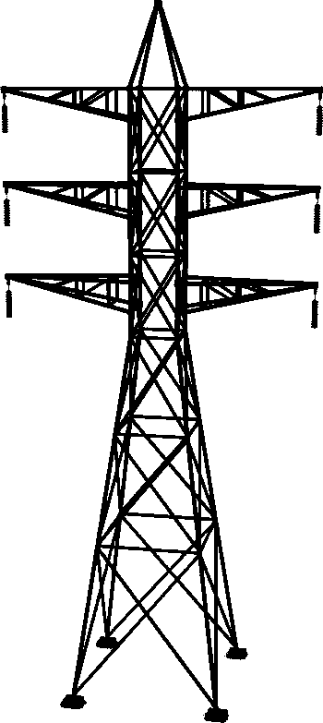


Problem of Power Quality
1. Amplitude
2. Fundamental Frequency
3. Harmonic Distortion
4. Transient

Slide 15
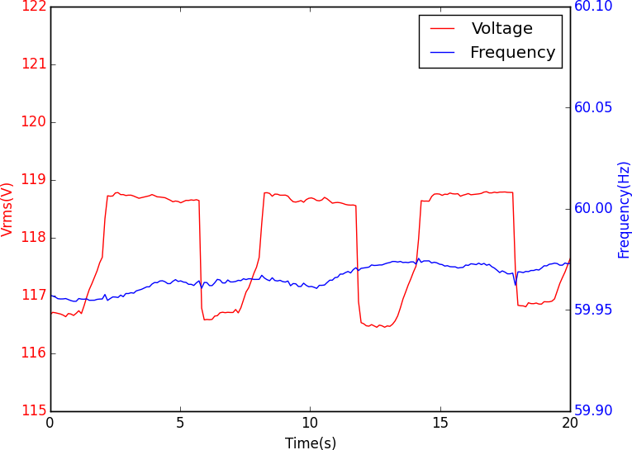
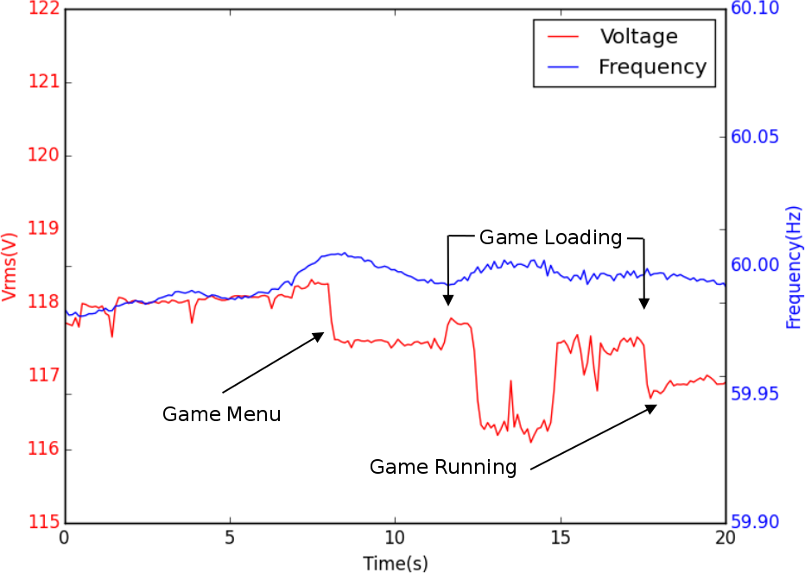
Local Detection Issues
?
?
?

Slide 16


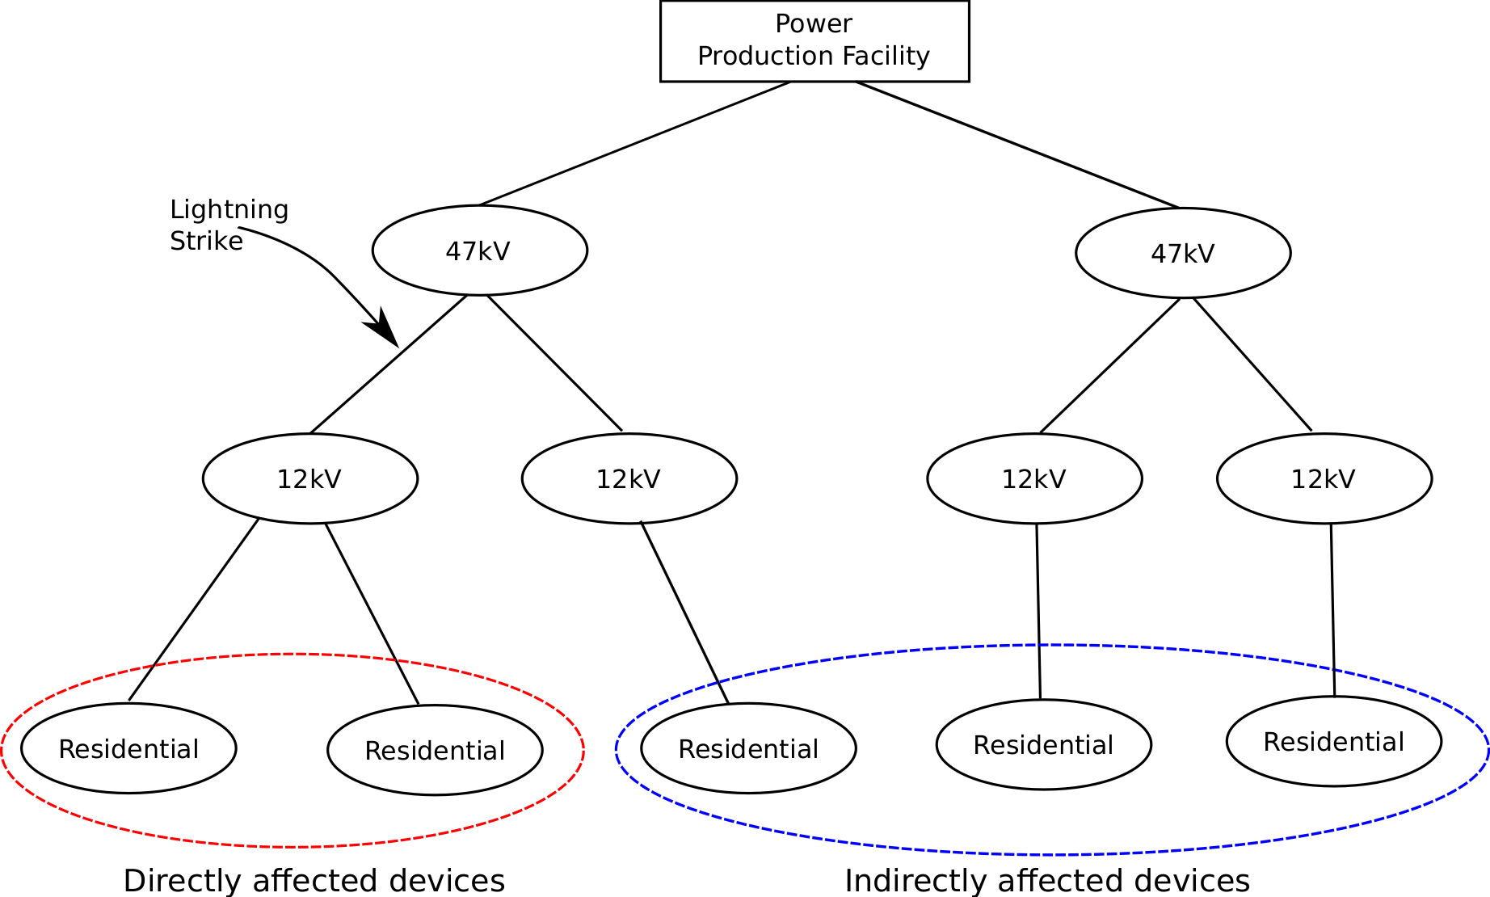


Local Detection Issues
K Kahle. Power converters and power quality.
CERN, 2016

Slide 17
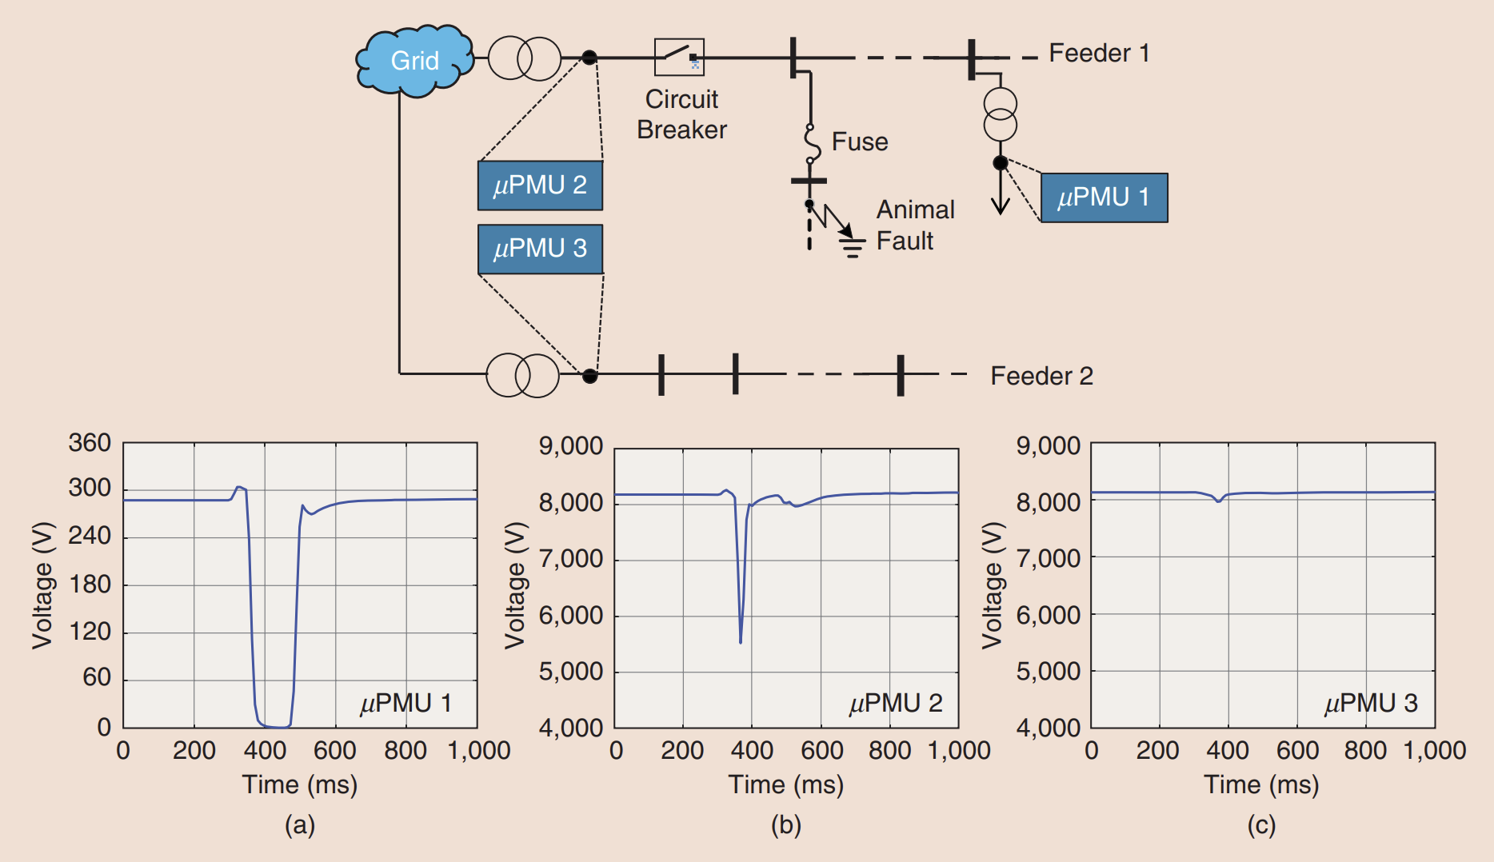

Mohsenian-Rad, Hamed, Emma Stewart, and Ed Cortez.
"Distribution synchrophasors: Pairing big data with analytics to create actionable information."
IEEE Power and Energy Magazine (2018)

Slide 18
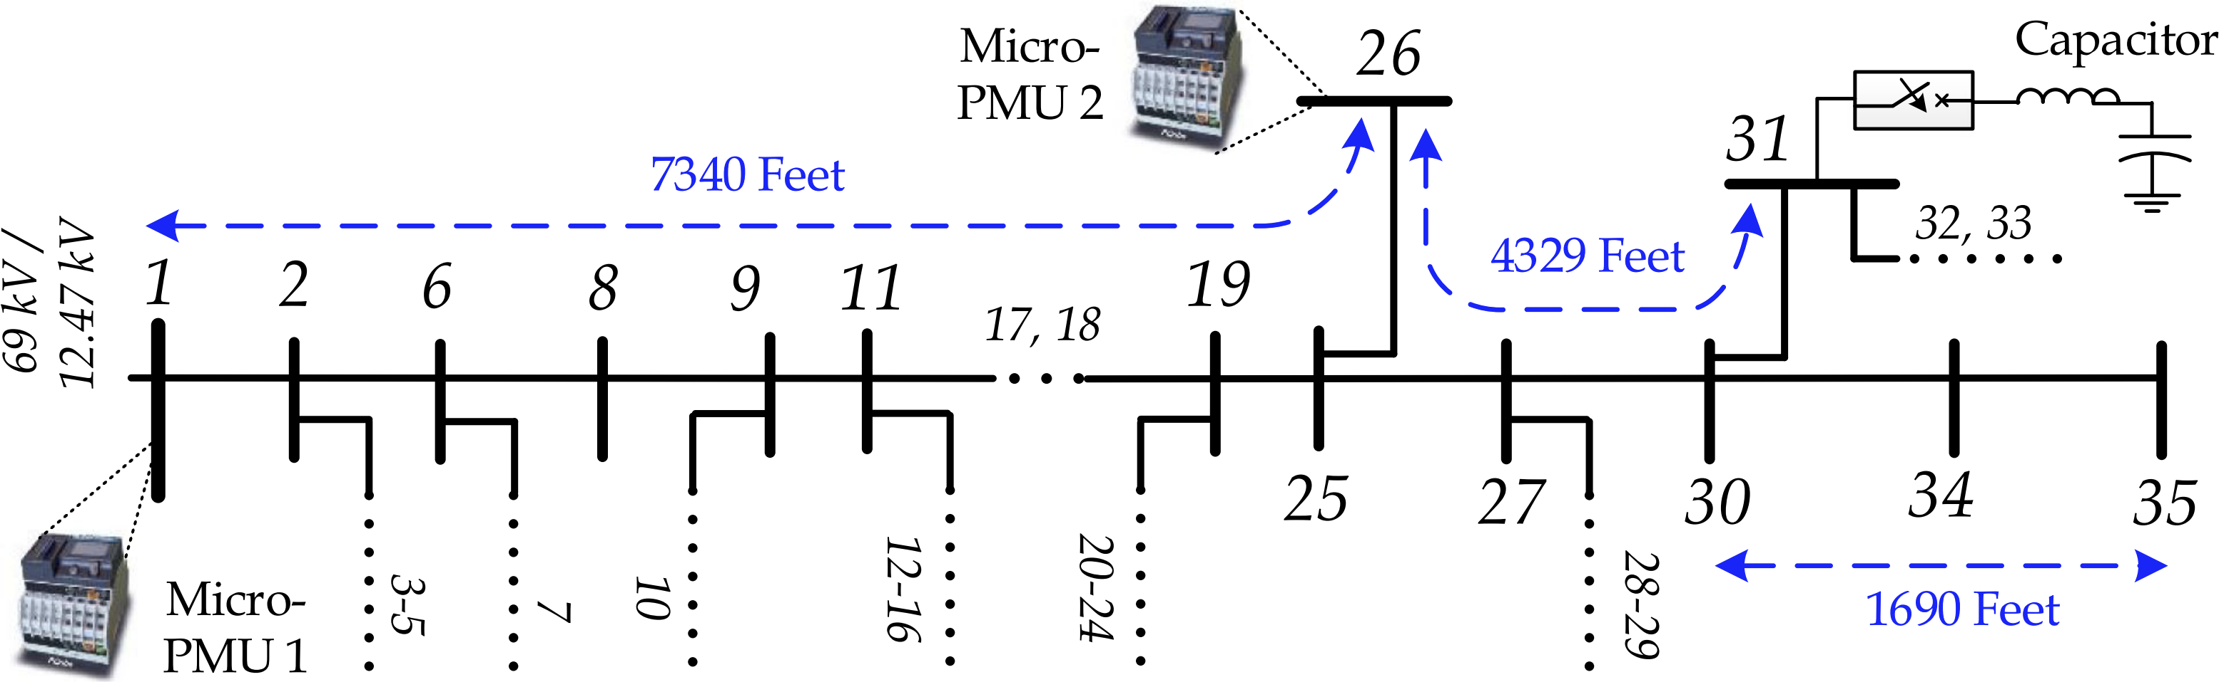
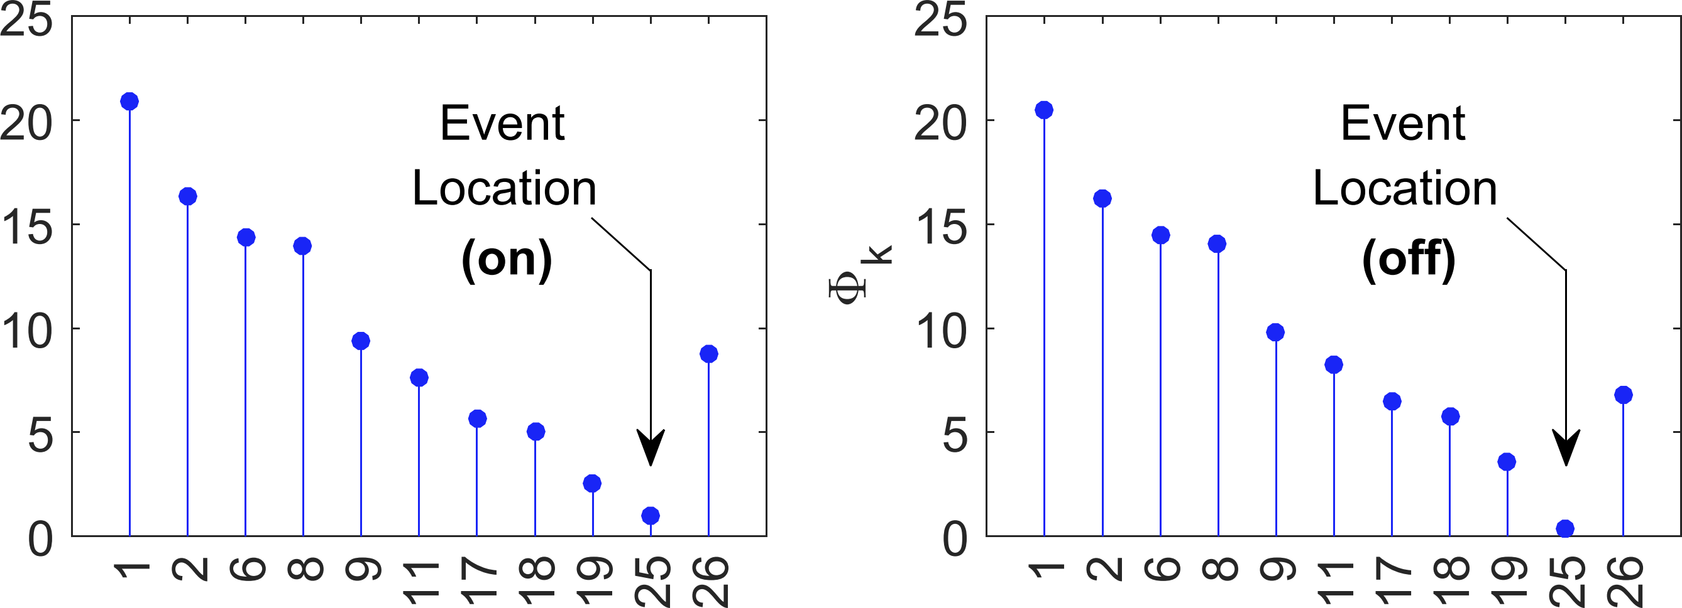
Farajollahi, Mohammad, et al. "Locating the source of events
in power distribution systems using micro-PMU data."
IEEE Transactions on Power Systems (2018)

Slide 19
The main challenge is to go beyond manual methods based on the intuition and heuristics of human experts...
… it is crucial to develop the machine intelligence needed to automate and scale up the analytics on billions of µPMU measurements and terabytes of data on a daily basis and in real time.
Mohsenian-Rad, Hamed, Emma Stewart, and Ed Cortez.
"Distribution synchrophasors: Pairing big data with analytics to create actionable information."
IEEE Power and Energy Magazine 16.3 (2018): 26-34.
I wonder where this is going?

Slide 20
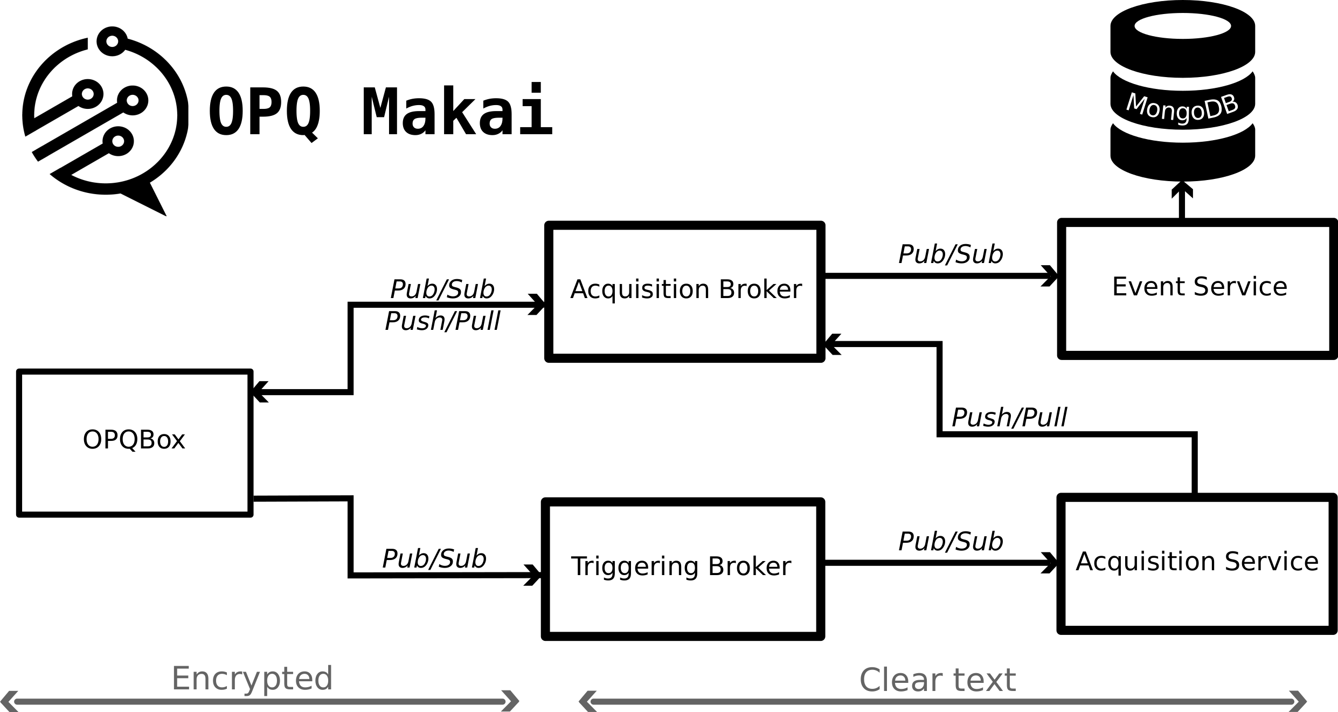
Open Power Quality
Gridwide event detection

Slide 21
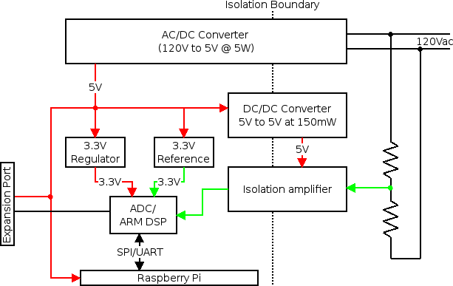
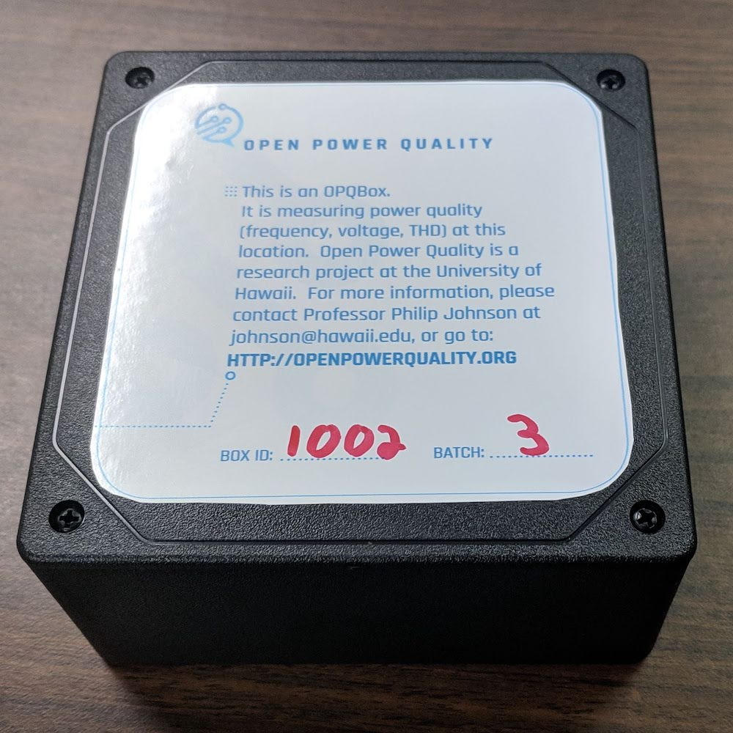

OPQ Box
Hardware

Slide 22

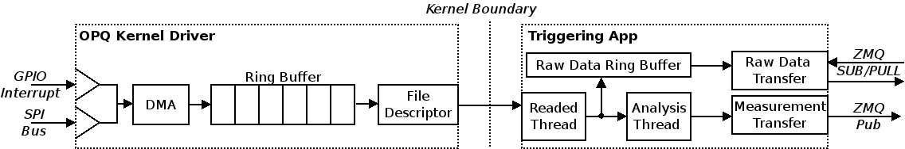
OPQ Box
Software

Slide 23

OPQ Box
Metrics
Metrics:
- V_{rms}
- Fundamental Frequency
- THD
- Transient
Transmission Rate:
- 1s (Mean/Min/Max)
RDRB:
- 1 Hour

Slide 24
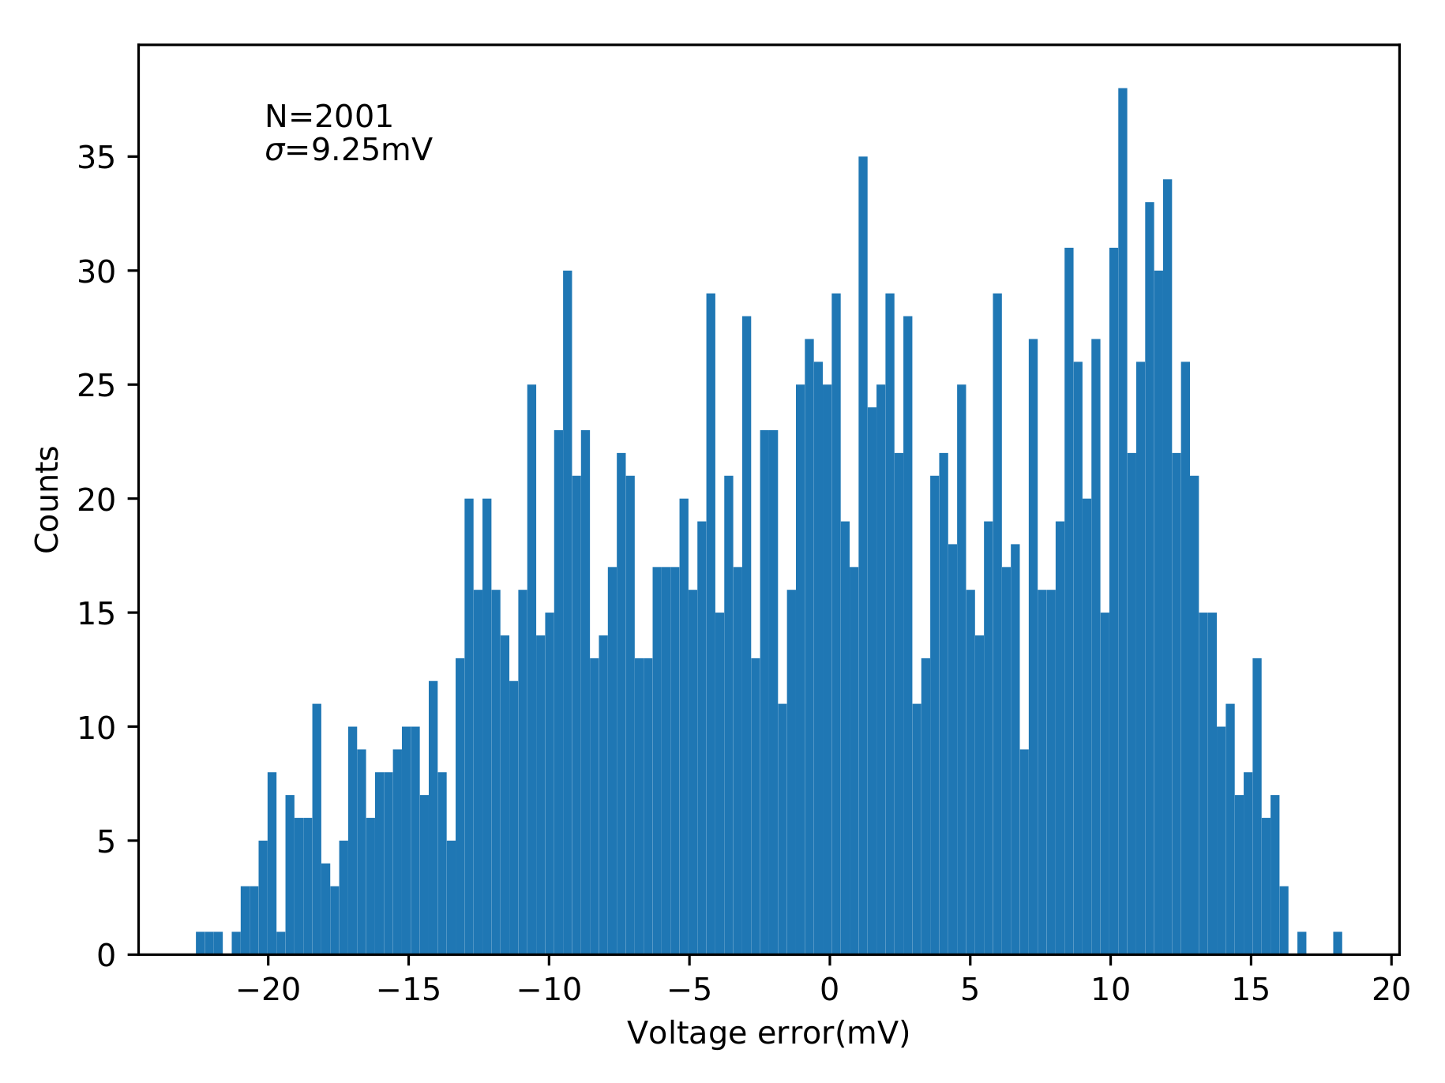
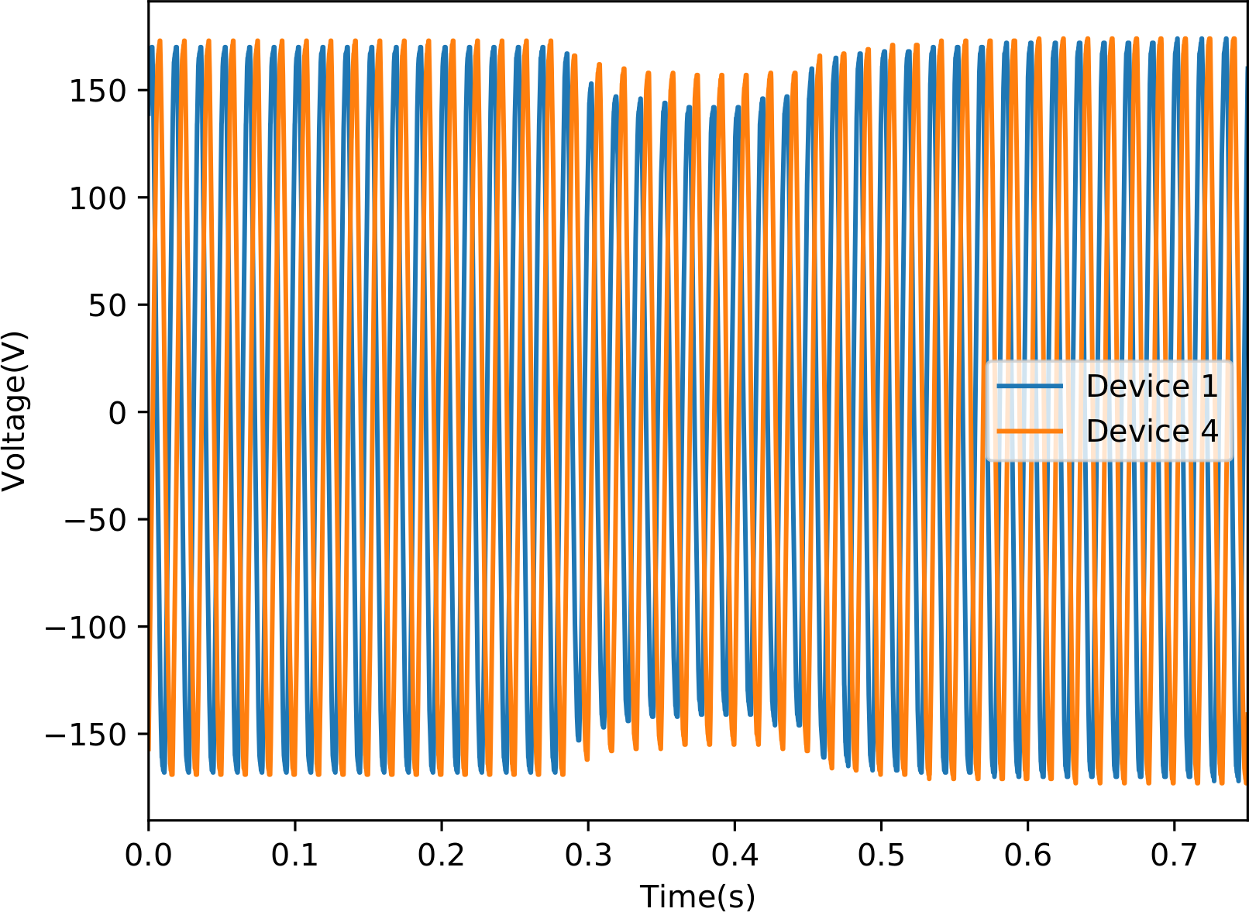
Amplitude(V_{rms})

Slide 25
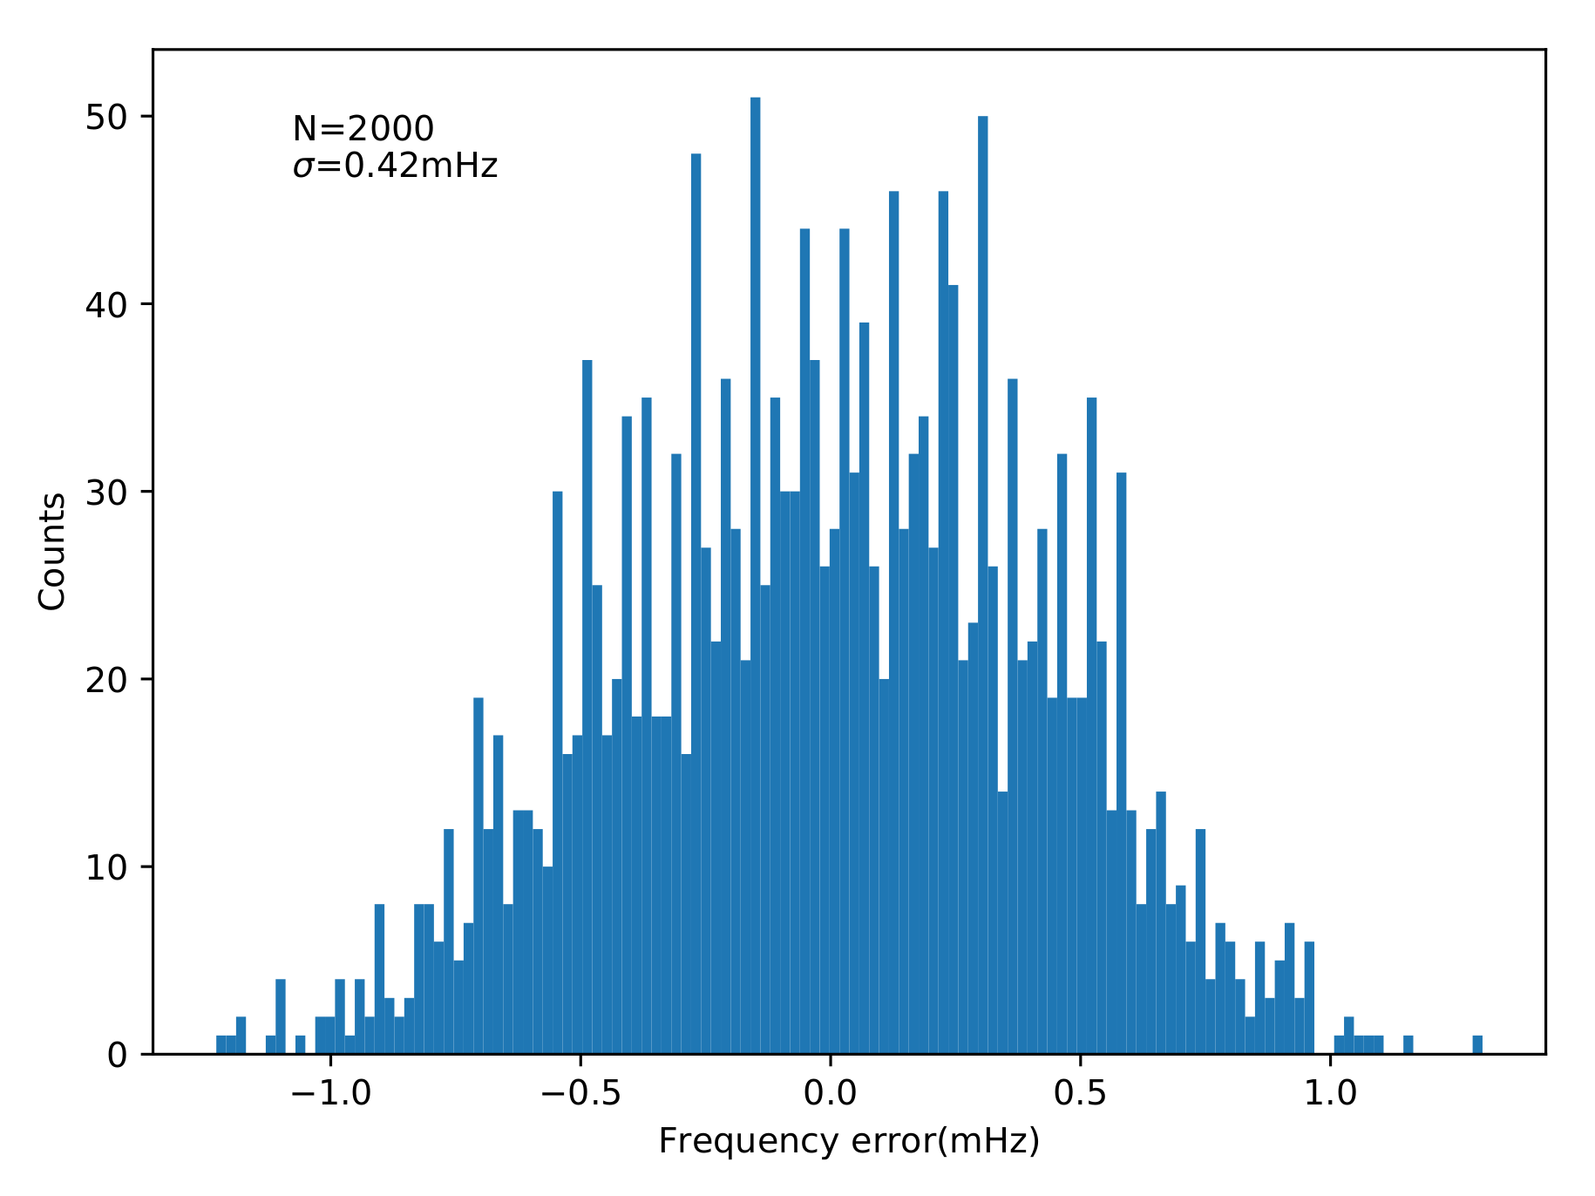
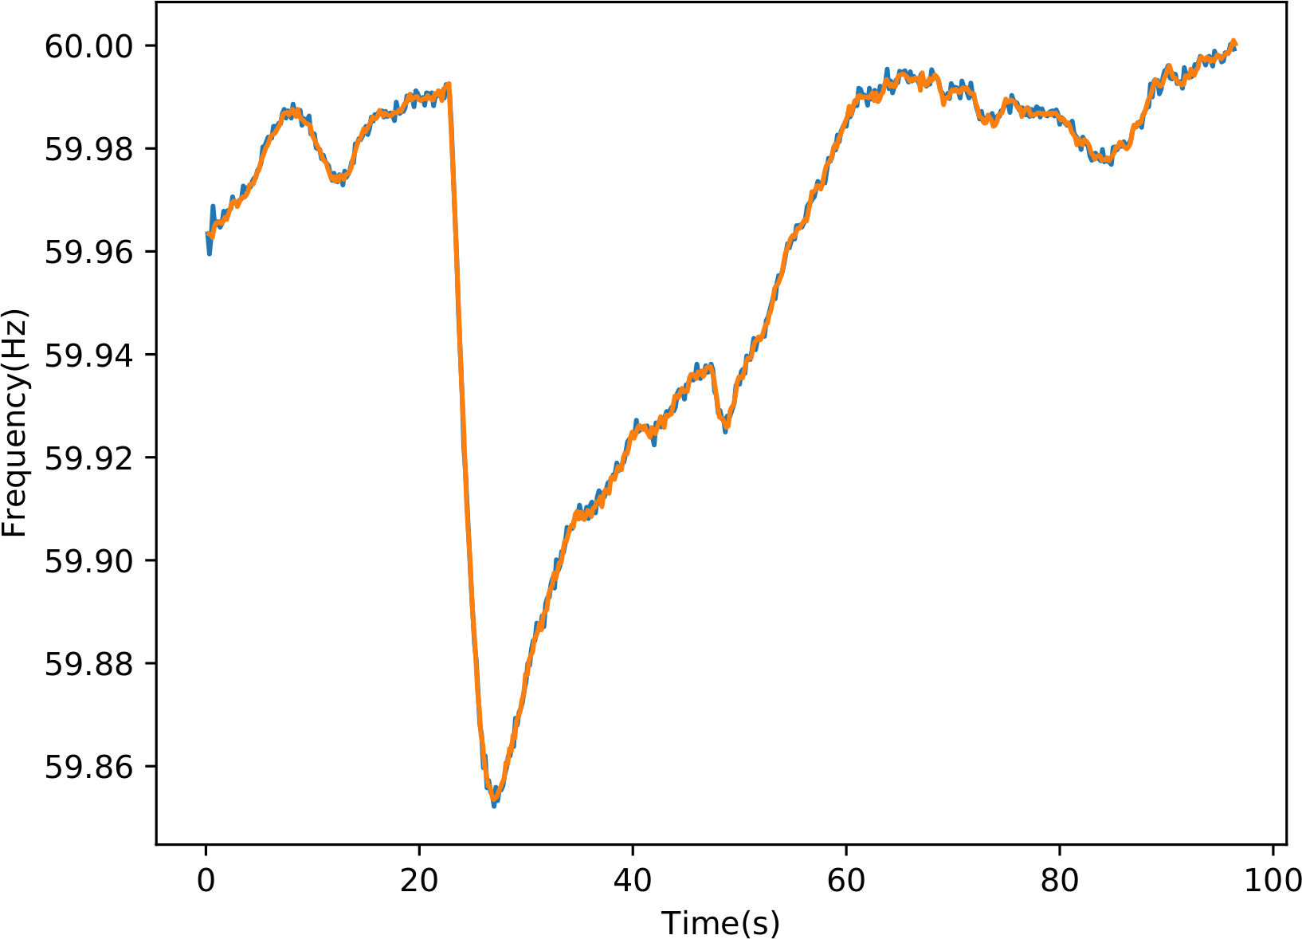
Frequency f_{fundamental}

Slide 26
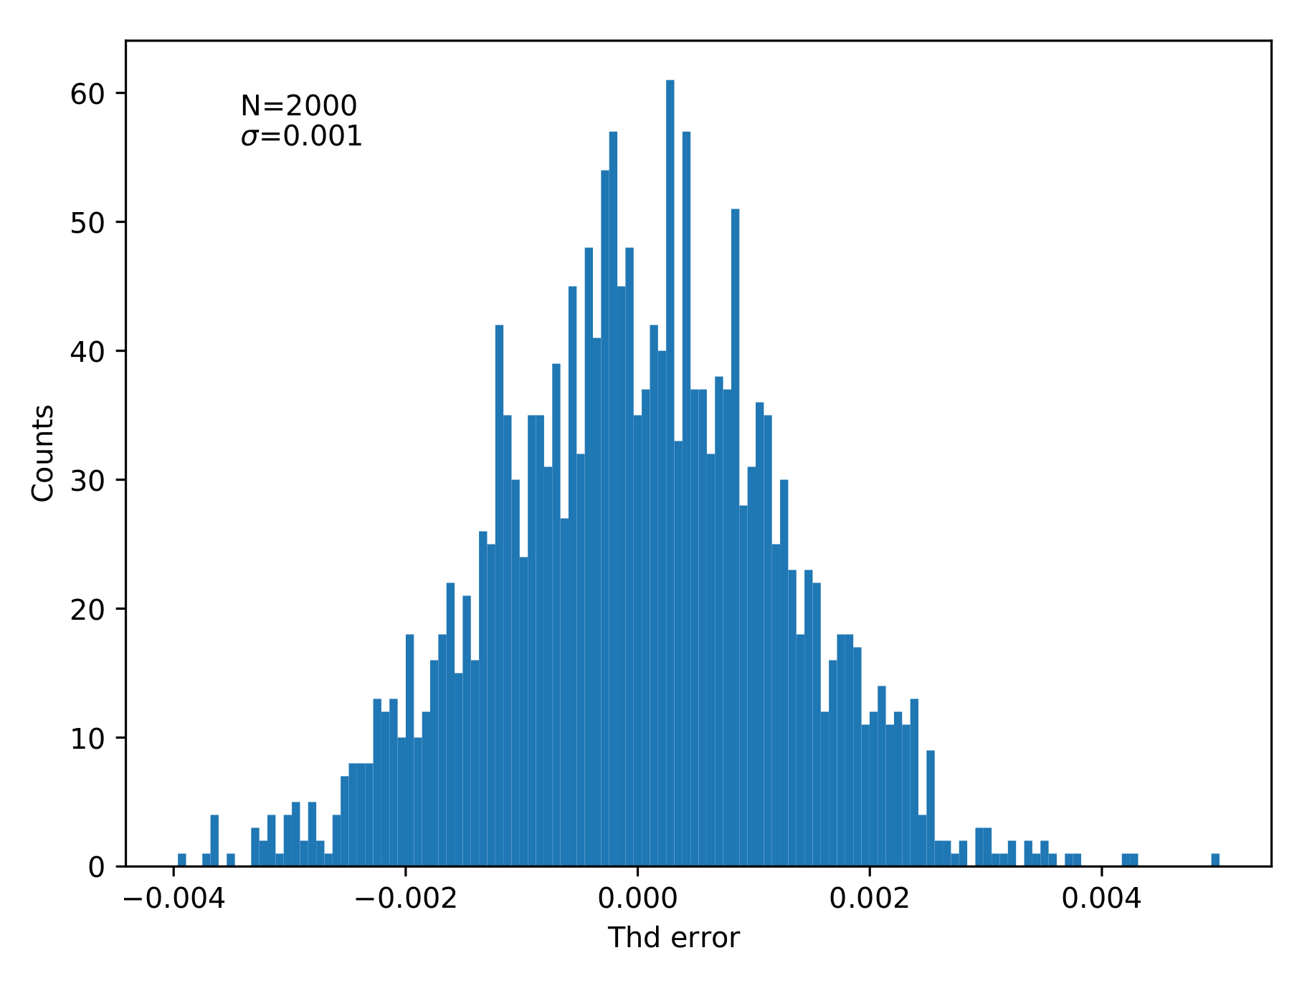
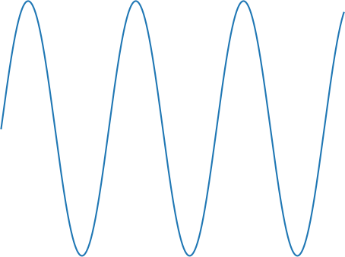
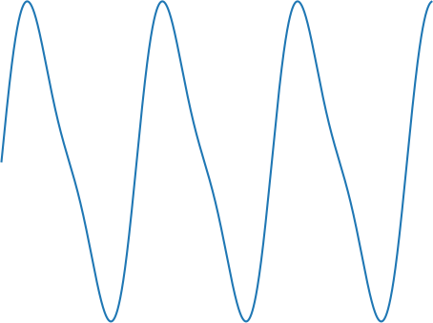
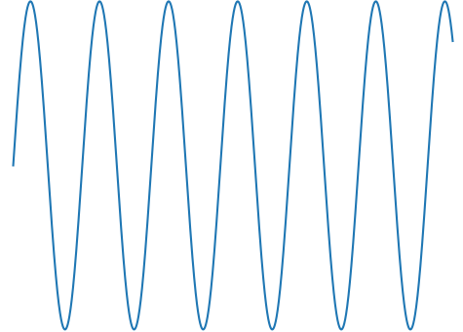

Total Harmonic Distortion
THD
+
=

Slide 27
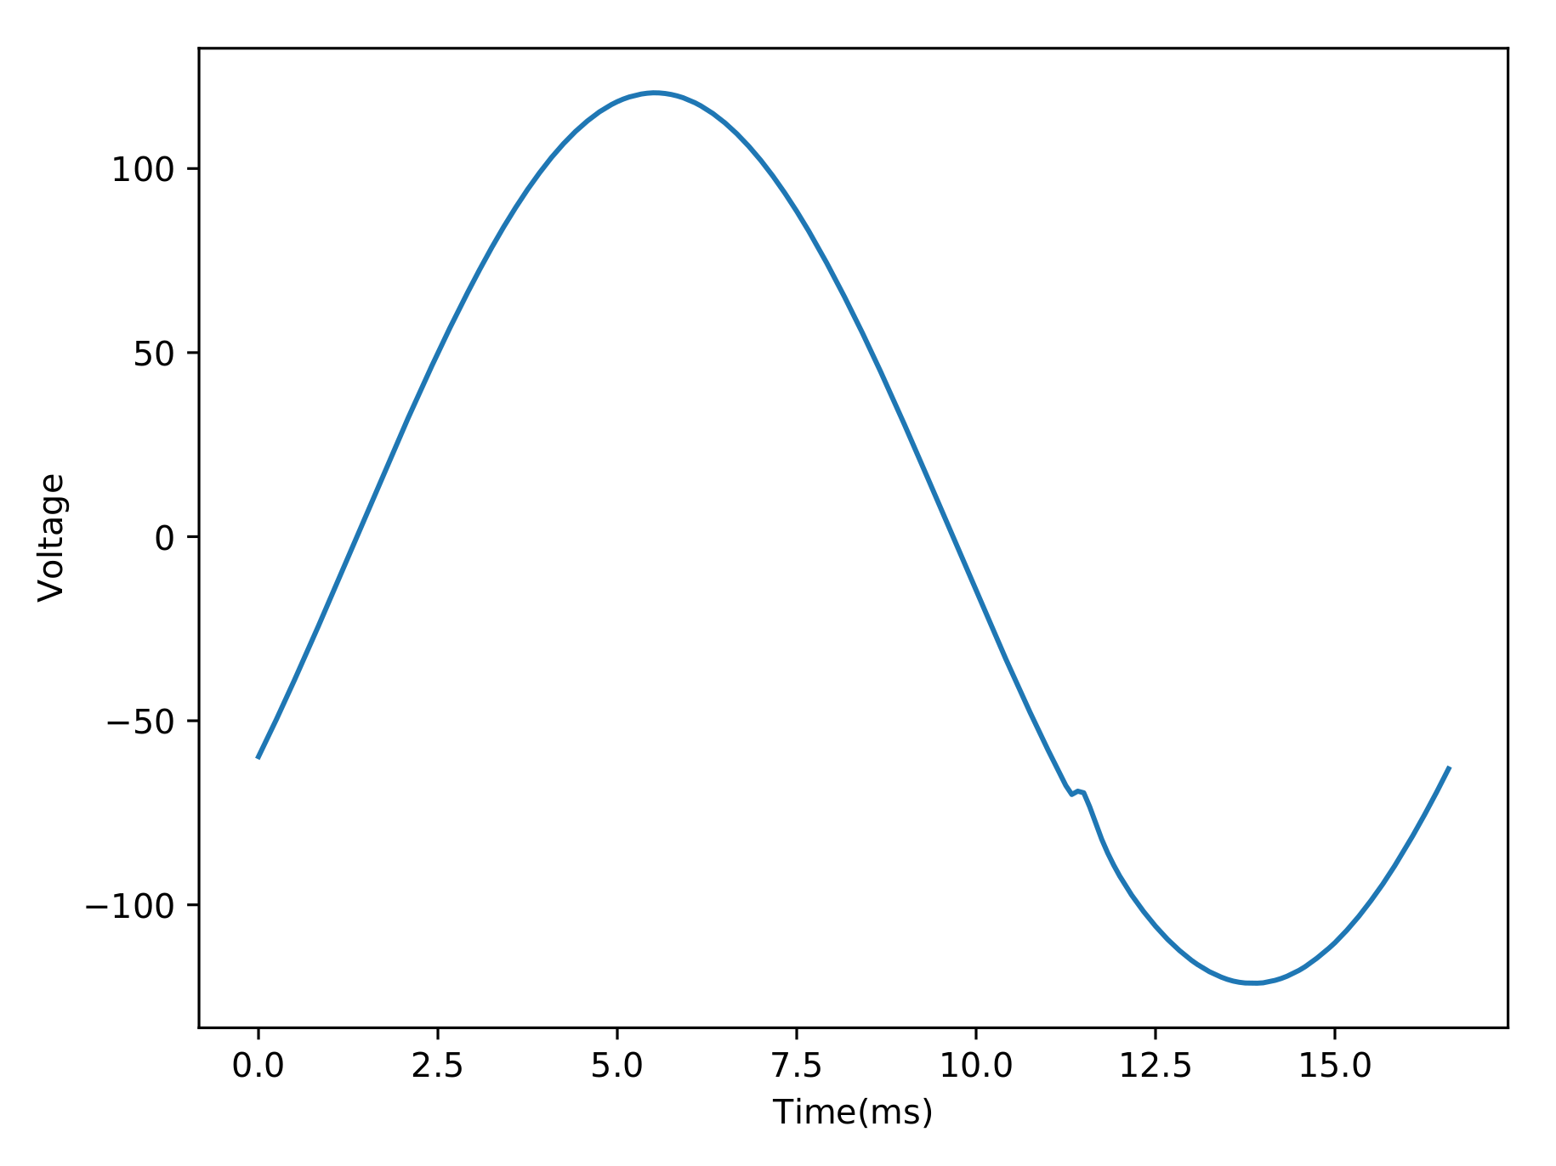
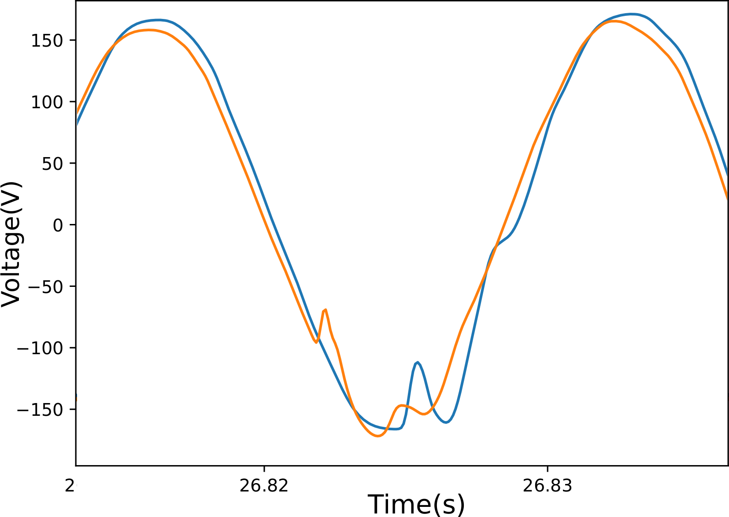
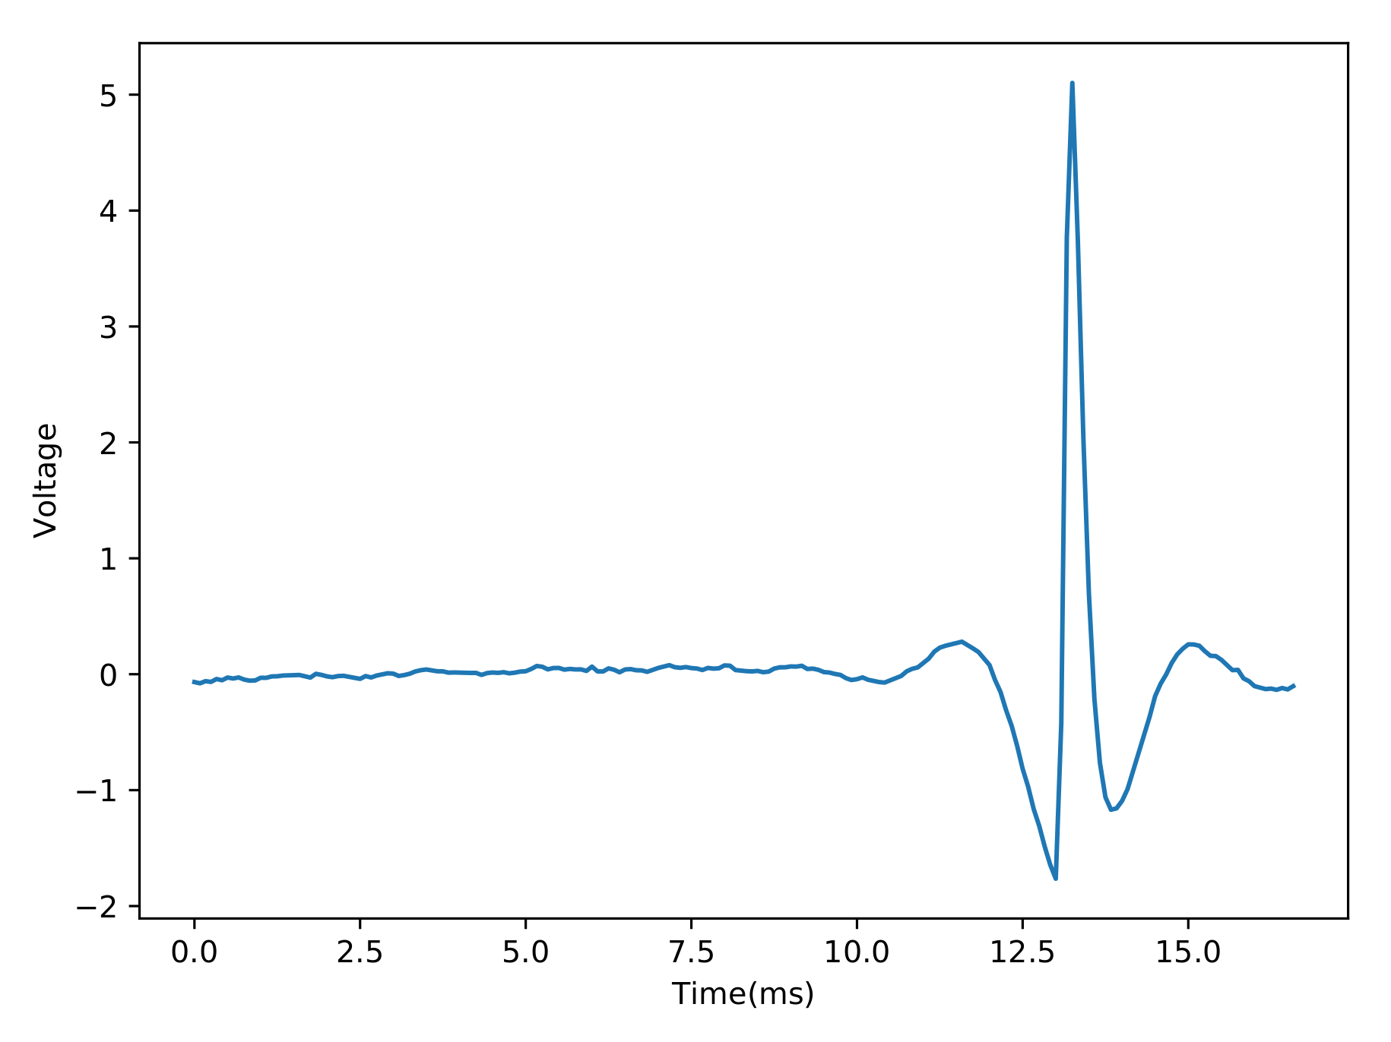
Transients

Slide 28
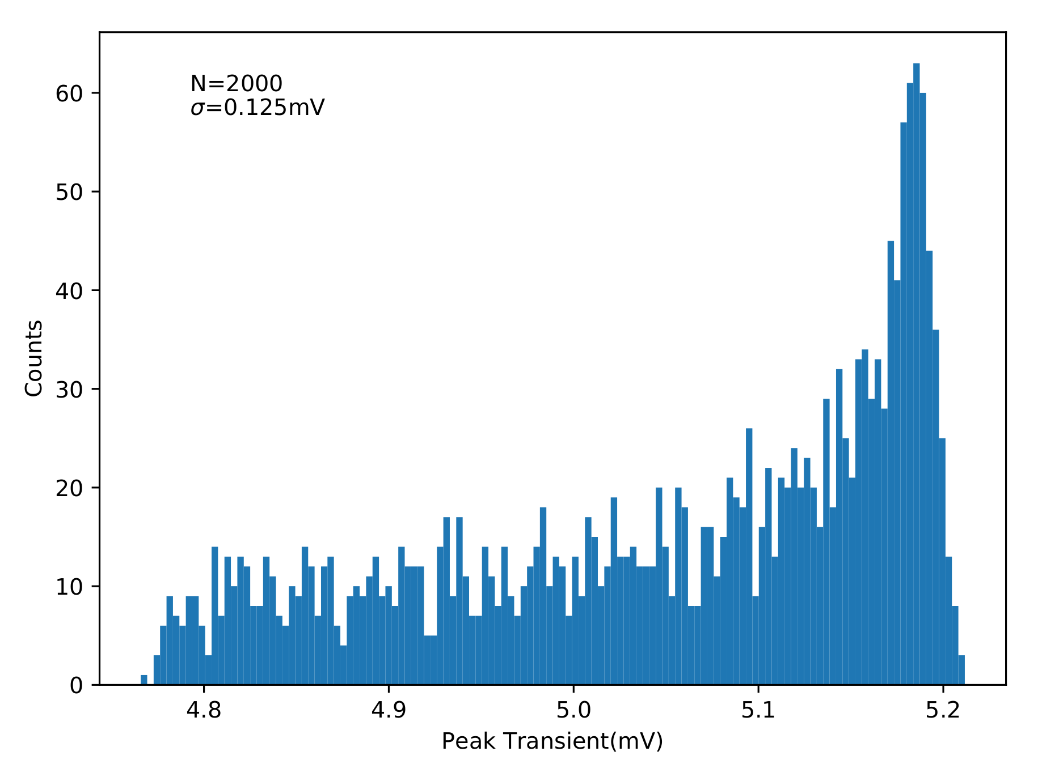
OPQ Box
Evaluation of Transients.
THD

Slide 29
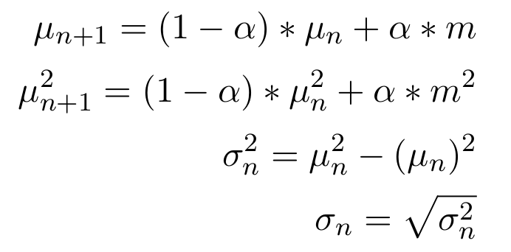
Napali Device Model
Event chronology:
1. Any device passes threshold.
2. Record any device > 3*std.
3. Wait until all devices are below threshold.
4. If device count is > 1 request data from
- Devices which passed threshold.
- Devices with a metric > 3*std.
5. If device count == 1:
- No request is made.
6. Return to monitoring.
For each device:
- mean
- std
Leaky mean:

Slide 30
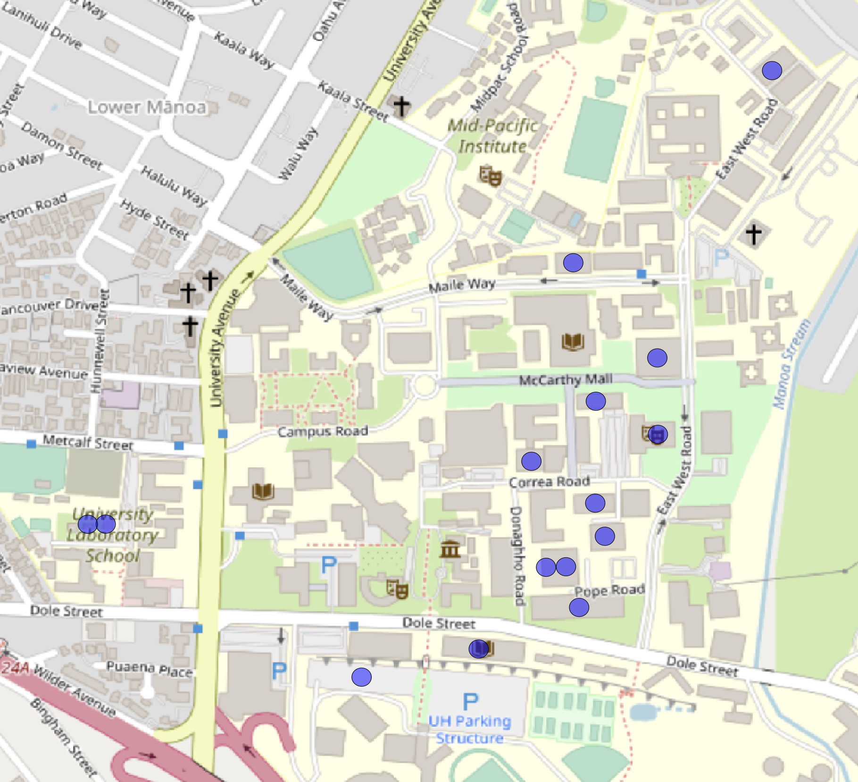
UH Deployment in-situ validation
- 15 Devices.
- 3 months of data.
- Still running.
Anyone want a PQ network?

Slide 31
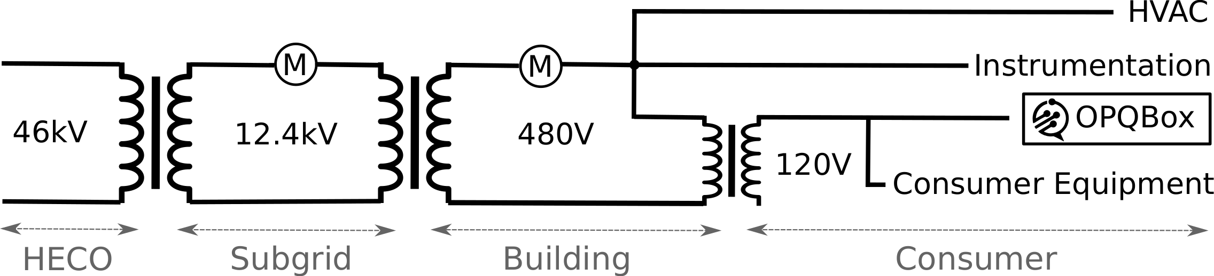
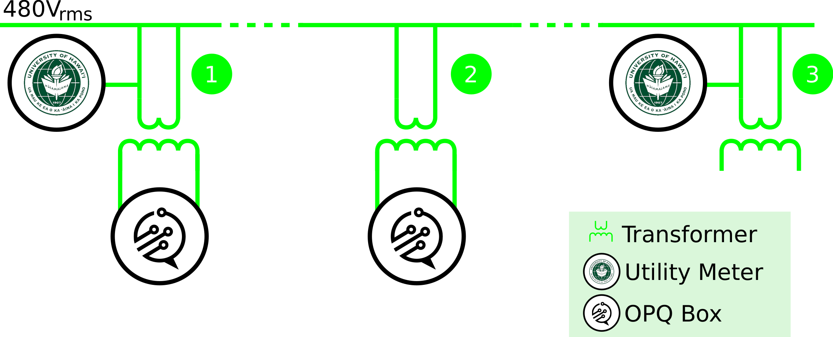
UH Deployment

Slide 32
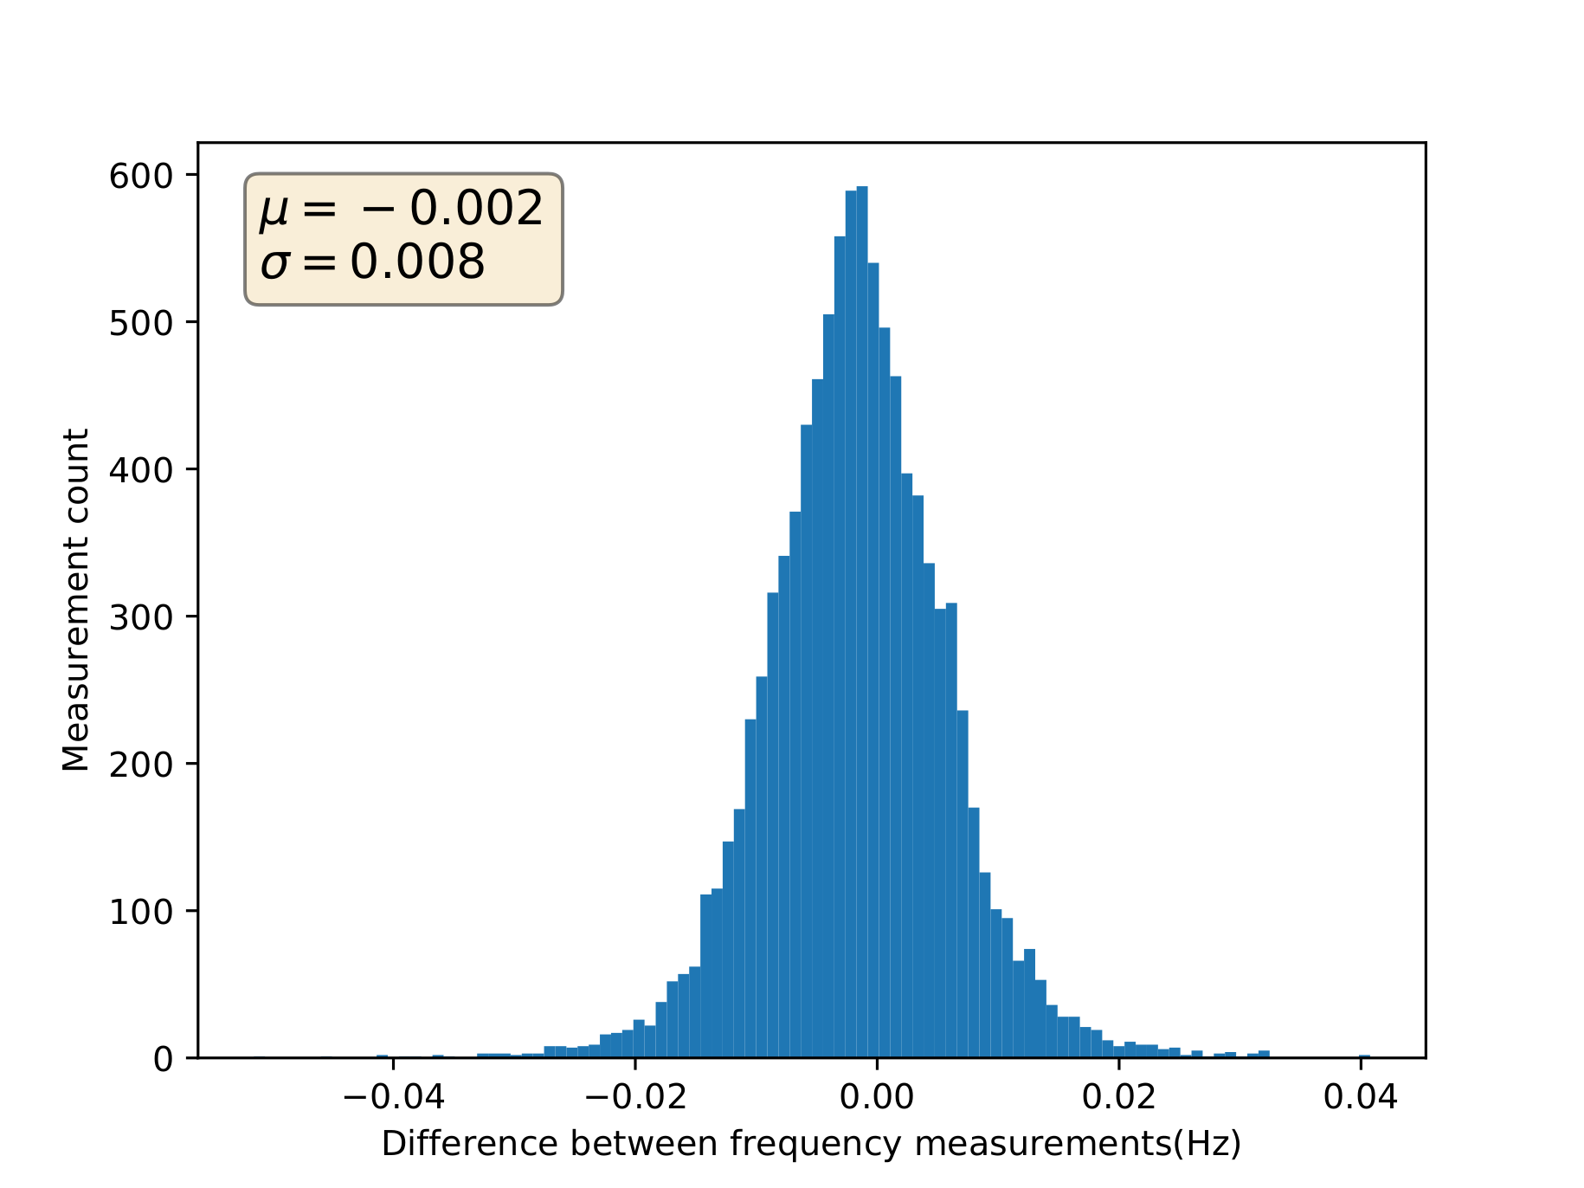
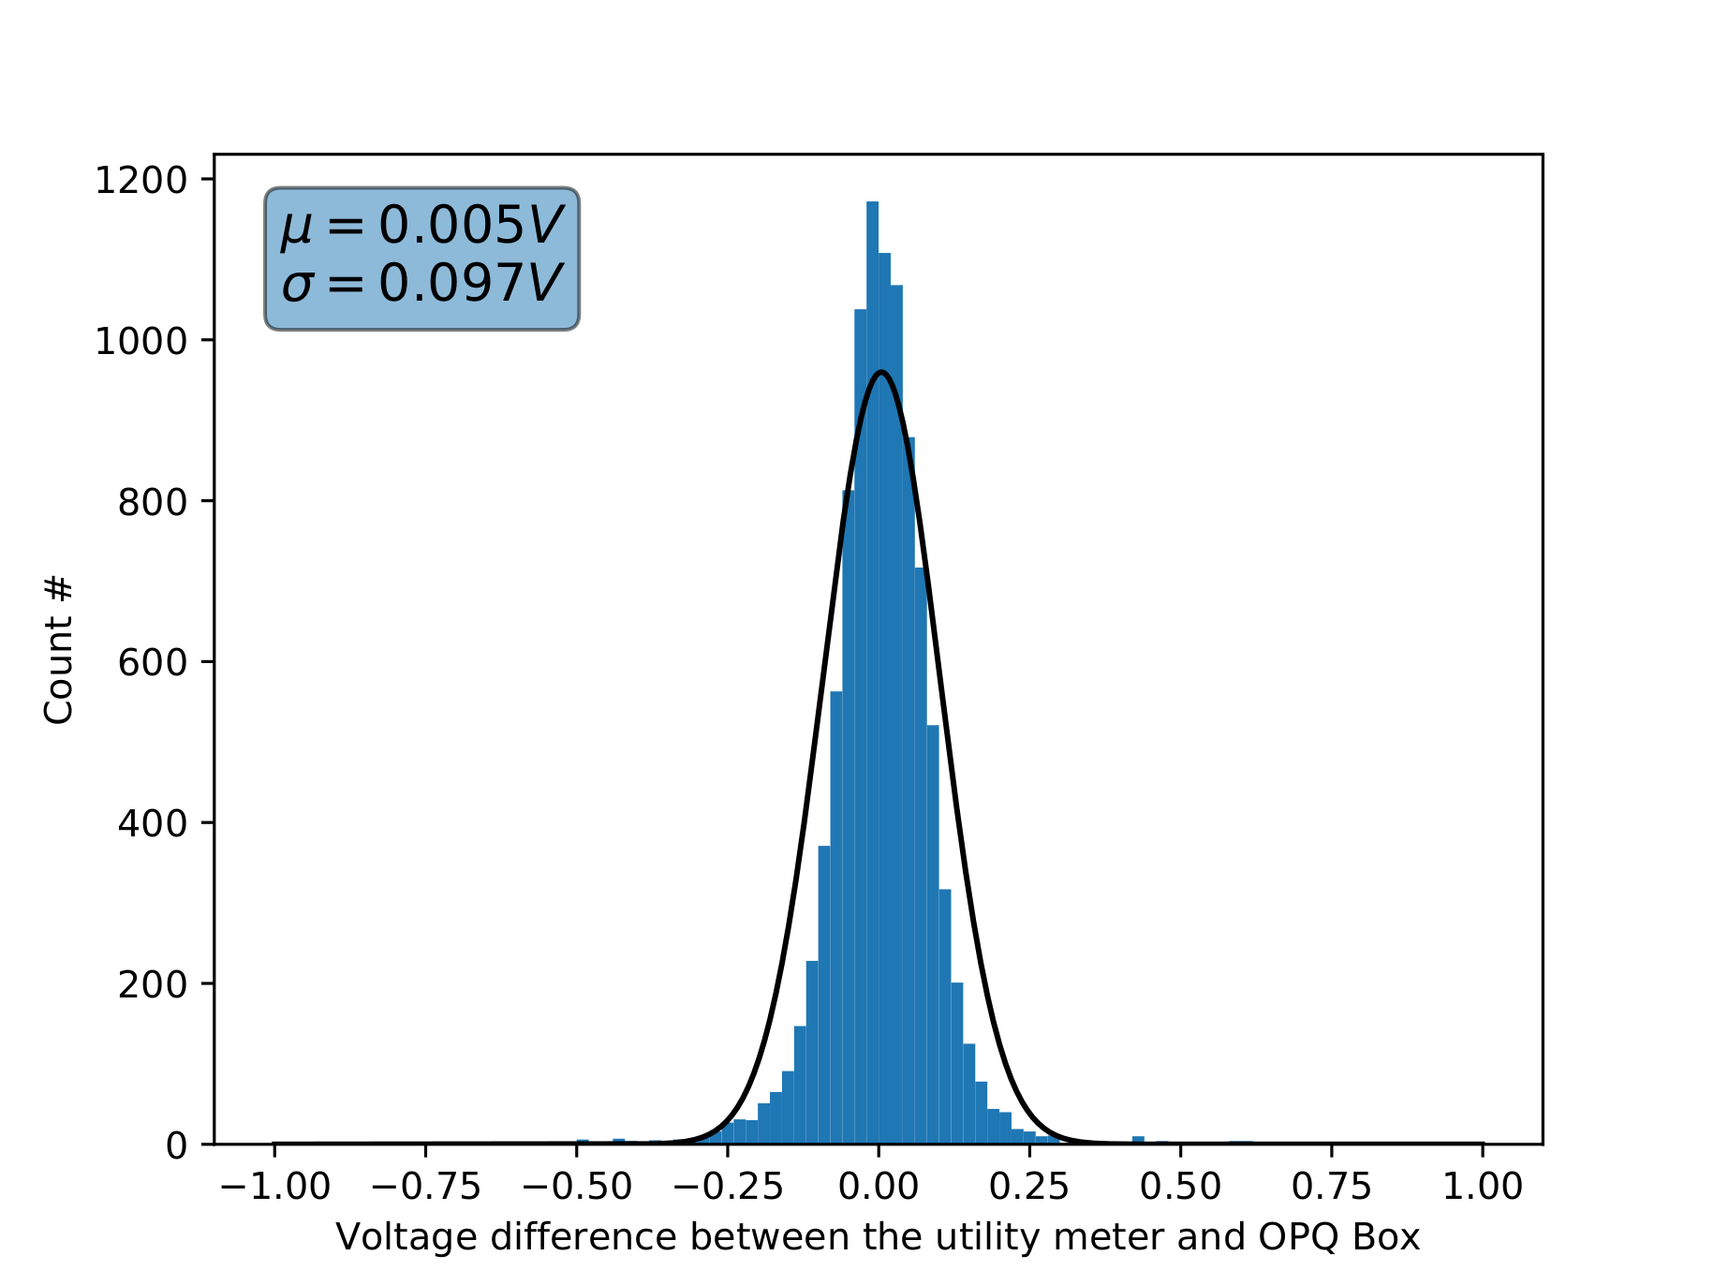
OPQ Boxes
Comparison with UH meters

Slide 33
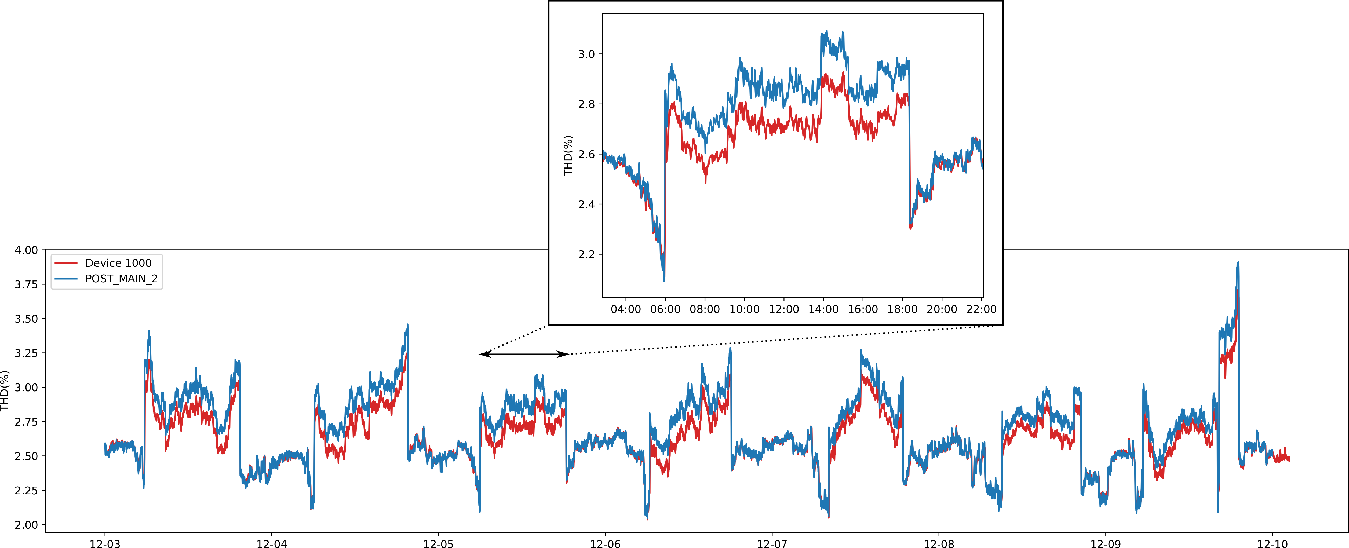
OPQ Boxes
Comparison with UH meters

Slide 34
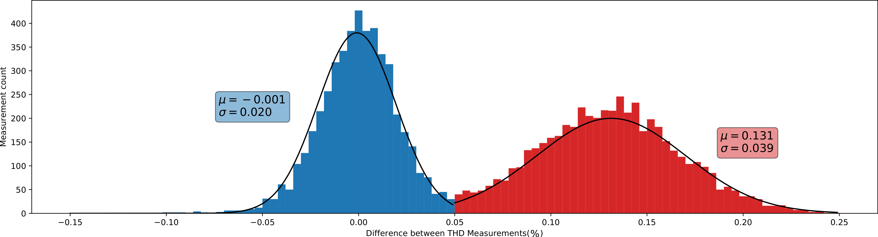
OPQ Boxes
Comparison with UH meters

Slide 35
Napali Validation
1. Napali minimizes bandwidth usage
2. Napali mitigates device latency effects
3. Napali minimizes sink processing requirements
4. Sub-threshold data acquisition is a viable event detection strategy
5. Temporal locality triggering results in a low false negative detection

Slide 36
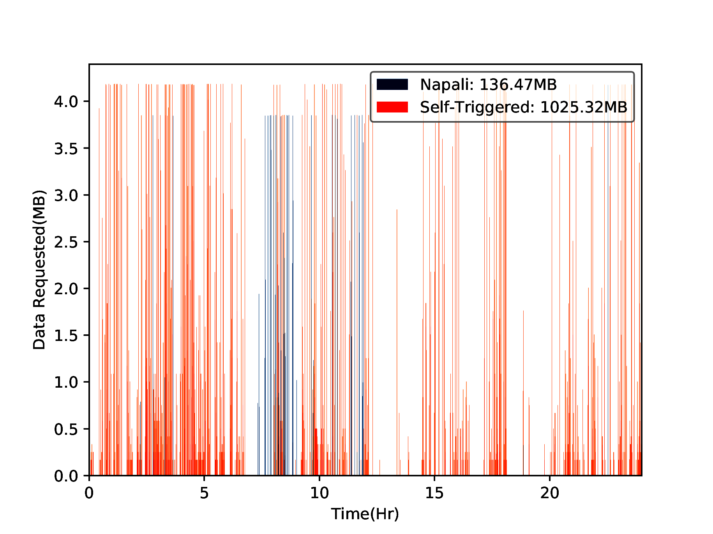
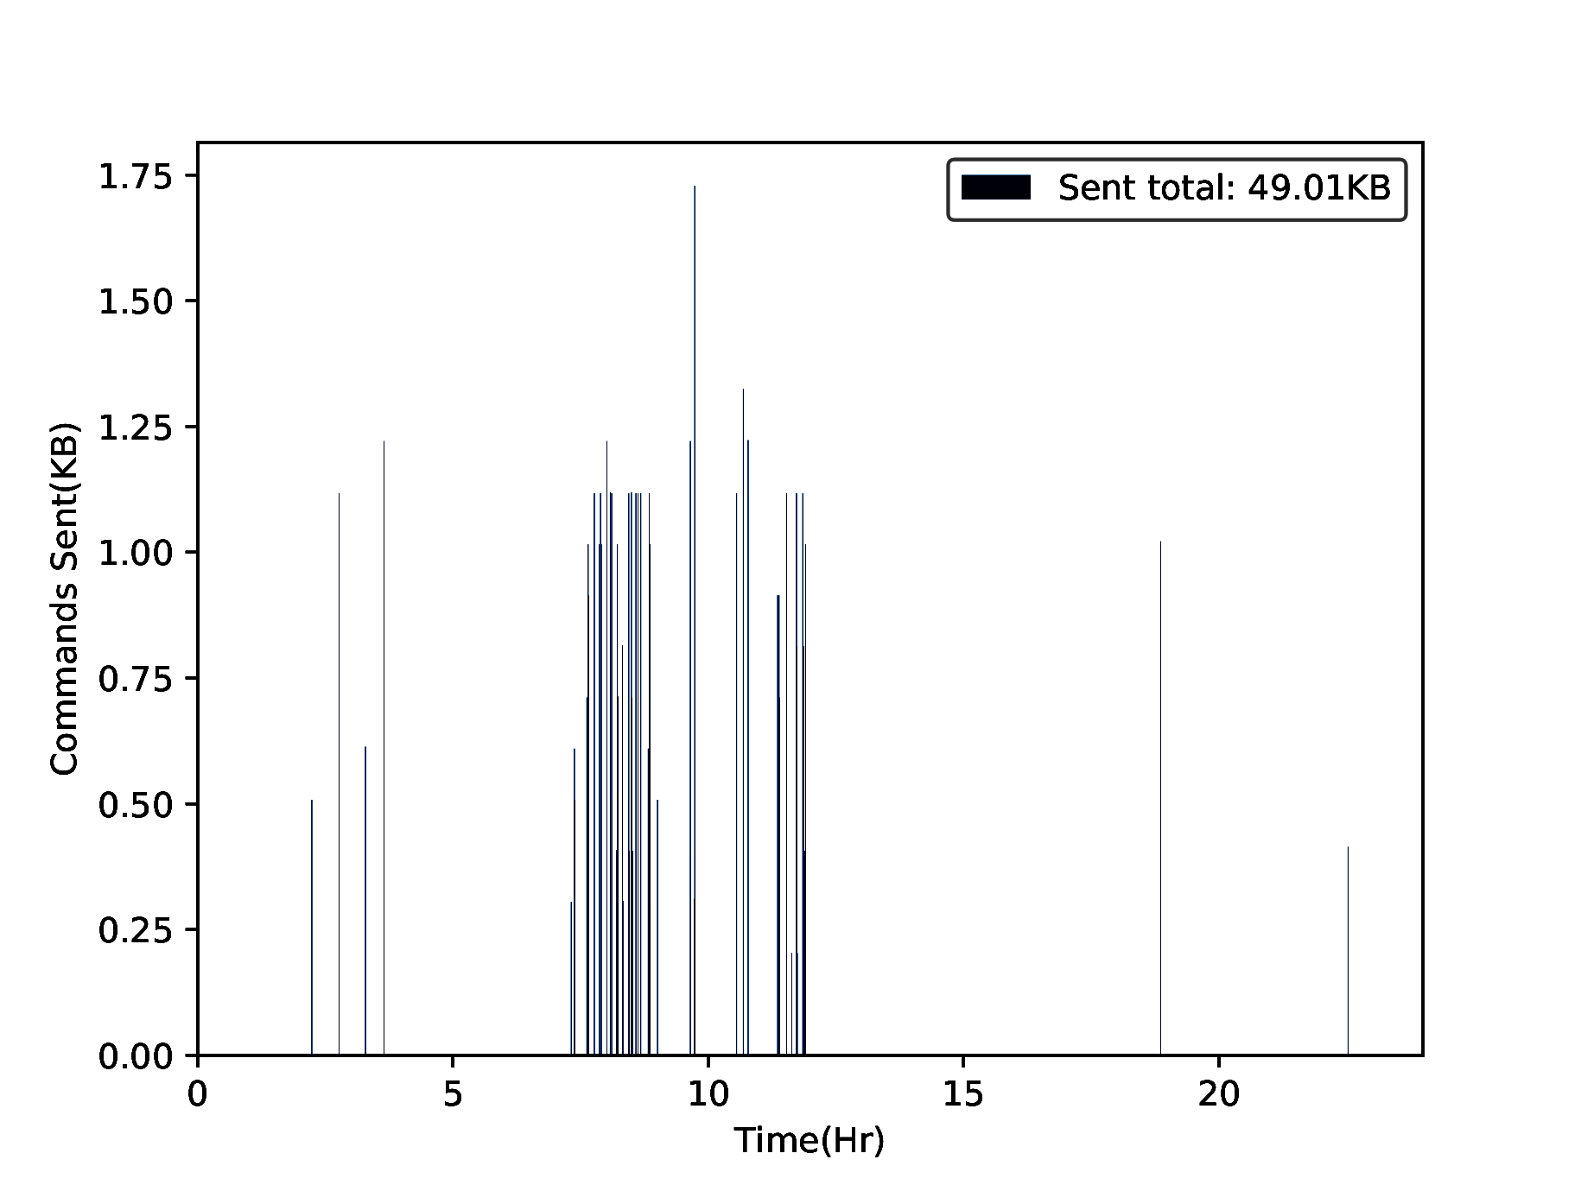
Bandwidth Usage

Slide 37
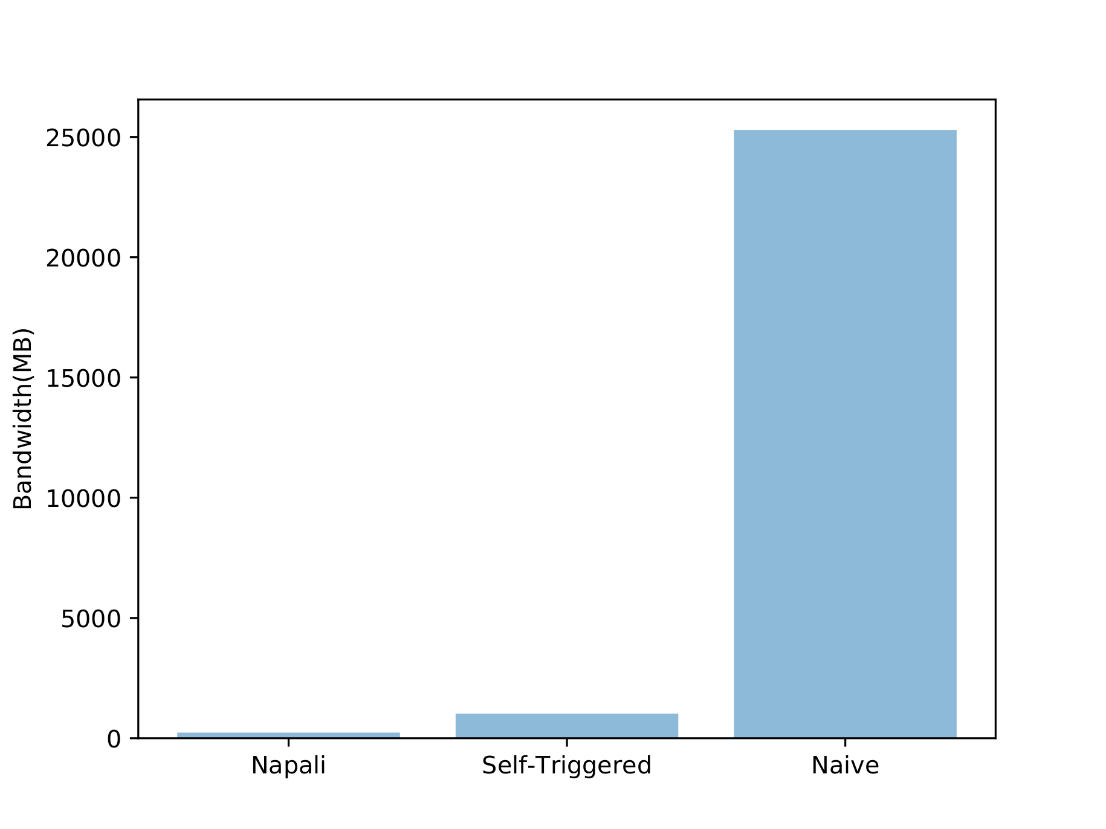
Bandwidth Usage
Exquisite!

Slide 38
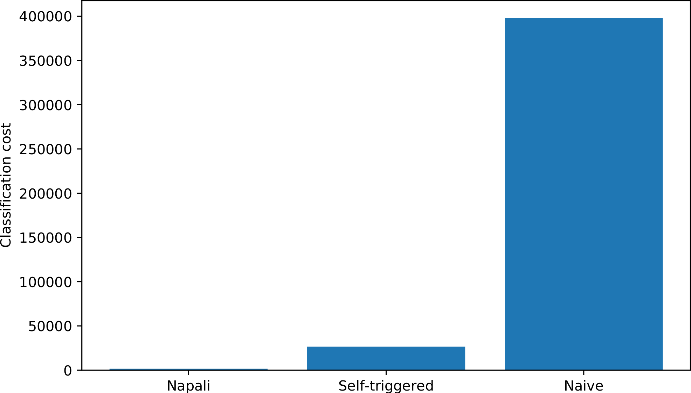
Computational Requirement
Flawless!

Slide 39
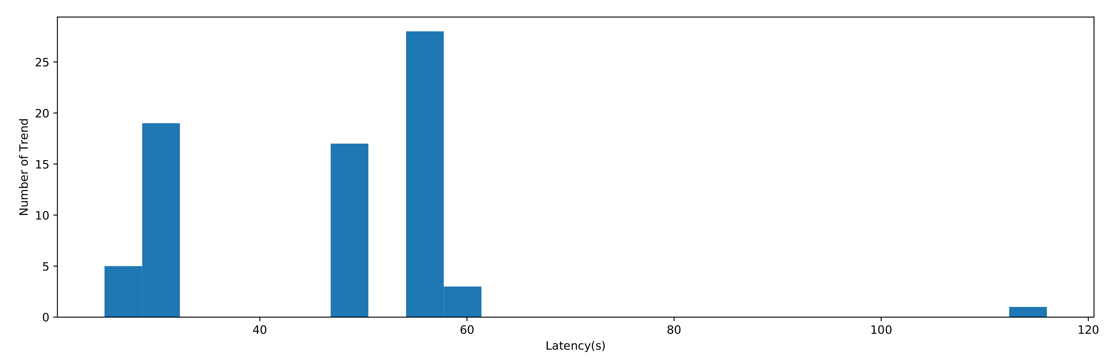
Latency
Late metrics over 24 hours

Slide 40
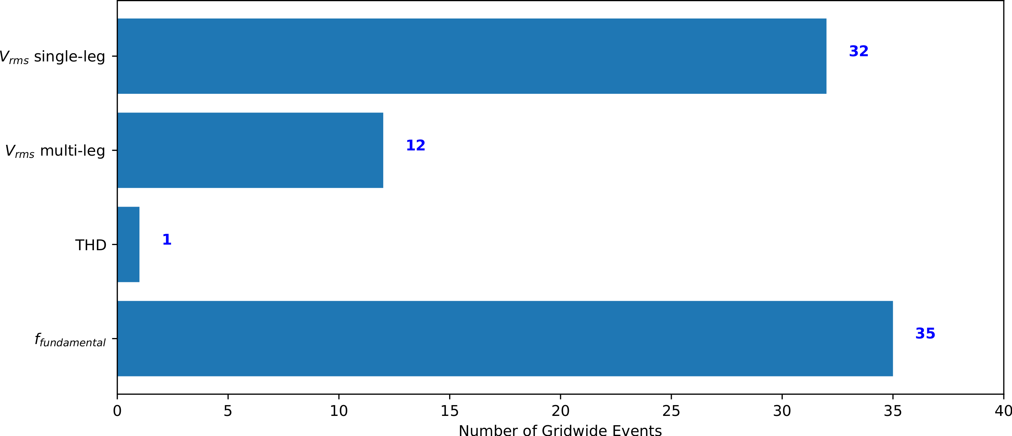
Temporal locality triggering

Slide 41
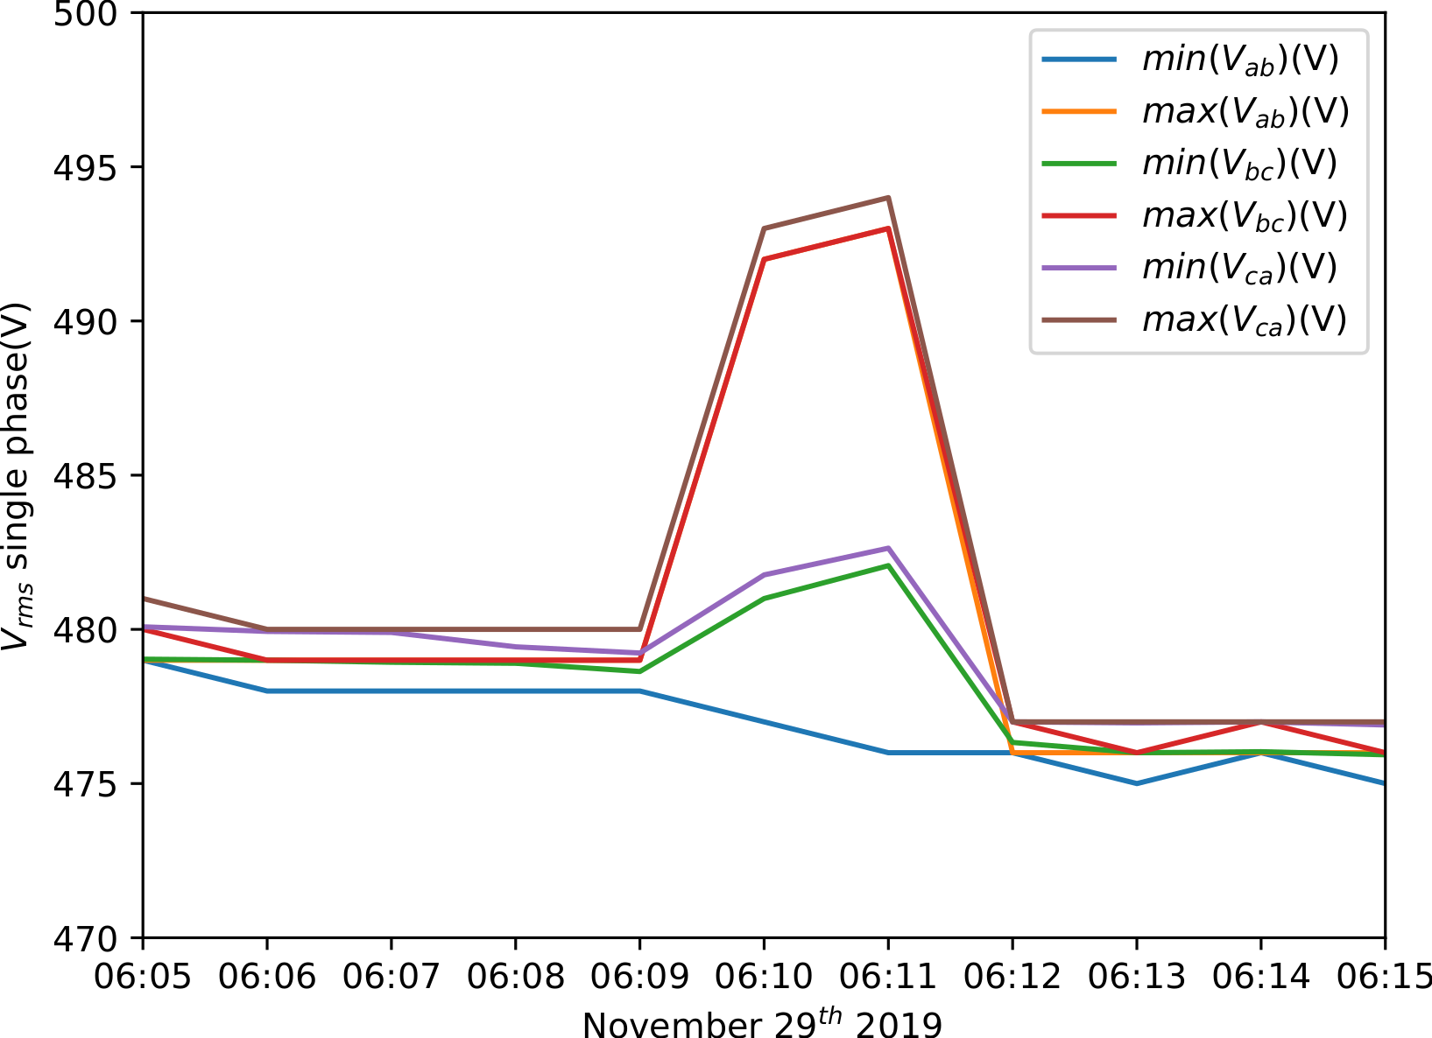
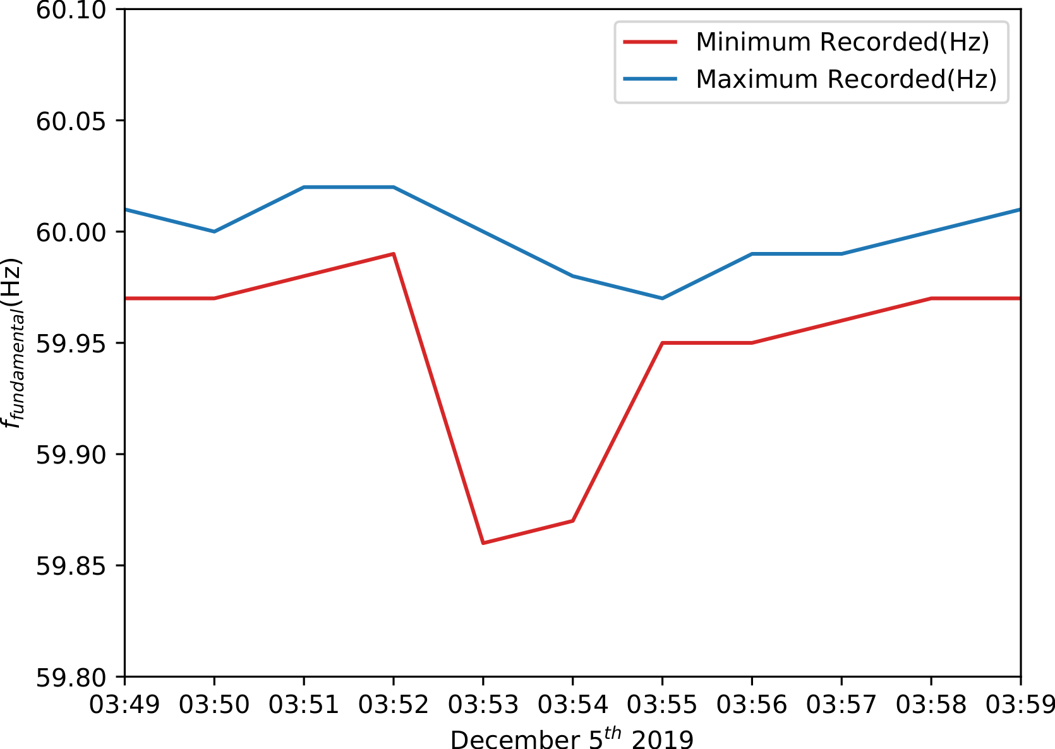
Temporal locality triggering
Ground truth event examples.

Slide 42
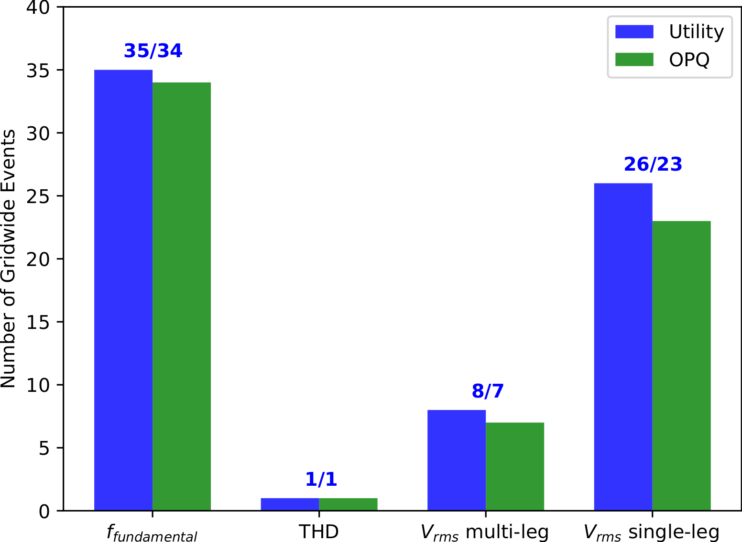
Temporal locality triggering
Detected events
Marvelous!

Slide 43
Sub-threshold Events
1. Select events where:
- single collocated utility meter passes threshold.
- one or more non-collocated utility meters passes threshold.
2. Compare the OPQ data with utility meters.
Only 3 events!

Slide 44
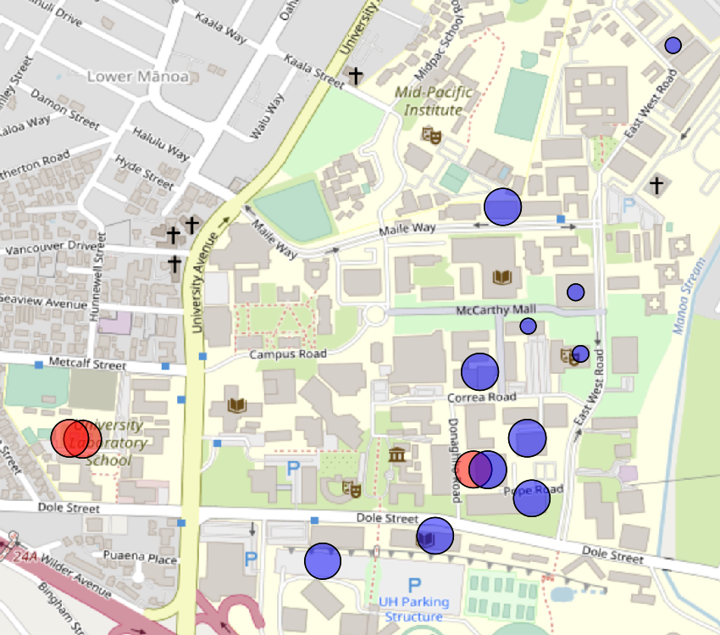
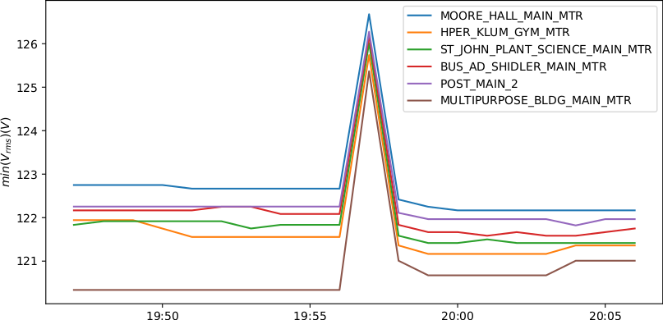
Event #1

Slide 45
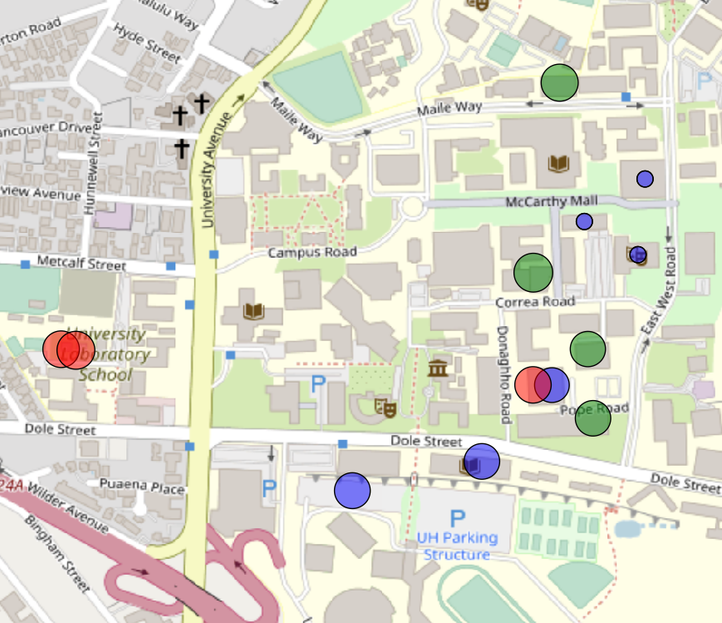
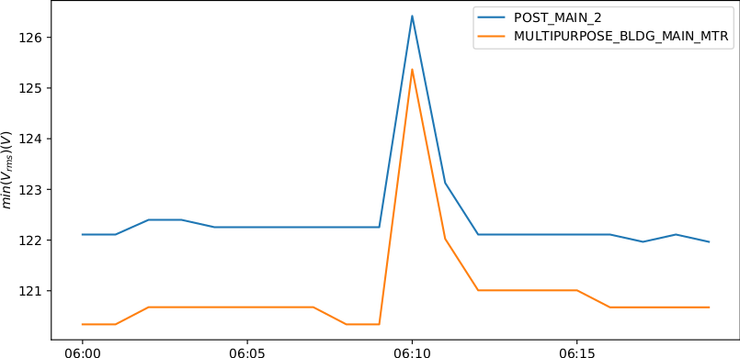
Event #2

Slide 46
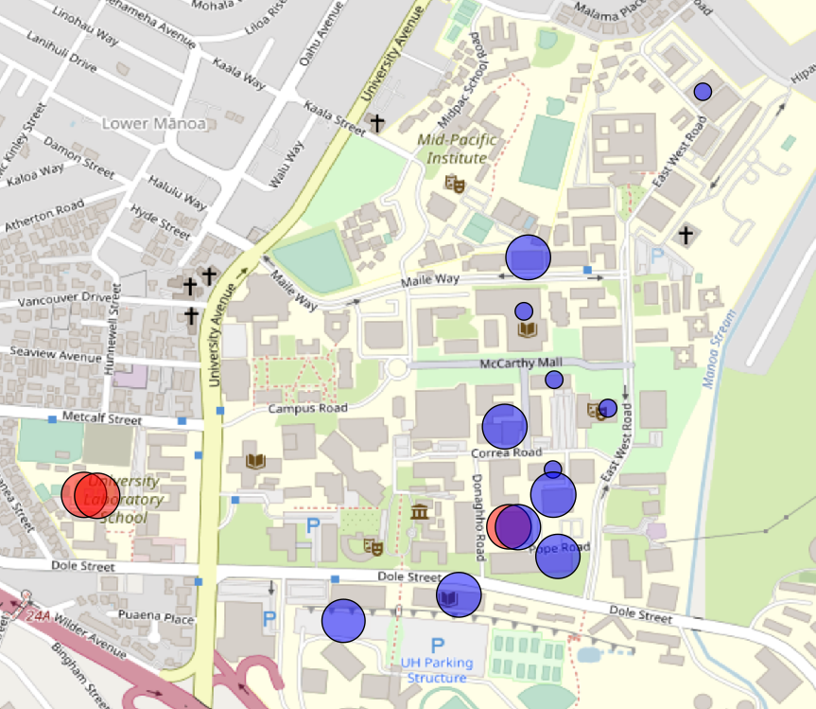
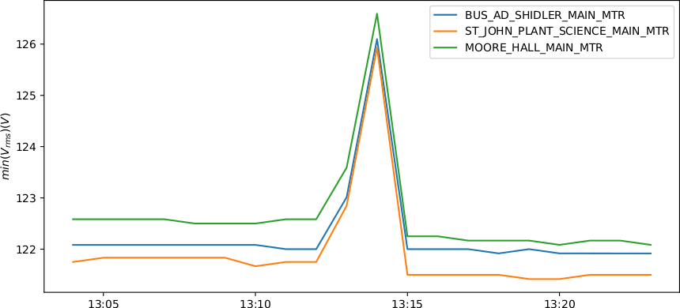
Event #3

Slide 47
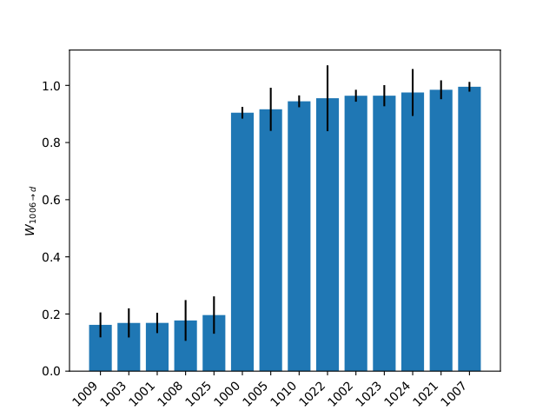

Event Clustering

Slide 48


Common Event

Slide 49

Pairwise Dissimilarity
V_{rms}

Slide 50


Clustering
V_{rms}

Slide 51


Clustering
Transients

Slide 52


Clustering
THD

Slide 53


True Gridwide Events
THD

Slide 54



Future Work
1. AI instead of statistical model
2. Scalability study
3. Privacy study
4. Power outage resiliency
5. Integration with Utility
6. Move to other domains

Slide 55

Turtle and Fishy

Slide 56

Tiger
2012-2019

Slide 57


Thanks!

Slide 58
Claim
Napali architecture can, in principle, provide benefits for other domains beyond power quality.

Slide 59
Additional Benefits of Napali
Outside the scope of this thesis
1. Increased flexibility with respect to privacy protection.
2. Increased resiliency with respect to power failure

