Slide 2
Tutorial: Impedance
Sergio Calatroni & Benoît Salvant- CERN

Slide 3
Tutorial
Goals
Get acquainted with the main concepts related to beam impedance
Understand the effect of different materials, and different geometries
Means
Experimental measurements with Vector Network Analyser (VNA)
Sincere thanks to Jean-Jacques Gratier from Keysight / Computer Controls for kindly providing a E5080A VNA for free for the school
Computational exercises with CST Studio Suite and ImpedanceWake2D (IW2D)
Sincere thanks to Monika Balk from CST / 3DS for providing several free full licenses for Studio Suite for the duration of the school
Short explanations of theoretical background
The students group will be divided in two for the experimental work
Computer work will be done in teams of 2.

Slide 4
Plan of the tutorial
Introduction
Surface impedance (10’ Sergio)
Recap on beam impedance, introduction to CST studio Suite and IW2D (20’ Benoît)
Work with network analyser 1 (60’ Sergio)
Measurement of induction of different materials with solenoid
Identification of materials and coatings
And in parallel: first practice with CST Studio Suite (60’ Benoît)
Different runs on predefined models: tubes, cavities, bellows…
Guided simulations with IW2D (30’)
Dependence of impedance on chamber diameter, bunch length, coating, …
Work with network analyser 2 (30’)
Measurement of resonances (with/without RF fingers)
And in parallel: simulations à la carte (30’)
Ice-cream break

Slide 5
What is impedance?
A term with many meanings, depending on context
Impedance in electrical circuits
Impedance of materials
Surface impedance
Beam coupling impedance
There is a common rationale:
Voltage and current flowing in the circuit, the material, the surface
The beam current, and the potential it generates on the vacuum pipe

Slide 6

Square resistance and surface resistance
Consider a square sheet of metal and calculate its resistance to a transverse current flow:
This is the so-called square resistance often indicated as $R_{∎}$
a
a
current
d

Slide 7
Square resistance and surface resistance
And now imagine that instead of DC we have RF, and the RF current is confined in a skin depth:
This is a (simplified) definition of surface resistance R_{s}
a
a
current
δ
d

Slide 8
Surface impedance
V~
z
S=d²
x
;
y

Slide 9
Normal metals in the local limit
(in DC)

Slide 10
Surface impedance practice
For a bulk metal:
Thin film over a substrate (metal)?
Depends on substrate
Depends on thickness wrt skin depth
Practice: open two-layers.xlsx
Thanks to Patrick Krkotić and Uwe Niedermayer for the paper “Iterative Model for Calculating the Surface Impedance of Multilayers”, 2016

Slide 11
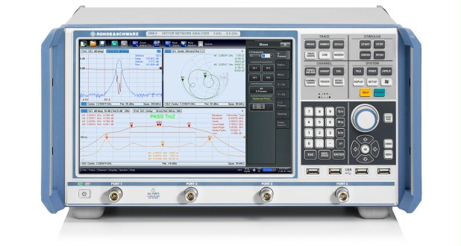
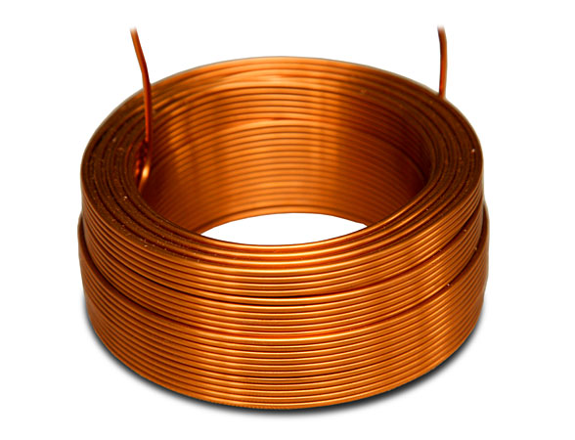
Coil measurement from 100 kHz to 2 MHz

Slide 12
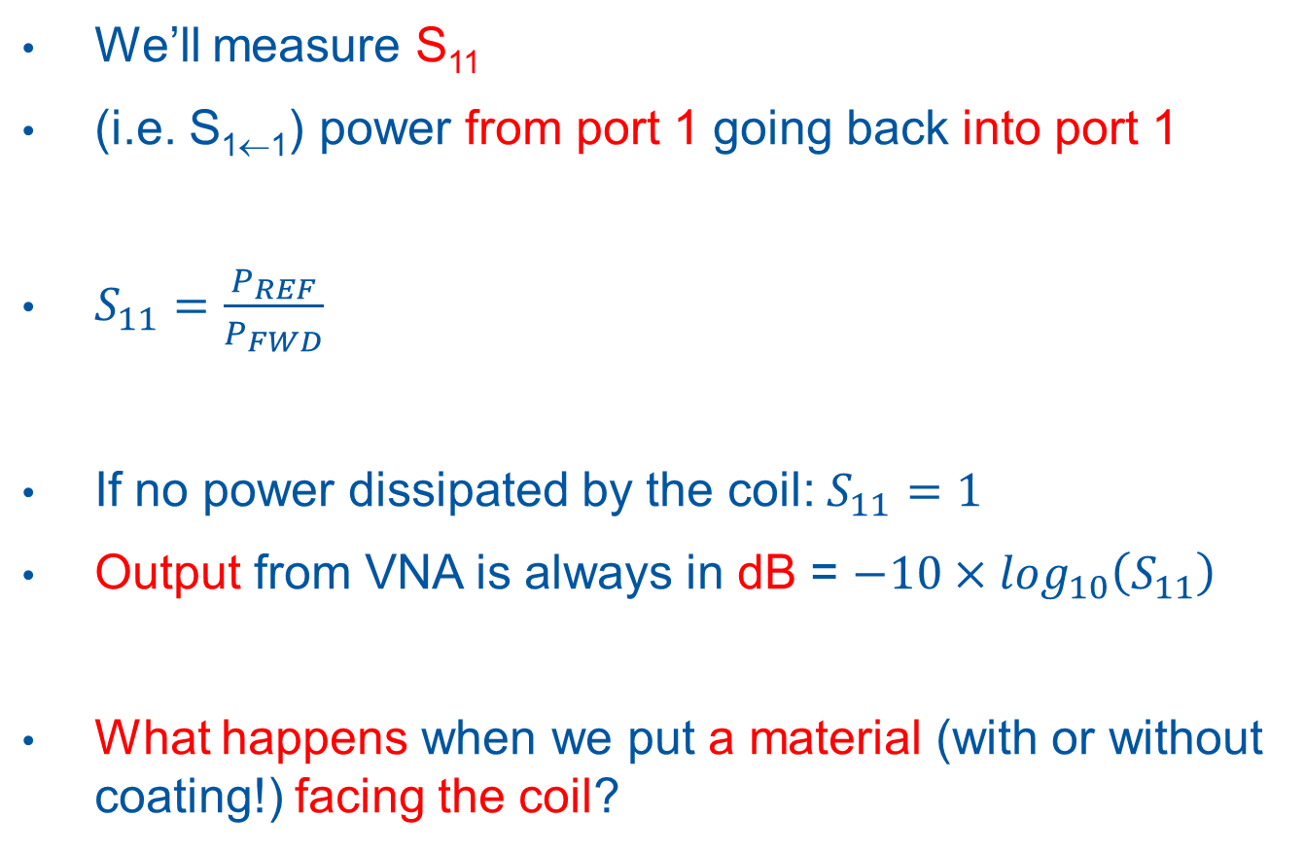
How the measurement is done
We’ll measure S₁₁
(i.e. S_{1←1}) power from port 1 going back into port 1
$S_{11}=\frac{P_{REF}}{P_{FWD}}$
If no power dissipated by the coil: $S_{11}=1$
Output from VNA is always in dB = $−10×\log_{10}\left(S_{11}\right)$
What happens when we put a material (with or without coating!) facing the coil?

Slide 13
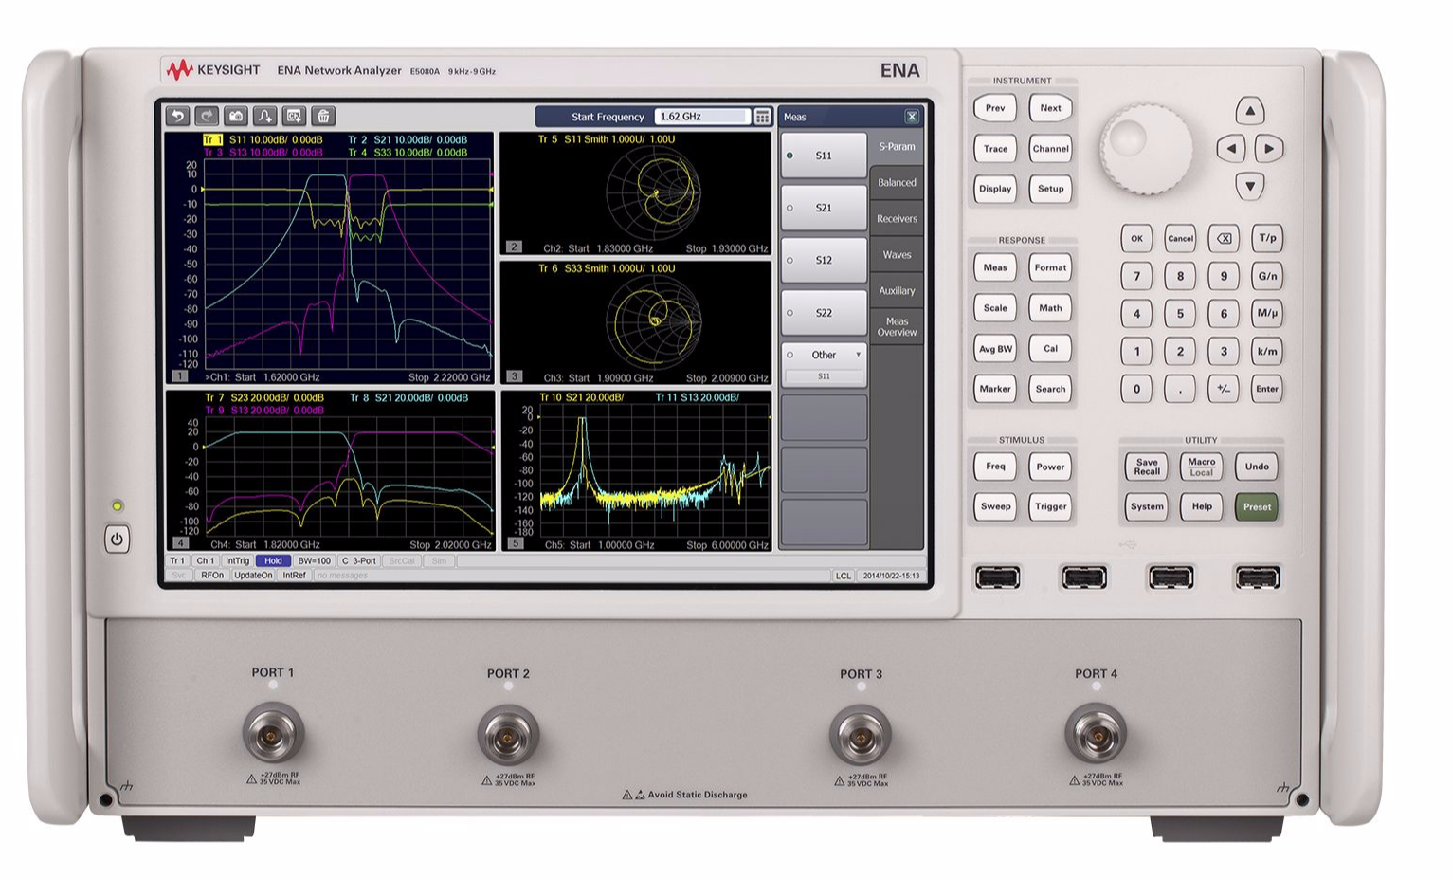
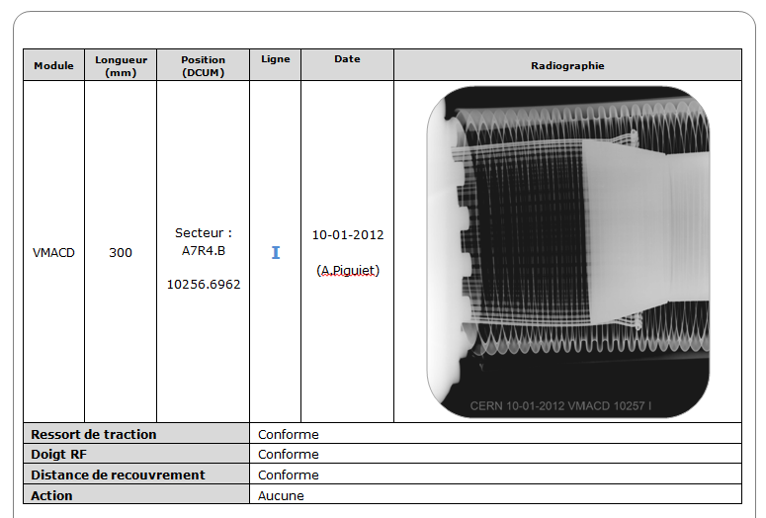
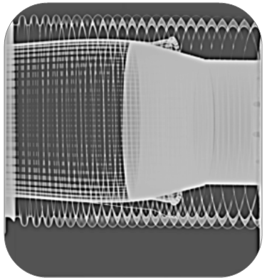
Cavity measurement with Keysight VNA up to 1.5 GHz

Slide 14
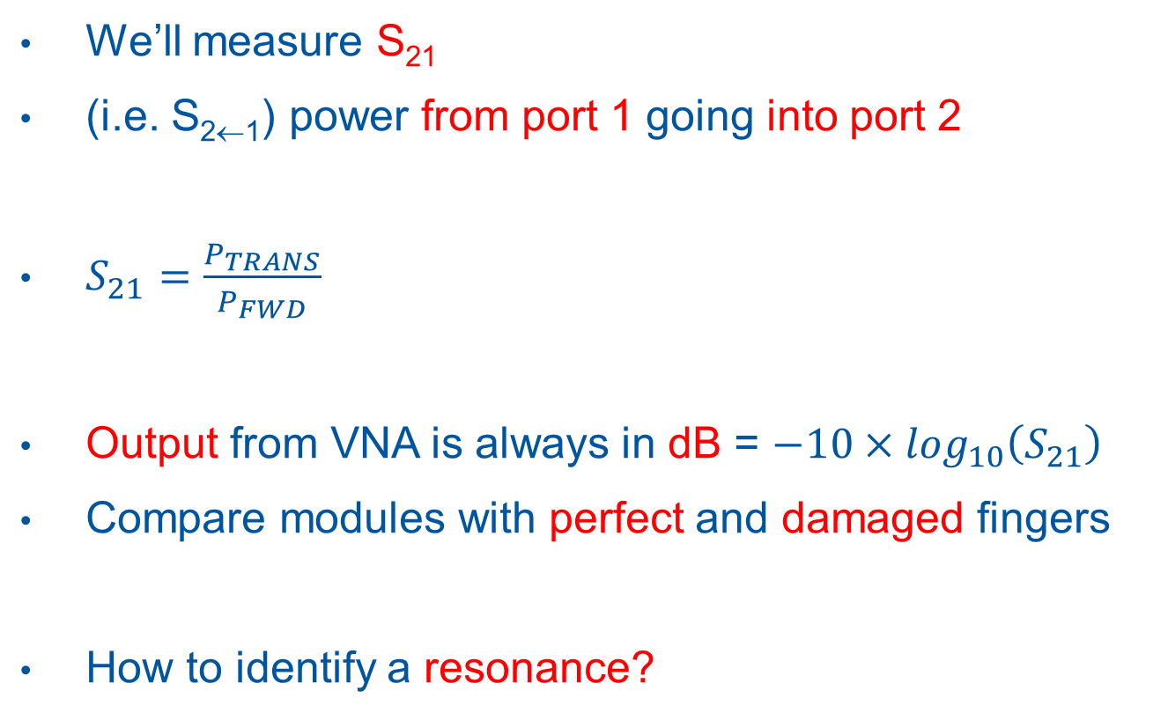
How the measurement is done
We’ll measure S₂₁
(i.e. S_{2←1}) power from port 1 going into port 2
$S_{21}=\frac{P_{TRANS}}{P_{FWD}}$
Output from VNA is always in dB = $−10×\log_{10}\left(S_{21}\right)$
Compare modules with perfect and damaged fingers
How to identify a resonance?

Slide 15
Impedance in accelerators

Slide 16

Impedance: image charges
$$\text{}=2b$$
Image charges flow on the surface of the beampipe
The wakefields potential is proportional to surface impedance of the vacuum chamber surface

Slide 17
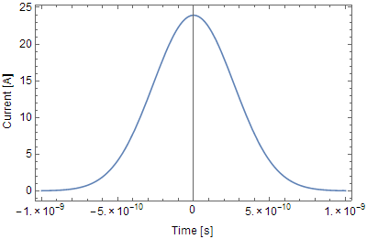
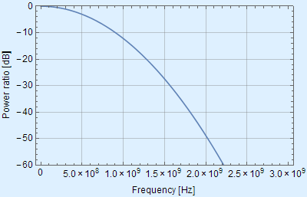
Bunch frequency spectrum: LHC case
Real bunches
Gaussian bunches of 10¹¹ protons, 8 cm long
Beam instantaneous image current
Frequency spectrum (Fourier transform)
Power dissipation from wakes is
where is a summation of
over the bunch frequency spectrum
( is the accelerator circumference)
( is the vacuum chamber circumference)
Line spacing: revolution frequency (11 KHz for LHC)
From: E. Métral

Slide 18
Transverse impedance
F. Sacherer in: Proceedings of the First Course of the International School of Particle Accelerators, CERN 77-13, p. 198

Slide 19
From wakefields to impedance
Wakefields have an effect on beam stability, in particular the transverse plane
Risetime of resistive-wall instability depends on the transverse impedance
with at the frequency of the unstable mode

Slide 20
Betatron motion – simplified model
Unperturbed motion of single particle with and
Quadrupoles give the restoring (focussing) force -> harmonic oscillations
Adding a perturbation to the beam that changes focussing:
Growth rate of instability

Slide 21
Anomalous skin effect

Slide 22
Limits for conductivity and skin effect
1. Normal skin effect if:
e.g.: high temperature, low frequency
2. Anomalous skin effect if:
e.g.: low temperature, high frequency
Note: 1 & 2 valid under the implicit assumption
1 & 2 can also be rewritten (in advanced theory) as:
It derives that 1 can be true for and also for

Slide 23
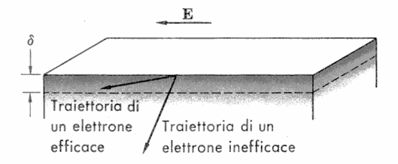
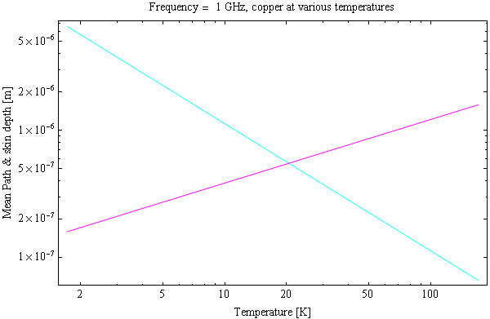
Mean free path and skin depth
Mean free path
Skin depth

Slide 24
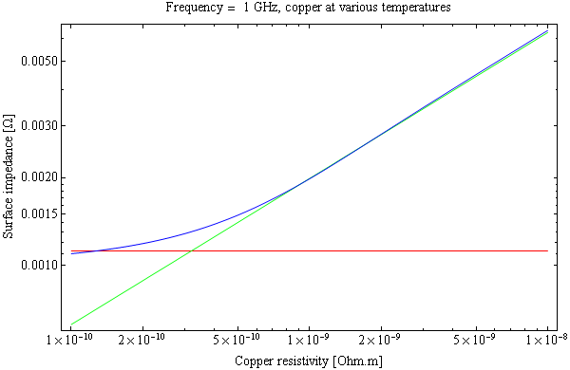
Anomalous skin effect
Anomalous skin effect
Asymptotic value
Normal skin effect
Understood by Pippard, Proc. Roy. Soc. A191 (1947) 370
Exact calculations Reuter, Sondheimer, Proc. Roy. Soc. A195 (1948) 336

Slide 25
Two-layers

Slide 26
Iterative model

