Slide 1
Recommending CouchSurfers
Machine Learning for Social Travel
Ron Sun, Tobi Baumgartner,
Tim Althoff, Sergey Karayev

Slide 2
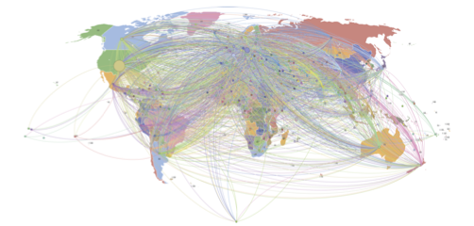
CouchSurfing.org
More than 4M users
252 countries
366 languages.

Slide 3
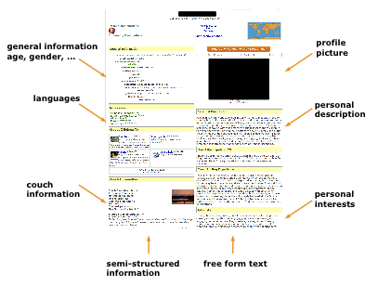
CouchSurfing.org

Slide 4
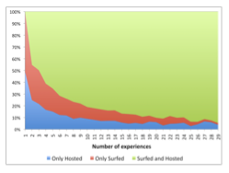
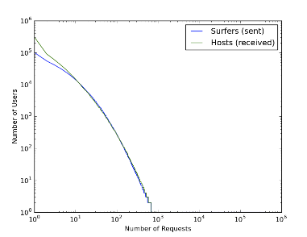
CouchSurfing.org

Slide 5
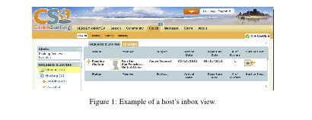
CouchSurfing.org
Want to maximize likelihood of a host accepting a surfer.

Slide 6
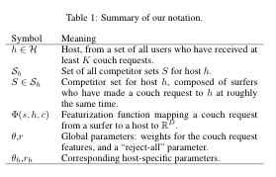
Problem and Notation

Slide 7
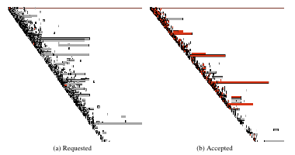
Competitor Sets
sf

Slide 8
Competitor Sets
sf

Slide 9


Prediction Model

Slide 10
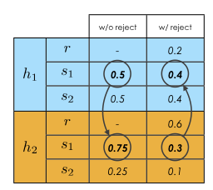
Reject Option

Slide 11

Prediction Model

Slide 12
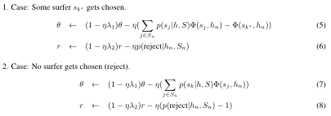
Learning

Slide 13
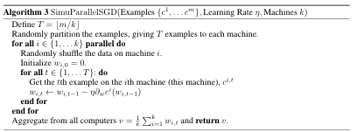
Learning

Slide 14







SGD
SGD
SGD
SGD

Slide 15
Features
importance sampling figure
cross-product figure

Slide 16
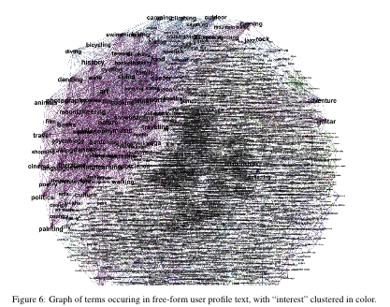
Features

Slide 17
Evaluation
explain scheme

Slide 18
Evaluation
plot1

Slide 19
Evaluation
plot2

Slide 20
Conclusions
whatever

