Slide 1
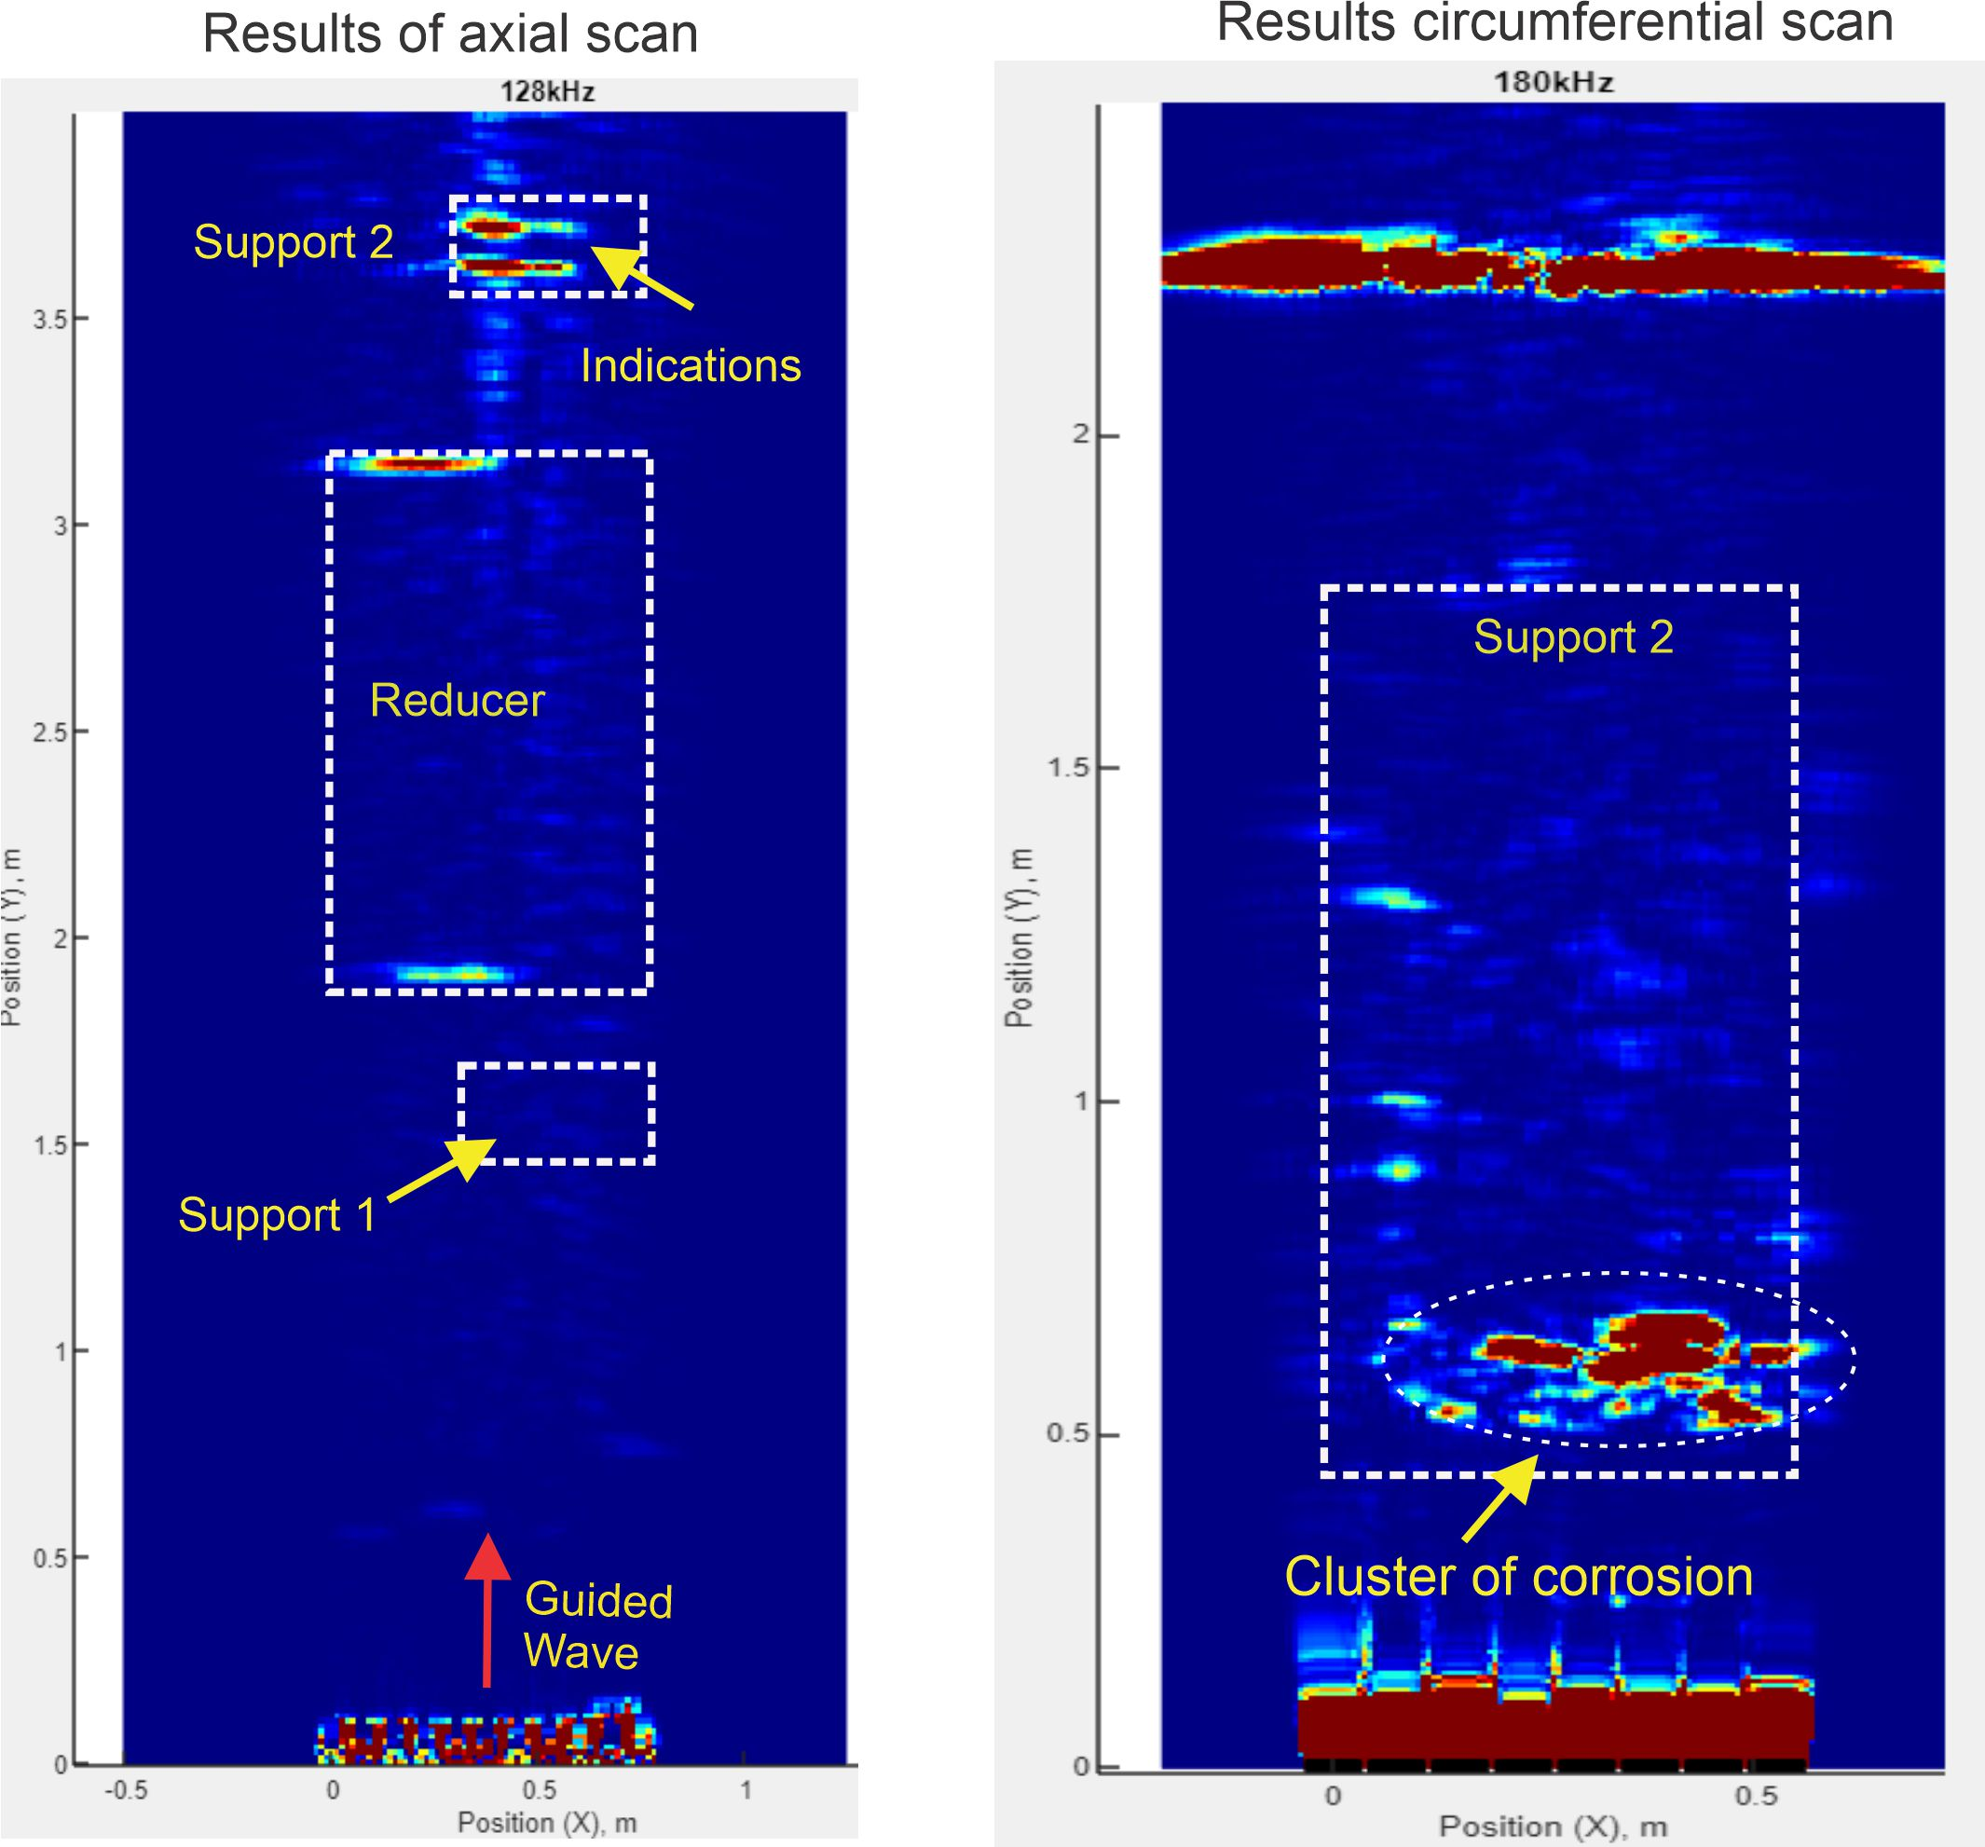
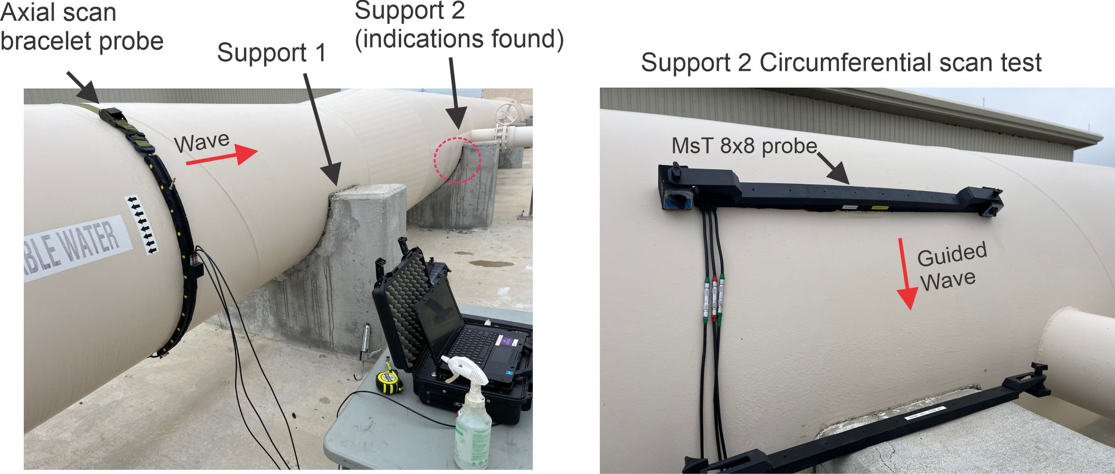
Pipe Supports: Axial and Circumferential Scans
Reducer area
Through transmission
Bracelet probe with 11 segments was placed on 1.07 m (42 in.) OD 10 mm (0.4 in.) wall CS pipe for axial scan
Conditions under two concrete pipe supports were evaluated, with a suspect area found under support 2
MsT 8x8 probe was placed on top of support 2 for a circumferential scan
A corrosion cluster was identified at a distance 0.5 m (20 in.) from the probe)
s1 s2 s3 s4 s5 s6 s7 s8 s9 s10 s11
s1 s2 s3 s4 s5 s6 s7 s8
Probe

Slide 2
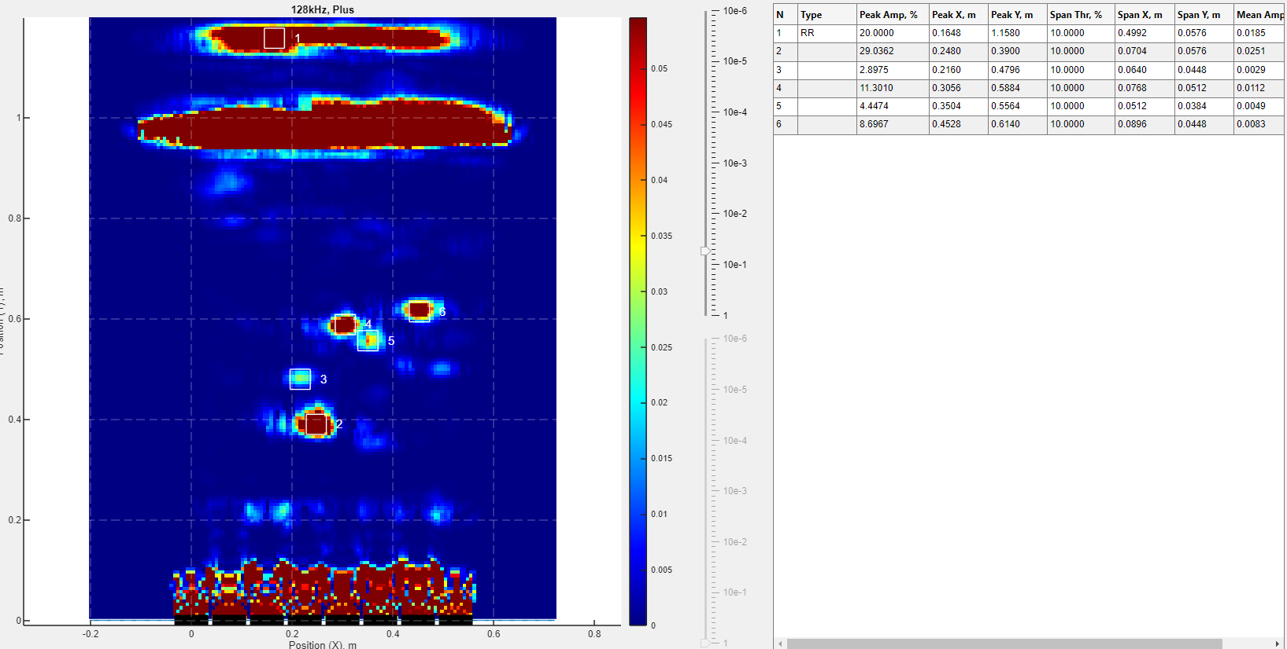
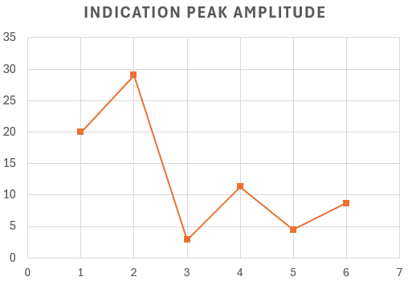
Indication Reporting
Weld as reference reflector
Attachment
Pit3
Pit4
Pit5
Pit6
Through transmission
Welded
attachment
Pit6
Pit4
Weld
(calibration)
Pit4
Pit5
Pit6
Pit3
Pit3
Pit5
Welded
attachment
Indication reporting includes selection of reference reflector and defect indications
The report contains indication peak amplitude, x and y coordinates, and indication span in x and y direction
Ranking of anomalies could be performed based on relevant peak amplitude information taking into account anomaly span information
Dead zone

