Slide 1
Nonstandard Finite Difference Methods for Numerical ODE/PDE
Sergey Voronin

Slide 2
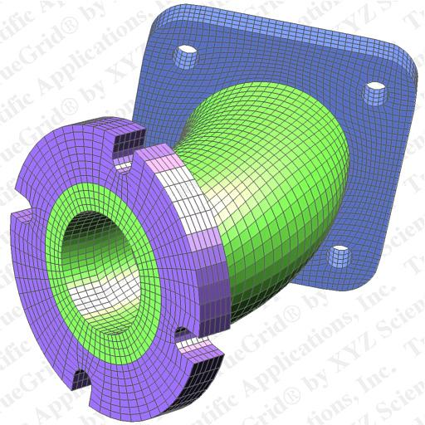
Numerical Solution of ODEs and PDEs
Finite Difference Methods
Collocation Methods
Spectral Methods
Finite Element Methods

Slide 3
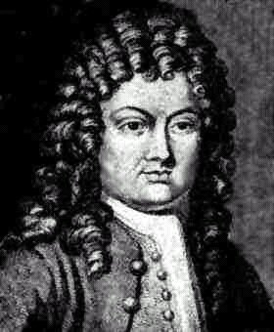
Review of Finite Differences
Grid Discretization
Replacement of Derivatives by their discrete approximations
Derivative approximations come from Taylor's expansion theorem

Slide 4
Why Use Finite Differences?
Relatively easy to implement on the computer.
Low space requirements. Even for schemes that cannot be expressed explicitly, iterative methods may be used to solve systems of equations produced by FD eliminating the need to store and manipulate large matrices.
May be adapted to more complex grids by using variable spacing.

Slide 5
Approximation Formulas (1)

Slide 6
Approximation Formulas (2)

Slide 7
Approximation Formulas (3)

Slide 8
Approximation Formulas (4)

Slide 9
ODEs
Example: The Decay Equation
In this case, the exact solution is known:

Slide 10
Application of FD
We apply the forward first order approximation for the time derivative to get the forward Euler scheme:

Slide 11
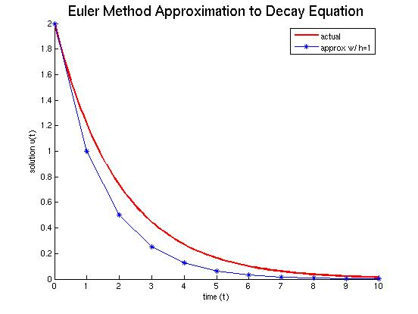
FD Approx Results (1)

Slide 12
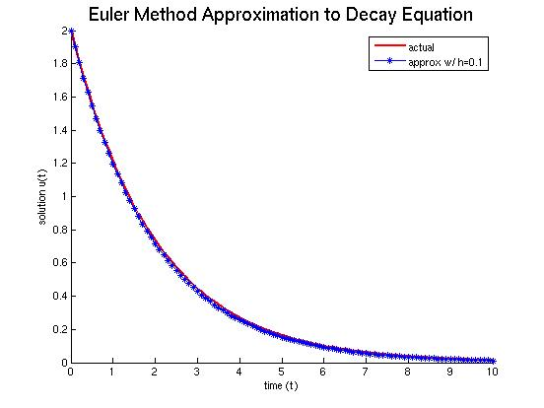
FD Approx Results (2)

Slide 13
Can we do better?
We can decrease the error by decreasing the step size (h), but at a cost of computational increases.
We can use a faster converging method like Runge–Kutta, but sometimes, we cannot afford to cut the step size to get the accuracy that we need.
We can modify our scheme, by using a Nonstandard Finite Difference approach.

Slide 14
How do we apply NSFD?
First, we need to modify the FD derivative approximation:

Slide 15
Rules for Constructing NSFD Schemes [Mickens]
1) “The orders of the discrete derivatives should be equal to the orders of the corresponding derivatives appearing in the differential equation.”
2) “Discrete Representations for derivatives must, in general, have non-trivial denominator functions.”

Slide 16
Rules for Constructing NSFD Schemes (2) [Mickens]
3) “Non-linear terms should, in general, be replaced by non-local discrete approximations.”
4) “Special conditions that hold for the solutions of the differential equations should also hold for the solutions of the finite difference scheme.”

Slide 17
A Look at the Original Scheme
It violates rule 4. The solution to the decay equation monotonically decreases to zero if

Slide 18
NSFD Approach (1)
NSFD “algorithm” for scalar ODEs:
In this case, the derivative approximation is:

Slide 19
NSFD Approach (2)
R* is determined as follows:

Slide 20
Application to Decay ODE (1)

Slide 21
Application to Decay ODE (2)

Slide 22
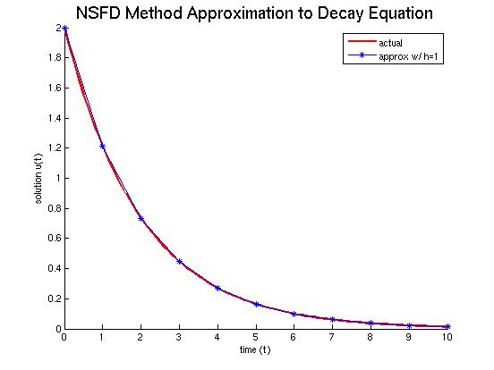
Application to Decay ODE (3)

Slide 23
Application to Logistical ODE (1)

Slide 24
Application to Logistical ODE (2)

Slide 25
Application to Logistical ODE (3)

Slide 26
Application to Logistical ODE (4)
NFSD Scheme for Logistic ODE:
Let's compare this scheme to the classical fourth order Runge-Kutta scheme for different values of r and h.

Slide 27
Application to Logistical ODE (5)

Slide 28
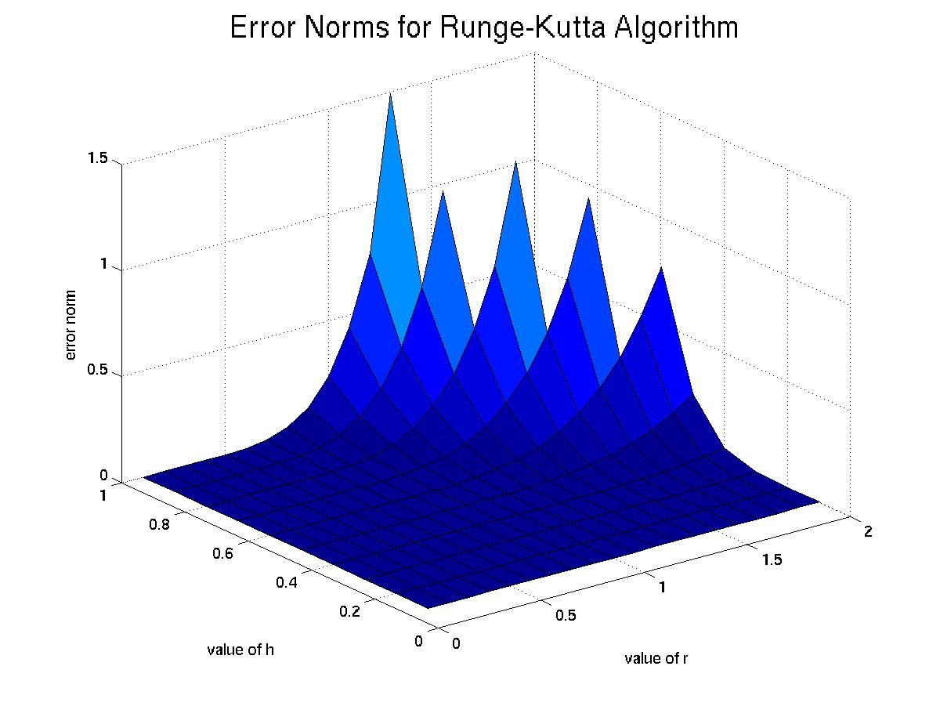
Application to Logistical ODE (6)

Slide 29
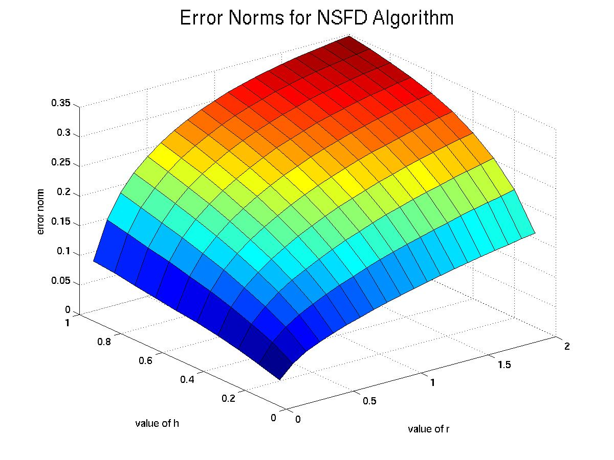
Application to Logistical ODE (7)

Slide 30
NSFD and PDE
Sample Problem – 1D Wave Equation

Slide 31
Standard Finite Differences (1)

Slide 32
Standard Finite Differences (2)

Slide 33
NSFD and the Wave PDE (1)

Slide 34
NSFD and the Wave PDE (2)
We know a particular exact solution:

Slide 35
NSFD and the Wave PDE (3)
We want to make the scheme exact with respect to a particular solution:

Slide 36
NSFD and the Wave PDE (4)

Slide 37
NSFD and the Wave PDE (5)

Slide 38
NSFD and the Wave PDE (6)
We can now derive the NSFD scheme:

Slide 39
NSFD Scheme for the Wave PDE

Slide 40
Comparing NSFD and Std FD

Slide 41
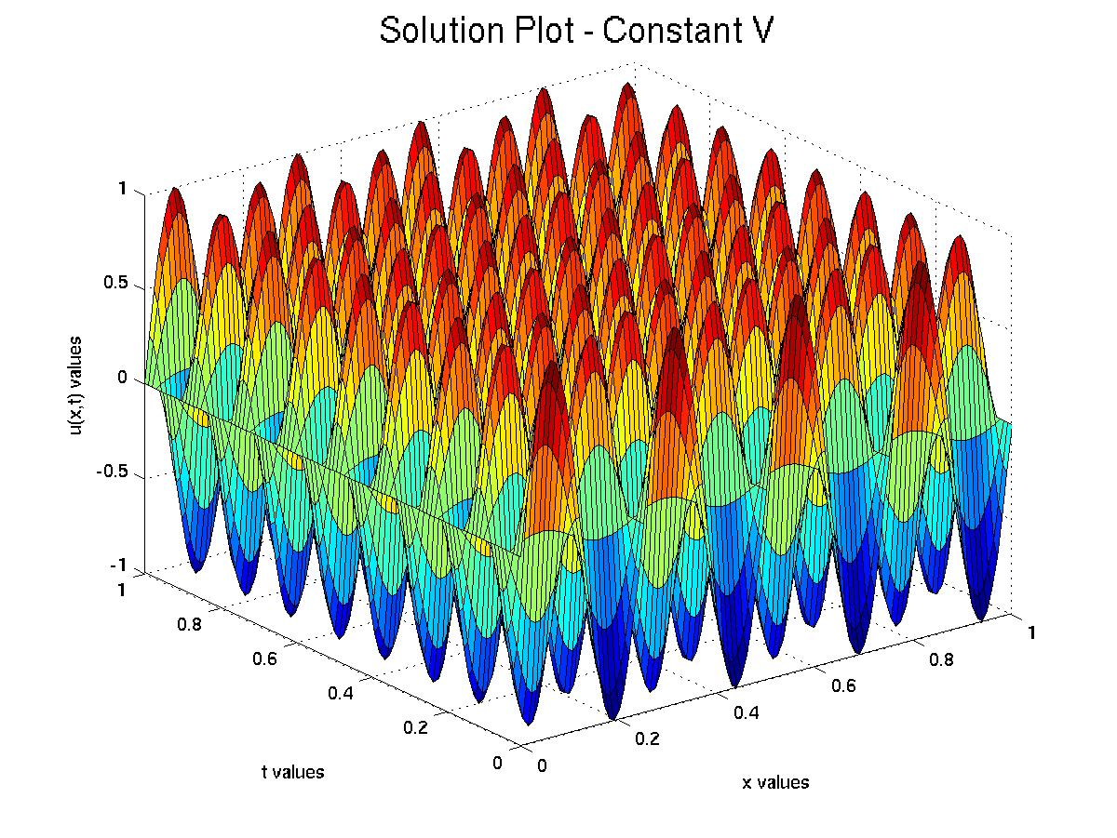
Constant V Solution

Slide 42
Constant V Errors
Standard Algorithm Errors:
h = 0.1 k = 0.02 max absolute error = 1.53884
h = 0.025 k = 0.005 max absolute error = 0.554372
h = 0.00625 k = 0.00125 max absolute error = 0.0351087
h = 0.0015625 k = 0.0003125 max absolute error = 0.00220772
Non-Standard Algorithm Errors:
h = 0.1 k = 0.02 max absolute error = 5.88418e-15
h = 0.025 k = 0.005 max absolute error = 1.21569e-14
h = 0.00625 k = 0.00125 max absolute error = 1.08599e-11
h = 0.0015625 k = 0.0003125 max absolute error = 3.64967e-11

Slide 43
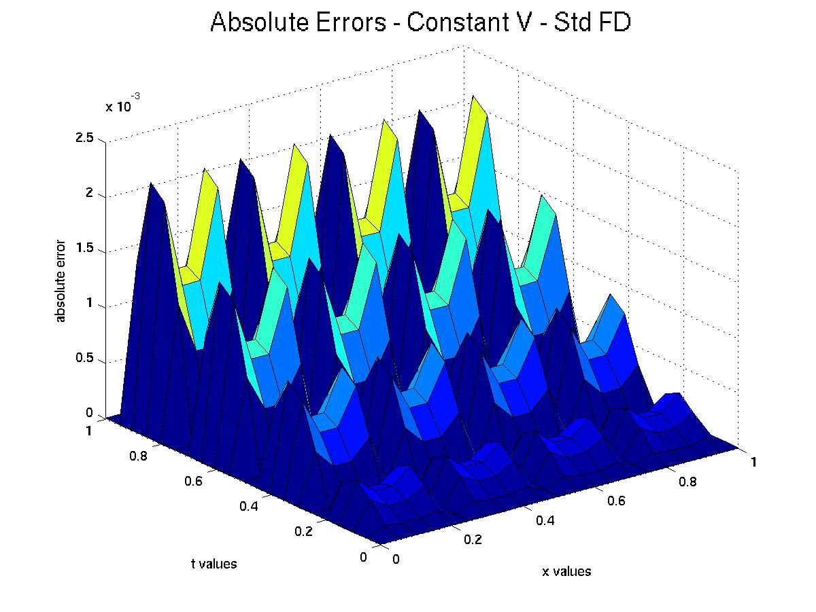
Constant V Error – Std FD

Slide 44
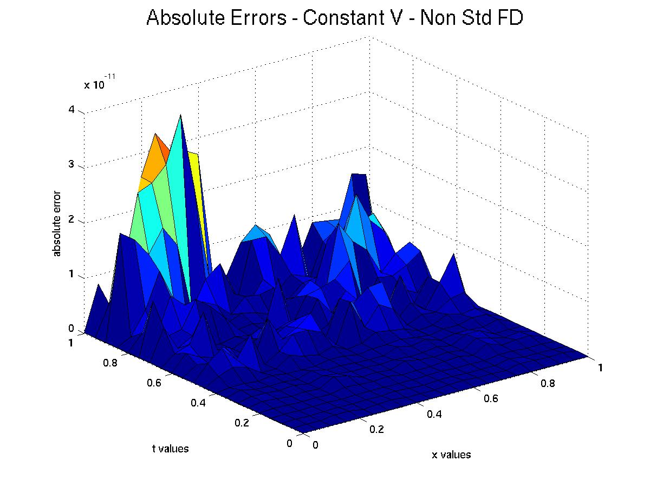
Constant V Error – NSFD

Slide 45
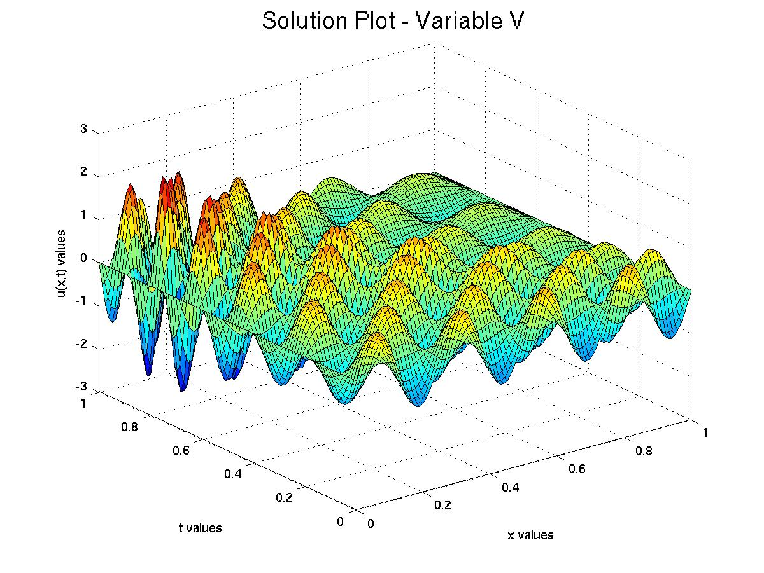
Variable V Solution

Slide 46
Variable V Errors
Standard Algorithm Errors:
h = 0.1 k = 0.02 max absolute error = 1.99215
h = 0.025 k = 0.005 max absolute error = 2.43195
h = 0.00625 k = 0.00125 max absolute error = 0.177339
h = 0.0015625 k = 0.0003125 max absolute error = 0.00728029
Non-Standard Algorithm Errors:
h = 0.1 k = 0.02 max absolute error = 2.007
h = 0.025 k = 0.005 max absolute error = 1.41017
h = 0.00625 k = 0.00125 max absolute error = 0.107026
h = 0.0015625 k = 0.0003125 max absolute error = 0.00414318

Slide 47
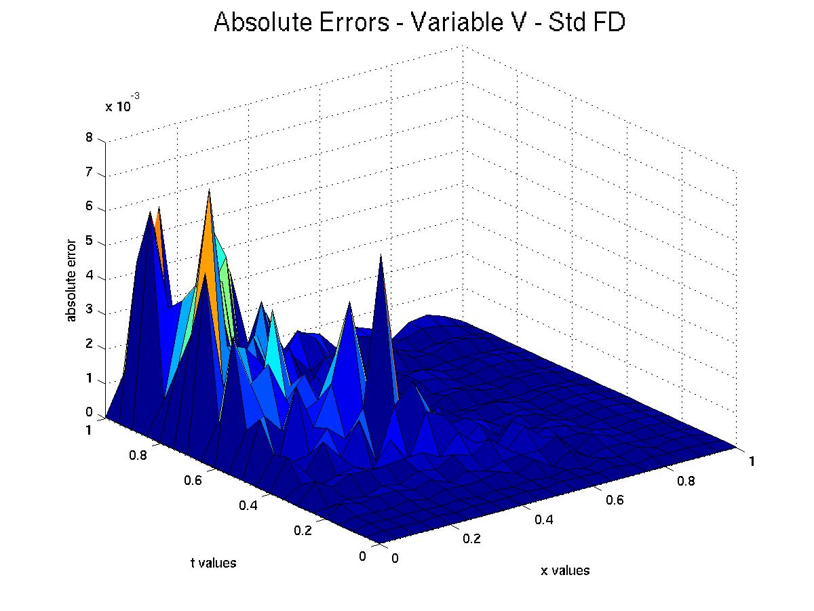
Variable V Error – Std FD

Slide 48
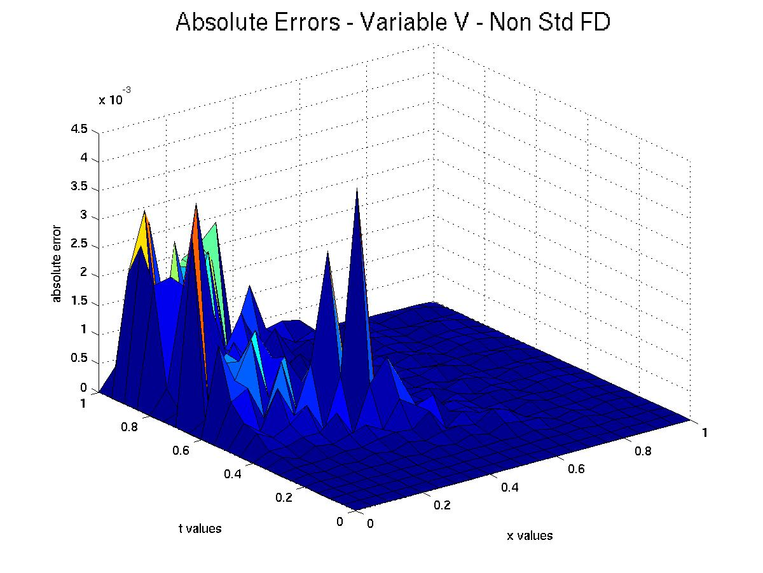
Variable V Error – NSFD

Slide 49
Summary and Conclusions (1)
The provided codes demonstrate that Non-Standard Finite Difference Methods can be effective in the numerical solution of some ODEs and PDEs.
In our Decay ODE test case, the NSFD algorithm resulted in an exact scheme. For the logistic ODE, we saw that the distribution of errors from the NSFD method was favorable even to a higher order Runge-Kutta method.
For our Wave Equation PDE test case, the NSFD algorithm is exact for the constant velocity case and produces less error than the standard FD algorithm in the variable velocity case.

Slide 50
Summary and Conclusions (2)
The NSFD method is in general, as easy to apply as the standard finite difference method. The computational costs of the method are similar to standard schemes.
NSFD is effective because it attempts to modify an existing FD scheme based on the properties of the individual equation, such as limiting properties and particular solutions.
NSFD is not a universal method. It is a growing collection of approaches to various differential equations.

Slide 51
References
Cole, James. “Applications of Nonstandard Finite Differences to Solve the Wave Equation and Maxwell's Equations” in Chap. 3 of Applications of Nonstandard Finite Difference Schemes, Mickens, Ronald, editor, World Scientific, Singapore, 2000.
Mickens, Ronald. “Nonstandard Finite Difference Schemes for Differential Equations.” Journal of Difference Equations and Applications. Vol. 8 (2002): 823-847.
Mickens, Ronald. Advances in the Applications of Nonstandard Finite Difference Schemes. World Scientific, Singapore, 2005.

