Slide 1
Consensus among Consensus Methods
Anna Popova, Michel Regenwetter, and
Sergey V. Popov
University of Illinois at Urbana-Champaign
Thanks:
American Psychological Association (APA)
Air Force Office of Scientific Research (AFOSR),
National Institute of Mental Health (NIMH),
National Science Foundation (NSF)

Slide 2
Outline
"Impossibility" in Social Choice
Partial Ranking Ballots
(STV elections of APA)
Three models for Partial Rankings
Model Dependence and Bootstrap
Empirical Consensus among Consensus Methods
Notes:
Characteristics of empirical data
Rules agreed upon winner
Rules agreed upon social order

Slide 3
"Impossibility" in Social Choice
Partial Ranking Ballots
(APA Presidential elections)
Three models for Partial Rankings
Model Dependence and Bootstrap
Empirical Consensus among Consensus Methods
Notes:
Since the end of 18th century there is prolific literature discussing impossibility in social choice.

Slide 4
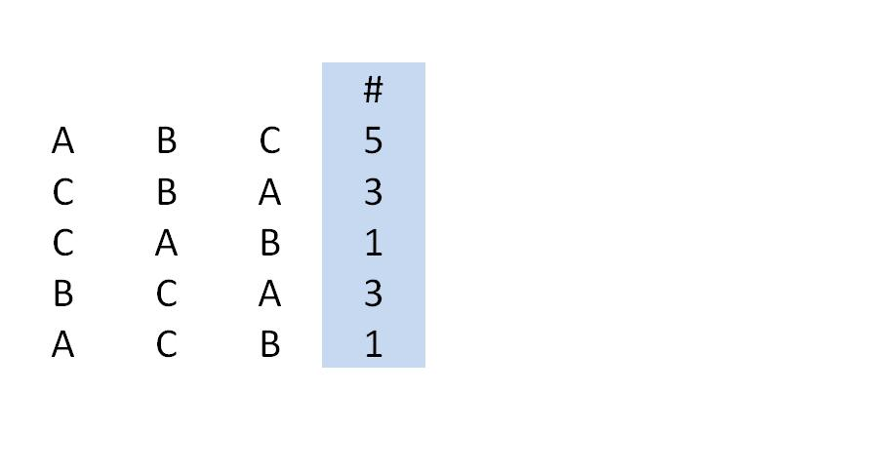
A hypothetical profile
3 candidates (A, B, C)
13 voters
Notes:
Voter’s preference ranking/relation
5 voters like a best, b second best and c the least

Slide 5
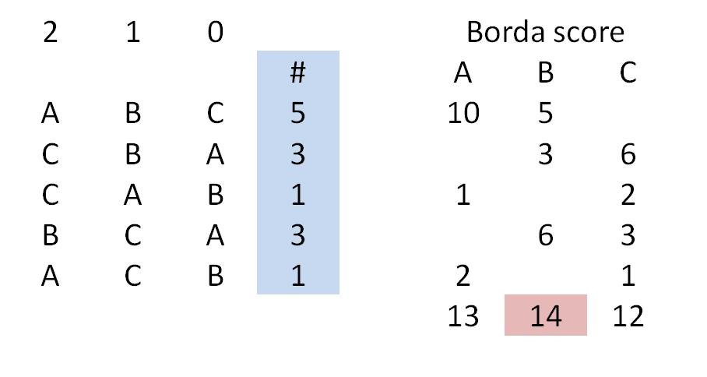
Borda
Notes:
Within rank ->borda score
Cand a scores 10 points from first 5 voters
Total borda score
Animation! With total at the end!

Slide 6
Borda
Total Borda Score
Notes:
Within rank ->borda score
Cand a scores 10 points from first 5 voters
Total borda score
Animation! With total at the end!

Slide 7
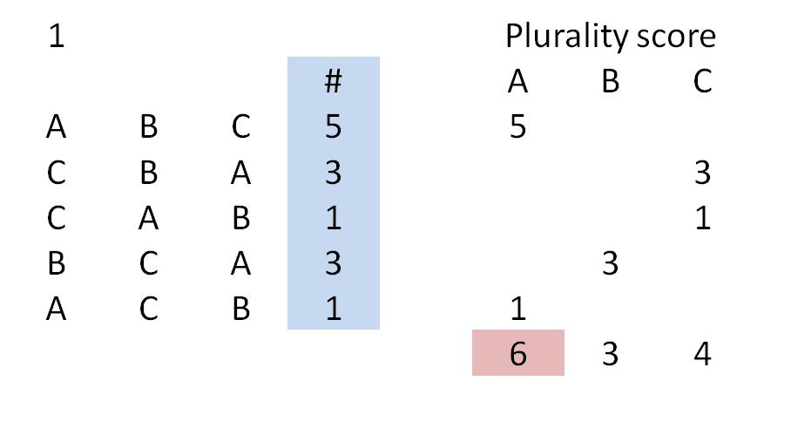
Plurality
Notes:
Plurality score from voter
Total plurality score

Slide 8
Plurality
Total Plurality Score
Notes:
In some rules there is a criterion that the plurality winner if the score is more than a certain number of points, otherwise on the second stage they eliminate weakest candidate
For example common criterion is more than a half or the electorate and common procedure is to eliminate candidate b because a does not have enough voters
Plurality score from voter
Total plurality score

Slide 9
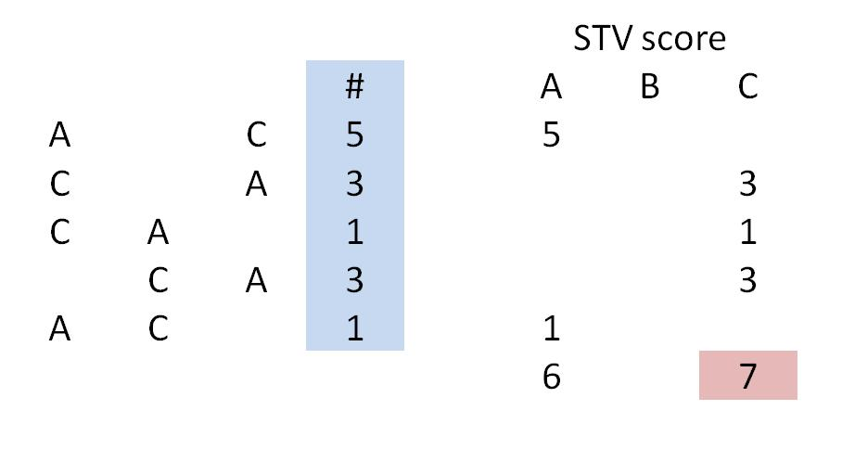
Single Transferable Vote
(Alternative Vote)
Notes:
After elimination c has more than a half of votes and C is elected

Slide 10
Single Transferable Vote
(Alternative Vote)
Total STV Score
Notes:
After elimination c has more than a half of votes and C is elected

Slide 11
For now:
Voting Rule | Borda | Plurality | STV
Winner | B | A | C

Slide 12
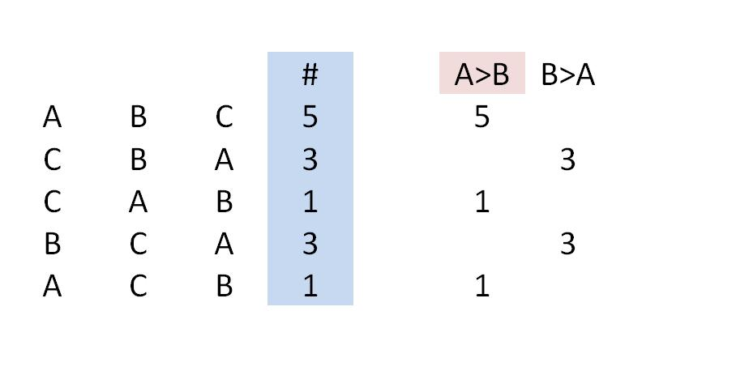
Condorcet (Majority)
Notes:
Pairwise comparisons!
A is prefereed to b by 7 people so a is majority preferred to b

Slide 13
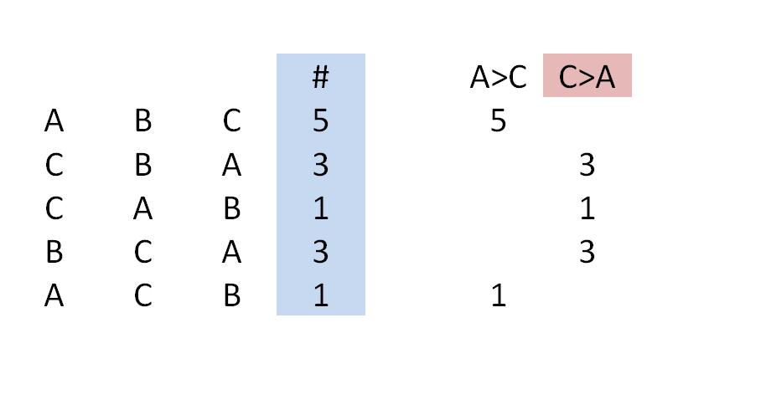
Condorcet (Majority)
Notes:
Maj pref TO a

Slide 14
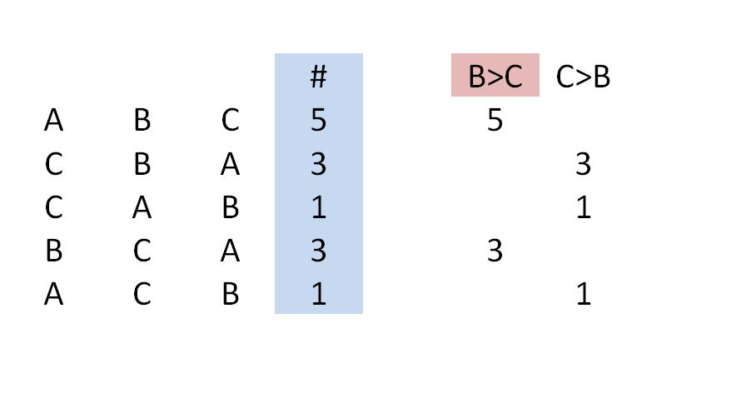
Condorcet (Majority)

Slide 15
Are Consensus Methods Irreconcilable?
Voting Rule | Borda | Plurality | STV | Condorcet
Winner | B | A | C | cycle

Slide 16
"Impossibility" in Social Choice
Partial Ranking Ballots
(APA Presidential elections)
Three models for Partial Rankings
Model Dependence and Bootstrap
Empirical Consensus among Consensus Methods
Notes:
We looked at partial ranking ballots from American Psychological Association presidential election
Characteristics of empirical data
American Psychological Association election
Rules agreed upon winner
Rules agreed upon social order

Slide 17
American Psychological
Association Presidential Elections
(Single Transferable Vote)
Good approximation of political elections
8 Data sets (1998-2005)
Size +/- 20,000 voters
Ballots: Partial/Full Rankings of 5 Candidates

Slide 18
Two Types of Data
Complete Ranking
Partial Ranking
B
D
C
E
A
B
D
C
Notes:
Some voters do this and some voters do that

Slide 19
"Impossibility" in Social Choice
Partial Ranking Ballots
(APA Presidential elections)
Three models for Partial Rankings
Model Dependence and Bootstrap
Empirical Consensus among Consensus Methods

Slide 20
Three Models of Partial Rankings
Weak order model
Unranked candidates are tied at the bottom of the preference
Partial order model (Zwicker)
No preference b/w candidates when one or both are unranked
E
E
B
D
C
B
D
C
A
A
Notes:
Everything ON the left is pref to everything ON the right
One voter stated that he prefers b to d to c and do not state any preferences for e and a,
Then according to WO we assume he prefers 3 cand he listed to 2 cand he did not rank, and we assume that they are tied at the bottomn
According to PO we only assume b to d to c and make no further assumptions, for ex we do not assume that voter prefers a to b or b to a

Slide 21
Three Models of Partial Rankings
Size-Independent Linear Order model
Partial ranking is “beginning” of an unknown linear order
Linear order “profile” inferred statistically
B
D
C
A
E
B
D
C
E
A
Notes:
Size-Independent “Linear@ (emph) Order model

Slide 22
"Impossibility" in Social Choice
Partial Ranking Ballots
(APA Presidential elections)
Three models for Partial Rankings
Model Dependence and Bootstrap
Empirical Consensus among Consensus Methods
Notes:
To what extend our substantive results are dependent on the model we use
Rules agreed upon winner
Rules agreed upon social order

Slide 23
Results 1998
1998 | Condorcet
WO | CBADE

Slide 24
Results 1998
Bootstrapped Confidence
bold > 95%
1998 | Condorcet | Borda
WO | CBADE | CBADE
Notes:
Before introduce what’s bold face
When social order in bold face we are more than 95% sure in this order

Slide 25
Results 1998
Bootstrapped Confidence
bold > 95%
1998 | Condorcet | Borda | Plurality
WO | CBADE | CBADE | CEABD
Notes:
C and B are identical, but Plurality is different, from now on I will underline anything which is different from C social order

Slide 26
Results 1998
Bootstrapped Confidence
bold > 95%
1998 | Condorcet | Borda | Plurality
WO | CBADE | CBADE | CEABD
ZW | CBDAE | CBDAE | CAEBD

Slide 27
Results 1998
Bootstrapped Confidence
bold > 95%
1998 | Condorcet | Borda | Plurality
WO | CBADE | CBADE | CEABD
ZW | CBDAE | CBDAE | CAEBD
SIM | CBDAE | CBDAE | CAEBD
No Cycle

Slide 28
Results 2005
Bootstrapped Confidence
bold > 95%
2005 | Condorcet | Borda | Plurality
WO | BADEC | BADEC | ABDEC
ZW | BADEC | BADEC | ABDEC
SIM | BADEC | BADEC | ABDEC
No Cycle
Notes:
2005 is the only year and plurality is the only year where we have any disagreement about the winner

Slide 29
Agreement among winners
APA data (Weak Order Model)
Bootstrapped Confidence
bold > 95%
 | Condorcet Borda | Condorcet Plurality | Borda Plurality | All 3
1998 | >.99 | >.99 | >.99 | >.99
1999 | >.99 | .79 | .79 | .79
2000 | >.99 | >.99 | >.99 | >.99
2001 | >.99 | >.99 | >.99 | >.99
2002 | >.99 | >.99 | >.99 | >.99
2003 | >.99 | >.99 | >.99 | >.99
2004 | >.99 | >.99 | >.99 | >.99
2005 | >.96 | .03 | .06 | <.03

Slide 30
Agreement among winners
APA data (Partial Order Model)
Bootstrapped Confidence
bold > 95%
 | Condorcet Borda | Condorcet Plurality | Borda Plurality | All 3
1998 | >.99 | >.99 | >.99 | >.99
1999 | .89 | .86 | .93 | .67
2000 | >.99 | >.99 | >.99 | >.99
2001 | >.99 | >.99 | >.99 | >.99
2002 | >.99 | >.99 | >.99 | >.99
2003 | >.99 | >.99 | >.99 | >.99
2004 | >.99 | >.99 | >.99 | >.99
2005 | .89 | .70 | .67 | .63

Slide 31
Agreement among winners
APA data (Linear Order Model)
Bootstrapped Confidence
bold > 95%
 | Condorcet Borda | Condorcet Plurality | Borda Plurality | All 3
1998 | >.99 | >.99 | >.99 | >.99
1999 | >.99 | 0.79 | 0.79 | 0.75
2000 | >.99 | >.99 | >.99 | >.99
2001 | >.99 | >.99 | >.99 | >.99
2002 | >.99 | >.99 | >.99 | >.99
2003 | >.99 | >.99 | >.99 | >.99
2004 | >.99 | >.99 | >.99 | >.99
2005 | 0.97 | 0.02 | 0.04 | 0.02

Slide 32
Generalized Voting Rules*
Condorcet
Borda
Plurality
Anti Plurality
STV
Coombs
Plurality Runoff
* Source: Regenwetter & Rykhlevskaia (2007), Regenwetter et al. (2006)

Slide 33
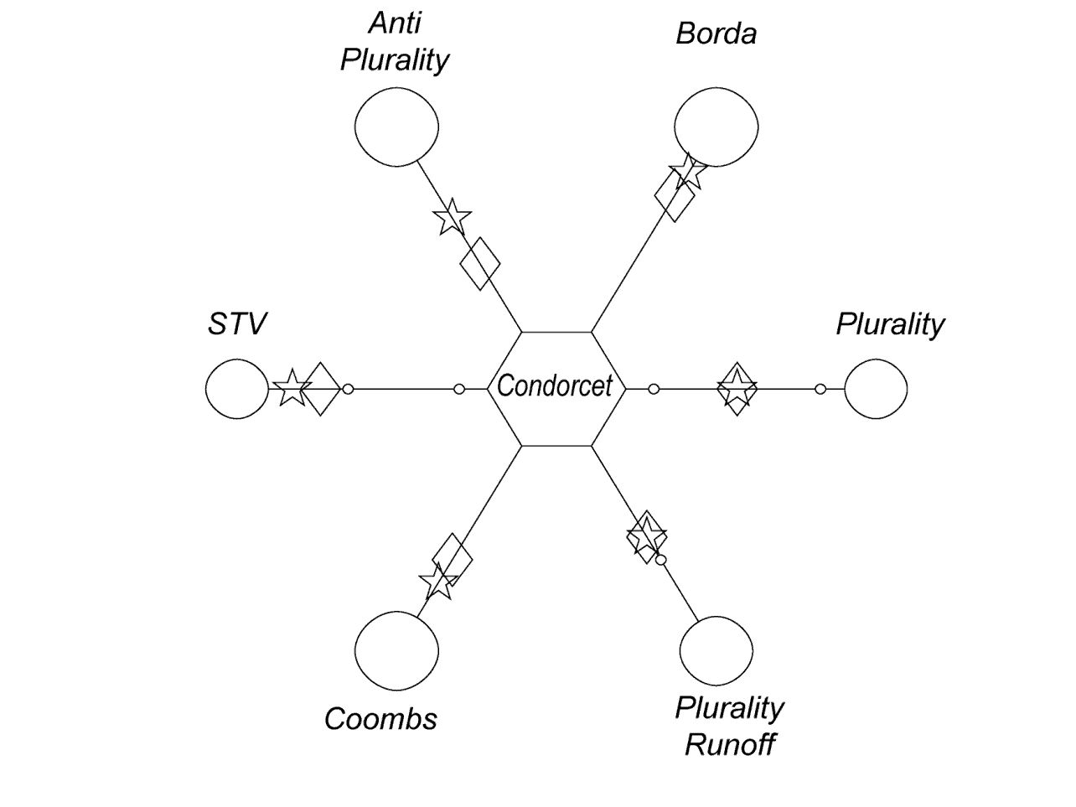
Winners
Notes:
Split in two!!!!
We want to have circle as far from the center as possible b/c that indicates high confidence of agreement
And we want the circle to be a s big as possible b/c that indicates many data sets have agreement on winners
Two theoretical predictions stars refer to IC and diamond refers to IAC. Thepretical predictions are closer to the center than empirical finidngs
We find a lot more agreement then theoretical prediction
We agregated results across all 3 models and 8 datasets. And created following visualization.
Each leg is an interval from 0 to 1. it represents proportions of coincedences of two social choice rules winners (bootstrap confidence)
Diameter of the circle on this interval represents the proportion of datasets among all models and datasets (Max=1) s.t. they have such location.
Diamond represents impartial culture benchmark and star represents impartial anonymus culture benchmark.

Slide 34
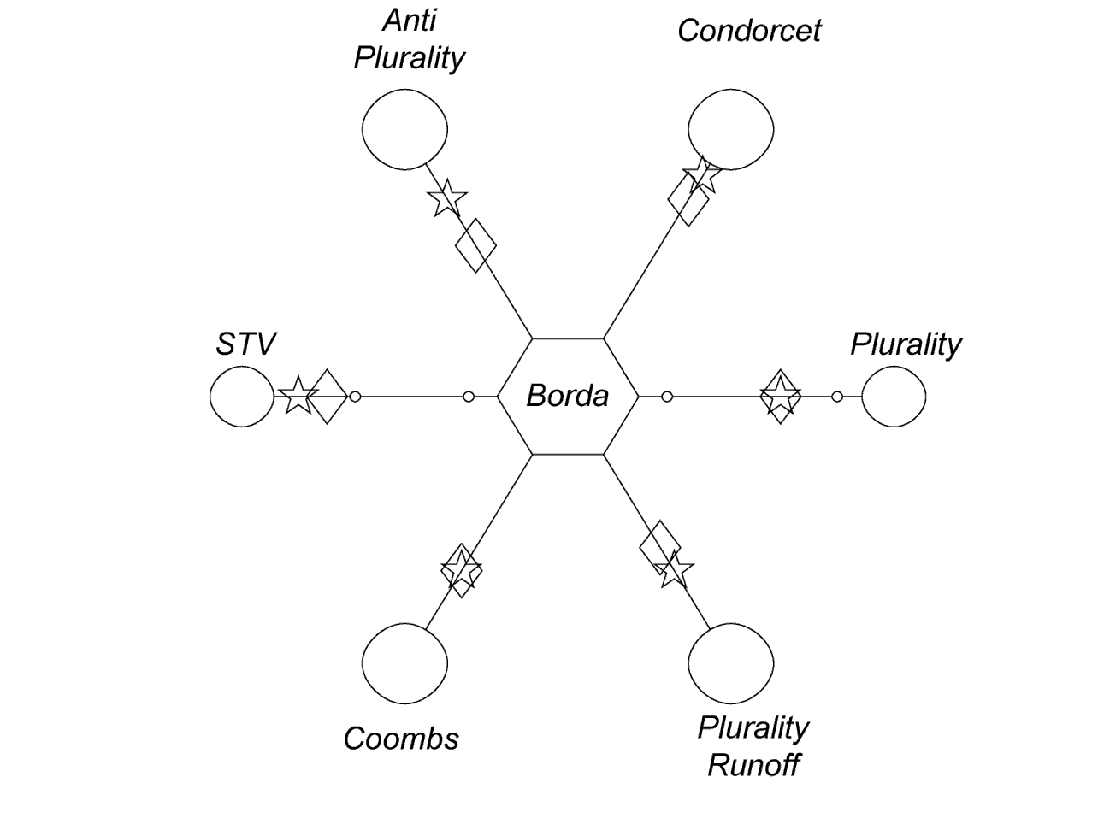
Winners
Notes:
We have a similar picture when we use Borda rule as a reference

Slide 35
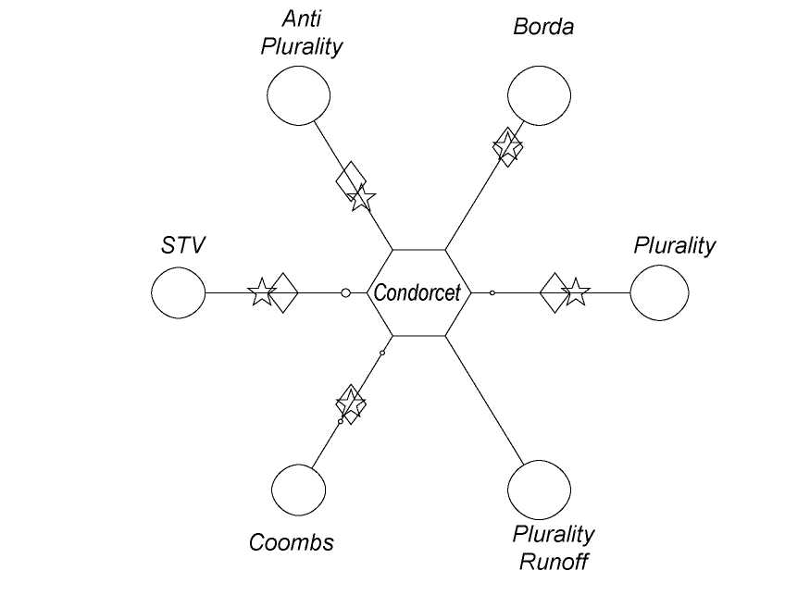
Losers

Slide 36
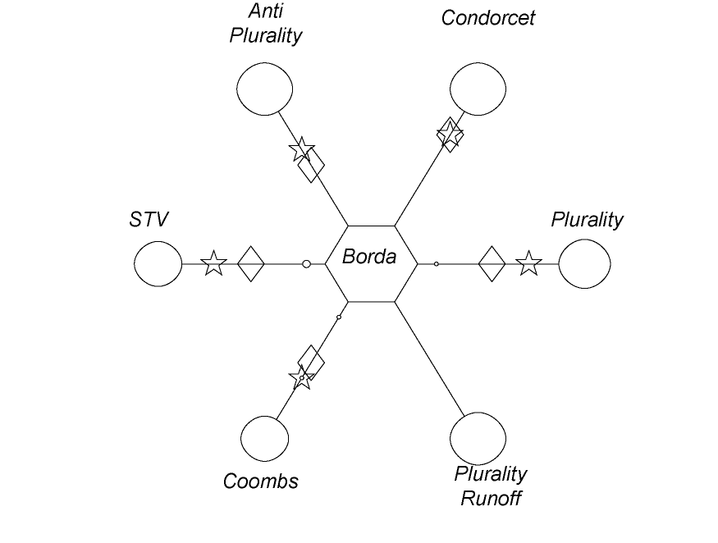
Losers

Slide 37
Conclusion
Impossibility theorems and voting paradoxes
Hypothetical profiles in text books
Empirical consensus (in large scale data)
Notes:
impos. TH : different rules based on different principles must be expected to disagree
The literature emphasize how Badly diff rules disagree and present hypoth. Profiles with high probab of disagreement
This is a good proxi for political elections and we are looking for
When and why there is such a consensus and what is the behaviorally plausible explanation
Behavioral science can motivate new mathematical research

Slide 38
Conclusion
Impossibility theorems and voting paradoxes
Hypothetical profiles in text books
Empirical consensus (in large scale data)
Thank you!
e-mail: apopova2@uiuc.edu
Notes:
impos. TH : different rules based on different principles must be expected to disagree
The literature emphasize how Badly diff rules disagree and present hypoth. Profiles with high probab of disagreement
This is a good proxi for political elections and we are looking for
When and why there is such a consensus and what is the behaviorally plausible explanation
Behavioral science can motivate new mathematical research

Slide 39
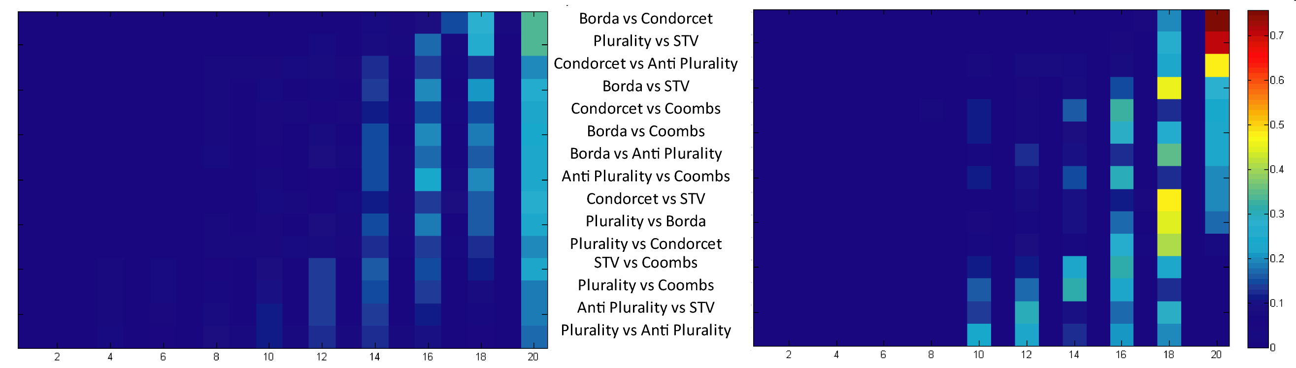
Empirical Consensus among
Consensus Relations
Notes:
Put after conclusions

Slide 40
Agreement among winners under Impartial Culture
 | LO3* | LO5 | WO5
Condorcet Borda | .82 | .66 | .68
Condorcet Plurality | .69 | .43 | .51
Borda Plurality | .76 | .54 | .59
All 3 |  | .39 | .46
*Source: Gehrlein and Fishburn (1978: Table 1, 48)
Notes:
Drop! Move to the end

