Slide 1
Opening a Russian Restaurant in Scarborough, Toronto
Applied Data Science Capstone Project
IBM Data Science Professional Certificate

Slide 2
Problem
Given the existence of a large Russian diaspora in Toronto, the idea to open a Russian restaurant seems lucrative. However, we must know where is the best place to open it, as the location is a crucial thing for this type of business.
We must choose from a wide variety of areas, the best place. The problem is: How to choose it ?

Slide 3
Used Data
Data on Toronto neighborhoods
Population & Ethnic Distribution of Each Ward from Scarborough borough – Using the public available data
The most popular places in the chosen borough – Using the Foursquare open API’s

Slide 4
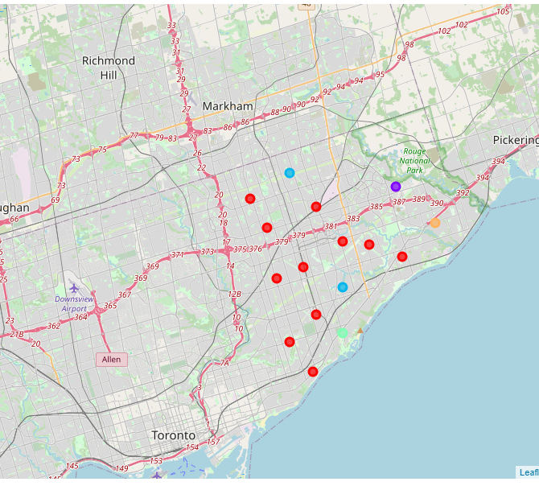
The obtained clusters for Scarborough Cluster 0 = Red Cluster 1 = Purple Cluster 2 = Blue Cluster 3 = Orange

Slide 5
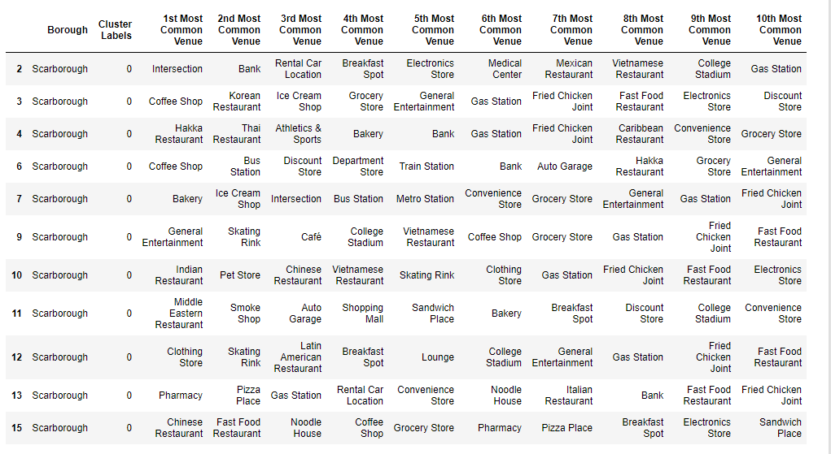
Characteristics of the selected cluster: Cluster 0

Slide 6
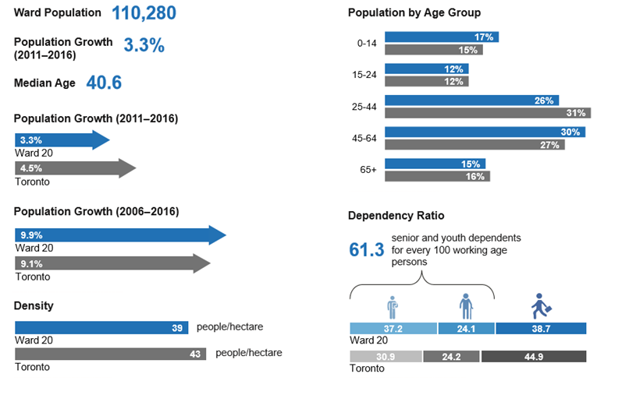
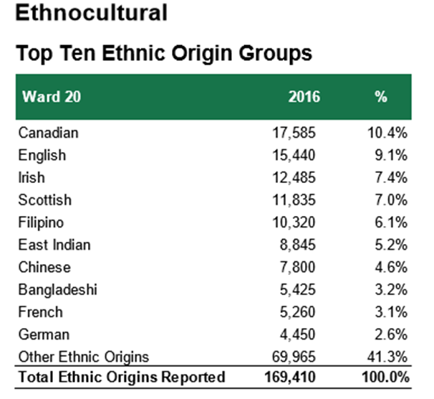
Characteristics of the selected Ward: Scarborough Southwest
The Canadian and English origins will make the advertising campaign easier and cheaper, given a stronger cultural affinity.

Slide 7
Results
The study of the Scarborough borrow showed the absence of any important Russian community. The population of the analyzed wards has a preponderant Asian origin, except the Ward 20 - Scarborough Southwest, which has a more “European profile”. Our clustering analysis showed this ward as a part of the first, and the biggest cluster, which has the highest economic activity.
These are the main reasons for which we selected this ward as a place to open our business: a Russian restaurant. We see that it has fairly good chances to succeed, given the high popularity of the restaurants among the population of the selected cluster.

Slide 8
Discussions
The main finding of this study is the absence of an important Russian minority, which can represent a big problem for the incipient phase of our business. However, we consider that we’ve extracted the maximum from the analyzed borough.
An eventual next step will be an inclusive ML clustering of the entire Toronto area, to find the places with a higher concentration of Russian people and the highest commercial potential.

Slide 9
Conclusions
During this Capstone project, I’ve analyzed the Scarborough borough in Toronto, to find the best place for the launch of a Russian restaurant.
We used a Machine Learning algorithm, to make a cluster analysis of the mentioned borough. After, we compared the obtained clusters with the ethnic profile of each ward from the chosen cluster. We selected the Ward 20 - Scarborough Southwest, as its population has European origins, which will make it easier to advertise our business.
The further development of this analysis will be the study of the entire area of Toronto, to find the places with the highest concentration of Russian and Slavic population and good commercial potential. In these places, we’ll eventually open another restaurant.

