Slide 1
Exploring the Emotify dataset genre and emotion classification from music information retrieval
Sergi Andreu and Carsten van de Kamp

Slide 2


Goal and relevance
Goal: find relevant features of audio data for the prediction of genre and emotion
Relevance:
Improve musical knowledge
Helps understanding the mechanisms behind the subjective nature of human perception
Applications:
Music recommendation
Creating playlists that fit to current mood
Music creation
e.g. if you want your music to be super sad, adjust that feature
Notes:
Carsten

Slide 3

The Emotify dataset [1]
4 genres with 100 songs each
8408 annotations produced by a Facebook game
Choose maximally 3 out of 9 emotions
Skipping songs and switching genre allowed
Notes:
Carsten

Slide 4
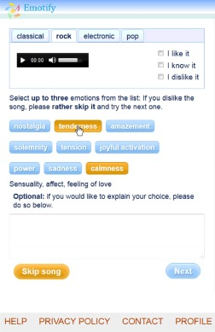
Geneva Emotional Music Scale [2]
Amazement
Solemnity
Tenderness
Nostalgia
Calmness
Power
Joyful activation
Tension
Sadness

Slide 5
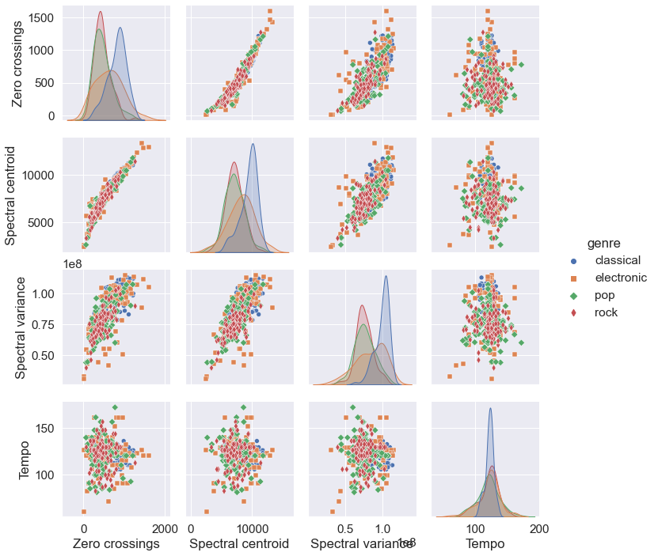

Attempts
Simple features
Zero crossings
Spectral centroid
Spectral variance
Tempo
Notes:
Carsten

Slide 6
Attempts
Simple features
Zero Crossings
Spectral Centroid
Spectral Variance
Tempo
Result: (kernel) SVM’s with poor accuracy → Simple features not separable
Conclusion: Emotions and genre have a complex representation, or the features used are irrelevant
Notes:
Carsten

Slide 7
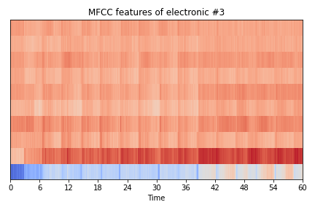

Attempts
Complex features
Rhythm
MFCC
STFT
Train CNN
Temporal invariance
Universal function approximator
Result: Too little data, too many variables → Overfitting
Conclusion: aim at smaller/pretrained models
Notes:
Sergi

Slide 8

And now?
Improve predictions by finding more complex high-level features
Use pre-trained MusiCNN [3]
Train the simple models (SVM, kNN) on these high-level features
Notes:
Sergi

Slide 9


Conclusions
Small dataset with high-dimensional samples and noisy labels
Ill-posed problem
But data=music! → Use transfer knowledge from MIR
Finding good features is not easy!
Training takes a lot of time
Trade-off: model complexity classification accuracy
Prefer models that could be explained in subjective/musical terms "easily“
Notes:
Sergi

Slide 10
Exploring the Emotify dataset genre and emotion classification from music information retrieval
Sergi Andreu and Carsten van de Kamp

