Slide 1
Credit hour system

Slide 2
Team member
KARIM AHMED
YOUSSEF MOHAMED
SERGI SAMIR
MAHMOUD REDA
MOHAMED HESHAM

Slide 3
Introduction :
Our system is dedicated to calculate the total GPA of the students posted from the staff, who take the grades from the doctors
Student is able to sign up his information, so the staff register students records
Doctor teaches courses to students and gives grades to staff
Assisting teachers give sections to students

Slide 4
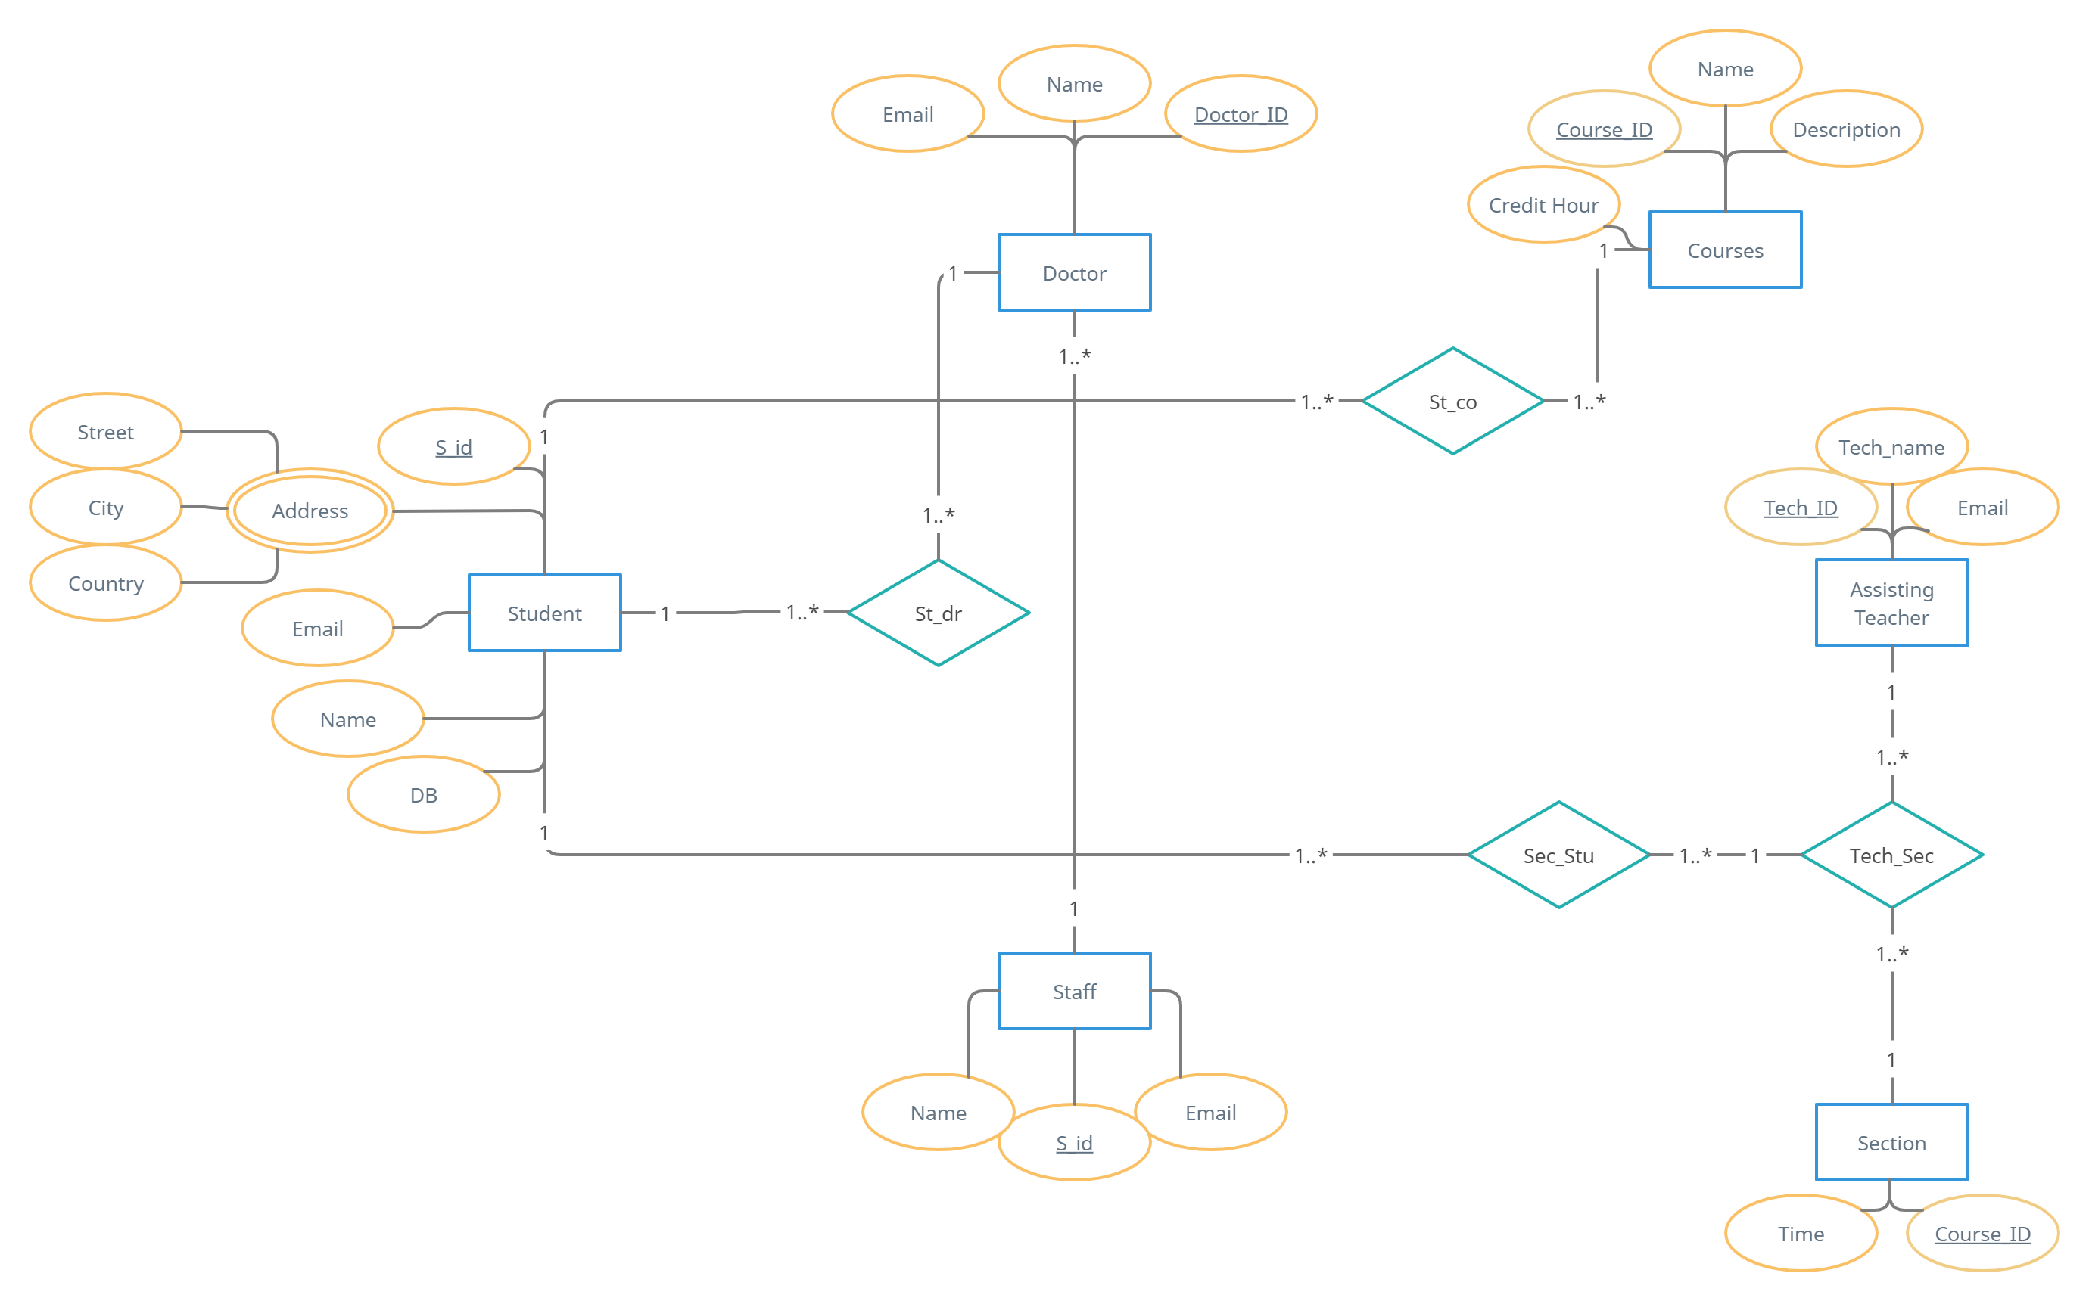
Entity relationship diagram:

Slide 5
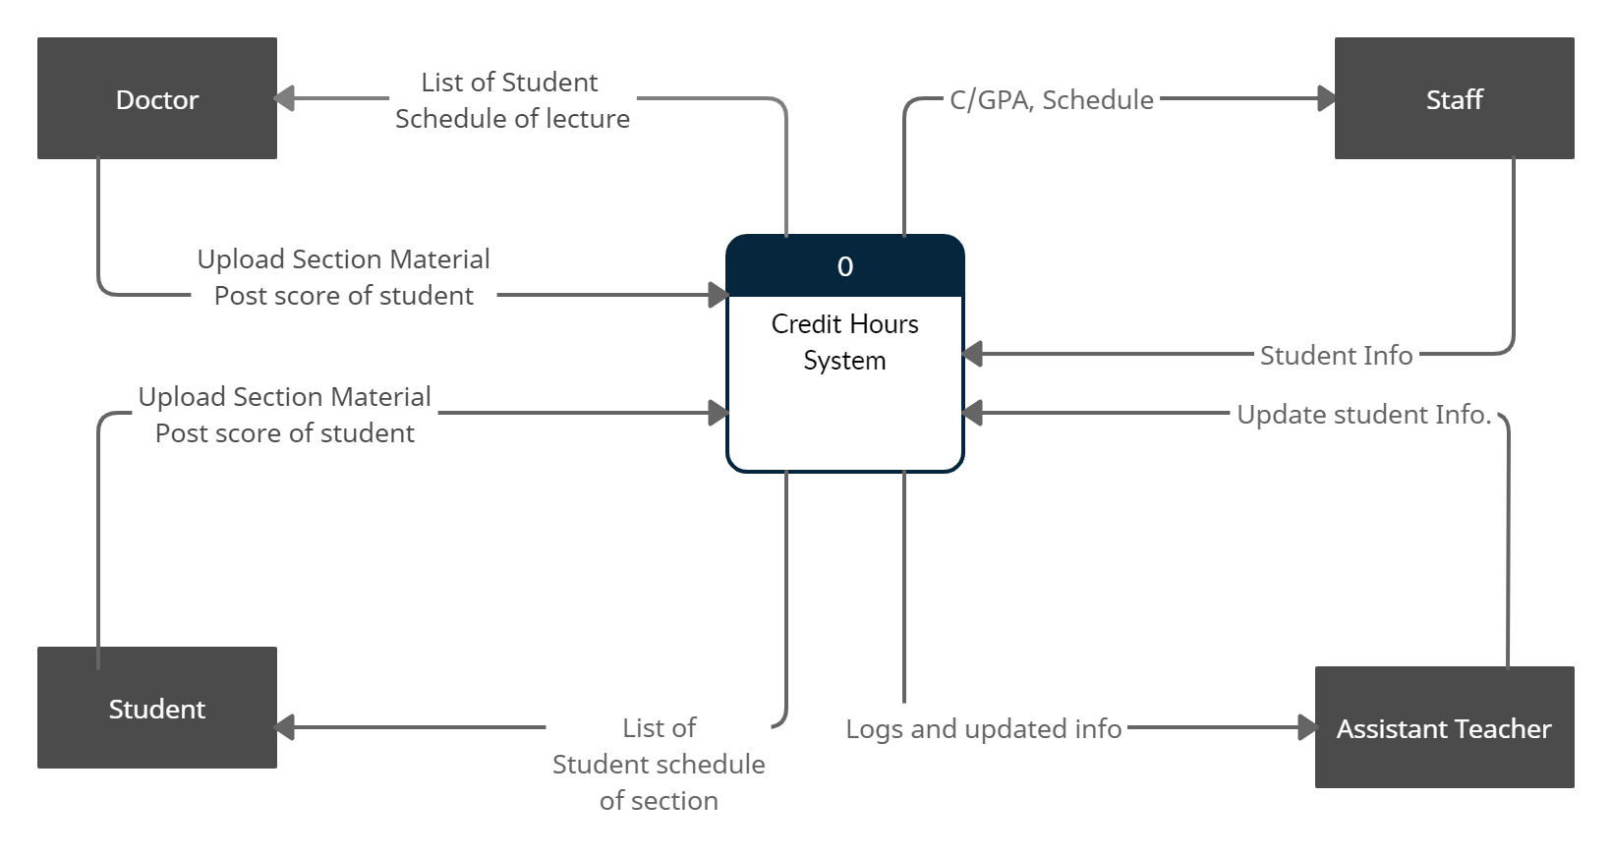
Data flow diagram: (level 0)

Slide 6
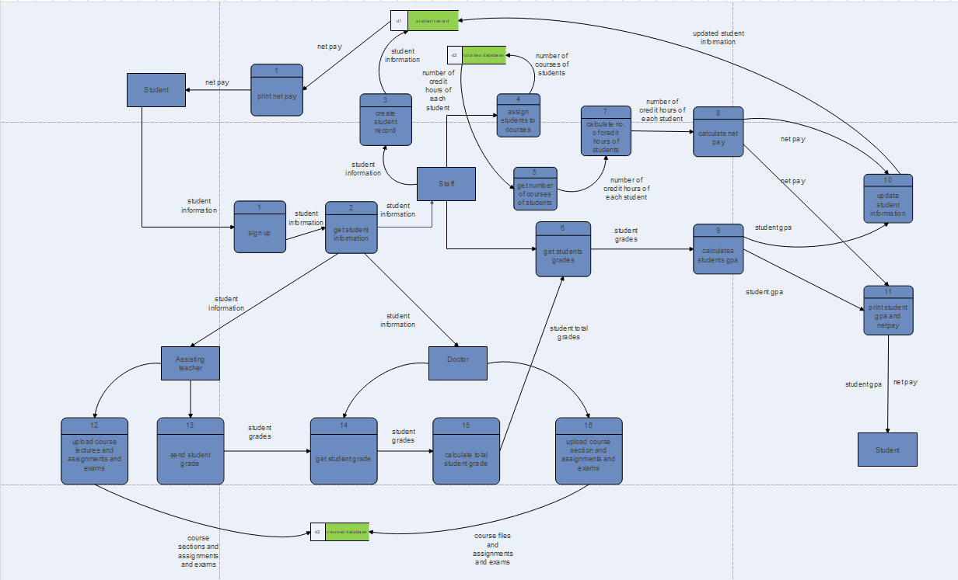
Data flow diagram: (level 1)

Slide 7
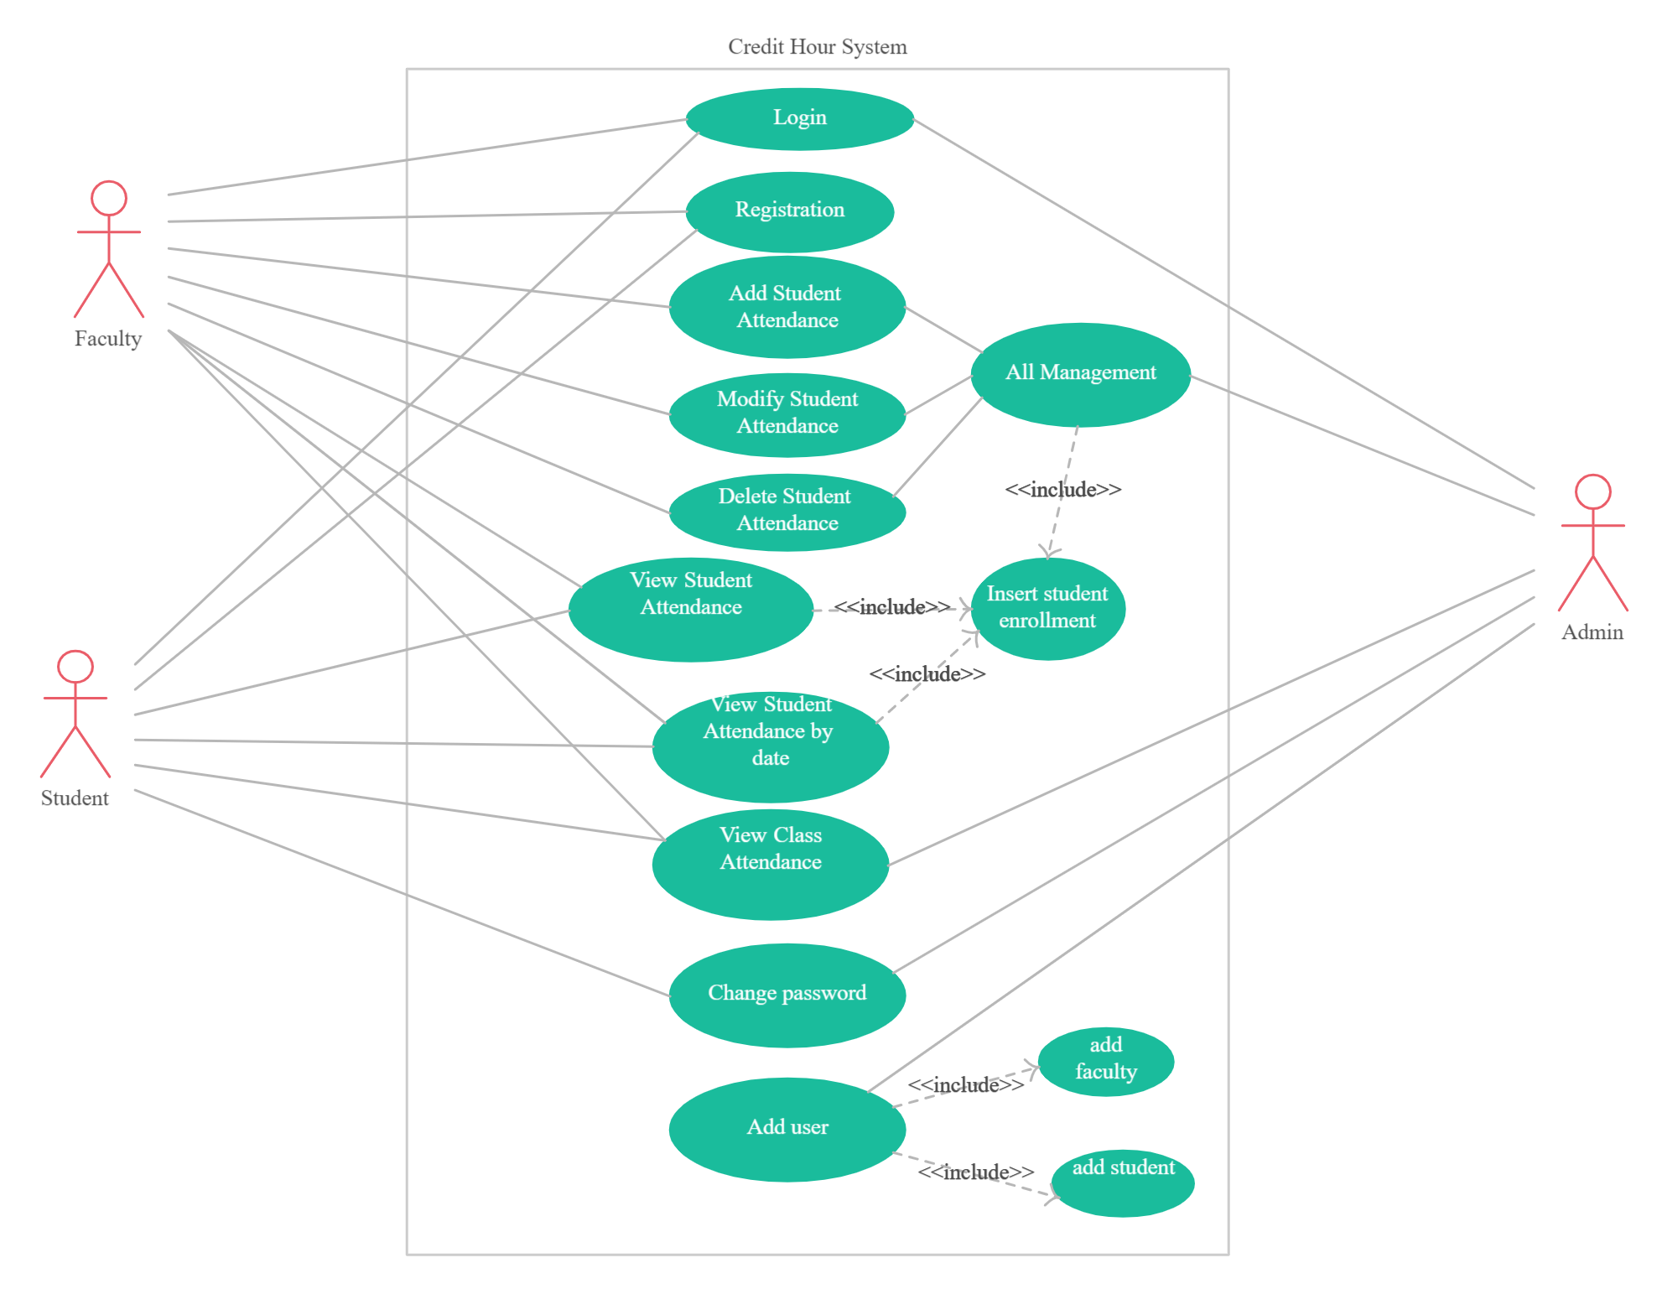
Use case:

Slide 8
Stakeholders analysis:
Suggested Interview Questions for Key Stakeholders:
SIM Credit Hours System – web /mobile application (SCHS) :
.Tell us more about yourself : 1) What is your position and what are your responsibilities?
2)What is your relationship with the SIM Credit Hours System?
.Your goals for the Project : 1) What impact does the site currently have on your work?
2) In a few words, how would you describe the site?
3)In your view, what would make a redesign of the site successful? What are your goals?
4) How does this project tie into the overall faculty of science strategy and initiatives?
5) What aspects of the site (if found) do you feel need improvement?

Slide 9
.People important to our success – and how we can serve them :
1) Which customers does SIM Credit Hours System communicate with most?
2) Who are the (intended) users of site?
3)How diverse are these users’ needs?
4) Looking at all the users of the site, which ones are most critical?
. Type of interactions you want customers to have:
1) What kind of information or activities do you want to support on this project?
2) What kind of relationship or experiences do you want to create?
3) What next steps do you want site users to take?
4) What emotions, if any, do you want the site to evoke?
5) What other of your projects may be related to the site?

Slide 10
. Other initiatives or projects that could impact this work :
1) What other related efforts could impact the redesign (SIM Credit Hours System)?
2) What other project do you think do an excellent job of educating consumers in renewable energy and energy efficiency?
. Standards we should adhere to :
1) What design, branding and communication standards impact the design of the site?
. Comments :
1) Who do you see as the key partners and decision makers in the redesign process?
2)Can you provide any words of advice?
3)Are there blockers to success that we should look out for?
4)What are your bottom line “must-haves”? Additional information
5)Is there anything else you’d like to share with us today?

