Slide 1



A Flu Shot Learning Project
Class: Data Circle
Team: NeuroShot
Americano Guerrero Diana Paola
Makhin Sergii
Notes:
Hi, I’m Sergii, and together with Diana, we investigated one of the puzzling aspects of human behavior: why people sometimes reject measures that protect their health, even when those measures are simple and proven. We focused on the decision to get a flu vaccine, comparing uptake of the standard seasonal flu vaccine and the one for the H1N1 “swine flu” strain.

Slide 2
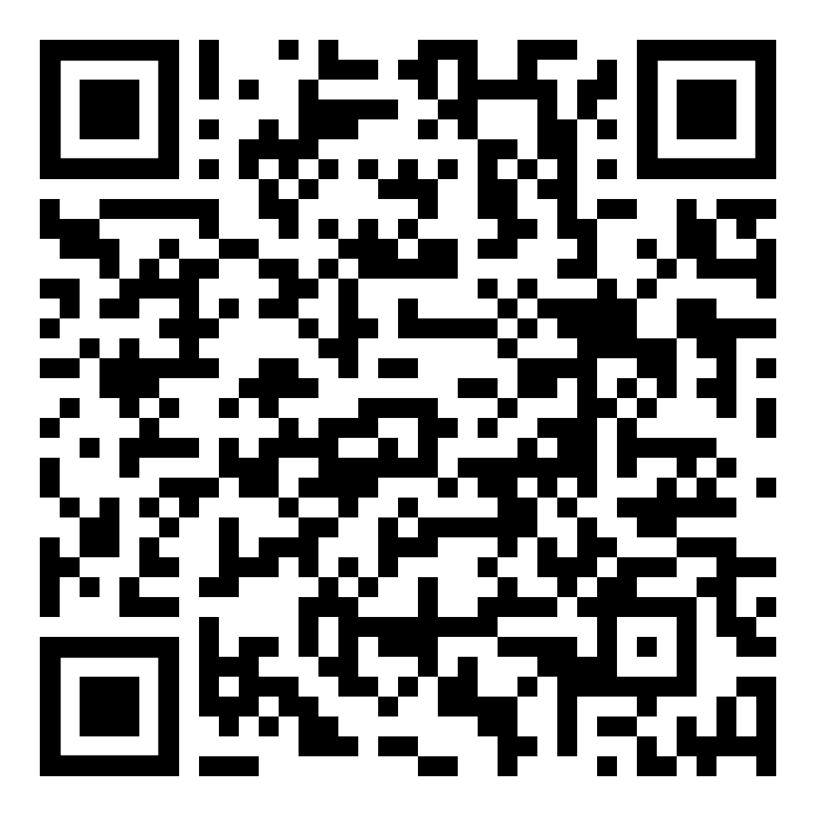


Understanding Flu Vaccination Decisions
Question:
Why do people opt for or against being vaccinated?
Focus:
Seasonal flu vs. H1N1 vaccine decisions
Data:
National 2009 H1N1 Flu Survey ~27K U.S. cases
Goal:
Uncover behavioral drivers of vaccination uptake
Value:
Better understanding of vaccine hesitancy to enable targeted outreach and healthier communities
Notes:
Our work builds on data from the National 2009 U.S.-wide Flu Survey during the global H1N1 outbreak. The swine flu pandemic had caused hundreds of thousands of deaths worldwide, and the H1N1 vaccine became available in October 2009.
Using this large dataset (about 27,000 respondents) we looked at how socioeconomic, demographic, health-behavior and opinion factors shaped whether people got vaccinated. While the data are limited to a particular time (just after the H1N1 outbreak) and a specific population (U.S.), they still offer valuable, stable signals about decision patterns.
Our findings can help public-health organisations understand and address why many people decline well-studied preventive measures. This matters especially in light of the recent COVID-19 pandemic, which underscored how dangerous low vaccination uptake can be.

Slide 3
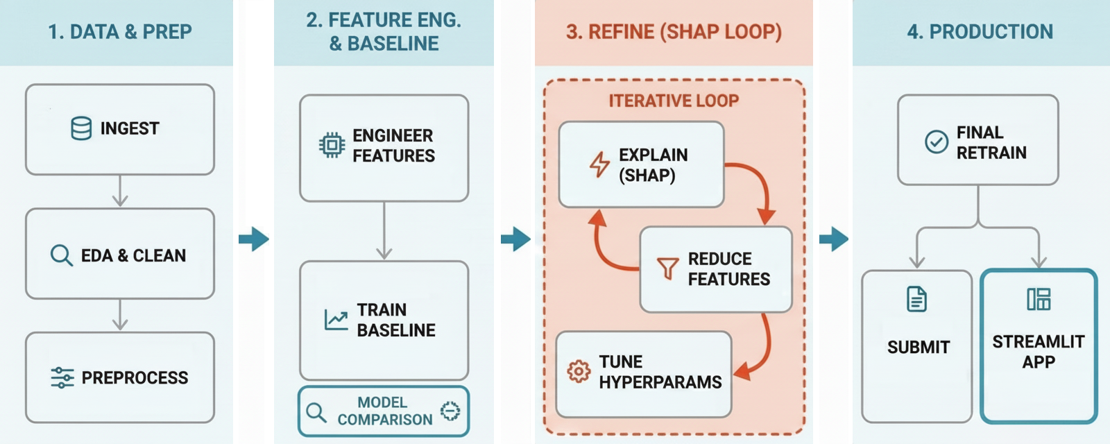
Project Workflow
Notes:
We started by ingesting and cleaning a large public flu-vaccination dataset, performing exploratory analysis and preprocessing to ensure data quality.
Next, we engineered new features based on the given ones and trained baseline models to establish initial predictive performance.
Through an iterative refinement loop, we used a popular model explainability technique (SHAP) to interpret predictions, reduce unnecessary features, and tune hyperparameters.
Finally, we retrained the optimized model and prepared it for submission and interactive deployment via a Streamlit application

Slide 4
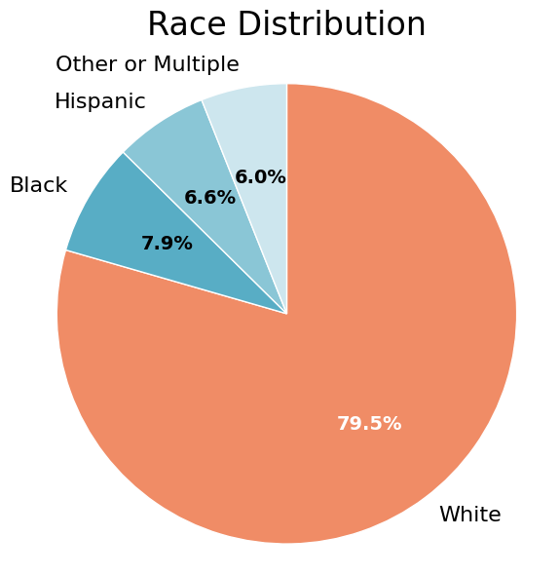
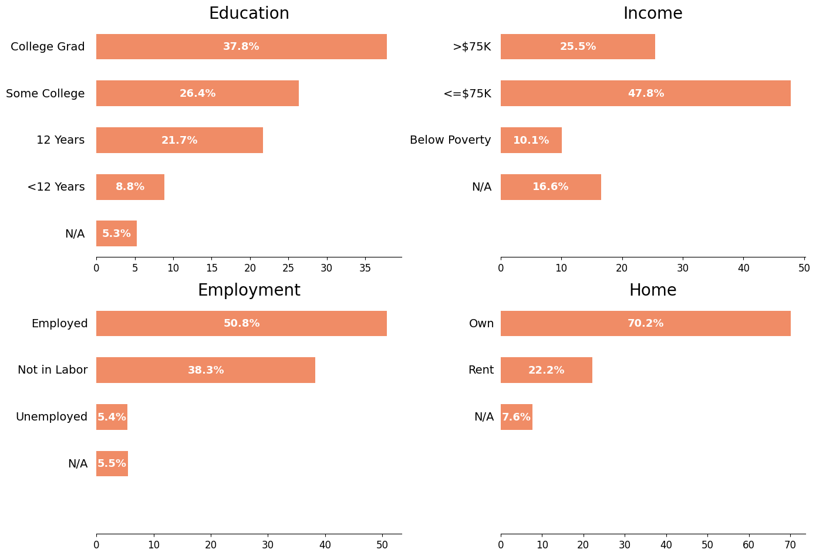
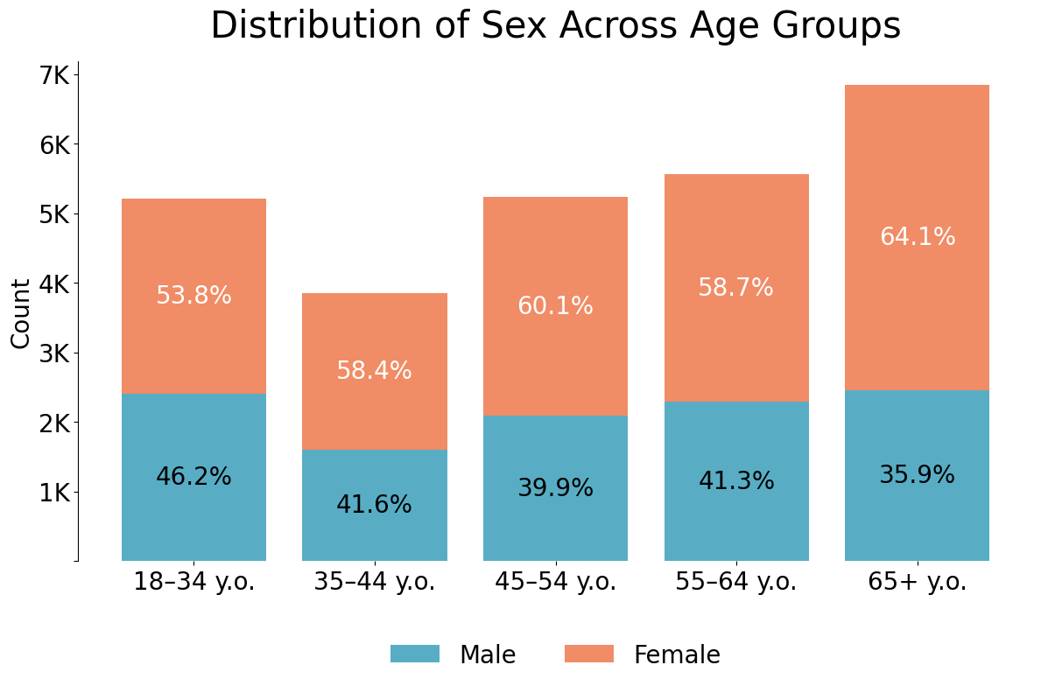
Socio-Economic Composition
Notes:
It is important to keep in mind that every dataset reflects the population it was collected from and therefore carries representational biases. Before extending any conclusions to other contexts or countries, we need to understand who is actually represented in the data.
This slide summarizes the socio-economic composition of our dataset. The sample is predominantly White, relatively well educated, and largely employed, with a high share of homeowners. Income and education levels are skewed toward middle- and higher-income groups, and women are slightly more represented, especially in older age groups.
These characteristics are essential context for interpreting our results: they shape both vaccination behavior and the limits of how broadly our findings can be generalized beyond the U.S. population captured in this survey.

Slide 5
Feature Strategy: From Raw Data to Meaningful Signals
FEATURES
Overall: 35
Categories:
behavioral and opinion scales
binary health and access indicators
ordinal socio-economic variables
high-card. categorical fields (industry/occupation)
MISSINGNESS
Up to 45-50 % in industry, occupation, health insurance
Imputation strategies:
Median imputations for behavioral and opinion variables
NaN’s defined explicitly as ‘Missing’ for socio-economic and employment fields
ENCODING
Ordinal mappings for naturally ordered features (e.g. age, education, income)
One-hot encoding for small categories (e.g. sex, insurance, housing)
Target-encoding for industry/occupation
Notes:
The dataset contains dozens of heterogeneous features covering health behavior, opinions, demographics, and socio-economic context. Our strategy focused on making this complexity usable without losing meaning.
Missingness was handled explicitly and intentionally, rather than treated as noise.
For behavioral and opinion variables, we used median imputation to preserve scale meaning.
For socio-economic and employment variables, missing values were treated as informative categories.
Doctor-recommendation fields were conservatively imputed as “no recommendation” when missing.
For encoding, we applied different methods depending on semantics:
Ordinal mappings for naturally ordered features like age, education, and income.
One-hot encoding for small categorical sets (e.g. sex, insurance, housing).
Target encoding for high-cardinality features (industry and occupation) to retain predictive signal without exploding dimensionality.

Slide 6



Feature Engineering
Engineered Feature Categories:
Preventive behavior patterns
Risk & belief consolidation
Health vulnerability indicators
Doctor influence signals
Interaction features
EXAMPLE:
Belief in Vaccine Effectiveness
+
Perceived Risk of Flu Without Vaccine
–
Fear of Getting Sick from Vaccine
=
Pro-Vaccine Attitude Score
Why This Feature Exists
Mirrors how people weigh pros vs. cons
Combines multiple opinions into one signal
Represents a mental decision balance, not a statistic
Notes:
Finally, we introduced feature engineering to reflect real-world decision mechanisms rather than isolated variables.
We engineered features by grouping many individual survey questions into meaningful categories that reflect how people actually make health decisions, such as behavior, beliefs, medical risk, and access to medical services.
One example is Perceived Vaccine Advantage. Instead of treating opinions separately, we combined three related ideas: how effective people think the vaccine is, how risky they believe the disease is, and how worried they are about possible side effects.
This mirrors a natural thought process: people mentally weigh benefits against risks before acting. By encoding that trade-off directly, we aim to represent decision-making more realistically than with isolated variables.

Slide 7
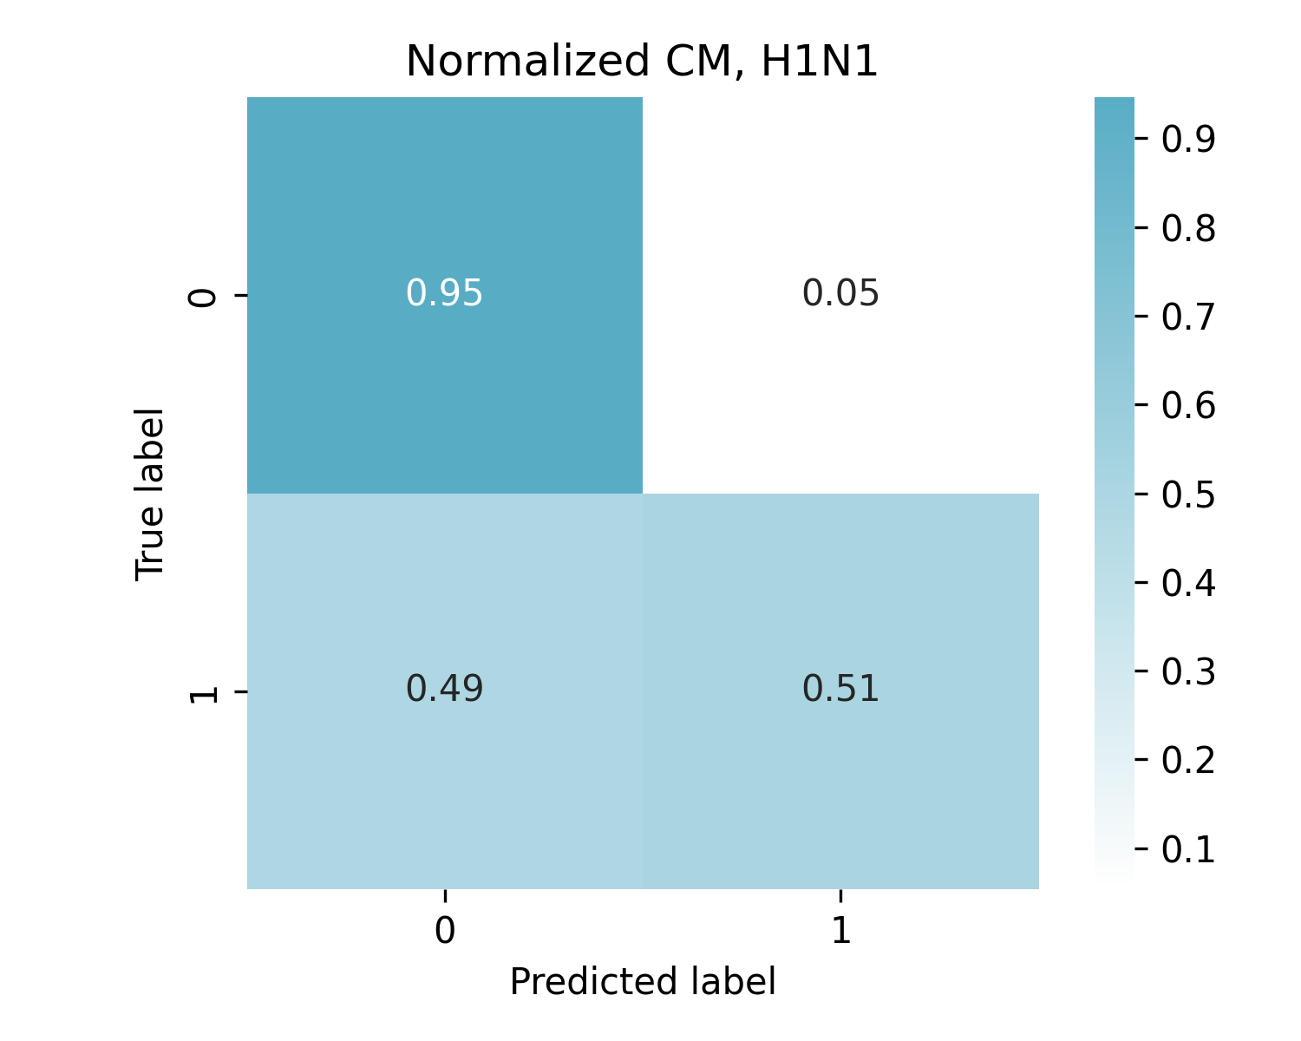
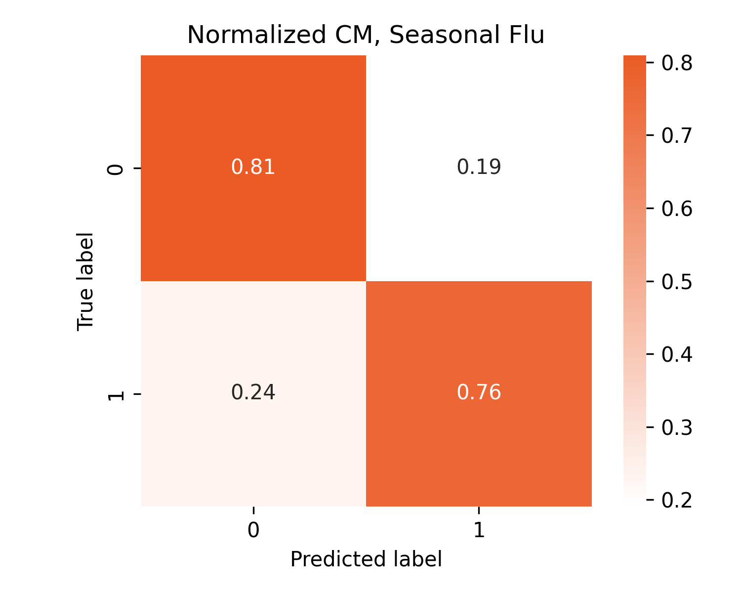
Model Selection
Challenge:
Seasonal Flu dataset: balanced (53% No/ 47% Yes)
H1N1 dataset: heavily skewed (79% No / 21% Yes)
WINNER: LightGBM
Tested Models:
Logistic Regression: Linear baseline
Random Forest: Non-linear bagging ensemble
LightGBM: Gradient boosting framework
Selection Metric: ROC-AUC
Why?
threshold independence
robustness to imbalance
H1N1: High Precision, Low Recall
Misses 5% of unvaccinated and 49% of vaccinated
Seasonal Flu: Balanced Performance
Misses 19% of unvaccinated and 24% of vaccinated
Notes:
We started with a distinct challenge: two very different datasets. The Seasonal Flu data is effectively balanced, but the H1N1 data is heavily skewed, with only 21% of people actually getting the vaccine.
To handle this, we tested three models: a Logistic Regression baseline, a Random Forest, and LightGBM, which is state-of-the-art for tabular data. We chose ROC-AUC as our guiding metric because it ignores the imbalance: we need a model that actually ranks high-risk people correctly, not just one that maximizes accuracy by guessing 'No' every time.
The clear winner was LightGBM, scoring an 0.87 AUC for H1N1 and 0.86 for Seasonal Flu.
But looking deeper, we see a key difference. The Seasonal model is balanced, missing about 20% of cases either way. The H1N1 model, however, is too conservative. It misses only 6% of the unvaccinated, but it misses nearly half of the people who actually got the vaccine.
That key insight defines our next step: we need to fine-tune specifically to fix that recall gap

Slide 8

Model Fine-Tuning
Tuning Objective: F1-Score
to find the optimal "sweet spot" between Precision and Recall
Target | Metric | Change | Implication
H1N1 | Recall | ⬆️ +36.28% | Major Goal Achieved (Fewer Misses)
/Skewed/ | Precision | ⬇️ -18.85% | Accepted trade-off for higher recall
 | F1-Score | ⬆️ +5.96% | Overall utility improved
 | ROC-AUC | ⬆️ +0.48% | Predictive power slightly improved
Seasonal | Recall | ➡️ -0.27% | Stable performance
/Balanced/ | Precision | ➡️ -0.46% | Consistent precision
 | F1-Score | ➡️ -0.36% | Consistent utility
 | ROC-AUC | ➡️ +0.27% | Predictive power consistent
Fix for Imbalance
scale_pos_weight applied to H1N1
Hyperparameter Optimization
RandomizedSearchCV
(30 iterations, 5-fold CV)
num_leaves, learning_rate, and regularization
Notes:
We selected LightGBM after comparing several models because it achieved the strongest overall performance.
The key challenge was class imbalance, especially for H1N1, where vaccinated cases were much rarer. Optimizing for standard metrics would favor predicting “no,” so we instead fine-tuned the model using F1-score, which balances precision and recall and better reflects the real objective.
We also adjusted for imbalance using class weighting and validated the tuning with cross-validation, rather than relying on a single train-test split.
This led to a clear improvement for H1N1: the model identifies far more vaccinated individuals, increasing recall by over 36% and improving the overall F1-score. For Seasonal Flu, which was already balanced, performance stayed mostly the same, confirming the model was already near optimal.
Overall, fine-tuning made the model more effective where the problem was hardest, without sacrificing robustness.

Slide 9


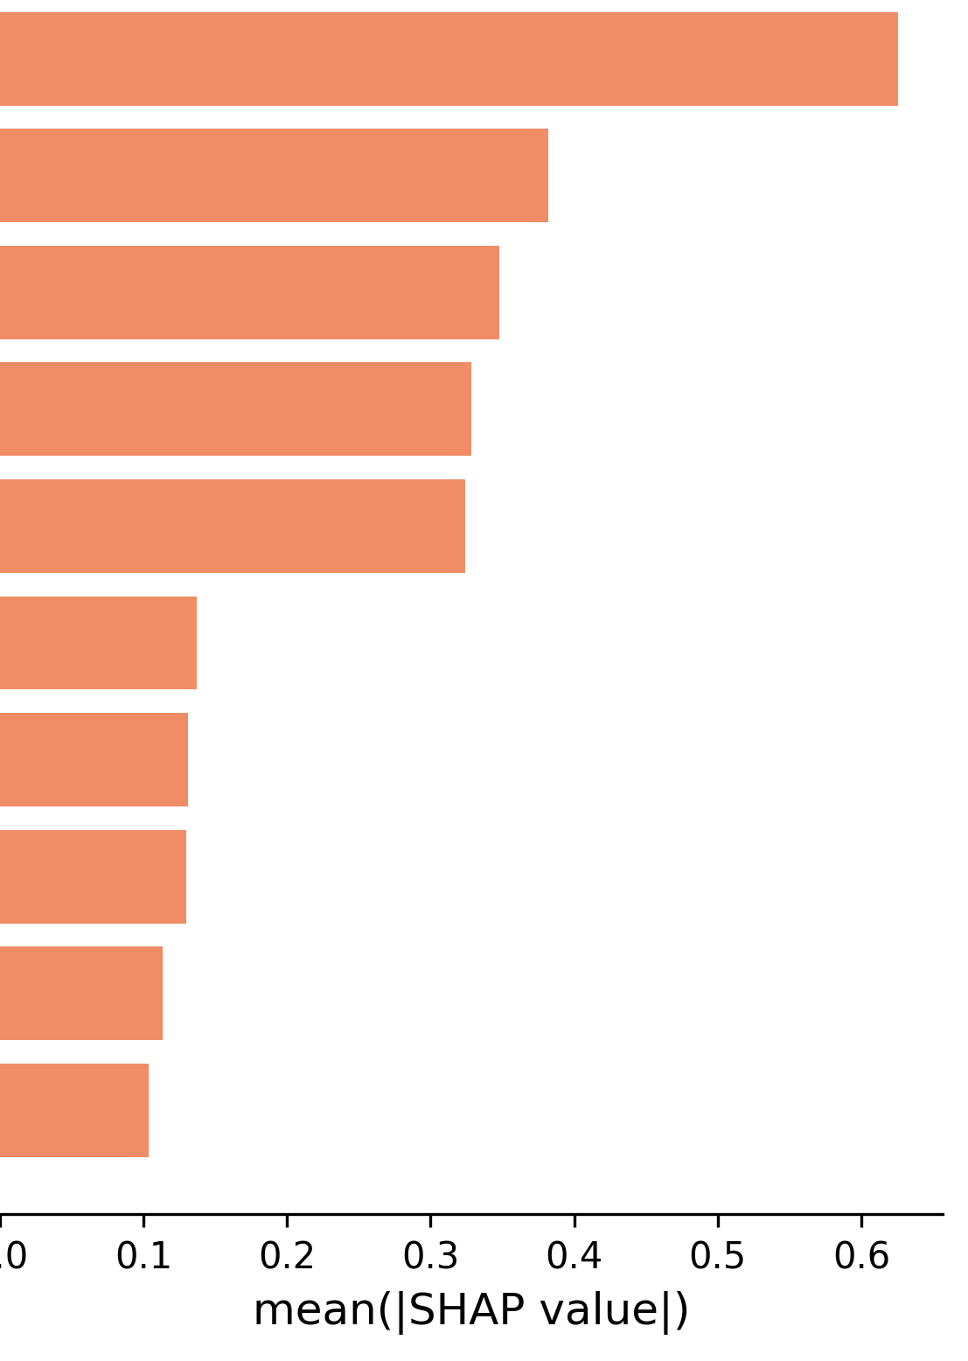
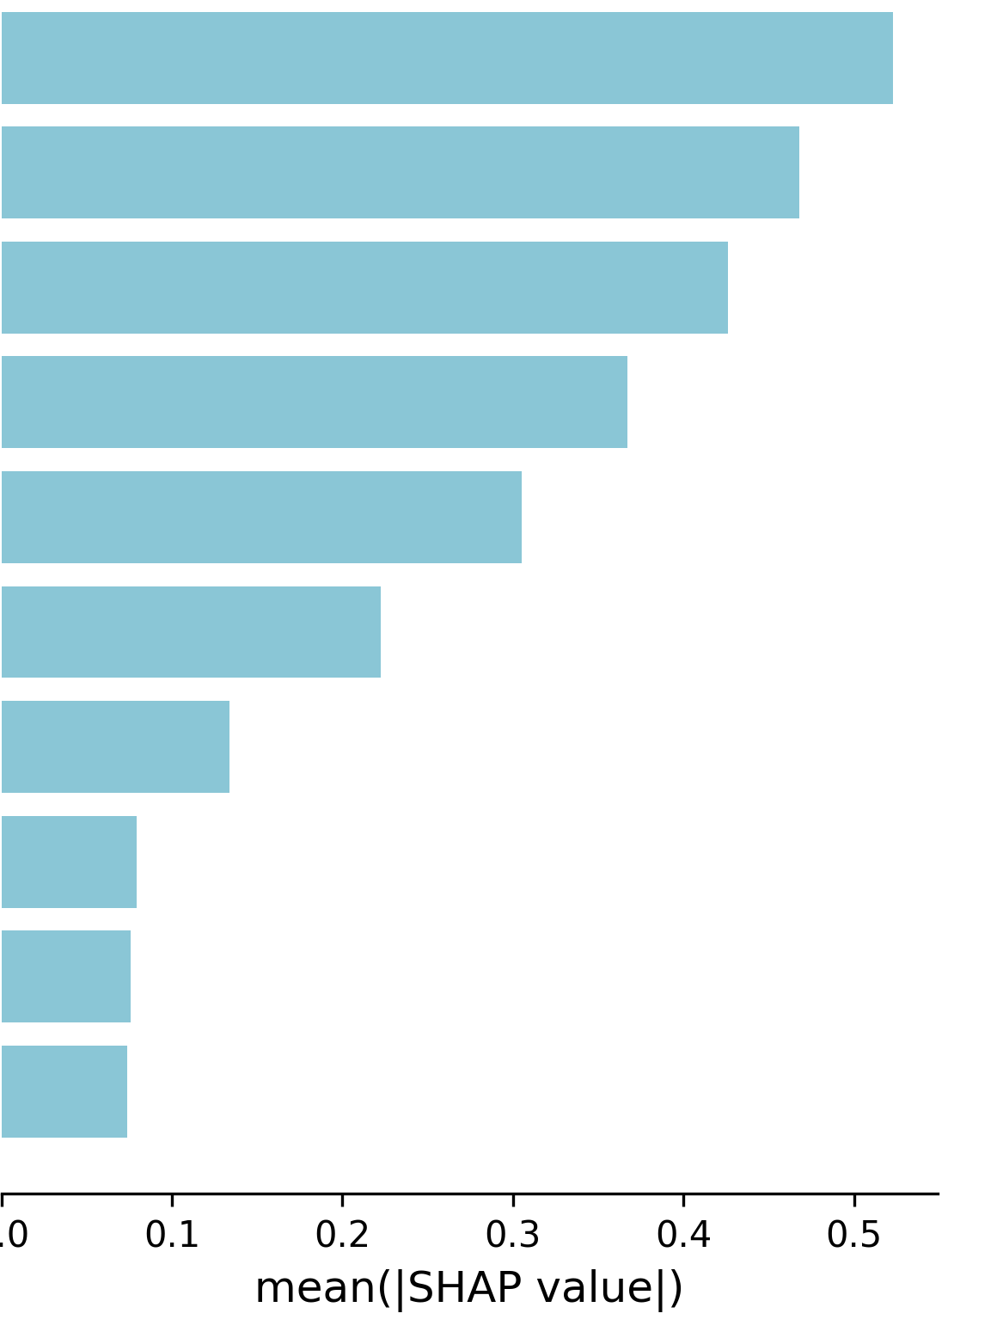
Feature Importance Analysis (SHAP): Top 10
H1N1 Model Feature Importance
Seasonal Flu Model Feature Importance
Doc.recom. H1N1
Health Insur.
Opp.: H1N1-Vac is Effective
Opp.: Risk if no H1N1-Vac
- Health Insur. (unreported):
Pro-Vac Att. H1N1
Age
-Opp.: Sick from H1N1-Vac
Pro-Vac Att. Seas.Flu
Male Sex
Pro-Vac Att. Seas. Flu
Doc.recom. Seas. Flu
Age
Opp.: Seas.Flu-Vac is Effective
Opp.: Risk if no Seas.Flu-Vac
Health Insur.
Pro-Vac Att. H1N1+Doc.recom.
-Opp.: Sick from Seas.Flu-Vac
H1N1 Knowledge
Education
Notes:
SHAP analysis indicates that both vaccination decisions are driven primarily by attitudes and physician recommendation rather than demographics.
For seasonal flu, a composite pro-vaccine attitude score dominates prediction, suggesting habitual and belief-consistent behavior.
In contrast, H1N1 vaccination, representing a novel and risk-salient decision, relies more heavily on explicit beliefs about vaccine effectiveness, perceived infection risk, and doctor endorsement, with the aggregate attitude score playing a secondary role.
Health insurance status strongly influences H1N1 uptake but is less decisive for seasonal flu.
Age shows a stronger effect for seasonal flu, consistent with routine preventive behavior, while education and sex contribute modestly.
Notably, positive seasonal flu attitudes and physician recommendation jointly increase the likelihood of H1N1 vaccination, highlighting belief spillover and authority amplification effects.

Slide 10
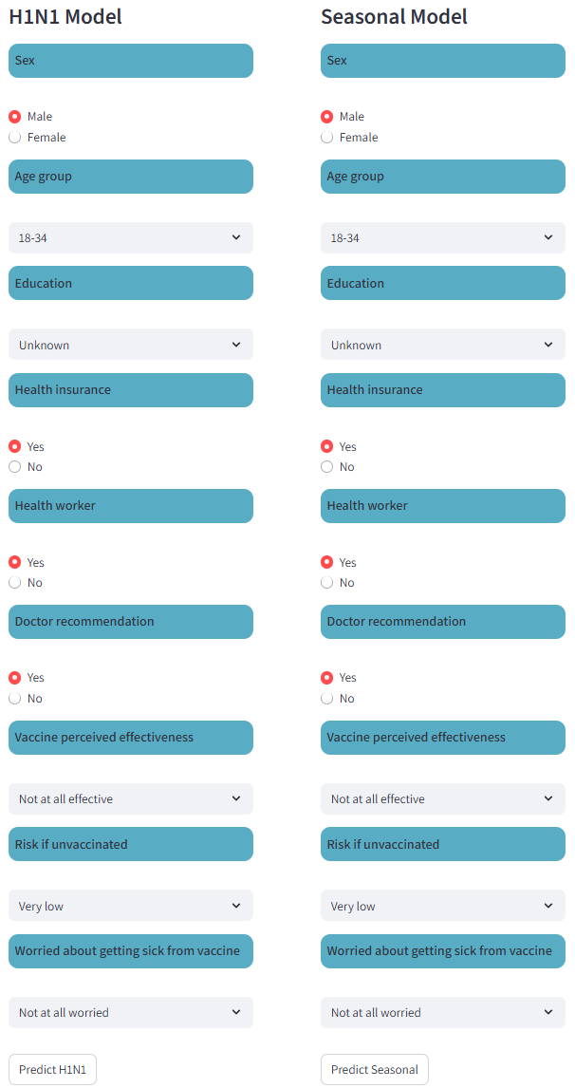
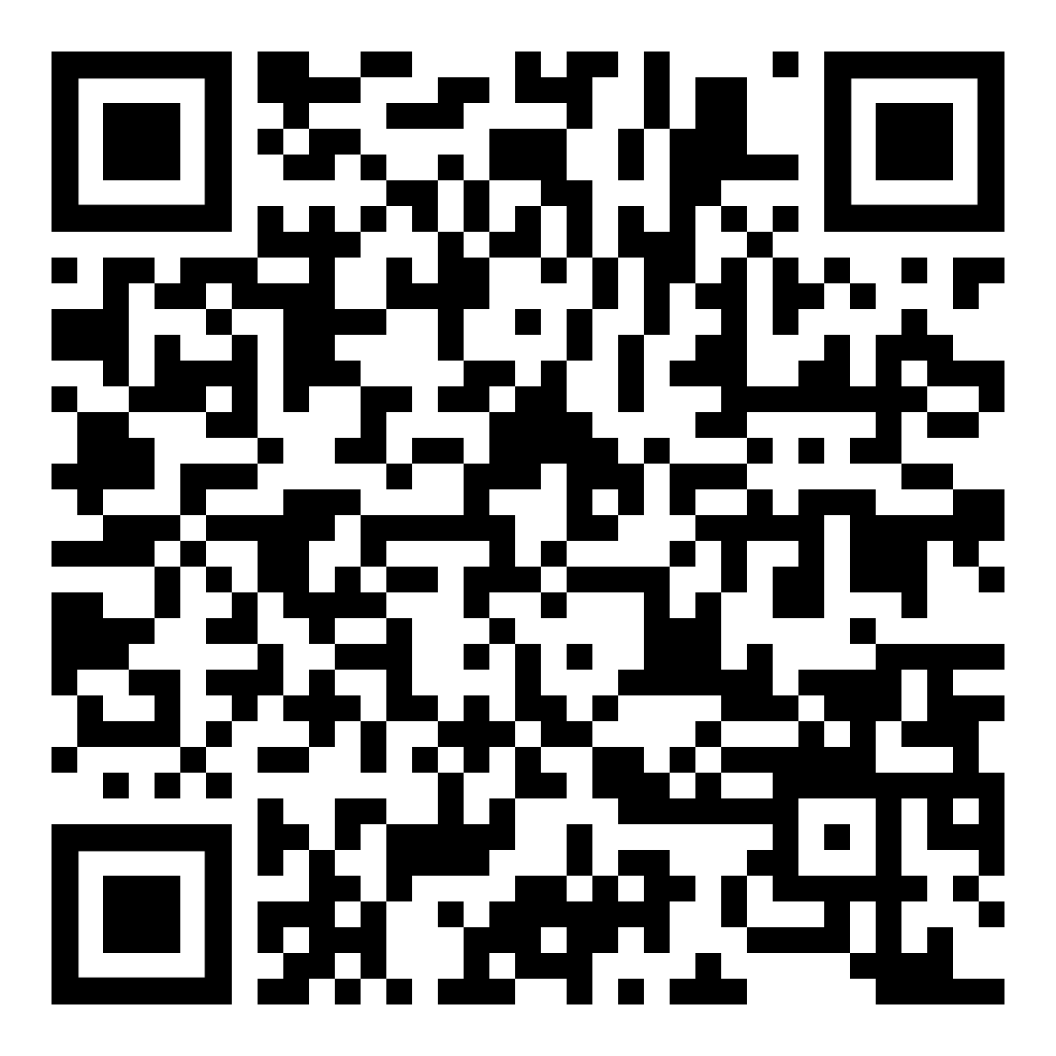
Model Performance and Deployment
Full feature models achieve averaged
ROC-AUC 0.8613 on the test dataset
(<1% the known best result)
Light 9-feature models perform with
<3% ROC-AUC loss
Light Models deployed on the
Streamlit platform:
Try-Out:
Start with doctor recommendation:
This option produces the largest change, especially for H1N1.
Beliefs drive predictions:
Vaccine effectiveness, risk if unvaccinated, and fear of side effects matter more than demographics.
Seasonal Flu vs. H1N1 differ:
Age matters more for Seasonal flu; being a male (vs female) matters for H1N1.
Notes:
We achieved near-benchmark performance with our full model and then reduced it to a nine-feature light version with less than a three percent performance drop.
That lighter model is deployed on Streamlit so users can try it directly.
To explore it effectively, start with doctor recommendation, focus on beliefs rather than demographics, and note that age matters more for seasonal flu while perceived risk matters more for H1N1.

Slide 11

What We Learned
Attitudes and physician recommendation dominate prediction for both vaccines, while demographic traits play a secondary role
Seasonal flu vaccination reflects habitual behavior: a strong, integrated pro-vaccine attitude is the most important predictor
H1N1 vaccination followed a different logic: uptake depended more on specific beliefs (effectiveness, perceived risk) and direct doctor recommendation than on general pro-vaccine attitudes
Doctor recommendation is especially influential in outbreak contexts, acting as a key amplifier of existing beliefs
Access matters: health insurance status was an important predictor for H1N1 vaccination, pointing to structural barriers rather than hesitancy alone
Positive vaccination attitudes carry over across vaccines, increasing uptake during emergency situations
Key takeaway:
Effective vaccination strategies should prioritize trusted messengers, clear risk-benefit communication, and access
Notes:
Across both vaccines, attitudes and physician recommendations were the strongest predictors of uptake, with demographics playing a smaller role. Seasonal flu vaccination reflected habitual behavior driven by general pro-vaccine attitudes, while H1N1 vaccination depended more on specific beliefs about risk and effectiveness, direct doctor recommendation, and access factors such as insurance. Overall, effective vaccination strategies should focus on trusted messengers, clear risk-benefit communication, and removing access barriers.

Slide 12


Thank you very much!
Any questions?
Sergii Makhin
Psychologist, Cognitive Neuroscientist
https://www.linkedin.com/in/sergii-makhin/
Americano Guerrero Diana Paola
Psychologist, Cognitive Neuroscientist
https://www.linkedin.com/in/dpamericanog/
Notes:
Thank you very much for your attention.
I’ll be happy to answer any questions.

