Slide 1

Lab Book 2.0. Couplers
Student: Sergi Pla Torró

Slide 2
Instructions General
SCRIPTS
From GitHub →
Fork the repo: https://github.com/cccanvas-upv/pic-upv-lab2.git
Clone the repo using VSCode
Run the Jupyter Notebook:
COUPLERS_Student.ipynb
Cross-Sections to be studied:
w (width)
w (width)
h
(height)
Core
Core
h
(height)
MMI Body
g
(gap)
Cladding
Cladding
Directional coupler (DC)
Multimode Interference (MMI) coupler

Slide 3
Directional coupler

Slide 4
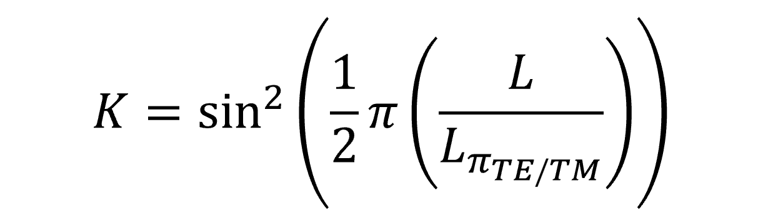
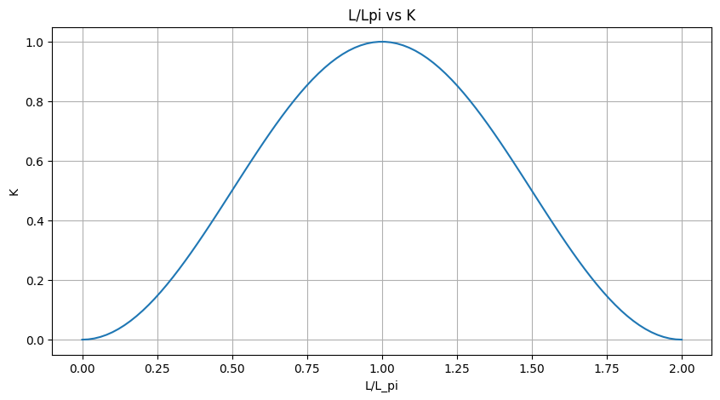
Learning outcome #1 – Directional coupler length and coupling coefficient Wavelength 1.5 µm – width 1.2 µm – gap 0.6 µm
Comment results (distance needed for a complete energy transfer between waveguides, distance needed for splitting power in half.. )
Cuando L=Lπ​, el coeficiente K=1 y toda la potencia se ha transferido a la segunda guía. En cambio, cuando L=Lπ/2, se obtiene K=0.5, lo que significa que la potencia se divide por igual entre las dos salidas (splitter 50/50). Por tanto, el análisis permite identificar dos distancias clave del dispositivo: Lπ​, necesaria para la transferencia completa de energía de una guía a otra, y Lπ/2, necesaria para dividir la potencia en mitades iguales.

Slide 5
Learning outcome #2 – 2x2 Directional Coupler Width 0.6 - 1.6 µm (step 0.1 µm) – Wavelength 1.55 µm
deep waveguide
Paste propagation plots and output text here
Comment results (Coupling relationship, Lpi, losses, … )

Slide 6
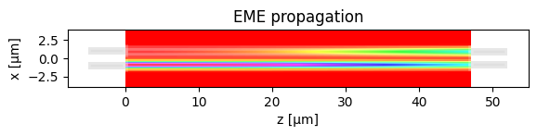
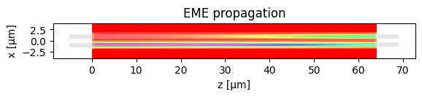

Comments on Learning Outcome 2
------- Parameters -------
MMI length 47.0138
MMI length increment 0.0000
IO wg width 1.0000
IO wg width increment 0.0000
------------------------
Total power IN coupled 0.9687
Total OUT power: 0.9582
Excess loss [dB] = 0.1855
------------------------
Power over OUTs: ['0.4790', '0.4792’]
Ratio over OUTs ['0.4999', '0.5001']
- Width: 0.6 $μm$
------- Parameters -------
MMI length 64.0328
MMI length increment 0.0000
IO wg width 1.0000
IO wg width increment 0.0000
------------------------
Total power IN coupled 0.9842
Total OUT power: 0.9738
Excess loss [dB] = 0.1153
------------------------
Power over OUTs: ['0.4870', '0.4868’]
Ratio over OUTs ['0.5001', '0.4999']
- Width: 0.7 $μm$

Slide 7
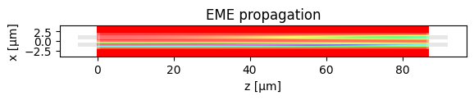
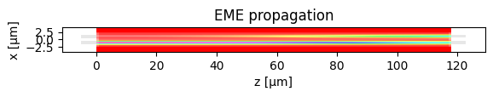

Comments on Learning Outcome 2
------- Parameters -------
MMI length 86.9820
MMI length increment 0.0000
IO wg width 1.0000
IO wg width increment 0.0000
------------------------
Total power IN coupled 0.9881
Total OUT power: 0.9777
Excess loss [dB] = 0.0981
------------------------
Power over OUTs: ['0.4887', '0.4890’]
Ratio over OUTs ['0.4998', '0.5002']
- Width: 0.8 $μm$
------- Parameters -------
MMI length 117.8872
MMI length increment 0.0000
IO wg width 1.0000
IO wg width increment 0.0000
------------------------
Total power IN coupled 0.9832
Total OUT power: 0.9729
Excess loss [dB] = 0.1194
------------------------
Power over OUTs: ['0.4864', '0.4865’]
Ratio over OUTs ['0.5000', '0.5000']
- Width: 0.9 $μm$

Slide 8
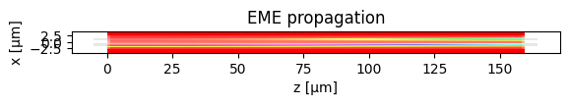
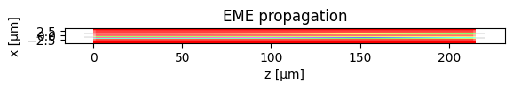

Comments on Learning Outcome 2
------- Parameters -------
MMI length 159.4421
MMI length increment 0.0000
IO wg width 1.0000
IO wg width increment 0.0000
------------------------
Total power IN coupled 0.9662
Total OUT power: 0.9559
Excess loss [dB] = 0.1959
------------------------
Power over OUTs: ['0.4777', '0.4782’]
Ratio over OUTs ['0.4997', '0.5003']
- Width: 1 $μm$
------- Parameters -------
MMI length 215.2738
MMI length increment 0.0000
IO wg width 1.0000
IO wg width increment 0.0000
------------------------
Total power IN coupled 0.9360
Total OUT power: 0.9258
Excess loss [dB] = 0.3347
------------------------
Power over OUTs: ['0.4629', '0.4630’]
Ratio over OUTs ['0.4999', '0.5001']
- Width: 1.1 $μm$

Slide 9



Comments on Learning Outcome 2
------- Parameters -------
MMI length 290.2146
MMI length increment 0.0000
IO wg width 1.0000
IO wg width increment 0.0000
------------------------
Total power IN coupled 0.8917
Total OUT power: 0.8819
Excess loss [dB] = 0.5458
------------------------
Power over OUTs: ['0.4408', '0.4411’]
Ratio over OUTs ['0.4998', '0.5002']
- Width: 1.2 $μm$
------- Parameters -------
MMI length 390.6951
MMI length increment 0.0000
IO wg width 1.0000
IO wg width increment 0.0000
------------------------
Total power IN coupled 0.8473
Total OUT power: 0.8378
Excess loss [dB] = 0.7684
------------------------
Power over OUTs: ['0.4188', '0.4191’]
Ratio over OUTs ['0.4998', '0.5002']
- Width: 1.3 $μm$

Slide 10



Comments on Learning Outcome 2
------- Parameters -------
MMI length 525.2393
MMI length increment 0.0000
IO wg width 1.0000
IO wg width increment 0.0000
------------------------
Total power IN coupled 0.7871
Total OUT power: 0.7782
Excess loss [dB] = 1.0890
------------------------
Power over OUTs: ['0.3890', '0.3893’]
Ratio over OUTs ['0.4998', '0.5002']
- Width: 1.4 $μm$
------- Parameters -------
MMI length 705.3303
MMI length increment 0.0000
IO wg width 1.0000
IO wg width increment 0.0000
------------------------
Total power IN coupled 0.7299
Total OUT power: 0.7216
Excess loss [dB] = 1.4167
------------------------
Power over OUTs: ['0.3608', '0.3609’]
Ratio over OUTs ['0.4999', '0.5001']
- Width: 1.5 $μm$

Slide 11


Comments on Learning Outcome 2
------- Parameters -------
MMI length 946.2335
MMI length increment 0.0000
IO wg width 1.0000
IO wg width increment 0.0000
------------------------
Total power IN coupled 0.6724
Total OUT power: 0.6648
Excess loss [dB] = 1.7729
------------------------
Power over OUTs: ['0.3327', '0.3321’]
Ratio over OUTs ['0.5004', '0.4996']
- Width: 1.6 $μm$
En primer lugar, la longitud necesaria para alcanzar el 3 dB crece de forma aproximadamente exponencial con el gap. Pasa de 47 µm (gap = 0.6 µm) a 946 µm (gap = 1.6 µm), multiplicándose aproximadamente por 1.35 cada 0.1 µm. Esto confirma que, al aumentar la separación entre guías, disminuye el solapamiento evanescente, se reduce el coeficiente de acoplo y el batido modal se vuelve más lento, requiriendo dispositivos mucho más largos.
En segundo lugar, aparece un compromiso claro entre gap y pérdidas. La eficiencia global (Total Power OUT) es máxima alrededor de 0.8 µm (~97.8%) y la pérdida por inserción es mínima (~0.10 dB). A partir de 1.1–1.2 µm la longitud se vuelve tan grande que las pérdidas acumuladas aumentan rápidamente, alcanzando ~1.77 dB para 1.6 µm. Por tanto, gaps grandes penalizan fuertemente el rendimiento debido a las pérdidas introducidas al incrementar la longitud efectiva del dispositivo.
En tercer lugar, el balance entre salidas es excelente en todos los casos. Las razones de potencia se mantienen prácticamente en 0.5/0.5 (desviaciones del orden de 10⁻³). En conjunto, los resultados indican que el rango 0.7–0.9 µm, y especialmente 0.8 µm, ofrece el mejor compromiso entre tamaño, eficiencia y bajas pérdidas. Gaps mayores conducen a dispositivos excesivamente largos y con pérdidas significativamente superiores, mientras que gaps más pequeños reducen tamaño (pudiendo comprometer los límites de fabricación) pero no mejoran sustancialmente la eficiencia respecto al óptimo en 0.8 µm.

Slide 12
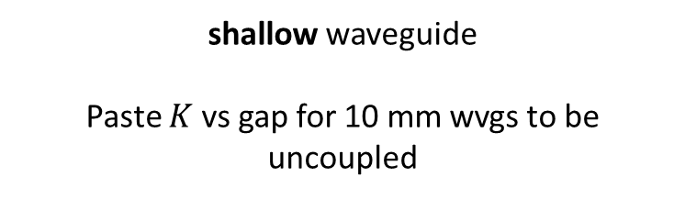
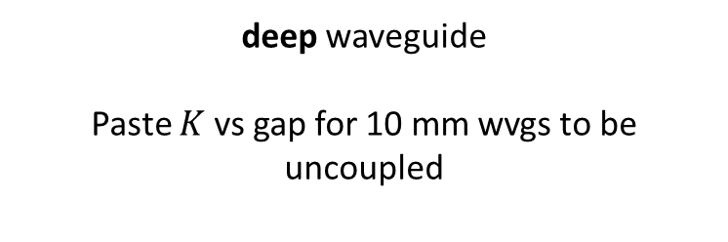
Learning outcome #3 – Parallel uncoupled waveguides Wavelength 1.55 µm, width 1.0 µm, gap to be found for uncoupled wvgs
deep waveguide
Paste $K$ vs gap for 10 mm wvgs to be uncoupled
shallow waveguide
Paste $K$ vs gap for 10 mm wvgs to be uncoupled
Hints:
All waveguides running in parallel are coupled somehow. Controlling the degree of coupling is key for those waveguides you don’t want coupling over certain level (i.e. uncoupled waveguides). Uncoupled waveguide definition, we will use K<0.01. Parallel waveguide length = 10 mm (typical length of a chip). Find minimum gap shallow / deep w=1.0µm wvl 1.55 µm.

Slide 13
Multimode Interferometer (MMI) Coupler

Slide 14
Learning outcome #4 – 4.1 2x2 Multimode Interference Coupler Wavelength 1.55 µm, wMMI = 6.6 µm
deep waveguide
Paste propagation plots and console results
Comment results (Coupling relationship, Lpi, losses, comparison with Directional Coupler… )

Slide 15
Learning outcome #4.2 – 2x2 Multimode Interference Coupler - Optimization Wavelength 1.55 µm, wMMI = 6.6 µm
deep waveguide
Paste propagation plot and console results
Target: make equal ratio over outputs (even if not 0.5) and minimize excess loss (even if not 0.0 dB)
With same settings of previous LO, now adjust try to manually optimize the MMI by changing iteratively:
- Change dL_MMI
- Change I/O waveguide position +/- dy
Hints: observe the 2D EME propagation results to guide you to the best settings of a) and b).
Comment results

Slide 16
Learning outcome #4.3 – 2x2 Multimode Interference Coupler – Optimization (II) Wavelength 1.55 µm, wMMI = 6.6 µm
deep waveguide
Paste propagation plot and console results
Target: make ratio over outputs 0.5 + excess loss < 0.1 dB
With same settings of previous LO, now modify the notebook so I/O waveguides have a different width.
- The nominal I/O waveguide width you have been using is 1.0 µm, increase it.
(Warning! Every time you change the I/O waveguide width you have to re-run modes calculation)
Hints: observe the 2D EME propagation results to guide you to the best settings of a) and b).
Comment results

Slide 17
Learning outcome #5 – 1x4 Multimode Interference Coupler Wavelength 1.55 µm, wMMI = ? µm
deep waveguide
Paste propagation plots and console results
Repeat all the design process for a 1x4 MMI Coupler.

Slide 18


Extra #1 – Directional wavelength dependence Wavelengths from 1.5 to 1.7 µm, gap = 0.6 µm, width 1.0 µm
deep waveguide
Paste $L_{π}$ vs wvl for TE and TM plot here
shallow waveguide
Paste $L_{π}$ vs wvl for TE and TM plot here
slab = 150nm
Comment results

Slide 19


Extra #2 – Directional coupler gap dependence Wavelength 1.55 µm, width 1.0 µm, gap 0.2-2.4 µm (step 0.2 µm)
deep waveguide
Paste $L_{π}$ vs gap for TE and TM plot here
shallow waveguide
Paste $L_{π}$ vs gap for TE and TM plot here
slab = 150nm
Make conclusions and observations from your results

Slide 20
Extra #3 – MMI coupler wavelength dependence Wavelengths from 1.5 to 1.7 µm, wMMI = 6.6 µm
deep waveguide
Paste $L_{π}$ vs wvl for TE and TM plot here
shallow waveguide
Paste $L_{π}$ vs wvl for TE and TM plot here
slab = 150nm
Comment results (Important. Compare with Directional Coupler)

Slide 21


Extra #4 – MMI coupler body width dependence Wavelength 1.55 µm, wMMI = 5-10 µm (steps 0.5 µm)
deep waveguide
Paste $L_{π}$ vs width for TE and TM plot here
shallow waveguide
Paste $L_{π}$ vs width for TE and TM plot here
slab = 150nm
Polarization independent coupler: is there any point for which the MMI coupler can work identically for TE and TM? Answer yes / no and explain why?

Slide 22

Thank you

