Slide 1
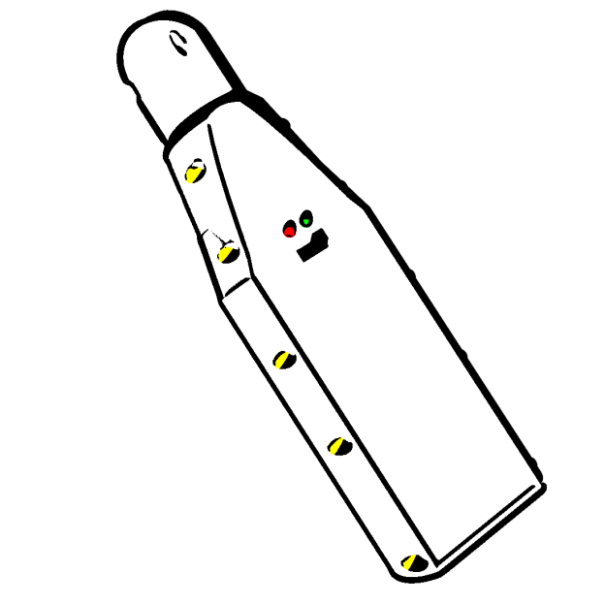
DIY Nitrox Analyzer
By Sergio Alves

Slide 2

Inception
As a TEC scuba diver I often breath hyperoxic gases while decompressing (it accelerates decompression).
To avoid entering into convulsions… and die… because of a too high ppO2, it’s important to know the precise O2 % of the gas mix and then calc the MOD (maximum operating depth) => never breath it below MOD
Commercial analyzers are simple boxes with an O2 cell and a kind of Multimeter (really simple devices) but very expensive > 200$

Slide 3

Project Goals
Build a reliable DIY device
  Precision per bit ~300 nV
  Price < 100 CHF
  Open source
Demonstrate the capacity to
  lead a project from an idea to a finite product
  develop C++ firmware
  develop UI for android
  use a Bluetooth connection
  model/design and print a complex
  container (box)

Slide 4

How should it work ?
Switch Analyzer on
Launch Android application
  If not in auto connect mode click the connection button
After successful connection the device will enter in auto calibration mode (to get the O2 cell value for the current gaz (air ~ 20.9 % O2)
After calibration the controller will read continuously the sensor at a rate of 1S/s (sample/second) and the application will display the O2 value

Slide 5
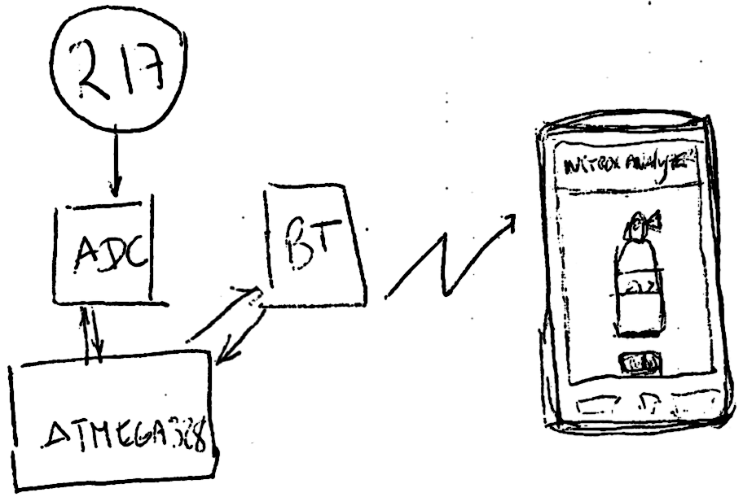
How to integrate?

Slide 6
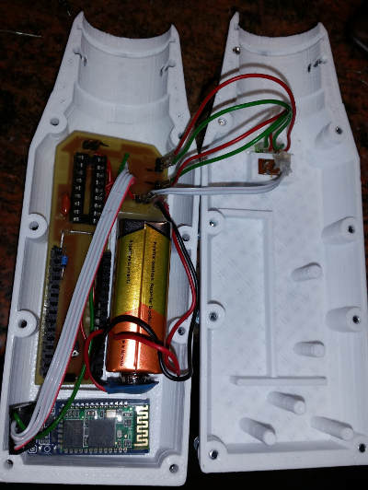
Components
Hardware
  A 3D printed box
  An Arduino Nano for device control
  A Bluetooth serial module
  A 24 bits ADC for a high signal
  measurement accuracy
  R17 Medical O2 Oxygen cell sensor
Software
  C++ Firmware embedded in Atmega328
    16MHz controller with 2 Kb Ram, 32 Kb Rom (limited resources)
  Java mobile application running on Android OS

Slide 7

Challenges
Software
  Create an easily upgradable protocol handler in both firmware and mobile application and make them communicate
  Create a driver to “drive” the ADS1210 chip
Hardware
  Develop the smallest box able to hold a R17 cell, a Nano board, a 9V battery and a Bluetooth module
Create something precise enough to be confident using it and that runs straight forward
Develop a device without any kind of physical user interaction (buttons, screen, audio)

Slide 8
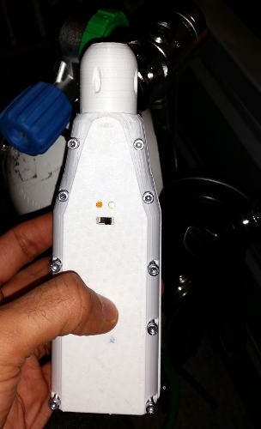
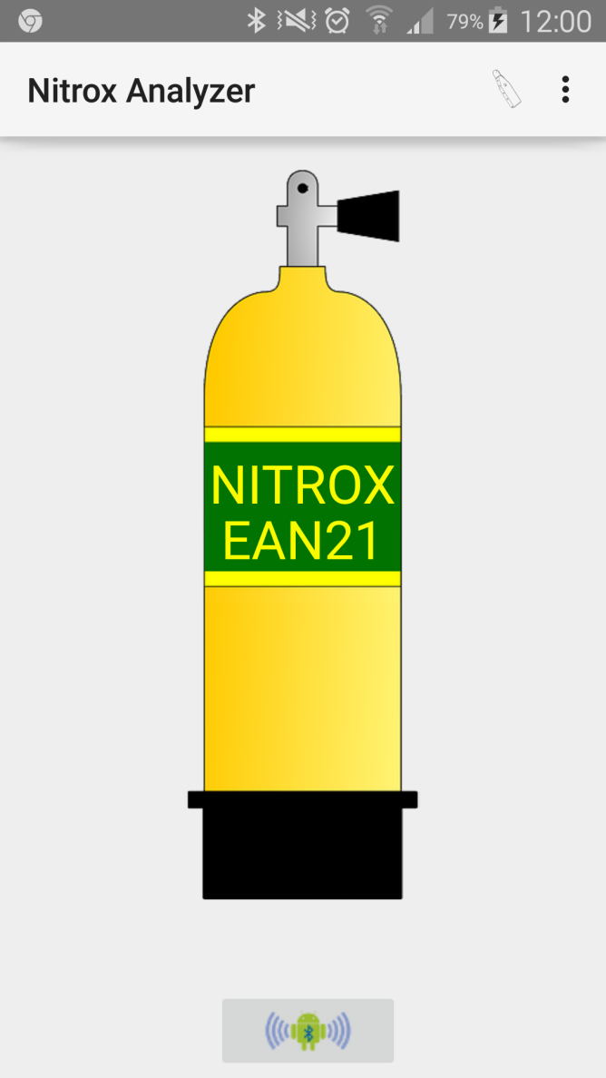
Some time later…

Slide 9

How to improve?
Features
  connection to a Bluetooth analyzer
  auto calibration
  continuous o2 measurement
  displaying o2 cell dates (install, validity)
Wanted features
  update install validity dates
  display progress bar to help to know when a measure is valid
  keep a track of read values
  creates a more TEC view with higher precision
  allow to have 2 O2 cells to have a duplicate measure. This will render the device very safe and avoid wrong measures

Slide 10

Because I belive in pen Source
All files, schemas, images, source codes are available and licensed under GNU GPL3 on
https://github.com/sergio-alves/NitroxAnalyzer

Slide 11
Live demo
Lets see how KISS is it !!!

