Slide 1
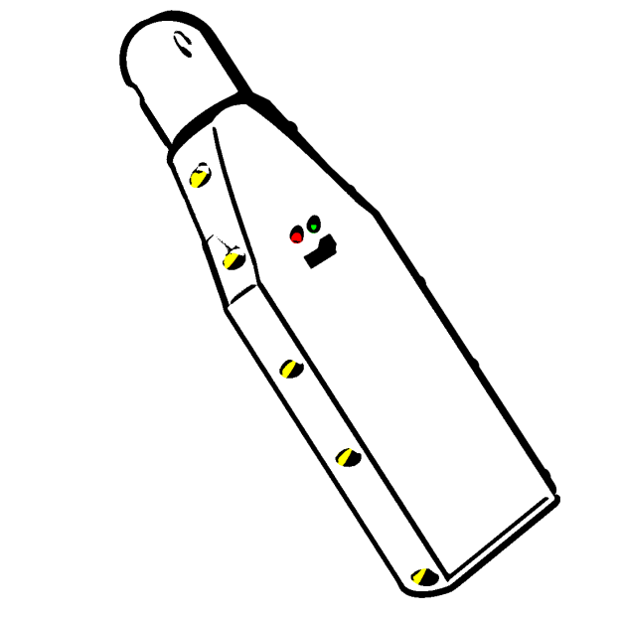
DIY Nitrox Analyzer
By Sergio Alves

Slide 2

Inception
As a TEC scuba diver I often breath hyperoxic gases while decompressing (it accelerates decompression).
To avoid entering into convulsions… and die… because of a too high ppO2, it’s important to know the precise O2 % of the gas mix and then calc the MOD (maximum operating depth) => never breath it below MOD
Commercial analyzers are simple boxes with an O2 cell and a kind of Multimeter (really simple devices) but very expensive > 200$

Slide 3

Project Goals
Build a reliable DIY device
Precision per bit ~300 nV
Price < 100 CHF
Open source
Demonstrate the capacity to
lead a project from an idea to a finite product
develop C++ firmware
develop UI for android
use a Bluetooth connection
model/design and print a complex container (box)

Slide 4

How should it work ?
Switch Analyzer on
Launch Android application
If not in auto connect mode click the connection button
After successful connection the device will enter in auto calibration mode (to get the O2 cell value for the current gaz (air ~ 20.9 % O2)
After calibration the controller will read continuously the sensor at a rate of 1S/s (sample/second) and the application will display the O2 value

Slide 5
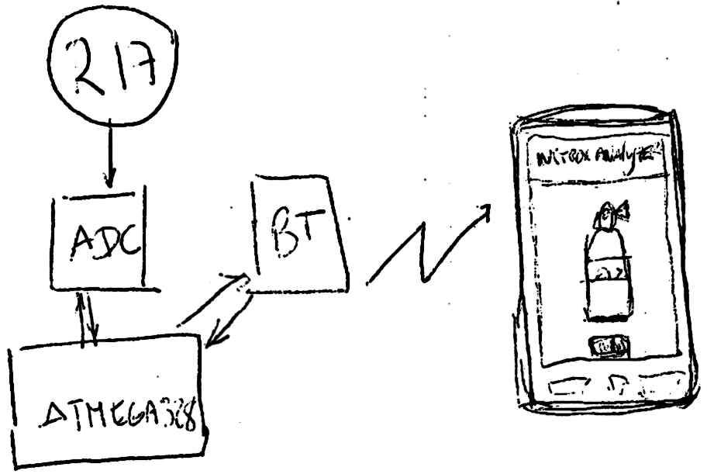
How to integrate?

Slide 6
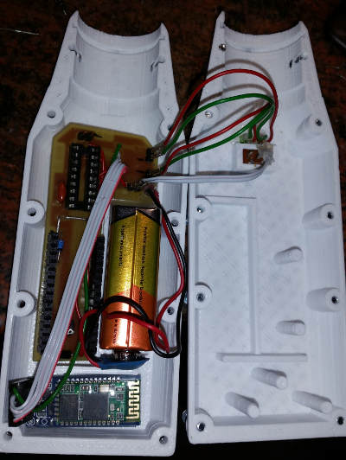
Components
Hardware
A 3D printed box
An Arduino Nano for device control
A Bluetooth serial module
A 24 bits ADC for a high signal measurement accuracy
R17 Medical O2 Oxygen cell sensor
Software
C++ Firmware embedded in Atmega328
16MHz controller with 2 Kb Ram, 32 Kb Rom (limited resources)
Java mobile application running on Android OS

Slide 7

Challenges
Software
Create an easily upgradable protocol handler in both firmware and mobile application and make them communicate
Create a driver to “drive” the ADS1210 chip
Hardware
Develop the smallest box able to hold a R17 cell, a Nano board, a 9V battery and a Bluetooth module
Create something precise enough to be confident using it and that runs straight forward
Develop a device without any kind of physical user interaction (buttons, screen, audio)

Slide 8

How to improve?
Features
connection to a Bluetooth analyzer
auto calibration
continuous o2 measurement
displaying o2 cell dates (install, validity)
Wanted features
update install validity dates
display progress bar to help to know when a measure is valid
keep a track of read values
creates a more TEC view with higher precision
allow to have 2 O2 cells to have a duplicate measure. This will render the device very safe and avoid wrong measures

Slide 9
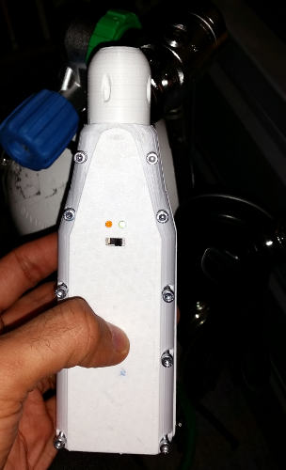
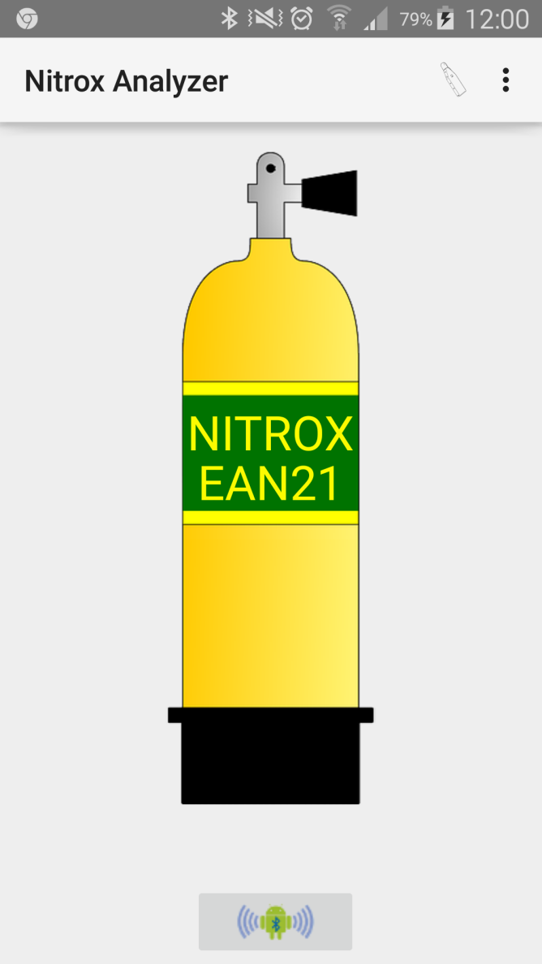
Some time later…

Slide 10

Because I belive in pen Source
All files, schemas, images, source codes are available and licensed under GNU GPL3 on
https://github.com/sergio-alves/NitroxAnalyzer

Slide 11
Live demo
Lets see how KISS is it !!!

