Slide 1
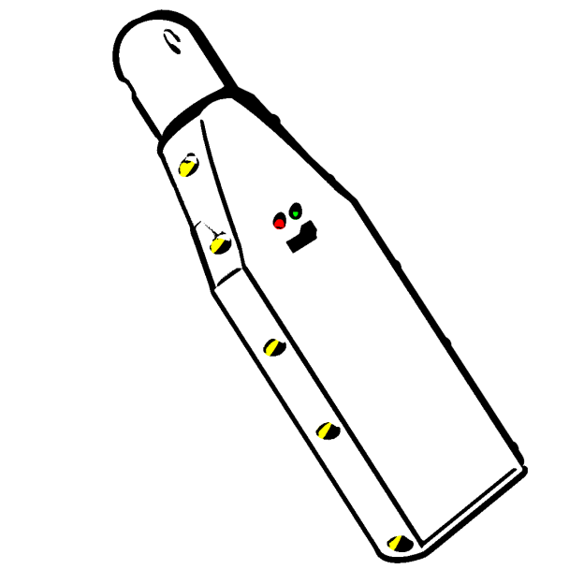
Nitrox Analyzer
By Sergio Alves

Slide 2
What is Nitrox Analyzer

Slide 3
More about Nitrox Analyzer
A portable device for oxygen measurement
To measure O2 rate of a breathable gas mix
Use Bluetooth low energy for data exchange
An android client application
Allow quick UI changes
An open source project
Android app sources
Atmel C++ firmware sources
Electronic board sources
3D Cad files for box printing

