Slide 1
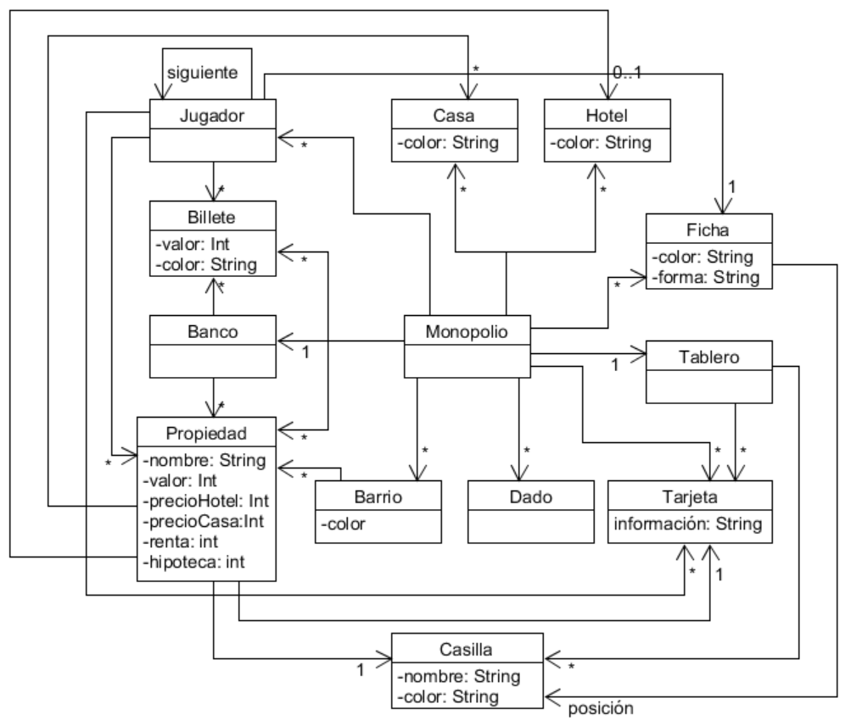
A Playbook for Business Architecture Construction
BAC-09-Metamodelo – Diagrama de clases | Negocio: Monopolio | Autor: j.yepes y s.pardog | Fecha:11/08/2022

