Slide 1
Scalable Cloud Programming
SafeTrade Voucher
Student: Sergio Oliveira – x23170981
Lecturer: Sahin Vikas

Slide 2
Architecture and Scalability
Serverless architecture: Defines that there are no fixed servers limiting growth.
Elastic Scalability: Ability to expand as required.
Stack Decoupled: Focus on the efficiency between Processing (Lambda) and Persistence (DynamoDB).
Event-Driven: Ready to handle events in real time.

Slide 3
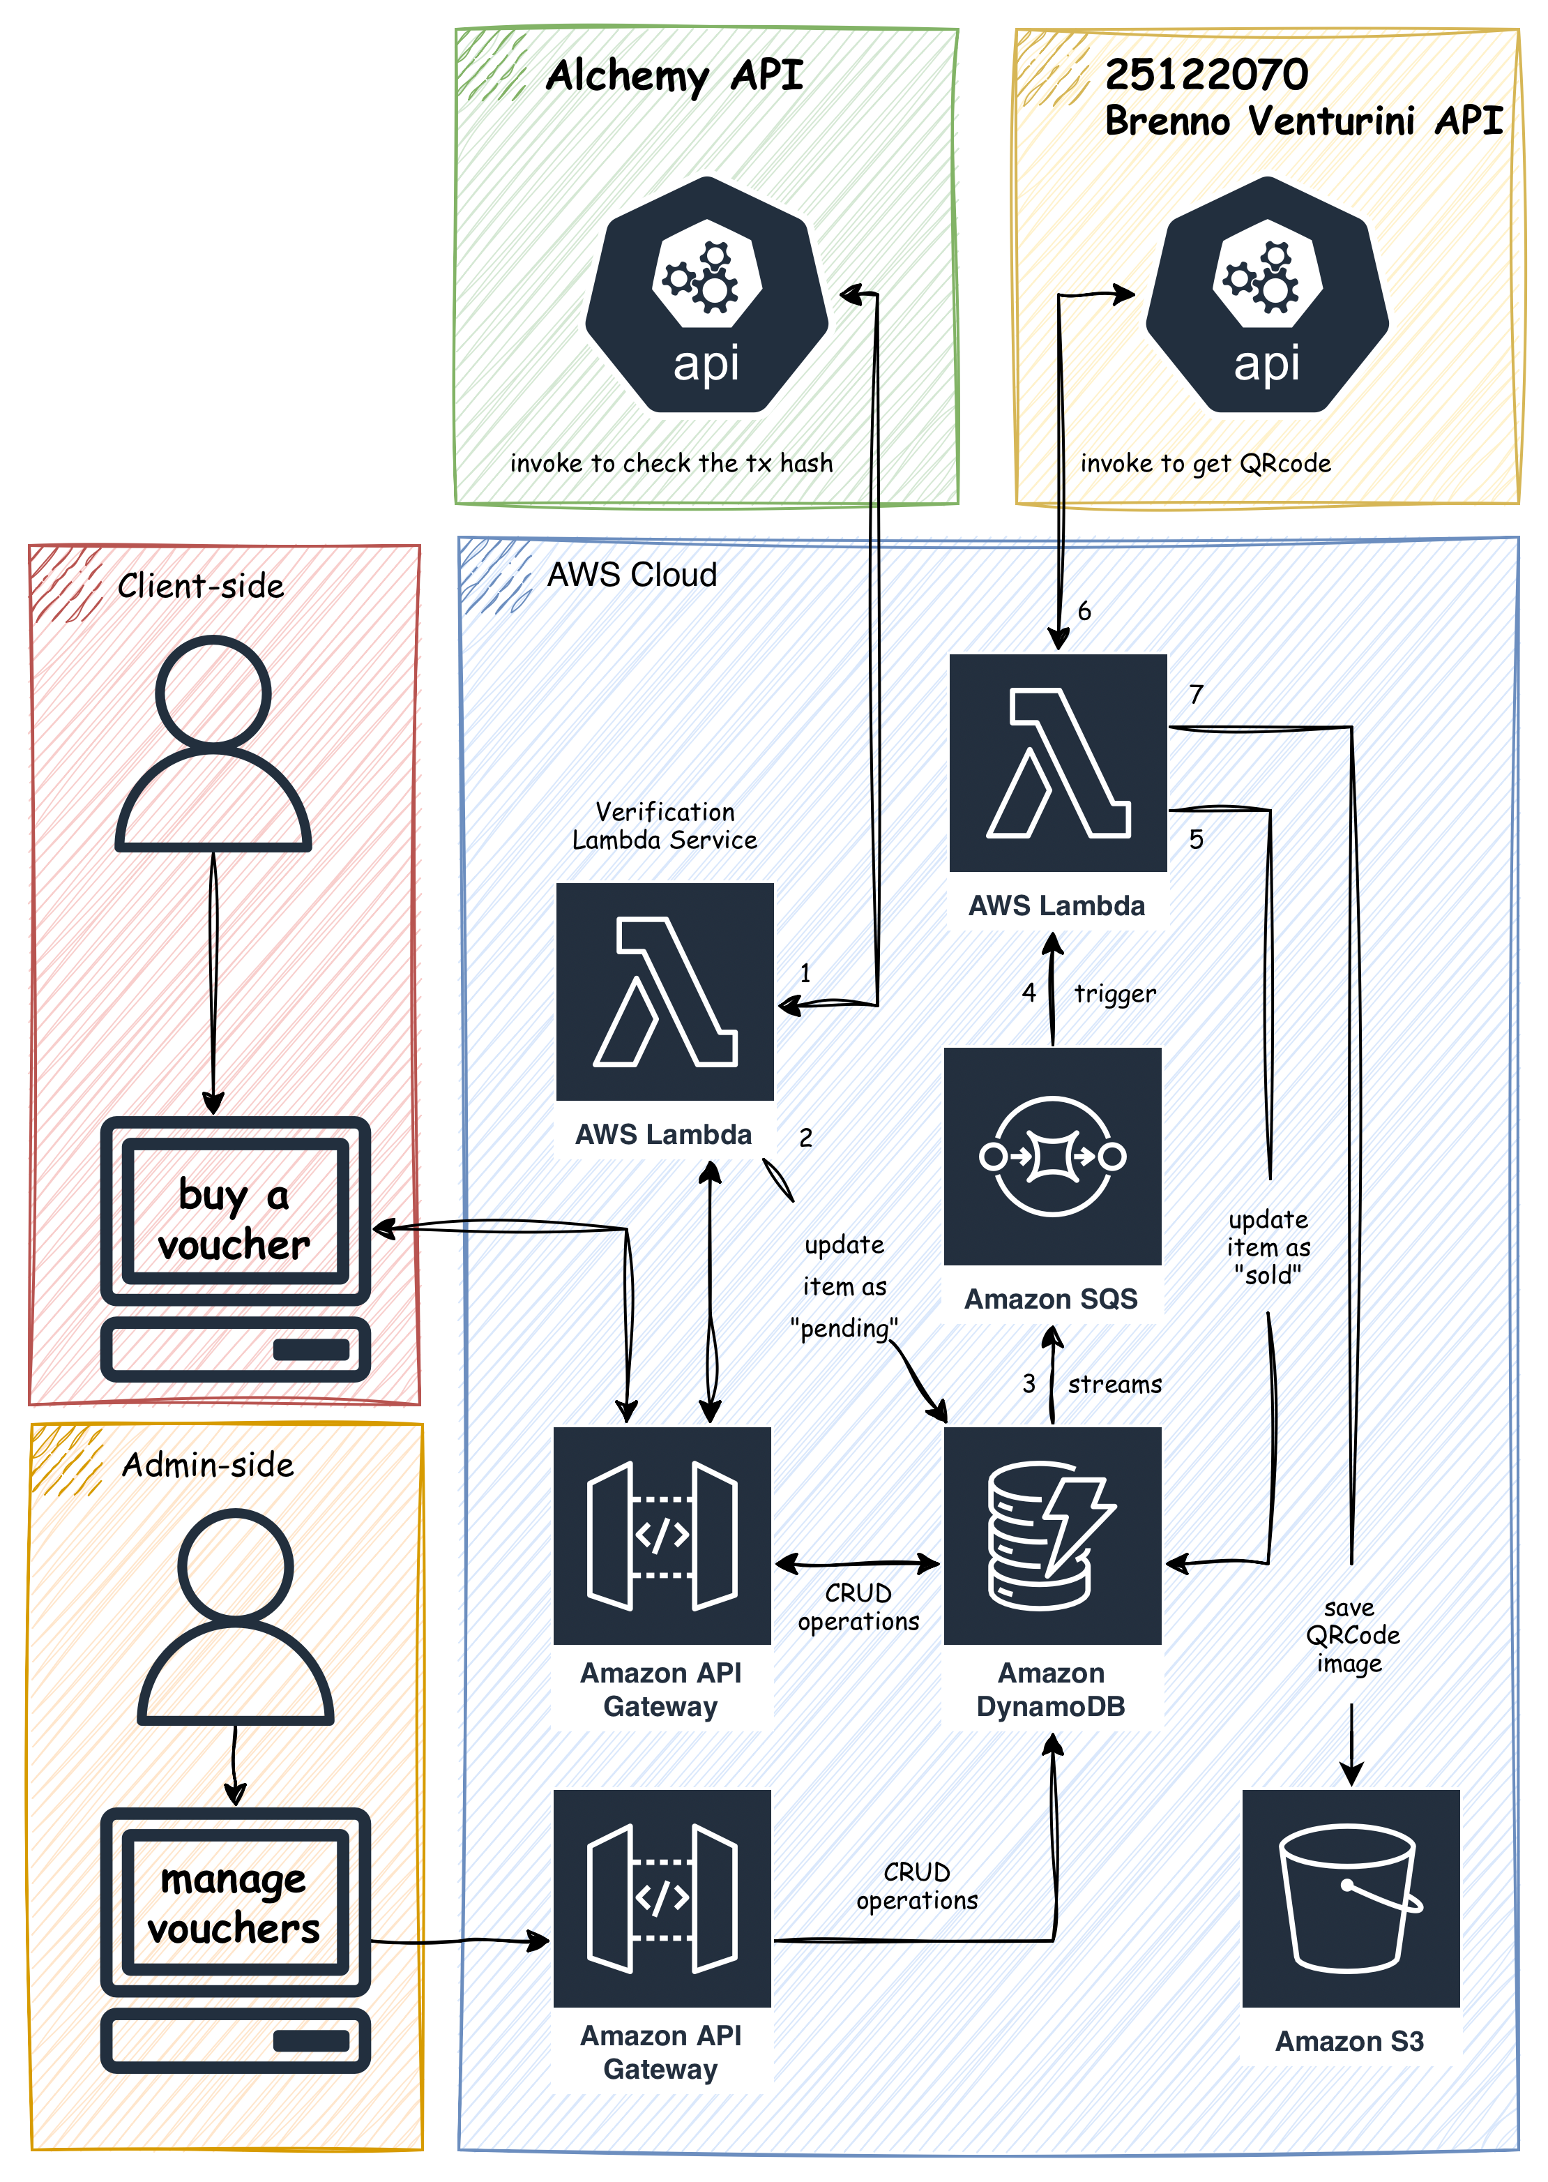
Diagram
Client-side
Admin-side

Slide 4
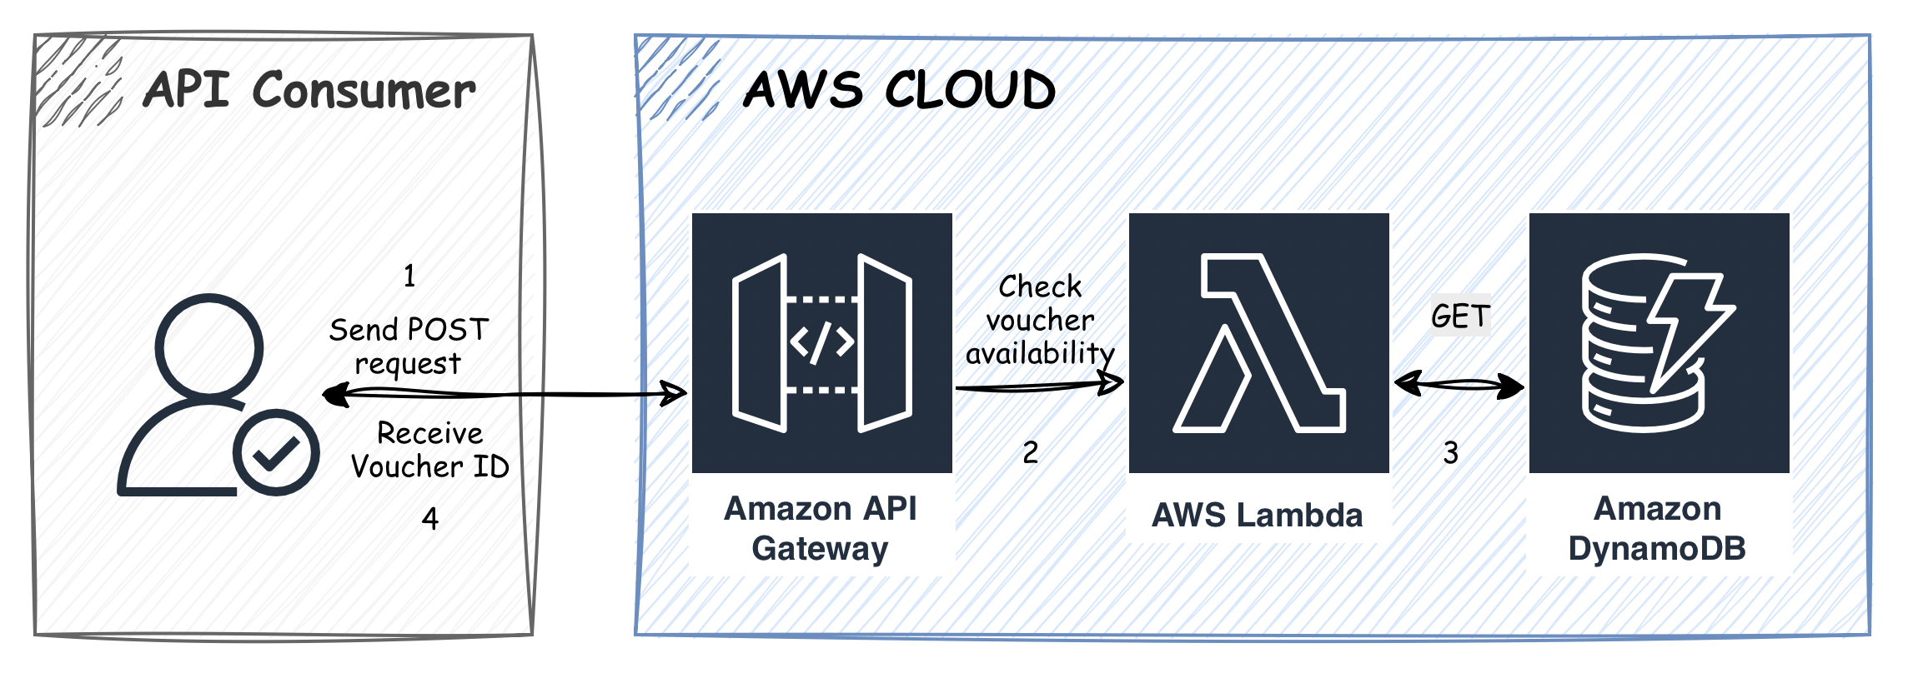
Diagram
https://app.swaggerhub.com/apis/student-c67-be7/api-safetrade-voucher/1.0.0

Slide 5
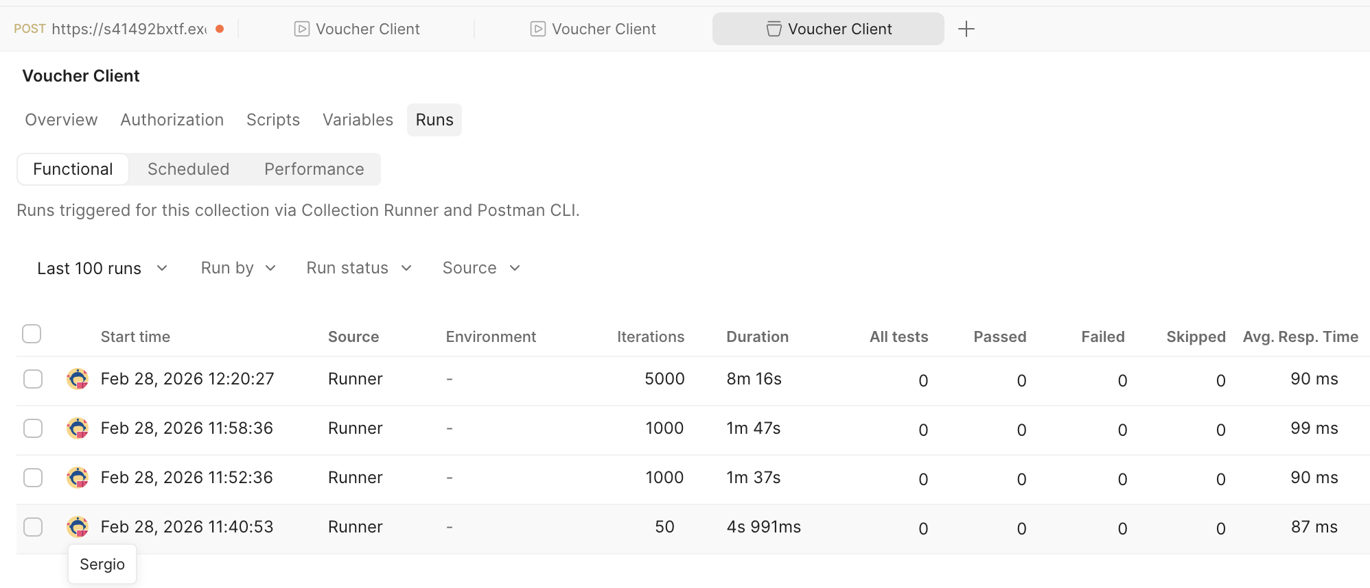
Scalability Test

Slide 6
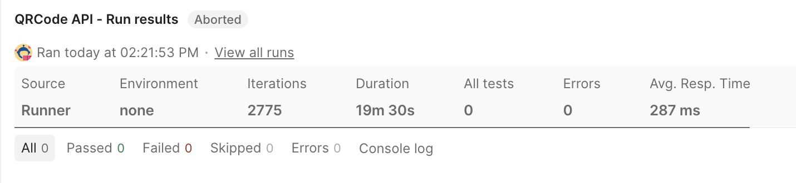
QRCode API - Test
https://heroic-nougat-c67308.netlify.app

Slide 7
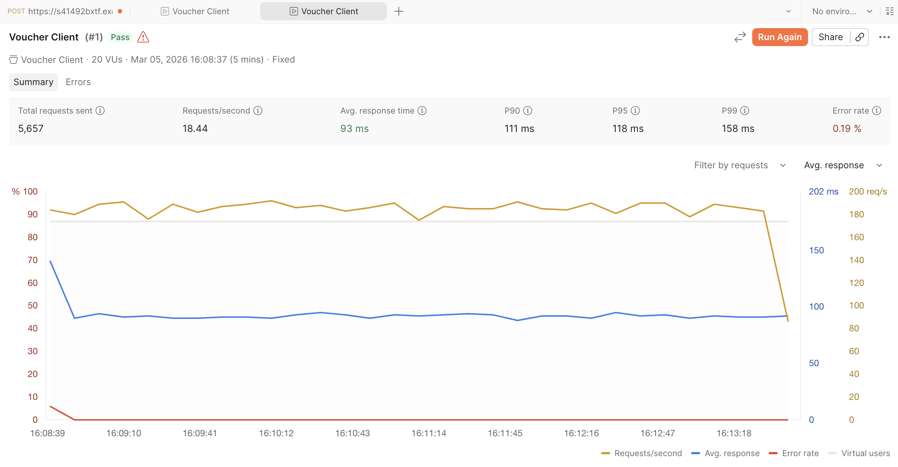
Load Test – 20 VU for 5min

Slide 8
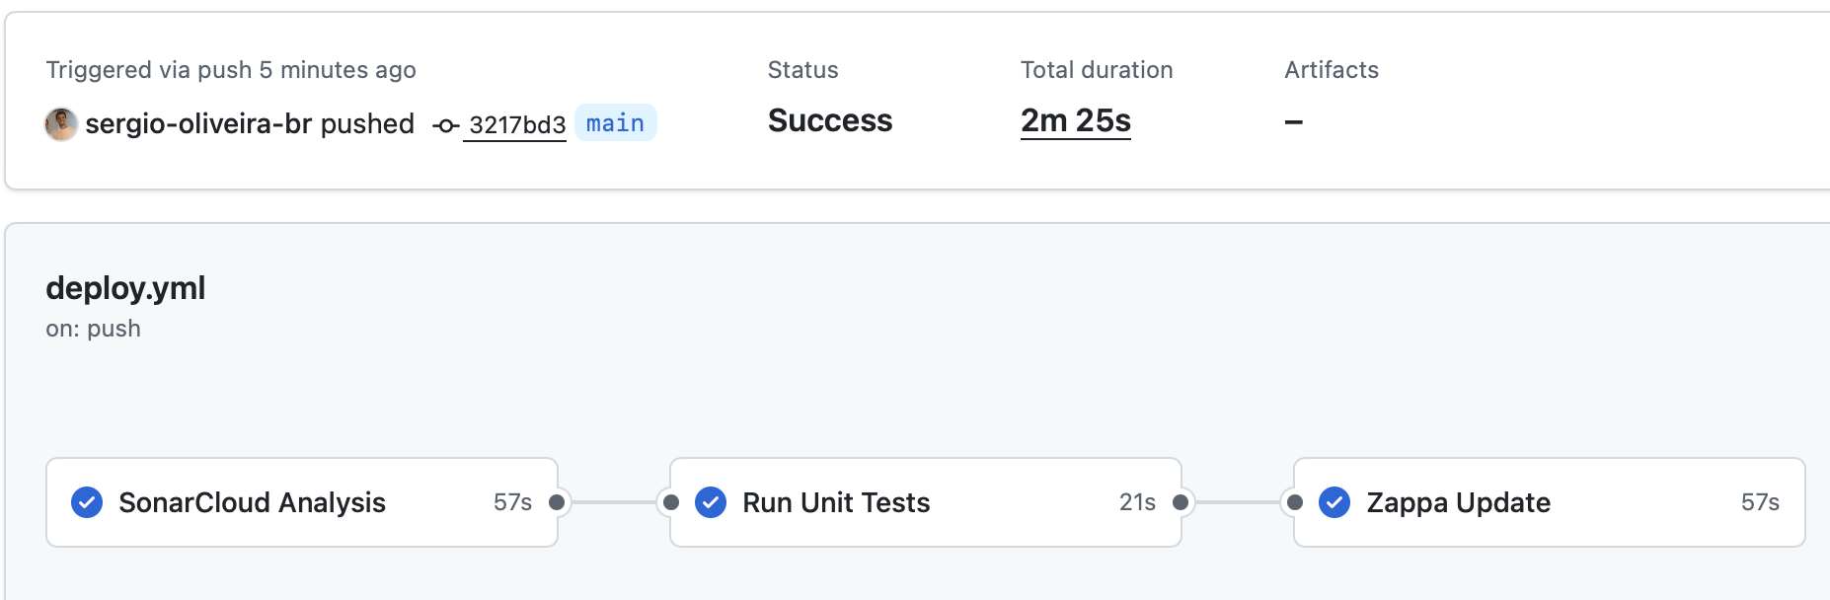
Pipeline – GitHub Actions
https://github.com/sergio-oliveira-br/safetrade_admin_service/actions/runs/22593616259

Slide 9
DEMO
http://ca-cpp-app-load-balancer-695619415.eu-west-1.elb.amazonaws.com
http://ca-cpp-app-load-balancer-695619415.eu-west-1.elb.amazonaws.com

