Slide 1
HEATING PORTFOLIO ANALYTICS
Portotherm
Prioritize buildings for investigation using existing monthly heat data.
Provisional brand. Local synthetic demonstration.
Provisional brand. Discussion proposal.
01
Notes:
Ürün adının geçici olduğunu ve tüm demo verisinin sentetik olduğunu açıkça söyle. Isıtma kontrolü veya kanıtlanmış tasarruf iddiası yok.
Source: provided product brief and repository artifacts. No real pilot outcomes claimed.

Slide 2
PROBLEM HYPOTHESIS
The investigation decision
Which building should we review first?
Monthly records can sit across files, with unclear units, missing periods and limited follow-up.
We will test this workflow problem with Latvian apartment managers.
Synthetic demo data — not measured customer results
02
Notes:
Bu problem henüz müşteri araştırmasıyla doğrulanmadı. Sahte müşteri sözü veya pazar büyüklüğü verme.
Source: provided product brief and repository artifacts. No real pilot outcomes claimed.

Slide 3
CUSTOMER DISCOVERY
The first customer hypothesis
20–100 buildings in a professionally managed apartment portfolio.
Buyer: management company decision maker
Daily user: portfolio manager or analyst
Technical reviewer: local energy specialist
Synthetic demo data — not measured customer results
03
Notes:
20–100 aralığı pazar verisi değil segment varsayımı. İlk pilot yalnızca 5–10 binayı kapsayacak. Roller gerçek ekip üyeleri değildir.
Source: provided product brief and repository artifacts. No real pilot outcomes claimed.

Slide 4
HOW IT WORKS
A documented review workflow
01 Import and validate monthly CSV/XLSX
02 Calculate a weather reference with the engine
03 Review optional Claude explanations and drafts
04 Explicitly approve tasks and track evidence
Synthetic demo data — not measured customer results
04
Notes:
Ardışık akışı anlat. Yeni sensör veya otomatik ısıtma kontrolü zorunlu değil. Gerçek hava kaynağının pilotta doğrulanması gerekiyor.
Source: provided product brief and repository artifacts. No real pilot outcomes claimed.

Slide 5
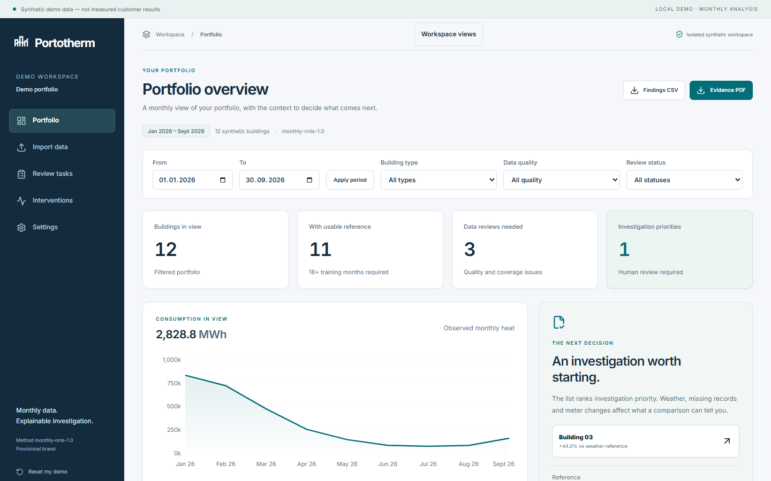
LOCAL PRODUCT DEMONSTRATION
A working synthetic portfolio
12
synthetic buildings
11
usable references
1
investigation priority
Synthetic demo data — not measured customer results
05
Notes:
Kaynak: çalışan yerel uygulamadan reports/screenshots/07-portfolio-pitch.png. Sayılar reports/demo-statistics.json ile aynı motorun çıktısı. Sentetik sonuçlar müşteri başarısı değildir.
Source: provided product brief and repository artifacts. No real pilot outcomes claimed.

Slide 6
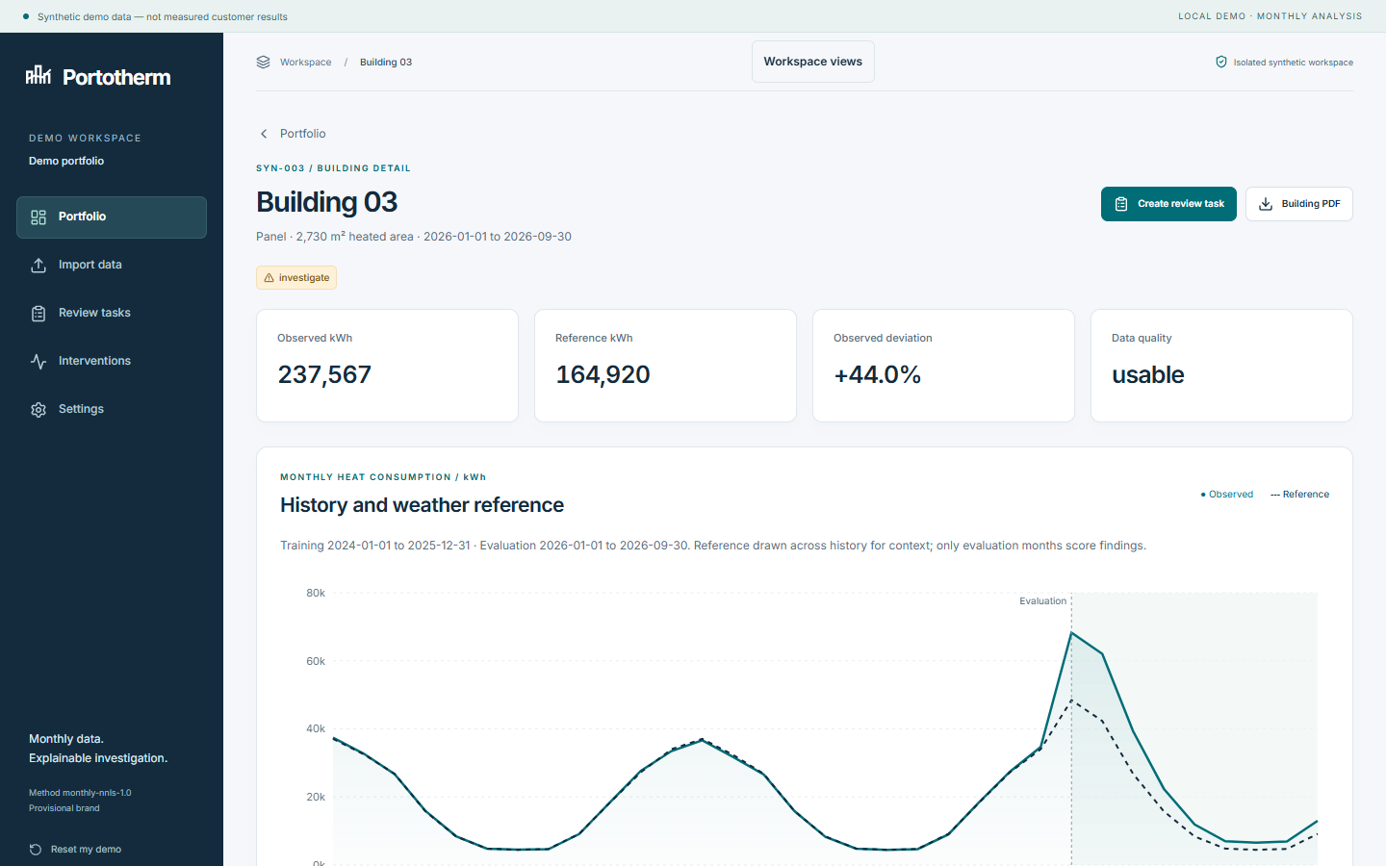
EXPLAINABLE MONTHLY REFERENCE
The reason stays visible
Own history + days + heating degree days
Training ends before evaluation begins.
Threshold, persistence, quality and alternative explanations stay visible.
A human decides what to investigate.
Synthetic demo data — not measured customer results
06
Notes:
Kaynak: çalışan uygulamadan 08-building-pitch.png. Yöntem docs/methodology.md. Sayaç değişimi, kullanım ve sıcak su karıştırıcıdır. İstatistiksel güven yüzdesi veya arıza olasılığı sunulmaz.
Source: provided product brief and repository artifacts. No real pilot outcomes claimed.

Slide 7
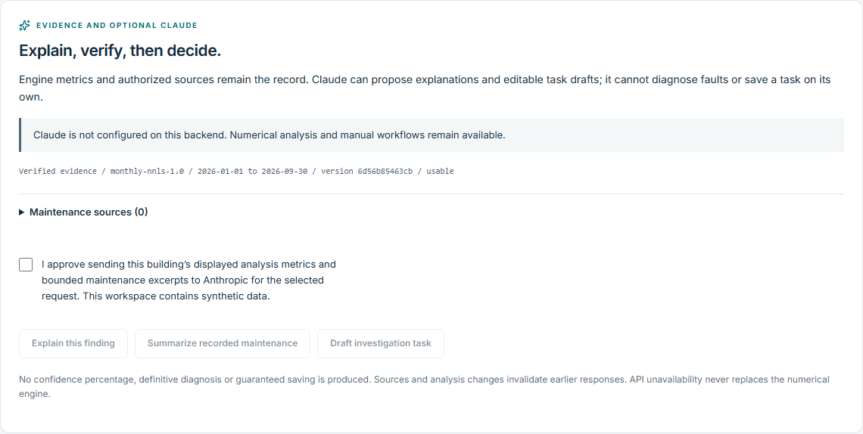
OPTIONAL / BACKEND ONLY / USER APPROVED
Claude helps with the review
Suggested column mapping
Evidence-backed explanations
Investigation task drafts
The engine calculates. A person approves.
Actual local synthetic screen; no live API result claimed. Architecture: docs/technical/ai-architecture.md
07
Notes:
Claude anahtari backend ortaminda tutulur. Kolon onerisi normal parser kontrolunden ve kullanici onayindan gecer. Aciklama metrik ve kaynak kimliklerine baglidir. Gorev taslagi duzenlenir, analiz surumu tekrar kontrol edilerek acik onayla kaydedilir. Ekran gercek sentetik uygulamanin anahtarsiz durumudur. Canli API testi bu teslimde yapilmadi.
Source: provided product brief and repository artifacts. No real pilot outcomes claimed.

Slide 8
PROPOSED SCOPE: 5–10 BUILDINGS
A six-week retrospective pilot
Week 1 Scope, permissions and data inventory
Week 2 Import and quality review
Week 3 Historical reference and initial findings
Week 4 Manager and expert feedback
Week 5 Review tasks and intervention records
Week 6 Learnings and continuation decision
Synthetic demo data — not measured customer results
08
Notes:
Altı haftada yıllık tasarruf kanıtı vaat edilmez. Ölçümler: veri kullanılabilirliği, inceleme süresi, eyleme değer bulgu, yanlış alarm nedenleri, görev tamamlanması. Hedefler birlikte kararlaştırılacak.
Source: provided product brief and repository artifacts. No real pilot outcomes claimed.

Slide 9
COMMERCIAL HYPOTHESES
A business model to validate
Per-building subscription
Portfolio package
Setup or pilot fee + subscription
Discovery starts with manager interviews and a small authorized pilot.
Price and support costs remain unvalidated.
Synthetic demo data — not measured customer results
09
Notes:
Fiyat örnekleri docs/business/pricing.md içinde yalnızca görüşme hipotezi. Gerçekleşmiş gelir, müşteri veya ROI yok. Temizleme ve uzman emeği maliyeti kritik.
Source: provided product brief and repository artifacts. No real pilot outcomes claimed.

Slide 10
READINESS
Demonstrated and still pending
Demonstrated locally
Pending before a real pilot
Synthetic engine, imports, evidence reports, source documents and tested consent/approval boundaries.
Live Claude verification, real weather, identity deployment, data agreements and independent expert review.
Synthetic demo data — not measured customer results
10
Notes:
Demo hazır olmak pilot veya üretim hazır demek değil. Docker Compose ve PostgreSQL yerelde çalıştırıldı; sağlık, migration/seed ve temel tarayıcı akışı geçti. Gerçek kimlik sağlayıcı staging testi bekliyor.
Source: provided product brief and repository artifacts. No real pilot outcomes claimed.

Slide 11
CAPACITY TO CONFIRM
Founder details and open roles
Founder biography and confirmed team information have not been supplied.
Needed for a credible pilot:
Local energy specialist
Building manager with authorized data access
Privacy and legal review capacity
Synthetic demo data — not measured customer results
11
Notes:
İsim, eğitim, şirket, ekip veya geçmiş başarı uydurma. Düzenlenebilir docs/meeting/founder-profile.json dosyasını kurucu görüşmeden önce doğrulanmış bilgilerle doldurmalı.
Source: provided product brief and repository artifacts. No real pilot outcomes claimed.

Slide 12
CONSULTATION REQUEST
The next step with LIAA
Introductions to relevant apartment managers
A local reviewer for technical validation
Guidance on the suitable support route and next action
The consultation is not program acceptance or funding approval.
Provisional brand. Discussion proposal.
12
Notes:
22 Ekim 2026 tarihi verilen brief kaynaklı; saat ve erişim özel olarak doğrulanacak. Resmi portal başvuruları kapalı gösteriyordu: liaa.business.gov.lv/en/support-opportunities/business-incubation-aid, erişim15 Ekim2026. Yabancı kurucu uygunluğu ve sonraki çağrı sorulacak; hibe hakkı iddia edilmez.
Source: provided product brief and repository artifacts. No real pilot outcomes claimed.

