Slide 1
Comparing LM CO2 ods versus UMBC and LBLRTM ods
Sergio DeSouza-Machado
UMBC, March 20, 2018

Slide 2
Work Done
We are generating a new compressed database for kCARTA (our pseudo-monochromatic LBL radiative transfer code), using HITRAN 2016. This will be used to develop fast models for AIRS, CrIS and IASI
All gases (except CO2) will have optical depths computed using UMBC_LBL, which is a monochromatic code based on GENLN2. Lineshape used is Voigt (though for water vapor we also use the “without basement” term so we can add in a continuum from AER).
For CO2 we previously had a code I developed using Strow/Tobin/Machado linemixing for the 15 um and 4 um regions, based on lab data from Rutherford Appleton Lab and HITRAN 2000. Bit old so …..
More recently (two years ago) we used the LBLRTM 12.4 CO2 optical depths. Averaged over 49 regression profiles, the typical BT differences between the our ODs and LBLRTM ODs are on the order of 0.2 K or less (convolved over AIRS and CrIS).
I downloaded the LM package included with HITRAN 2016, generated ODs and found in the 720-780 cm-1 region the mean BT differences compared to LBLRTM are much larger, on the order of 0.6 K (convolved over AIRS and CriS)

Slide 3
Comparisons over 49 regression profiles
400 ppm atmospheric CO2 Optical depths computed using
-UMBC linemixing
-LBLRTM 12.4
-LBLRTM 12.8
-LM 2016 with first order linemixing
-LM with full linemixing
The optical depths were compressed for use with kCARTA
TOA radiances computed for 49 regression profiles (US Std, Tropical, MLS, MLW, SAS, SAW etc)
Plots shown on following two pages, all versus LBLRTM12.4
Vertical axis is delta(BT) and horizontal axis is wavenumber
Mean and std deviation over the 49 regression profiles

Slide 4
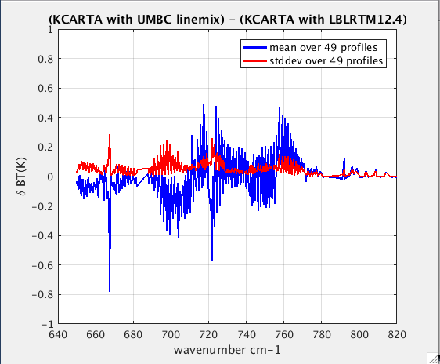
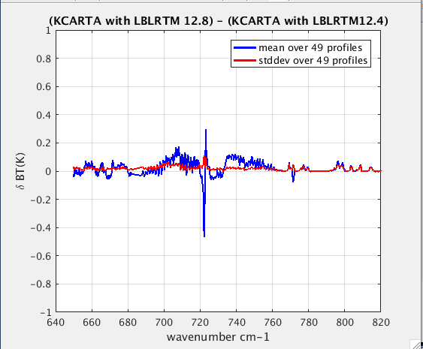
UMBC and LBLRTM12.8
Umbc linemix lblrtm 12.8
Notes:
See code in /home/sergio/KCARTA/TEST/TEST_370_385_400ppmCO2_LBLRTM/final_results_compare_370_385_400ppm.m

Slide 5
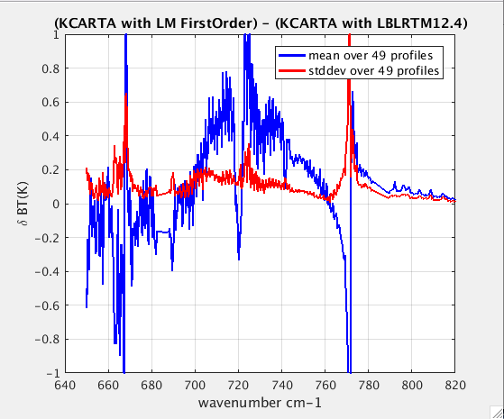
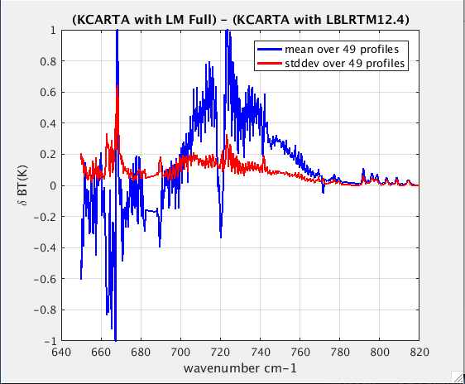
LM 2016
LM First Order LM Full
Notes:
See code in /home/sergio/KCARTA/TEST/TEST_370_385_400ppmCO2_LBLRTM/final_results_compare_370_385_400ppm.m

Slide 6
Doing Voigt Calcs
Since LM package also outputs Voigt ODs, I went generated a CO2 Ods using both the LM Voigt OD output and our UMBC LBL code with HITRAN 2016
Ods were noticeably different; did simple clear sky radiative transfer (emiss = 1, no background thermal) in the 15 um region and noticed that the BTDs between LM and UMBC looked very similar to what was shown on previous slide!
Looked at the lineparameter files included with the LM package and noticed
HITRAN2016 line centers and line strengths are the same
HITRAN 2016 line widths (air-broad and self-broad) are different!
Created a new line file for UMBC by reading in the (about 6500) LM line parameter files, and editing the individual strings so that sbroad/abroad are in the same locations as in the HITRAN 2016 tapes
Ran off our UMBC LBL Voigt code with these LM parameters, and saw the differences with the LM Voigt ODs noticeably shrink down (BT diffs less than 0.1 K, at 0.0025 cm-1 resolution there seem to be some differences on top of lines - at AIRS resolution this is about 0.02 K – not tracked it down but I know UMBC uses fixed temperature dependence for self-broad while looks like LM has a parameter for self-broad temperature dependence)
Notes:
sbroad = str2num(lm(50:54));
sbroad = num2str(sbraod,'%5.3f');
hitnew3 = [lm(1:25) lm(26:35) lm(36:40) sbroad lm(64:73) lm(74:77)];
hitnew3(length(hitnew3)+2:160) = '0';
hitnew3(68:117) = lm(090:139); %% space/junk with spectroscopic params

Slide 7
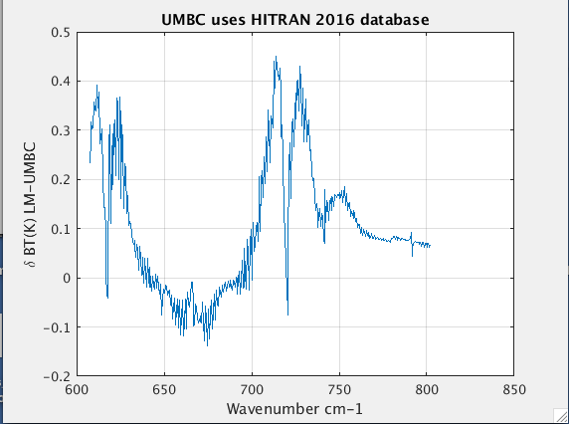
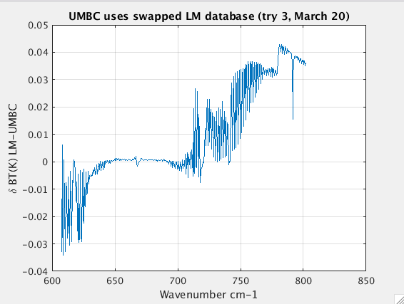
Simple Radiative Transfer using voigt lineshape TOA BTD between (UMBC LBL Voigt) – (LM Voigt)
UMBC with H2016 UMBC with LM
Notes:
See /umbc/xfs2/strow/asl/s1/sergio/home/HITRAN2UMBCLBL/JMHartmann_HITRANXY_CO2LM/compare_voigt_LM_run8.m toffset = 6 (us Std)

Slide 8
Summary
Large differences in TOA brightness temperatures (about 0.6 K) in the 700-760 cm-1 region between LBLRTM 12.4 Ods and those computed using LM code, seen in Slide 5
Left panel of Slide 7 shows that when we use UMBC LBL Voigt code with HITRAN 2016 line parameters (for US Std profile), and compare to calculations using LM2016 Voigt, differences resemble what is in Slide 4 (LBLRTM 12.4 CO2 ods compared to LM2016)
Right panel of Slide 7 shows when we use UMBC LBL Voigt code with LM parameters, the differences shrink down to less than 0.04 K (convolved with an AIRS-like SRF).
Note that the LM line parameters differ from HITRAN 2016 parameters in the self and air broadening; line centers and strenghts are the same
Larrabee does say he could give me some CriS gas cell spectra …..
But first I’d like someone to verify my conclusions that the differences between LBLTM 12.4 and LM linemixing are partly (probably not wholly) due to the LM line broadening parameters!

