Slide 1
Atmospheric
Refraction
And Related Phenomena

Slide 2
Overview
Refractive invariant
The atmosphere and its index of refraction
Ray tracing through atmosphere
Sunset distortions
Green flash

Slide 3
Spherical Earth Approximation
For the purposes of this discussion, we will assume that the earth is a sphere
Earth is not really a sphere, but it is close enough for our purposes
Ray tracing using this model is very easy because there is a conserved quantity along the entire ray’s trajectory

Slide 4
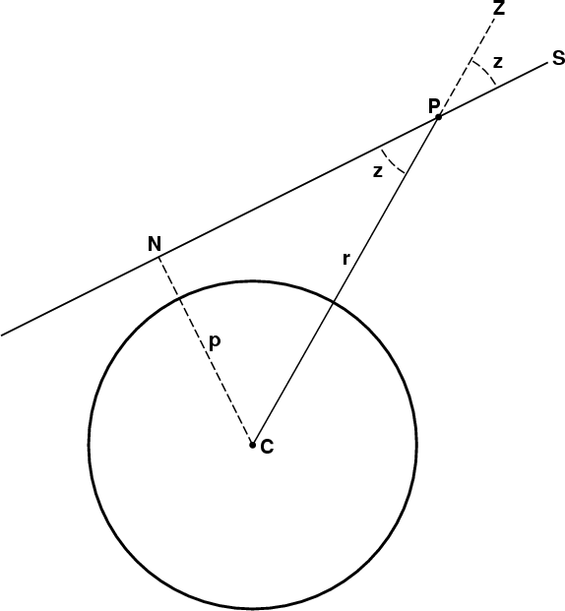
Refractive invariant
If there were no atmosphere,
sin (z) = p/r
r sin (z) = p
where p is the distance of the ray’s closest approach.
This quantity, p, is invariant for any point P along the ray.

Slide 5
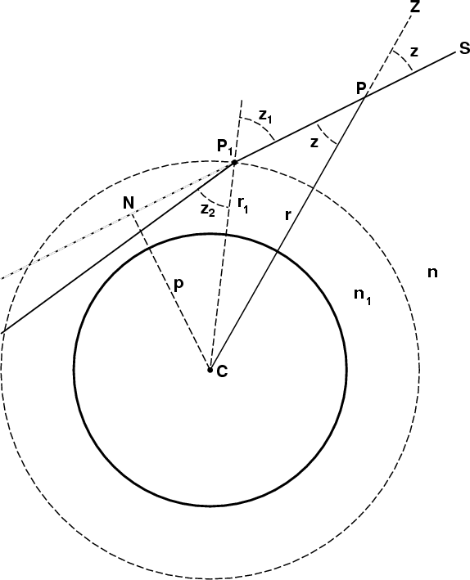
Refractive invariant, cont
For a ray entering a homogeneous atmosphere,
n₁ sin (z₂) = sin (z₁)
n₁ r₁ sin (z₂) = r₁ sin (z₁) = p
But r₁ sin (z₂) = p₁ , which is invariant along refracted ray.
p = n r sin (z)
(before and after refraction)

Slide 6
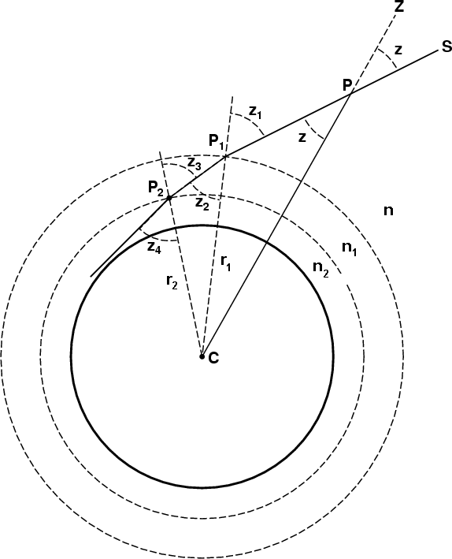
Refractive Invariant, cont
For an atmosphere with 2 layers
n₂ sin (z₄) = n₁ sin (z₃)
n₂ r₂ sin (z₄) = n₁ r₂ sin (z₃)
= n₁ r₁ sin (z₂)
= n₁ p₁
= p
But r₂ sin (z₄) = p₂ , which is invariant along refracted path.
p = n r sin (z)
(at any point along ray)

Slide 7
Refractive Invariant, cont
This process can be repeated for any number of layers with different index of refraction.
For any given ray, calculate p then solve for z:
z (r) = arcsin (p/n(r)r)
  if n(r)r is decreasing monotonically along ray’s path, z must be increasing monotonically
    ∴ 2 rays that converge on a point can never again cross
  since sin(z) is symmetric about 90, if ray’s path has a minimum then it is symmetric about this minimum

Slide 8
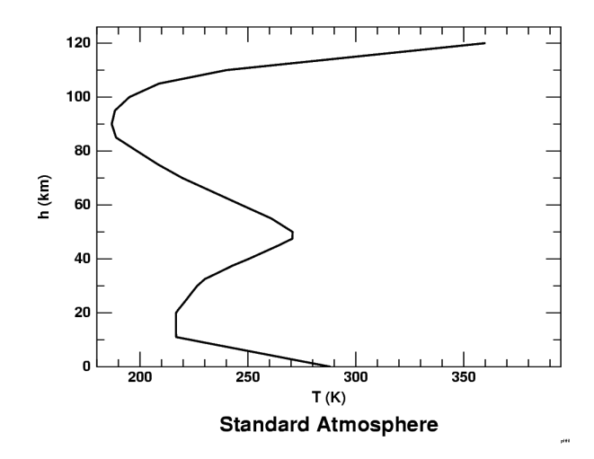
Standard Atmosphere Model
based on meteorological data
temperature related to index, but only for lower 8-10 km
small contribution from upper layers of atmosphere

Slide 9
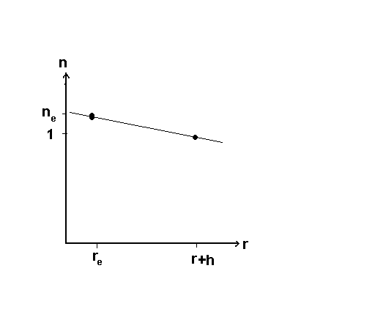
Trevor’s Model of Atmosphere
like the lower portion of standard atmosphere
specify:
  h_{a} (height of atmosphere)
  r_{a} (radius of earth)
  n_{e} (index at surface)
Gives index as a function of height
n (r) = 1 + (r – r_{e})(n_{e} – 1)/h

Slide 10
Ray Tracing
Calculate p based on (x₀,y₀,θ₀)
Calculate intersection of ray with next layer of atmosphere (x₁,y₁)
Calculate index, n₁, at next layer based on model of atmosphere
Calculate new zenith angle, z₁, using refractive invariant,p
Calculate θ₁
repeat steps 2-6

Slide 11
Ray Tracing, cont
Calculate p given (x₀,y₀,θ₀) :
P(t) = P₀ + t v
=[x₀+t cos(θ₀) , y₀ + t sin(θ₀)]
x(t)² ⁺ y(t)² = r₀²
= x₀² ⁺ y₀²
t_{a,b} = 0 , -2(x₀ cos (θ₀) + y₀ sin(θ₀))
The ray is closest when t = t_{p} = (t_{a}+t_{b})/2
p=x(t_{p}) ² + y(t_{p}) ²

Slide 12
Ray Tracing , cont
Calculate where ray intersects next layer of atmosphere at r₁:
P₁(t) = P₀ + t v
=( x₀+ t cos(θ₀) , y₀ + t sin(θ₀) )
x(t)² ⁺ y(t)² = r₁²
t_{a,b} = -((x₀ cos (θ₀) + y₀ sin(θ₀)) ±
((x₀ cos (θ₀) + y₀ sin(θ₀)) ² – (x₀² + y₀² - R₁² )
P₁ = ( x₁ , y₁ )

Slide 13
Ray Tracing, cont
Calculate index of refraction for next strata,n₁, using n=n(r)
Calculate z₁ using refractive invariant p
p = n r sin(z)
z₁= arcsin (p/n₁r₁)
Calculate θ₁
θ₁ = z₁ + arctan(y₁/x₁) - 
Repeat steps 2-6

Slide 14
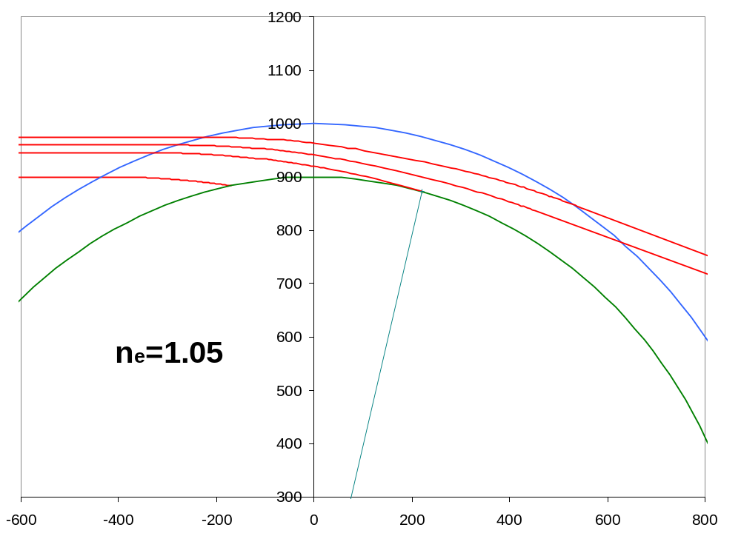
Ray Tracing Example
Ray tracing based on my model with n=1.05 at surface
notice that rays don’t cross

Slide 15
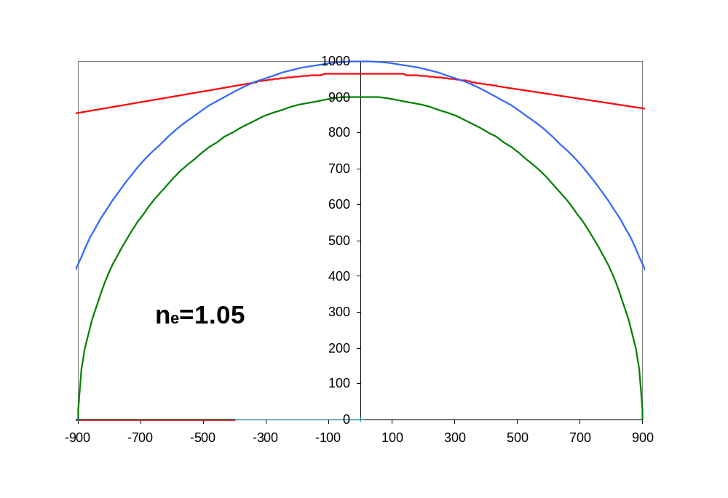
Ray Tracing Example 2
Ray tracing based on my model with n=1.05 at surface
Notice that ray is symmetric about its minimum

Slide 16
Distortions of Sunsets
Position of sun
Angular size of sun
Rate of sun setting

Slide 17
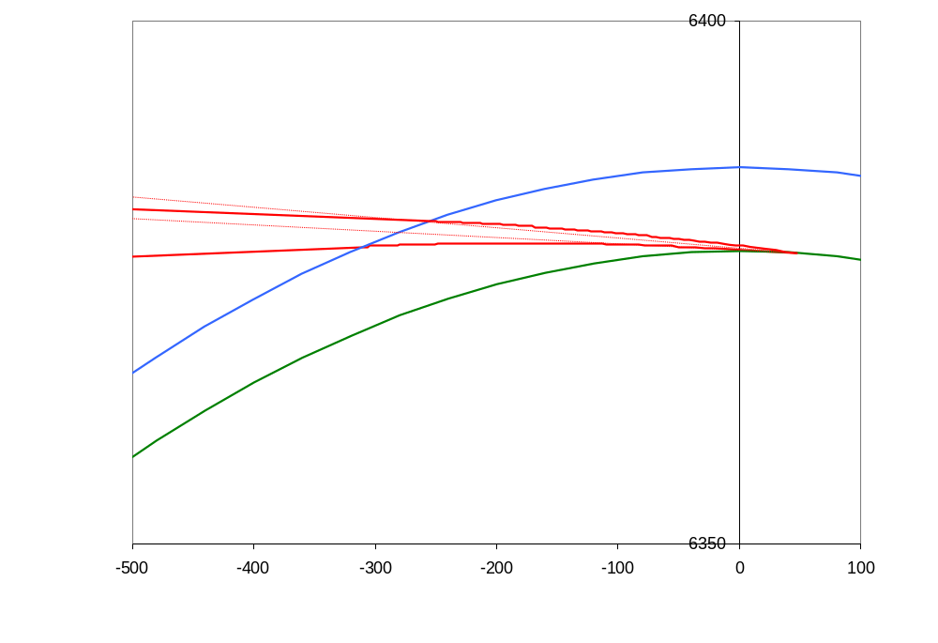
Position and Angular Size of Sun
Rays traced using my model with n=1.00029 at surface, h_{atm}=8 km, and actual sizes of earth and sun
Sun appears higher and smaller than it really is

Slide 18
Angular Size of Sun
Vertical size of sun
  actual angular size of sun = 0.54
  at sunset, measured to be = 0.45
  at sunset, my model predicts size = 0.34
Horizontal size
  reduced by refraction because its extremities are both moved up towards the zenith on converging great circles, bringing them closer together
  very small effect (approx 0.03%)

Slide 19
Rate of Sun Setting
The speed at which the sun goes down is determined by:
  the rate of rotation of the earth,
    d/dt = 360/(24*60*60 s)
  the angular size of the sun
  ☞ = 0.54
  the latitude of the observer
  the season (inclination of earth toward sun)
  the effects of atmospheric refraction

Slide 20
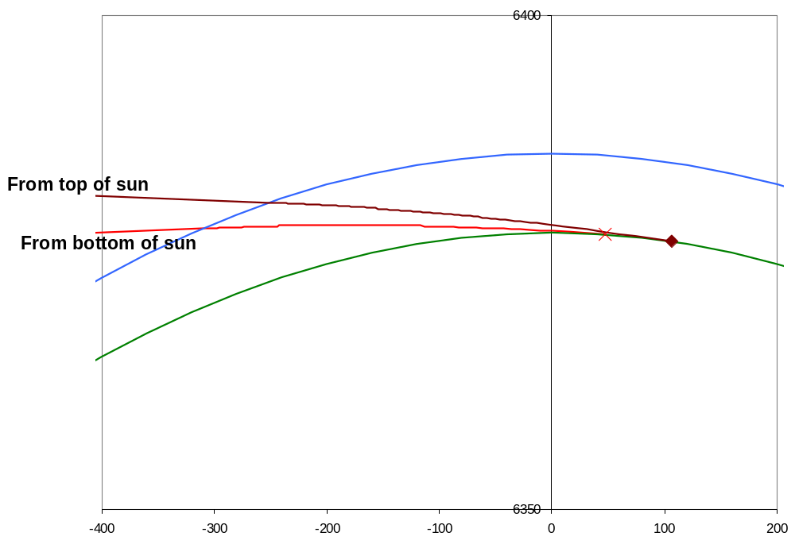
Rate of Sun Setting, cont
plot shows the points where the top and bottom rays from sun set
angle between then 

Slide 21
Rate of sun setting, cont
On March 21 if there were no refraction the time for sun to set would be (at 50 lat):
T =  /_{(cos (θ) d/dt)} = 197.5 s
On March 14, I timed sunset to take
T = 150 s
My model predicts  = 0.533
T = / _{d/dt} = 127.9 s

Slide 22
The Green Flash
sun appears green just as it crosses horizon at sunrise and sunset
only seen if conditions are just right
there is a long history of wrong or incomplete explanations
  refraction through waves
  after image in eye after seeing red sunset
due mainly to:
  differential refraction of different wavelengths
  Rayleigh scattering
  temperature inversion causing mirage

Slide 23
Differential Refraction
index of refraction varies slightly for different wavelengths of light
n_{red} = 1.000291
n_{green} = 1.000295
n_{blue} = 1.000299
shorter wavelengths experience more refraction, thus set later than longer wavelengths

Slide 24
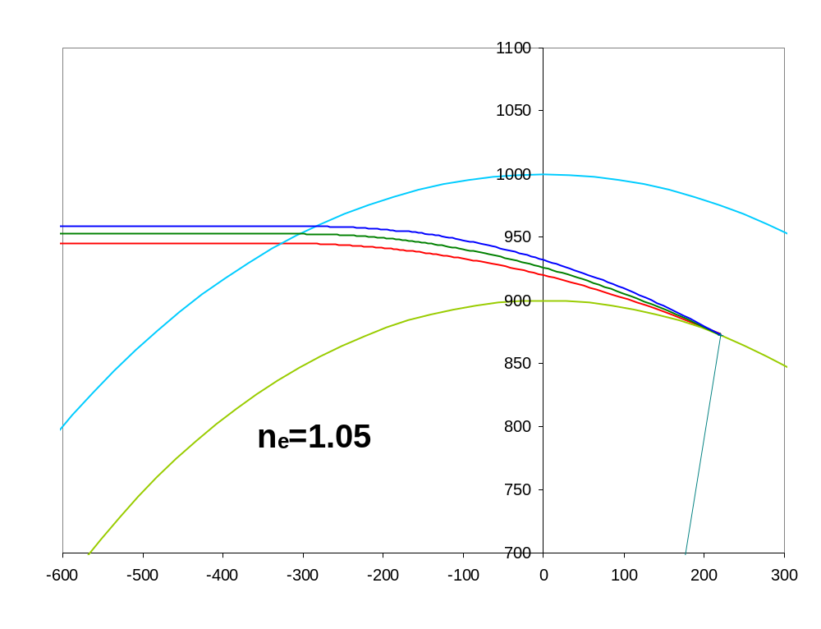
Differential Refraction
Red light has set, but blue and green light is still above horizon

Slide 25
Rayleigh Scattering
light interacts with particles that are of similar dimension as wavelength of light
light absorbed then re-emitted in a different direction
air particles happen to be right size to scatter blue light
reason that sky is blue
light coming directly from sun that we see at sunset almost devoid of blue light
  safe to look at sunset, as harmful UV rays are removed by scattering through thick slice of atmosphere

Slide 26
Basic Explanation of Green Flash
as red light (long ) from sun is just about to disappear, the blue and green light (shorter ) is still above horizon
the blue light has been removed by Rayleigh scattering, leaving green light
This explanation is correct, but not complete. The effect it produces is 10X to weak to be seen with the naked eye.
Something else must be magnifying the green light to make it visible...

Slide 27
Mirages
Mirages are what is seen when light from a single point takes more than one path to the observer. The observer sees this as multiple images of the source object.
2 basic types:
  inferior mirage
  superior mirage
Inferior mirage is what typically makes the green flash visible

Slide 28
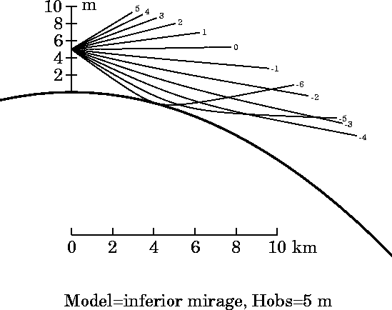
Inferior Mirage
Occurs when temperature at surface is very high (low n) and observer looking down at heated region
rays bend upward toward the region of higher n upward
nr no longer monotonic, meaning rays below observer can cross, creating mirage
  sin(z)=p/nr
Green rays that have not yet set are bent toward observer
This is what makes green flash visible to naked eye

Slide 29
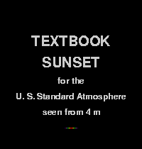
Green Flash, no Mirage

Slide 30
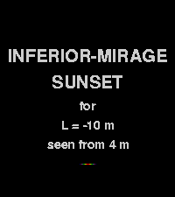
Green Flash, with Mirage

Slide 31
good night

