Slide 1
POWER ENJOY SOFTWARE ENGINEERING 2 2016/2017
AUTHORS
Sergio CAPRARA
Soheil GHANBARI
Erica TINTI

Slide 2
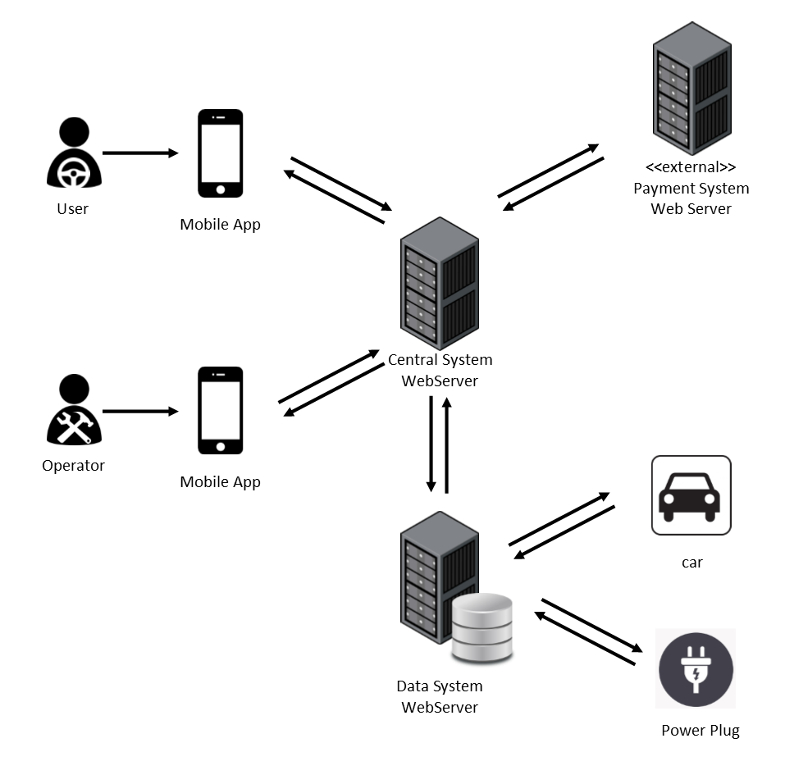
OVERALL SYSTEM

Slide 3
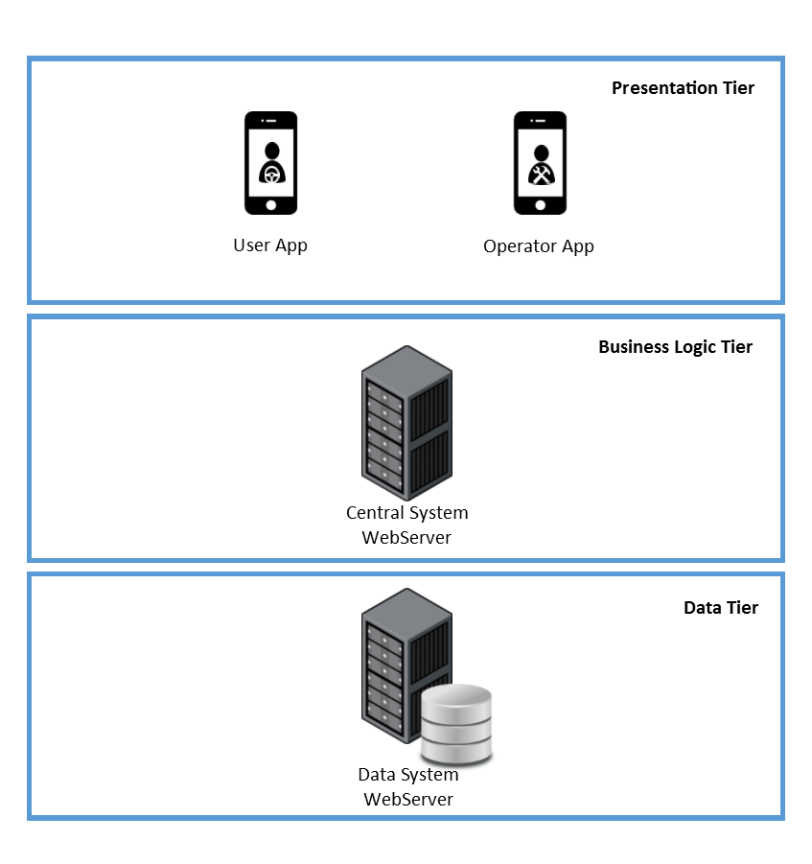
OVERALL SYSTEM THREE-TIER ARCHITECTURE
PRESENTATION TIER
The views are provided to the users and operators through the application on their mobile phones.
BUSINESS LOGIC TIER
The Central System contains the main logic of the application and communicates with the user devices and the Data System.
DATA TIER
The Data System collects the data of all the cars, users and operators into a database and interacts with cars and power plugs to change or get their status.

Slide 4
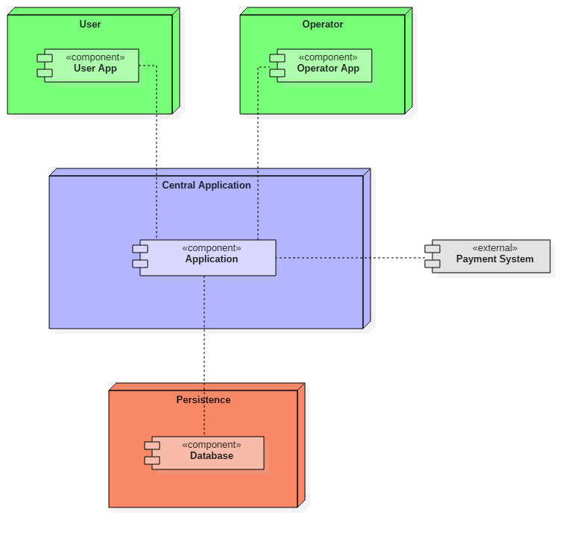
HIGH-LEVEL COMPONENTS
User and Operator
Applications
Central
Application
External Payment System
Persistence

Slide 5
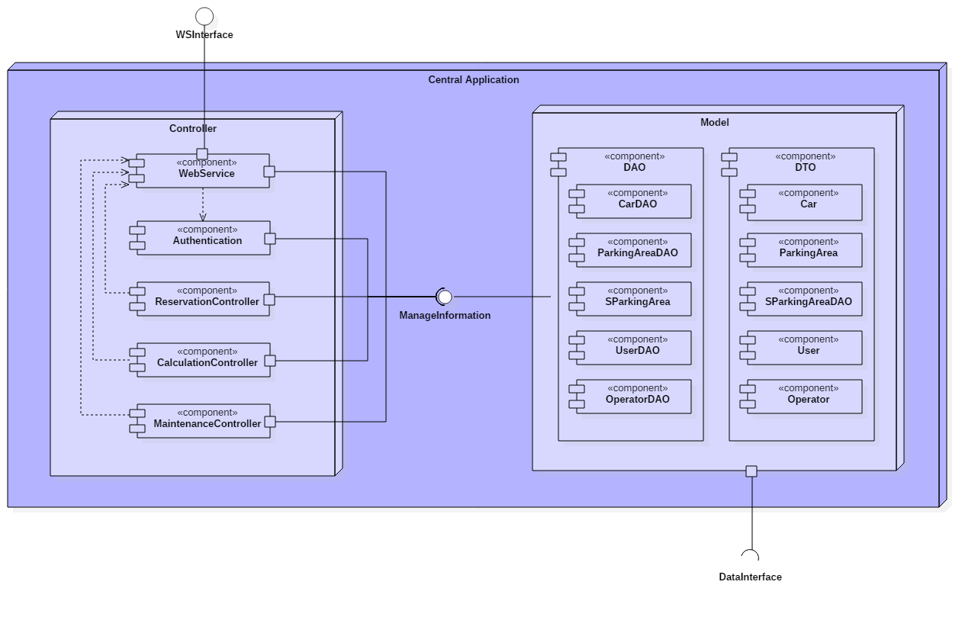
COMPONENTS CENTRAL APPLICATION

Slide 6
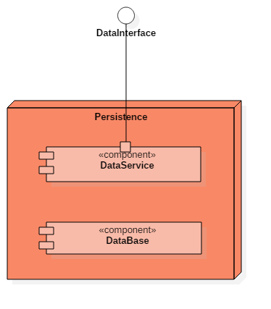
COMPONENTS PERSISTENCE
Provides a way to interact with the system installed on cars and with power plugs.
Gets information and can set power plug status.
Storage of the data of our system

Slide 7
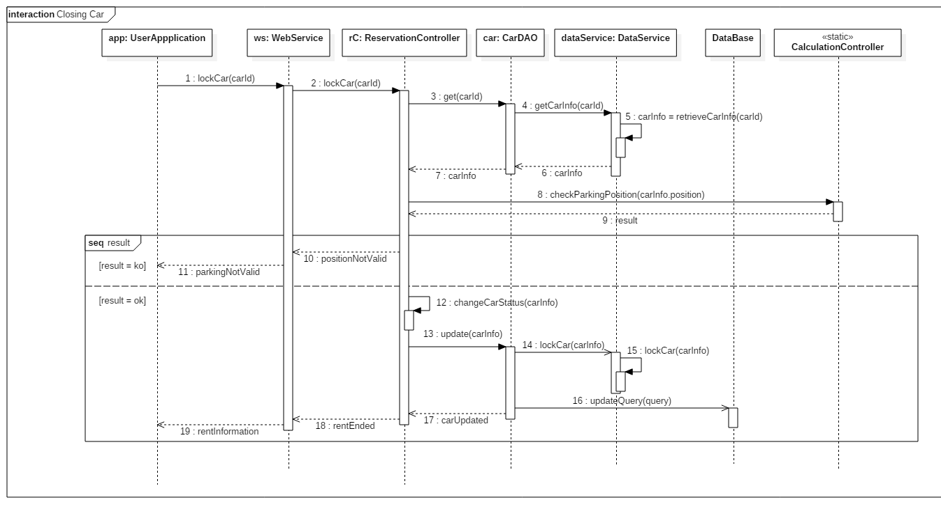
RUNTIME VIEW

Slide 8
ARCHITECTURAL STYLES AND PATTERNS
Client-Server
Architectural design pattern.
The server side manage all the application. The client is represented by the mobile application and just request and show infomations by the server.
Model-View-Controller
Used to separate who own the business logic (controller) from who own the data (model) and who show the data (view). Used both in server side and client side.
Data Access Objects
Used to separate the data access mechanism from the application logic. Details of data storage are hided from the rest of the application. DAO components offer an interface to access both the DB and the DataServices.

Slide 9
ALGORITHMS
function calculateFinalAmount(car) {
float timeUsed = car.getTripLength();
float passengerDiscount = 0, batteryDiscount = 0, plugDiscount = 0, lowBatteryFee = 0;
float total = timeUsed * System.pricePerMinute;
if (car.getPassengersNum() > 1) {
passengerDiscount = total * 0.1;
}
if (car.getBatteryLevel() > 50) {
batteryDiscount = total * 0.2;
}
if (car.isCharging() == true) {
plugDiscount = total * 0.3;
}
if (car.getBatteryLevel() < 20 and
checkDistanceBetween(findClosestStation(car.getPosition()), car) > 3) {
lowBatteryFee = total * 0.3;
}
float finalCharge = total – passengerDiscount – batteryDiscount – plugDiscount + lowBatteryFee;
return finalCharge;
}

Slide 10
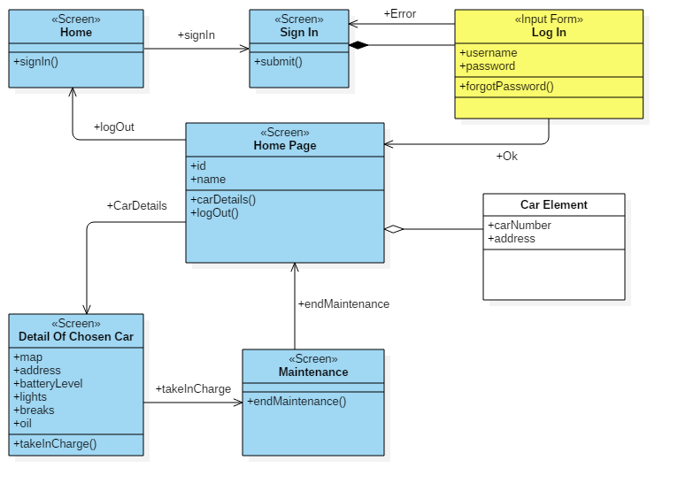
USER EXPERIENCE OPERATOR DIAGRAM

Slide 11
QUESTIONS?

