Slide 1
POWER ENJOY SOFTWARE ENGINEERING 2 2016/2017
AUTHORS
Sergio CAPRARA
Soheil GHANBARI
Erica TINTI

Slide 2
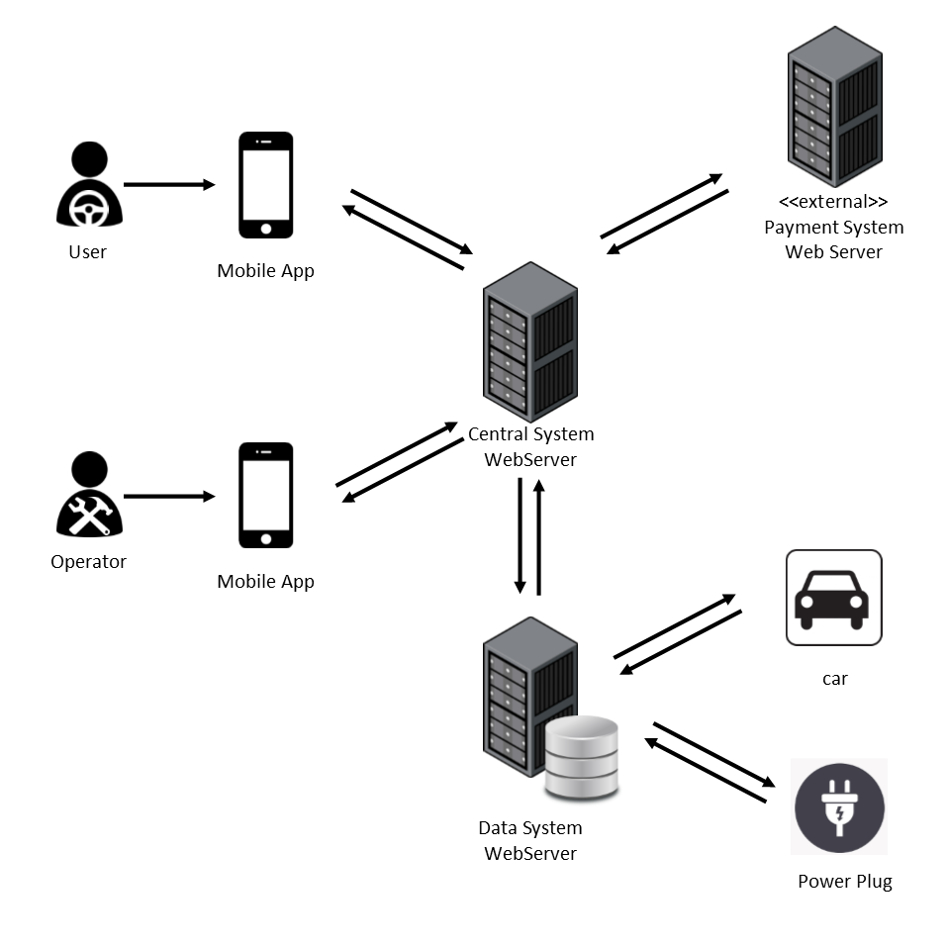
OVERALL SYSTEM

Slide 3
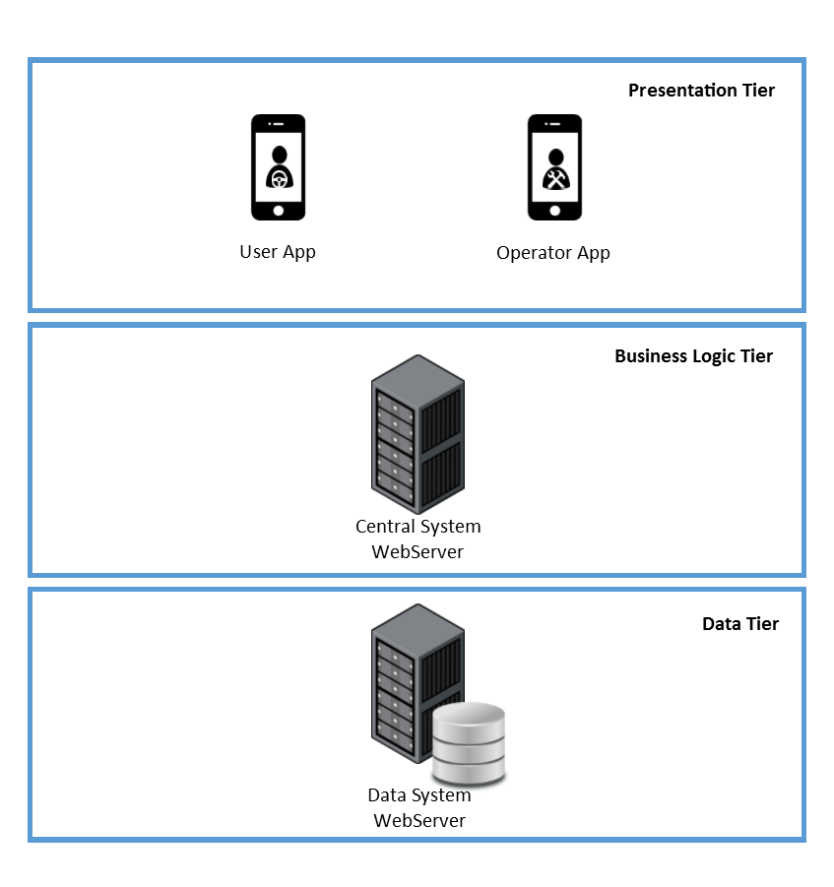
OVERALL SYSTEM THREE-TIER ARCHITECTURE
PRESENTATION TIER
The views are provided to the users and operators through the application on their mobile phones.
BUSINESS LOGIC TIER
The Central System contains the main logic of the application and communicates with the user devices and the Data System.
DATA TIER
The Data System collects the data of all the cars, users and operators into a database and interacts with cars and power plugs to change or get their status.

Slide 4
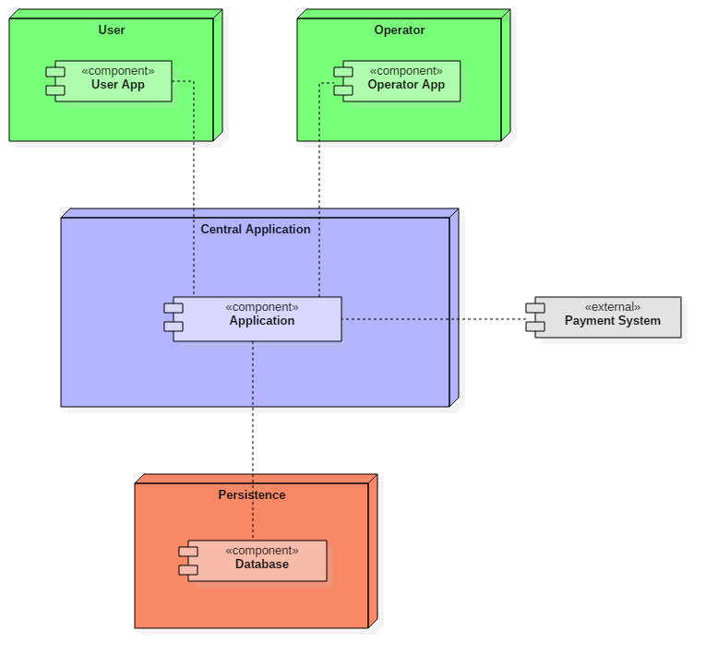
HIGH-LEVEL COMPONENTS
User and Operator
Applications
Central
Application
External Payment System
Persistence

Slide 5
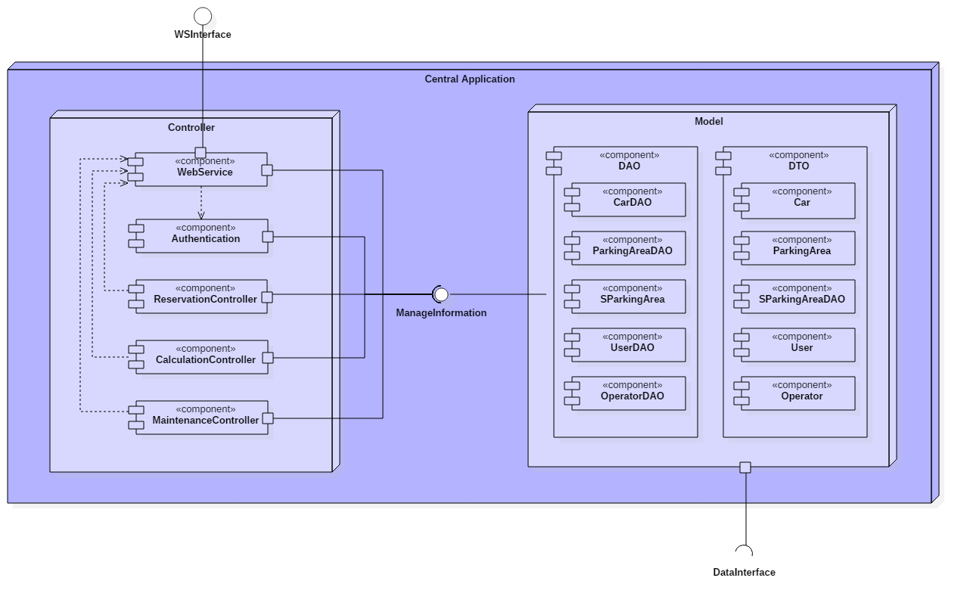
COMPONENTS CENTRAL APPLICATION

Slide 6
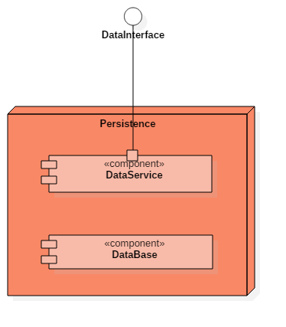
COMPONENTS PERSISTENCE
Provides a way to interact with the system installed on cars and with power plugs.
Gets information and can set power plug status.
Storage of the data of our system

Slide 7
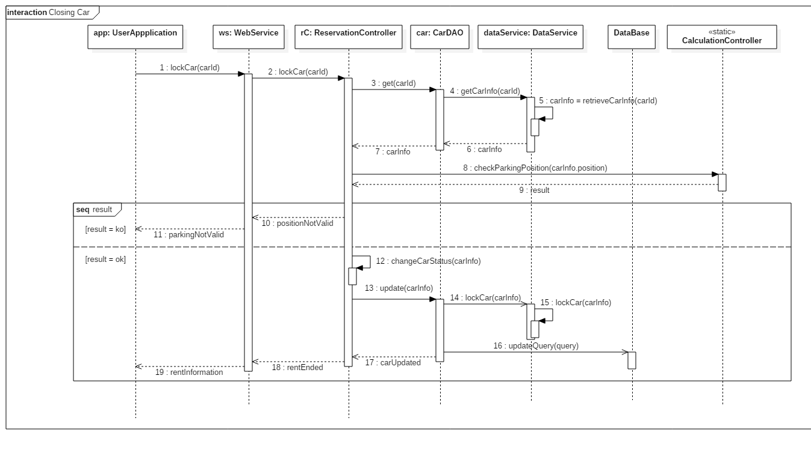
RUNTIME VIEW

Slide 8
INTERFACES AND SOME METHODS
WSINTERFACE
MANAGEINFORMATION
DATAINTERFACE
logIn(user, pass)
reserveCar(user, carId)
finishRental(user, car)
Mobile App
WebService
get(id)
getAll()
update(obj)
Controller
Model
getCarInfo(carId)
getAllPowerPlugs()
setPowerPlug(plugId)
Model
DataService

Slide 9
ARCHITECTURAL STYLES AND PATTERNS
Client-Server
Communication between mobile applications and WebService using JSON.
The Server-side application uses Java EE 7.
Central Application runs on IBM WebSphere Application Server (Liberty profile) that fully supports Java EE 7 and allows the integration with Open Source software.
On the Database Server: IBM WebSphere AS (Liberty profile) and IBM DB2 DBMS.
Model-View-Controller
Data Access Objects

Slide 10
ALGORITHMS
function calculateFinalAmount(car) {
float timeUsed = car.getTripLength();
float passengerDiscount = 0, batteryDiscount = 0, plugDiscount = 0, lowBatteryFee = 0;
float total = timeUsed * System.pricePerMinute;
if (car.getPassengersNum() > 1) {
passengerDiscount = total * 0.1;
}
if (car.getBatteryLevel() > 50) {
batteryDiscount = total * 0.2;
}
if (car.isCharging() == true) {
plugDiscount = total * 0.3;
}
if (car.getBatteryLevel() < 20 and
checkDistanceBetween(findClosestStation(car.getPosition()), car) > 3) {
lowBatteryFee = total * 0.3;
}
float finalCharge = total – passengerDiscount – batteryDiscount – plugDiscount + lowBatteryFee;
return finalCharge;
}

Slide 11
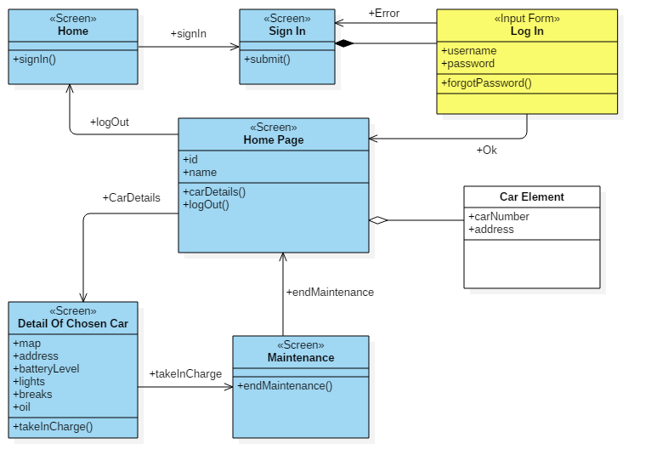
USER EXPERIENCE OPERATOR DIAGRAM

Slide 12
QUESTIONS?

