Slide 2
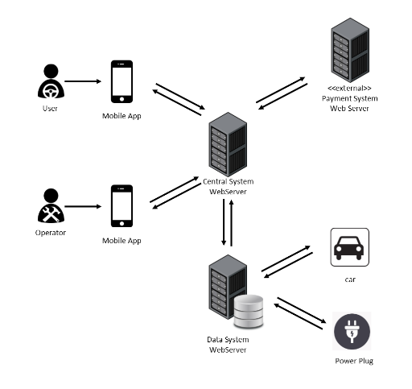
Overall system

Slide 3
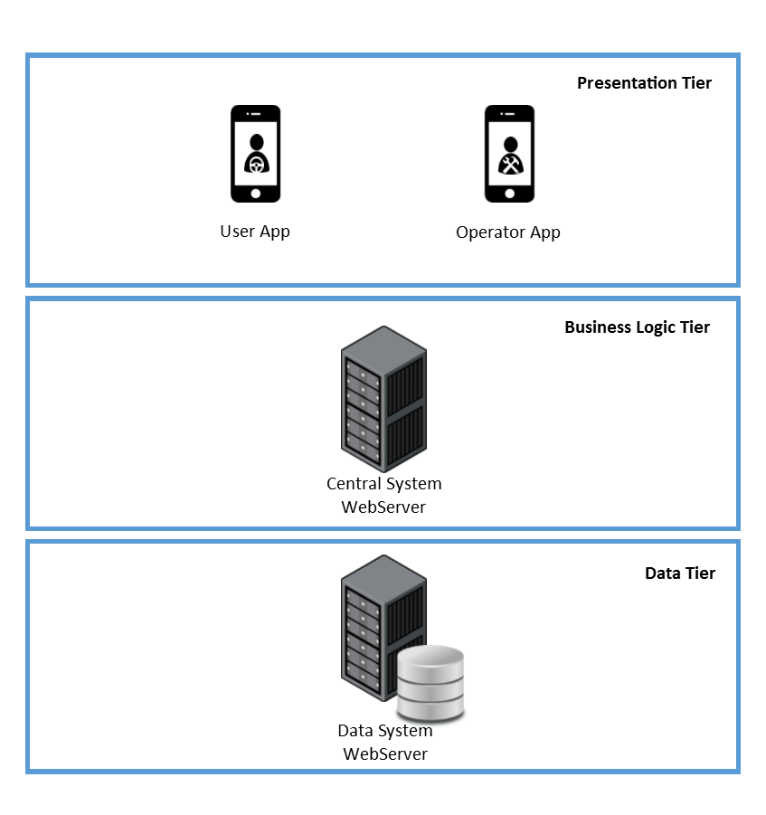
Overall system THREE-TIER ARCHITECTURE
PRESENTATION TIER
The views are provided to the users and operators through the application on their mobile phones.
BUSINESS LOGIC TIER
The Central System contains the main logic of the application and communicates with the user devices and the Data System.
DATA TIER
The Data System collects the data of all the cars, users and operators into a database and interacts with cars and power plugs to change or get their status.

Slide 4
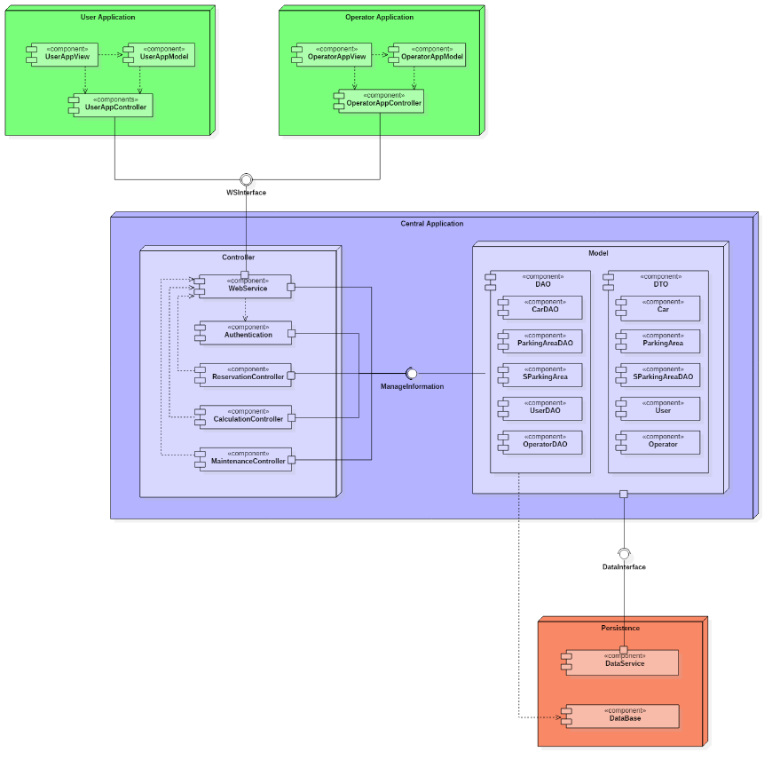
Components

Slide 5
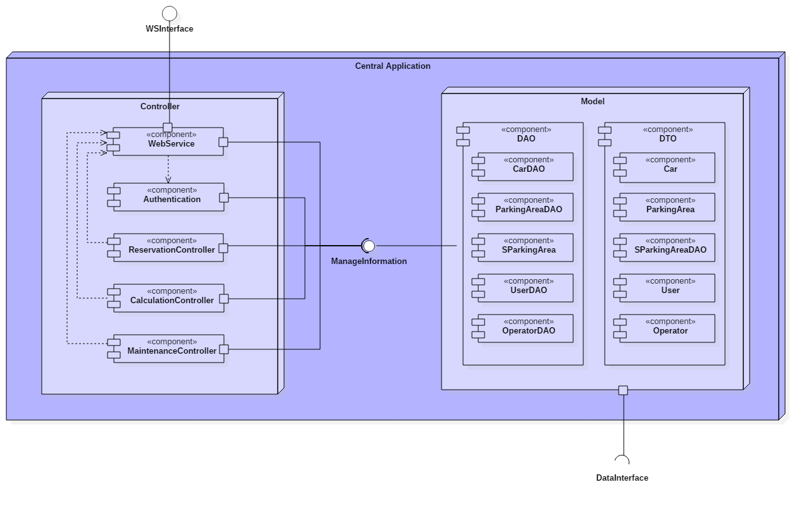
Central application

Slide 6
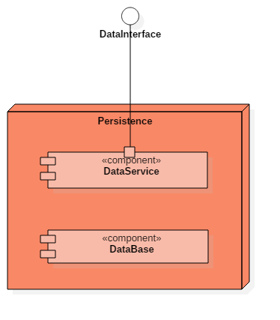
persistence

Slide 7
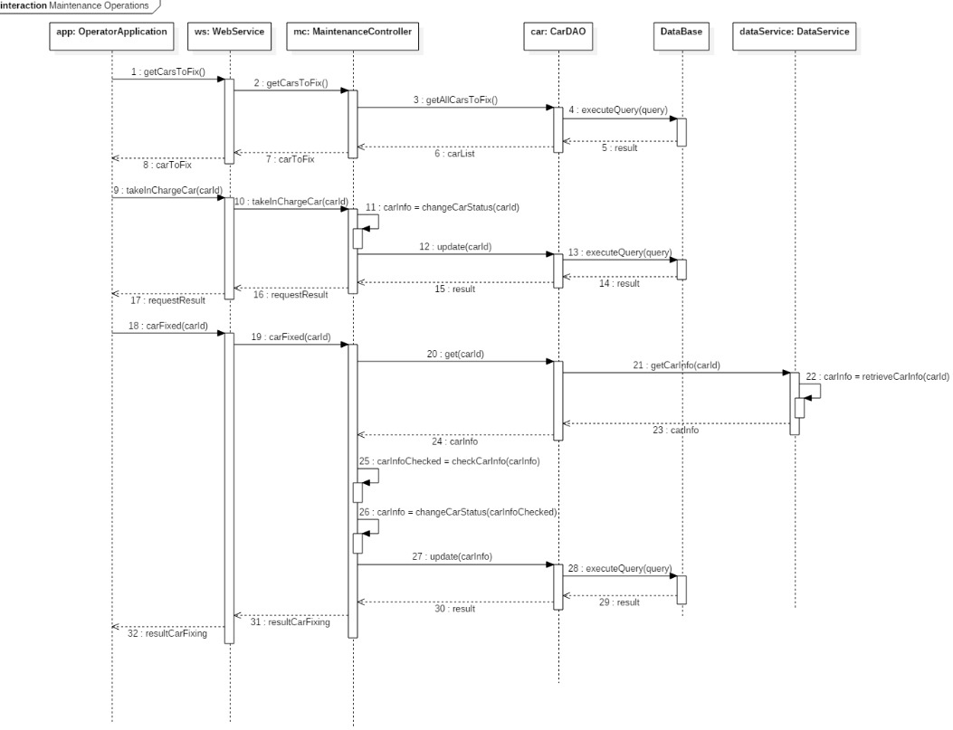
The runtime view

Slide 8
interfaces
WSInterface
ManageInformation
DataInterface

Slide 9
ARCHITECTURAL STYLES AND PATTERNS

Slide 10
algorithms

Slide 11
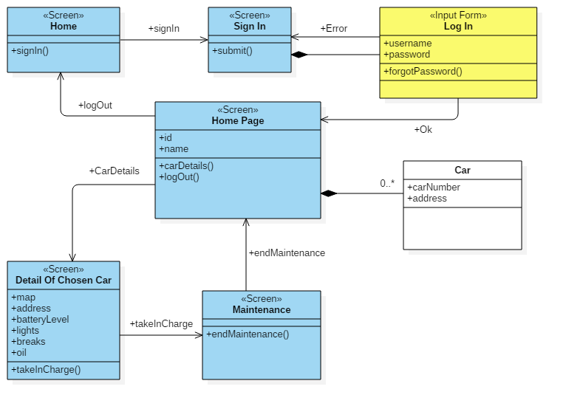
Ux diagrams

Slide 12
Questions?

