Slide 1
POWER ENJOY SOFTWARE ENGINEERING 2
AUTHORS
Sergio CAPRARA
Soheil GHANBARI
Erica TINTI

Slide 2
PowerEnjoy – WHAT IS IT?
«Develop a DIGITAL MANAGEMENT SYSTEM
for a CAR SHARING service
that exclusively employs ELECTRIC CARS»

Slide 3
CONTENTS
RASD
REQUIREMENTS ANALISYS SPECIFICATIONS
DD
ARCHITECTURE DESIGN
TP
INTEGRATION TEST PLAN
PP
PROJECT PLAN

Slide 4
ACTORS OF THE SYSTEM
User: the person that registers to the system and interacts through the PowerEnjoy app installed on his phone.
Operator: a person, already known by the system, that can access to the list of the cars that have low battery or that need technical assistance.

Slide 5
GOALS OF THE SYSTEM
USER GOALS
REGISTRATION
LOGIN
FIND AVAILABLE CARS
VIEW BATTERY LEVEL.
SEE PARKING AREAS.
SEE SPECIAL PARKING AREAS.
RESERVE A CAR.
OPEN THE RESERVED CAR
CANCEL A RESERVATION
NOTIFY FINISH RENTING
AMOUNT CHARGED
ACCESS AND MODIFY PROFILE INFO
OPERATOR GOALS
LOGIN
SEE CARS THAT NEED MAINTENANCE
NOTIFY END OF THE MAINTENANCE.

Slide 6
SOME ASSUMPTIONS
The user has INTERNET ACCESS enabled on his phone.
SPECIAL PARKING AREAS are a subset of safe parking areas and correspond to the ones with PowerEnjoy’s power plugs.
A CAR IS UNAVAILABLE: battery <5%, broken, in use, reserved
Only registrations by users having a EUROPEAN DRIVING LICENCE are supported.
Operators are already registered to the system.
The SYSTEM CAN ALWAYS ACCESS TO THE REAL-TIME INFORMATION of the car.
The system can CHECK THE AVAILABILITY OF POWER PLUGS of all special parking areas and set status.

Slide 7
SOME REQUIREMENTS
The user should be able to RESERVE A CAR:
The user should be able to select one of the cars to see its status and reserve it.
The system should make the car unavailable to other users once the user confirms his choice.
The system should retain the reservation for an hour and cancel it when the time limit is reached. In this case a 1 EUR fee should be charged.
After the rental, the user should be able to inform the system that he is LEAVING THE CAR:
The user should have a way to notify the system he has finished using the car.
The system should verify the status of the car and check the parking.
If all is correct the system should lock the car and make it available again.

Slide 8
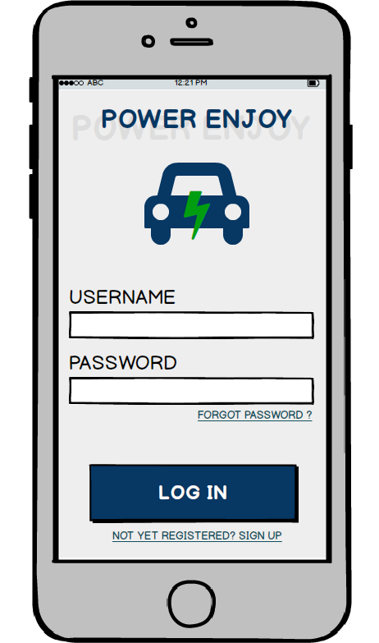
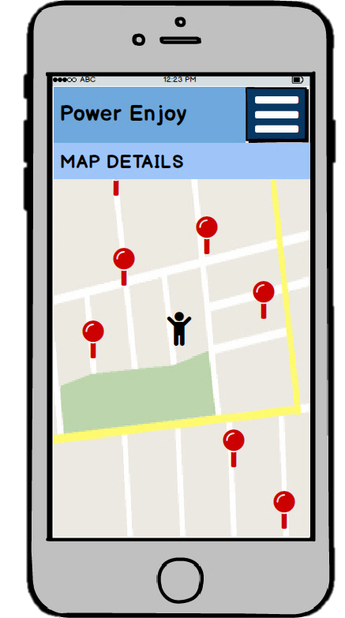
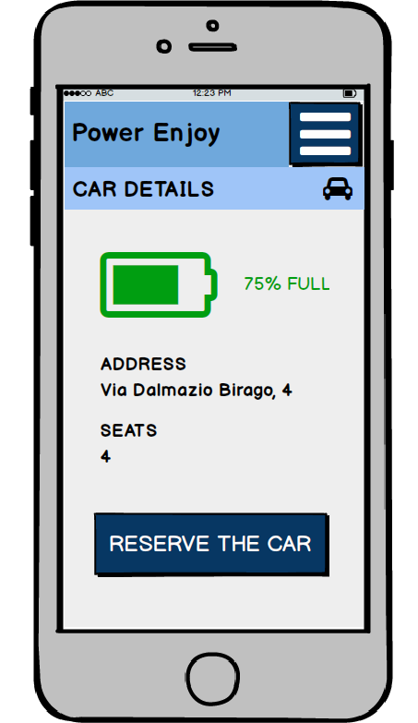
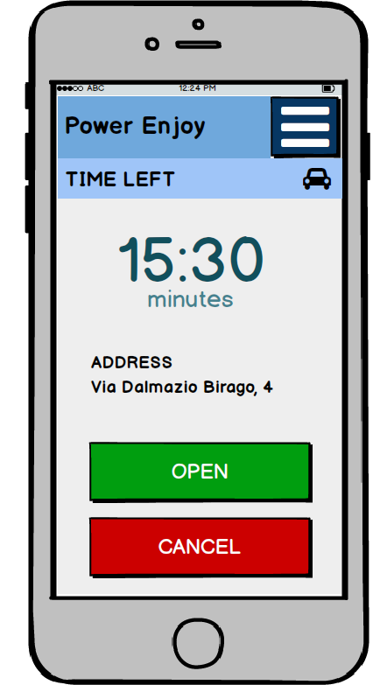
USER INTERFACE

Slide 9
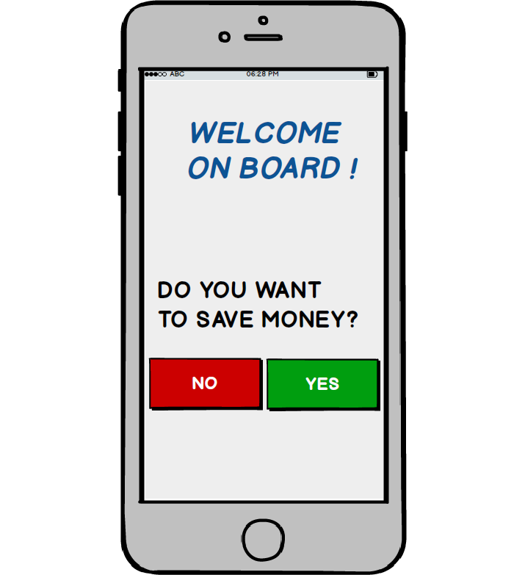
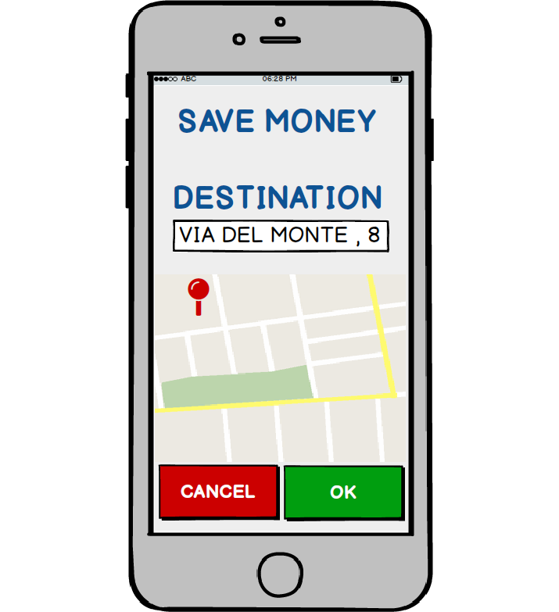
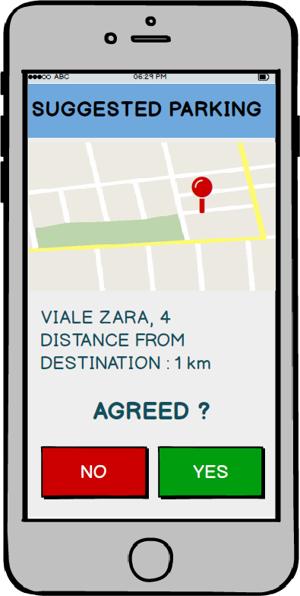
A USE CASE: USER CHOOSES MONEY SAVING OPTION
Flow of events
The system asks the user for the final destination.
The user enters the address.
The system checks entered address and looks for free power plugs in close stations.
The system shows the result to the user asking for confirmation.
The user accepts to park in the station selected by the system.
The system reserves the free power plug.
The system provides the address and number of the slot reserved for the power supply.
Notes:
Exceptions
The address entered by the user does not exist or is out of the area: the system informs the user of the error and suggests to retry.
The user refuses to park in the suggested station: the system suggests to retry the search to find a better result.
No free slots available: the system informs the user that there are no charging slots available, so it suggests the user to retry later.

Slide 10
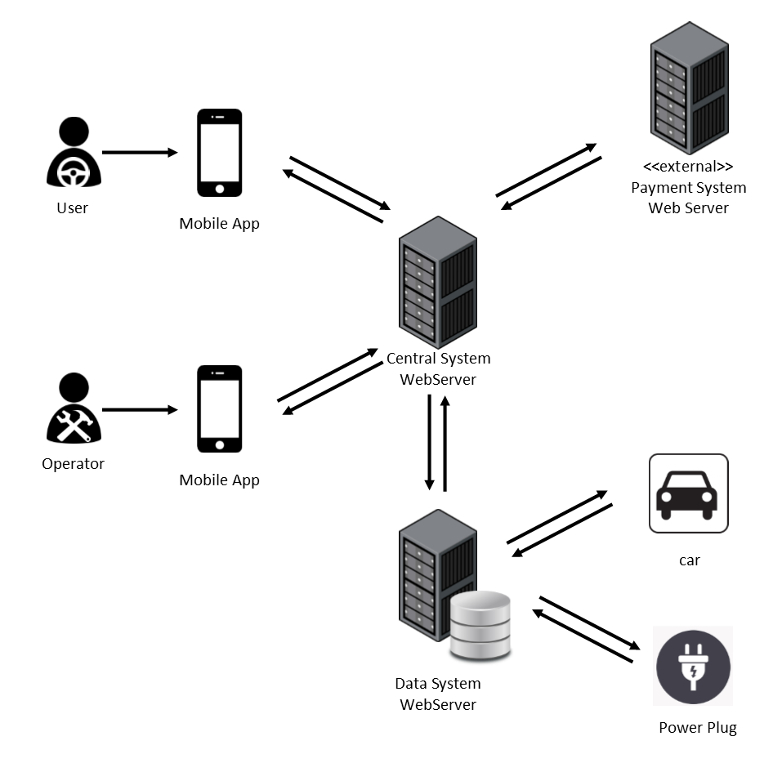
ARCHITECTURE DESIGN: OVERALL SYSTEM

Slide 11
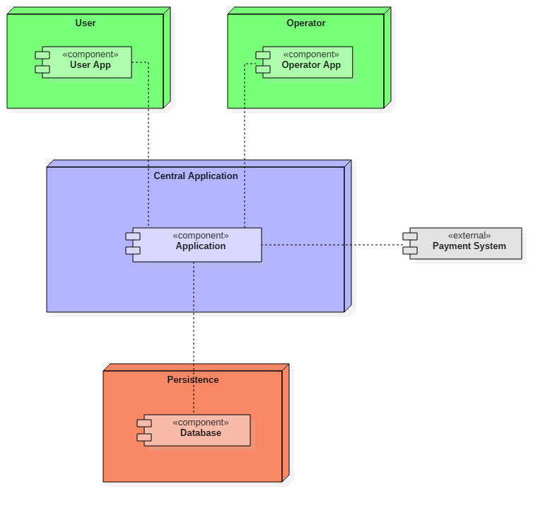
HIGH-LEVEL COMPONENTS
User and Operator
Applications
Central
Application
External Payment System
Persistence

Slide 12
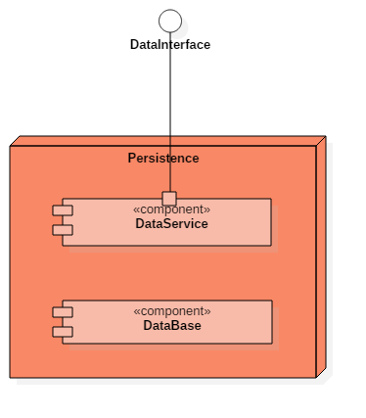
COMPONENTS PERSISTENCE
Provides a way to interact with the system installed on cars and with power plugs.
Gets information and can set power plug status.
Storage of the data of our system

Slide 13
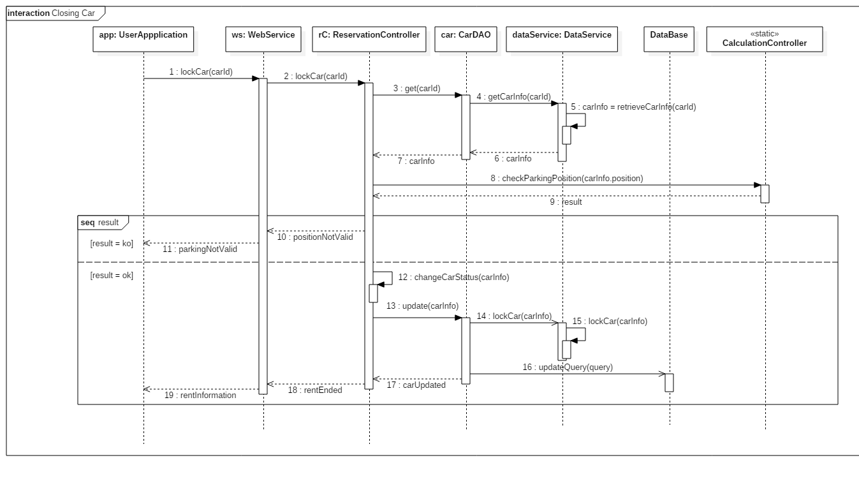
RUNTIME VIEW

Slide 14
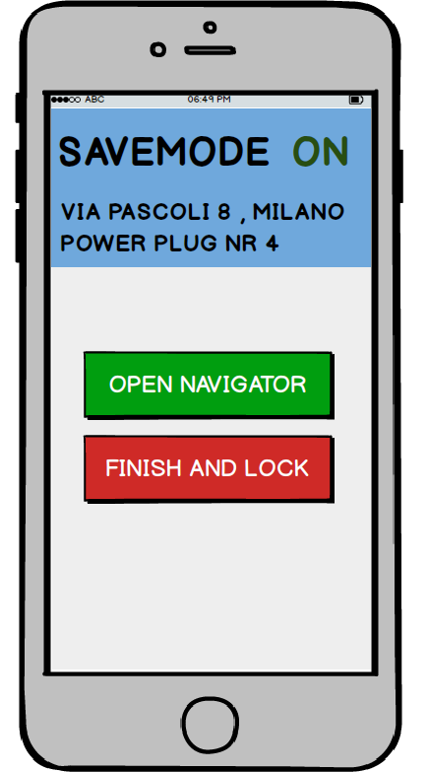
USER EXPERIENCE SAVING MONEY OPTION MOCK-UPs

Slide 15
INTEGRATION TEST COMPONENTS
The higher level of components of our system that need to be integrated are:
User Application
Operator Application
Controller
Model
Database
The listed components are divided into lower level components, that will need integration testing.
More in detail, the Controller is composed by WebService, Authentication, Maintenance Controller, Reservation Controller, Calculation Controller.
The Model has DAO components and some Pojo components. The last one don’t need to be considered for integration. Note that DAO components won’t be unit tested.
Data low level components are the DataService and the Database.
Concerning the two mobile applications, we will only integrate the User App Controller and Operator App Controller with the rest of the system.

Slide 16
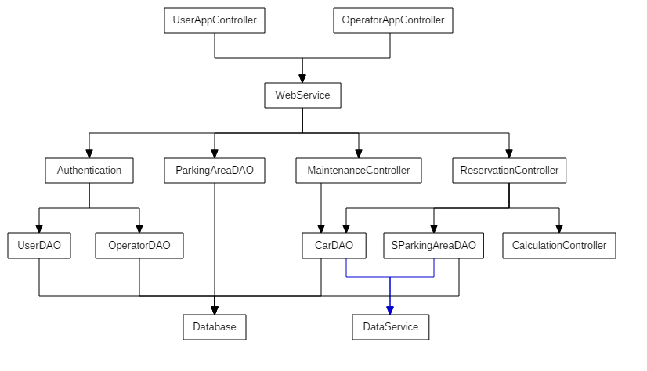
INTEGRATION TEST DIAGRAM

Slide 17
INTEGRATION TEST THE BOTTOM-UP APPROACH
Test will proceed starting from the bottom of the hierarchy and moving to the top on each step.
This approach will include the USE OF DRIVERS, for the case in which a component is ready to be tested and its direct parent is not completely written yet.
EASIER (= faster) METHOD FOR FINDING AND CORRECTING FAULTS
SAFER WAY
FOR TESTING
+

Slide 18
INTEGRATION TEST COMPONENT INTEGRATION SEQUENCE

Slide 19
INTEGRATION TEST COMPONENT INTEGRATION EXAMPLE

Slide 20
INTEGRATION TEST USED TOOLS AND EQUIPMENT
TOOLS
JUNIT: useful to check the result returned by methods. Both unit testing and writing drivers.
ARQUILLIAN: integration testing framework that integrates Junit.It makes the integration testing simpler (ex: Management of the container lifecycle, the deployment)
MANUAL TESTS: to evaluate usability and reactivity of the system through the mobile application, and the interaction with the provided user interface.
EQUIPMENT
A dedicated TESTING SERVER for the Central Application.
DIFFERENT SMARTPHONES for testing user and operator applications.

Slide 21
INTEGRATION TEST TEST DATA
IBM DB2 Test Database Generator, provided by IBM, can be used for generating data. It allows the definition of:
the structure of the table,
constraints on how the data should be generated,
the output format (SQL, CSV, XML).
Using this tool will be helpful as it will accelerate the testing phase.

Slide 22
PROJECT PLAN FUNCTION POINTS - COCOMOII
Type of Component | FPs
External Inputs | 36
External Outputs | 18
External Inquiries | 30
Internal Logic Files | 41
External Interface Files | 29
Total | 154

Slide 23
COCOMO II SCALE DRIVERS
Scale Factors | Very Low | Low | Nominal | High | Very High | Extra High
PREC | thoroughly unprecedented | largely unprecedented | somewhat unprecedented | generally familiar | largely familiar | thoroughly familiar
SF_{j} | 6.20 | 4.96 | 3.72 | 2.48 | 1.24 | 0.00
FLEX | rigorous | occasional relaxation | some relaxation | general conformity | some conformity | general goals
SF_{j} | 5.07 | 4.05 | 3.04 | 2.03 | 1.01 | 0.00
RESL | little (20%) | some (40%) | often (60%) | generally (75%) | mostly (90%) | full (100%)
SF_{j} | 7.07 | 5.65 | 4.24 | 2.83 | 1.41 | 0.00
TEAM | very difficult interactions | some difficult interactions | basically cooperative interactions | largely cooperative | highly cooperative | seamless interactions
SF_{j} | 5.48 | 4.38 | 3.29 | 2.19 | 1.10 | 0.00
PMAT | Level 1 Lower | Level 1 Upper | Level 2 | Level 3 | Level 4 | Level 5
SF_{j} | 7.80 | 6.24 | 4.68 | 3.12 | 1.56 | 0.00

Slide 24
COCOMO II COST DRIVERS
Cost Driver | Factor | Value
Required Software Reliability (RELY) | Nominal | 1.00
Data Base Size (DATA) | High | 1.14
Product Complexity (CPLX) | Very High | 1.00
Developed for Reusability (RUSE) | Nominal | 1.00
Documentation Match to Life-Cycle Needs (DOCU) | Nominal | 1.00
Execution Time Constraint (TIME) | High | 1.11
Main Storage Constraint (STOR) | Nominal | 1.00
Platform Volatility (PVOL) | Low | 0.87
Analyst Capability (ACAP) | High | 1.19
Programmer Capability (PCAP) | High | 0.88
Personnel Continuity (PCON) | Very High | 0.81
Applications Experience (APEX) | High | 1.00
Platform Experience (PLEX) | High | 0.91
Language and Tool Experience (LTEX) | High | 0.91
Use of Software Tools (TOOL) | High | 0.90
Multisite Development (SITE) | High | 0.93
Required Development Schedule (SCED) | Nominal | 1.00
Total |  | 0.6472

Slide 25
COCOMO II EFFORT
EFFORT MULTIPLIER
PERSON MONTHS

Slide 26

COCOMO II SCHEDULE ESTIMATION
$$TDEV=C ∙{\left(PM\right)}^{F}$$
$$F=0.28+0.2 ∙\left(1.0699−0.91\right)=0.31198$$

Slide 27
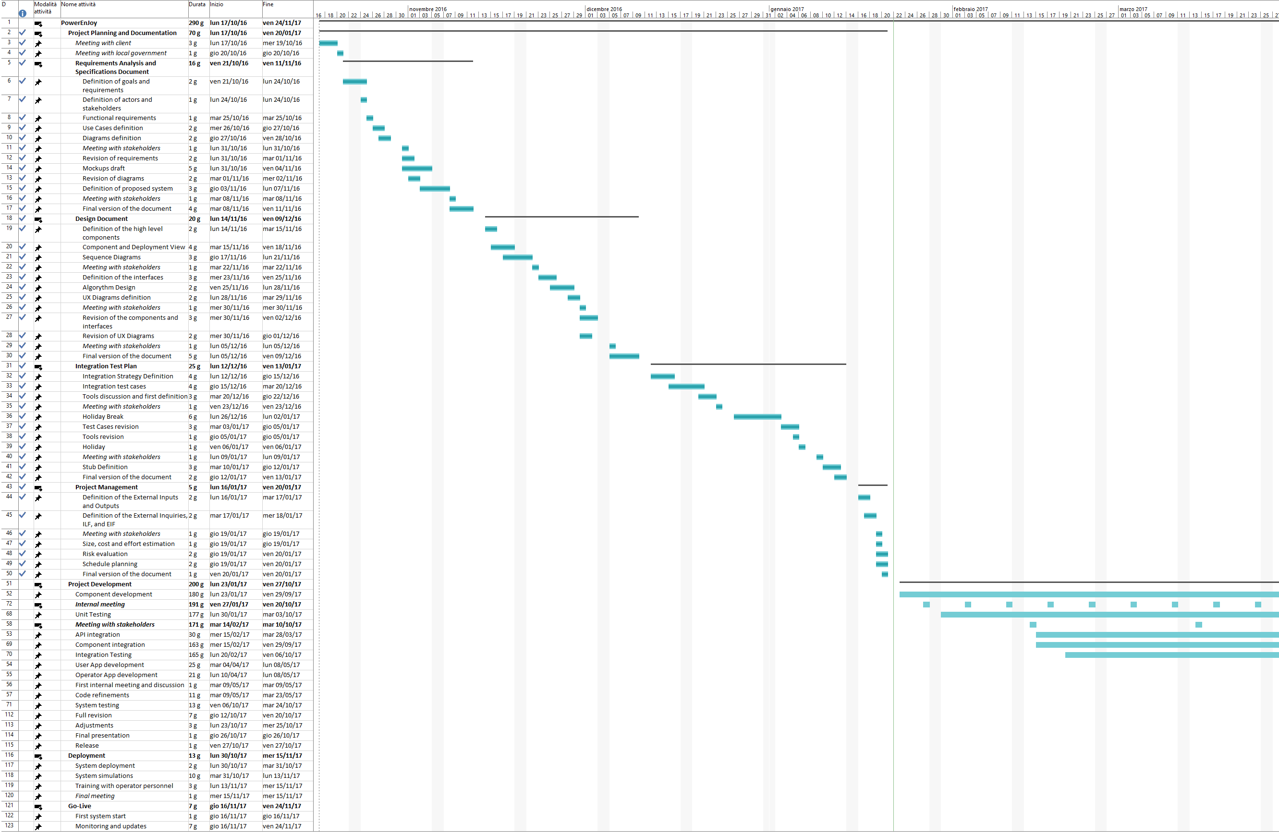
GANTT CHART SCHEDULE AND RESOURCES

Slide 28
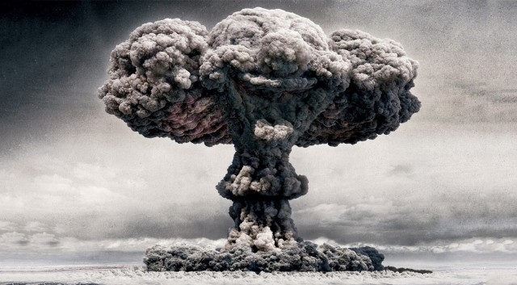
RISK MANAGEMENT (PARTIAL)
NO INTERNET CONNECTION
NATURAL EVENTS
LAW CHANGE
NO ELECTRICITY
RESIGNATION
LOSS OF DATA
REACH OFFICE

Slide 29
QUESTIONS?

