Slide 1
POWER ENJOY SOFTWARE ENGINEERING 2 DESIGN DOCUMENT
AUTHORS
Sergio CAPRARA
Soheil GHANBARI
Erica TINTI

Slide 2
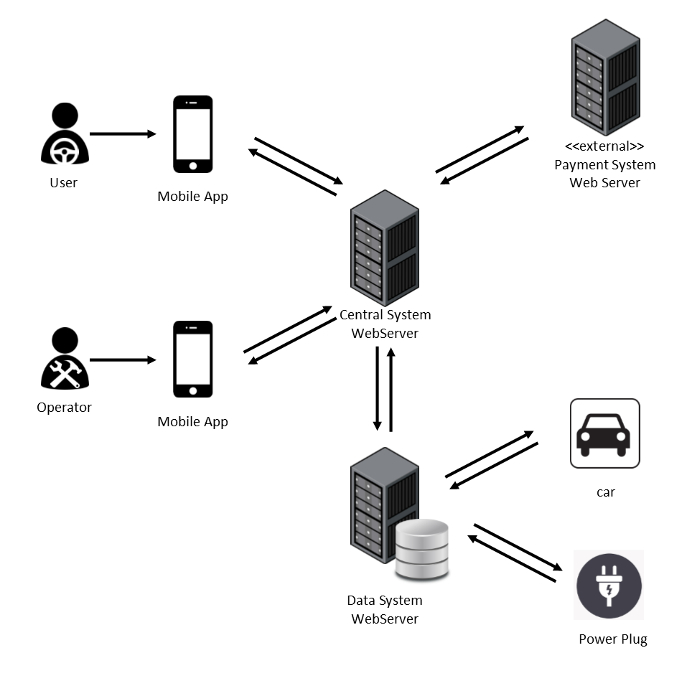
OVERALL SYSTEM

Slide 3
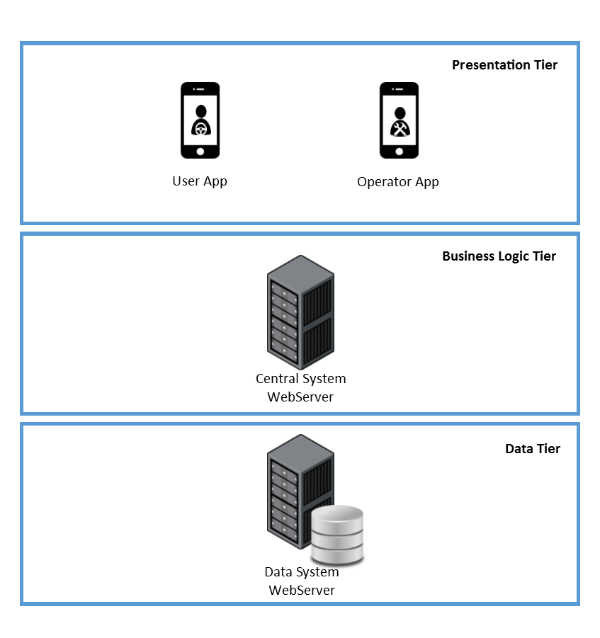
OVERALL SYSTEM THREE-TIER ARCHITECTURE
PRESENTATION TIER
The views are provided to the users and operators through the application on their mobile phones.
BUSINESS LOGIC TIER
The Central System contains the main logic of the application and communicates with the user devices and the Data System.
DATA TIER
The Data System collects the data of all the cars, users and operators into a database and interacts with cars and power plugs to change or get their status.

Slide 4
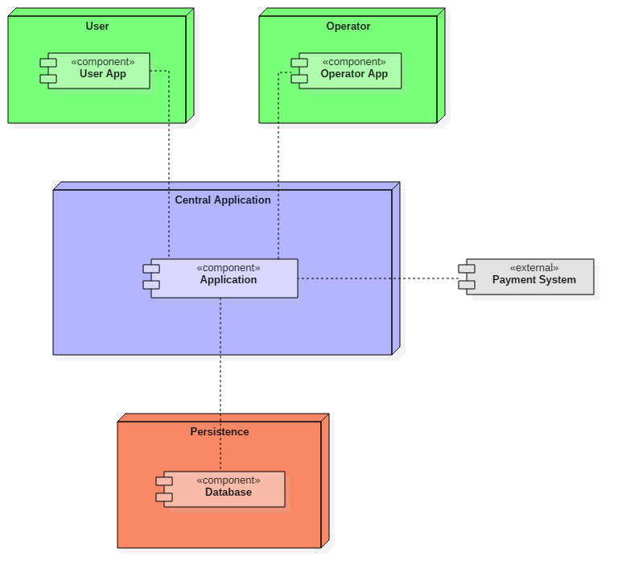
HIGH-LEVEL COMPONENTS
User and Operator
Applications
Central
Application
External Payment System
Persistence

Slide 5
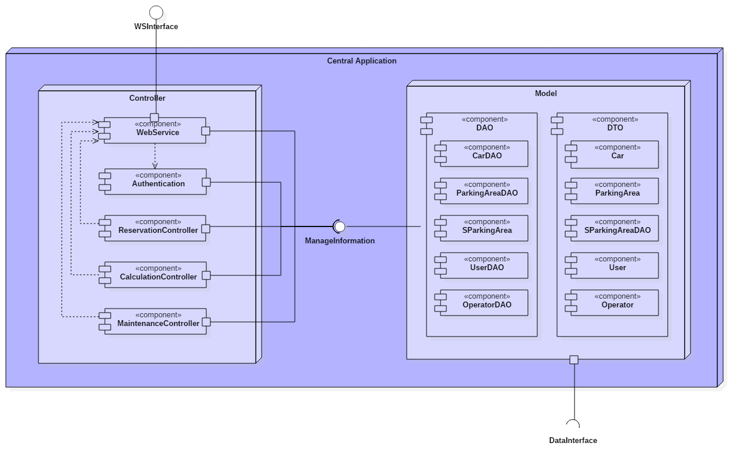
COMPONENTS CENTRAL APPLICATION

Slide 6
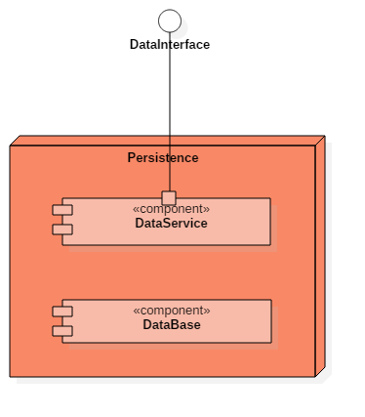
COMPONENTS PERSISTENCE
Provides a way to interact with the system installed on cars and with power plugs.
Gets information and can set power plug status.
Storage of the data of our system

Slide 7
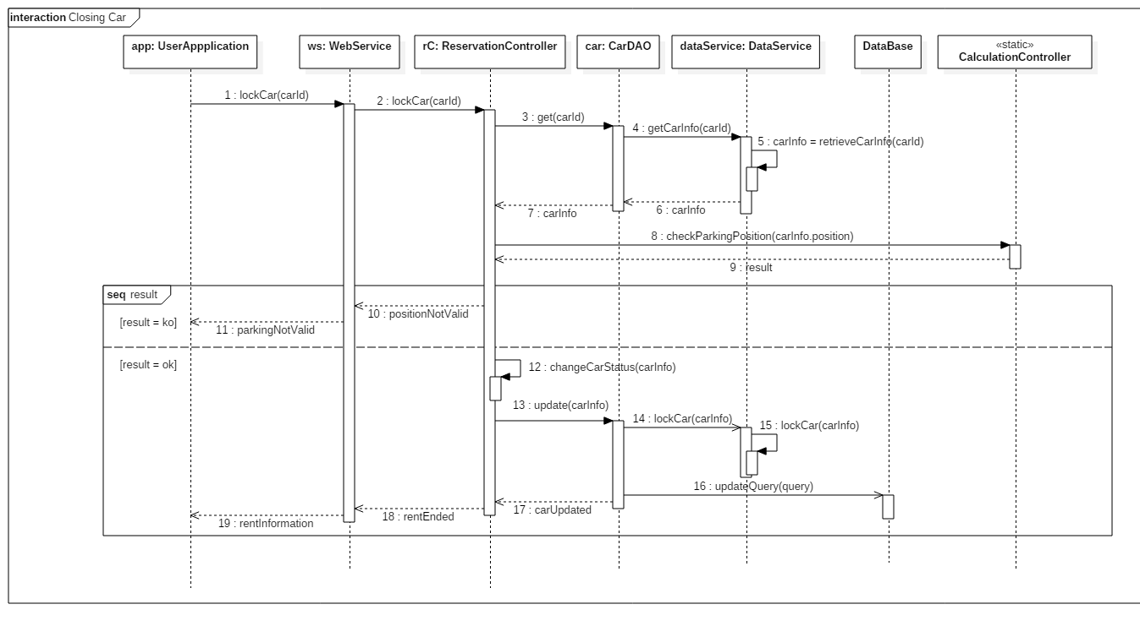
RUNTIME VIEW

Slide 8
ARCHITECTURAL STYLES AND PATTERNS
Client-Server
Architectural design pattern.
The server side manages all the application. The client is represented by the mobile application and just requests and shows information by the server.
Model-View-Controller
Used to separate who owns the business logic (controller) from who owns the data (model) and who shows the data (view). Used both in server side and client side.
Data Access Objects
Used to separate the data access mechanism from the application logic. Details of data storage are hidden from the rest of the application. DAO components offer an interface to access both the DB and the DataServices.

Slide 9
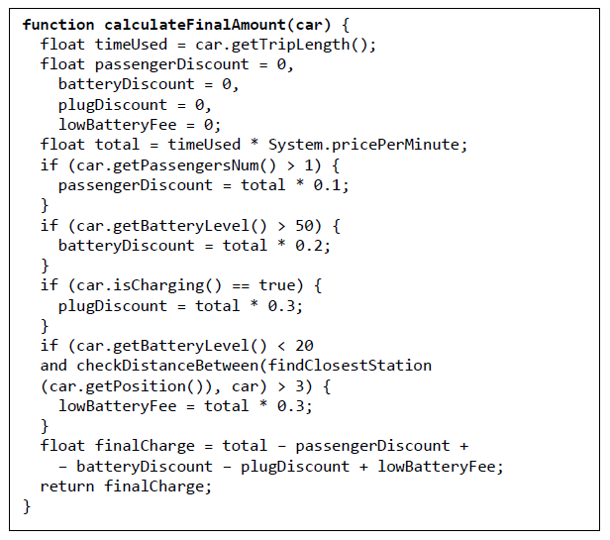
ALGORITHMS

Slide 10
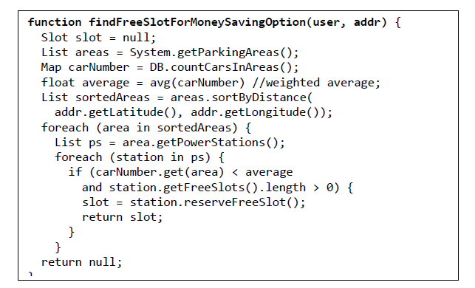
ALGORITHMS

Slide 11
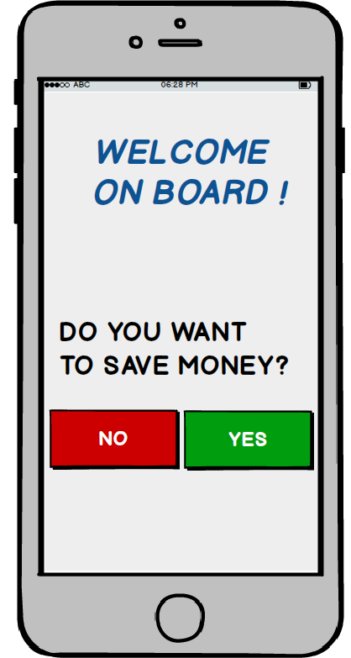
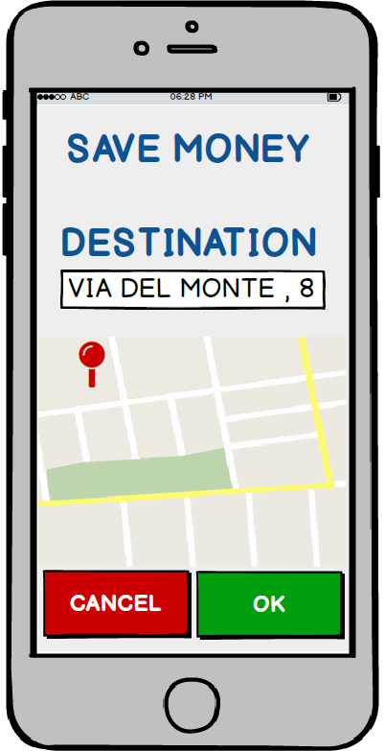
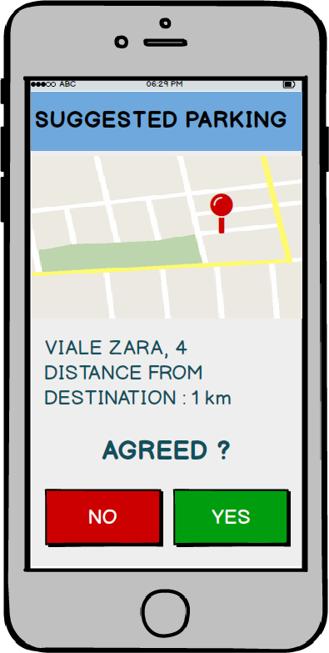
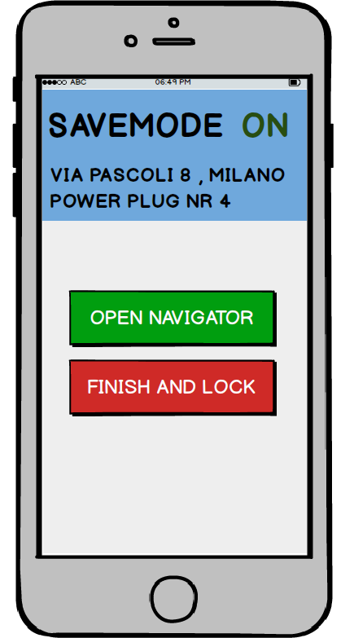
USER EXPERIENCE SAVING MONEY OPTION MOCK-UPs

Slide 12
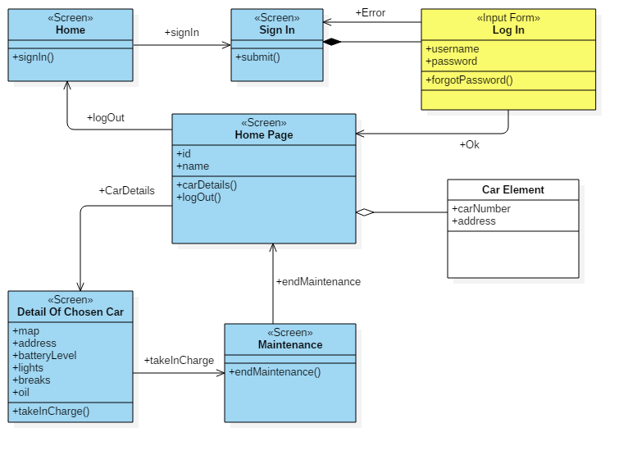
USER EXPERIENCE OPERATOR DIAGRAM

Slide 13
QUESTIONS?

