Slide 1


“Power enjoy” RASD
Software Engineering 2
AA 2016/2017
Sergio CAPRARA Soheil GHANBARI Erica TINTI

Slide 2
Actors of the proposed system
User: the person that registers to the system and interacts through the PowerEnjoy app installed on his phone.
Operator: a person, already known by the system, that can access to the list of the cars that have low battery or that need technical assistance.

Slide 3
Goals of the system
USER GOALS
The user should be able to REGISTER to the system.
Already registered users should be allowed to LOGIN.
The user should be able to FIND AVAILABLE CARS around him or close to a specific address.
The user should see the BATTERY LEVEL of a car before making a reservation.
The user should be able to RESERVE A CAR.
The user should be granted the ACCESS TO THE RESERVED CAR once he reaches it.
The user should be allowed to CANCEL a reservation.
The user should be able to ACCESS PROFILE and payment method and make changes.
The user should be informed of the AMOUNT he has been charged of.
After the rental, the user should be able to inform the system that he is LEAVING the car.
The user should be able to see all the PARKING AREAS.
The user should be able to see all the SPECIAL PARKING AREAS.
OPERATOR GOALS
Operators should be allowed to LOGIN to the system.
Operators should be allowed to see the list of CARS THAT NEED MAINTENANCE and their details.
Operators should be allowed to notify the take in charge of a car and the END OF THE MAINTENANCE.

Slide 4
Assumptions (partial)
The user has INTERNET ACCESS enabled on his phone.
SPECIAL PARKING AREAS are a subset of safe parking areas and correspond to the ones with power plugs reserved to PowerEnjoy cars exclusively. PowerEnjoy cars can only be charged and plugged in special parking areas.
Safe parking areas and special parking areas are already defined and identified by coordinates: the system is initialized at start-up time with such a set of areas.
A CAR IS UNAVAILABLE for reservations when it has less than 5% of battery level, has technical issues, or it is already in use or reserved by another user. Otherwise, it is available.
Only registrations by users having a EUROPEAN DRIVING LICENCE are supported.
Operators are already registered to the system.
The SYSTEM CAN ALWAYS ACCESS TO THE REAL-TIME INFORMATION of the car, such as its position, the number of people inside it, the battery level, the charging status and control unit information. Depending on this information, the system can manage the status of the car.
The system can CHECK THE AVAILABILITY OF POWER PLUGS of all special parking areas at any time through a third part system collecting and providing this information. The system can also set the status of a power plug if needed.

Slide 5
Requirements (partial)
The user should be able to reserve a car:
The user should be able to select one of the cars to see its status and reserve it.
The system should make the car unavailable to other users once the user confirms his choice.
The system should retain the reservation for an hour and cancel it when the time limit is reached. In this case a 1 EUR fee should be charged.
After the rental, the user should be able to inform the system that he is leaving the car:
The user should have a way to notify the system he has finished using the car.
The system should verify the status of the car and check the parking.
If all is correct the system should lock the car and make it available again.
Operators should be allowed to notify the take in charge of a car and the end of the maintenance:
The system should provide a way to take in charge a car.
The operator should be able to notify the system that the maintenance has finished.

Slide 6
Example of scenario klarissa activates the saving money option
Klarissa is a student and she likes to save money.
By night, even if busses are cheaper, she prefers to move by car because she thinks it will be safer.
Like every weekend, she's out with her friends, and now it's time to get back home. Her friends don't live far from her, and since they are only in 4, she offers them to bring them all home too, this way she knows she will have the 10% off.
She finds a car close to them and she reserve it. The car has the 40% of energy, then she will not receive this kind of discount but anyway it's enough to bring everyone home.
When she gets into the car, she activates the save mode, and then she enters his address.
The system shows the possible special parking areas close to her destination and she chose one that is just 300mt from home. The system informs her that it has reserved the charging column 4 at the selected special parking area.
She drives her friends home and then goes to the selected special parking area and plugs the car in the right energy tower.
When she closes the car, she gets notified on her phone that she achieved a total discount of 40%, then she only spent 2€! Not bad!

Slide 7
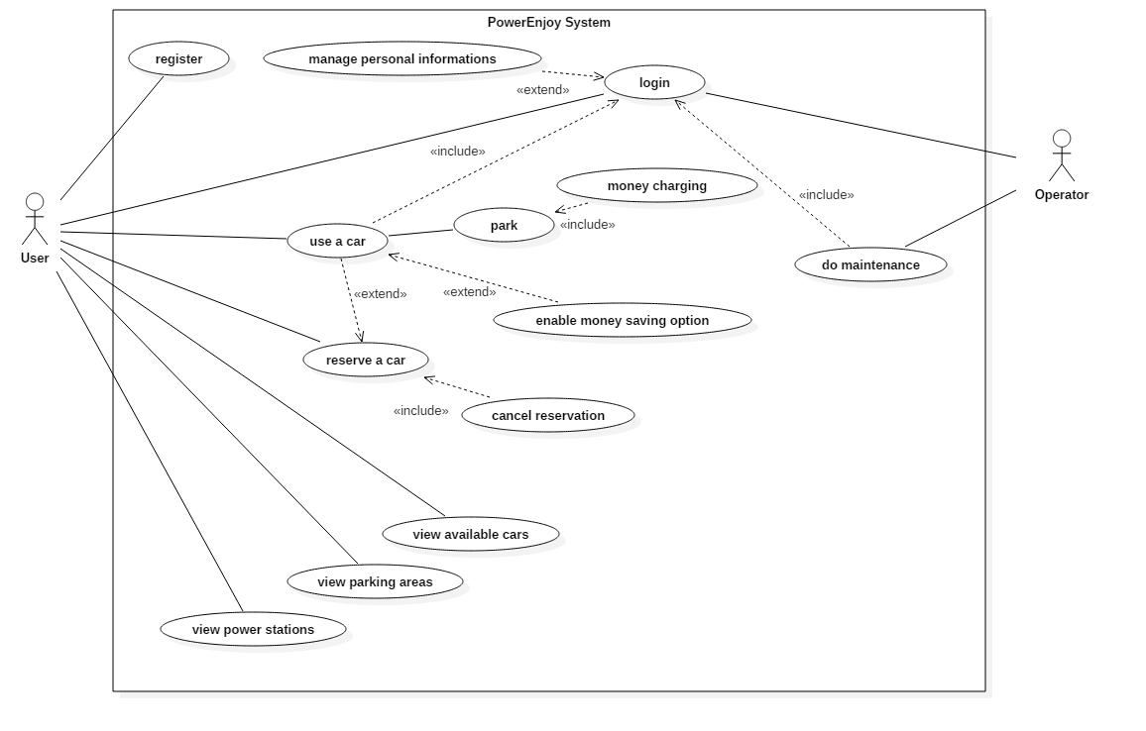
Use cases

Slide 8
Use case: User chooses money saving mode
Actors User
Entry Conditions The user has entered the car.
Flow of events
The system asks the user for the final destination.
The user enters the address.
The system checks entered address and looks for free power plugs in close stations.
The system shows the result to the user asking for confirmation.
The user accepts to park in the station selected by the system.
The system reserves the free power plug.
The system provides the address and number of the slot reserved for the power supply.
Exit conditions
The user sees information and directions to the slot and the power station.
Exceptions
The address entered by the user does not exist or is out of the area: the system informs the user of the error and suggests to retry.
The user refuses to park in the suggested station: the system suggests to retry the search to find a better result.
No free slots available: the system informs the user that there are no charging slots available, so it suggests the user to retry later.

Slide 9
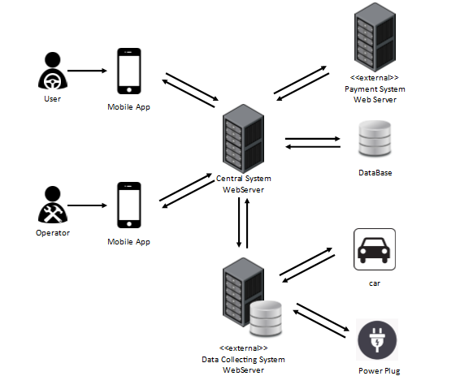
Proposed system

Slide 10
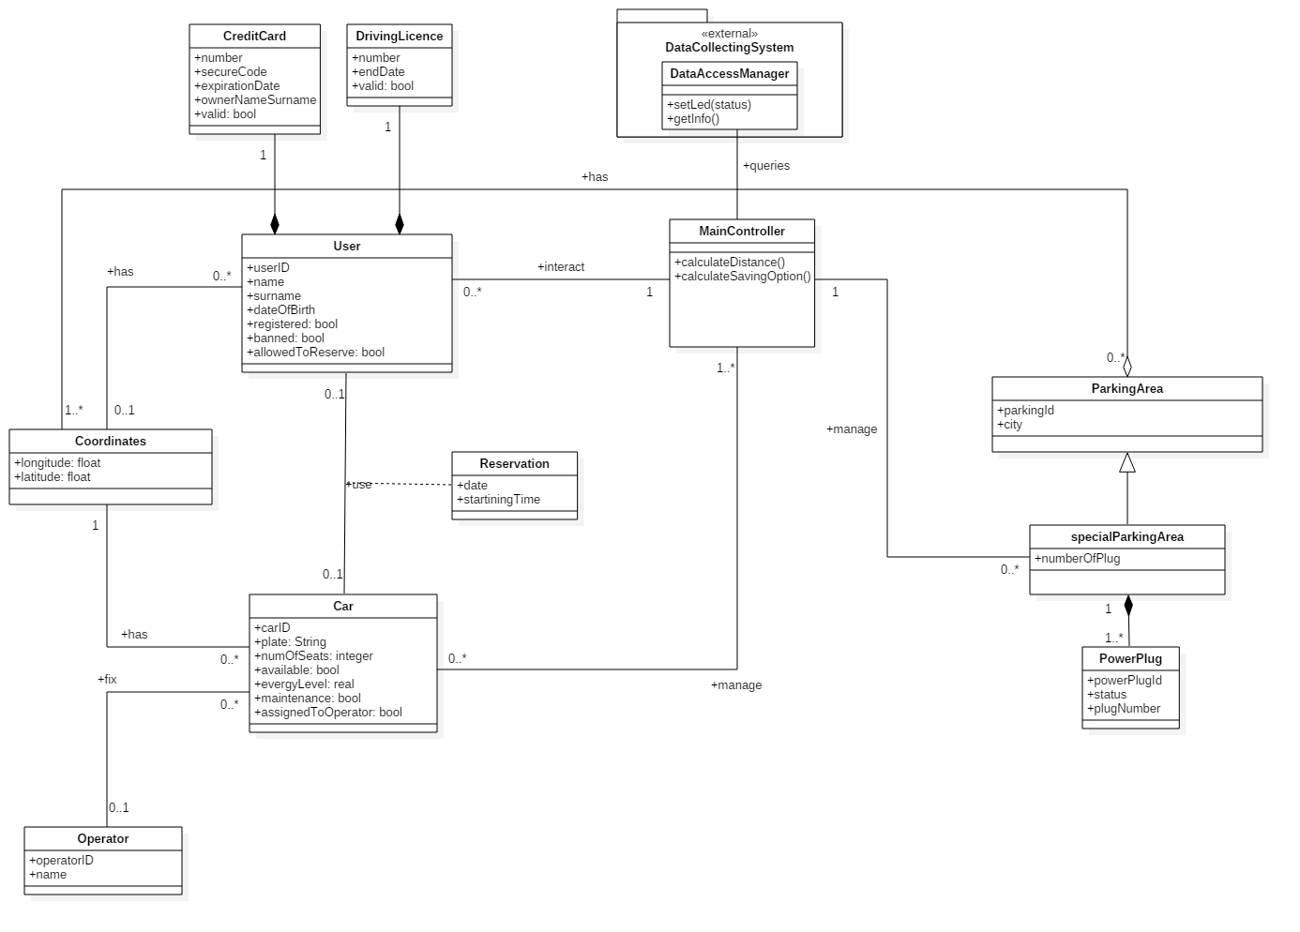
Class diagram

Slide 11
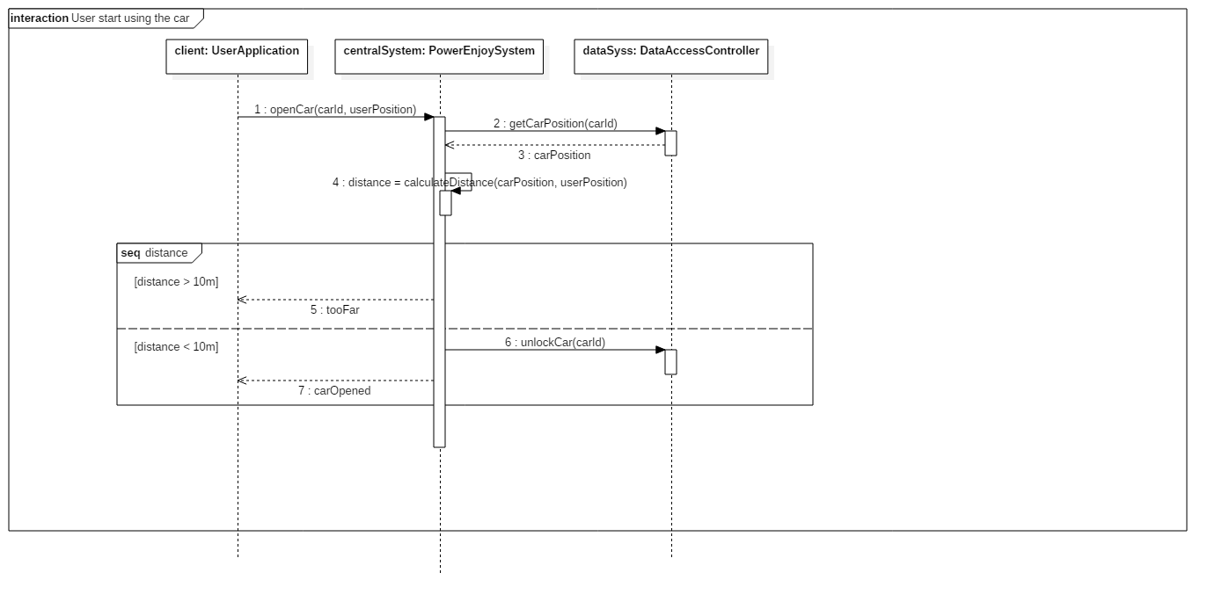
Sequence diagram example: start using the car

Slide 12
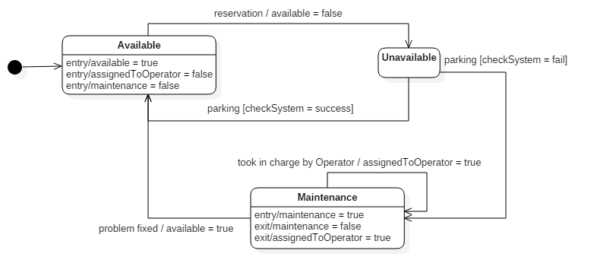
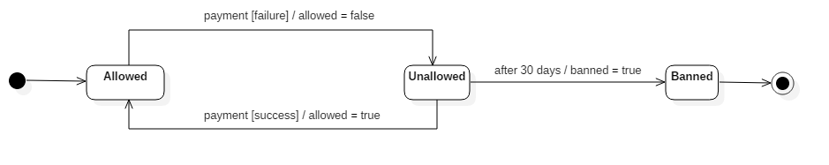
State diagrams
Car state
User states

Slide 13
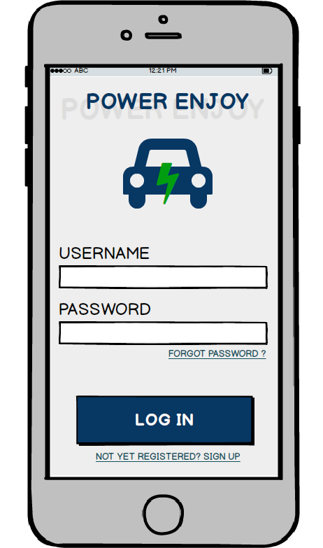
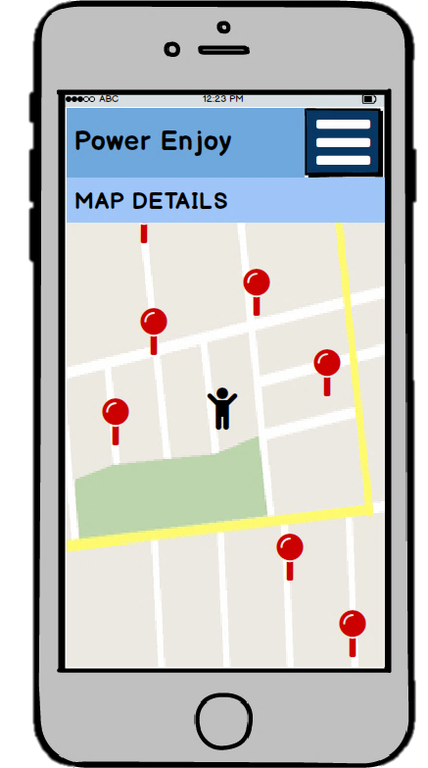
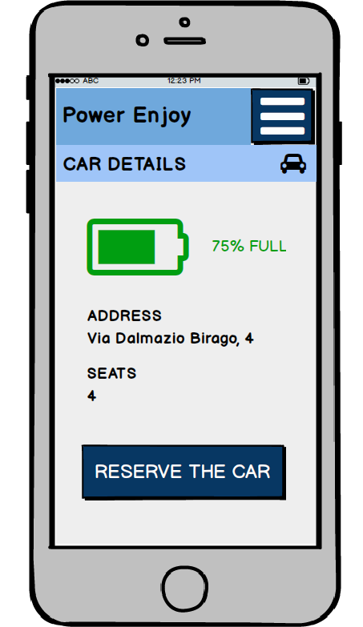
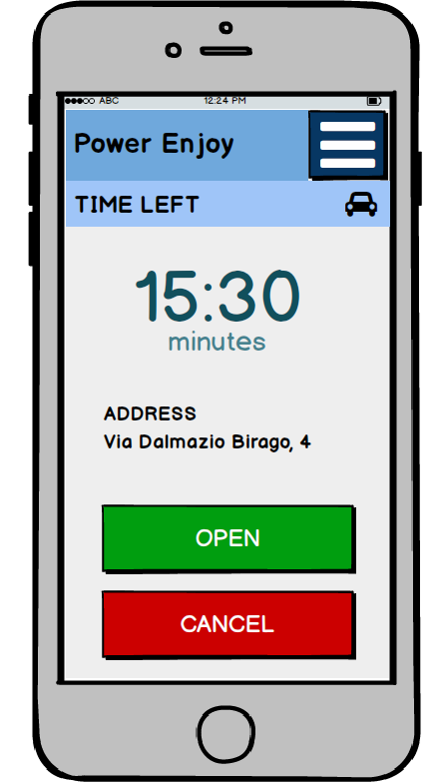
User interface

Slide 14
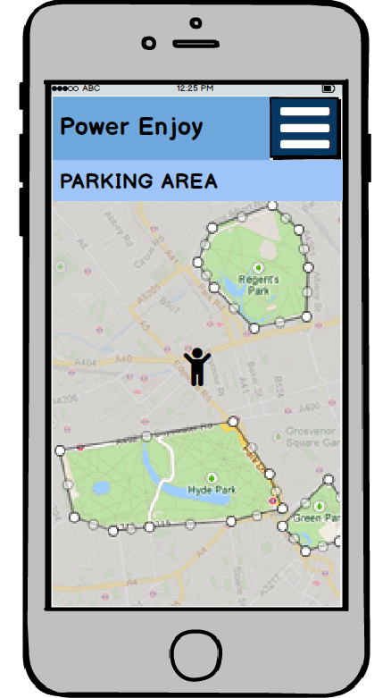
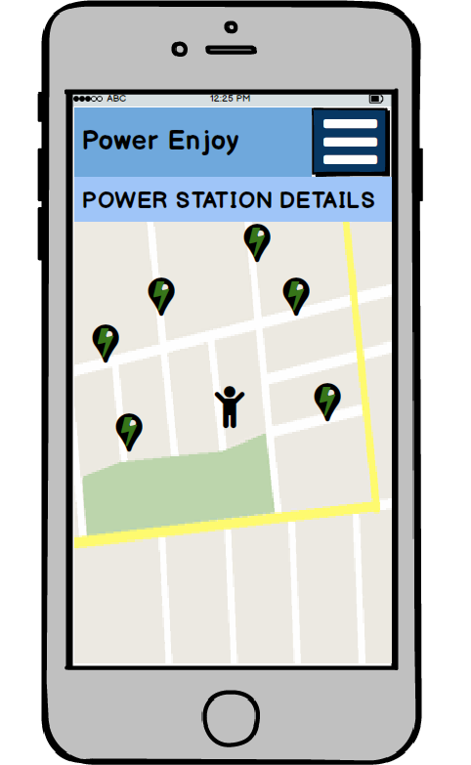
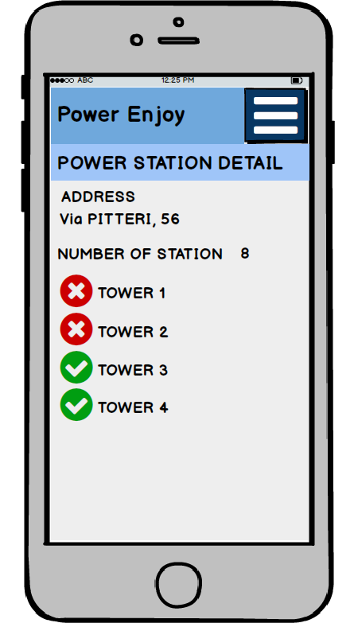
User interface: parking area and power station

Slide 15
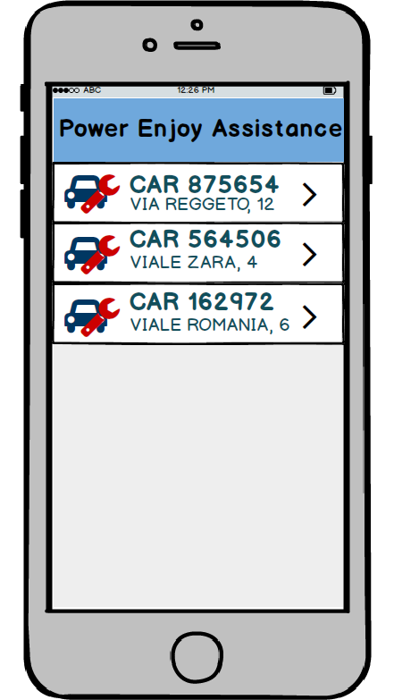
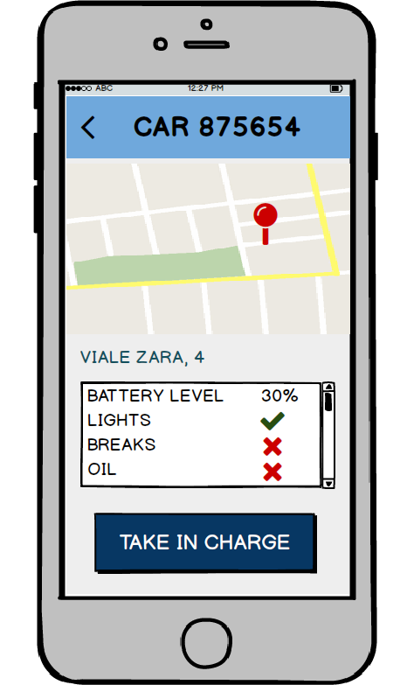
Operator interfaces

Slide 16
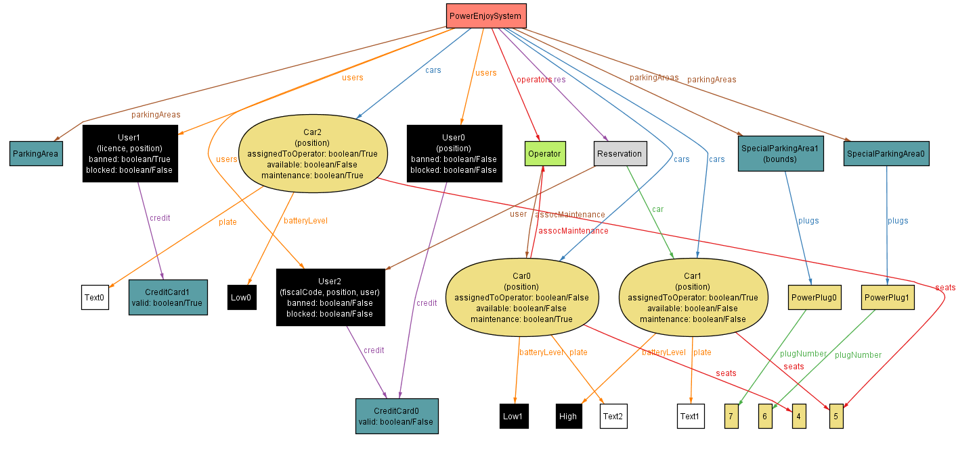
Alloy world

Slide 17
Thank you for your attention

