Slide 1
POWER ENJOY SOFTWARE ENGINEERING 2
AUTHORS
Sergio CAPRARA
Soheil GHANBARI
Erica TINTI

Slide 2
CONTENTS

Slide 3
ACTORS OF THE SYSTEM
User: the person that registers to the system and interacts through the PowerEnjoy app installed on his phone.
Operator: a person, already known by the system, that can access to the list of the cars that have low battery or that need technical assistance.

Slide 4
GOALS OF THE SYSTEM
USER GOALS
The user should be able to REGISTER to the system.
Already registered users should be allowed to LOGIN.
The user should be able to FIND AVAILABLE CARS around him or close to a specific address.
The user should see the BATTERY LEVEL of a car before making a reservation.
The user should be able to RESERVE A CAR.
The user should be granted the ACCESS TO THE RESERVED CAR once he reaches it.
The user should be allowed to CANCEL a reservation.
The user should be able to ACCESS PROFILE and payment method and make changes.
The user should be informed of the AMOUNT he has been charged of.
After the rental, the user should be able to inform the system that he is LEAVING the car.
The user should be able to see all the PARKING AREAS.
The user should be able to see all the SPECIAL PARKING AREAS.
OPERATOR GOALS
Operators should be allowed to LOGIN to the system.
Operators should be allowed to see the list of CARS THAT NEED MAINTENANCE and their details.
Operators should be allowed to notify the take in charge of a car and the END OF THE MAINTENANCE.

Slide 5
ASSUMPTIONS (PARTIAL)
The user has INTERNET ACCESS enabled on his phone.
SPECIAL PARKING AREAS are a subset of safe parking areas and correspond to the ones with power plugs reserved to PowerEnjoy cars exclusively. PowerEnjoy cars can only be charged and plugged in special parking areas.
Safe parking areas and special parking areas are already defined and identified by coordinates: the system is initialized at start-up time with such a set of areas.
A CAR IS UNAVAILABLE for reservations when it has less than 5% of battery level, has technical issues, or it is already in use or reserved by another user. Otherwise, it is available.
Only registrations by users having a EUROPEAN DRIVING LICENCE are supported.
Operators are already registered to the system.
The SYSTEM CAN ALWAYS ACCESS TO THE REAL-TIME INFORMATION of the car, such as its position, the number of people inside it, the battery level, the charging status and control unit information. Depending on this information, the system can manage the status of the car.
The system can CHECK THE AVAILABILITY OF POWER PLUGS of all special parking areas at any time through a third part system collecting and providing this information. The system can also set the status of a power plug if needed.

Slide 6
REQUIREMENTS (PARTIAL)
The user should be able to reserve a car:
The user should be able to select one of the cars to see its status and reserve it.
The system should make the car unavailable to other users once the user confirms his choice.
The system should retain the reservation for an hour and cancel it when the time limit is reached. In this case a 1 EUR fee should be charged.
After the rental, the user should be able to inform the system that he is leaving the car:
The user should have a way to notify the system he has finished using the car.
The system should verify the status of the car and check the parking.
If all is correct the system should lock the car and make it available again.
Operators should be allowed to notify the take in charge of a car and the end of the maintenance:
The system should provide a way to take in charge a car.
The operator should be able to notify the system that the maintenance has finished.

Slide 7
EXAMPLE OF SCENARIO KLARISSA ACTIVATES MONEY SAVING OPTION
Klarissa is a student and she likes to save money.
By night, even if busses are cheaper, she prefers to move by car because she thinks it will be safer.
Like every weekend, she's out with her friends, and now it's time to get back home. Her friends don't live far from her, and since they are only in 4, she offers them to bring them all home too, this way she knows she will have the 10% off.
She finds a car close to them and she reserve it. The car has the 40% of energy, then she will not receive this kind of discount but anyway it's enough to bring everyone home.
When she gets into the car, she activates the save mode, and then she enters his address.
The system shows the possible special parking areas close to her destination and she chose one that is just 300mt from home. The system informs her that it has reserved the charging column 4 at the selected special parking area.
She drives her friends home and then goes to the selected special parking area and plugs the car in the right energy tower.
When she closes the car, she gets notified on her phone that she achieved a total discount of 40%, then she only spent 2€! Not bad!

Slide 8
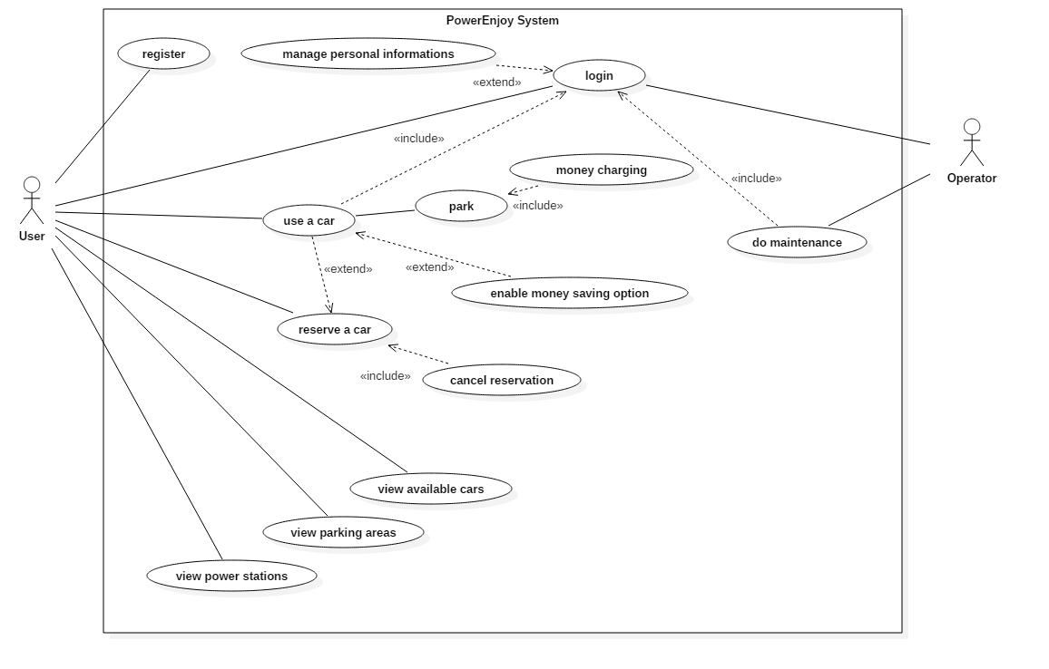
USE CASES

Slide 9
USE CASE USER CHOOSES MONEY SAVING OPTION
Actors User
Entry Conditions The user has entered the car.
Flow of events
The system asks the user for the final destination.
The user enters the address.
The system checks entered address and looks for free power plugs in close stations.
The system shows the result to the user asking for confirmation.
The user accepts to park in the station selected by the system.
The system reserves the free power plug.
The system provides the address and number of the slot reserved for the power supply.
Exit conditions
The user sees information and directions to the slot and the power station.
Exceptions
The address entered by the user does not exist or is out of the area: the system informs the user of the error and suggests to retry.
The user refuses to park in the suggested station: the system suggests to retry the search to find a better result.
No free slots available: the system informs the user that there are no charging slots available, so it suggests the user to retry later.

Slide 10
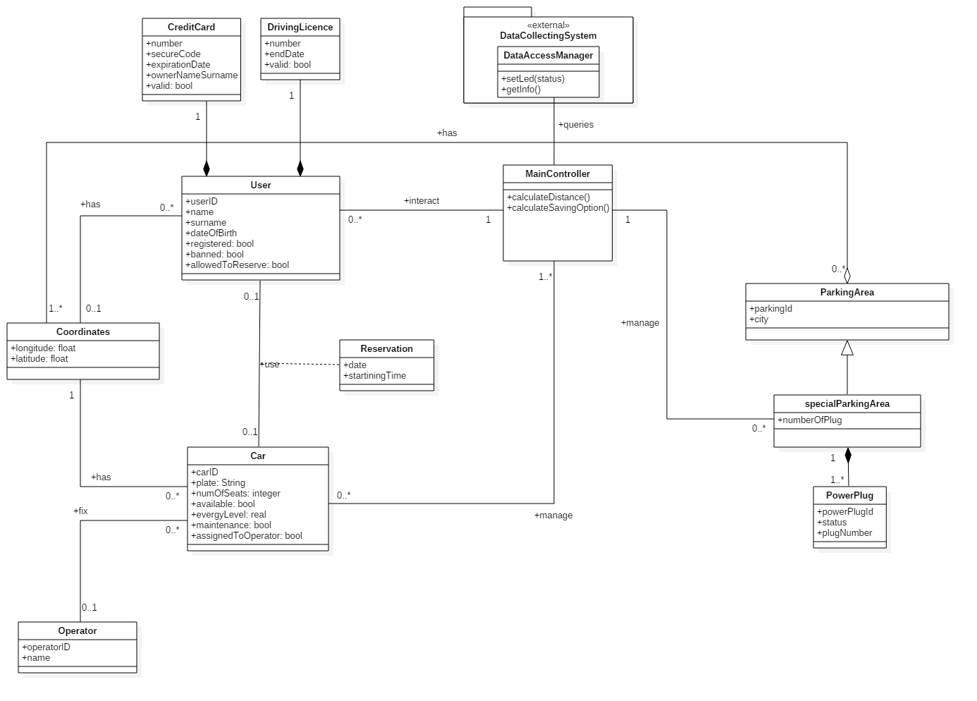
CLASS DIAGRAM

Slide 11
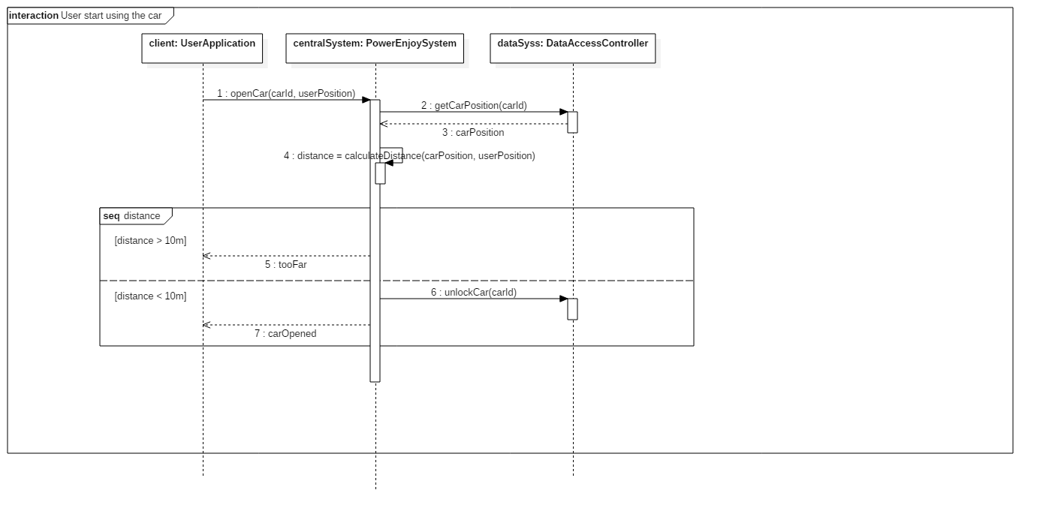
SEQUENCE DIAGRAM EXAMPLE START USING THE CAR

Slide 12
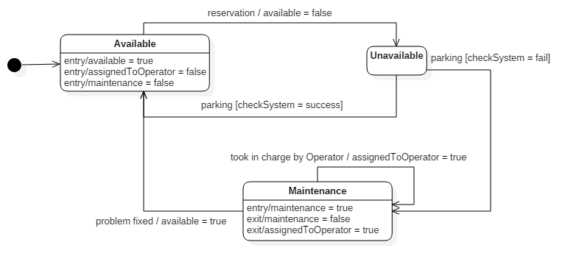
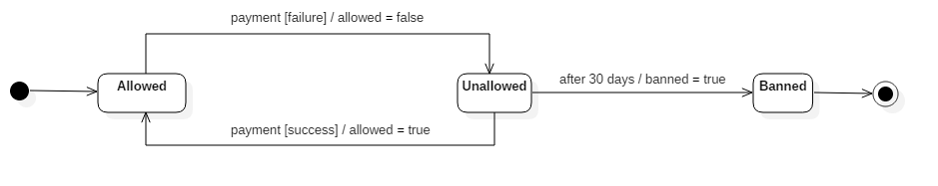
STATE DIAGRAMS
Car state
User states

Slide 13
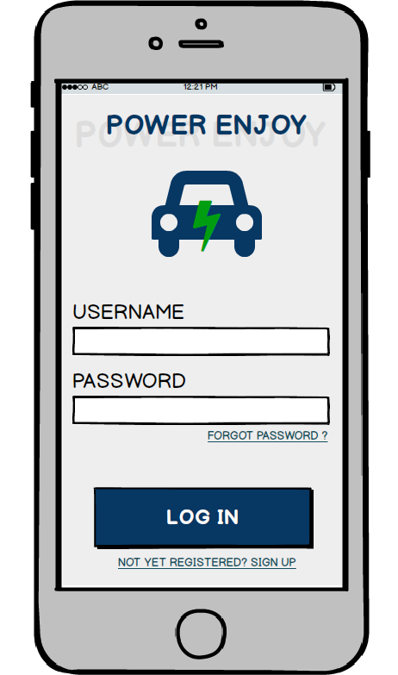
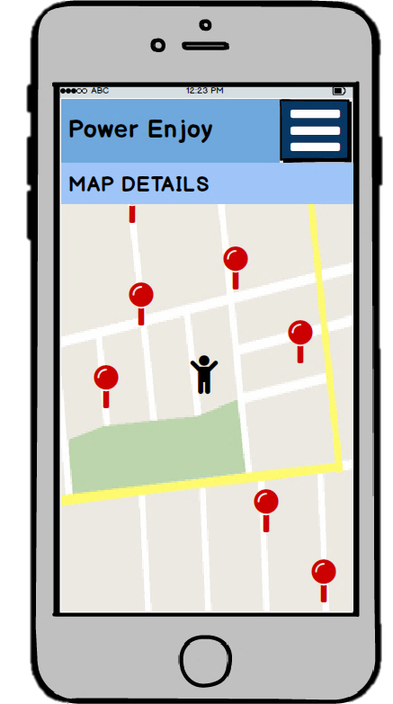
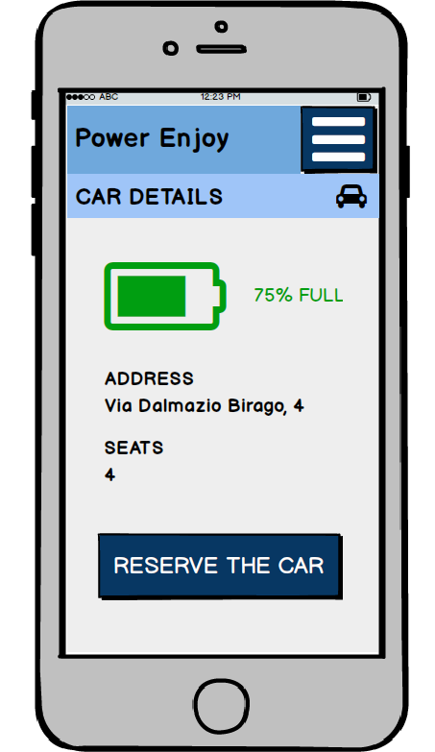
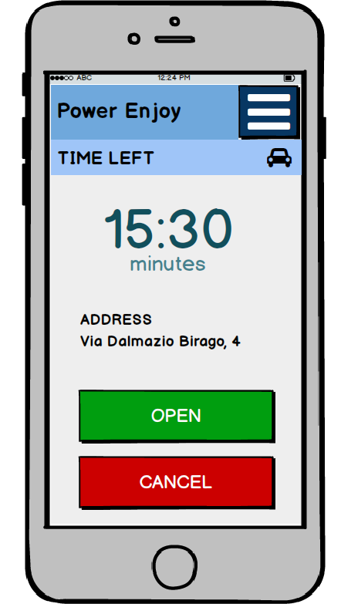
USER INTERFACE

Slide 14
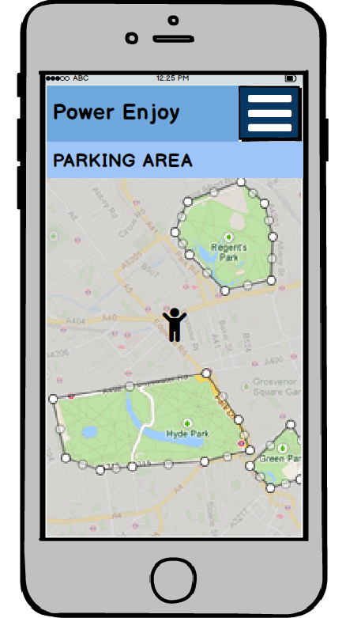
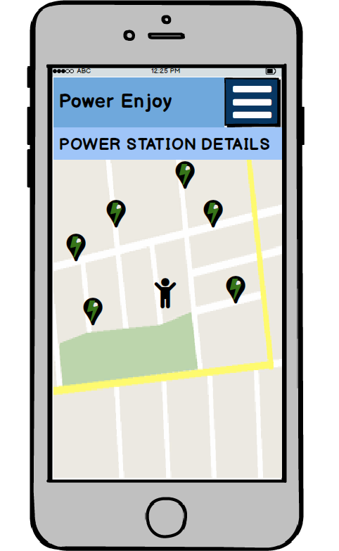
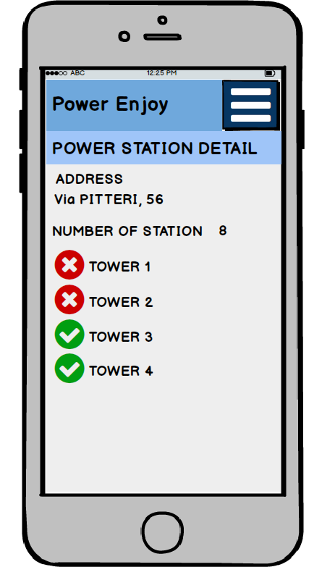
USER INTERFACE PARKING AREA AND POWER STATION

Slide 15
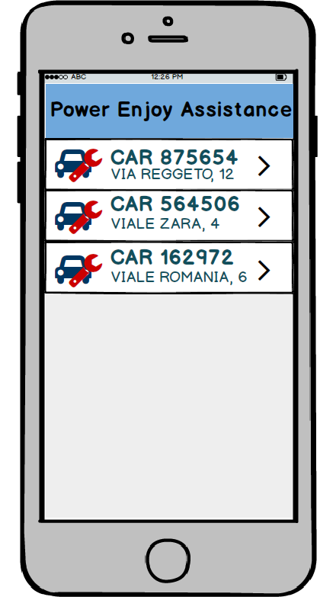
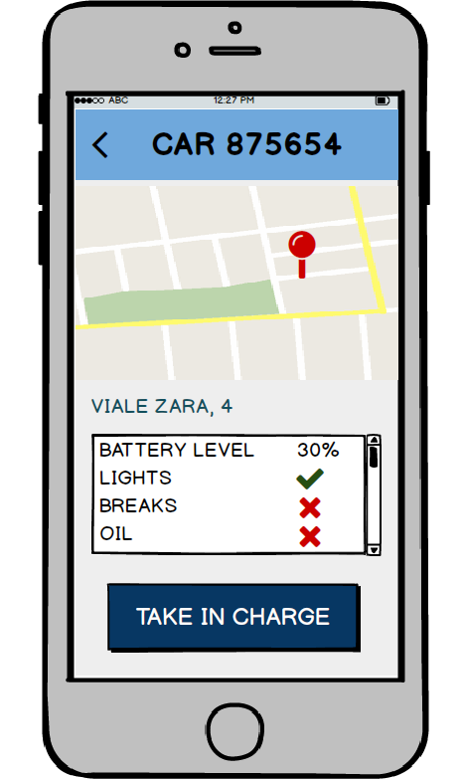
OPERATOR INTERFACES

Slide 16
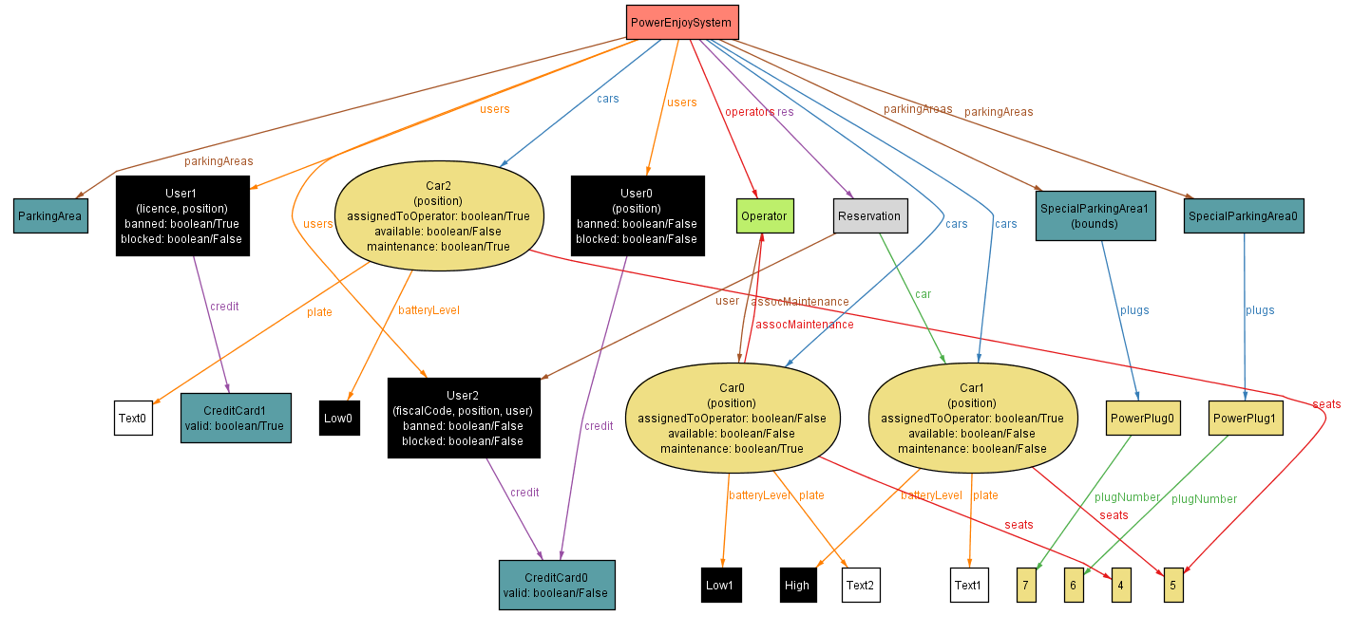
ALLOY MODEL

Slide 17
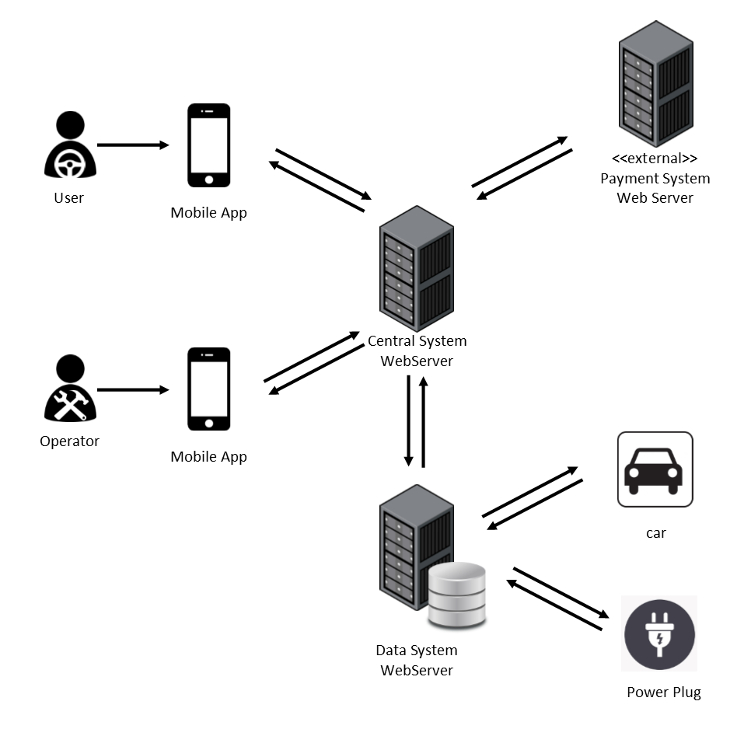
OVERALL SYSTEM

Slide 18
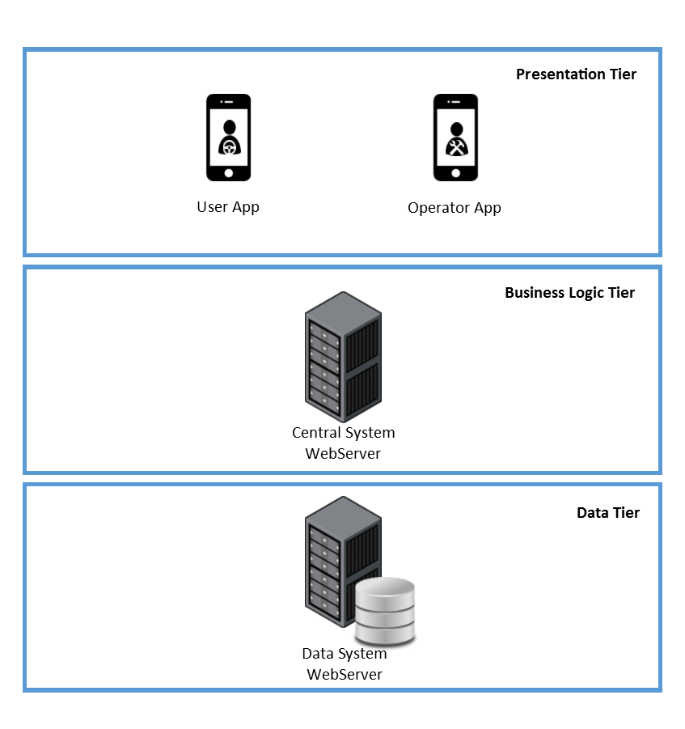
OVERALL SYSTEM THREE-TIER ARCHITECTURE
PRESENTATION TIER
The views are provided to the users and operators through the application on their mobile phones.
BUSINESS LOGIC TIER
The Central System contains the main logic of the application and communicates with the user devices and the Data System.
DATA TIER
The Data System collects the data of all the cars, users and operators into a database and interacts with cars and power plugs to change or get their status.

Slide 19
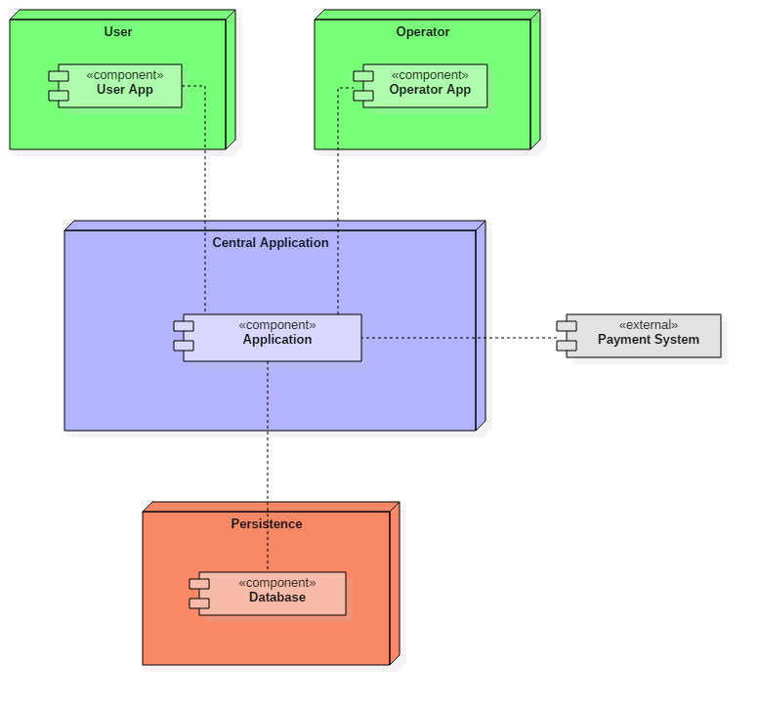
HIGH-LEVEL COMPONENTS
User and Operator
Applications
Central
Application
External Payment System
Persistence

Slide 20
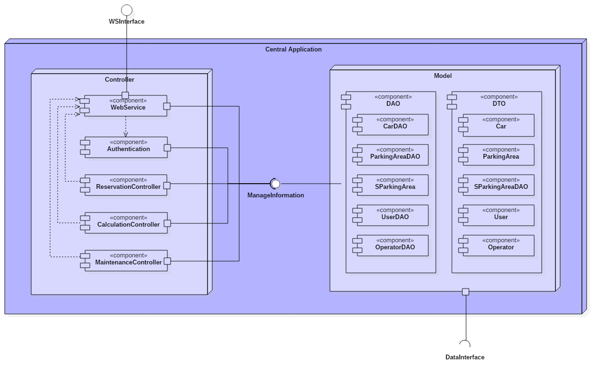
COMPONENTS CENTRAL APPLICATION

Slide 21
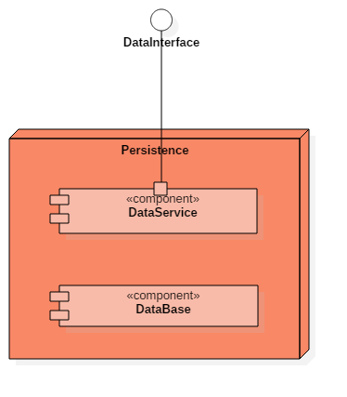
COMPONENTS PERSISTENCE
Provides a way to interact with the system installed on cars and with power plugs.
Gets information and can set power plug status.
Storage of the data of our system

Slide 22
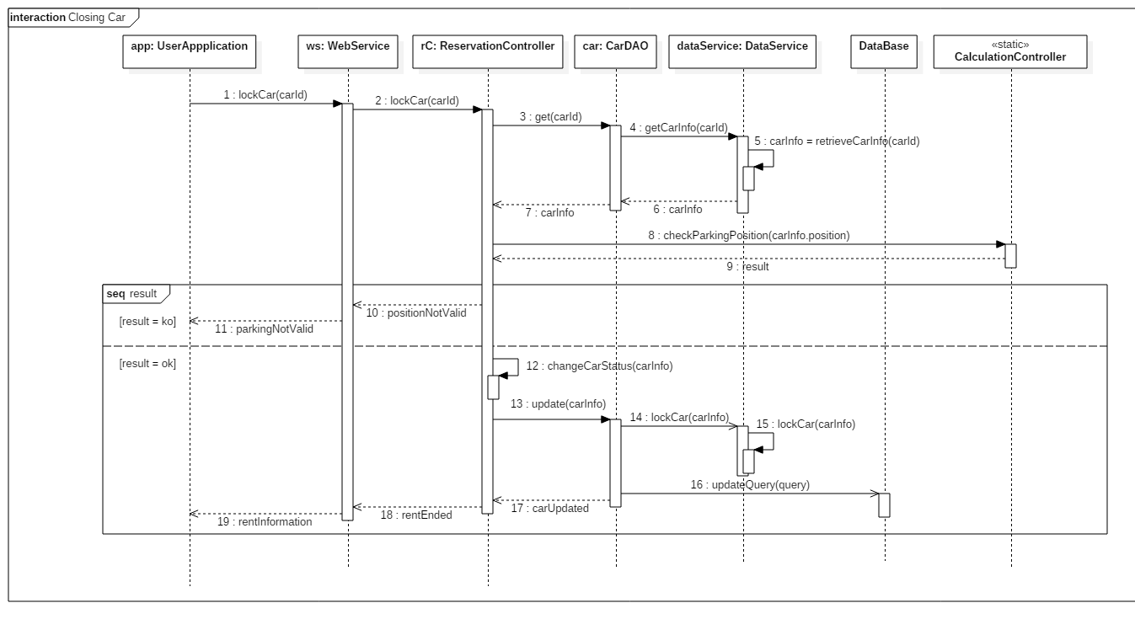
RUNTIME VIEW

Slide 23
ARCHITECTURAL STYLES AND PATTERNS
Client-Server
Architectural design pattern.
The server side manages all the application. The client is represented by the mobile application and just requests and shows information by the server.
Model-View-Controller
Used to separate who owns the business logic (controller) from who owns the data (model) and who shows the data (view). Used both in server side and client side.
Data Access Objects
Used to separate the data access mechanism from the application logic. Details of data storage are hidden from the rest of the application. DAO components offer an interface to access both the DB and the DataServices.

Slide 24
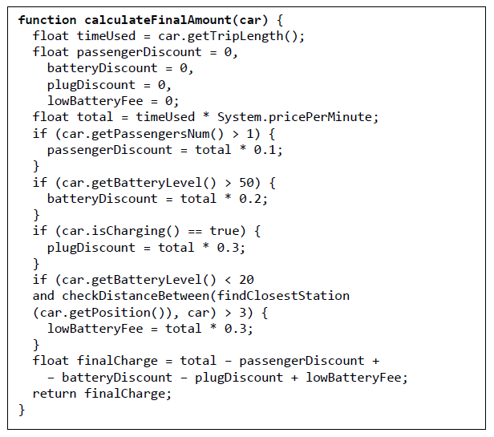
ALGORITHMS

Slide 25
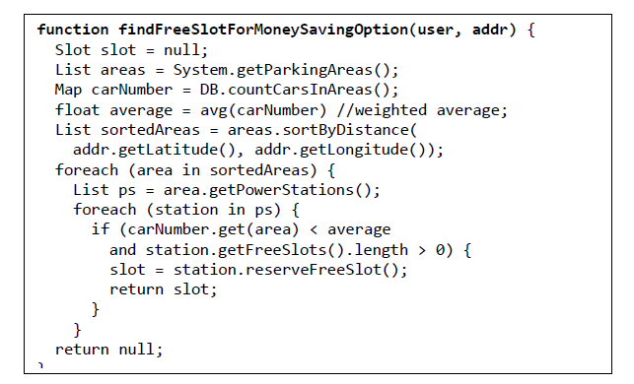
ALGORITHMS

Slide 26
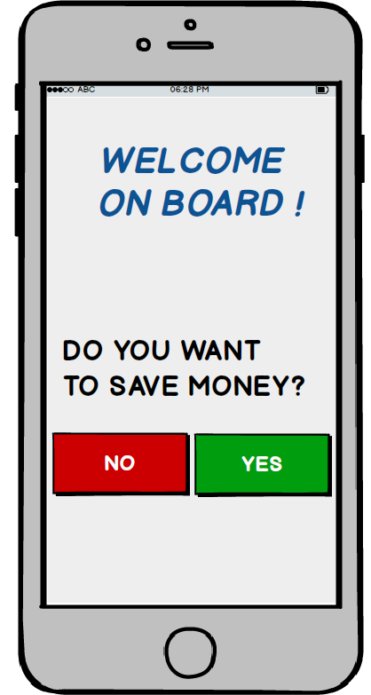
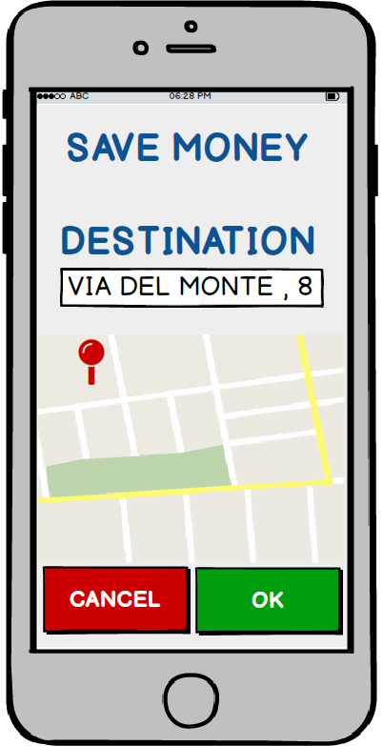
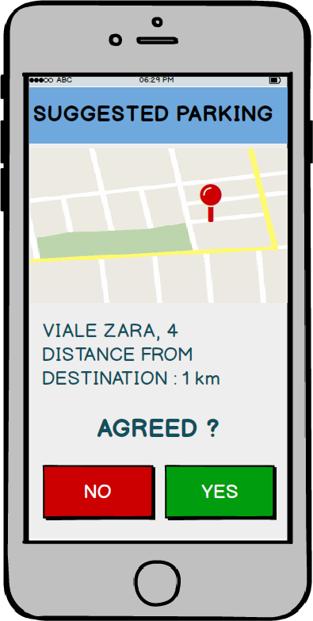
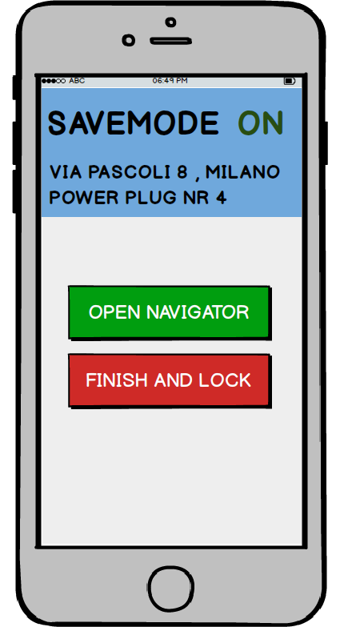
USER EXPERIENCE SAVING MONEY OPTION MOCK-UPs

Slide 27
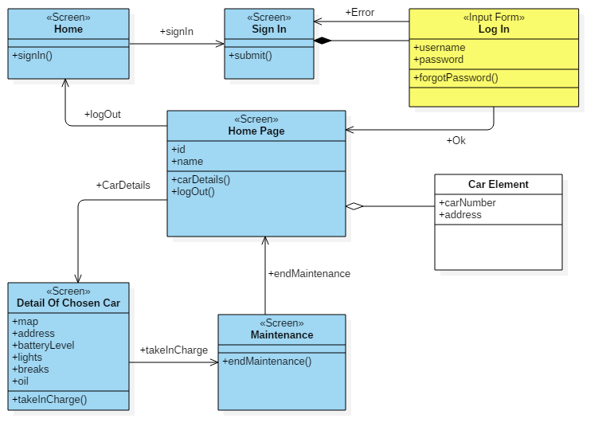
USER EXPERIENCE OPERATOR DIAGRAM

Slide 28
INTEGRATION TEST COMPONENTS
The higher level of components of our system that need to be integrated are:
User Application
Operator Application
Controller
Model
Database
The listed components are divided into lower level components, that will need integration testing.
More in detail, the Controller is composed by WebService, Authentication, Maintenance Controller, Reservation Controller, Calculation Controller.
The Model has DAO components and some Pojo components. The last one don’t need to be considered for integration. Note that DAO components won’t be unit tested.
Data low level components are the DataService and the Database.
Concerning the two mobile applications, we will only integrate the User App Controller and Operator App Controller with the rest of the system.

Slide 29
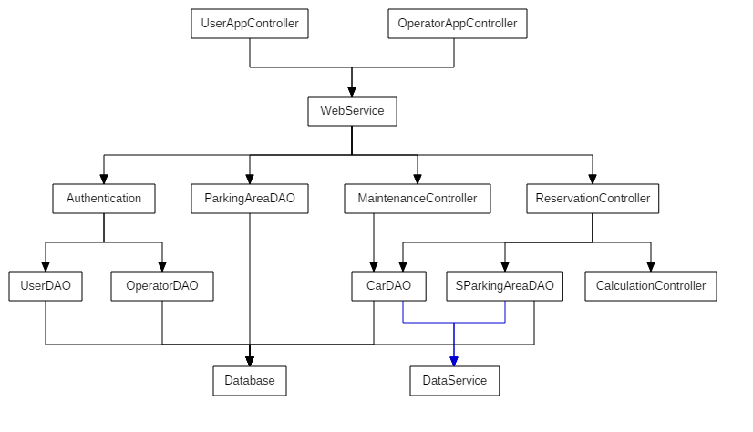
INTEGRATION TEST DIAGRAM

Slide 30
INTEGRATION TEST THE BOTTOM-UP APPROACH
The bottom-up approach has been chosen for testing the integration among components: tests will proceed starting from the bottom of the hierarchy and moving to the top on each step.
Due to the many critical points of our system, this strategy represents for us a safer way for testing and an easier method for finding and correcting software faults. We refer in particular to Data components and ReservationController, because most of the interactions of our system use them.
This approach will include the use of drivers, for the case in which a component is ready to be tested and its direct parent is not completely written yet.

Slide 31
INTEGRATION TEST COMPONENT INTEGRATION

Slide 32
INTEGRATION TEST COMPONENT INTEGRATION EXAMPLE

Slide 33
INTEGRATION TEST USED TOOLS AND EQUIPMENT
TOOLS
The higher level of components of our system that need to be integrated are:
Junit, useful to check the result returned by methods. We will use it for both unit testing and writing drivers.
Arquillian, an integration testing framework that integrates Junit.It makes the integration testing phase simpler, for example, making easier the management of the container lifecycle, the deployment of the archive to test and the capture of results and failures.
Manual tests, to evaluate usability and reactivity of the system through the mobile application, and the interaction with the provided user interface.
EQUIPMENT
Central application: deployed on a machine explicitly ment for integration tests, called Testing Server.
Client side: user and operator applications will be tested using a set of different smartphones.

Slide 34
INTEGRATION TEST DRIVERS
CarDAO Driver, SParkingAreaDAO Driver in the interaction with the DataService.
Authentication Driver to test its interaction with the UserDAO and the OperatorDAO.
MaintenanceController Driver to test its interaction with the CarDAO component.
ReservationController Driver in testing the interaction with the CarDAO, SParkingAreaDAO and CalculationController components.
WebService Driver to test the interaction with the Authentication, ParkingAreaDAO, MaintenanceController and ReservationController components.
UserAppController Driver, OperatorAppController Driver to test their interaction with the WebService component.

Slide 35
INTEGRATION TEST TEST DATA
IBM DB2 Test Database Generator, provided by IBM, can be used for generating data. It allows the definition of:
the structure of the table,
constraints on how the data should be generated,
the output format (SQL, CSV, XML).
Using this tool will be helpful as it will accelerate the testing phase.
Integration tests should also verify the responses of the system in cases as:
Null parameters in method call,
Invalid login credentials (User or Operator),
Invalid register information (applies to Users),
User or Operator with an expired driving licence,
Car parked outside of the valid Parking Area,
Reservation of a Car that has already been reserved,
Payment refused.

Slide 36
PROJECT PLAN FUNCTION POINTS: TABLE
Type of Component | Complexity of Components
 | Low | Average | High
External Inputs | 3 | 4 | 6
External Outputs | 4 | 5 | 7
External Inquiries | 3 | 4 | 6
Internal Logic Files | 7 | 10 | 15
External Interface Files | 5 | 7 | 10

Slide 37
FUNCTION POINTS EXTERNAL INPUTS
EI | Complexity | FPs
Login | Low | 3x2
Logout | Low | 3x2
User Registration | Average | 4
Profile Update | Average | 4
Payment Method Update | Average | 4
Cancel Reservation | Low | 3
End of Renting | Low | 3
Maintenance Request | Low | 3
End of Maintenance | Low | 3
Total |  | 36

Slide 38
FUNCTION POINTS EXTERNAL OUTPUTS
EO | Complexity | FPs
Registration Confirmation | Low | 4
Finished Rent Feedback | High | 7
Total Amount Notification | High | 7
Total |  | 18

Slide 39
FUNCTION POINTS EXTERNAL INQUIRIES
EQ | Complexity | FPs
Car Lookup | Average | 4
Car Information | Low | 3
Reserve Car | Low | 3
Car Unlock | Average | 4
View Parking Areas | Low | 3
View Special Parking Areas | Low | 3
View Profile Info | Low | 3
View Car Maintenance List | Low | 3
View Car Details | Average | 4
Total |  | 30

Slide 40
FUNCTION POINTS INTERNAL LOGIC FILES
ILF | Complexity | FPs
Car Info | Average | 10
User | Average | 10
Parking Area | Low | 7
Special Parking Area | Low | 7
Operator | Low | 7
Total |  | 41

Slide 41
FUNCTION POINTS EXTERNAL INTERFACE FILES
EIF | Complexity | FPs
Driving Licence | Low | 5
Geolocation and Mapping | Average | 7
Payment | Average | 7
Physical Car | High | 10
Total |  | 29

Slide 42
FUNCTION POINTS TOTAL
Type of Component | FPs
External Inputs | 36
External Outputs | 18
External Inquiries | 30
Internal Logic Files | 41
External Interface Files | 29
Total | 154

Slide 43
COCOMO II SCALE DRIVERS
Scale Factors | Very Low | Low | Nominal | High | Very High | Extra High
PREC | thoroughly unprecedented | largely unprecedented | somewhat unprecedented | generally familiar | largely familiar | thoroughly familiar
SF_{j} | 6.20 | 4.96 | 3.72 | 2.48 | 1.24 | 0.00
FLEX | rigorous | occasional relaxation | some relaxation | general conformity | some conformity | general goals
SF_{j} | 5.07 | 4.05 | 3.04 | 2.03 | 1.01 | 0.00
RESL | little (20%) | some (40%) | often (60%) | generally (75%) | mostly (90%) | full (100%)
SF_{j} | 7.07 | 5.65 | 4.24 | 2.83 | 1.41 | 0.00
TEAM | very difficult interactions | some difficult interactions | basically cooperative interactions | largely cooperative | highly cooperative | seamless interactions
SF_{j} | 5.48 | 4.38 | 3.29 | 2.19 | 1.10 | 0.00
PMAT | Level 1 Lower | Level 1 Upper | Level 2 | Level 3 | Level 4 | Level 5
SF_{j} | 7.80 | 6.24 | 4.68 | 3.12 | 1.56 | 0.00

Slide 44
COCOMO II COST DRIVERS
Cost Driver | Factor | Value
Required Software Reliability (RELY) | Nominal | 1.00
Data Base Size (DATA) | High | 1.14
Product Complexity (CPLX) | Very High | 1.00
Developed for Reusability (RUSE) | Nominal | 1.00
Documentation Match to Life-Cycle Needs (DOCU) | Nominal | 1.00
Execution Time Constraint (TIME) | High | 1.11
Main Storage Constraint (STOR) | Nominal | 1.00
Platform Volatility (PVOL) | Low | 0.87
Analyst Capability (ACAP) | High | 1.19
Programmer Capability (PCAP) | High | 0.88
Personnel Continuity (PCON) | Very High | 0.81
Applications Experience (APEX) | High | 1.00
Platform Experience (PLEX) | High | 0.91
Language and Tool Experience (LTEX) | High | 0.91
Use of Software Tools (TOOL) | High | 0.90
Multisite Development (SITE) | High | 0.93
Required Development Schedule (SCED) | Nominal | 1.00
Total |  | 0.6472

Slide 45
COCOMO II EFFORT

Slide 46
COCOMO II SCHEDULE ESTIMATION

Slide 47
GANTT CHART SCHEDULE AND RESOURCES

Slide 48
RISK MANAGEMENT (PARTIAL)

Slide 49
QUESTIONS?

