Slide 1
Team Glenfiddich
Final Presentation
Feifan Tang, Jeannie Gao, Joong Hoon Sim, Sergio Abbate, Yukai Zhang

Slide 2







What We Found about Airports
Public Safety
Transportation
Business
Safety and security are paramount to airports!
In 2013, heavily armed robbers, dressed as police breached Brussels Airport and made off with $50 million in diamonds
Critical assets needs protection
Drive cost low amid reduced revenue
Ensure operational efficiency
Rio airport handled 13,507,881 passengers over 2019
Number of air travellers are expected to grow 4.2% & 4.7% annually through to 2023
Airports are more than transportation hub
It’s a multi-functionalities entity
Notes:
Unauthorized access:
In 2013, however, a team of eight well-informed and heavily armed robbers, dressed as police, cut through the perimeter fence at Brussels Airport. They drove up to a passenger plane in two vehicles just as diamonds were being loaded, held the crew and guards at gunpoint, and made off with $50 million in precious stones.
Crowd density
Rio airport handled 13,507,881 passengers over 2019
Number of air travellers are expected to grow 4.2% & 4.7% annually through to 2023
Movement speed detection
Based on the 2020 report, the U.S. Federal Aviation Administration (FAA) awarded more than $1.2 billion in safety and infrastructure grants to airports
Critical assets need protection:passengers, facilities, and Heating, ventilation and cooling (HVAC), important services machineries.
Drive cost low amid reduced revenue
Ensure operational efficiency

Slide 3
The Challenge
Airports need systems and methods to improve security, safety, and operational continuity.
Notes:
ow can we utilize WIFI location data to enhance airport’s ?

Slide 4



Three Attributes To Focus On
Access
Infrastructure protection
Ensure uninterrupted airport operation
Crowd Density
Passenger safety protection (Fire and Evacuation Protocols)
Density control during pandemic
e.g. Social distance control for Covid 19
Crowd Movement
Passenger safety protection (Terrorism)
Quicker emergency warning system for airport

Slide 5
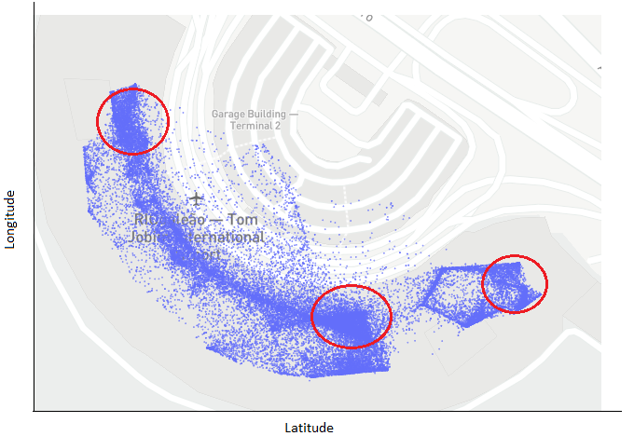
An Example from Rio Airport
Crowded Hotspots
21.Aug.2019 - 06:00 to 07:00 am
Zone area = 410 sqm
Devices inside = 570
Crowd density = 1.40 people per sqm
Not satisfying current Covid-19 restrictions

Slide 6




Value Proposition
Maximize effectiveness of existing security systems
Quicker emergency response
Grant access to real-time movement data
Detect unauthorized access to restricted areas

Slide 7




Value Proposition
Affordable system with minimal changes to infrastructure
Allow easy configuration by client
Provide concrete evidence for introduction of new security features
Present replicability opportunities

Slide 8





Our approach
Divide airport into zones
Receive data
Easily configurable
Complement existing systems
Assign parameters
Real-time input
Time, location, MAC address
1
2
Calculate key metrics
Detect anomalies
Density
Velocity
Unauthorized access
Abnormal density/velocity
3
4
Raise alert
Initiate response
5

Slide 9
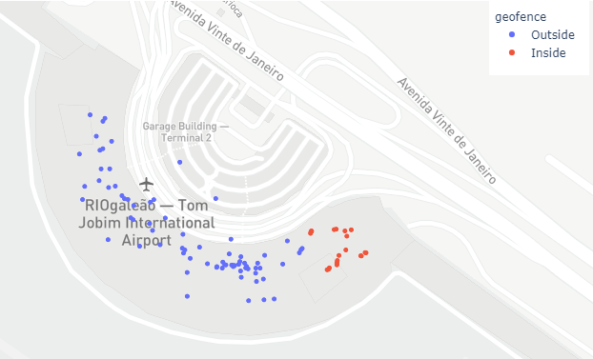
Detecting Unauthorized Access
Labeling Devices: ‘Staff’ vs ‘Passenger’
Geofencing: Identification of points Inside vs. Outside a Zone
Alarm system based on Label and Geofence
Notes:
For the technical approach, the first step was to detect authorized and unauthorized access. In order to do so, we labeled devices as ‘Staff’ or ‘Passenger’. A ‘Staff device is a device that shows up several times across a long period of time in the data and Passengers mostly show up in a single day. Later on, we used geofencing to determine if a point lies inside or outside a specified zone. The alarm system is based on these 2 labels. To test it, we set the logic so that the alarm system will pop up if a ‘Passenger’ is inside a restricted or unauthorized area

Slide 10
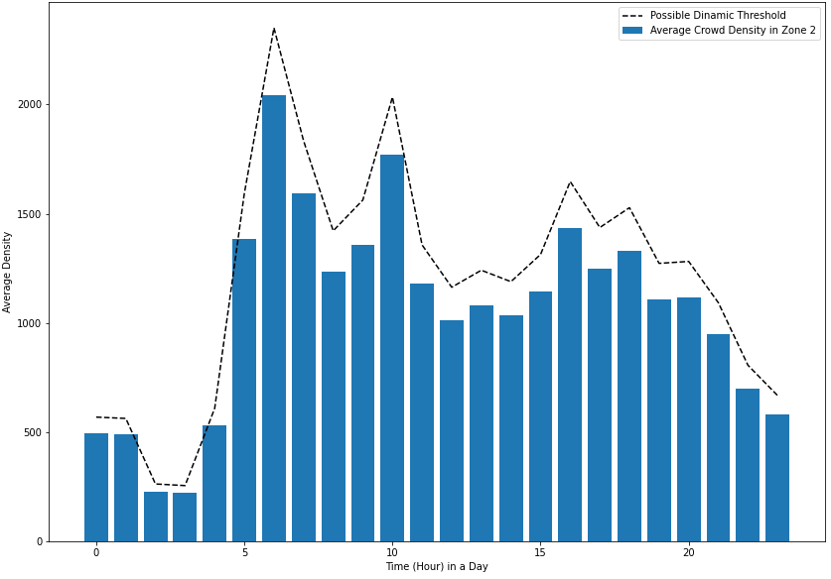
Monitoring Crowd Density
Dynamic vs Fixed
Eliminate duplicates
Counted unique devices in Zone in time intervals
Set up Density Threshold
Dynamic vs Fixed
Alarm System when Value > Threshold
Notes:
The second step of the technical approach was to monitor crowd density. In order to do so, we first eliminated duplicates so that the count of unique devices is correct. We then tested 2 different density threshold, a fixed one and a dynamic one. The fixed one would be something like ‘No more than 200 people are allowed in zone’. The problem with this is that based on different time intervals, the alarm system could pop up every 5 minutes. So we also tested the dynamic threshold, which considers the crowd density across different time intervals during the day. As seen in the graph to the right, in TPS2, the maximum average crowd density seems to be between 5 and 7 am, so the crowd density threshold will be more flexible during those hours

Slide 11



Detecting Movement Anomalies
Single Device Speed Calculation
Cluster Analysis - group of devices
Alarm System
Avg speed > threshold
N devices at speed > threshold
Notes:
The last step was to determine movement anomalies. In order to address this problem, we started by calculating single device speed. We later started analyzing the speed of movement throughout clusters, to see how fast group of people moved. We also tested 2 different thresholds in this, one is if the average speed of the group is above a specified threshold (like 2 m/s which would be a running speed). And the other, a more accurate one, if lets say 100 devices are travelling faster than 2 m/s, then something must be happening and the alarm will pop up

Slide 12


From Raw Data to Output
Input
Model
Output
Available data
Time interval
Zone extreme points coordinates
User parameters thresholds
Maps
Alarm Signal

Slide 13
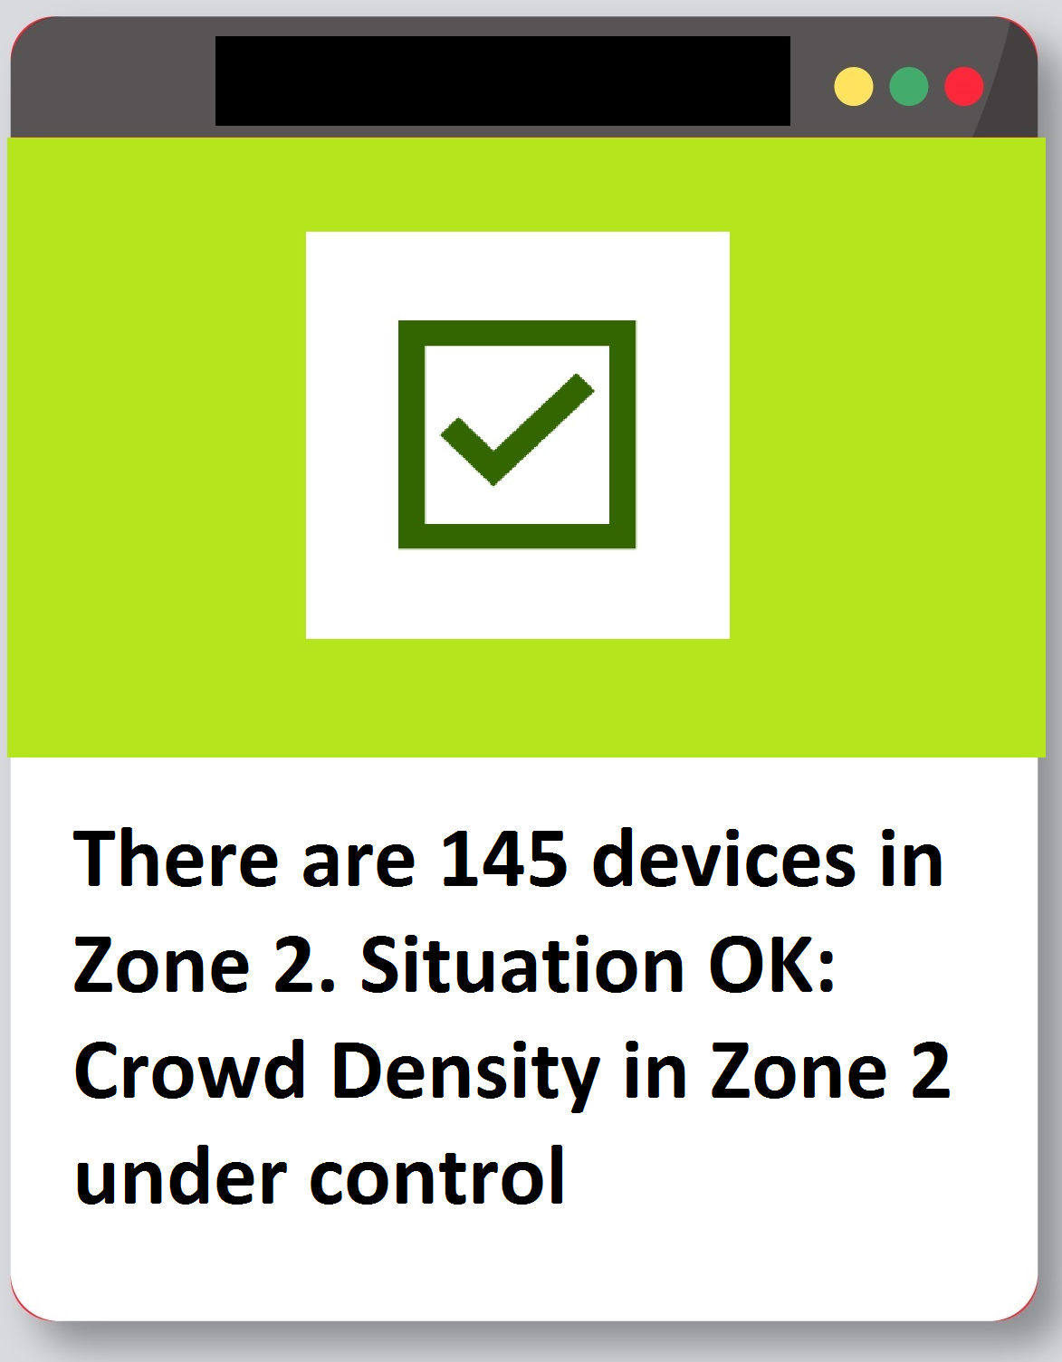
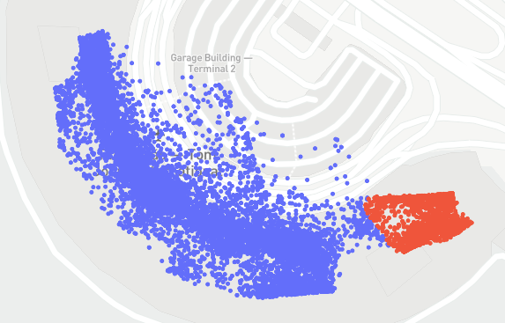
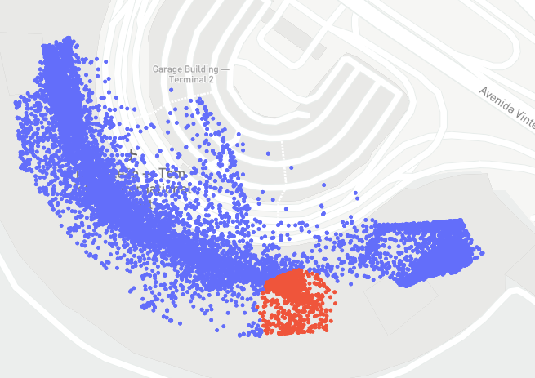
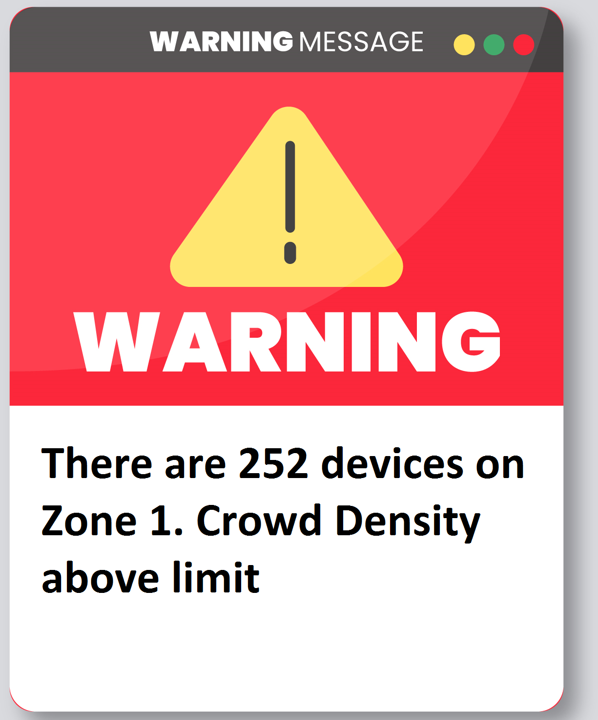
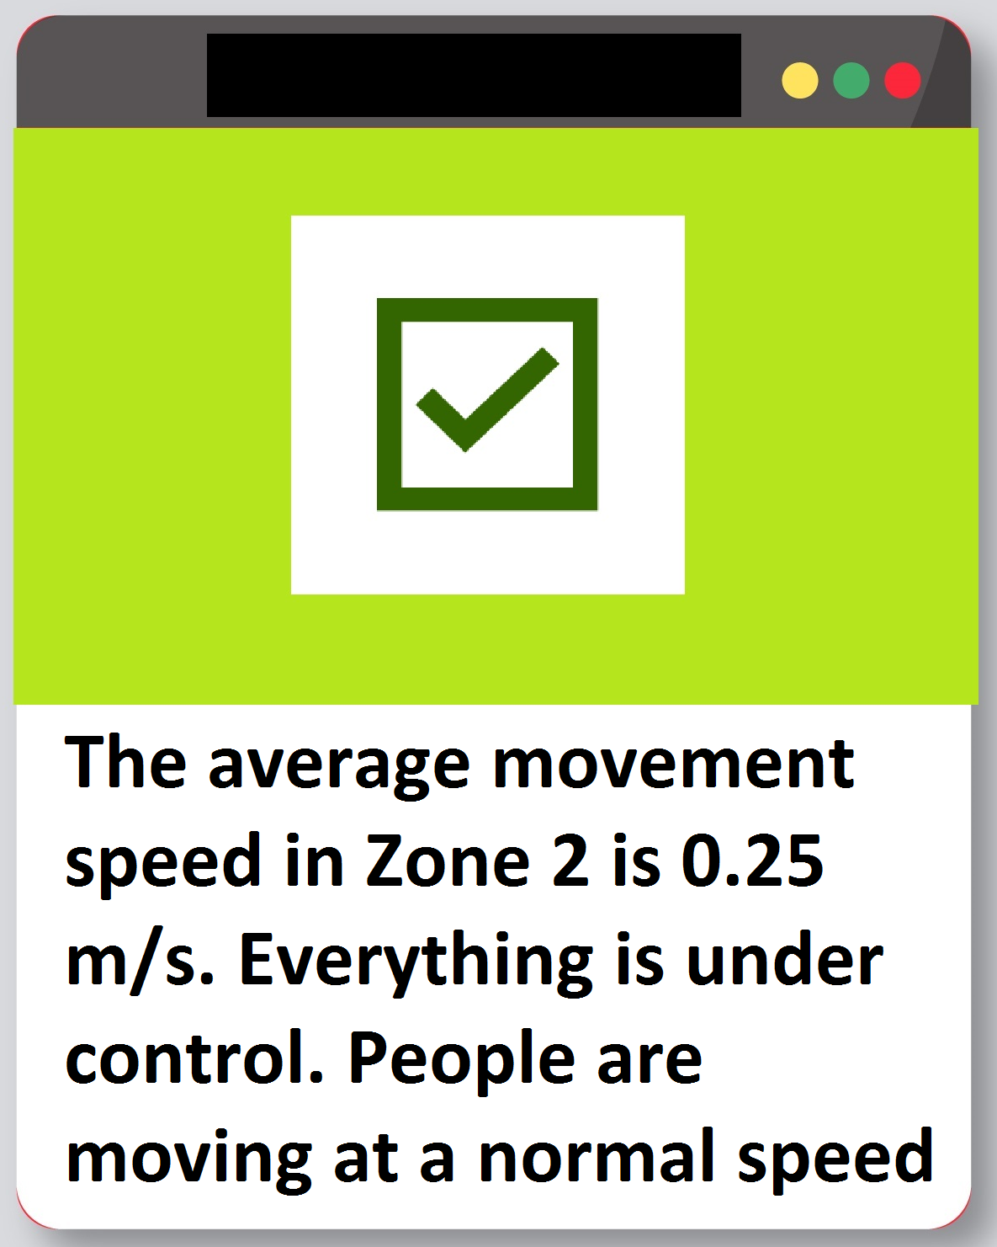
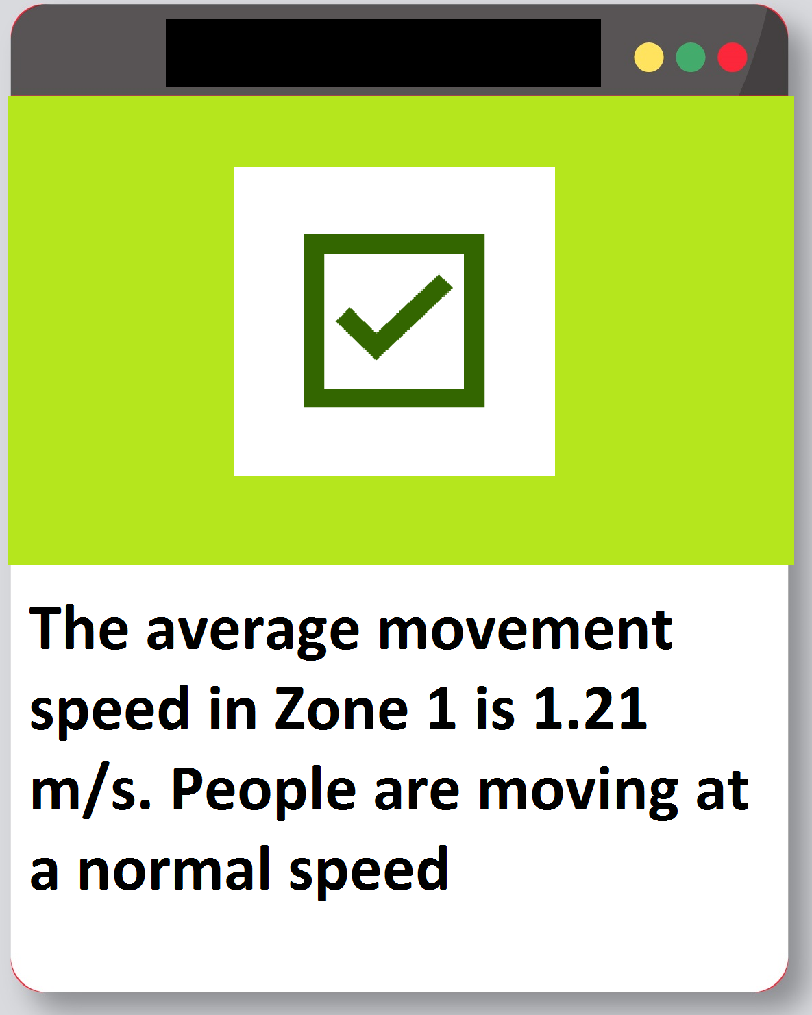
Testing the Model
Test: Variability in terminals, zones coordinates and parameters, data files
Multiple parameters on the same zone
Situation 1: Zone 2, 12:00 -13:00 pm
Situation 2: Zone 1, 15:00 - 16:00 pm

Slide 14
Connectivity and Signals
What Signals did we use? |  | What external signals can enhance the model?
Google Maps
Manual Labeling of ‘Staff’ vs. ‘Passenger’ |  | Real MAC ID’s from Staff Members
Hypothetical Zones |  | Actual Zones that are important and relevant for the Airport
Reasonable Parameters Thresholds |  | Actual parameter thresholds
 |  | Security Cameras within Zones
 |  | Security Guards Schedule
Easily integrated and will drive efficiency and soundness benefits to the model
Enhance Decision and Action after Insights

Slide 15



From Model to Delivery
Model Output
Insight: Warning, Status
Actions
Result: Value Delivered
Redirect resources
Improve emergency response time
Maximize effectiveness of existing security features
etc.
Notes:
Redirect resources to zone in question:
“Look at Camera 4”
“Tell the Guard to go to Zone 2”
“There is an unauthorized device in Zone 1, take a look
“There are too many people running in Zone 3, we should go check

Slide 16
Q & A
Thank you !

Slide 17
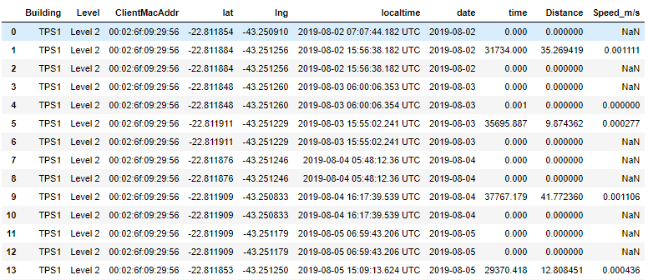
Appendix-Sample

Slide 18
Reference
https://www.cnn.com/2020/03/10/americas/chile-airport-robbery-intl-scli/index.html

