Slide 1

Etihad Airways
US Out-Of-Home campaign
Beyond Borders Campaign
Duration: July 7 - August 7 2026

Slide 2
United States

Slide 3
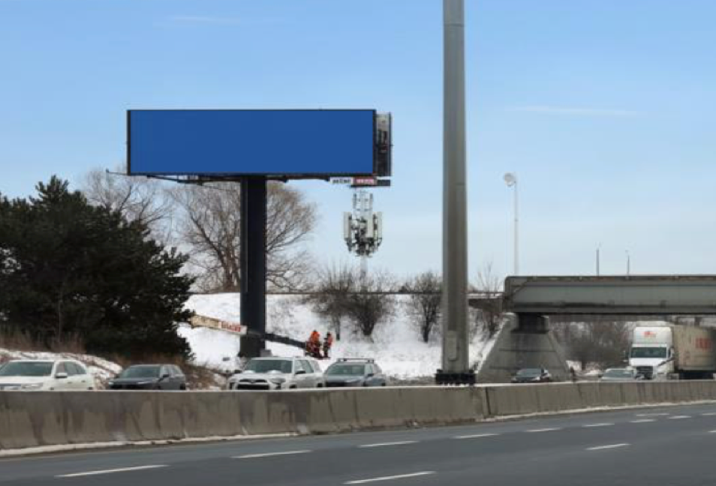

ONE TIMES SQUARE
LOCATION
Map link
Positioned in the heart of Downtown Atlanta, this dual digital spectacular is located within one of the city’s busiestcommercial and commuter corridors.
VISIBILITY
The large-format digital screens offer dominant visibility at a high-traffic intersection, benefiting from extended dwelltime due to traffic signals and congestion.
AUDIENCE
Engages a high-density flow of ISC professionals, consultants, and international business travelers moving throughAtlanta’s core,
TECHNICAL SPECIFICATIONS
NEARBY LANDMARKS
FORMAT : Digital
SPOT LENGTH : 10 seconds
Broadway - 100m
SIZE : 8 x 4 m
FREQUENCY : 20%
Broadway - 100m
UNITS : 4
TRAFFIC : 2,000,000 monthly
Broadway - 100 m

Slide 4
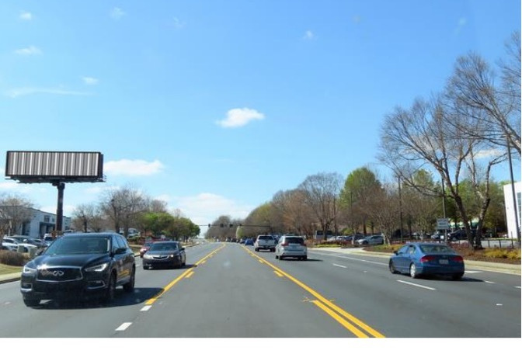
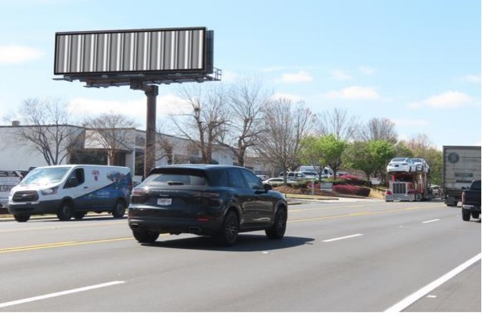
ONE TIMES SQUARE

Slide 5
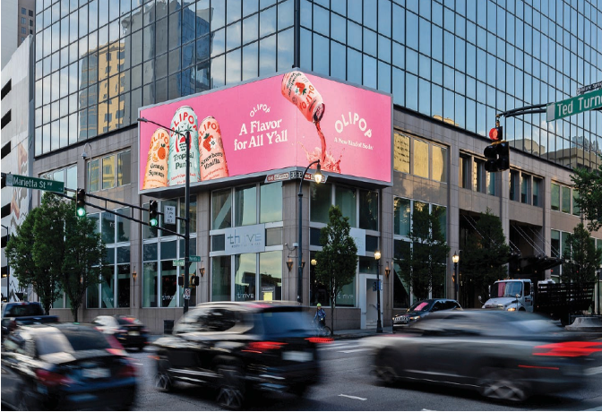
The Downtown Duo Digitals
LOCATION
Map link
Positioned in the heart of Downtown Atlanta, this dual digital spectacular is located within one of the city’s busiest commercial and commuter corridors.
VISIBILITY
The large-format digital screens offer dominant visibility at a high-traffic intersection, benefiting from extended dwelltime due to traffic signals and congestion. recall.
AUDIENCE
High-density flow of ISC professionals, consultants, and international business travelers moving throughAtlanta’s core, many of whom maintain frequent long-haul connections to the Indian Subcontinent and favor premium travel experiences.
TECHNICAL SPECIFICATIONS
NEARBY LANDMARKS
FORMAT : Static
SPOT LENGTH : 10 seconds
Broadway - 100m
SIZE : 16 x 70
FREQUENCY : 10%
Broadway - 100m
UNITS : 1
TRAFFIC : 2,000,000 monthly
Broadway - 100 m

Slide 6
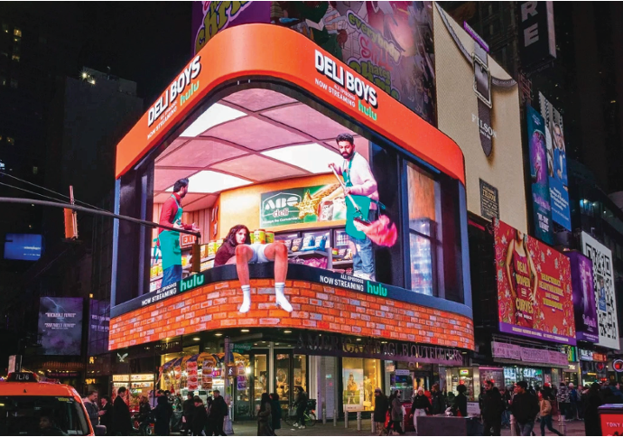
EVEREST DIGITAL
LOCATION
Map link
Located in the NoMad district, one of Manhattan’s fastest-growing luxury and hospitality zones, thisunit sits near Virgin Hotels New York City and key avenues connecting Midtown and Flatiron.
VISIBILITY
A high-impact, architecturally integrated digital unit offering premium, eye-level exposure. While not mass-reach like Times Square, it delivers highly targeted visibility within a concentrated, upscaleenvironment.
AUDIENCE
Targets affluent professionals, international travelers, and upscale consumers frequenting luxury hotels, fine dining venues, and corporate offices.
TECHNICAL SPECIFICATIONS
NEARBY LANDMARKS
FORMAT : Static
SPOT LENGTH : 10 seconds
Broadway - 100m
SIZE : 45 x 135
FREQUENCY : 10%
Broadway - 100m
UNITS : 1
TRAFFIC : 2,000,000 monthly
Broadway - 100 m

Slide 7
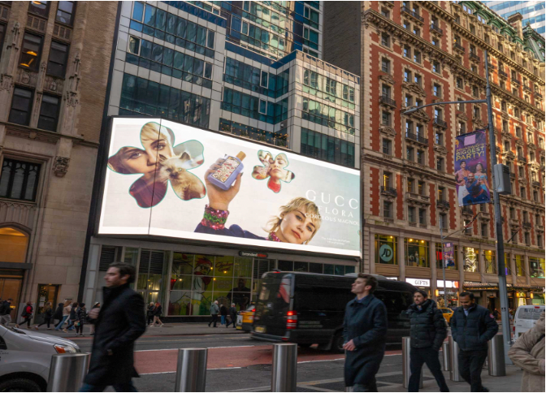
Bryant Park Digital
LOCATION
Map link
Overlooking Bryant Park in Midtown Manhattan, this unit sits within a prime commercial and leisuredistrict surrounded by offices, retail, and cultural attractions.
VISIBILITY
High-quality digital placement with extended dwell time driven by park visitors, office workers, and nearby pedestrian traffic. The environment enhances attention and engagement.
AUDIENCE
Reaches a premium mix of office professionals, tourists, and leisure visitors, with strong daytime and lunchtime traffic.
TECHNICAL SPECIFICATIONS
NEARBY LANDMARKS
FORMAT : Static
SPOT LENGTH : 10 seconds
Broadway - 100m
SIZE : 28 x 75
FREQUENCY : 10%
Broadway - 100m
UNITS : 1
TRAFFIC : 2,000,000 monthly
Broadway - 100 m

