Slide 1

Youtube Channels’ Global Analysis
IRONHACK
Data Analytics Bootcamp
Final Project By Sergio Burgos

Slide 2
Agenda
Geospatial Visualization: How looks the distribution of successful YouTube channels on a world map like and which geographical trends can be observed?
Content Strategy: Which are in 2022 the most popular categories and upload frequencies that resonate with audiences?
Trending Topics: how certain categories gain popularity over time and correlate with world events?
Regional Influencers: Who are the influential YouTube creators from different countries, and which is their impact on a global scale?
YouTube Analytics: Which are the success factors of top YouTube channels and what sets them apart from the rest?
Earnings Analysis: How does the correlation between channel performance and estimated earnings looks like?
Modeling: Future subscribers.

Slide 3

Global distribution
Youtube_Subscribers_Analyisis | Tableau Public

Slide 4
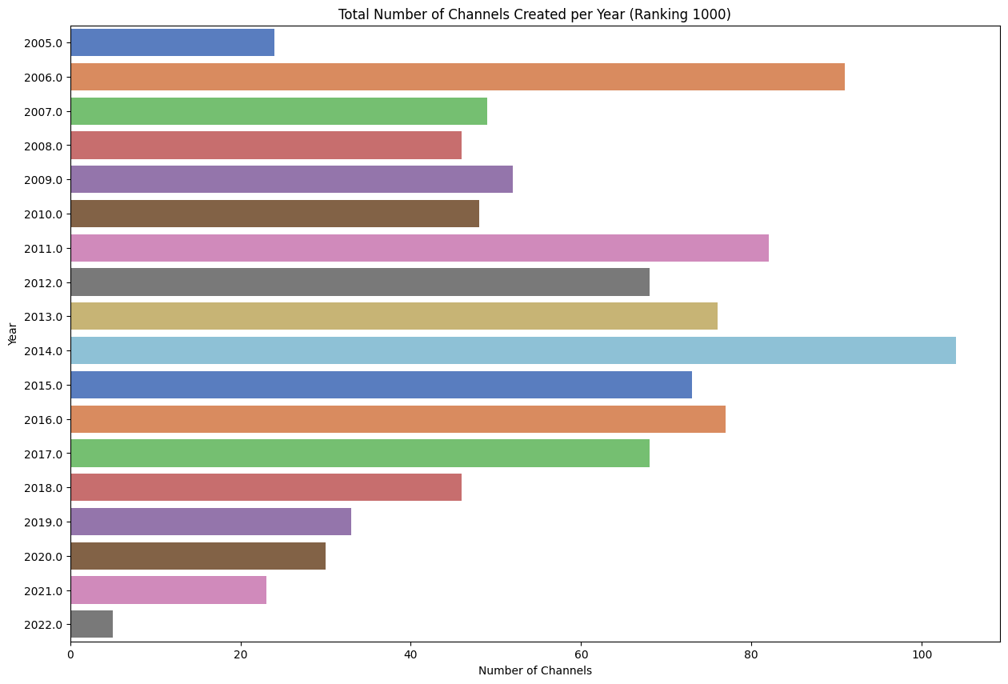

Slide 5
Content strategy

Slide 6
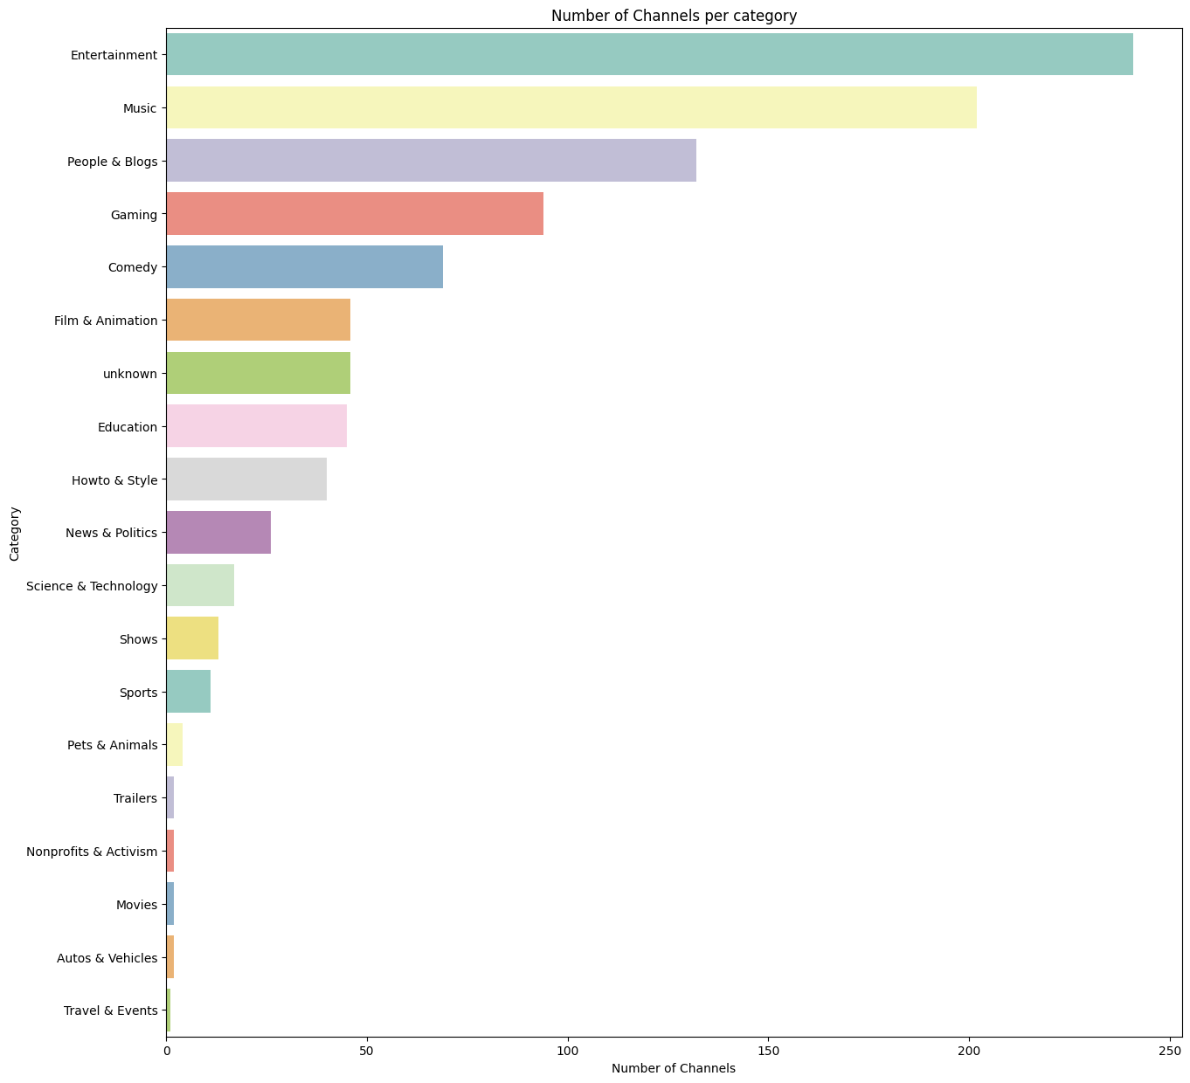

Slide 7
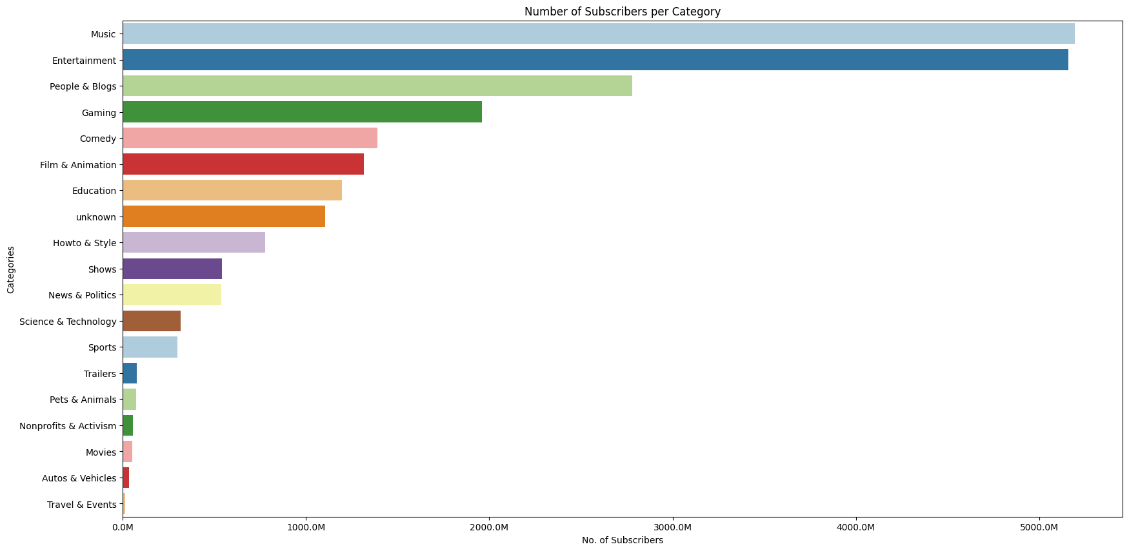

Slide 8
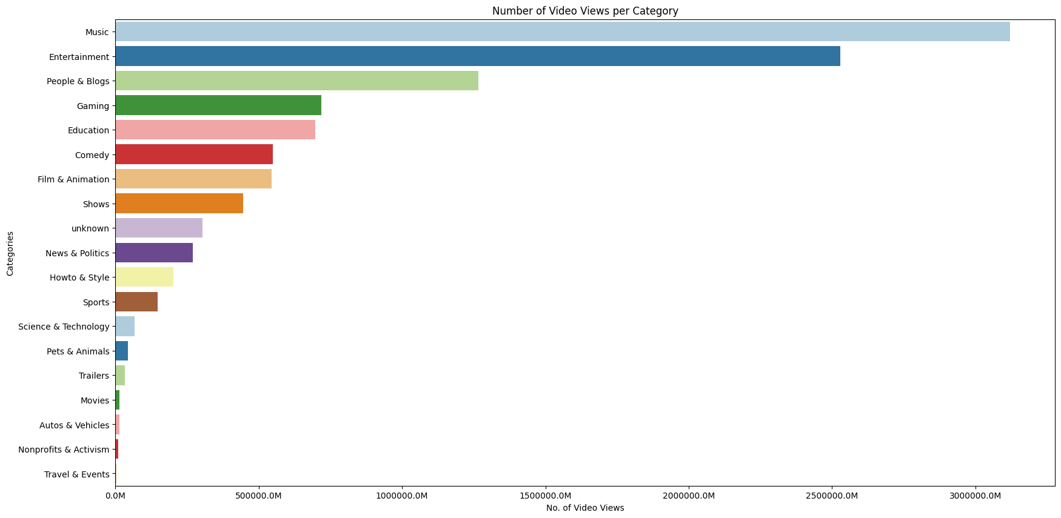

Slide 9
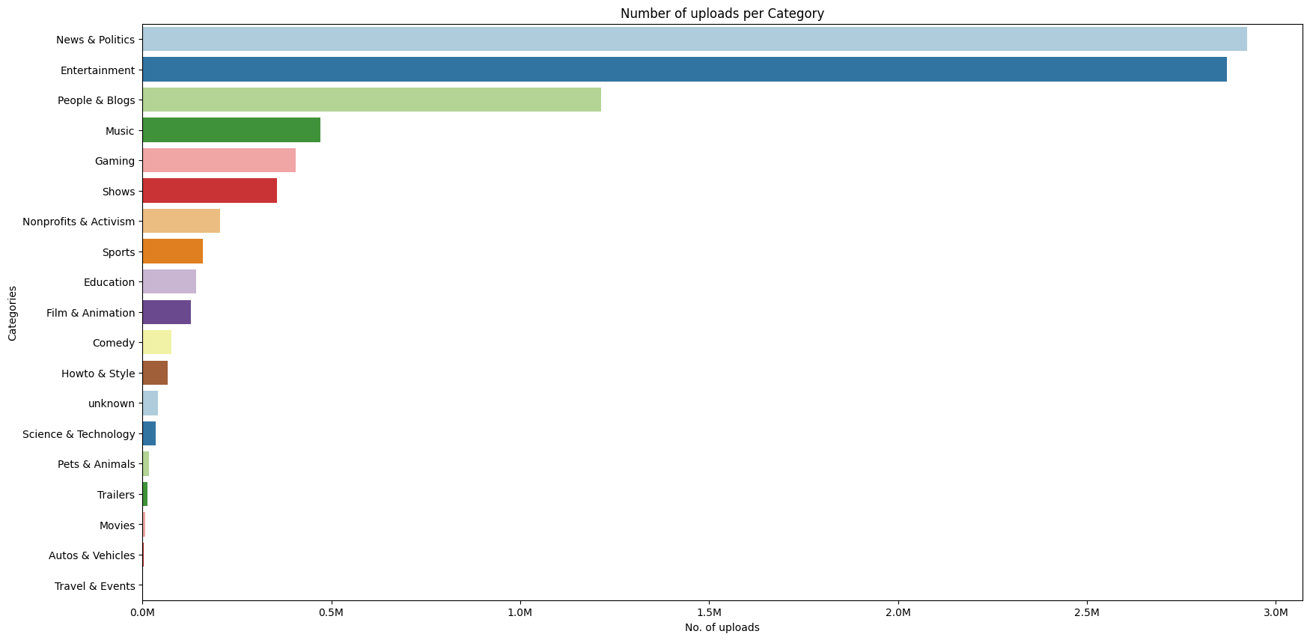

Slide 10
Trending Topics

Slide 11
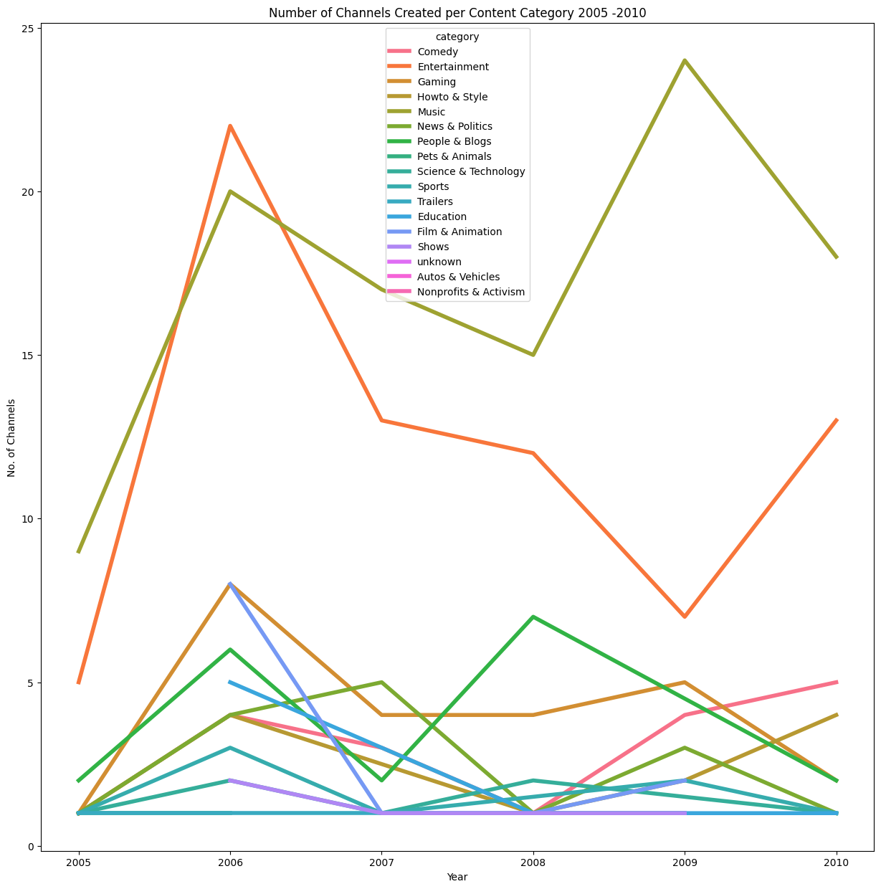

Slide 12
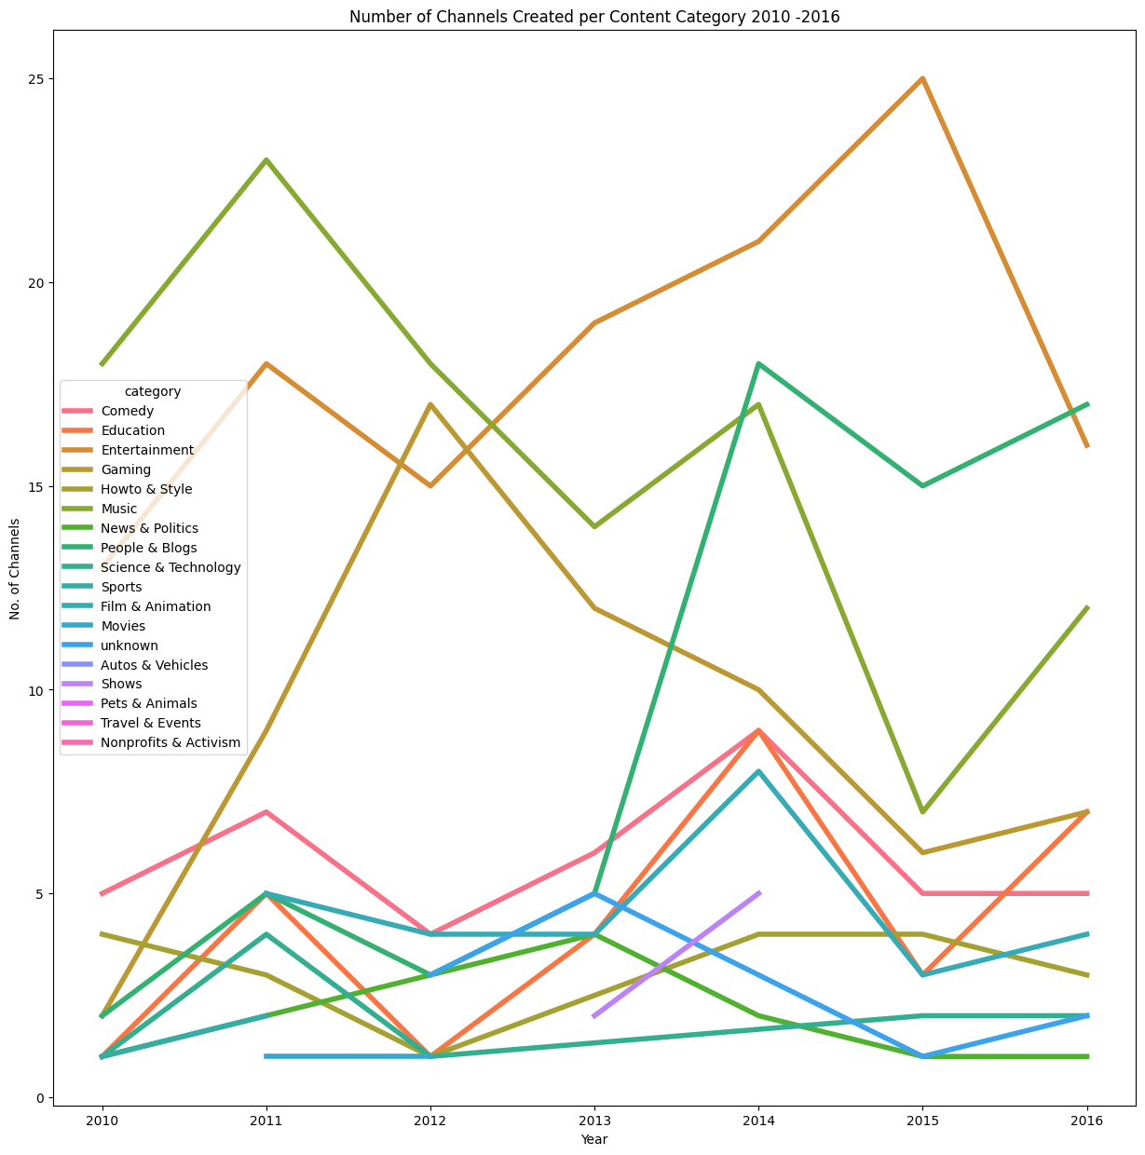

Slide 13
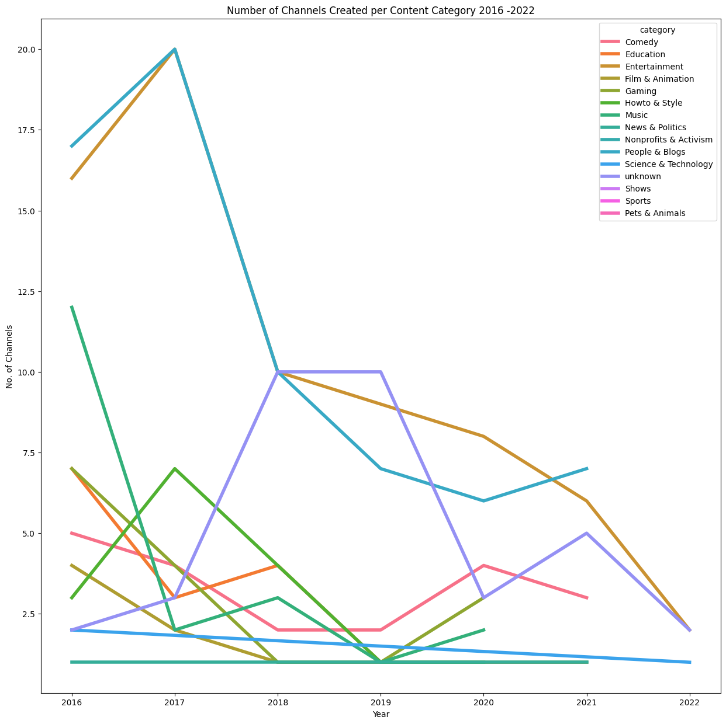

Slide 14
Earnings Analysis

Slide 15
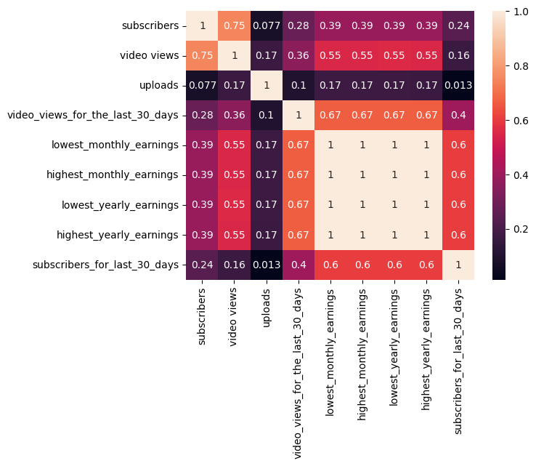
Correlation Matrix

Slide 16
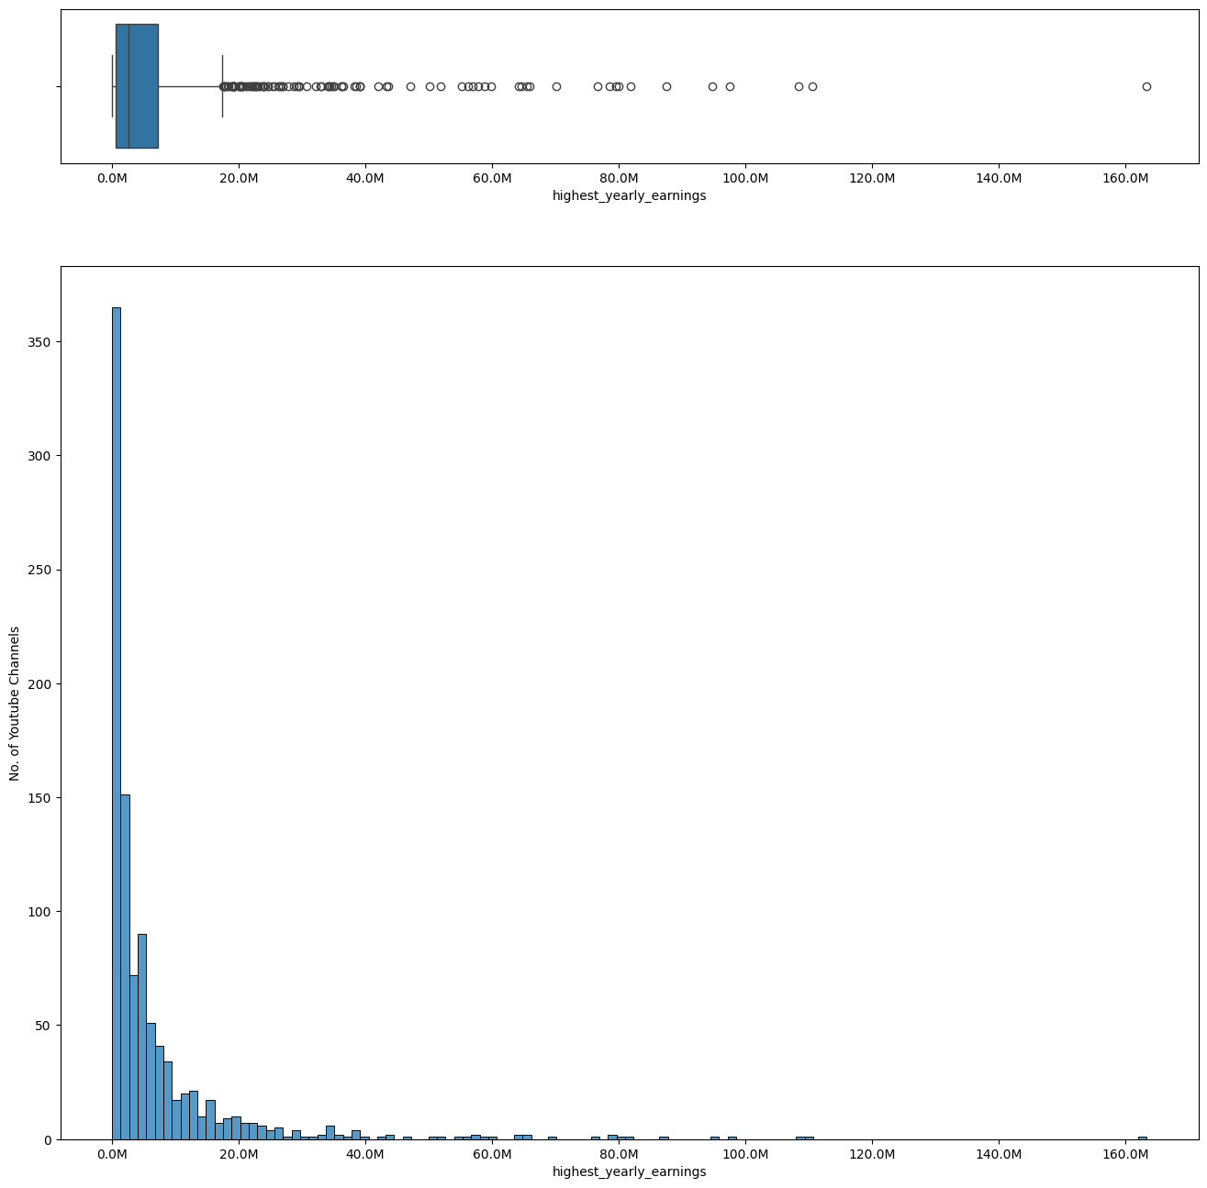

Slide 17


Slide 18
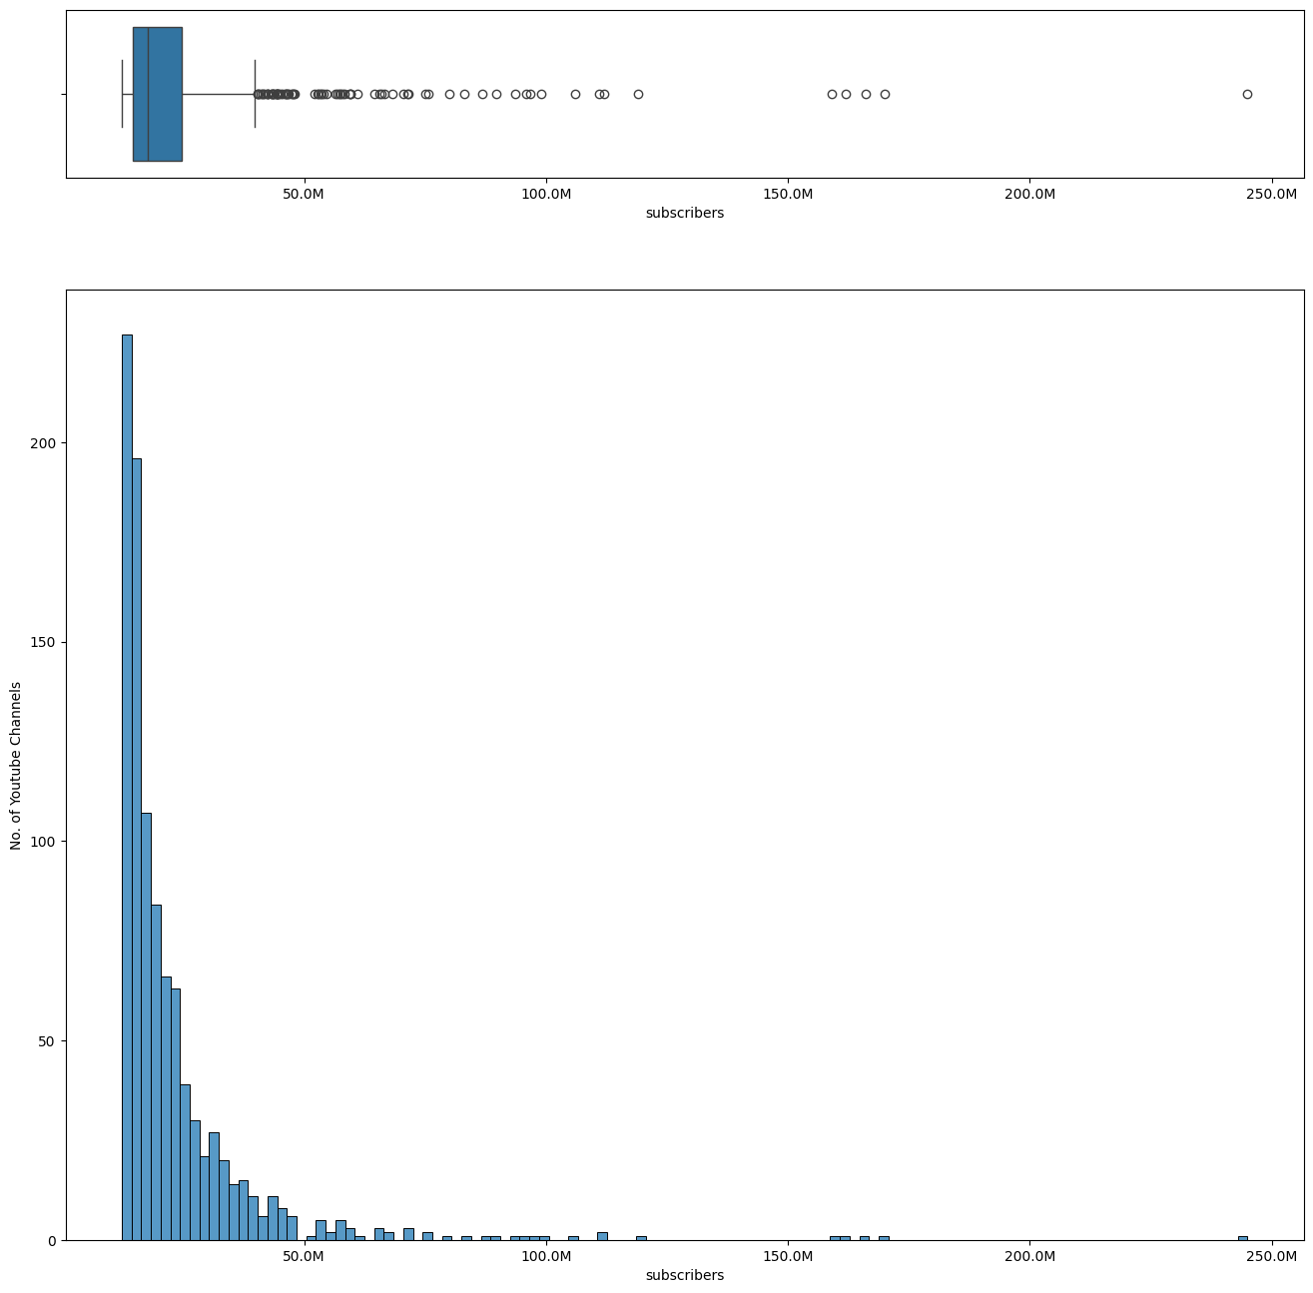

Slide 19
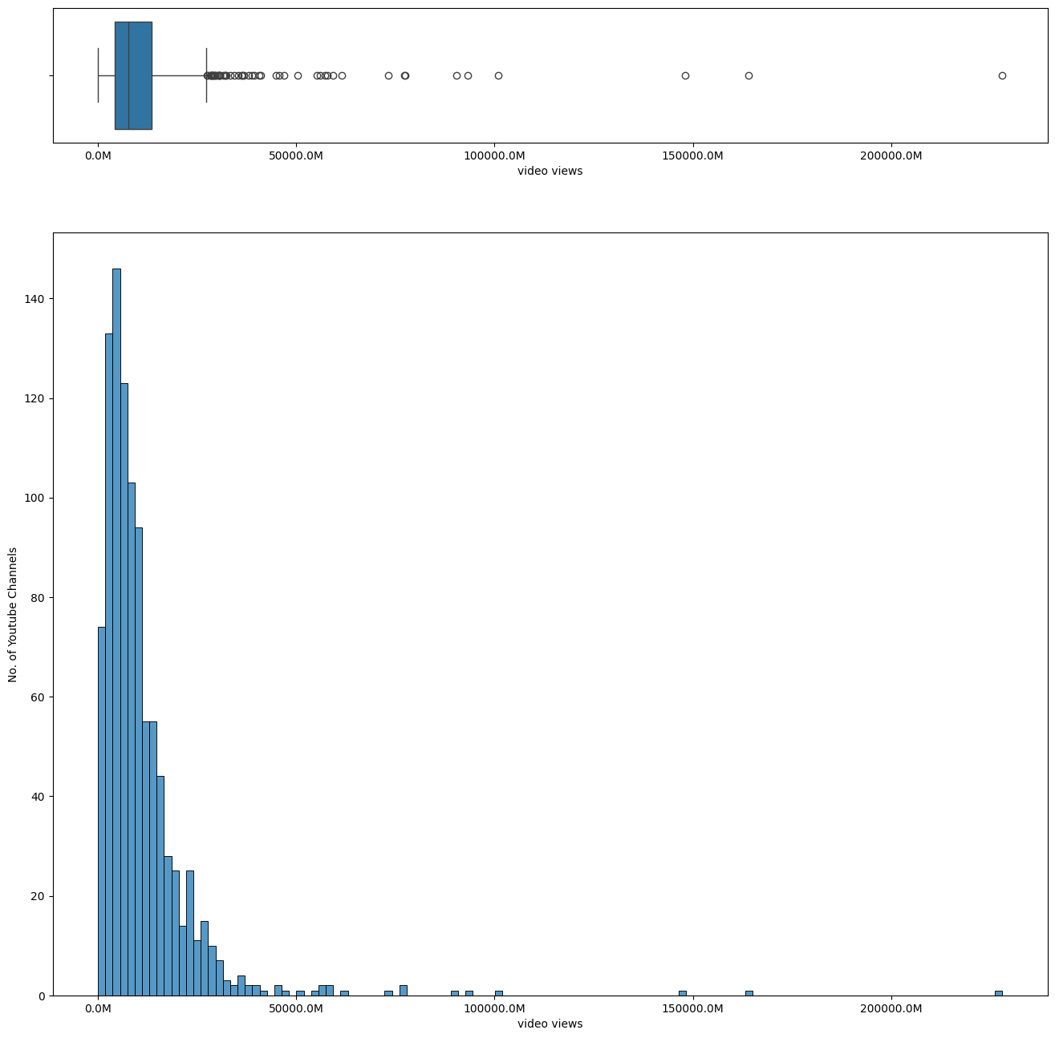

Slide 20
Models
Linear model
Decision Tree
Random Forest

Slide 21

Conclusions

Slide 22
Future Work

Slide 23

Thanks!

