Slide 1

Youtube Channels’ Global Analysis
IRONHACK
Data Analytics Bootcamp
Final Project By Sergio Burgos

Slide 3
Agenda
Geospatial Visualization: How looks the distribution of successful YouTube channels on a world map like and which geographical trends can be observed?
Content Strategy: Which are in 2022 the most popular categories and upload frequencies that resonate with audiences?
Trending Topics: how certain categories gain popularity over time and correlate with world events?
Regional Influencers: Who are the influential YouTube creators from different countries, and which is their impact on a global scale?
YouTube Analytics: Which are the success factors of top YouTube channels and what sets them apart from the rest?
Earnings Analysis: How does the correlation between channel performance and estimated earnings looks like?
Modeling: Future subscribers.

Slide 4

Global distribution
Youtube_Subscribers_Analyisis | Tableau Public

Slide 5
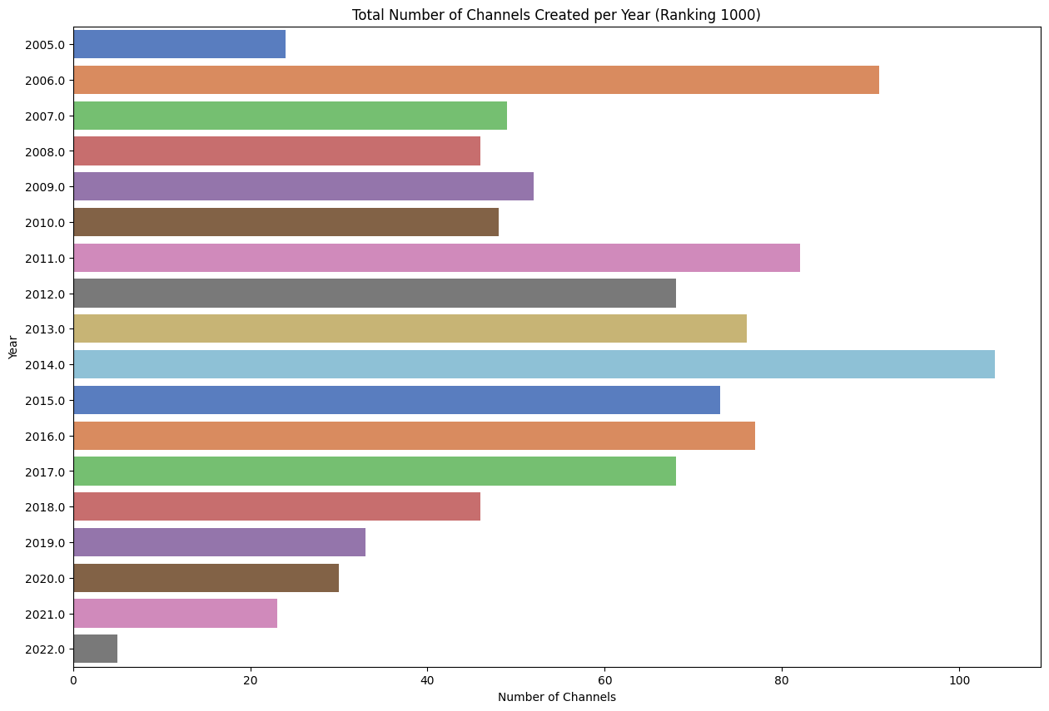

Slide 6
Content strategy

Slide 7
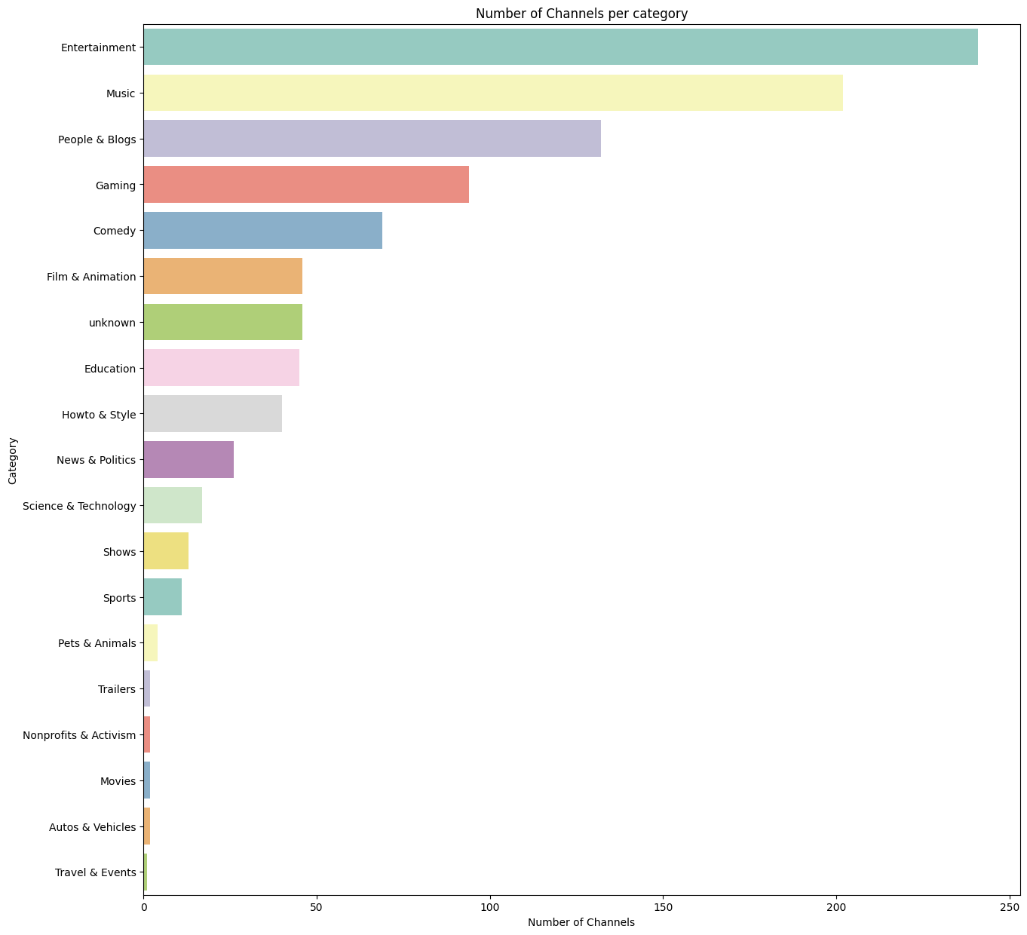

Slide 8
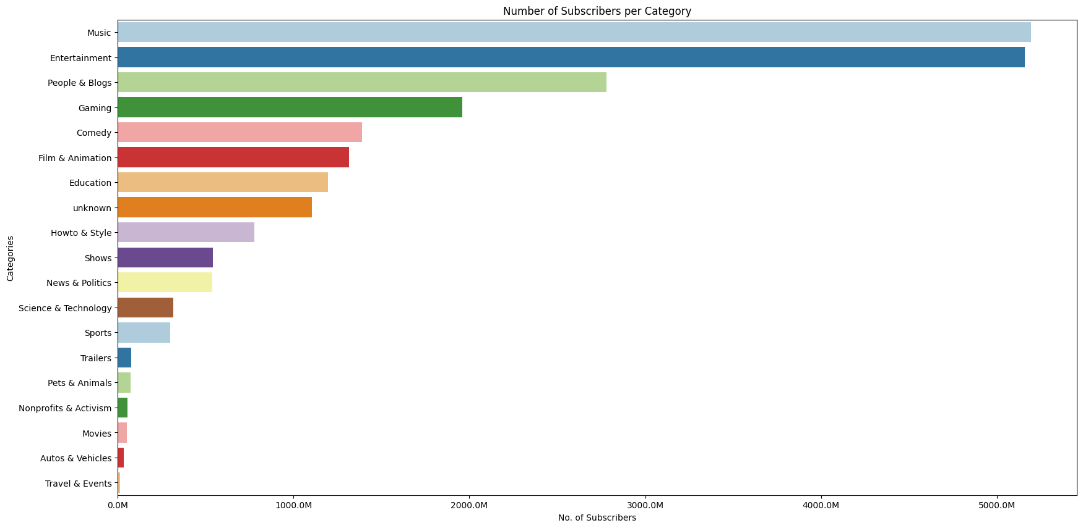

Slide 9
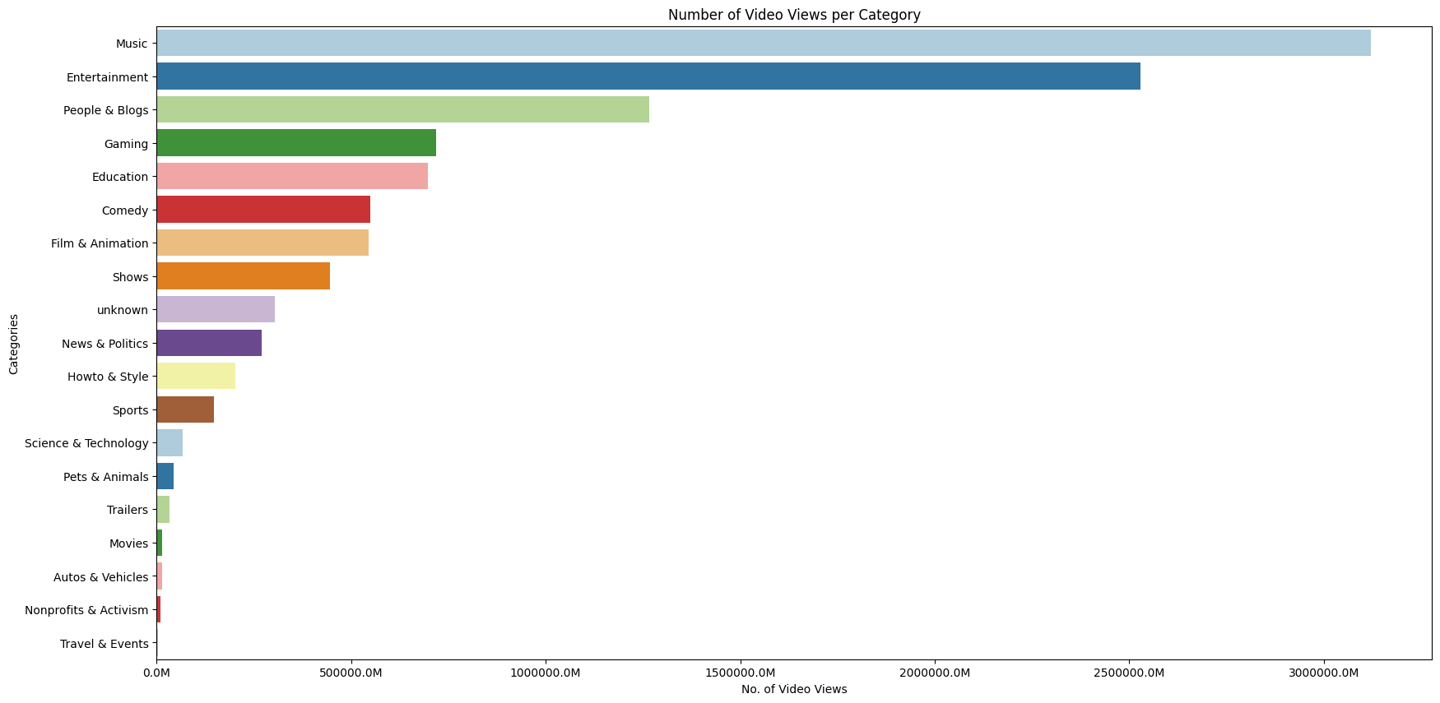

Slide 10
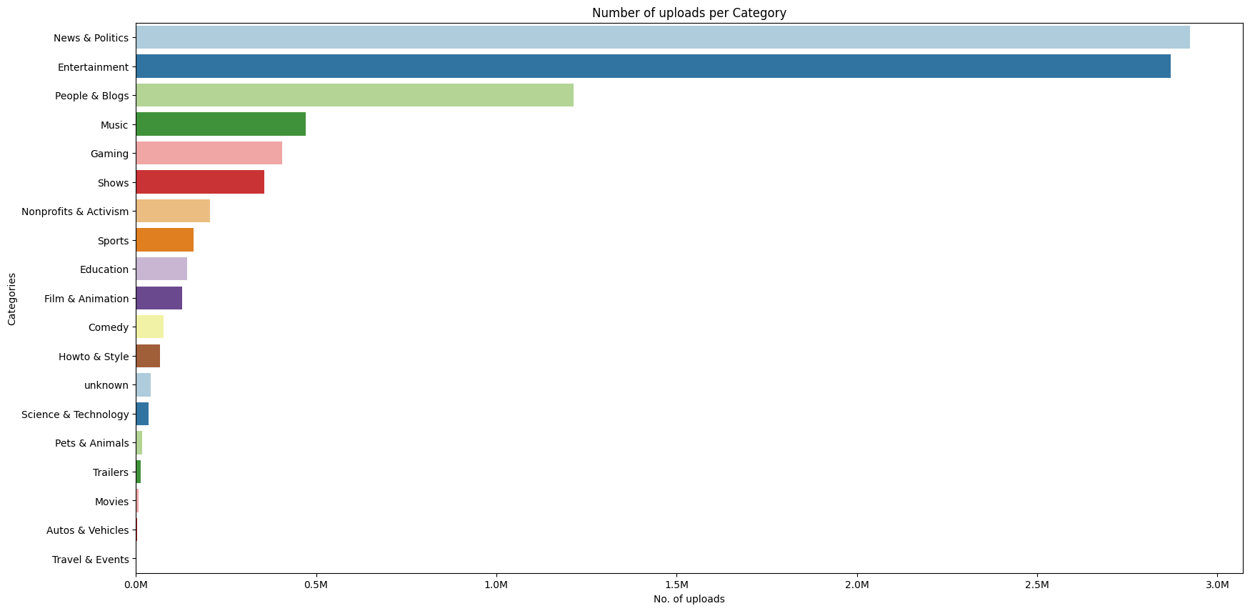

Slide 11
Trending Topics

Slide 12
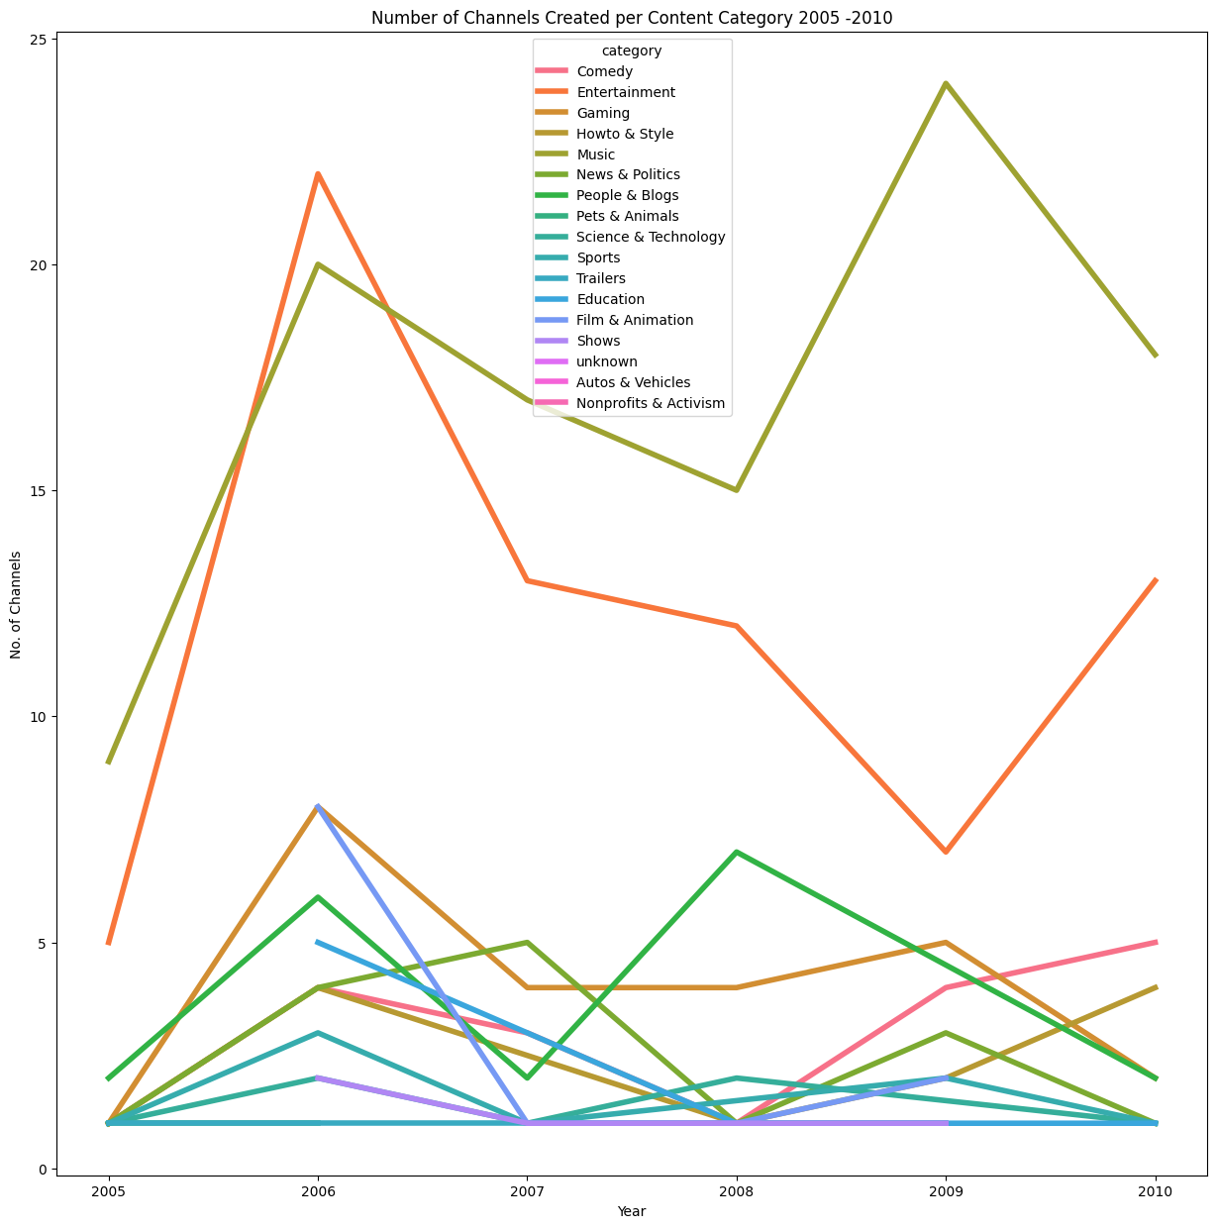

Slide 13
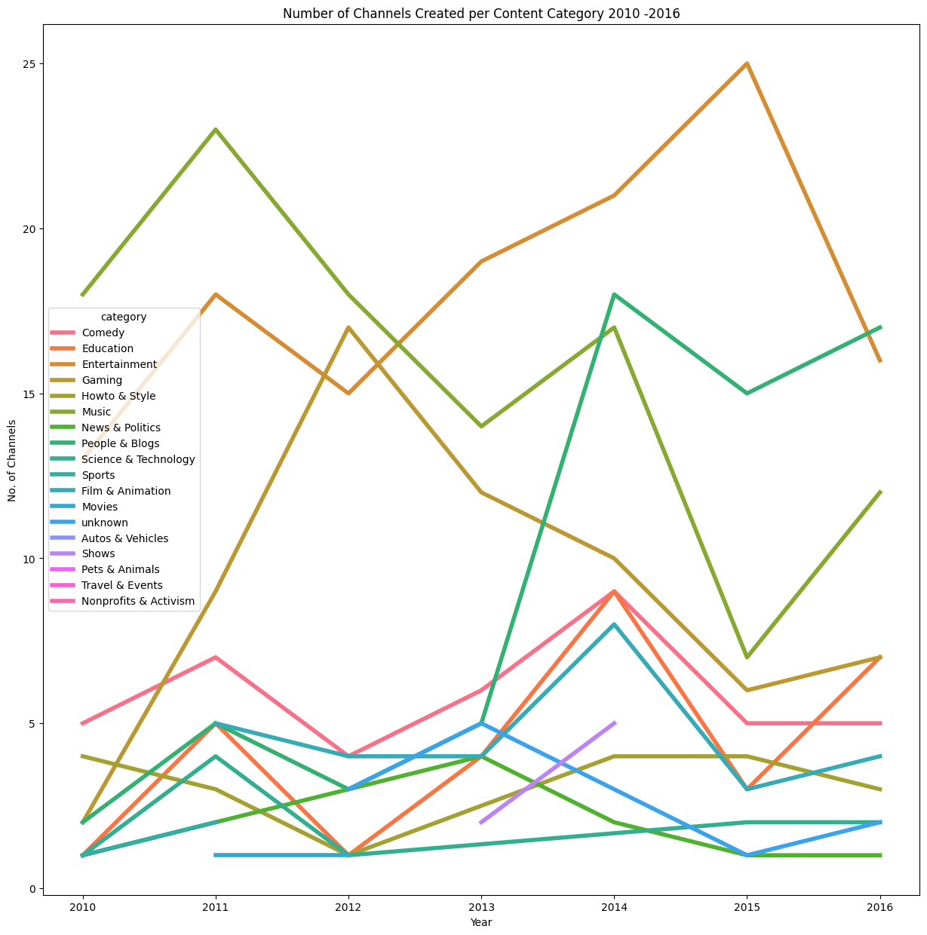

Slide 14
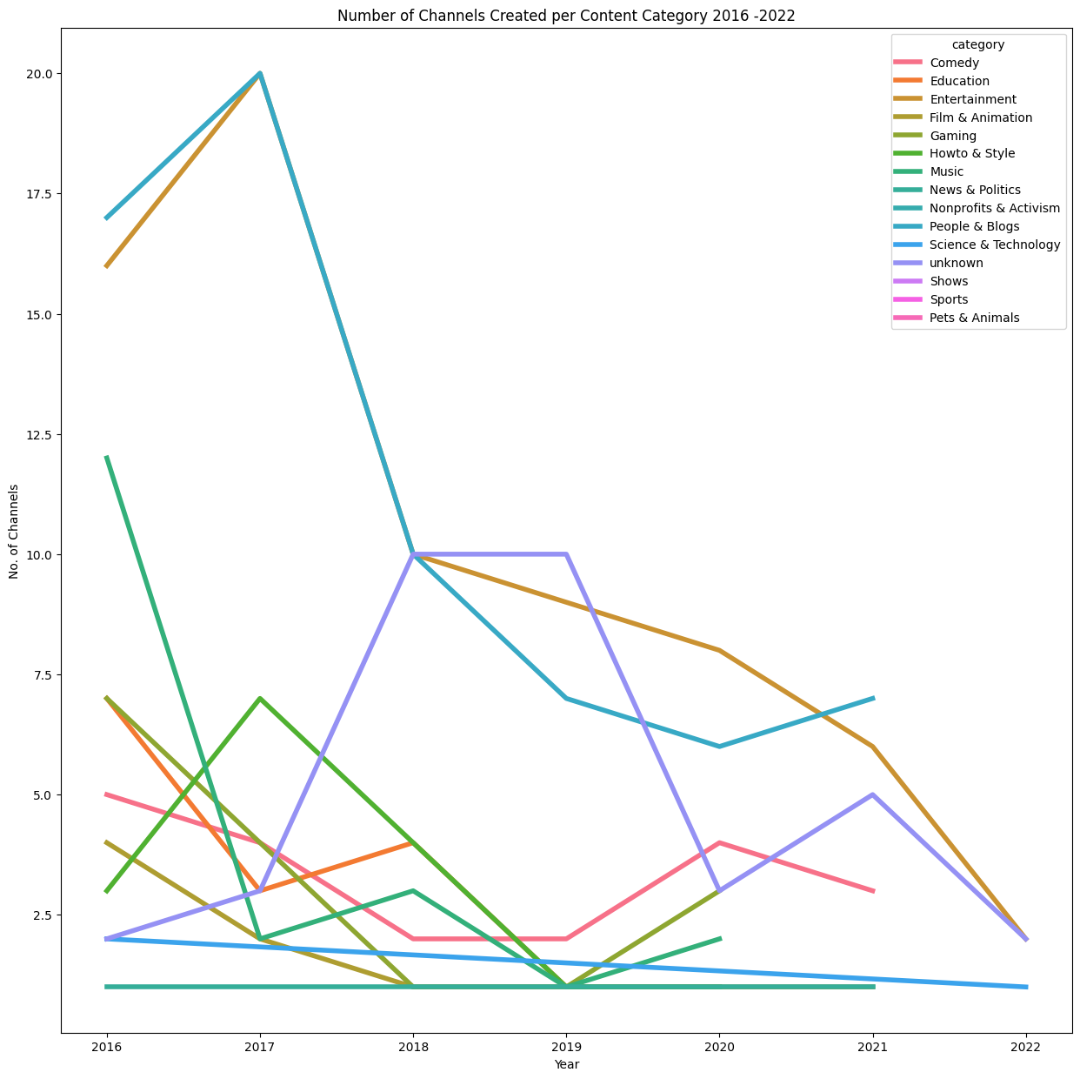

Slide 15
Earnings Analysis

Slide 16
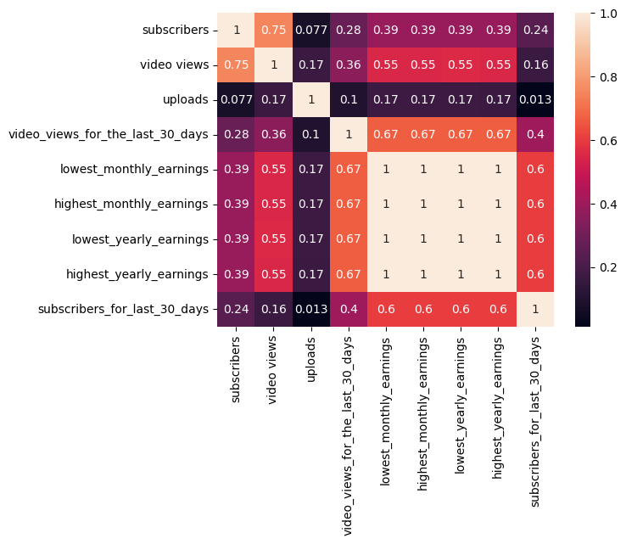
Correlation Matrix

Slide 17
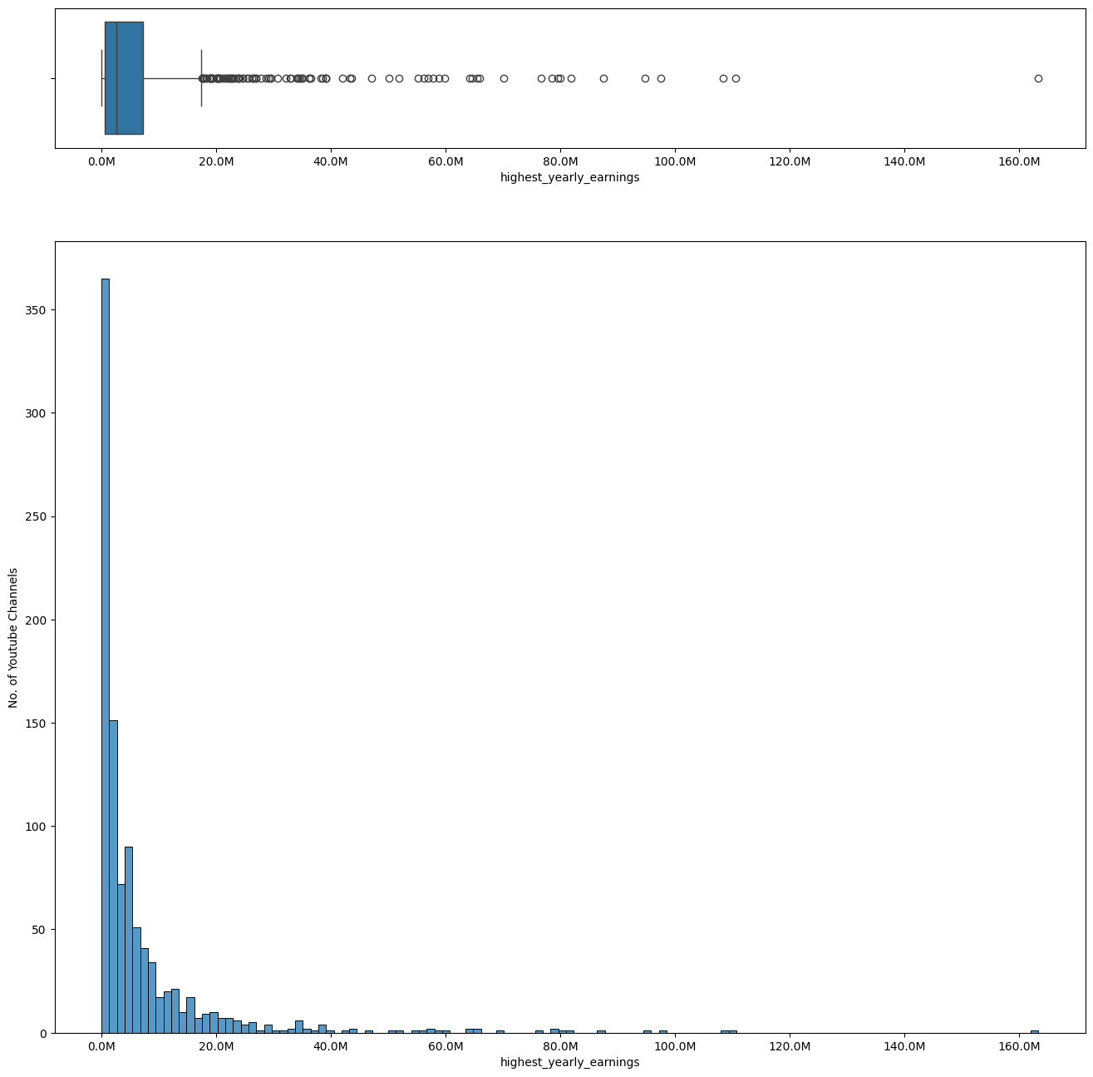

Slide 18


Slide 19
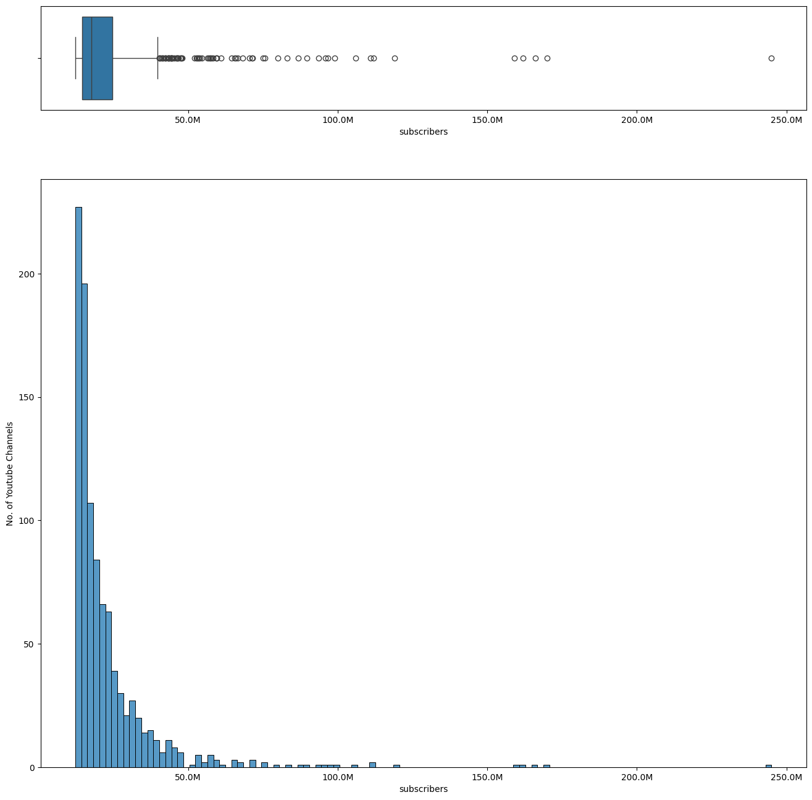

Slide 20
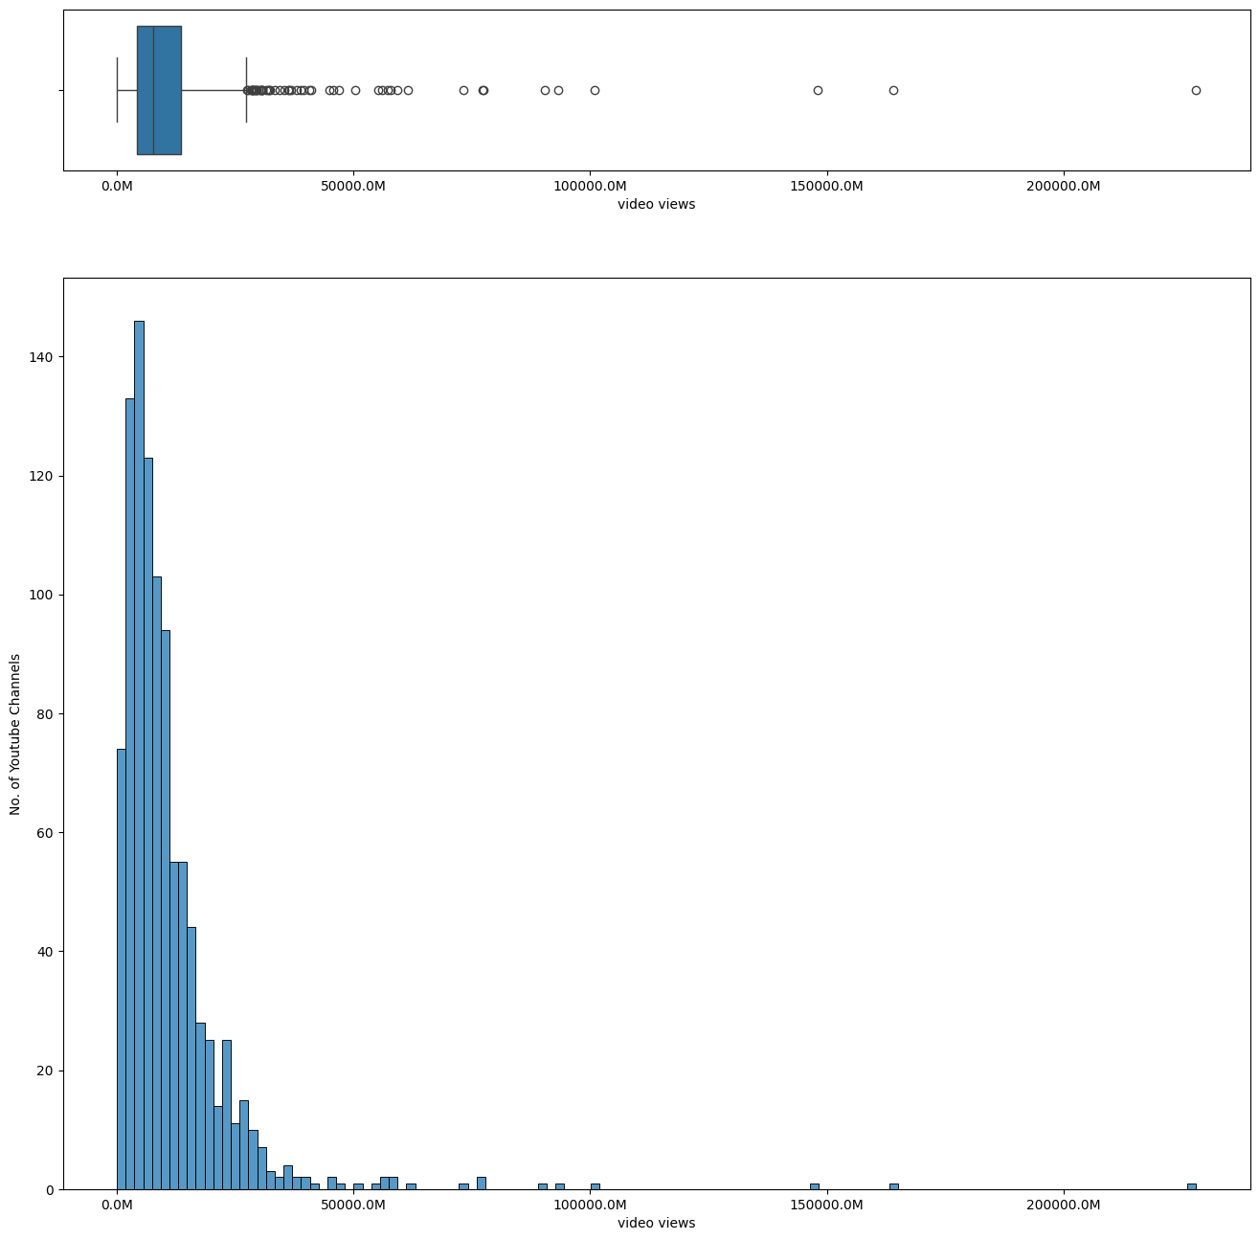

Slide 21
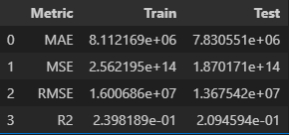
Models
Linear model

Slide 22
Models
Decisions Tree
'criterion': 'squared_error',
'max_depth': 5,
'min_samples_leaf': 2,
'min_samples_split': 10
The best R2 for the best hyperparameters is 0.46

Slide 23
Models
Random Forest The Accuracy for the Random Forest in the TRAIN set is 0.08
The Accuracy for the Random Forest in the TEST set is 0.04

Slide 24

Conclusions

Slide 25
Future Work

Slide 26

Thanks!

