Slide 1

ANALYSIS ON IMMIGRATION INTO OECD COUNTRIES
Ironhack Midbootcamp Project
By: Sergio Burgos

Slide 2


Slide 3
Questions
1. Which have been the five OECD countries that received the highest inflow of immigrants during 2010-2020?
2. Which are the top 5 OECD countries that have had the highest immigrants' outflows rates 2010-2020?
3. Which are the OECD countries with the highest nationality acquisition rates for the years 2010-2020?
4. Which are the top five OECD countries that present the best laboral integration rates according to the educational attainment of the immigrant 2015-2019?
5. Which are the OECD countries where immigrant women have reached the highest integration rate in the labor market during 2010-2020?

Slide 4

CHALLENGES

Slide 5
Analysis and Answers

Slide 6

One
Inflow of immigrants during 2010-2020

Slide 7
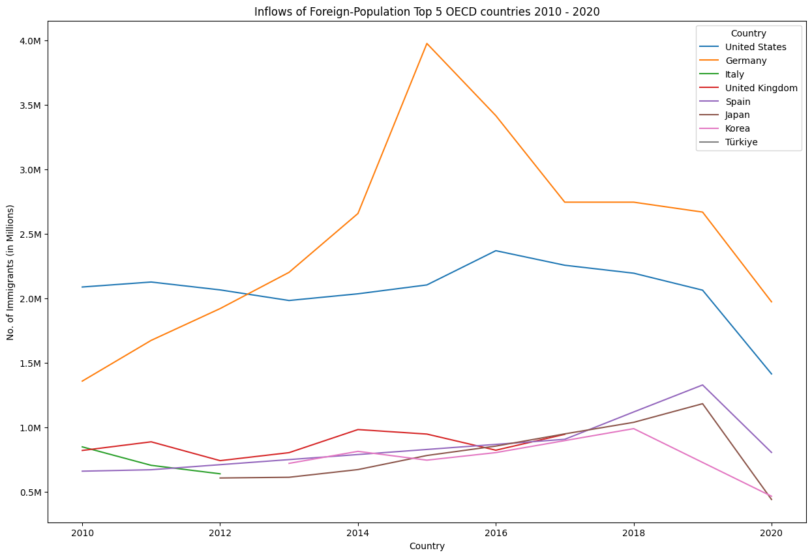

Slide 8

Two
Immigrants outflows rates 2010-2020

Slide 9
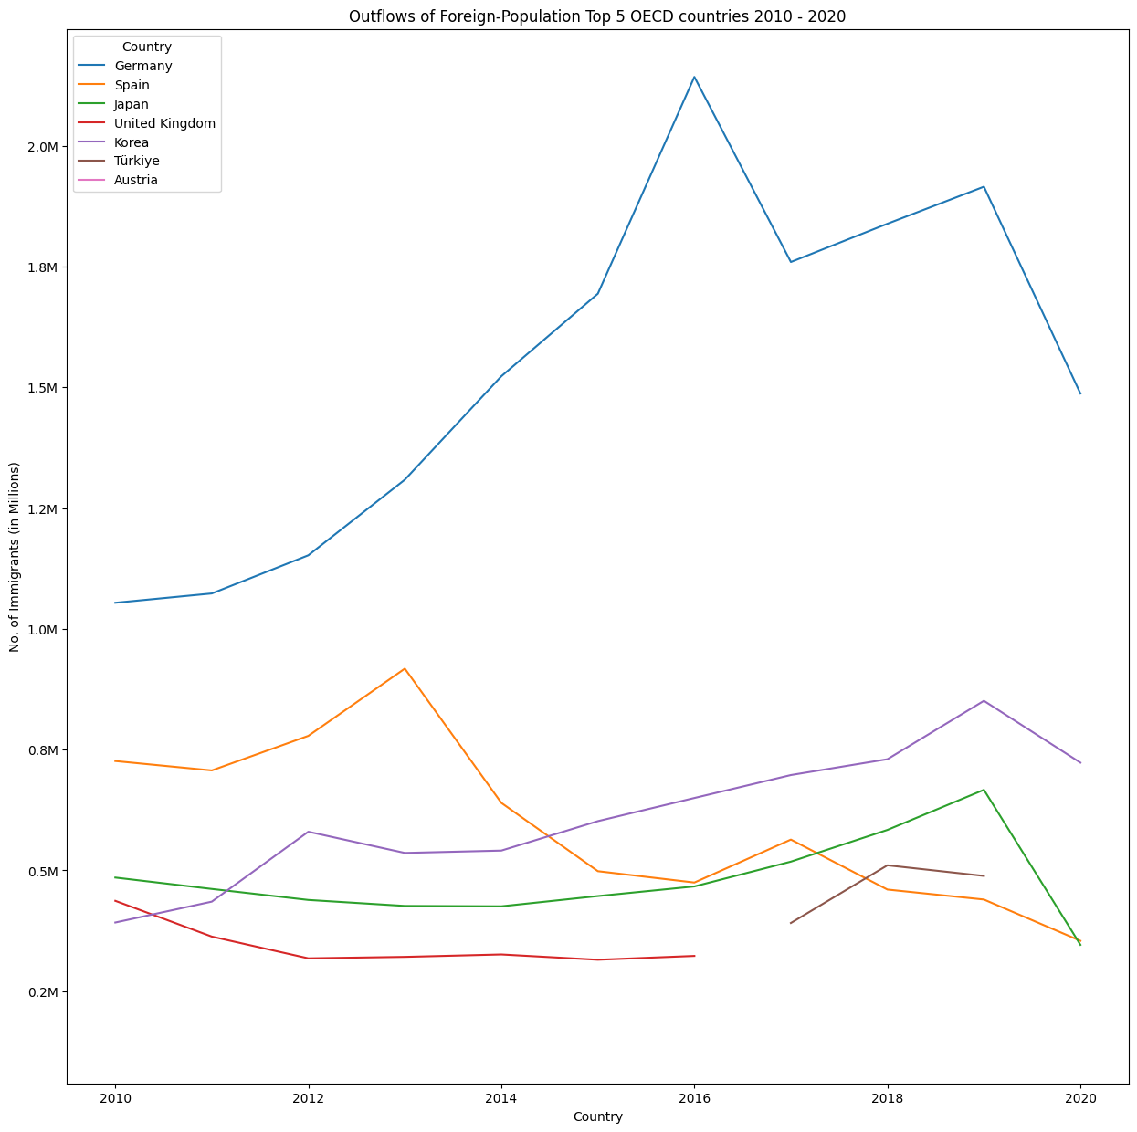

Slide 10

Three
Nationality acquisition rates for the years 2010-2020?

Slide 11
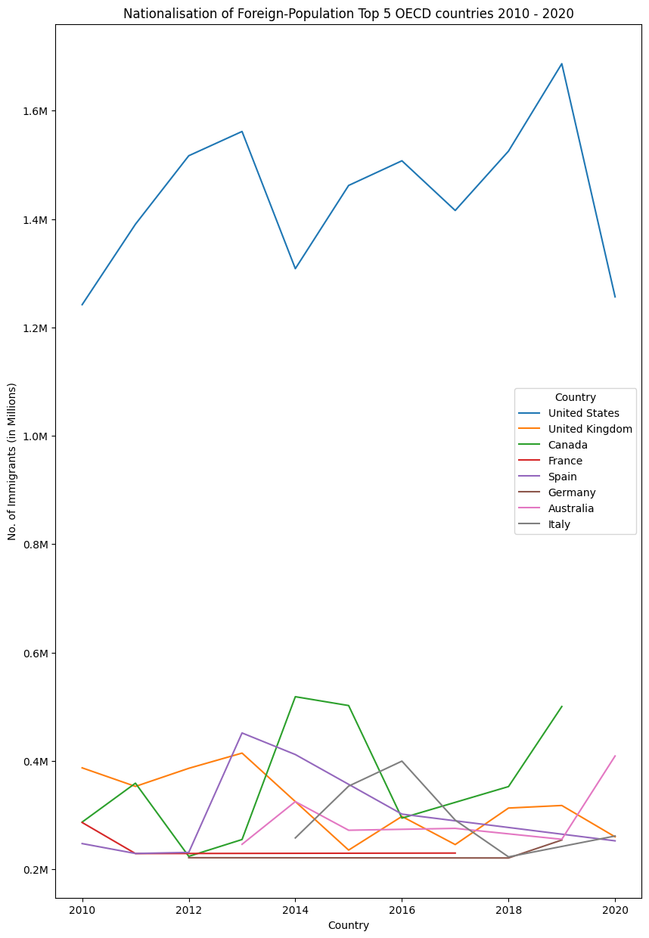

Slide 12

Four
Employment rates according to the educational attainment of the immigrant 2015-2019

Slide 13
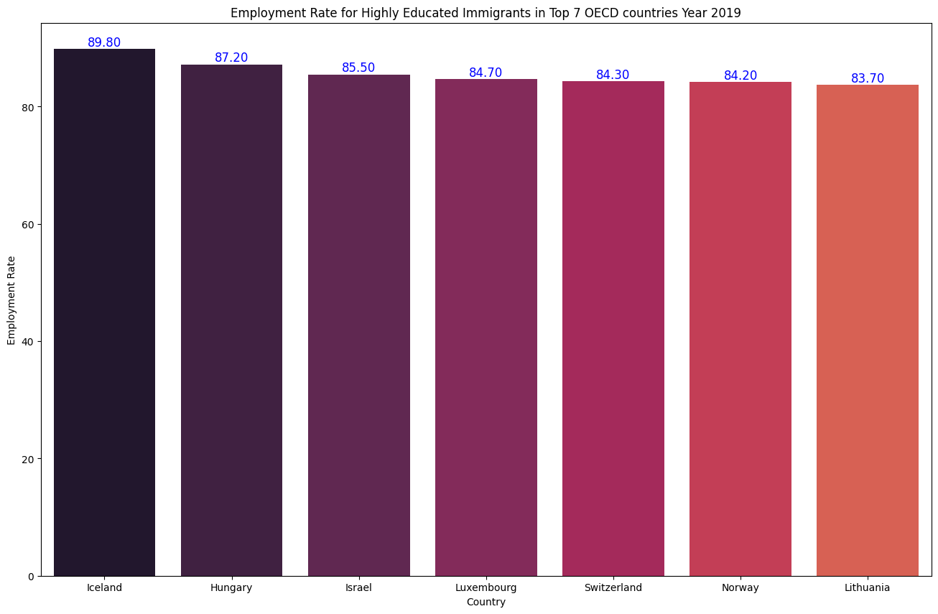

Slide 14
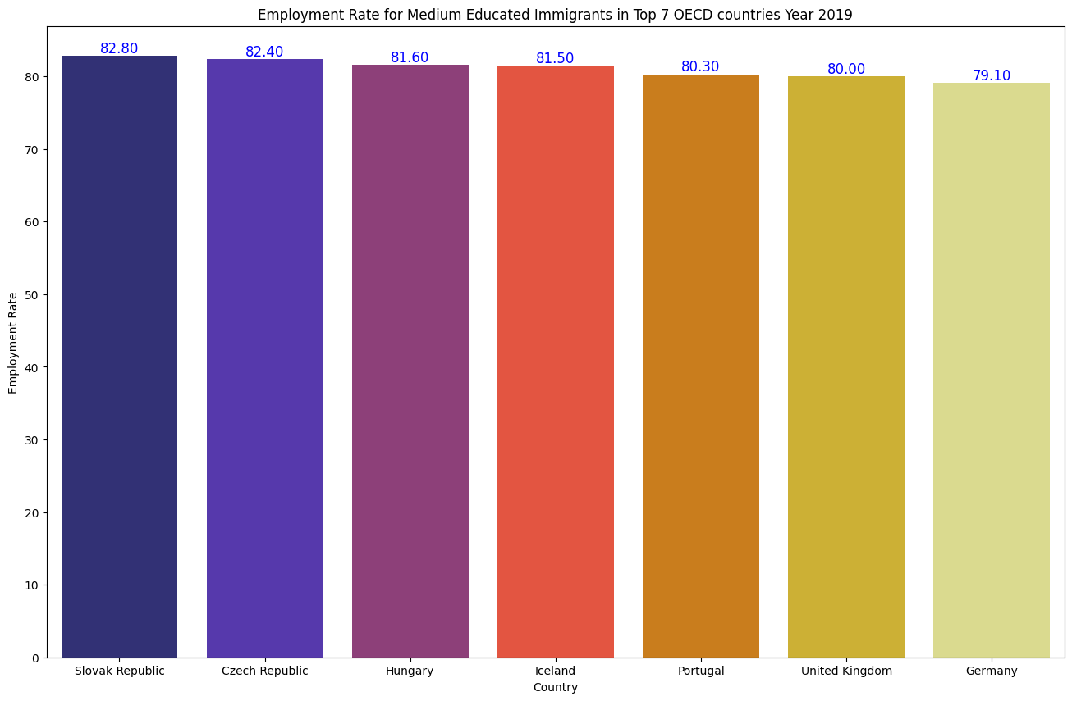

Slide 15
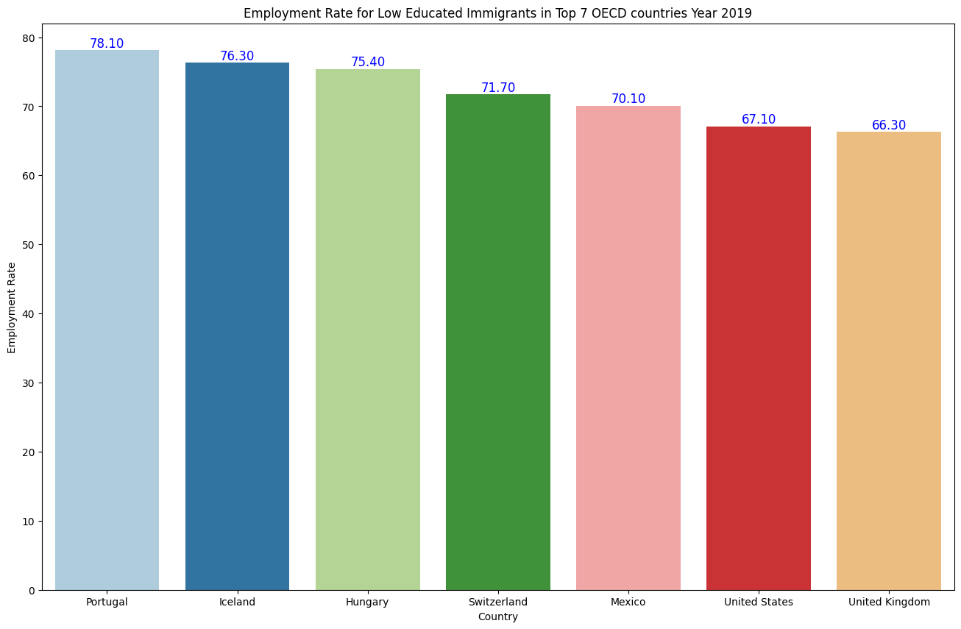

Slide 16

Five
Immigrant women employment rate during 2010-2020?

Slide 17
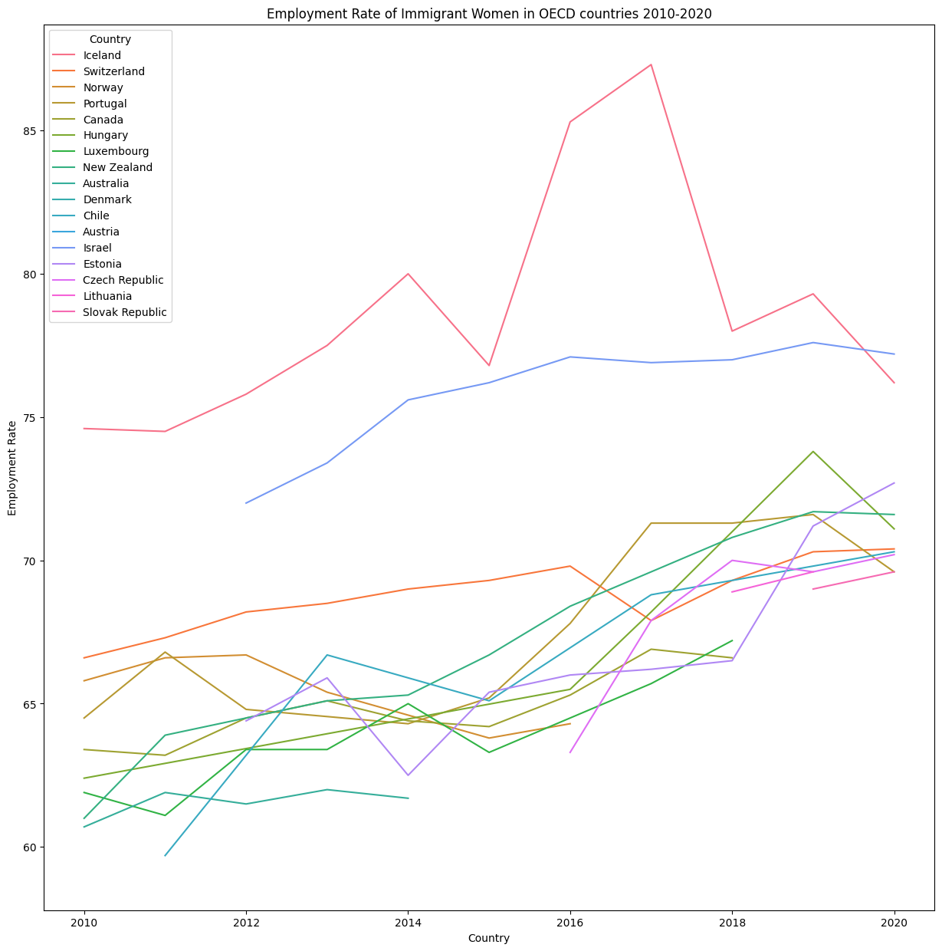

Slide 18

Conclusions

Slide 19
Future Work

Slide 20

Thanks

