Slide 1

ANALYSIS ON IMMIGRATION INTO OECD COUNTRIES
Ironhack Midbootcamp Project
By: Sergio Burgos

Slide 2
Questions
1. Which have been the five OECD countries that received the highest inflow of immigrants during 2010-2020?
2. Which are the top 5 OECD countries that have had the highest immigrants' outflows rates 2010-2020?
3. Which are the OECD countries with the highest nationality acquisition rates for the years 2010-2020?
4. Which are the top five OECD countries that present the best laboral integration rates according to the educational attainment of the immigrant 2015-2019?
5. Which are the OECD countries where immigrant women have reached the highest integration rate in the labor market during 2010-2020?

Slide 3

CHALLENGES

Slide 4
Analysis and Answers

Slide 5

One
Inflow of immigrants during 2010-2020

Slide 6
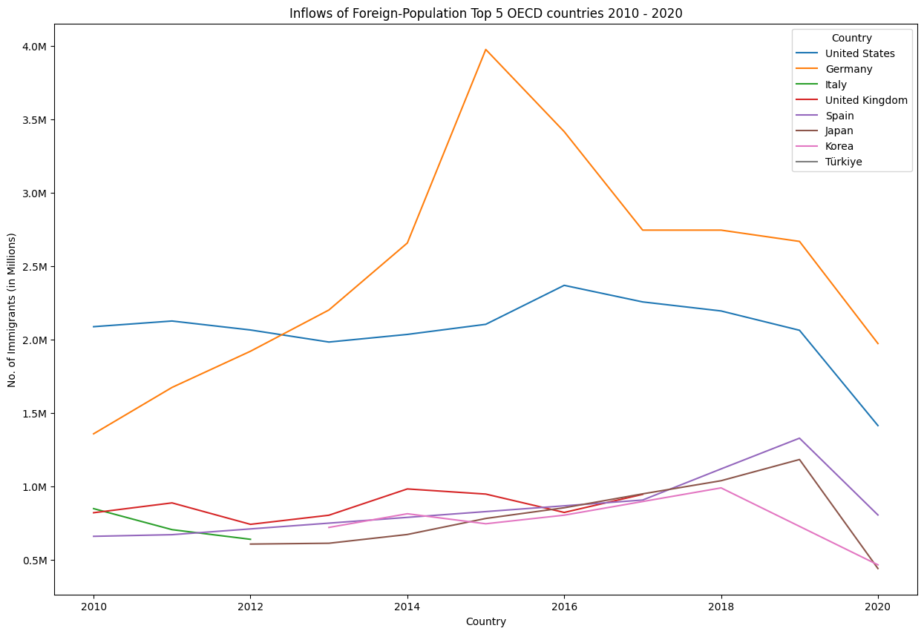

Slide 7

Two
Immigrants outflows rates 2010-2020

Slide 8
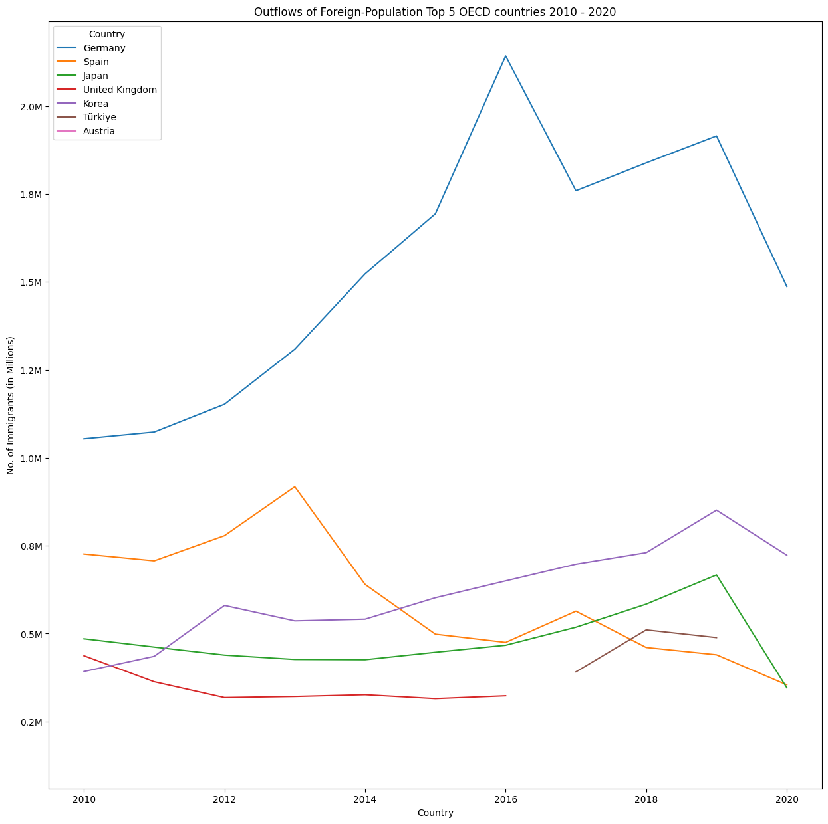

Slide 9

Three
Nationality acquisition rates for the years 2010-2020?

Slide 10
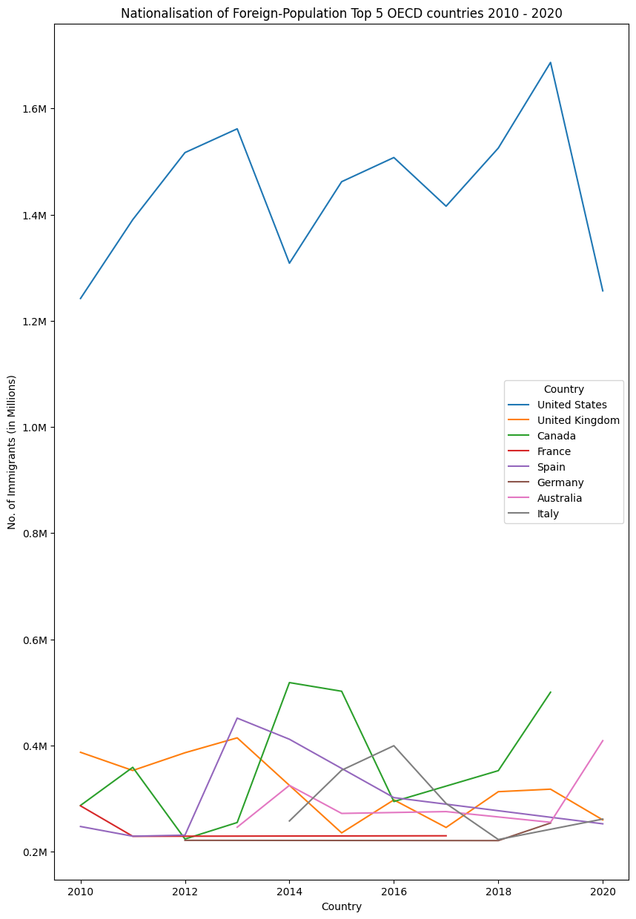

Slide 11

Four
Employment rates according to the educational attainment of the immigrant 2015-2019

Slide 12
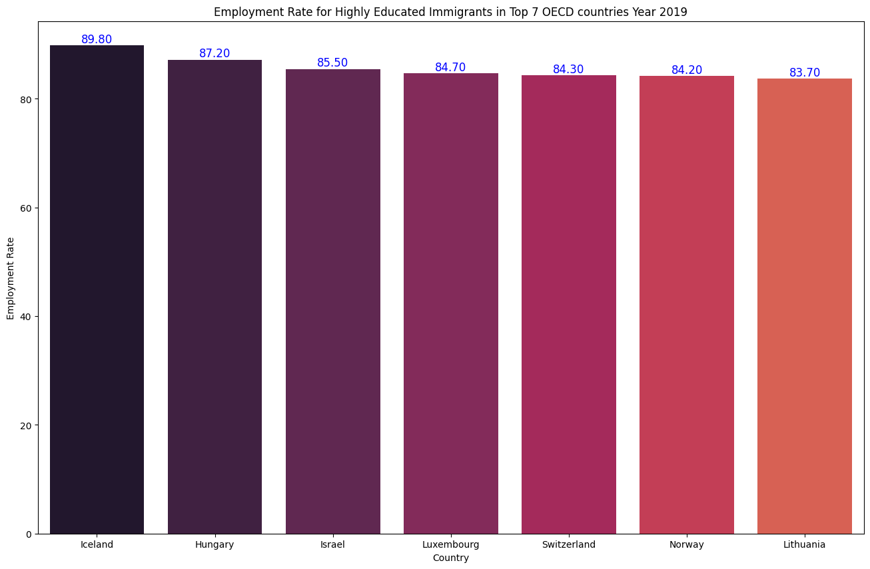

Slide 13
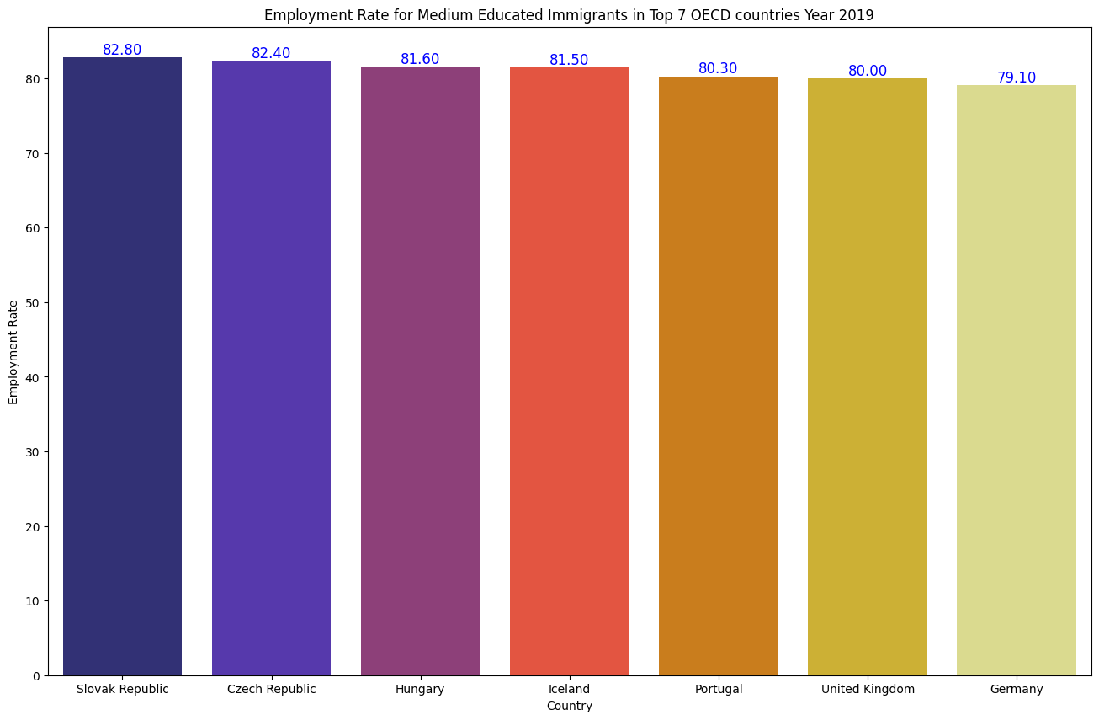

Slide 14
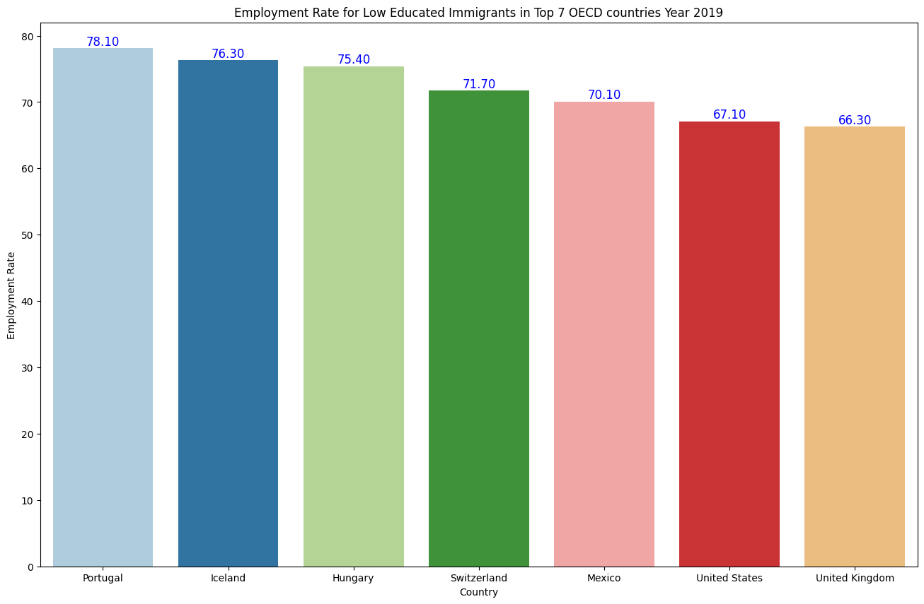

Slide 15

Five
Immigrant women employment rate during 2010-2020?

Slide 16
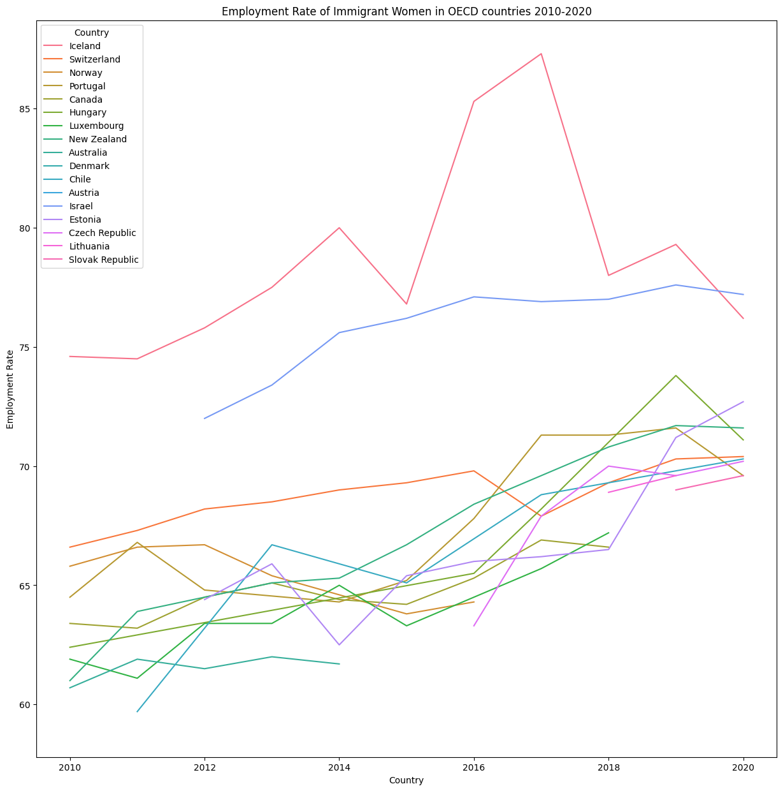

Slide 17

Future Work

Slide 18

Thanks

