Slide 1

An AI to master the world's most complex board game

Slide 2
WHAT IS THE GAME OF GO?
Go is one of the most popular board games not only in China but all over the world, played by more than 40 million people. The objective of the game is simple: capture as many enemy pieces or empty spaces as possible to make points of territory to end up winning the game.

Slide 3
WHAT DIFFERENTIATES GO FROM OTHER BOARD GAMES?
BASIC RULES
HARD TO MASTER
COMPLEXITY
The rules that define the game can be counted on the fingers of one hand.
Learning to play is not difficult, but being a professional is a challenge.
There are more possible positions in the game than there are atoms in the world.

Slide 4
The AI had previously mastered games such as chess, checkers and Tic Tac Toe, but...
Would AI be able to do the same with a game like Go?

Slide 5
UNDERSTANDING THE PROBLEM POSED BY THE GO GAME TO AI
BRUTE FORCE: DENIED USE
TOO MANY POSSIBILITIES
AN EXISTING BARRIER
RESULT
Excessive movements for testing and evaluation.
The complexity of the game is extremely high
A big challenge to beat for the computers and the Artificial Intelligence.
Previous AIs had only managed to play as amateurs.

Slide 6

DEEPMIND AND GOOGLE HAVE JUST ENTERED THE CHAT...

Slide 7
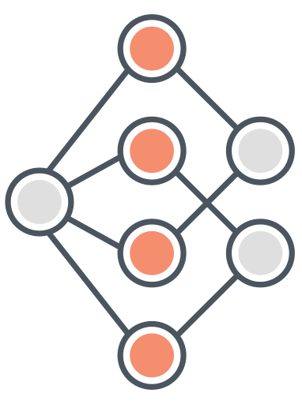
NEURAL NETWORKS BASED ON ADVANCED SEARCH TREES
A policy network + a value network + the use of reinforcement learning to balance the weights.
Trained on more than 30 million of games played by professional players.
Using the computing power of the Google Cloud to train the models.

Slide 8
ALPHAGO RESULTS
57%
99%
100%
OF EXPERT
OF WINS
OF WINS
human movement predictions
versus other developed Go AIs
versus the European Go champion, Fan Hui

Slide 9
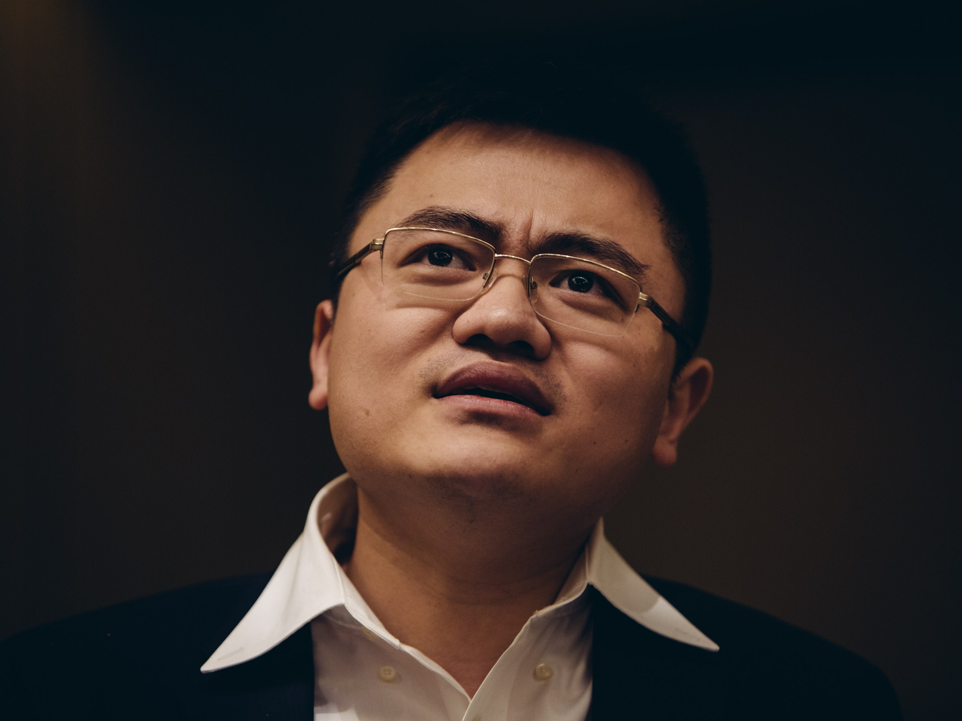
AND AS A CONSEQUENCE…
FAN HUI
ALPHAGO WOULD BECOME THE FIRST AI TO DEFEAT A PROFESSIONAL PLAYER OF GO

Slide 10
CONCLUSIONS
AI IS POWERFUL
NEED OF HUMANS
EXCITING FUTURE
AlphaGo is just one example of what the AI can do.
It's not all about giving data to an algorithm. Experts are needed
The next few years for AI are absolutely promising. Stay tuned!

Slide 11
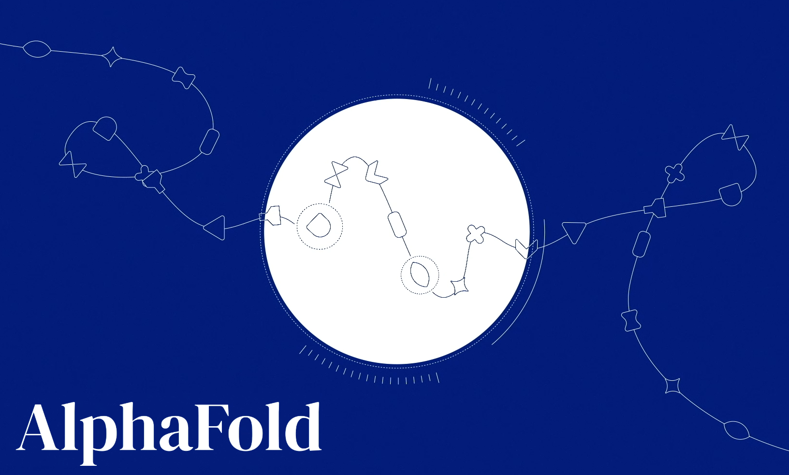
MORE ABOUT GOOGLE AND DEEPMING…
Learn more about the new proyect launched by Google and DeepMind: AlphaFold, an accurate algorithm to predict the 3D structure of a protein using a given array of amino acids.

