Slide 1



Setting up SMS-SYNC

Slide 2
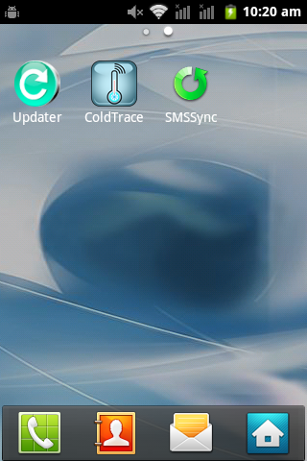
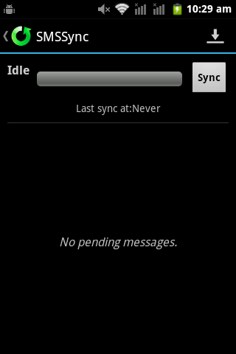
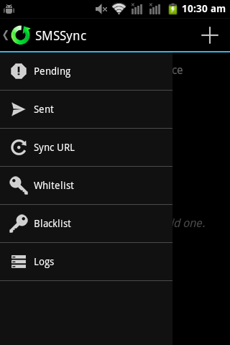
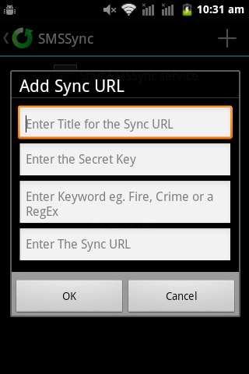
Instructions for setting up the SMSSYNC on the Gateway phones Follow these steps:

Slide 3
Enter Gaza for the title
Enter the following URL here. Pay close attention to make sure you enter the right URL
http://54.241.2.213/coldtrace/sms/smssync/inteluk/
Then press OK when you are done.

Slide 4
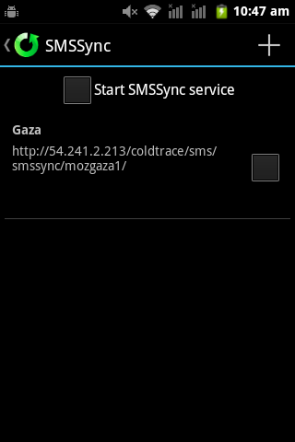
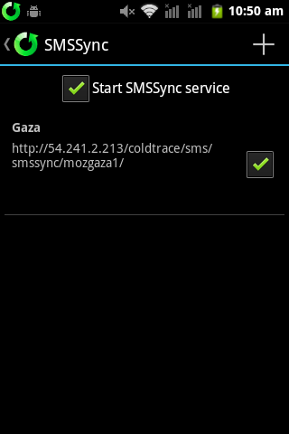
Select this box first.
Select these two boxes. You might have to click 2-3 times sometimes until it gets checked.

Slide 5
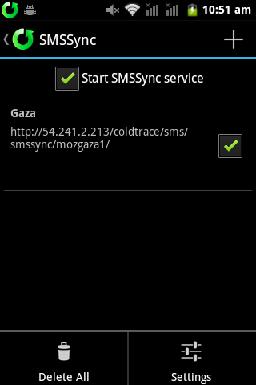
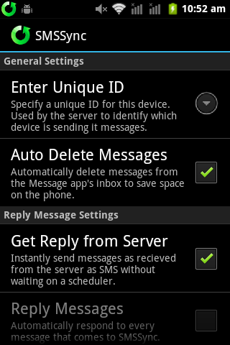
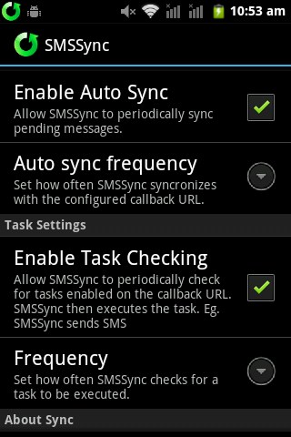
In smssync settings make sure the following are ON and checked:
- Auto Delete Messages
- Get Reply from Server
- Enable Auto Sync
- Enable Task Checking
Leave the frequencies as defaults. Don’t try to change them the app may crash.
Check the following boxes:
- Auto Delete Messages
- Get Reply from Server
- Enable Auto Sync
- Enable Task Checking
After checking these boxes, you are done and you can click the back button to quit out of the app.
Press on Menu button and click on Settings

Slide 6
Test (important!)
1. Send an sms from your own personal phone to the gateway phone contact Nexleaf to verify they have received it.
2. We will try to send an SMS back to you. Note: smssync only checks in every 5 minutes.

