Slide 1


Stateless Reinforcement Learning for Multi-Agent Systems: the Case of Spectrum Allocation in Dynamic Channel Bonding WLANs
Sergio Barrachina-Muñoz, Alessandro Chiumento, Boris Bellalta
Wireless Days 2021 (Paris, virtual conference)
30 June - 02 July, 2021
Notes:
Hello everyone. Thx for watching. My name is Sergio Barrachina-Muñoz and In this talk I will be presenting our paper entitled WiFi All Channel Analyzer
This is a work by myself, prof Boris Bellalta (we are both from UPF, Spain) and prof Knightly (from Rice University)

Slide 2
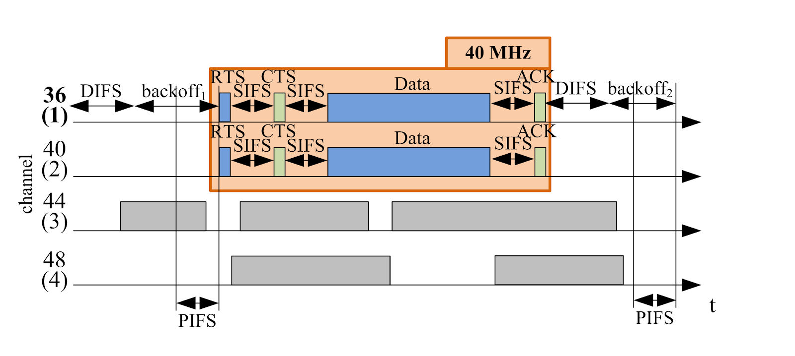
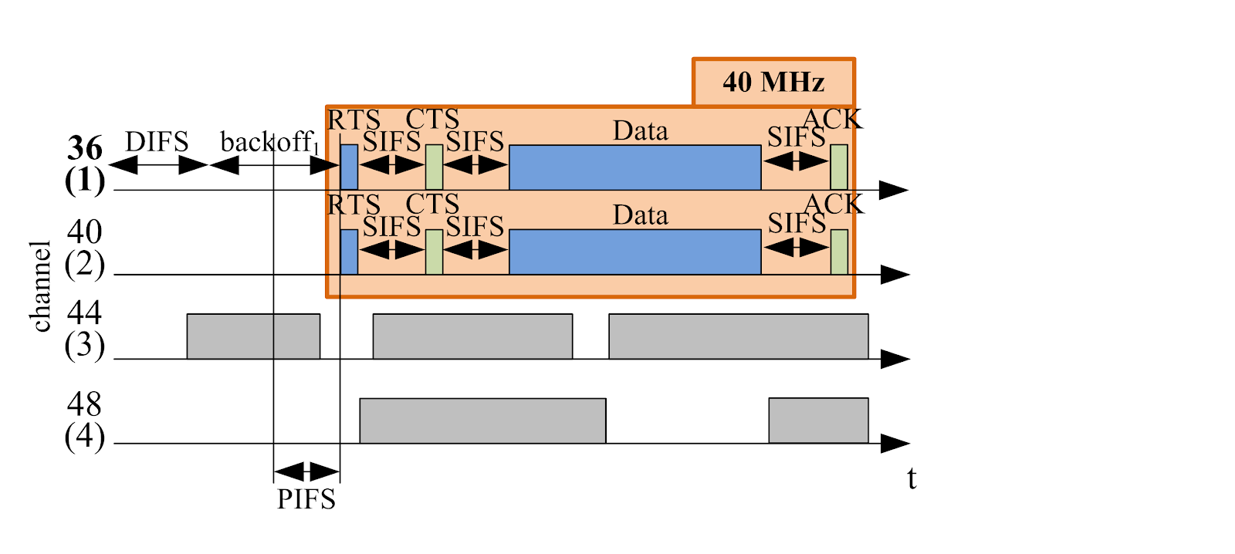
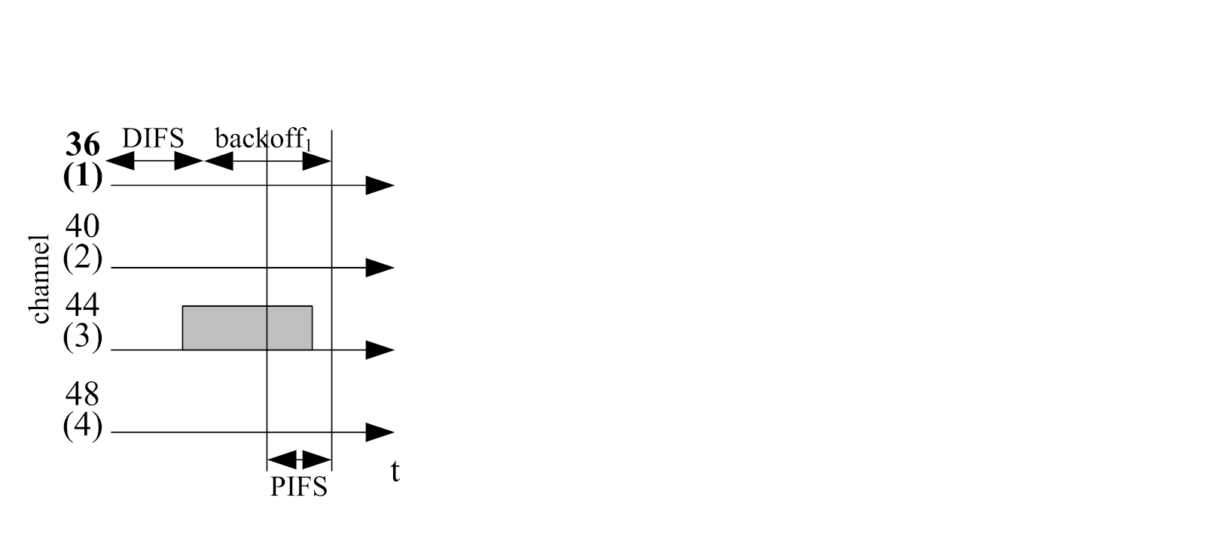
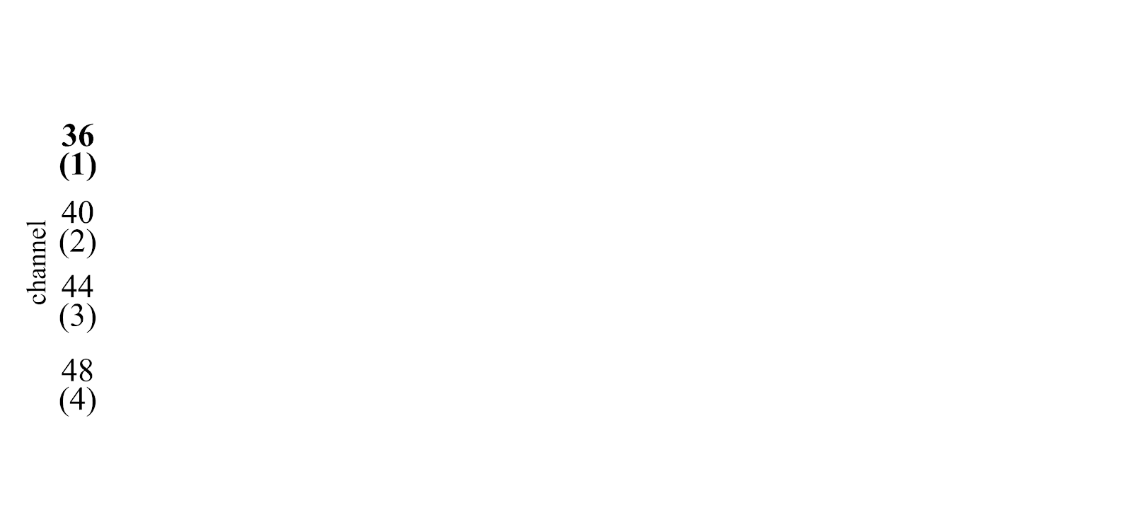
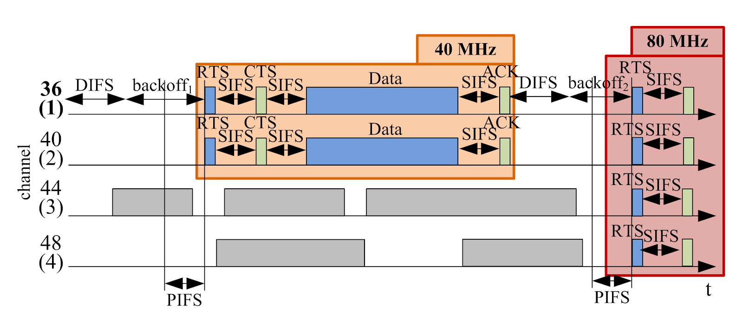
Wi-Fi spectrum management
channel allocation
primary
secondary
dynamic channel bonding

Slide 3



Contributions of the paper
RQ:
Responsive spectrum mgmt for next-gen Wi-Fi scenarios?
Contributions:
RL > heuristics, SL, and UL
Stateless RL > Complex RL
MABs in multi-agent scenarios
Lightweight and ready-to-use
Evaluation
Extensive simulations with Komondor
Use case with spatial distribution
https://github.com/sergiobarra/MARLforChannelBondingWLANs
https://zenodo.org/record/4265898#.YMto6mj7SUk
Notes:
- Thus, we proposed two main RQs to solve: 1) how is the spectrum status in general, and 2) is there any potential of increasing the spectrum efficiency by using multi-ch? → it turned out that we needed a new dataset
- DESIGN: As for the contributions, we present the design of WACA, a platform for measuring the power of ALL the channels in the WiFi’s 5-GHz band simultaneously. We focus on the 5-GHz band because the other at 2.4 has only 3-non overlapping chs, so multi-ch solutions do not apply well in there. In contrast in the 5-GHz band, we have 24 channels that can be bond. The key idea then is to take like screenshots of the whole spectrum so we know what is the power at all the chs at the same time.
- MEASUREMENT CAMPAIGN: Then, we overview an extensive set of measurement campaigns we collected with WACA (including from cafeterias to hotels, and even the Camp Nou stadium).
- EVALUATION: we first present a trace-driven framework for simulating different standard-compliant and custom multi-ch solutions by using the traces collected. And then, we provide a use case comparing cont vs non-cont CB.

Slide 4



RL vs. heuristics and other ML
Heuristics-based algorithms ✘ → ML
Why not SL/UL? Unfeasible to:
Generate dataset
Supervised learning
Train in acceptable time
Mapping to RL
Learn by trial-and-error
Interact with environment
Agent design
Reward: throughput satisfaction
Goal: maximize reward in finite horizon
And ...
Unsupervised learning
Reinforcement learning
Notes:
The WACA platform is composed of 6 WARP software defined radios, each one having a daughter board plugged in.
So, in total we are able to measure the power in 24 antennas, thus covering all the channels in the 5-GHZ band that permit CB, from channel 36 to channel 161.
In this picture, we observe how the channels are allocated to each antenna.

Slide 5
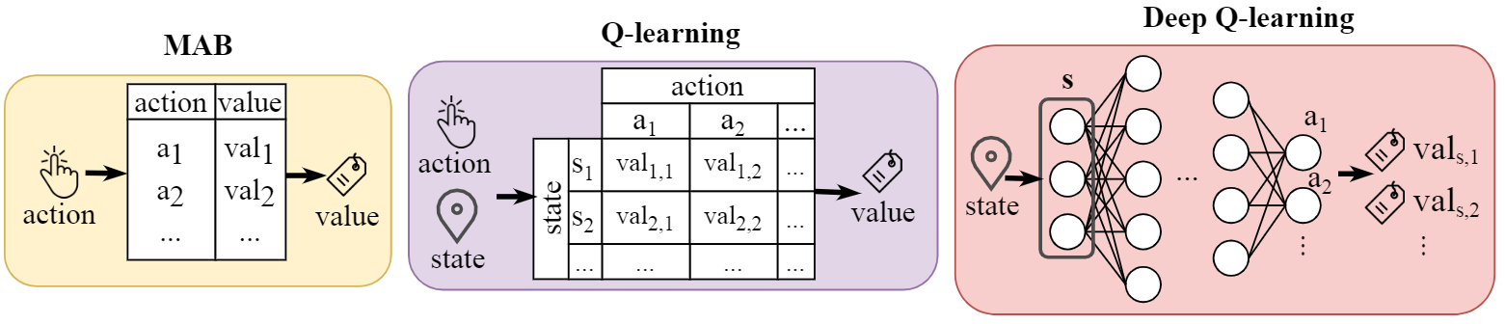
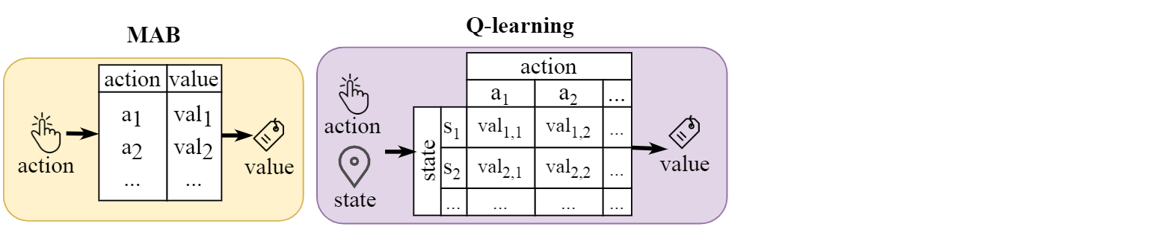
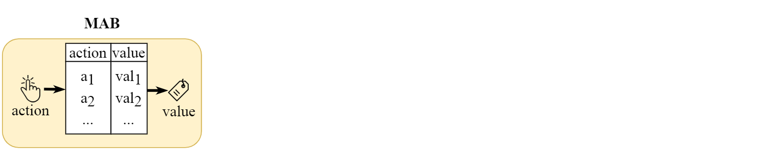
MABs as the RL formulation of choice
Attributes: primary channel p, max. bandwidth b
Actions: (p, b)
States:
MABs to disregard states: S = {Ø}
Boost responsiveness
Notes:
The WACA topology is really simple. As we see in the logical topology, we essentially need a host running the WARPLab framework (e.g., a laptop), a switch and the WARPs. So, the host communicates with the WARPs via the switch.
At the right picture we observe a physical realization of WACA.

Slide 6
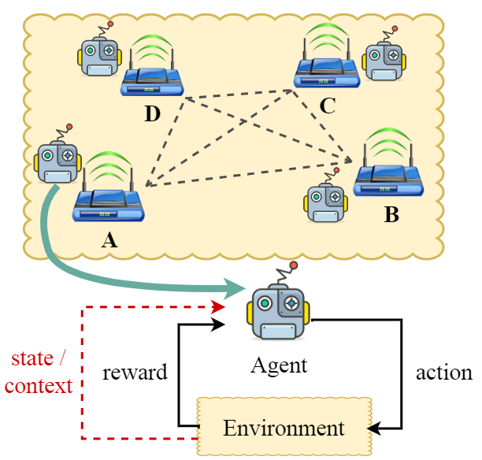
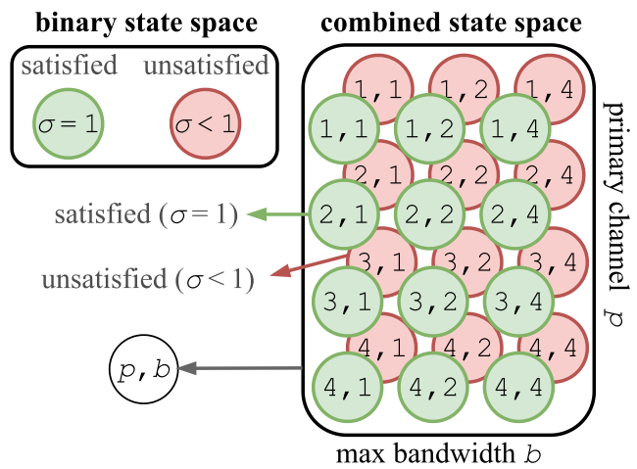
A petit (and complex) use case
x4 BSS’s spatially distributed
x4 channels and up to 80 MHz channel bonding
High load 50 Mbps
Stateless vs. contexts/states
Notes:
- So, how does WACA work? WACA relies on an iterative procedure where in each iteration the WARP transceivers measure the power of all the channels at the same time at a 10 us rate, and the gathered RSSI data is sent to the WARPLab host, which processes and stores it. In the presented dataset, we took 1 second of measurements per iteration.
- When the campaign finishes, we may post-process the RSSI measurements, which come in the form of a matrix, where the rows are timestamps and the columns are the channels. So, by simply comparing the RSSI to a certain CCA threshold, we are able to get the occupancy matrix, and then we can perform trace-driven simulations to assess the performance of different multi-channel algorithms.
- Notice that only by having this so-called power screenshots we are able to know the power at all the band at the same time and thus perform multi-channel algorithms with accuracy. For instance, assume a device has channel 1 as primary channel **** CLICK ****. Assume also that at time instant t3, the backoff counter expires since c1 was idle both at t1 and t2. So, we know that our device could aggregate c1, c3, and c4 they are also free at t3.

Slide 7
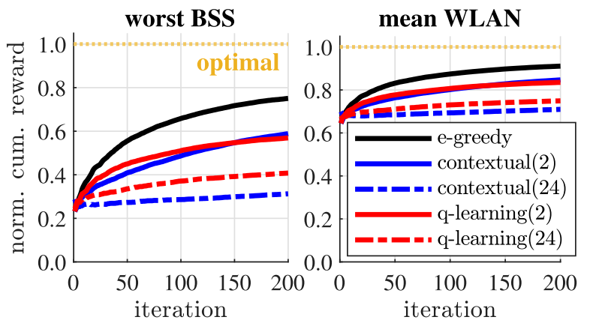
Evaluation
RQ: compare MAB, contextual MAB, and Q-learning
Findings:
MAB learns more and faster
The less the context/states, the better
Algorithms params.
ε-greedy:
ε₀ = 1.0
ε_{t} = ε₀ / sqrt(t)
Q-learning:
α = 0.8
γ = 0.0
Run chart of the normalized cumulative gain for the worst BSS and WLAN’s mean, averaged over 100 simulations. The number within the brackets in the contextual and Q-learning terms refers to the context/state space size. whether
Notes:
Finally, we propose in the paper a trace-driven framework for simulating different multi-channel solutions that we are currently using in our research.
And as use case, we provide an evaluation of the throughput performance of contiguous vs. non-contiguous CB. I must refer you to the paper for the time limitations of this talk, but essentially what we found is that NC is normally better than CONT, but there are some epochs where CONT wins, and this is due to resulting in different instants for transmission attempts. The contiguous policy occasionally (and quite randomly since the traces are the same) ends up with more favorable attempt instants.

Slide 8
Conclusions and future work
Decentralized spectrum allocation in DCB WLANs
Postulate MABs as an efficient ready-to use solution
Argue why complex RL do not suit the problem
Use case: MAB learn more and faster
Future work:
Viability of using complex RL for generating datasets on the go
Notes:
We postulate MABs as an efficient ready-to-use formulation for decentralized spectrum allocation in multi-agent DCB WLANs. We argue why complex RL approaches relying on states do not suit the problem in terms of fast adaptability. In this regard, we envision the use of states for larger time horizons, when the focus is not put on rapid-adaptation but on reaching higher potential performance in the long-run.

Slide 9

Any questions?
Sergio Barrachina-Muñoz
sbarrachina@cttc.cat
Postdoctoral researcher
SMARTECH department
Centre Tecnològic Telecomunicacions Catalunya (CTTC), Barcelona

Slide 10
BACKUP SLIDES
APPENDIX.

Slide 11
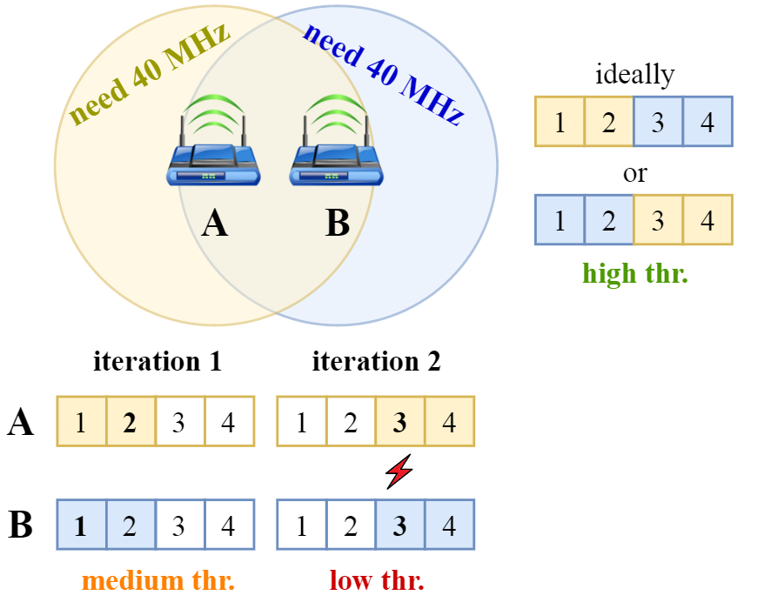
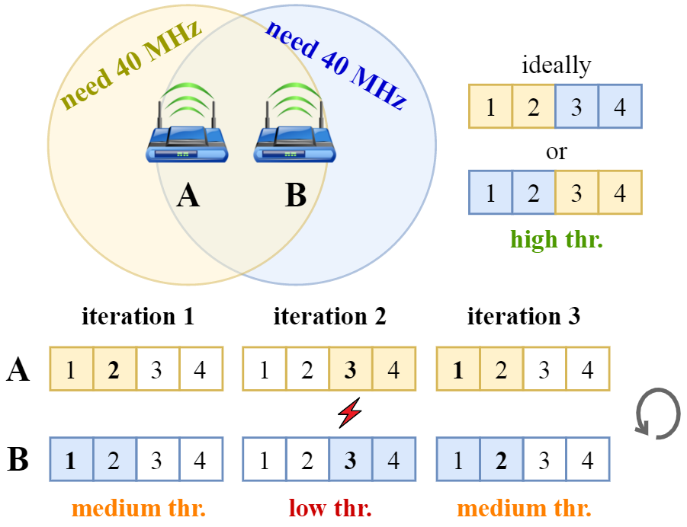
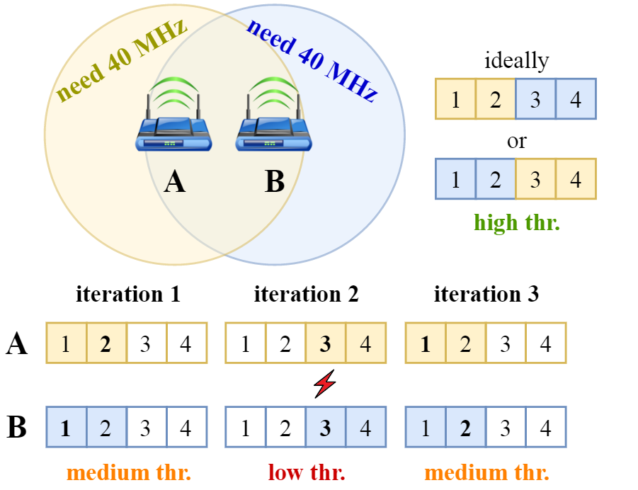
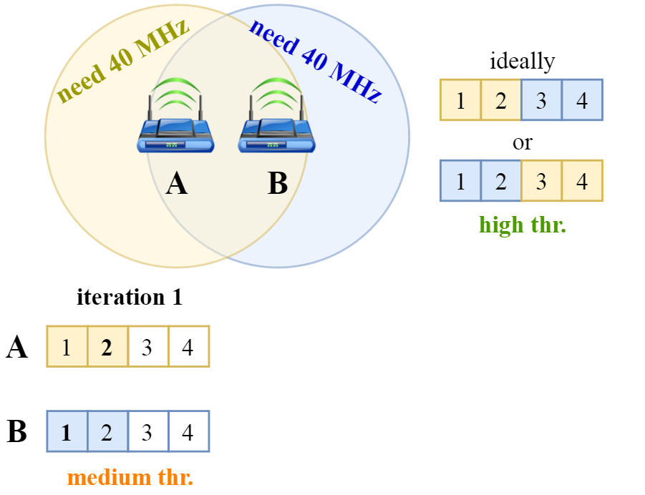
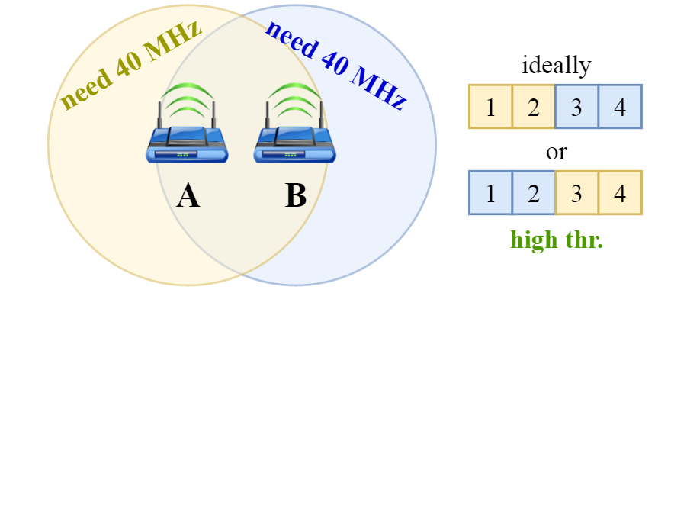
A change of paradigm towards ML
Heuristics pitfall: limited to meaningful observations
Unpractical in dynamic (multi-agent) scenarios
Notes:
We say that the dataset presented is a first of-its-kind because two main reasons:
-1: There are few multich spectrum measurements on WiFi. But more importantly, the rely on sequential scanning, , thus taking on the order of seconds to change from one channel to the next, orders of magnitude beyond the transmission time scale for channel bonding. With WACA we get rid off this issue by capturing the power of all the chs at the same time.
-2: As for the performance of multi-channel solution, there is great work in the literature on different proposals. However, these works relied on limited testbeds, simulations or analytical models, which is perfectly fine but has a main issue we overcome with WACA. We measure unlimited sources of power (or BSS’s) in real operational settings.

Slide 12
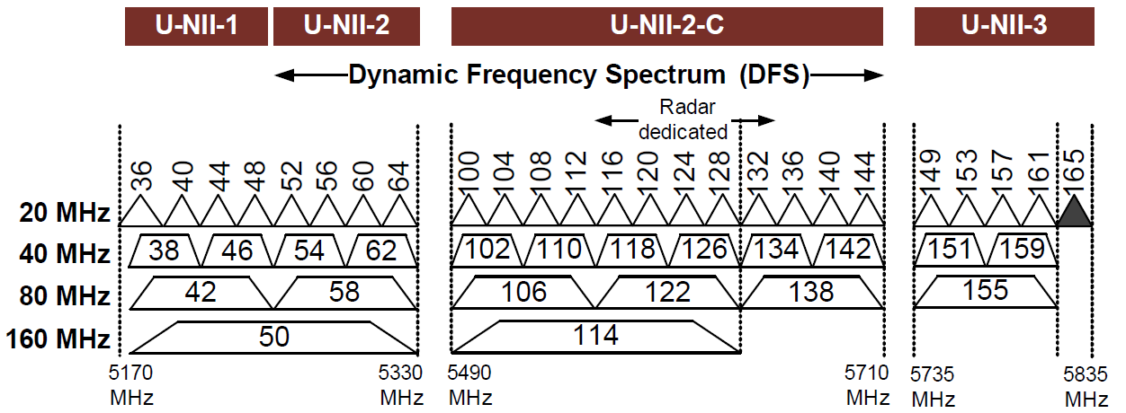
Spectrum management in Wi-Fi 6
Two factors:
Channel(s) allocation → which channels are allocated
Channel bonding → which channels are used for frame TX
5 GHz
basic
20 MHz
bonded
40 MHz
bonded
160 MHz
bonded
80 MHz
Notes:
BE 320 MHz AND MORE BW, BAND 6 GHZ

